Slide 1
FD2-VD CDR Update 24 June 2021
Anne, Marvin, Sandro

Slide 2
Most first drafts undergoing internal review
Reviewers for these chapters were contacted last Monday (reviewing Vertical_Single_Phase_FD_Technology-20jun.pdf, compiled 21 June):
CRP,
TPC electronics,
HV,
DAQ,
Prototypes
I&I is still under review/editing by CET this week.
PDS and physics chapter PoCs are responding to CET comments (I’ll update draft in EDMS when they are done)
Still to come: Executive Summary and parts of Project Organization

Slide 3
Next Steps
Internal review comments due around 1 July
Week of 5 July: chapter meetings to discuss comments
PoCs to update chapters (or coordinate with CET to do so)
Updated (second) drafts from PoCs due 15 July
We will likely still give draft to LBNC around 19 July. (TBC)
Hope to keep CDR schedule on track, then move to PDR

Slide 4
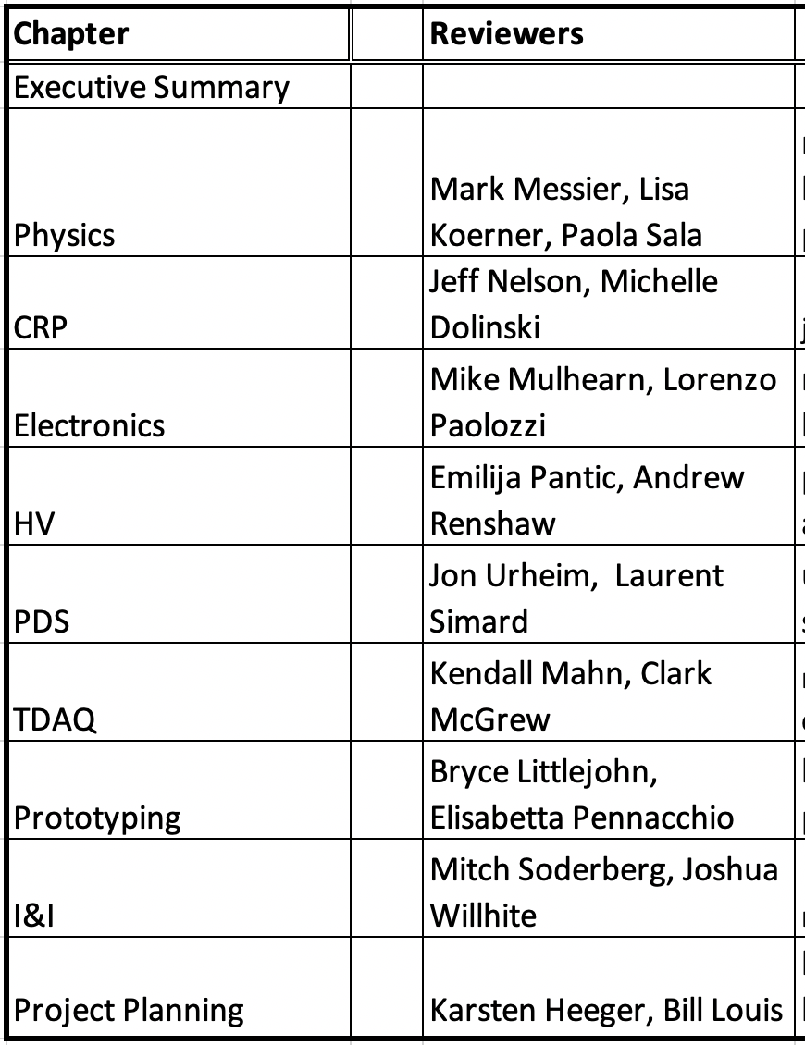
Proposed reviewers by chapter
Suggest alternative reviewer?
Claire David or Asher Kaboth?

