Slide 1
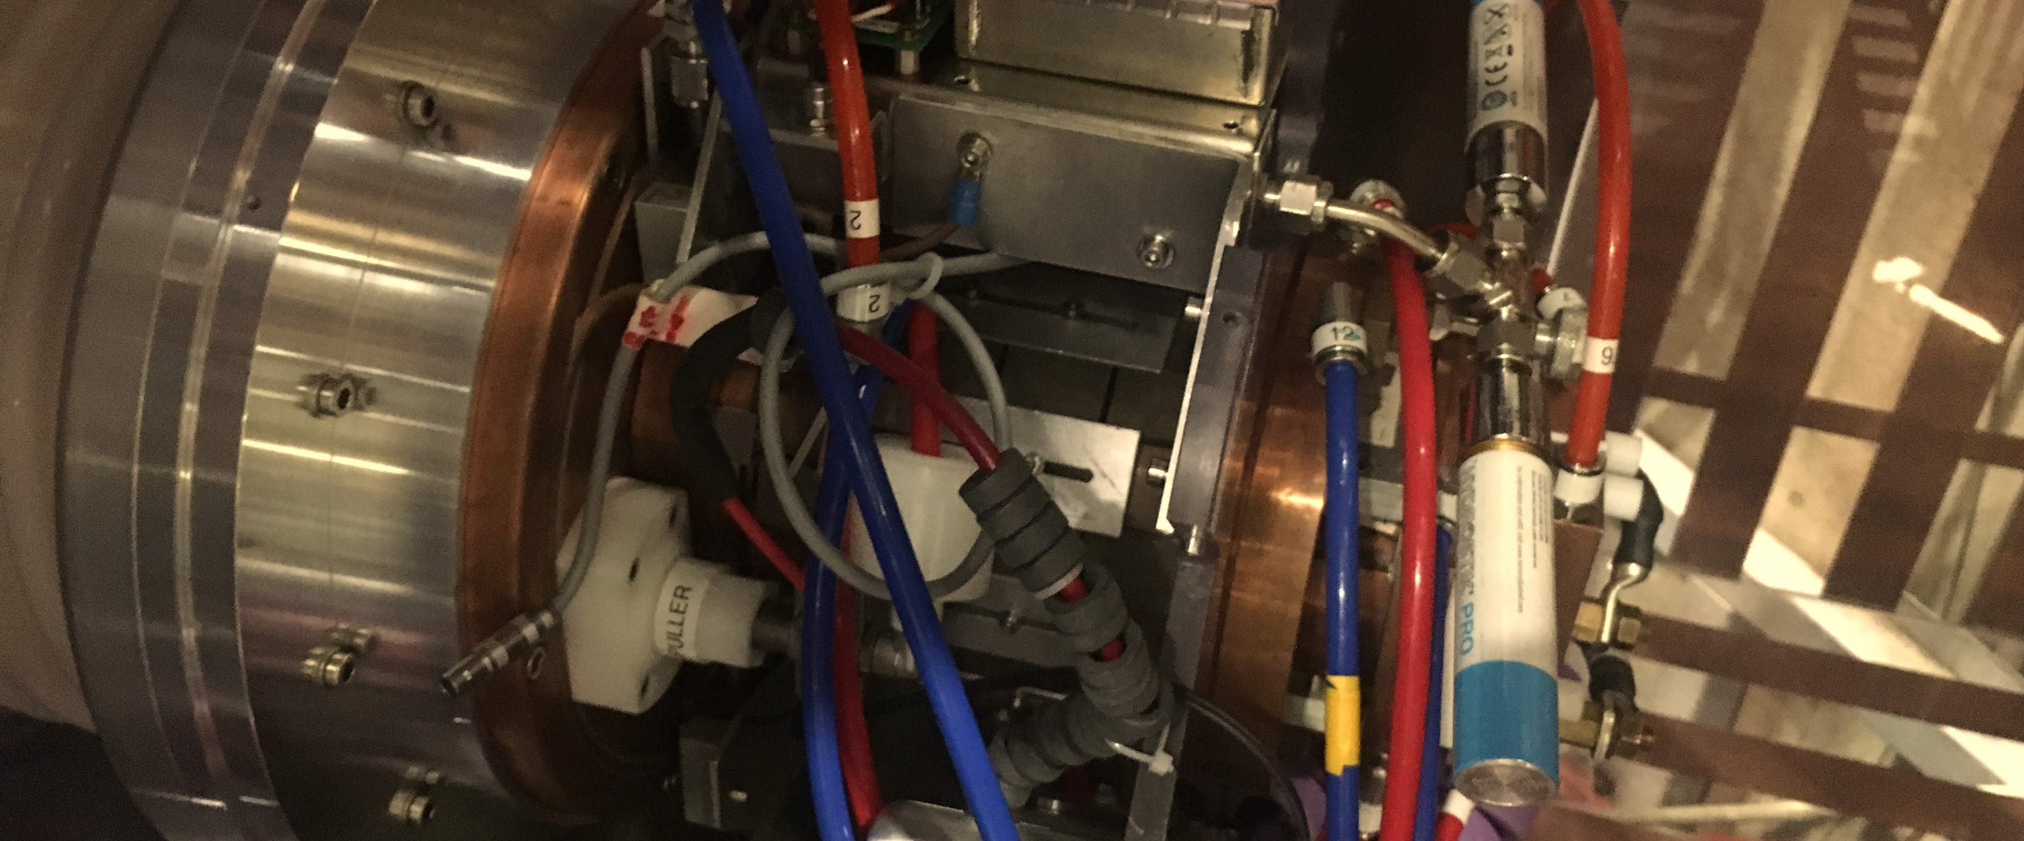
ELENA Source status and plans
D. Gamba, R. Gebel, B. Lefort, F. Wenander 18th of Jun. 2021
Just a few slides with pictures and previous observations

Slide 2
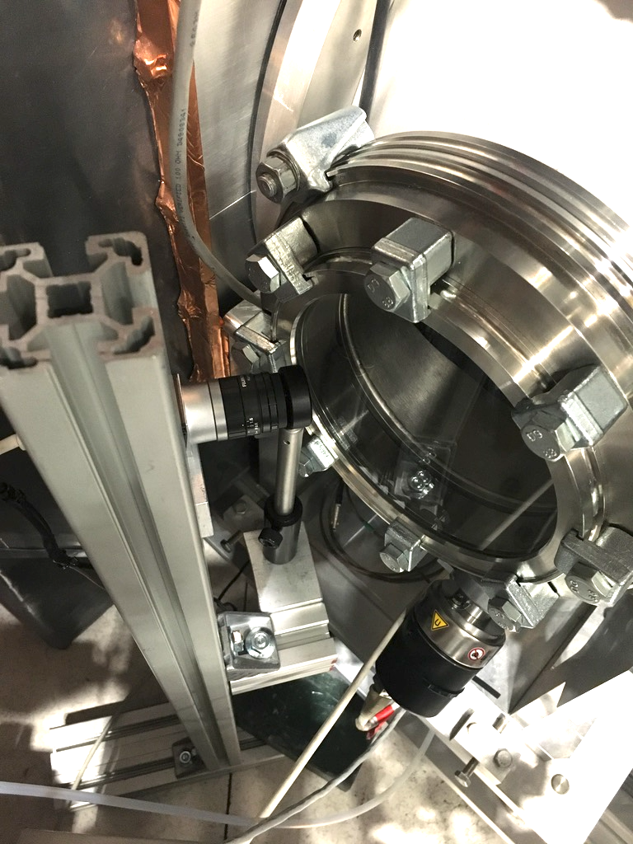
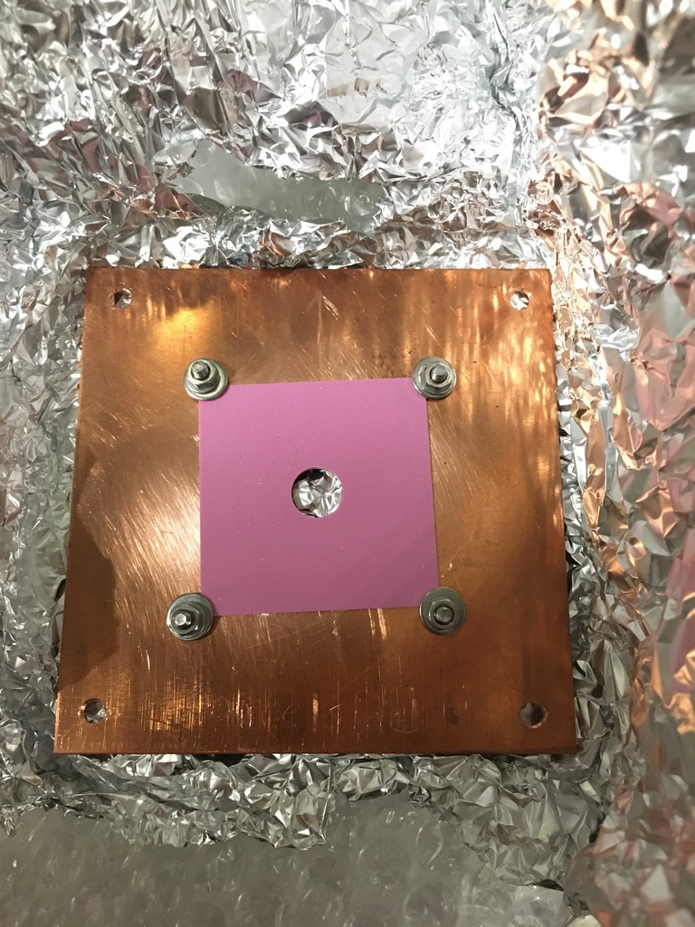
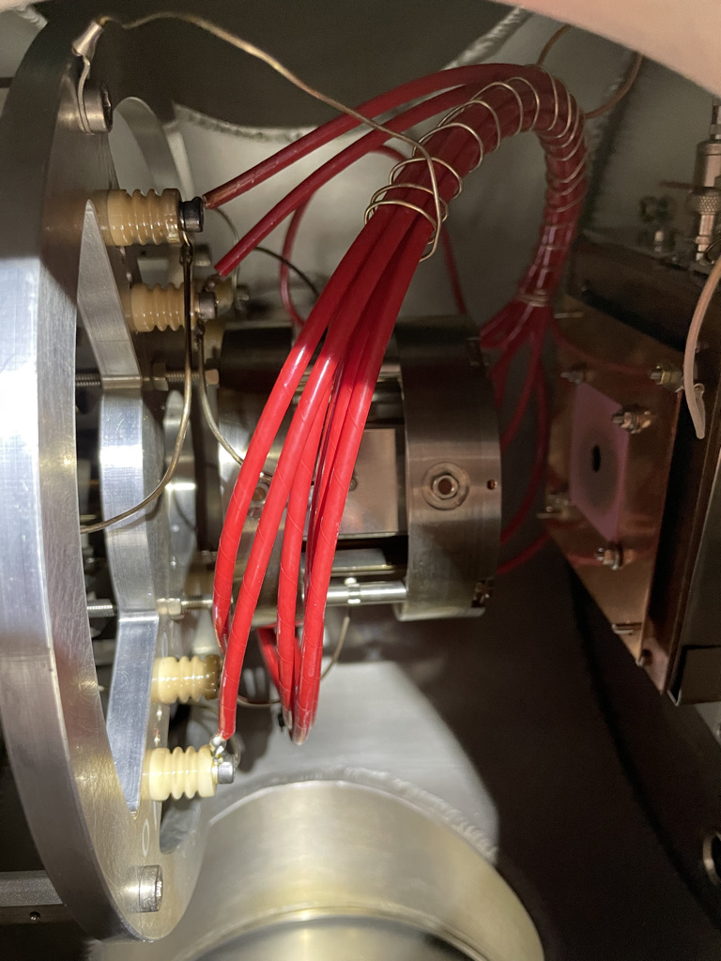
Camera setup
New digital camera that can be triggered
694 nm (10 nm FWHM) filter installed
Screen with hole (10 mm diam) installed

Slide 3
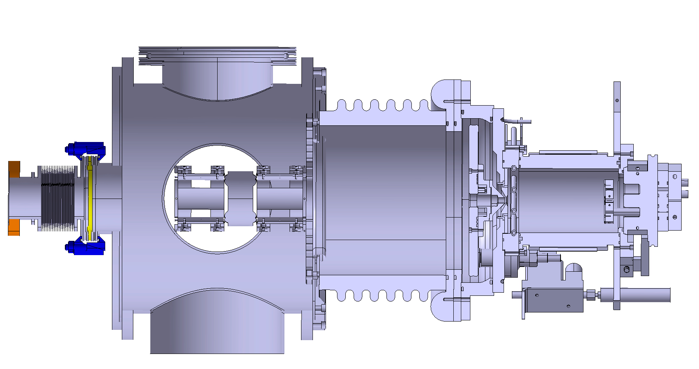
Source view
Still missing drawings of those areas
Being simulated by Ralf to see which solution is best
Holder to be changed (already in preparation by Ralf)
Presently measured to be about 21 cm
(from ground electrode to puller)
Notes:
C_{or, mol, H_2} &= 43.8 \cdot A \\
A &:= \text{cross section } \mathrm{[cm^2]}
% If correct, my equation is:
P_c \cdot S = Q = C_{or} (P_s - P_c)
From which I use:
P_c \left(\frac{S}{C_{or}} + 1\right) = P_s = (2200/5.5 + 1) P_c = 400 P_c
% conversion sccm in mbar l/s:
1 \mathrm{[sccm]} &= 0.016 \mathrm{[mbar \cdot l/s]}
% crosscheck:
P_c = \frac{Q}{S} = \frac{1.3 \times 10^{-2}}{2200} = 6\times 10^{-6} \mathrm{[mbar]}
% GAS to density…
P V &= n R T \\
N_A \frac{n}{V_s} &= N_A \frac{P_s}{R T} \\
T &= 293.15 \mathrm{[K]} \\
N_A &= 6.022 \times 10^{23} \\
R&= 83.14 \mathrm{ \left[ L\cdot mbar \cdot K^{-1} \cdot mol^{-1} \right] } \\
% we actually need this:
n_{H_2} &= N_A \frac{P_s}{R T} \\
n_{H_2} &= 2.47 \times 10^{22} \mathrm{[m^{-3} \cdot mbar^{-1}]} \cdot P_s \mathrm{[mbar]}
% Final result
P_s = 1.2\times 10^{-3} \mathrm{[mbar]};\, n_{H_2} = 3 \times 10^{19}\mathrm{[m^{-3}]}
Some general vacuum formulas:
Q &= P \mathrm{d}V/\mathrm{d}t = P S \\
\text{where } P &:= \text{pressure } \mathrm{[Pa]}\\
S &:= \text{flow rate } \mathrm{[m^3/s]} \\
Q &:= \text{throughput } \mathrm{[W]} \\
\\
Q &= C (P_2 - P_1) = C \Delta P \\
\text{where } P_1, P_2 &:= \text{pressures in connected volumes} \mathrm{[Pa]} \\
C &:= \text{conductance} \mathrm{[m^3/s]} \\
\\
C_{tot-series} &= \left(\frac{1}{C_1} + \frac{1}{C_2}\right)^{-1}\\
C_{tot-parallel} &= C_1 + C_2
Some forumlas from:
- https://www.pfeiffer-vacuum.com/en/know-how/introduction-to-vacuum-technology/fundamentals/conductance/
C_{or, mol} &= A \cdot \frac{\bar{c}}{4} \\
\text{where } C &:= \text{conductance } \mathrm{[l/s]} \\
A &:= \text{cross section } \mathrm{[cm^2]} \\
\bar{c} &:= \text{Mean thermal velocity } \mathrm{[m/s]} \\
\\
C_{or, mol, air} &= 11.6 A \\
C_{or, mol, H_2} &= 43.8 A \\
C_{pipe, mol} &= \frac{\pi \cdot d^3 \cdot \bar{c}}{12 \cdot l} \\
\text{where } C &:= \text{conductance } \mathrm{[l/s]} \\
l &:= \text{pipe length } \mathrm{[cm]} \\
d &:= \text{pipe diameter } \mathrm{[cm]} \\
\bar{c} &:= \text{Mean thermal velocity } \mathrm{[m/s]} \\
\\
C_{pipe, mol, air} &= 12.1 \cdot d^3/l \\
C_{pipe, mol, H_2} &= 45.7 \cdot d^3/l \\
- Mean termal velocity
Air: 464 m/s; H_2: 1754 m/s
Some statements from Ralf:
- Bottle used: 10 l at 30 bar
- The diameter of orifices are reduced compared to the original design. There should be drawings in the cabinet and spare parts in the green container. The current set-up consists out of copper parts. There is also a Molybdenum prototype for replacement. Without cross check it should be around 3.5 to 4 mm. 9 mm and 6 mm versions should be available too, if you need more beam current. 6 mm is fine for 300 microamps. 9 mm if you need a milliamp.
- The ELENA source is an improved electron bombardment source, as described in section 4.2. The cross section for ionization peaks for hydrogen in the range 50-150 eV. And it's more complex because there are in addition a magnetic multi cusp field, some filter magnets as well as plasma, volume and surface effects.
- Is a thinner or shorter filament less hot? Electron emission scales with 1/(surface area) and temperature, less surface requires higher temperatures. As usual, … the but: the emission law is exponential, therefore the reduced surface area is easily compensated by a few degrees. The plasma is complex, instability can be expected for many conditions. We are running at low discharge power, that’s critical for the performance because we’re using the source not at its optimum design parameters.

Slide 4
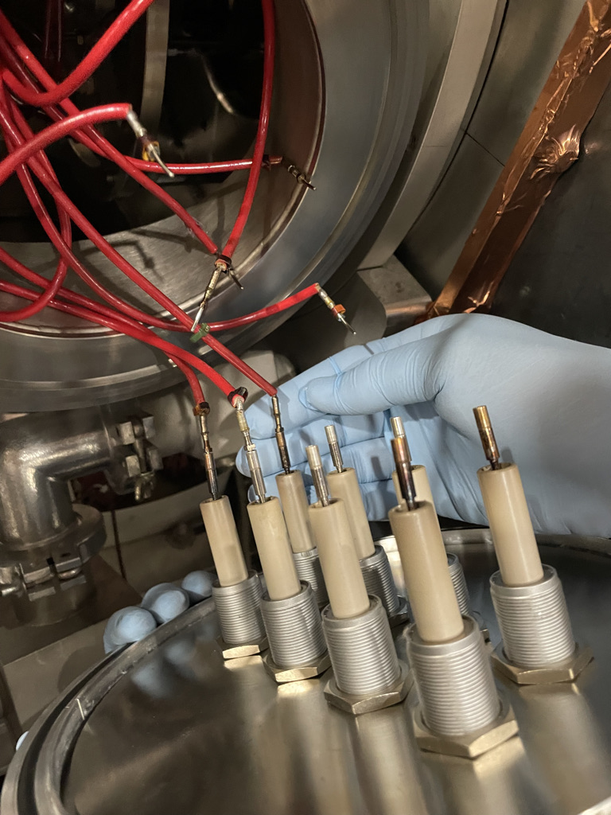
Two recent pictures
Marks on the screen due to “dark current”
Marks on cables (no picture here), probably in front of the “windows” from the quad holder
Feedthrow maybe not in best shape, why?

Slide 5
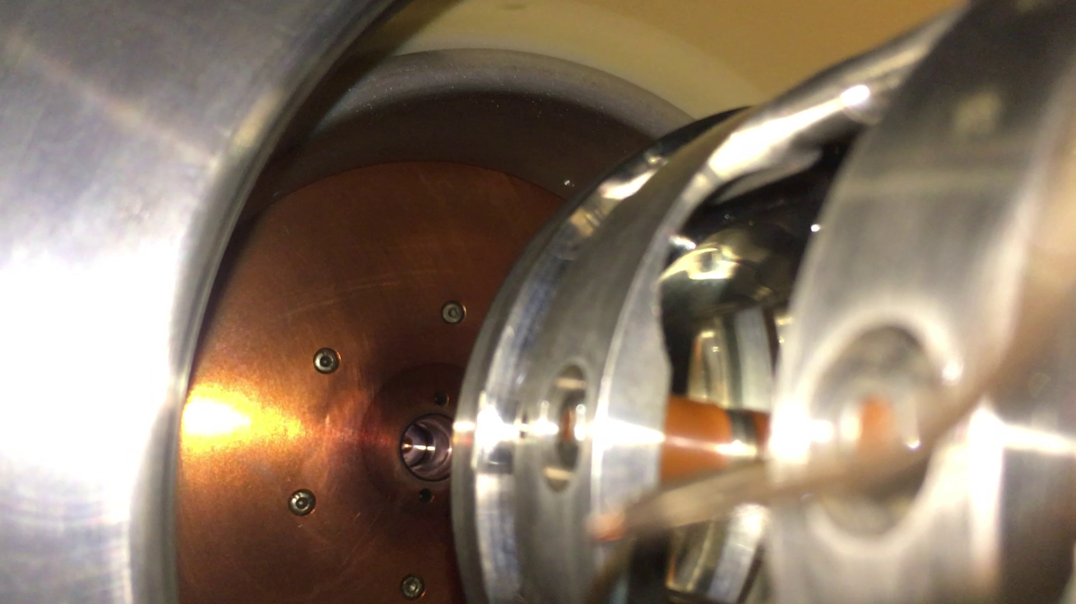
Quadrupoles chamber
Marks probably due to ionization of residual charge -> all positive charges go back to puller.
Need to make simulations to see where charges goes if generated on the ground electrode or in the vacuum in front of the puller.
New warning: p on puller -> e- dumped on ground electrode -> secondaries -> can only go the ceramic
Also, complex set of charges going back and forth between ground electrode and puller….
Simulations (Ralf might be able to do some, but not in the short term) also needed to:
improve ground electrode shape (i.e. maybe bringing quad assembly closer to puller. This is possible to do even now.)
Implement some shielding of isolator
Warning: dark current increases quickly if one goes too close with ground electrode.

Slide 6
Conclusions
We need to organise the dismantling of the source end of 2021
Ralf will send soon some new filament holder to allow for going back to thicker filament and higher filament current.
Ralf is planning to study/design new ground electrodes/shielding of ceramic. Aim to have this installed/tested end of 2021.
Think about spare parts: Ralf is thinking of sending here the spare 100 keV power supply
In ~3 years time, we might have also other sources that could be spare for us… to think about it…

Slide 7
Some notes by Fredrik:
Missing correct drawing of the gnd shield (triple point) on the HV side of insulator. Ralf has access to the correct drawing.
Ralf prefers to shield the insulator by extending the triple point shield, either from gnd or HV side
Ralf agrees to perform:
Ion simulations
Study design of HV insulator shielding
Probably produce the parts
Not sure one can move the quad assembly closer to the source due to field emission (dark current)
Spare HV converters should be shipped to CERN before the end of the year
Ralf wants to:
· Come to CERN end of the year
· Exchange the plasma electrode orifice from 4 to 6 mm diameter
· Exchange the filament holder and back flange to allow for hotter operation of the filament
· Go back to original (single) magnet dump configuration
· Exchange the o-rings in the source; should revise the source every 4-5 years
Ralf is concerned about the state of the Teflon piece insulating the filament from the source body
Ralf is concerned that there are local hotspots from the dumped electrons affecting the dump magnets
Ralf will receive a 400 Hz HT transformer from Hungary which can possibly operate in air. It is very compact with a footprint of ~220 x 220 mm2
As Julich is shutting down the lab, there might be other types of H- sources available from 2024
CERN should inform Laurette about the need for a ‘longer’ source shutdown

Slide 8
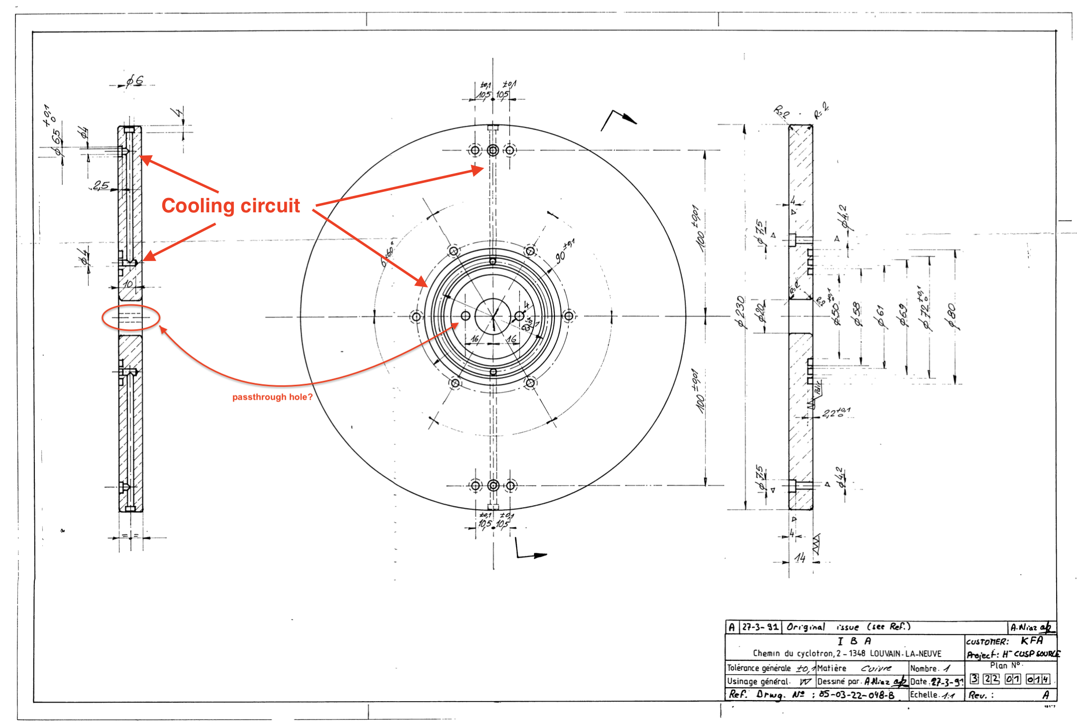
Puller drawing

Slide 9
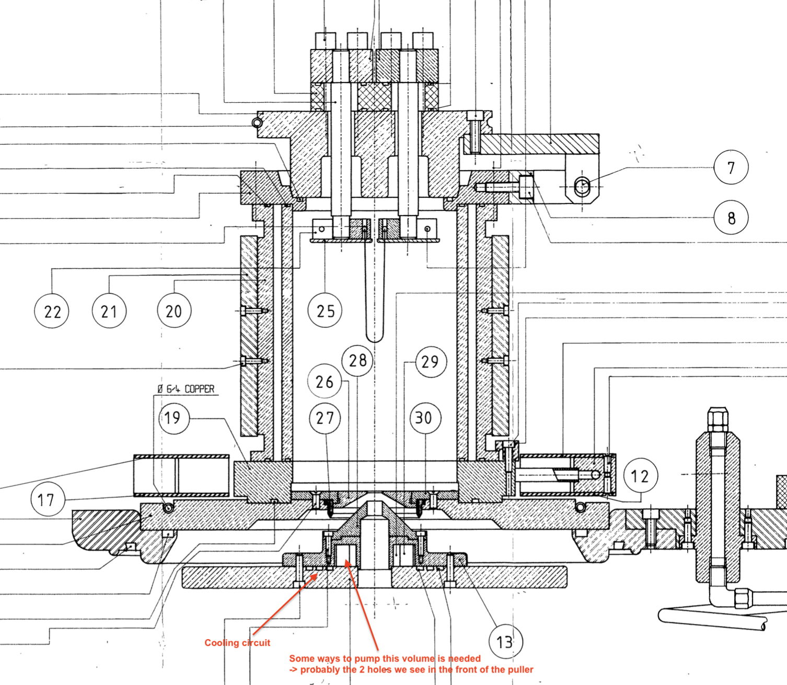
Source assembly drawing

