Slide 1
Hadr05 : longitudinal sampling calorimeter
It is the hadronic equivalent of TestEm3. It demonstrates
  - how to collect energy deposition
  - how to survey energy flow
  Basic features. Should have been present since a long time …
Geometry as generic as possible (same as TestEm3)
Physics via Physics Constructors
G4particleGun
Scoring via user hooks (eg. UserAction classes) and histograms
Interactivity and visualization

Slide 2
## Macro file for "Hadr05.cc : Copper-liquidArgon 50 layers
#
/control/verbose 1
/run/verbose 1
/process/em/verbose 0
/process/had/verbose 0
#
/testhadr/det/setNbOfLayers 50
/testhadr/det/setNbOfAbsor 2
/testhadr/det/setAbsor 1 Copper 31 mm
/testhadr/det/setAbsor 2 liquidArgon 4 mm
/testhadr/det/setSizeYZ 1.5 m
#
/run/initialize
#
/testhadr/gun/setDefault
/gun/particle proton
/gun/energy 5 GeV
#
/analysis/setFileName Cu-lAr
/analysis/h1/set 1 100 3. 5. GeV #edep in absor1
/analysis/h1/set 2 100 0. 500. MeV #edep in absor2
/analysis/h1/set 11 52 0. 52. none #long. profile in absor1
/analysis/h1/set 12 52 0. 52. none #long. profile in absor2
/analysis/h1/set 21 102 0. 102. none #energy flow
#
/run/printProgress 100
/run/beamOn 1000

Slide 3
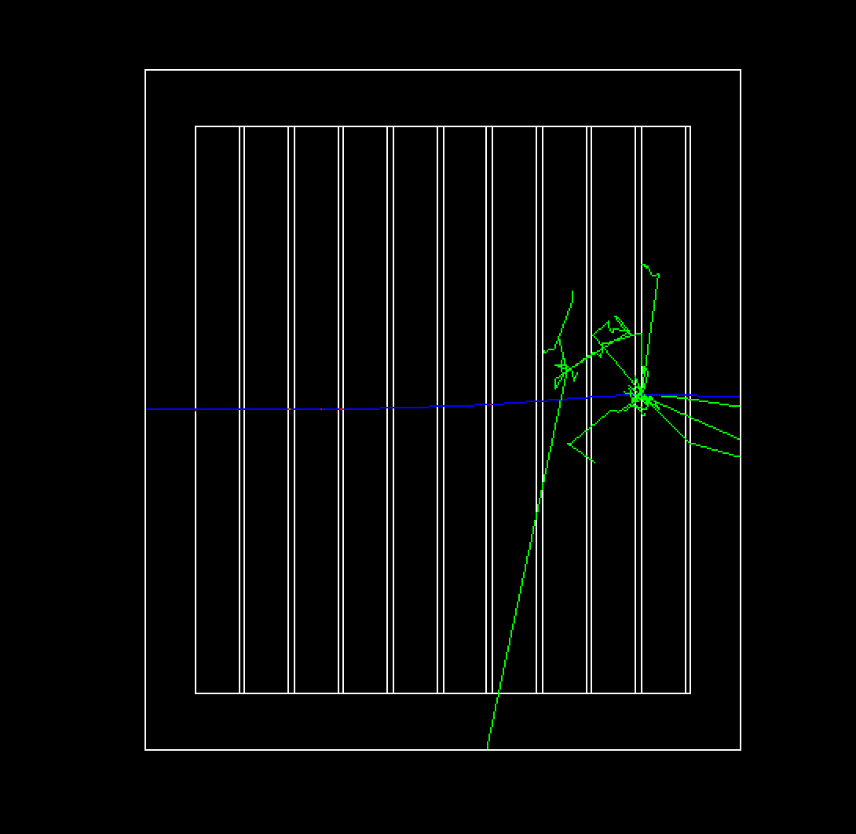
Proton ( 1 GeV)
In Cu-lAr

Slide 4
------------------------------------------------------------- ---> The calorimeter is 50 layers of:
Copper: 3.1 cm ---> sum = 1.55 m = 108 Radl = 9.944 NuclearInteractionLength
liquidArgon: 4 mm ---> sum = 20 cm = 1.428 Radl = 0.2334 NuclearInteractionLength
total thickness = 1.75 m = 109.4 Radl = 10.18 NuclearInteractionLength
transverse sizeYZ = 1.5 m
-------------------------------------------------------------
Run Summary ---> The run is 1000 proton of 5 GeV through calorimeter
Process calls frequency :
Decay= 5221 Radioactivation= 4220183 Rayl= 217355
Transportation= 5579758 annihil= 76920 compt= 2651326
conv= 62997 dInelastic= 63 eBrem= 455629
eIoni= 6352756 hBertiniCaptureAtRest= 840 hIoni= 827460
hadElastic= 3897307 ionIoni= 4191922 kaon+Inelastic= 3
kaon0LInelastic= 10 kaon0SInelastic= 3 lambdaInelastic= 8
msc= 397230 muIoni= 10468 muMinusCaptureAtRest= 11
nCapture= 31886 neutronInelastic= 81713 phot= 932748
pi+Inelastic= 1048 pi-Inelastic= 1018 protonInelastic= 3908
sigma+Inelastic= 1 tInelastic= 11
------------------------------------------------------------
material Edep rmsE sqrt(E0(GeV))*rmsE/Edep total tracklen
1 Copper 4.178 GeV 271.2 MeV 14.51 +- 0.459 % 2.06 m +- 42.8 cm
2 liquidArgon 84.903 MeV 30.78 MeV 81.08 +- 2.56 % 25.78 cm +- 7.59 cm
total Edep = 4.263 GeV
leakage : primary = 0 eV +- 0 eV secondaries = 269.7 MeV +- 0 eV ---> total = 269.7 MeV
total energy released : edep + eleak = 4.533 GeV

