Slide 1
Update on Advanced Examples: summary
S. Guatelli and F. Romano
On behalf of the Geant4 Advanced Examples WG

Slide 2
27 Advanced Examples Coord.: S. Guatelli (UOW), Dep.: F. Romano (INFN)
air_shower | B. Tomè | Detection system for cosmic ray shower simulation
ams_Ecal | M. Maire | Simulation of an Electromagnetic calorimeter
brachytherapy | S. Guatelli | Dosimetry for endocavitary, interstitial and superficial brachytherapy
composite_calorimeter | A. Ribon | A composite electromagnetic and hadronic calorimeter
ChargeExchangeMC | A. Radkov | Simulation of charge exchange real experiment
doiPET | A. Ahmed , S. Guatelli , M. Safavi | Simulation of a detector system for PET
eRosita | F. Longo | PIXE simulation with Geant4
fastAerosol | A. Knaian, N. MacFadden | Modelling of particle interactions with
gammaknife | F. Romano | A device for Stereotactic Radiosurgery with Co60 sources for treatment of cerebral diseases
gammaray_telescope | F.Longo | A simplified typical gamma-ray telescope with advanced description of the detector response
gorad | M. Asai | Model of a NASA space mission
hadrontherapy | G.A.P.Cirrone | Simulation of a transport beam line for proton and ion therapy
HGCal_testbeam | A. Zaborowska | High-end High Energy Physics test beam setup, for the endcap electromagnetic calorimeter of the CMS detector [CERN-LHCC-2017-023]
human_phantom | S: Guatelli | Dosimetry in analytical anthropomorphic phantoms
ICRP110_HumanPhantoms | S. Guatelli | Dosimetry in the ICRP110 Phantom
Iort_therapy | F. Romano | Simulation of a IORT device
lAr_Calorimeter | A. Dotti | Simulation of the Forward Liquid Argon Calorimeter of the ATLAS Detector at LHC
medical_linac | B. Caccia, G.A.P. Cirrone | A typical LINAC accelerator for IMRT,
microbeam | S. Incerti | Simulation of a cellular irradiation microbeam line using a high resolution cellular phantom
microelectronics | M. Raine | Simulation of tracks of few MeV protons in silicon
nanobeam | S. Incerti | Simulation of a nanobeam line facility
purging_magnet | J. Apostolakis | Electrons travelling through the magnetic field of a purging magnet in a radiotherapy treatment head
radioprotection | S. Guatelli, F. Romano | Microdosimetry with diamonds and silicum detectors for radioprotection in space missions
STCyclotron | F. Poignant, S. Guatelli | Modelling the production of radio-isotopes
underground_physics | A. Howard | A simplified typical dark matter detector (such as the Boulby Mine experiment)
xray_fluerescence | A. Mantero | Elemental composition of material samples through X-ray fluorescence spectra
xray_telescope | G. Santin | A simplified typical X-ray telescope (such as XMM-Newton or Chandra)

Slide 3
Plan for 2021 (1)
Maintenance and bug fixes (1,2)
  Ongoing
Code review in selected examples (1,2)
  Ongoing
  Done in microbeam, ICRP110Phantom, brachytherapy
  On-going in radioprotection, eRosita
Migration to C++11/14/17 (1,2)
  In the initial phase
Release of a new example for nanomedicine (gold nanoparticles in X-ray radiotherapy) (2)[*]
  The example will be released as an Extended Example of Geant4 in the next public release (AuNP)

Slide 4
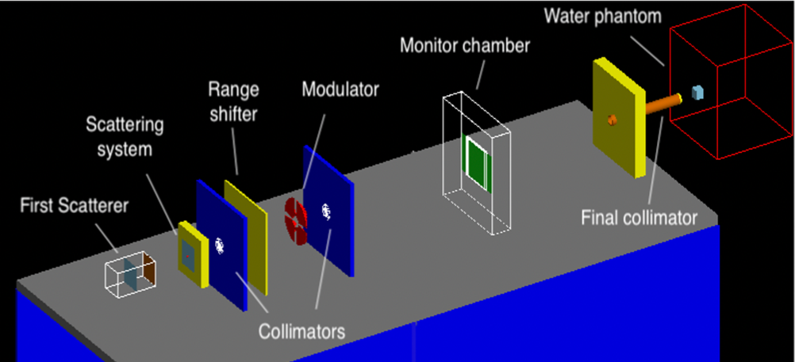
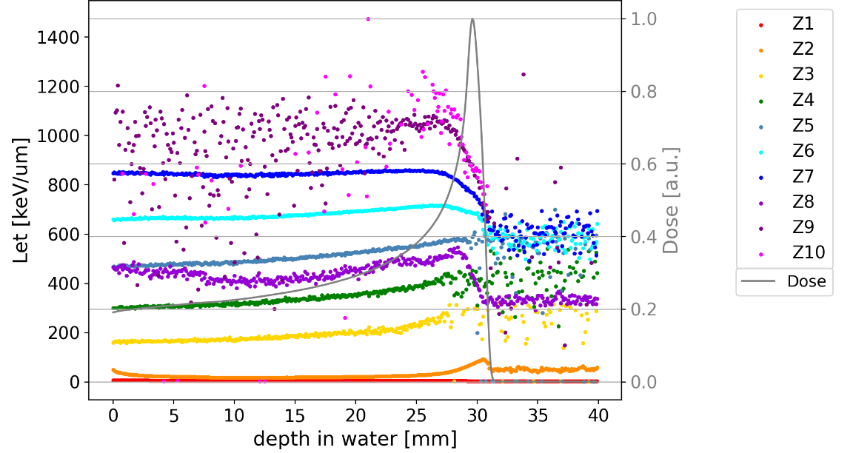


Plan for 2021: Hadrontherapy
  G. Petringa, P. Cirrone, L. Pandola, G. Miluzzo, S. Fattori
New developed algorithms to compute the LET
Validation done with clinical proton beams:
G. Petringa et al. “Study and validation of Monte Carlo methods for linear energy transfer calculation in voxelized geometries with clinical proton beams”, PMB, DOI: 10.1088/1361-6560/abaeb9 (2020)
On going validation with ions:
A new geometry : Best-Cyclotron beam line
 | Best Cyclotron source parameters
Energy | 70MeV
Energy spread (sigma) | 300keV
Spot dimension (FWHM of a gaussian distribution) | 3mm-5mm (sigma)
Spatial distribution type | Circular
Angular distribution type | Gaussian
Angular divergency | ~ 0.16 ° (sigma)

Slide 5
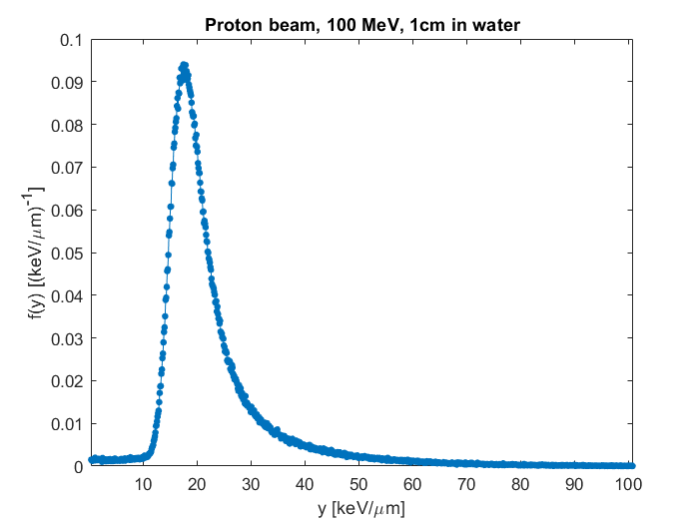
Radioprotection advanced example
Responsible developers:
S. Guatelli (University of Wollongong, Australia) and F. Romano (INFN - Catania Division, Italy)
New implementation of diamond microdosimeters (produced by University of Rome “Tor Vergata”): collaboration between INFN-Catania and University of Surrey (J. Magini, G. Parisi, G. Schettino and F. Romano)
→ completed
Implementation of simple macro commands for easy management of the geometrical configuration from Users:
  Possibility of changing the different simulated microdosimeters (Silcon vs microdiamond) via → completed
Cross-comparison with experimental data → completed/in progress (data acquired with low energy ion beams)
Simulation of double-stage microdiamond for particle identification → in progress
Python scripts for microdosimetric spectra and data analysis (first version) → in progress
10 μm thick microdiamond
see talk on the «Radioprotection example»
Diamond microdosimeters
Silicon microdosimeters

Slide 6
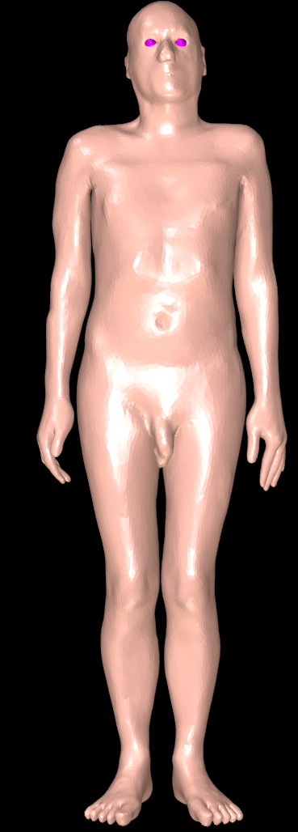
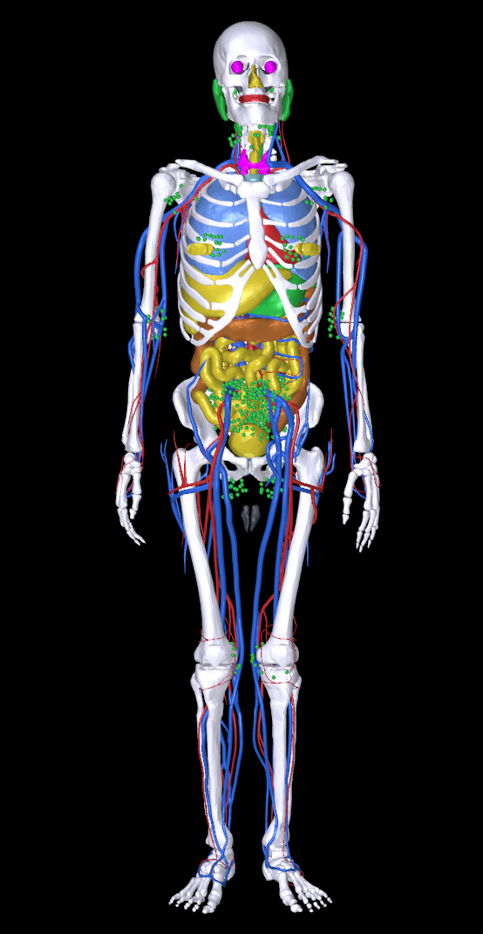
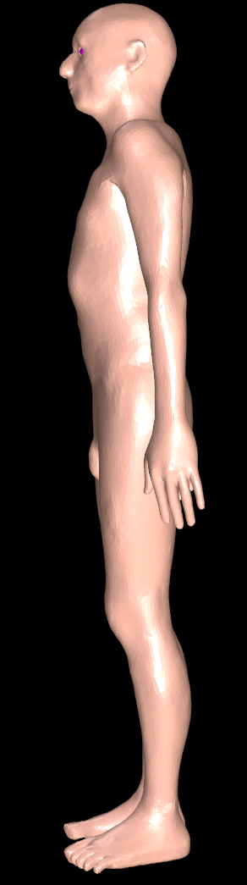
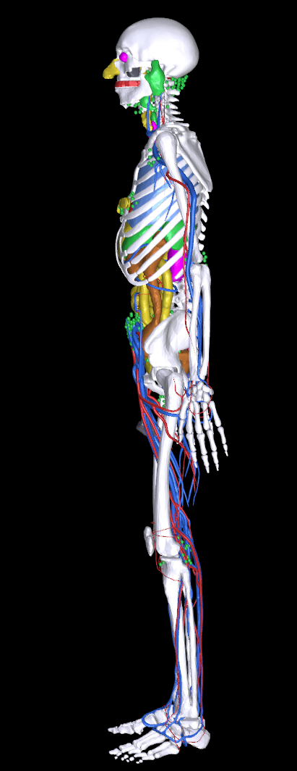
New Advanced example: ICRP145Phantom
ICRP Publication 145 on Adult Mesh-type Reference Computational Phantoms
Ann ICRP . 2020 Oct;49(3):13-201. doi: 10.1177/0146645319893605.
Calculation of the dose in the organs of the phantoms
To be released in Geant4 11, in agreement with the original developers of the models.
S. Guatelli – 2021 AIP Women in Physics Lecturer

Slide 7
Plan for 2021: Other
Current status: MT
  Examples that need to be migrated to MT :
    ChargeExchangeMC
    iort_therapy
    medical_linac
Migration to G4RunManagerFactory
  Migrated examples: in air_shower, amsEcal, composite_calorimeter, eRosita, fastAerosol, gammaknife, gammaray_telescope, gorad, hadrontherapy, HGCal_testbeam, human_phantom, ICRP110Phantoms, microbeam, microelectronics, nanobeam, radioprotection
  To migrate: ChargeExchangeMC, doiPET, iort_therapy, lAr_calorimeter, medical_linac, purging_magnet, x_rayfluorescence

Slide 8
Plan for 2021: Other
Remove eRosita, which is no longer maintained, with no Geant4 Collaborator responsible for it (2)
  F. Longo kindly agreed to maintain the example
Release of a new example showing how to import in Geant4 simulations IAEA Phase Space Files (2)[*]
  Ongoing by M. Cortes-Giraldo and collaborators
Measurements and statistical analysis of size, McCabe, Halstead, Chidamber and Kemerer software metrics over at least 50% of the advanced examples; explication of the results in relation to ISO/IEC 9126 and ISO/IEC 25000 (1,2)
  No update
Improvement of the webpage and documentation (1,2)
  Started but in stand-by to see how the Geant4 webpage will evolve

Slide 9
That’s all, thank you

