Slide 1
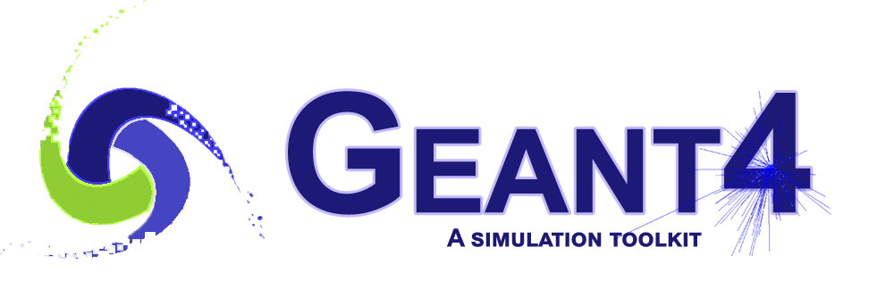
Integration of Opticks¹ and Geant4 (an advanced example: CaTS)
Hans Wenzel
Krzysztof Genser
Soon Yung Jun
Alexei Strelchenko
Fermilab-SLIDES-21-106-SCD
¹developed by Simon Blyth
(Institute of High Energy Physics, Chinese Academy of Sciences)

Slide 2

Outline
Motivation:
  Liquid Argon TPC’s,
  Scintillation/Ionization properties in liquid Argon,
  The computational challenge.
Opticks/G4Opticks.
CaTS.
Timing and Validation.
Summary and Outlook.
Next Steps.
CaTS: Calorimetry and Tracking Simulation
Hans Wenzel 26TH Geant4 Collaboration Meeting September 16th 2021

Slide 3
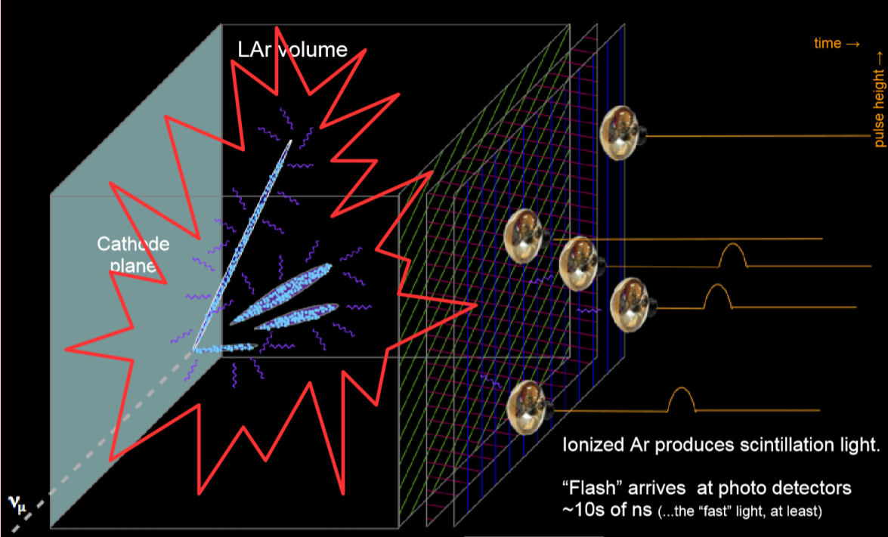
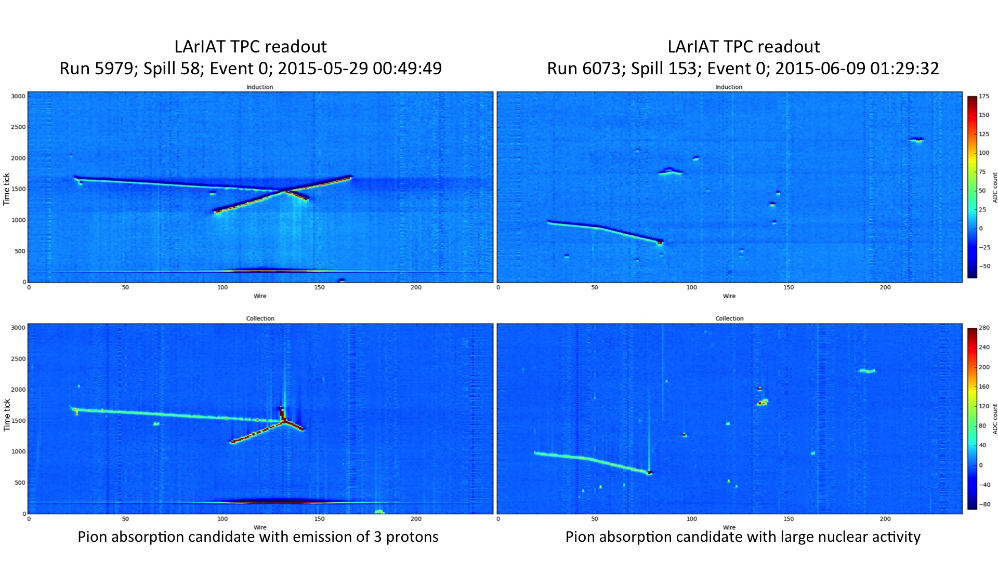
Motivation
Liquid Argon TPC’s are the technology of choice for many neutrino experiments: DUNE, protoDUNE, μBoone, LArIAT, ICARUS, SBND… as well as dark matter searches: DarkSide, ARGO, …
The image below shows a display of the ionization signal: time + stereo wires or pixels allows for 3D reconstruction
dEdx for PID
track length for energy/momentum ….
See e.g.,: Dorota Stefan:
https://indico.cern.ch/event/575069/contributions/2326563/attachments/1363382/2064171/LArPrinicipals.pdf
Hans Wenzel 26TH Geant4 Collaboration Meeting September 16th 2021

Slide 4
Scintillation/Ionization properties in liquid Argon¹
Liquid Argon is a very efficient scintillator with a very high light yield that depends on E-field and purity (Scintillation and e⁻-I⁺ pair production are competing effects.). For the simulation here we assume no E-field (Scintillation only) and a yield of 50,000 photons/MeV. A minimum ionization particle deposits 2.105 MeV/cm.
Liquid argon scintillation photons are emitted in a narrow band of 10 nm centered around 128 nm.
To match the photon wavelength to the quantum efficiency of the photodetector wavelength shifters (WLS) are used. A typical material is TPB with an emission spectrum peaked at 430 nm. WLS is “not” yet included in the simulation presented here.
The time profile consist of two components (slow 1500 ns and fast 6 ns) originated by the decay of the lowest lying singlet, Σ1u+, and triplet states, Σ3u+, of the excimer Ar2* to the dissociative ground state.
Liquid Argon is highly transparent to its own scintillation light (absorption length in the 10s of meters).
Rayleigh scattering length ~ 50-60cm.
¹) Input to the simulation
Hans Wenzel 26TH Geant4 Collaboration Meeting September 16th 2021

Slide 5
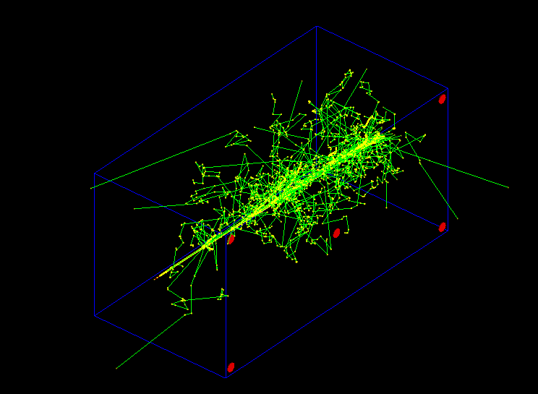
The computational challenge: Simulating a single 2GeV electron shower results in about 70 million VUV photons
Simple Geometry:
Liquid Argon: x y z: 1 x 1 x 2 m (blue)
5 photo detectors (red)
photon yield (no E-field): 50000 γ/MeV single 2GeV electron (shower not fully contained)
(low Z=18, low ρ = 1.78 g/cm³).
70 000 000 scintillation photons are produced.
Using Geant4 to simulate photon generation and propagation on the CPU takes:
~41 minutes/event
(Compared to 0.056 sec/event when no optical photon simulation)
Shown are only steps and particle tracks handled by Geant4,
no optical photons.
Hans Wenzel 26TH Geant4 Collaboration Meeting September 16th 2021

Slide 6
Opticks¹
¹developed by Simon Blyth
Opticks is an open source project. It translates Geant4 optical physics to NVIDIA® CUDA, OptiXTM. Generation and tracing of optical photons is the ideal application to be ported to GPU’s:
Only one particle involved (optical photon), but many of them (10s of millions)→ allows for massive parallelism (low latency, no big fluctuations in computing time.).
Only a few simple physics processes need to be implemented on the GPU. The processes are :
  G4Cerenkov (generate),
  G4Scintillation (generate),
  G4OpAbsorption,
  G4OpRayleigh,
  G4OpBoundaryProcess (only a few surface types),
  G4OpWLS (not yet implemented),
  G4OpMieHG, Reemission (not needed).
These processes don’t need a lot of input data (the so called Gensteps for the Cerenkov (C) and Scintillation (S) processes).
Only few photons reach the Photodetectors and produce a Hit. So very little data to transfer between host and device. (Gensteps→ Device, PhotonHits → Host).
Optical ray tracing is a well established field → benefit from available efficient algorithms (e.g., OptiXTM).
use NVIDIA® hardware (some with RTX: raytracing hardware acceleration) and software (CUDA, OptiX).
Hans Wenzel 26TH Geant4 Collaboration Meeting September 16th 2021

Slide 7
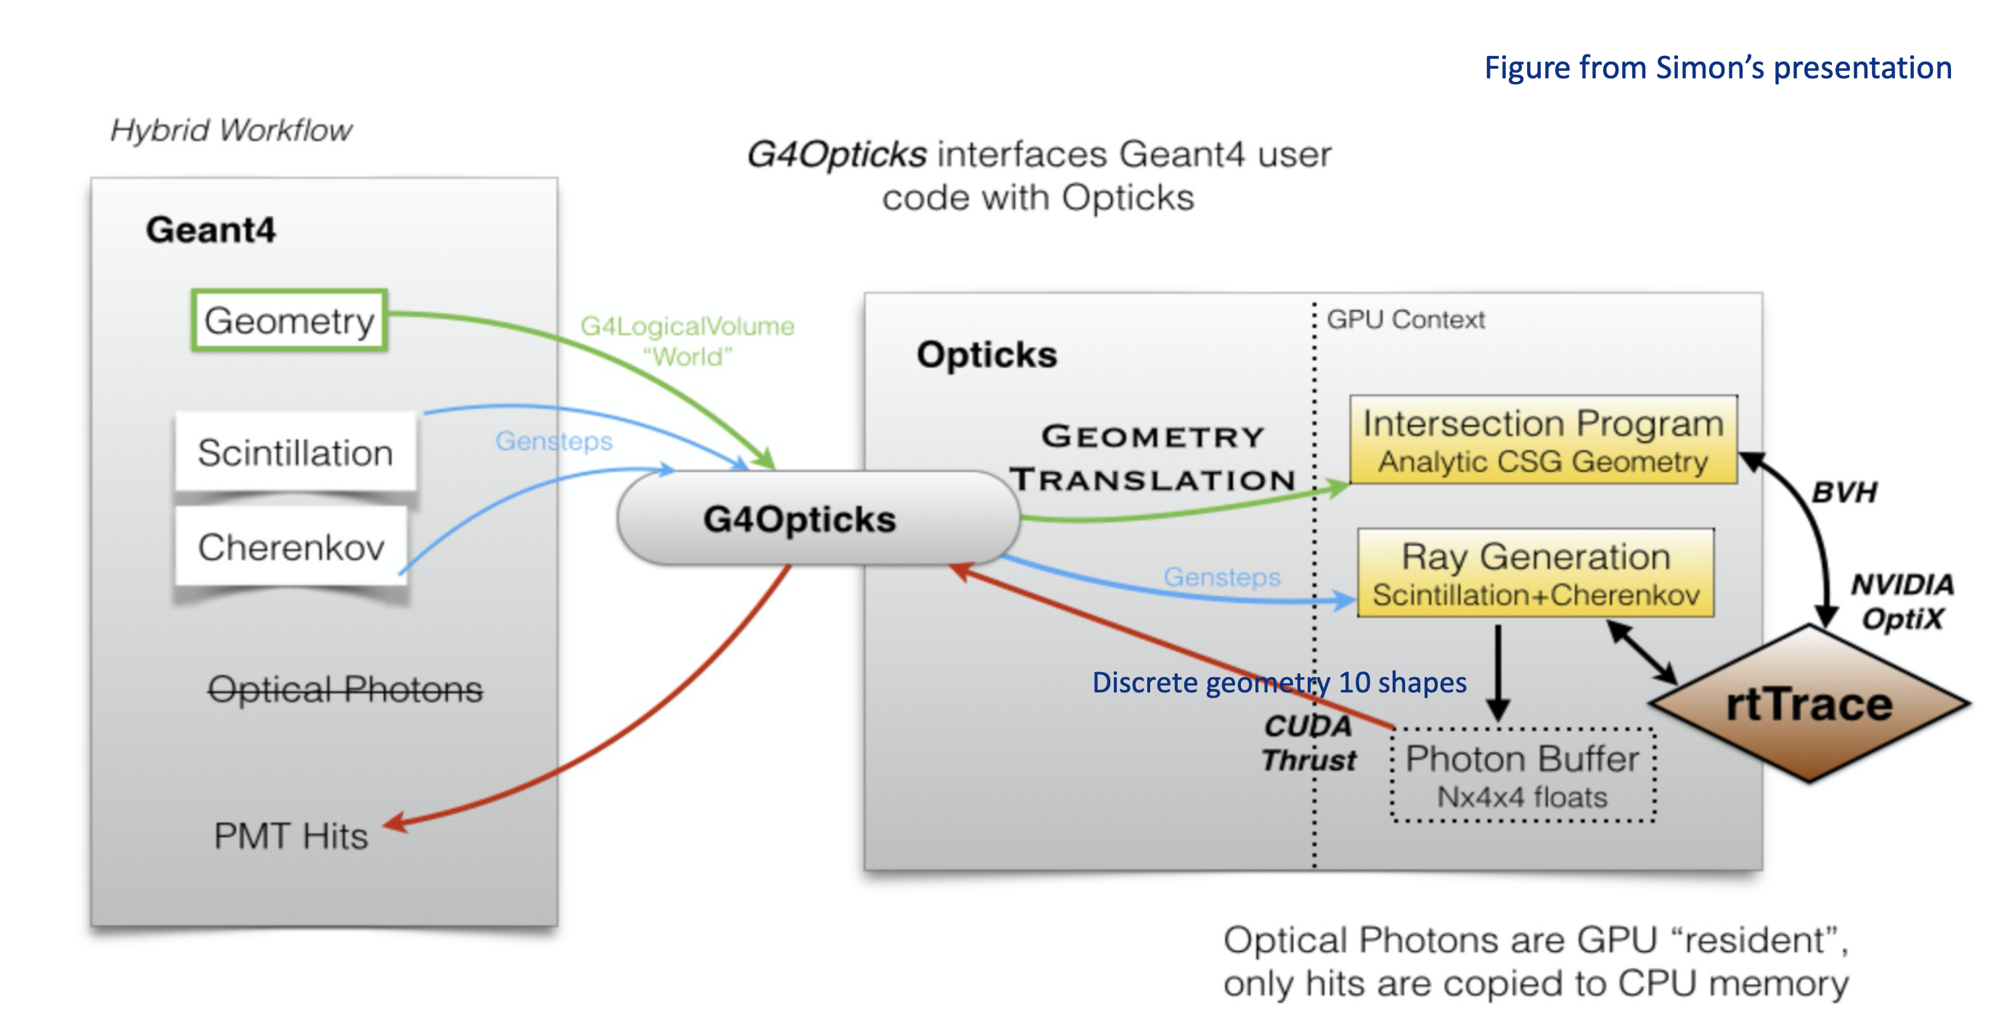
G4Opticks
G4Opticks (part of Opticks): interfaces Geant4 user code with Opticks. It defines a hybrid workflow where generation and tracing of optical photons is offloaded to Opticks (GPU/device) at stepping level when a certain amount photons is reached. Geant4 (CPU/host) handles all other particles.
The Geant4 Cerenkov and Scintillation (C/S) processes are only used to calculate the number of optical photons to be generated at a given step and to provide all necessary quantities to generate the photons on the GPU. The information collected is the so called GenStep which is different for Cerenkov and Scintillation (C/S).
Photon Hits are collected at the end of the G4Opticks call and added to the event hits collection.
Hans Wenzel 26TH Geant4 Collaboration Meeting September 16th 2021

Slide 8
Opticks Resources:
https://simoncblyth.bitbucket.io/env/presentation/opticks_may2020_hsf.html
EPJ Web of Conferences 214, 02027 (2019), https://doi.org/10.1051/epjconf/20192140202
Simon Blyth:
“Opticks : GPU Optical Photon Simulation for Particle Physics using NVIDIA® OptiXTM “
Detector geometry in Opticks: https://indico.cern.ch/event/975008/
Documentation: https://simoncblyth.bitbucket.io/opticks/index.html
Code repositories:
https://bitbucket.org/simoncblyth/opticks/ : main development repository
https://github.com/simoncblyth/opticks : used for snapshots and tagged releases.
The most recent tag is https://github.com/simoncblyth/opticks/releases/tag/v0.1.2
Hans Wenzel 26TH Geant4 Collaboration Meeting September 16th 2021

Slide 9
CaTS: Calorimeter and Tracker Simulation
Geant4 Application that allows to simulate Detector setups ranging from a single Detector (e.g. single crystal) to complex setups (e.g. test beam experiment consisting of many detector elements). It is used to demonstrate the G4Opticks hybrid workflow, works with Geant4 > 10.7.01. Main Code repository: https://github.com/hanswenzel/CaTS
Its features are:
No changes to Geant4! Only make use of provided interfaces: UserActions, Sensitive Detectors...
G4Opticks is a runtime/build time option.
Uses gdml with extensions for flexible Detector construction and to provide optical properties at runtime. The gdml extensions include:
  Assigning sensitive detectors to logical Volumes. Available:
    RadiatorSD, lArTPCSD, TrackerSD, PhotondetectorSD, MscSD, CalorimeterSD, DRCalorimeterSD,….
  Assigning step-limits to logical Volume.
  Assigning visualization attributes.
Uses G4PhysListFactoryAlt to define and configure physics at runtime via command line option:
time ./CaTS -g simpleLArTPC.gdml -pl 'FTFP_BERT+OPTICAL+STEPLIMIT' -m time.mac
time ./CaTS -g simpleLArTPC.gdml -pl 'FTFP_BERT+OPTICAL+STEPLIMIT' -m time_G4.mac
Uses Root IO to provide persistency for Hits.
G4opticks:
  Uses Geant4 to collect Scintillation and Cerenkov Gensteps. The harvesting is done in sensitive Detectors(SD) (RadiatorSD/lArTPCSD).
  PhotonHits are collected in PhotonSD.
Hans Wenzel 26TH Geant4 Collaboration Meeting September 16th 2021

Slide 10
CaTS workflow
Geant4 (Host)
G4Opticks(Device)
event loop:
Begin of event:
gdml
Step:
lArTPCSD ProcessHits:
collect electrons → lArTPCHits
collect gensteps (C/S),
.mac
Gensteps
No. Photons>NMAX:
Gensteps (C/S)
Generate and propagate Cerenkov and Scintillation photons
Photon Hits
PhotonHits
Gensteps
End of event:
Gensteps (C/S)
Generate and propagate Cerenkov and Scintillation photons
lArTPCHits
PhotonHits
Photon Hits
input
output
TTree:
Event 1: lArTPCHits. PhotonHits. ……
Root file
Event 2: lArTPCHits. PhotonHits. ……
Event 3: lArTPCHits. PhotonHits. ……
Hans Wenzel 26TH Geant4 Collaboration Meeting September 16th 2021

Slide 11
CaTS resources
Main git repository: https://github.com/hanswenzel/CaTS/: used for development.
Instructions how to build and run CaTS: https://github.com/hanswenzel/CaTS/blob/master/README.md
Instructions how to build Opticks and how to install all necessary software:
https://github.com/hanswenzel/CaTS/blob/master/Instructions.md
CaTS examples (examples consist of: gdml file, Geant4 macro and an application that makes histograms from the hits collections): https://github.com/hanswenzel/CaTS/blob/master/Examples.md
CaTS is also available in fork of the Geant4 GitLab repository (as advanced example), used for snapshots and tagged releases.
https://gitlab.cern.ch/wenzel/geant4-dev/-/tree/CaTSv1_0/examples/advanced/CaTS
Hans Wenzel 26TH Geant4 Collaboration Meeting September 16th 2021

Slide 12
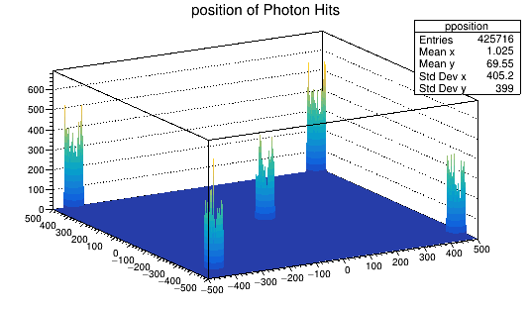
Performance:
Hardware:
CPU | Intel(R) Core i7-9700K 3.6GHz 32 GB memory.
GPU | GeForce RTX 2070 CUDA Driver Version /11.3 CUDA Capability: 7.5 VRAM: 7981 Mbytes Cores: 2304
Timing results (Geant4 10.7.p01):
Geant4 optical physics | 2438 sec/event
G4Opticks, RNGmax¹ 10 | 6.45 sec/event
G4Opticks RTX enabled, RNGmax¹ 10 | 2.72 sec/event
G4Opticks, RNGmax¹ 100 | 6.86 sec/event
G4Opticks RTX enabled, RNGmax¹ 100 | 2.87 sec/event
Geant4/(Geant4 + Opticks) comparison:
2438/6.45 = 378 (x 2.4 ~ 900 with RTX) x speed up
RTX Ray tracing hardware acceleration is usually not available on HPC platforms
Memory pre allocated for pre-initialized (at installation) curandState files to load.
Hans Wenzel 26TH Geant4 Collaboration Meeting September 16th 2021

Slide 13
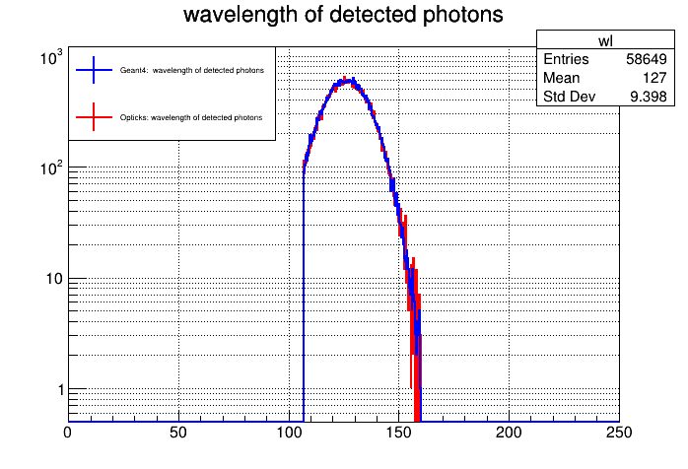
Validation: Comparison of Geant4 and Opticks
PhotonHit:
register property of every photon that hits a Photo detector surface:
unsigned id{0}; // id of Photo Detector
unsigned pid{0}; // Process ID
G4double wavelength{0};
G4double time{0};
G4ThreeVector position{0};
G4ThreeVector direction{0};
G4ThreeVector polarization{0};
Point like light source, Photons at sensors-> still need
To compare Geant4/Opticks scintillation implementation in detail
Hans Wenzel 26TH Geant4 Collaboration Meeting September 16th 2021

Slide 14
Summary and Outlook:
The work was performed as part of the Geant4 R&D Activity.
We integrated Opticks with Geant4 (>10.7.p01). Small changes to Geant4 interfaces were introduced when needed.
Provided timing/memory usage results. For our test case we observe an overall speedup by a factor of 390/900 (without/with RTX) compared to running Geant4 optical simulation on the CPU.
The example CaTS:
  Provides ROOT persistency for Hit collections.
  Provides Sensitive detector plugins for different detector types.
  Provides various detector geometries and configurations as gdml.
  Gensteps chunks are collected in-situ during the stepping loop, once a predetermined chunk size, that can be set via a Geant4 messenger class, is reached the optical photon propagation is offloaded to the GPU (device). The rest of simulation and Gensteps collection is done on the CPU (host). The remaining Photons are processed at the end of Event.
GPU Hardware is developing fast (accelerating). All results here are based on GeForce RTX 20 Series Turing platforms with first generation RTX.
Expect performance boost from moving to OptiXTM 7 (Simon Blyth is working on it).
Hans Wenzel 26TH Geant4 Collaboration Meeting September 16th 2021

Slide 15
Next Steps
Make it an advanced Geant4 example. Available in GitLab for review, create pull request once ready.
Make use of modern C++ (11, 17) features.
Allocate resources at CERN where Opticks and CaTS can be installed and added to automated testing (Ben Morgan).
Create singularity container to run on HPC resources.
Identify the best workflow depending on application to best utilize modern hardware (GPU and CPU) making use of event-based multithreading as well as G4Tasking.
Implement wavelength shifting (WLS) process on GPU and update Opticks optical processes so that they correspond to the current Geant4 optical processes and uses the same material properties.
Evaluate treatment of random numbers on GPU.
Keep up with Opticks (e.g., move to Optix 7) development.
Hans Wenzel 26TH Geant4 Collaboration Meeting September 16th 2021

Slide 16
Backup slides

Slide 17
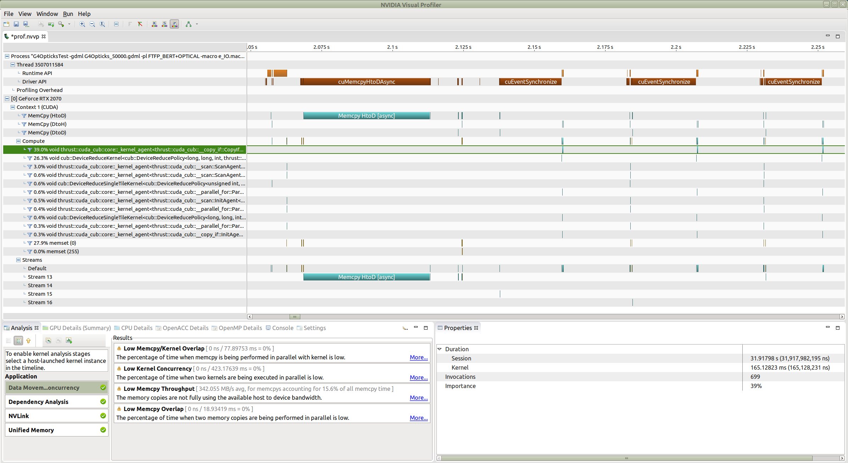
Profiling using NVIDIA’s nvprof
Besides at the beginning there is very little data transfer between device and host.
(Gensteps-> Device, PhotonHits -> Host)
Hans Wenzel 26TH Geant4 Collaboration Meeting September 16th 2021

Slide 18
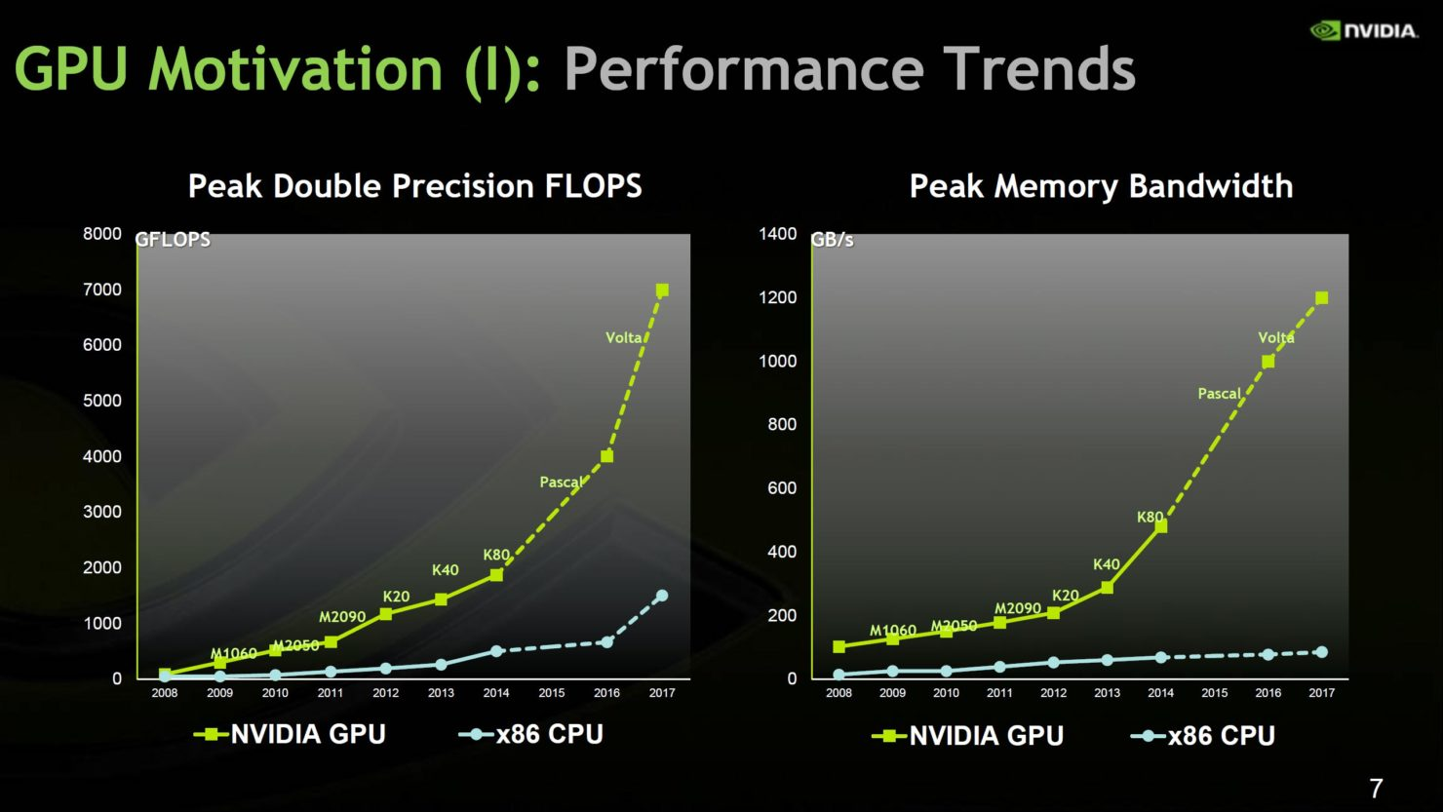
https://wccftech.com/nvidia-pascal-gpu-analysis/
Hans Wenzel 26TH Geant4 Collaboration Meeting September 16th 2021

Slide 19
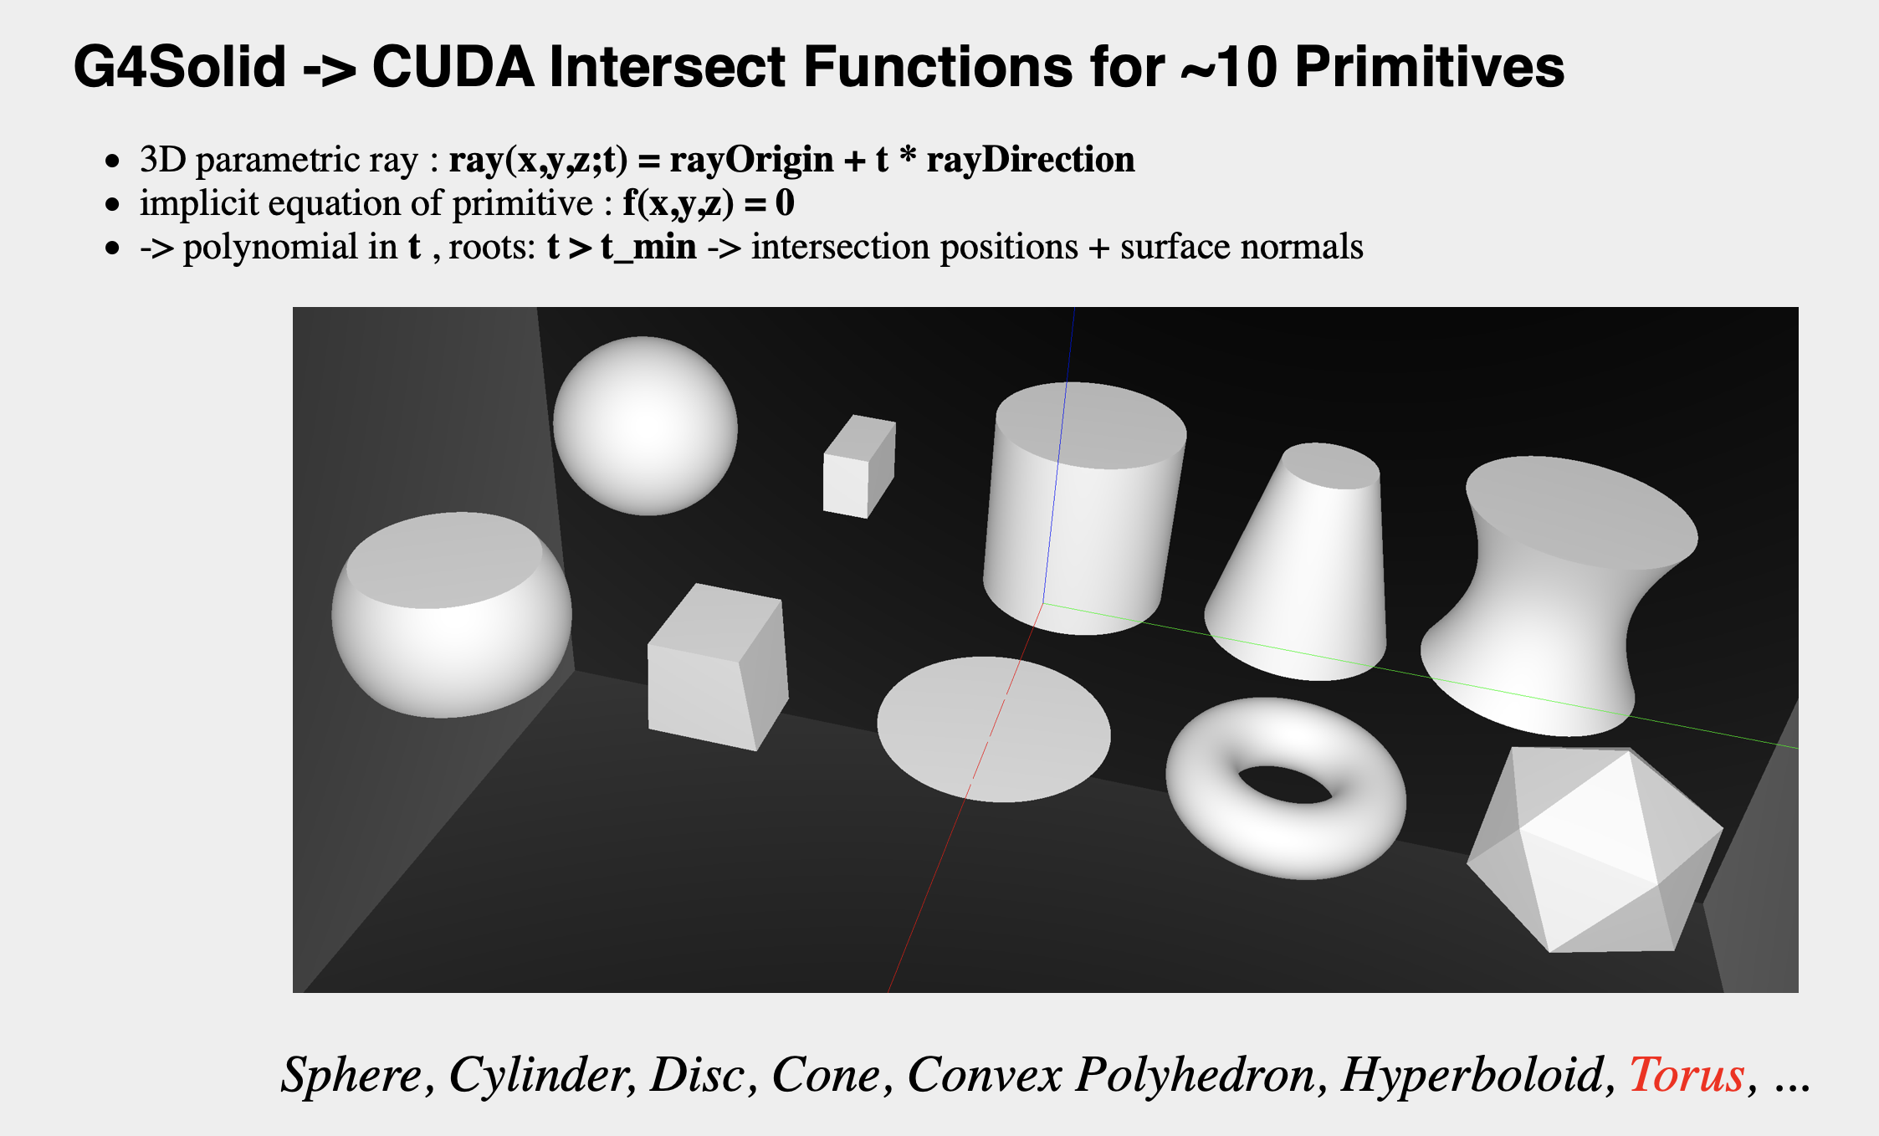
Hans Wenzel 26TH Geant4 Collaboration Meeting September 16th 2021

Slide 20
Gensteps
Cerenkov Genstep:
OpticksGenstep_G4Cerenkov_1042, // (int)gentype (0)
aTrack->GetTrackID(), // (int)ParenttId
aMaterial->GetIndex(), // (int)MaterialIndex
numPhotons, // (int)NumPhotons
x0.x(), // x0.x (1)
x0.y(), // x0.y
x0.z(), // x0.z
t0, // t0
deltaPosition.x(), // DeltaPosition.x (2)
deltaPosition.y(), // DeltaPosition.y
deltaPosition.z(), // DeltaPosition.z
aStep->GetStepLength(), // step_length
aParticle->GetDefinition()->GetPDGEncoding(), // (int)code (3)
aParticle->GetDefinition()->GetPDGCharge(), // charge
aTrack->GetWeight(), // weight
preVelocity, // preVelocity
betaInverse, // (4)
wl_minmax ? wmin_nm : pmin,
wl_minmax ? wmax_nm : pmax,
maxCos,
maxSin2, // (5)
meanNumberOfPhotons1,
meanNumberOfPhotons2,
postVelocity
A Genstep collects all information necessary to generate Scintillation and Cerenkov photons on the GPU.
Hans Wenzel 26TH Geant4 Collaboration Meeting September 16th 2021

