Slide 1
Geant4 Reverse MC status
L. Desorgher
Radiation Physics Institute, IRA-CHUV, Lausanne

Slide 2
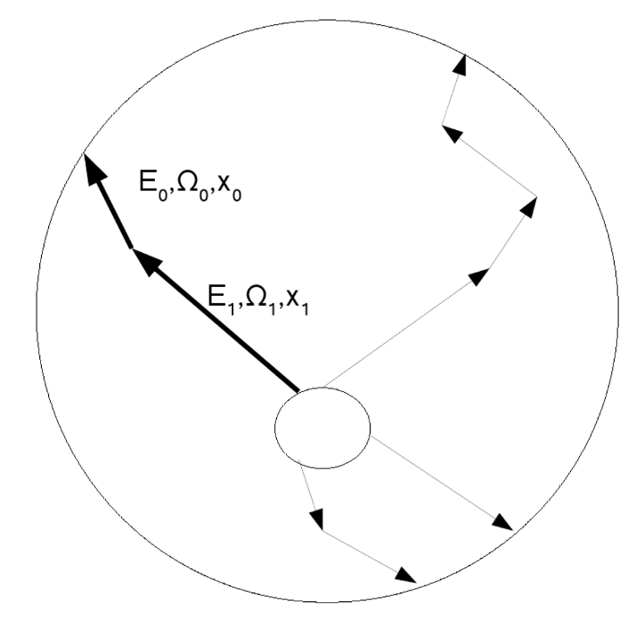
Geant4 Reverse MC
Introduction
Improvement electron dose computation for thick shielding
Test with complex geometry
Problem on proton dose computation
Test in multithreading mode
Verification of precision computation

Slide 3
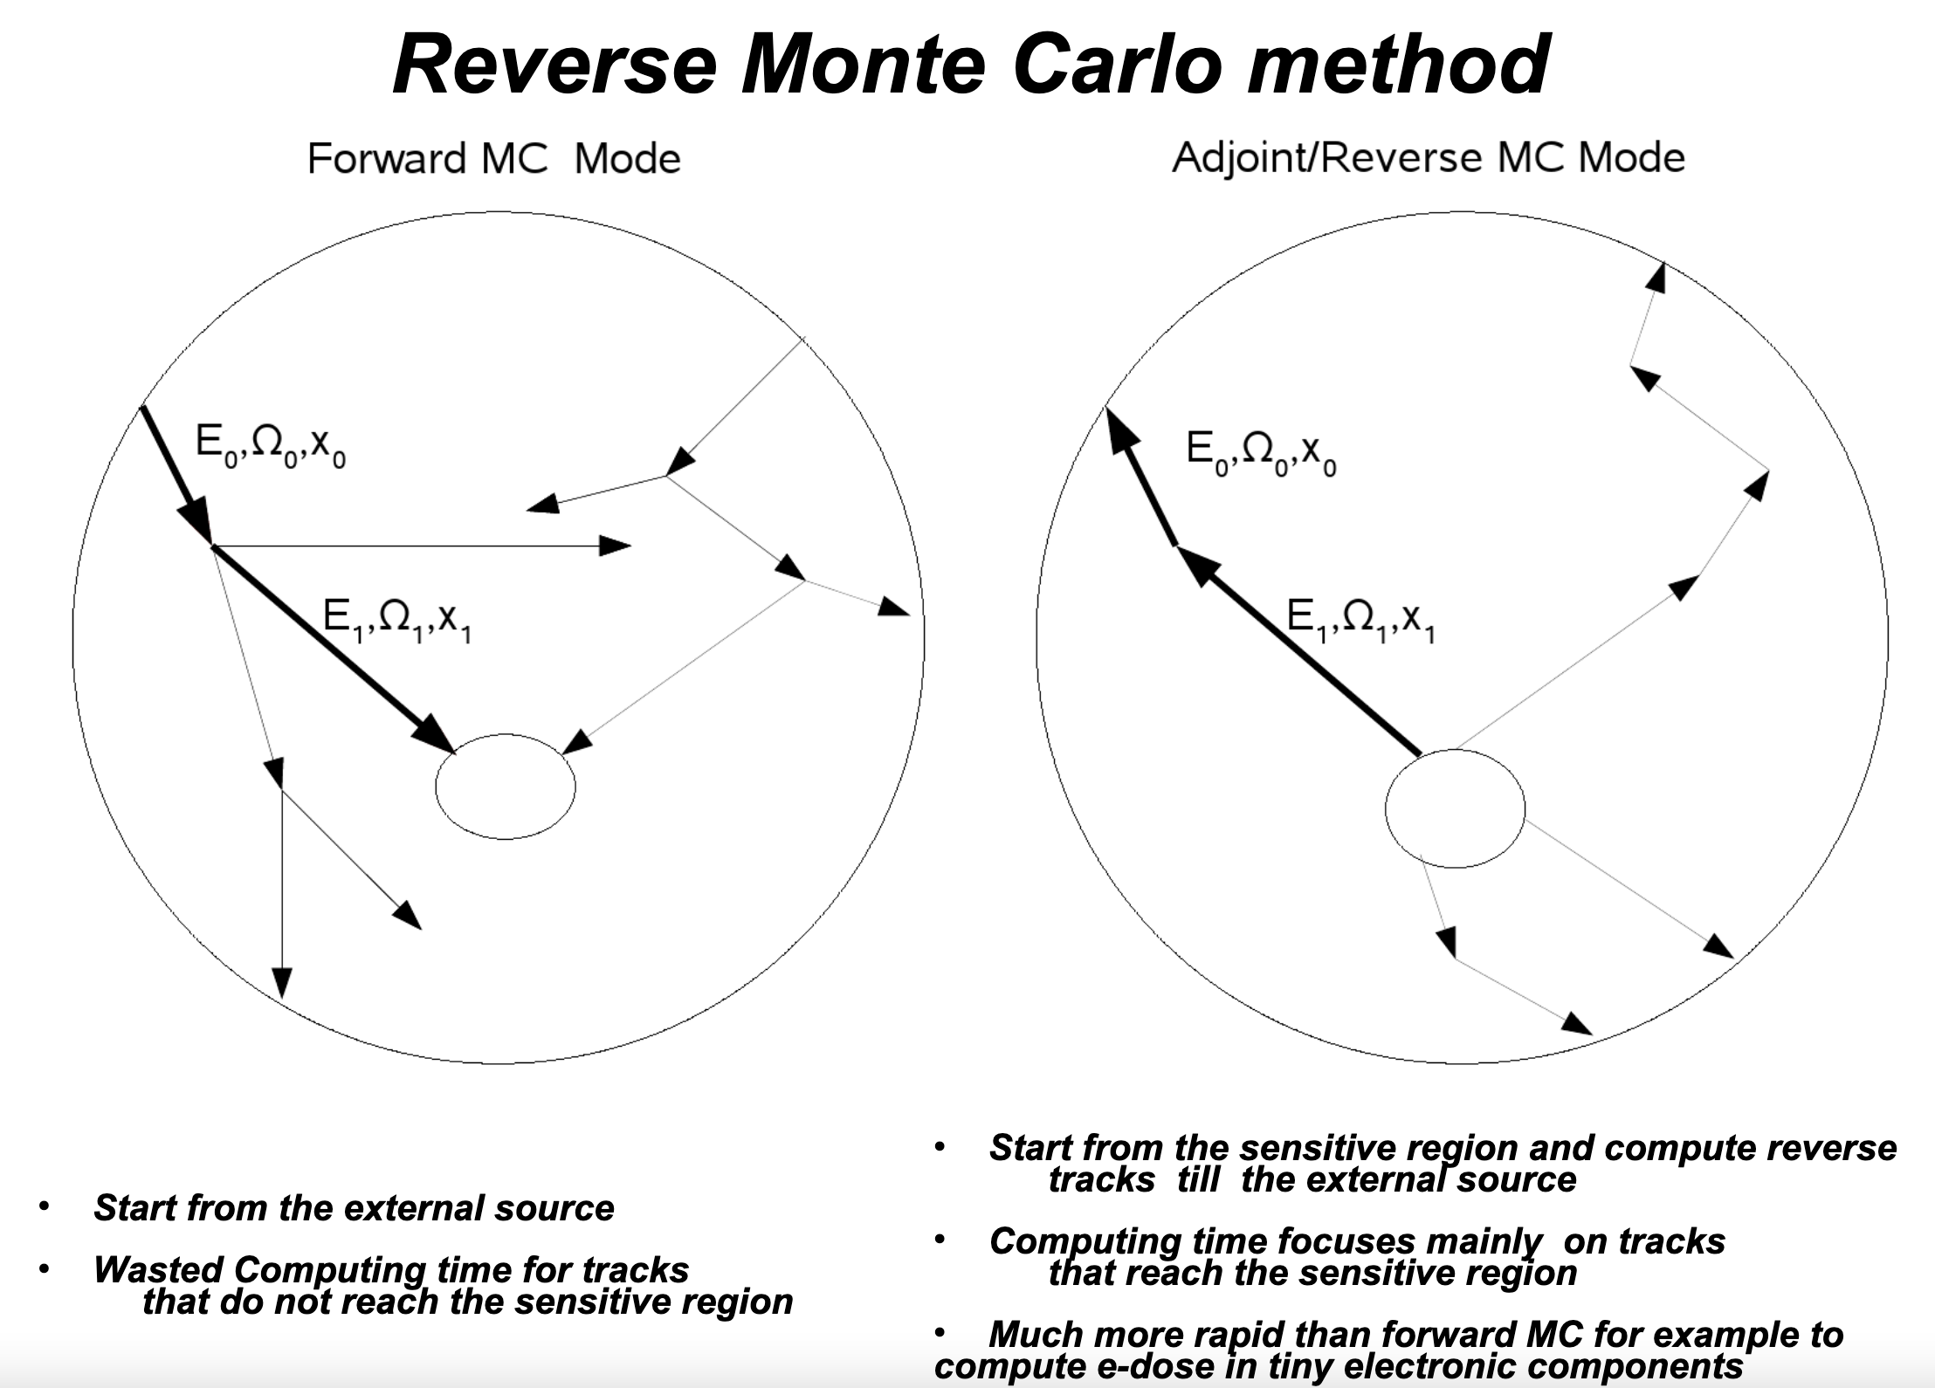

Slide 4
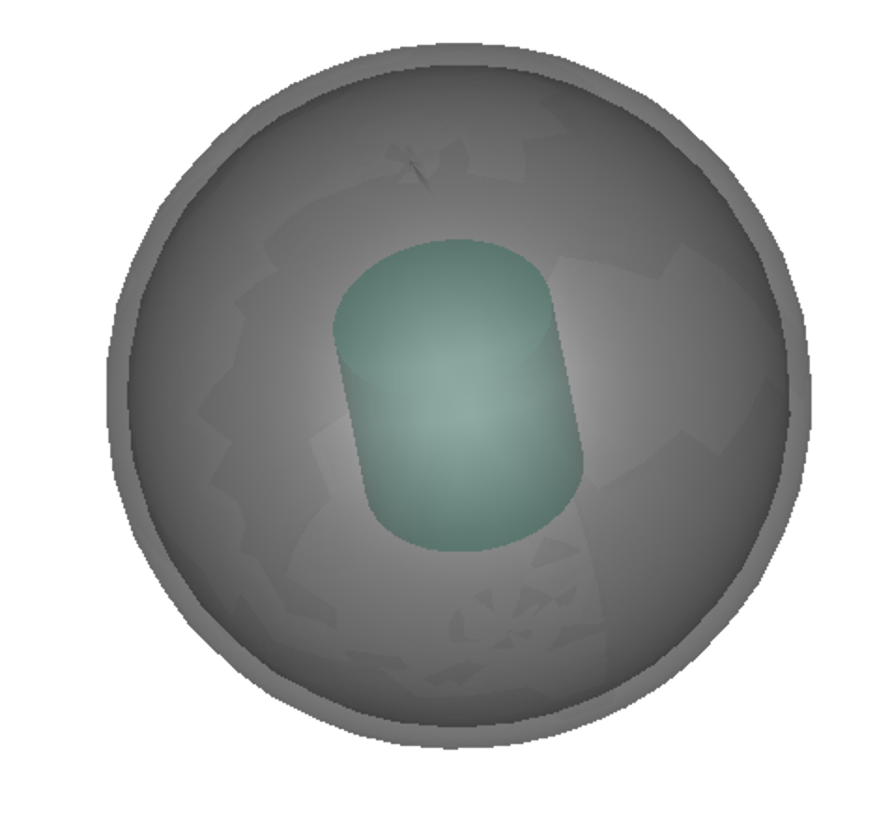
Energy deposited in sensitive volume behind Al shielding
Discrepancy between Geant4 Reverse MC and Geant4 analog at thick shielding where the dose from
secondary gamma dominates

Slide 5
photon fluence at 2 cm thick shielding from photon source
Discrepancy in photon fluence at low energy
Discrepancy disappears when the bremsstrahlung is switched off
Seem to indicate that the Compton is not properly sampled when the bremsstrahlung is switch on

Slide 6
Modification in the reverse photon forced interaction
Analysis Reverse photon forced interaction
Applied modifications
Reverse bremsstrahlung is sampled much more often during the reverse forced interaction compared to the reverse Compton
Reverse photon processes are sampled more often in the inner part of the shielding
Sample reverse bremsstrahlung and Compton with a 50-50% probability
Sample linearly the occurrence of reverse processes along the reverse tracking path

Slide 7
Dose vs Al shielding thickness after modifications
Spectrum exp(-E/0.4 MeV)

Slide 8
Dose vs Al shielding thickness – MEO spectrum

Slide 9
Dose vs Ta shielding thickness after modifications
Spectrum exp(-E/0.4 MeV)

Slide 10
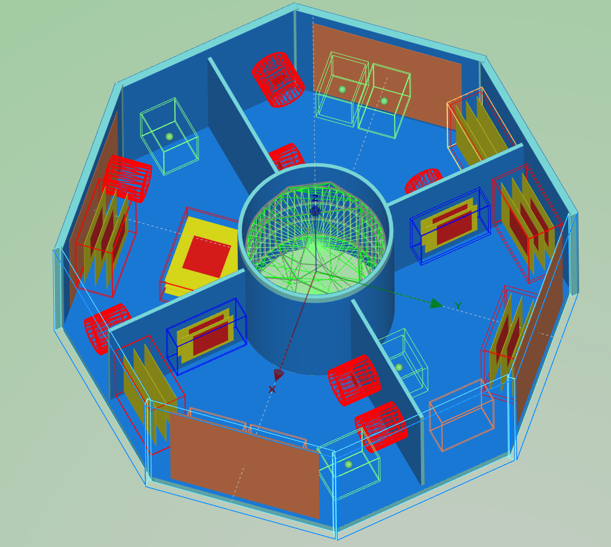
Electron dose with ESA Spacecraft_test geometry
Middle Erath Orbit spectrum
Name Det | Shielding | Analog dose (MeVcm²) | Reverse dose (MeVcm²)
det_4_2_fwd | Al 7 mm | 3.88 10⁻⁵ (0.5) | 4.15 10⁻⁵ (0.25)
det_5_2_fwd | Al 1 mm | 3.58 10⁻³ (0.2) | 4.03 10⁻³ (0.06)
det_7_2_fwd | Pb 4 mm | 1.21 10⁻⁵ (0.2) | 8.44 10⁻⁶ (0.6)

Slide 11
Convergence of dose results – det7

Slide 12
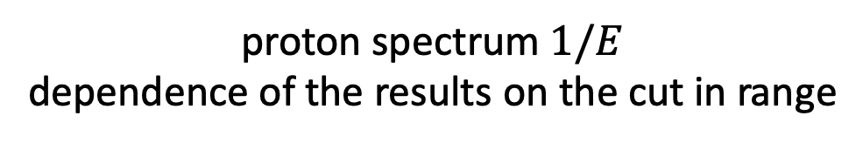
Energy deposited in sensitive volume behind Al shielding
proton spectrum $1/E$
dependence of the results on the cut in range

Slide 13
Energy deposited in sensitive volume behind Al shielding
Without post step weight correction
Post step weight correction for reverse proton not necessary up to 0.01 mm cut in range
At smaller cut in range more discrete ionisation occur and the weight correction should be applied

Slide 14
Geant4 exampleRMC1 in multithreading mode
Add the capability of using GDML file for the geometry definition
Porting of the G4RMC example in MT mode. Thanks to M. Axiotis
Need to use /run/setCut command before /run/initialize in MT mode
Convergence file and precision test in MT mode
  One convergence file per working thread
  Precision test at the level of working thread
  Merging of the results by the master at end of run

Slide 15
G4RMC MT vs sequential mode

Slide 16
Verification of precision computation in G4 RMC example
350 simulations with 5 10⁴ events - 5 mm Al shielding
dose / mean dose
Precision / 𝞂 (dose)
Computation of dose and dose precision follows the central limit theorem!

Slide 17
Conclusions
Gamma Reverse tracking algorithm based on forced interaction has been modified to improve the e- dose computation under thick shielding
Geant4 Reverse MC is now working in multithreading mode
Ongoing investigation on proton bug
Updated G4Adjoint classes and exampleRMC1 will be provided in Geant4.11 release

