Slide 2


CERN Science for Society:
Technologies for Quantum Communications
Alberto Di Meglio
CERN QTI Coordinator
CERN openlab
IT Department - CERN
01/07/2021

Slide 3
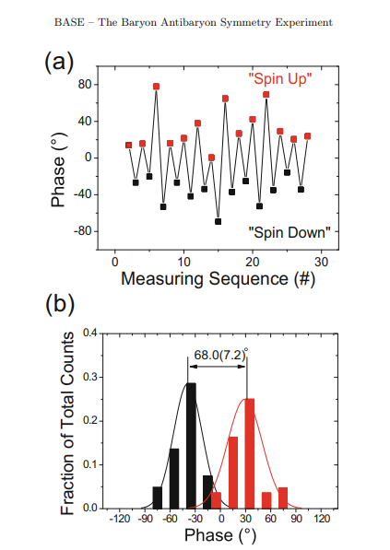
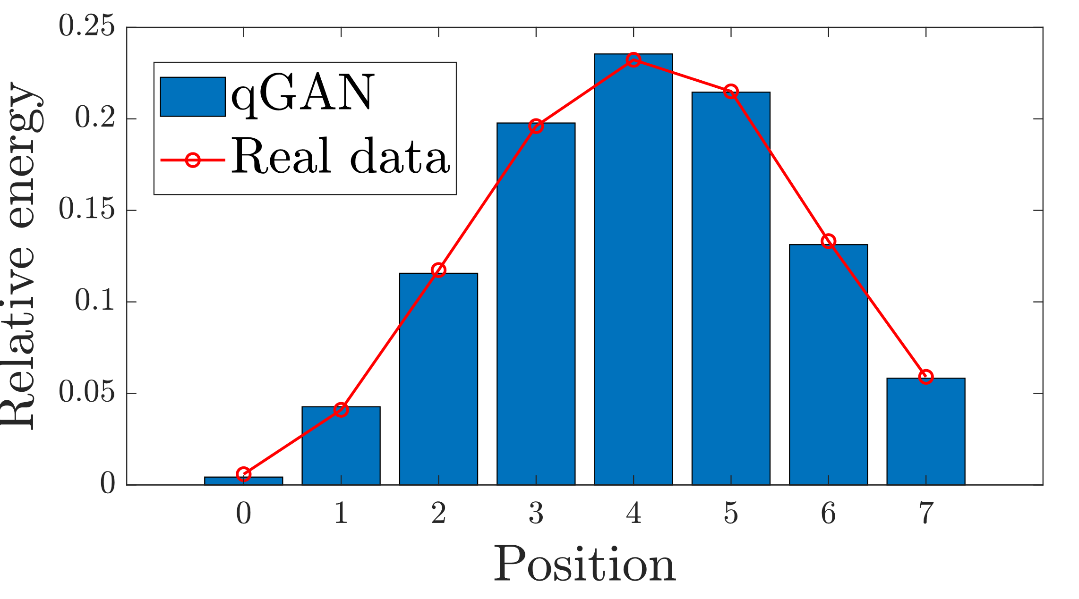
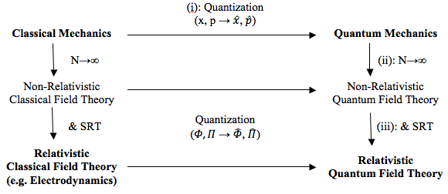
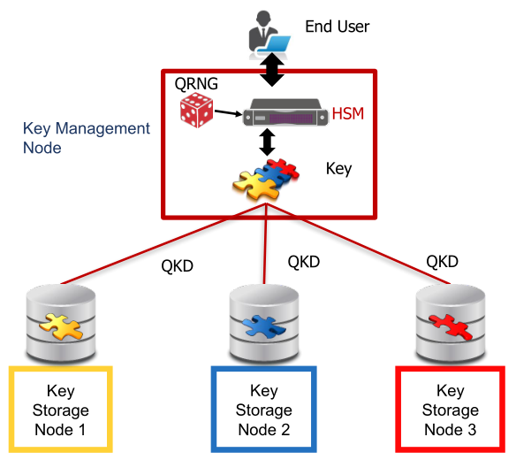
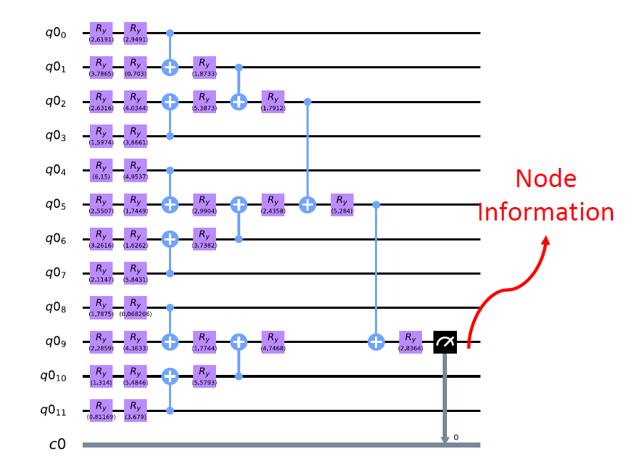
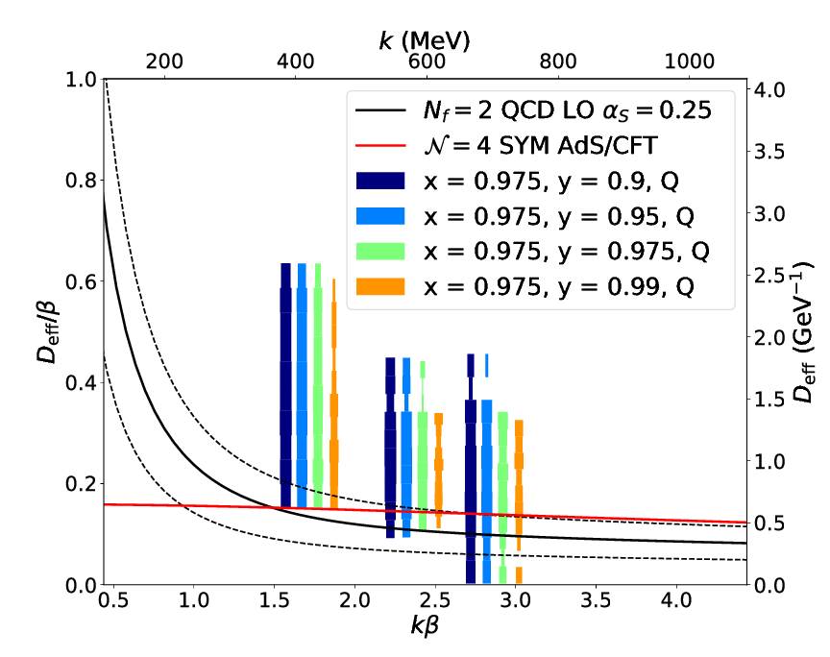
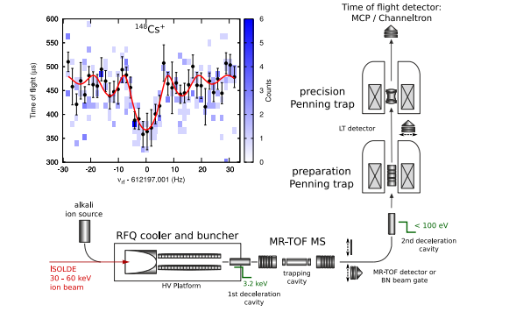
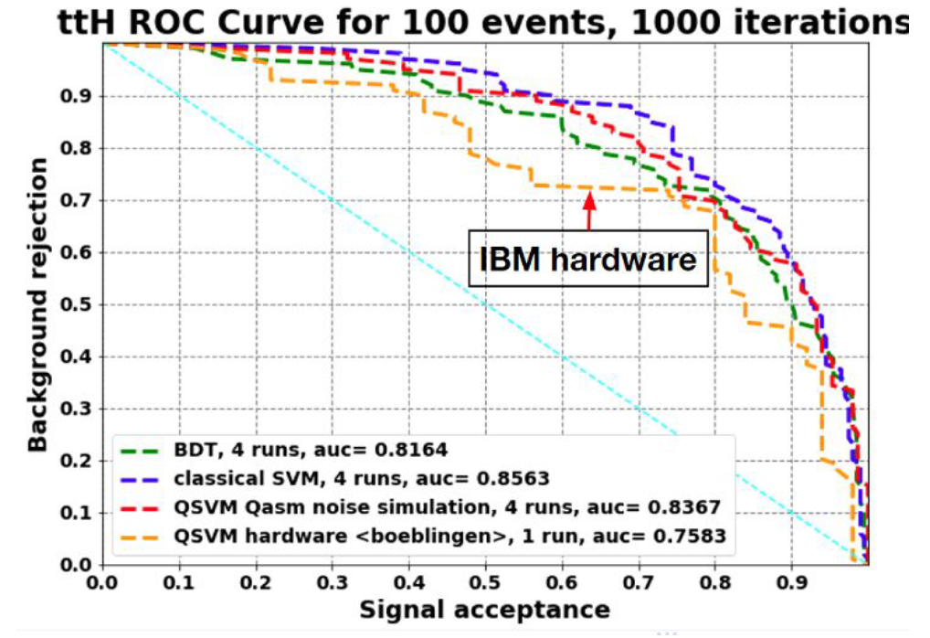
CERN Unique Expertise and Activities
Computing
Sensing
Communications
Theory
Simulation
https://doi.org/10.1140/epjst/e2015-02607-4
Quantum Field Theory
BASE phase-sensitive measurement of spin allowing very precise magnetic field drift measurements
Reconstruction
openQKD
Repeater node in the CERN Data Centre
Classification
https://cds.cern.ch/record/2703396
https://doi.org/10.1088/1361-6471/aa5a20
Lattice QCD
ISOLTRAP Mass-Spec
Many pilot projects already started as part of the CERN openlab quantum programme (https://openlab.cern/quantum)

Slide 4
CERN Quantum Technology Initiative
CERN Management
Sensing,
Detectors R&D
Communication
Joint HEP R&D Programme
Advisory Board and QT Forum (with large representation of the
Member States)
QT Initiative Management
Computing & Engineering
Simulation,
Information Processing
Strategy
Coordination
R&D
Capacity building
Academic Programmes / Industrial Collaborations

Slide 5
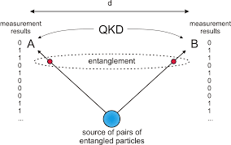
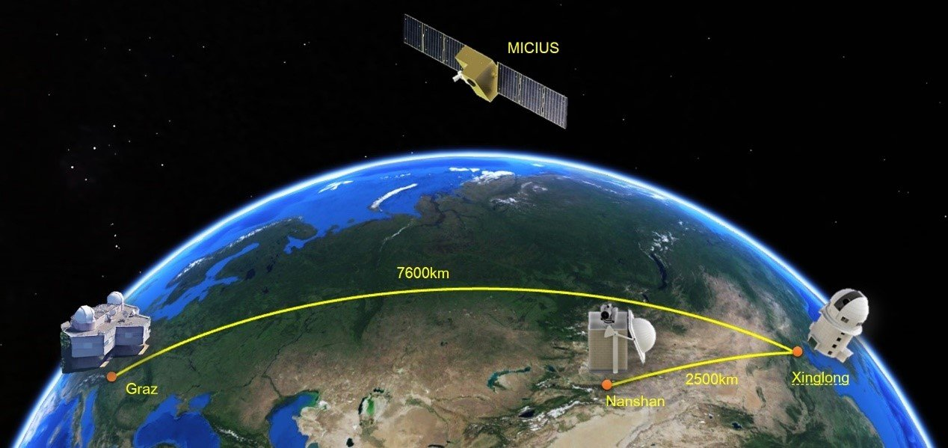
Quantum Communications
John Bell was a theoretical physicist at CERN when he published his work on Bell’s inequalities and the Bell’s Theorem in 1964
  A test of the “spooky action at a distance”
Work on extending the distance of range of quantum communication channels already had CERN involved 2009-2011 As part of the SwissQuantum project
The current record in fiber is ~500 km using TF-QKD
Free-space satellite connections can reach a few 1000’s km (Micius, Beijing-Graz)
Current research focuses on setting network of links and nodes with various techniques (repeaters, error correction nodes, etc)
Several possible approaches
  Discrete qubits (fully quantum or hybrid, bb84, etc.)
  Coherent states, continuous amplitudes
  Hybrid discrete/continuous approaches, field qubits (logical qubits based on energy states)
Many top-level initiatives being set up to coordinate R&D in this area, e.g.
  The openQKD project in EU part of the Quantum Flagship framework
  The DoE Blueprint for Quantum Internet and the “Chicago Loop”
  China Integrated Communication Network

Slide 6

Quantum Infrastructures
1
CERN started the Web; we have some expertise it’s in our DNA ☺
CERN was part of early quantum networks experiments already 10+ years ago
Interest in taking part in EU and international network deployment initiatives to build the future Quantum Infrastructures
Currently discussing with academic and commercial network and technology providers (GEANT, IDQ) to test devices and protocols with HEP and non-HEP workloads
Working on protocols and algorithms (QKD), time synch technologies (White Rabbit), photon sources and lasers
2
3

Slide 7




Data in transit
Data Analysis
Auditing and monitoring
Data at rest
QUANTUM-based privacy and self-determination
Funded as an openQKD open call project
End-to-end use of QKD to secure distributed data analysis over cloud infrastructures
  Currently designing a QKD simulation toolkit to investigate different protocols, attacks and mitigations
Data analysis: homomorphic encryption, SMPC, Federated Learning
Auditing: quantum block chains
Medical use cases: image classification and segmentation for neurological diseases research

Slide 8
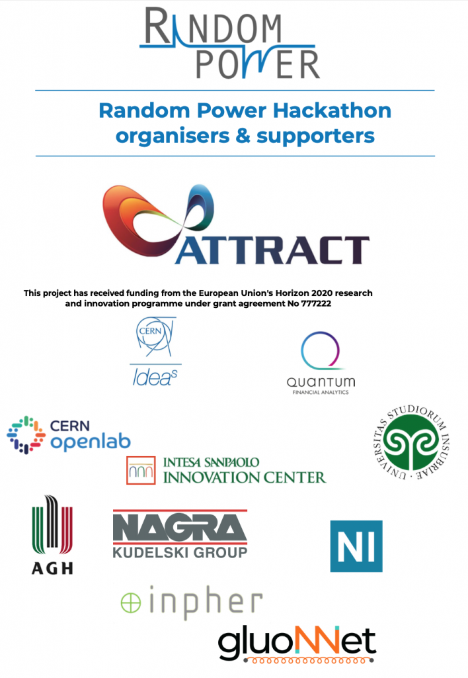
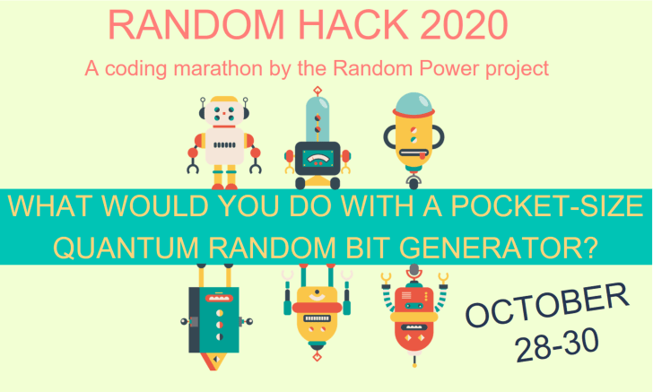
Education and Innovation
The CERN Team has won the hackaton with a project to use a novel noise pattern detection algorithm and randomly-generated noise to encrypt information

Slide 9
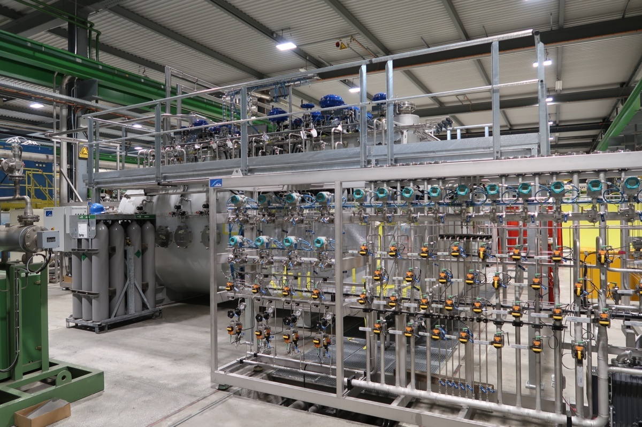
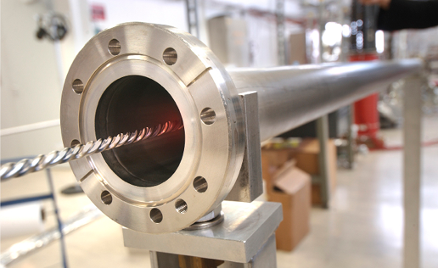
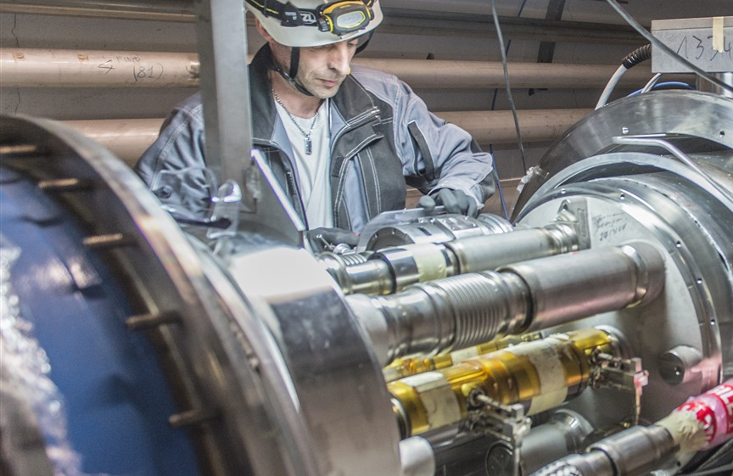
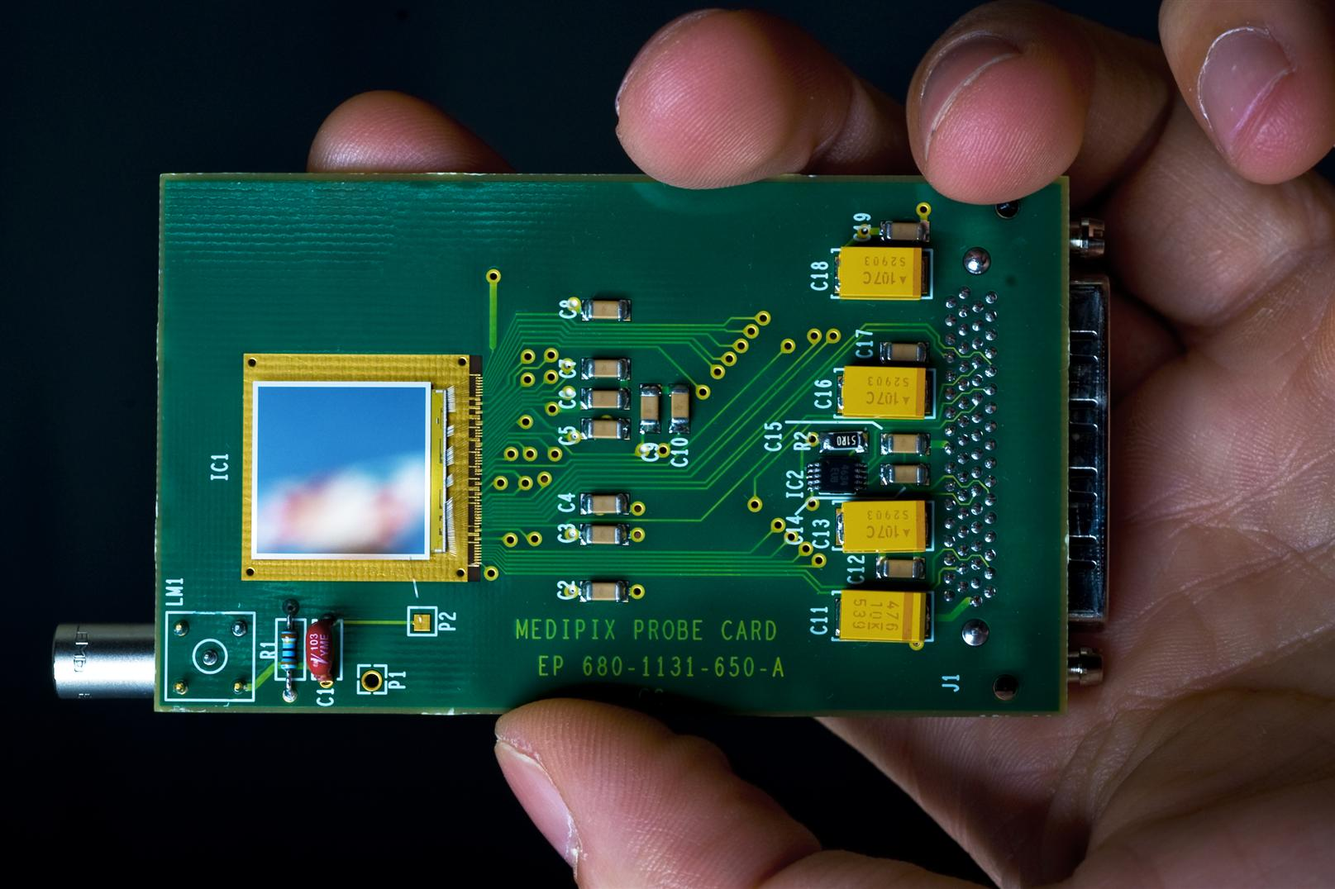
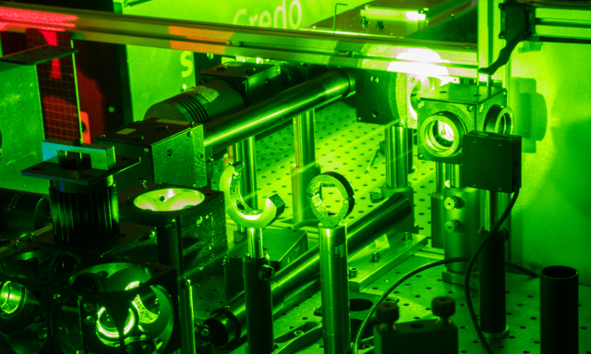
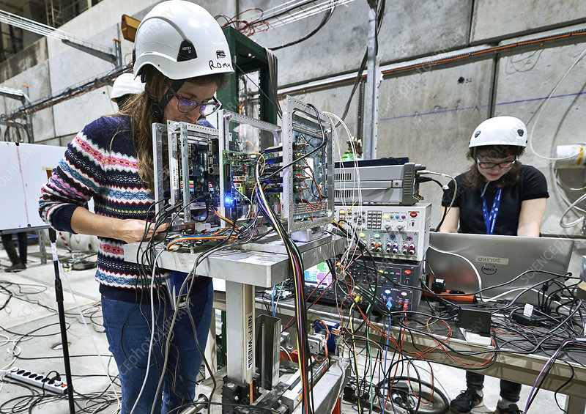
Engineering
Cryogenics
Vacuum
Mechanical Eng.
Material Science
Radiation Sensors
Lasers
Electronics

Slide 10
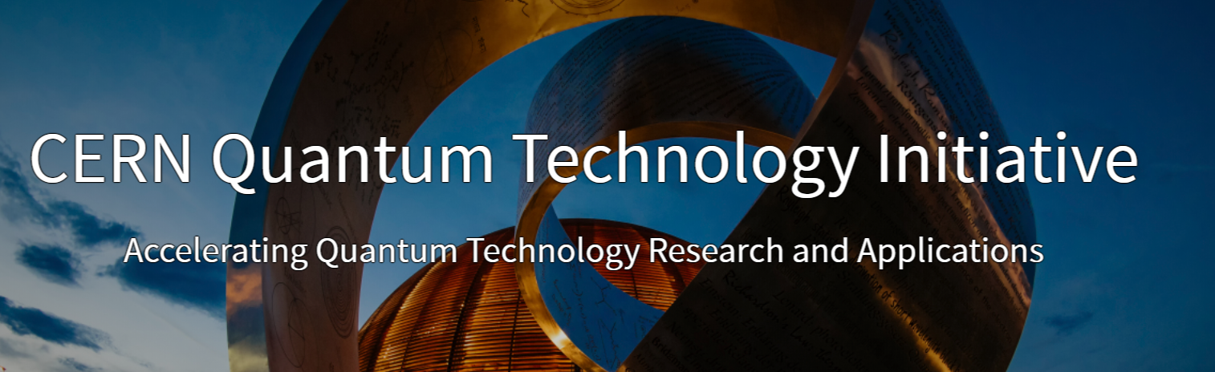
Thanks!
https://quantum.cern/
alberto.di.meglio@cern.ch
@AlbertoDiMeglio

