Slide 1


Slide 2


What is the CERN Webfest?
Our annual hackathon since 2012
Weekend-long event
Participants work in small teams
Based on open web technologies
Design web and mobile applications that can be of benefit to society
Mentorship, guidance and skills training
Competition with prizes for winners
Focused on students, but open to all

Slide 3
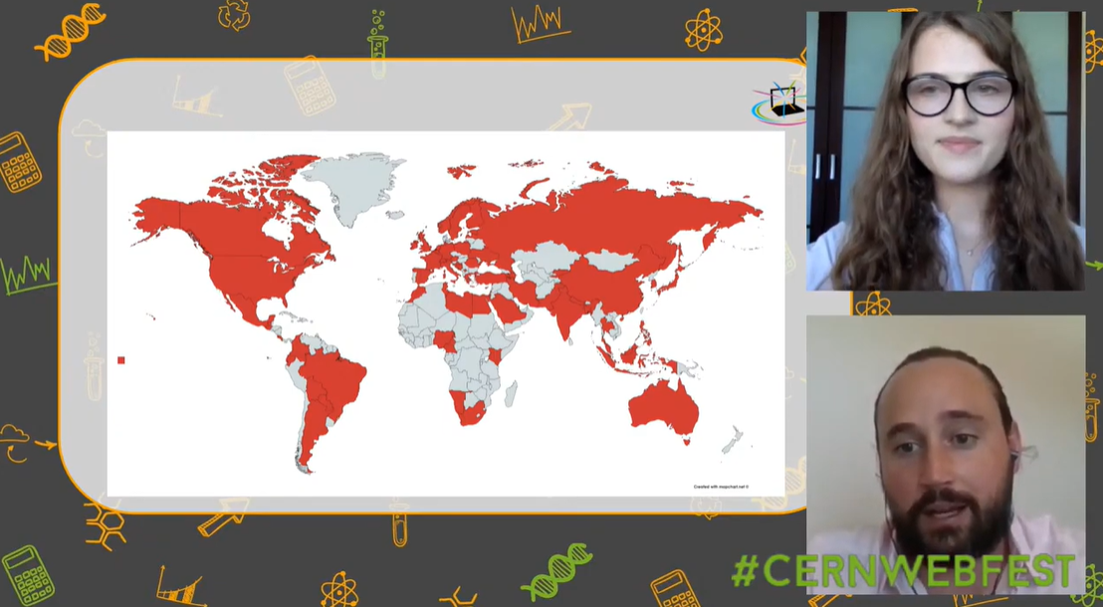
Webfest 2020
Our first online hackathon
Held online due to pandemic
Open to all aged 16 and above
400 people signed up, from 75 countries
Theme: ‘working together apart: accelerating collaboration’
Example projects:
online detective-themed science show for school children
web library of LaTeX equations
app to assist with urban planning at large research centres
platform for sharing remote access to lab equipment
machine-learning program to help prevent social-media content from exacerbating depression.
Andrew Purcell --- 1 July 2021

Slide 4
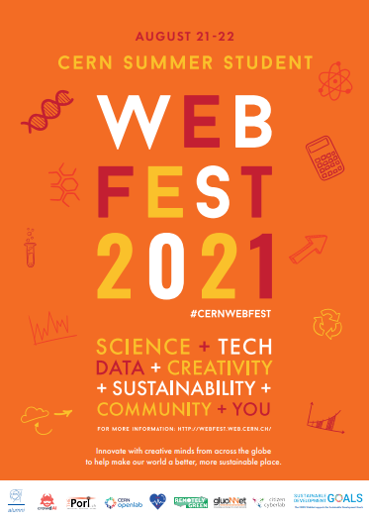
Webfest 2021
A truly global hackathon
Dates: Weekend of 21-22 August
Location : Will be held online for the second year
Platform/format: same as last year
Website: https://webfest.cern
Sign up here: https://indi.to/e-webfest2021
Theme: Science, society, sustainability
Andrew Purcell --- 1 July 2021

Slide 5
Webfest 2021
A truly global hackathon
3. Good health and well-being
4. Quality education
9. Industry, innovation, and infrastructure
16. Peace, justice and strong institutions
17. Partnerships for the goals
13. Climate action
Andrew Purcell --- 1 July 2021

Slide 6
Webfest 2021
A truly global hackathon
Skills sessions and talks
App security
Making video presentations
Communicating complexity
How to give presentsations
Exercising and relaxation
Entertainment
Networking
Chat discussion forum
Andrew Purcell --- 1 July 2021

Slide 7
Webfest 2021
A truly global hackathon
Collaboration opportunities
Project/challenge proposals
Mentorship
Thematic talk(s)
Skills workshops
Judge(s)
Prizes/invitations/other?
Andrew Purcell --- 1 July 2021

Slide 8

QUESTIONS?
webfest-team@cern.ch
webfest.cern
openlab.cern

