Slide 1

WG on Field Quality for Curved Magnets – HITRIplus WP7-WP8
Elena Benedetto, SEEIIST (WP7) & DANIEL BARNA, Wigner U. (WP8)
Joint SEEIIST-NIMMS meeting, 2/7/2021

Slide 2
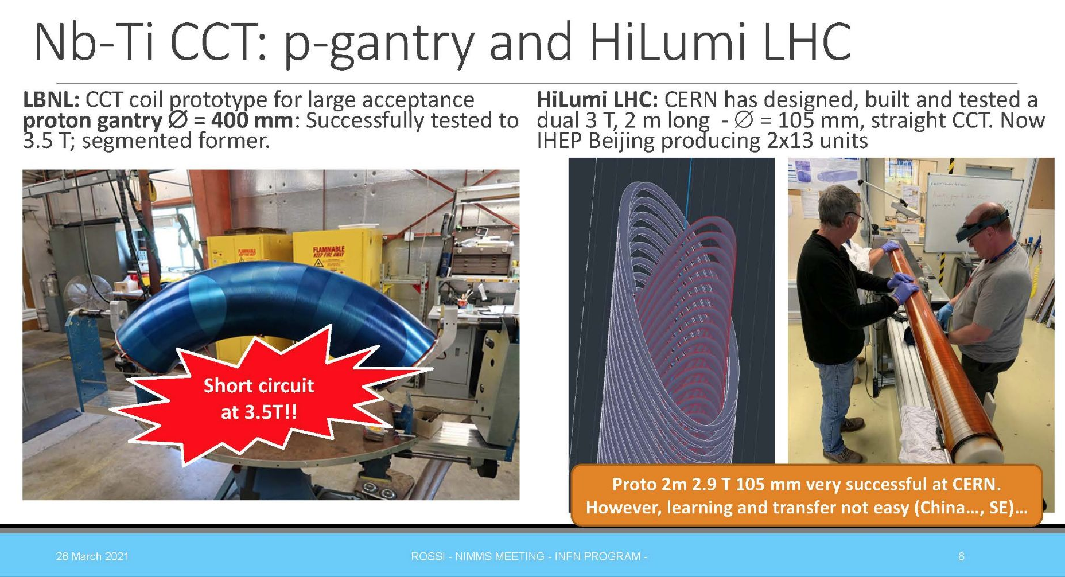
HITRIplus MAGNETS
3-5 Tesla
Bending angle 90º (up to)
Bending radius < 2m
Aperture 100mm (up to)
Combined function or AG layers
L. Rossi

Slide 3
MANDATE - WG ON FIELD QUALITY FOR CURVED MAGNETS
The working group will study the problem of the best way to define the field quality for strongly curved magnets used for ion therapy, both for gantry and synchrotron, where the field level of 3-5 T implies curvature radius of 1-3 m and large aperture.
The working group, beside proposing useful operative parameters to characterize and compare the FQ content of various design, will also examine the various methods to measure and model the FQ content and make practical recommendations.
BEAM DYNAMICS
Synchrotron & Gantry
MAGNET DESIGN
FQ
MAGNET MEASUREMENT

Slide 4
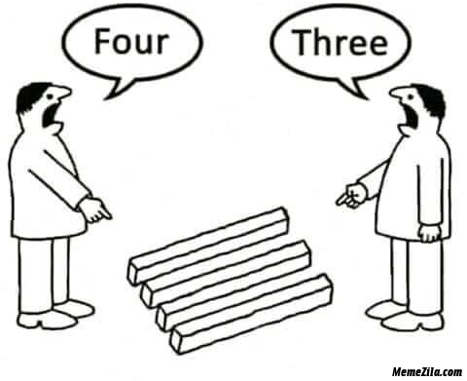
STRONGLY CURVED, LARGE APERTURE MAGNET FIELD QUALITY
BEAM PHYSICIST
MAGNET EXPERT
At least 2 or 3 communities, let’s try to
Understand how we do things…
And establish a common language (or at least a manual)
...there was an interesting workshop in 2013, btw:
Beam Dynamics meets Magnets https://indico.gsi.de/event/2352/

Slide 5
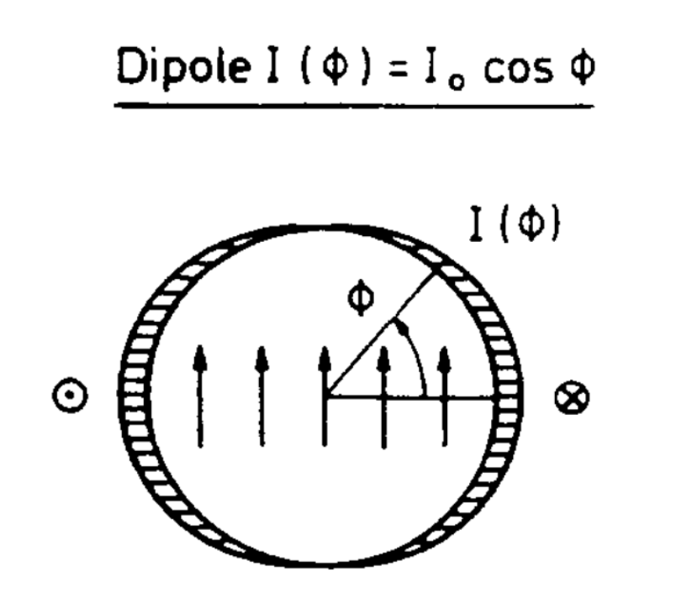
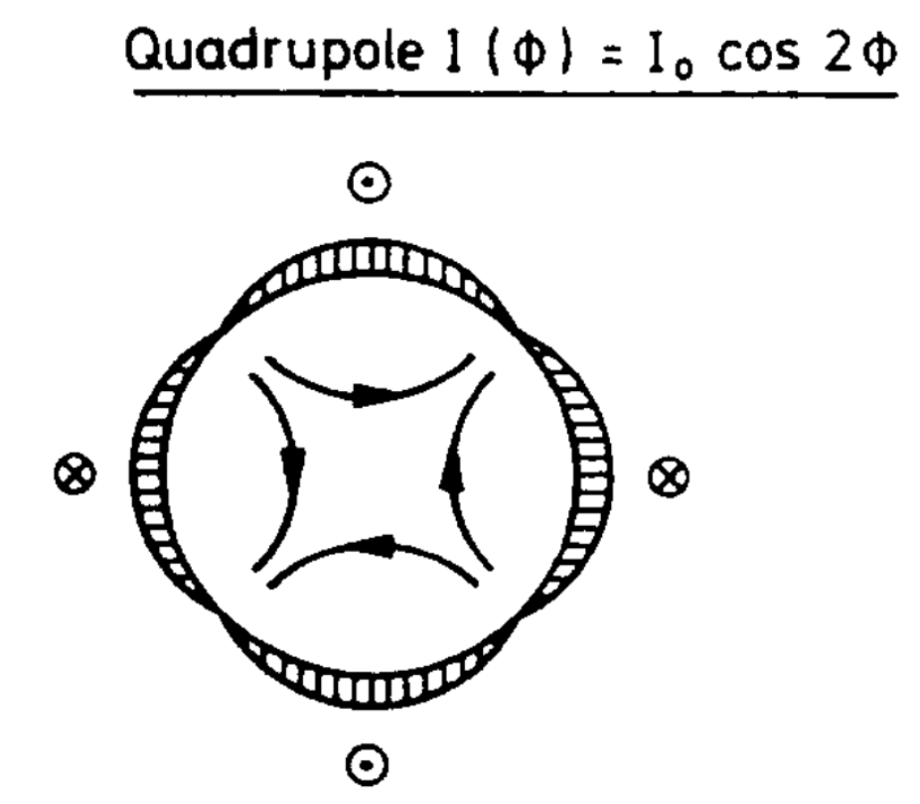
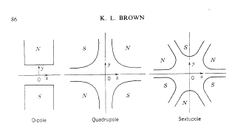
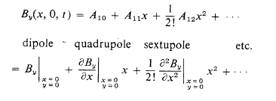
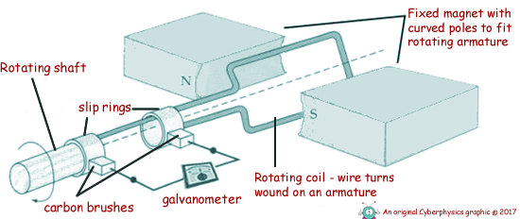

BEAM DYNAMICS VS. MAGNETS (DESIGN & MEASUREMENTS)
In a curved magnet, a field
r^{n} cos(n ϑ) (aka “multipole”)
is non-Maxwellian!!
One can sample Br in a circle and Fourier-analyze it (→ “naïve” multipoles), but the meaning of the obtained coefficients is not intuitive, and not clear
Beam optics code (PTC) uses field derivatives:
$$\frac{d^{n} B_{y}}{dx^{n}}$$
All other Taylor expansion coefficients can be recursively calculated, if these are given
This should be the common interface between optics, design and measurement
https://cds.cern.ch/record/283218/files/SLAC-75.pdf
Vs.
Multipole expansion, FFT on a reference radius
Only in straight geometry the coefficients are the same…
Rotating coil method

Slide 6
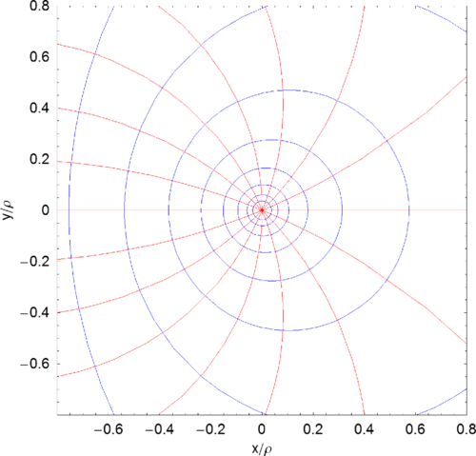
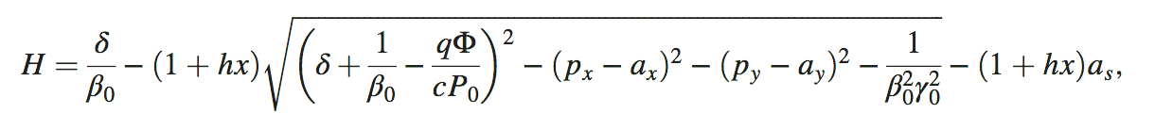
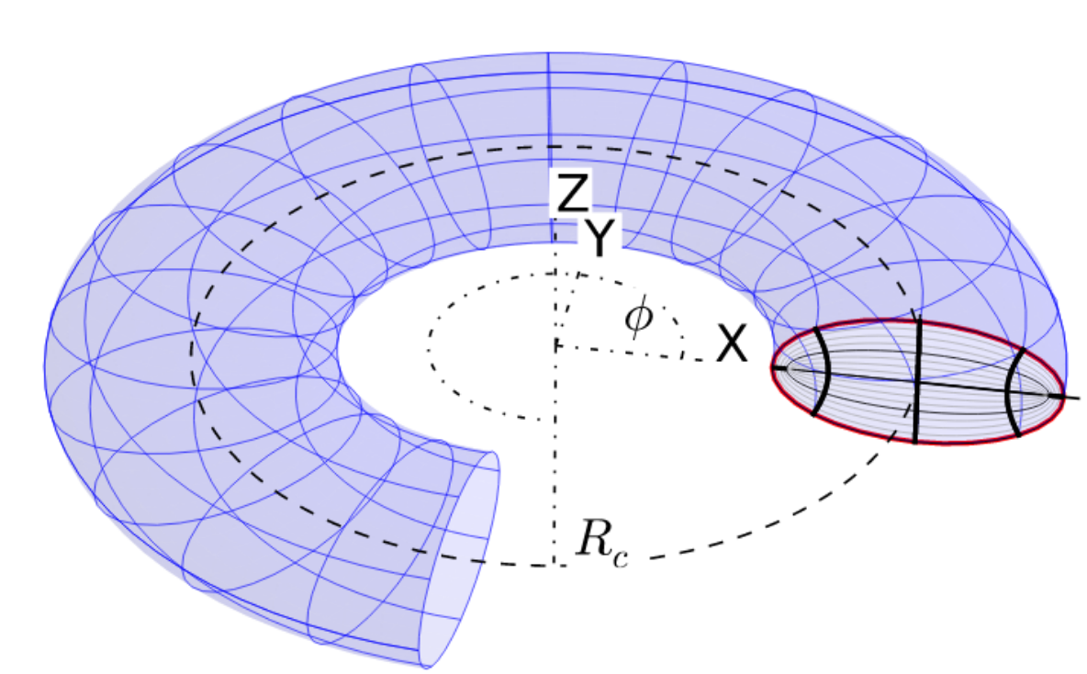
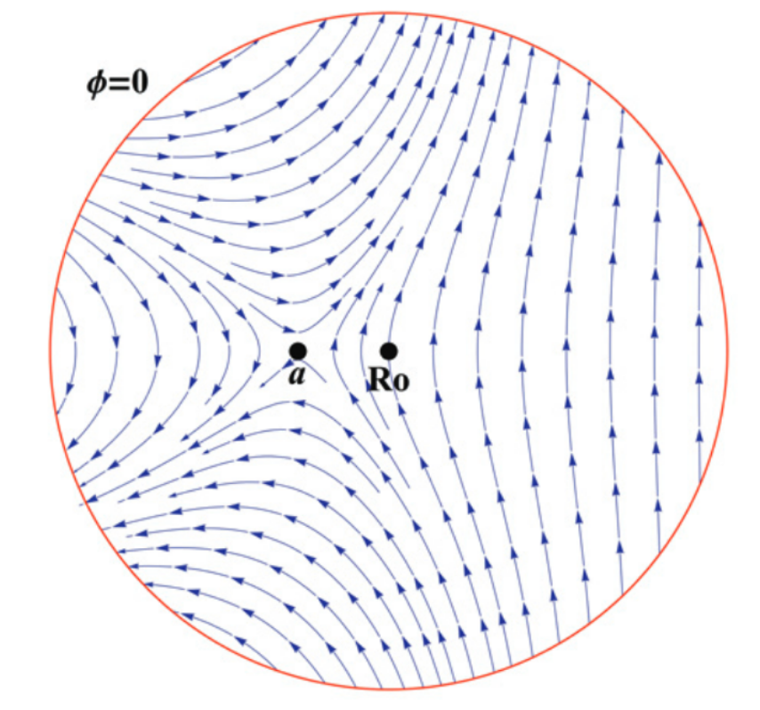
TOROIDAL COORDINATES - MULTIPOLES
Pros:
For analytical calculations
Cons:
Not intuitive
Evaluation of toroidal harmonics is said to be difficult
A. Wolski, A.T. Herrod “Explicit symplectic integrator for particle tracking in s-dependent static electric and magnetic fields with curved reference trajectory”, https://doi.org/10.1103/PhysRevAccelBeams.21.084001
P. Schnitzer, GSI, “Toroidal elliptical multipoles” for FAIR
L. Brouwer, S.Caspi et al., Toroidal multipoles for CCT magnets
(at which stage do we really need them?)

Slide 7
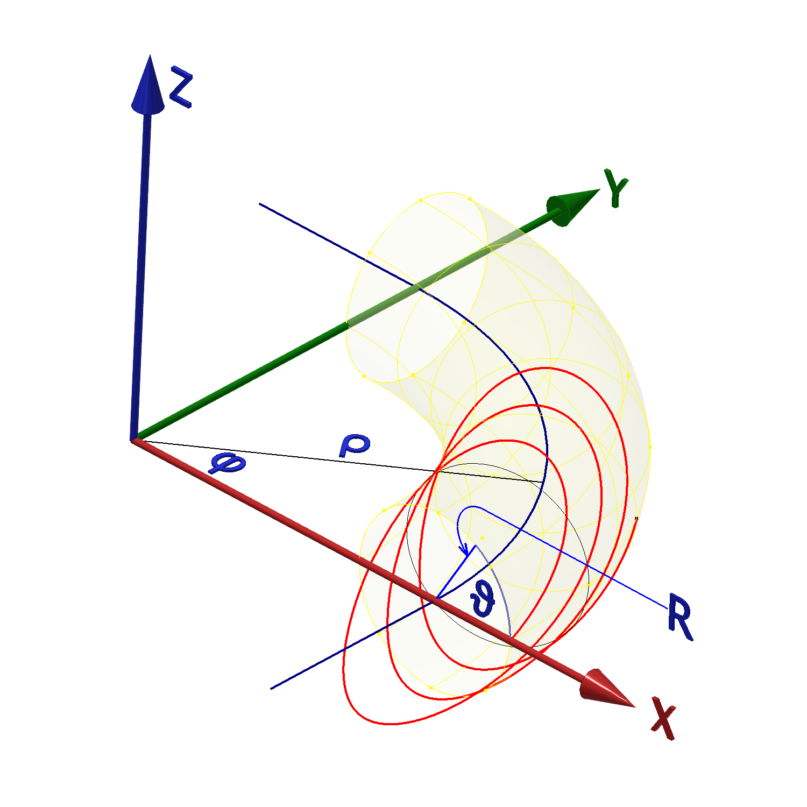
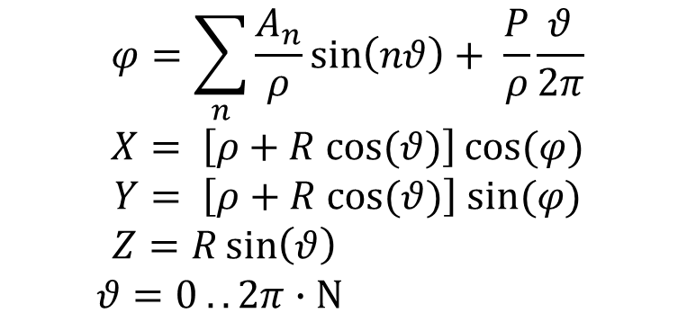
A practical parameterization with intuitive meaning of parameters
Analogous parameter of axial position: ϕ ↔ z
So modulate ϕ in the same way as for the straight magnet
Amplitude of swing at main radius
Pitch at main radius
$$φ=\sum_{n}{\frac{A_{n}}{ρ}\sin\left(nθ\right)}+ \frac{P}{ρ}\frac{θ}{2π}$$
$$X= \left[ρ+R cos⁡(θ)\right]\cos{(φ)}$$
$$Y= \left[ρ+R cos⁡(θ)\right] sin⁡(φ)$$
$$Z=R\sin\left(θ\right)$$
$$θ=0 .. 2π∙N$$
# of turns

Slide 8
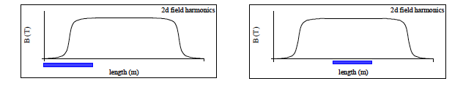
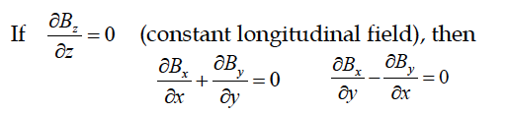
FRINGE FIELDS
Large aperture, small bending radius
Fringe field are important:
  model
  measure
  optimize coil ends
E. Todesco, Masterclass 2020
B. Muratori, http://dx.doi.org/10.1103/PhysRevSTAB.18.064001
not any longer

Slide 9
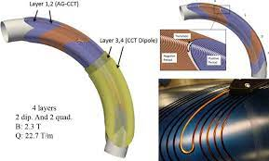
OTHER TOPICS
  Gantry (single-pass) vs. synchrotron
    Is particle tracking through field maps enough?
    For synchrotrons it is out of question, too slow! Use codes like MADX/PTC
  Integrated field or 3D map?
    Fringe fields are important → require modeling (integrated quantities still…)
    also transitions in AG-CCTs
  Magnet design: current pattern optimization to get required field coefficients
  Effect of laminated joke on the field quality
  Field quality, modeling, measurement…up to which detail?
    Characterizing quickly to compare and take decisions VS do the tracking !!!!
    Whatever the modeling (Fourier expansion or field derivatives) if the coefficients are small enough, the field quality is good enough! ;) S. Russenchuck provocative
    Completely measure full 3D map Vs. qualify the magnet to validate the model? (for 90⁰ magnet no access)
  Trim coil to fine-tune independently quadrupole &dipole

Slide 10
1 or 2 SHORT TALKS (to learn what we do) + DISCUSSION SESSION
  Magnetic field measurements in curved geometry (C. Petroni CERN, G .Montenero PSI, E.DeMatteis INFN)
  Field characterization, common framework (D. Barna)
  Gantry (E. Felcini)
  Synchrotron (E. Benedetto)
  Identifications of tasks (D. Barna)
Topics for future meetings
  Tracking and optimization inside the PSI CCT gantry (A.Gerbershagen CERN, will be invited)
  RAT code to generate CCT coils geometry (J.Van Nugteren will be invited)
  ISOLDE synchrotron based on CCTs (Liverpool group, Glyn Kirby)
  Analytical reconstruction of field from flux measurements (S. Russenchuck and collaborators…)
  Results from tasks…

Slide 11
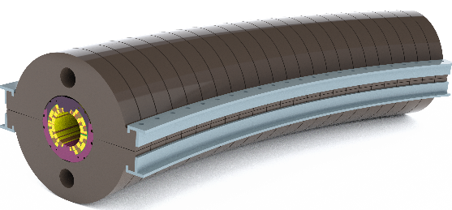
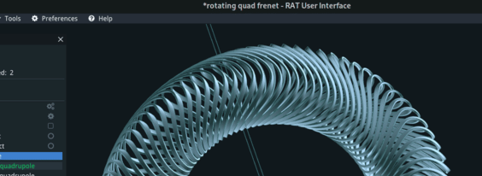
SUMMARY - WG on Field Quality for Curved Magnets
1 meeting per month (approx)
15 people present at the last meting
  CERN (Magnets group & NIMMS), PSI, INFN (MI, GE), CNAO, Wigner University, SEEIIST
3 communities represented, need to find a common ground:
  beam dynamics, magnet design, magnet measurements
Program of work starts taking shape…

Slide 12
Progress
Set up a regular scheme for meetings
Proposed a convention for coordinate systems and coordinate symbols, variables
Proposed common framework: field derivatives
Naïve “multipoles” discussed
Discussed measurement possibilities
Converged on winding parametrization

