Slide 1

BioDynaMo Benchmarking
Damla Gözük
damla.gozuk@cern.ch
Supervisor(s):
Fons Rademakers
Ahmad Hesam
07/09/2021

Slide 2

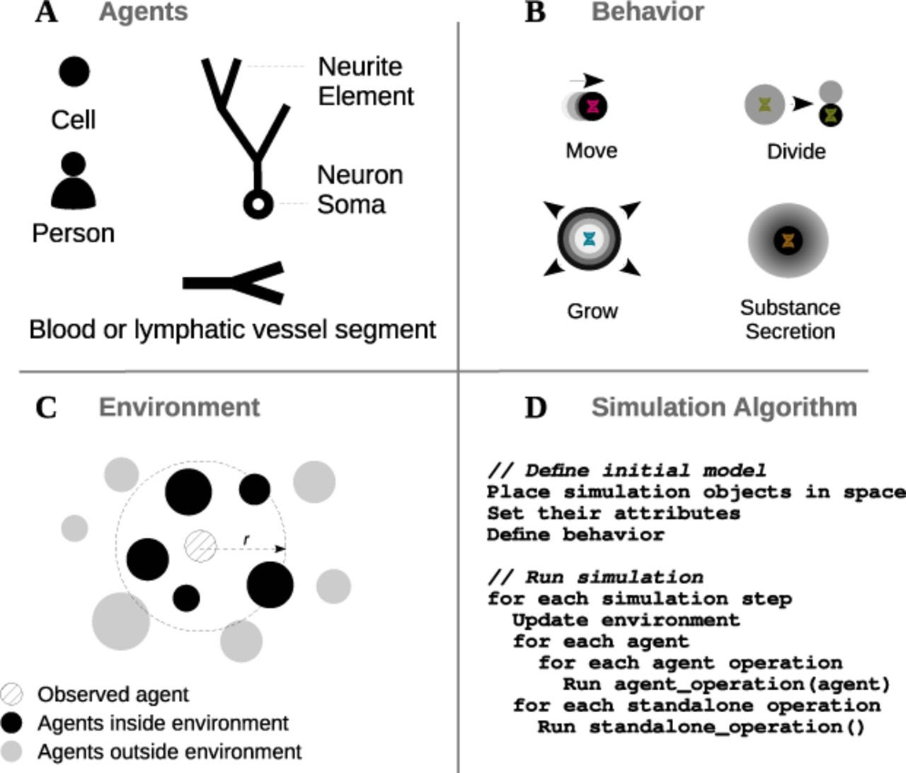
What is BioDynaMo
Source: Breitwieser et al. 2021, https://doi.org/10.1101/2020.06.08.139949 https://zenodo.org/record/4501515
Open-source, high performance, and modular agent-based simulation platform.
Written in C++ .
Agent - Based.
General Purpose.
Large Scale.
Easily Programmable.
Quality Assured.
Figure 1: BioDynaMo core simulation concepts

Slide 3
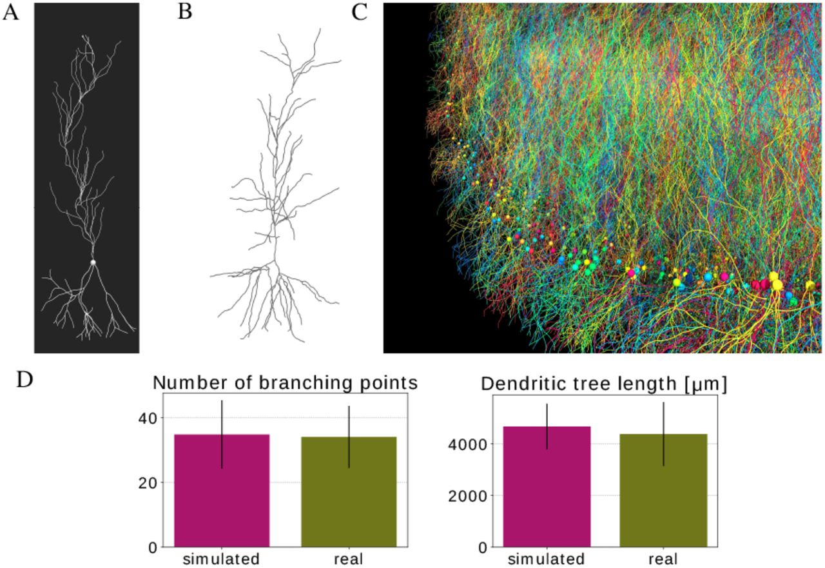
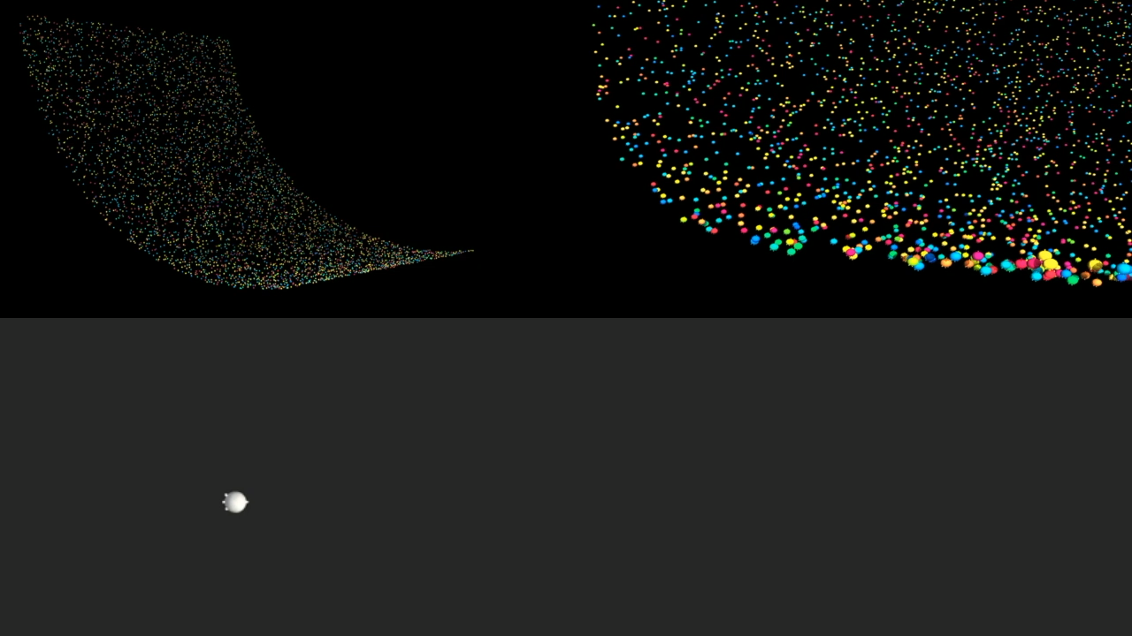
Use Cases
Source: Breitwieser et al. 2021, https://doi.org/10.1101/2020.06.08.139949 https://zenodo.org/record/4501515
Simulate neurite growth of pyramidal cells using chemical cues.
Figure 2: Pyramidal cell simulation
Video Demo

Slide 4


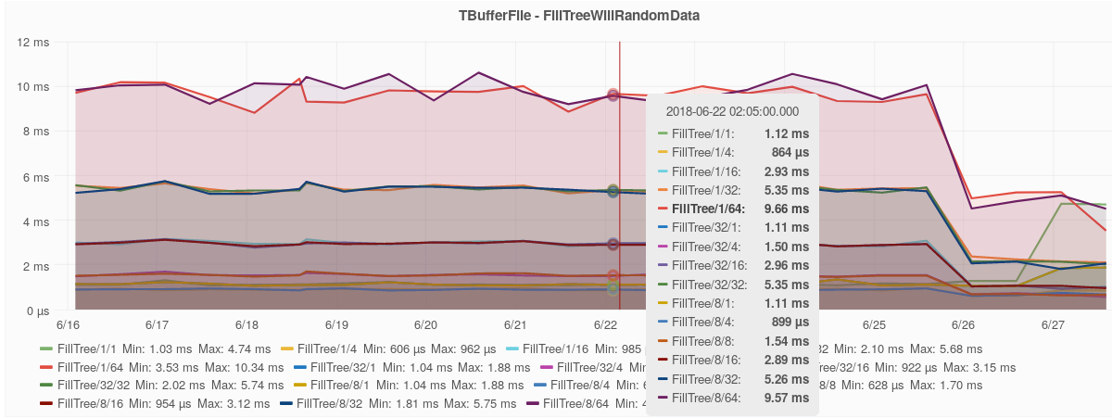
Benchmarking
Automated tests are important.
Code performance, Monitoring
Speed, Memory, hardware efficiency
ROOT System
Google Benchmark
Grafana
Figure 3: Example benchmarking plot.

Slide 5

Conclusions And Future Work
Management of setbacks related to new MacBook's M1 chip.
Leveraging ROOT’s benchmarking environment based on same tools.
Increased Performance.
Track slowdowns/speedups/memory increase/decrease between versions.
Assign performance numbers to a user's machine in the form of BDMMARKS.

Slide 6
QUESTIONS?
damla.gozuk@cern.ch
https://www.linkedin.com/in/damlagozuk/

Slide 7
Resources
Preprint of the BioDynaMo Paper
BioDynaMo: a general platform for scalable agent-based simulation Lukas Breitwieser, Ahmad Hesam, Jean de Montigny, Vasileios
Vavourakis, Alexandros Iosif, Jack Jennings, Marcus Kaiser, Marco Manca, Alberto Di Meglio, Zaid Al-Ars, Fons Rademakers, Onur
Mutlu, Roman Bauer bioRxiv 2020.06.08.139949; doi: https://doi.org/10.1101/2020.06.08.139949 Supplementary Information:
https://zenodo.org/record/4501515
BioDynaMo Webpage
https://biodynamo.org
Grafana Webpage
https://grafana.com/grafana
ROOT Webpage
https://root.cern

