Slide 1
Accelerator Controls
Stephane Deghaye (BE-CSS-FST)
29th & 30th of November 2021

Slide 2
Agenda
What is an accelerator made of?
Control System Requirements
Implementation Philosophy
A bit of History
Hardware & Software Architecture
CERN examples & Key Components
Detailed implementations and concepts

Slide 3
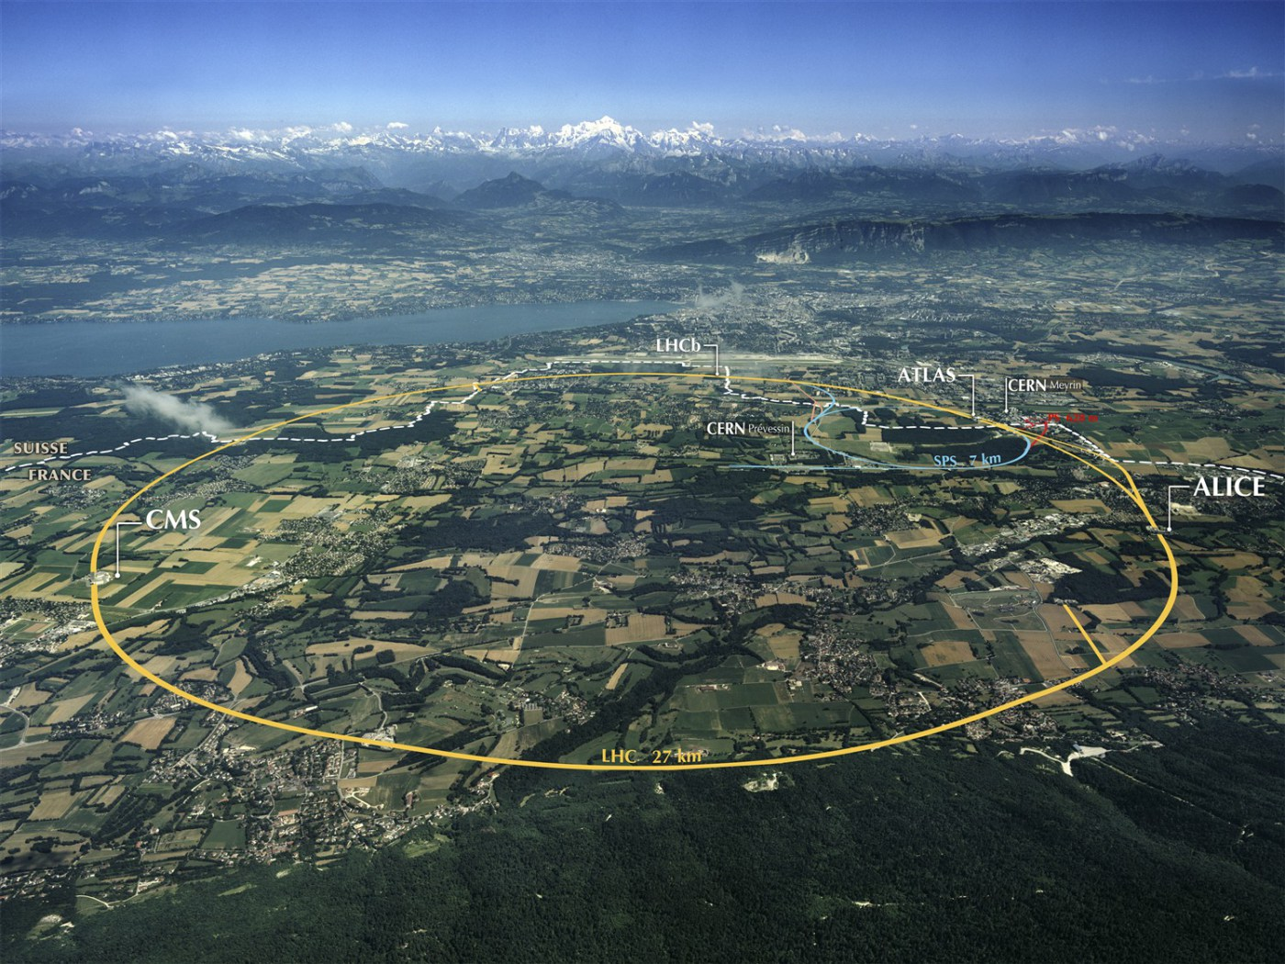
CERN Accelerator Complex

Slide 4
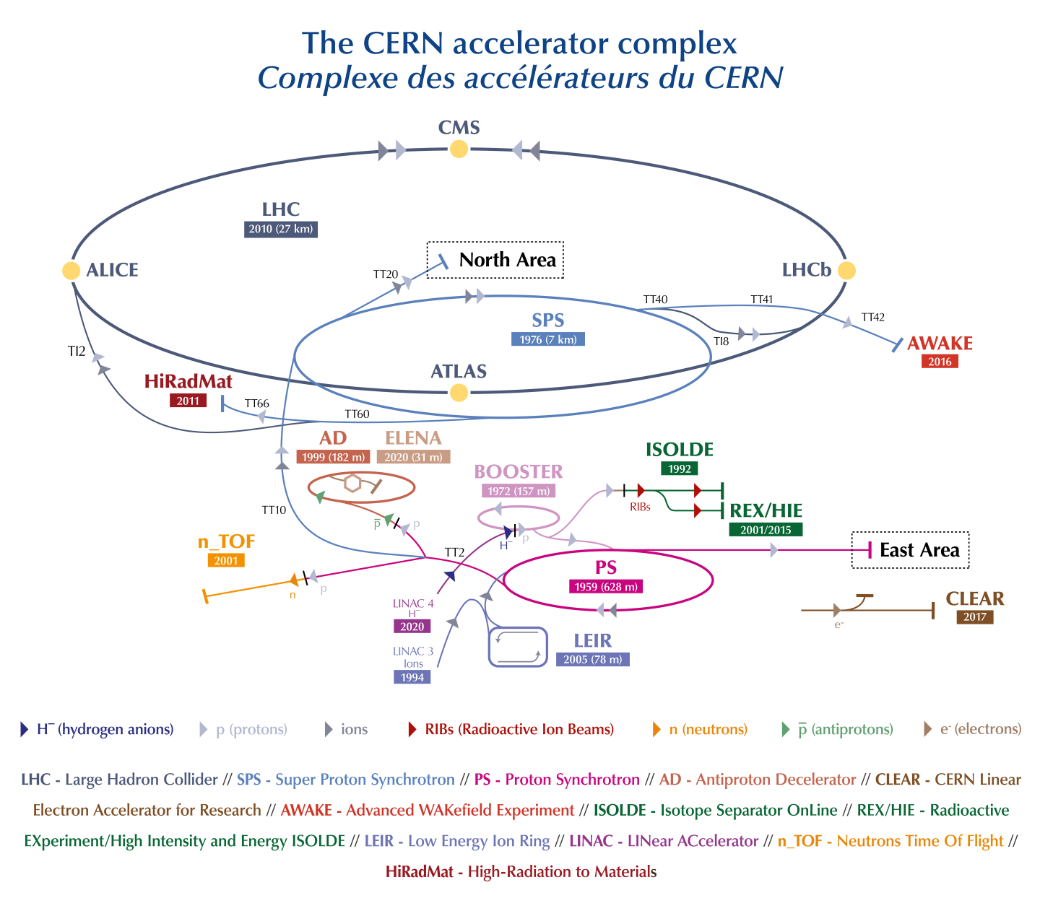
CERN Accelerator Complex
Notes:
10 accelerators (7 + 2 decelerators + clear)

Slide 5
What is an accelerator made of?
Particle accelerators are either linear or circular
Notes:
Linear = the particle only go through once while in the circular they go around for some time (@ CERN from 1 to a few seconds)
Purpose => Accelerate => need eqp to accelerate and give the right structure to the beam
But need to:
Focus (linear and circular)
Bend and steer (mainly circular)
Observe and measure
Inject in and extract from accelerator

Slide 6
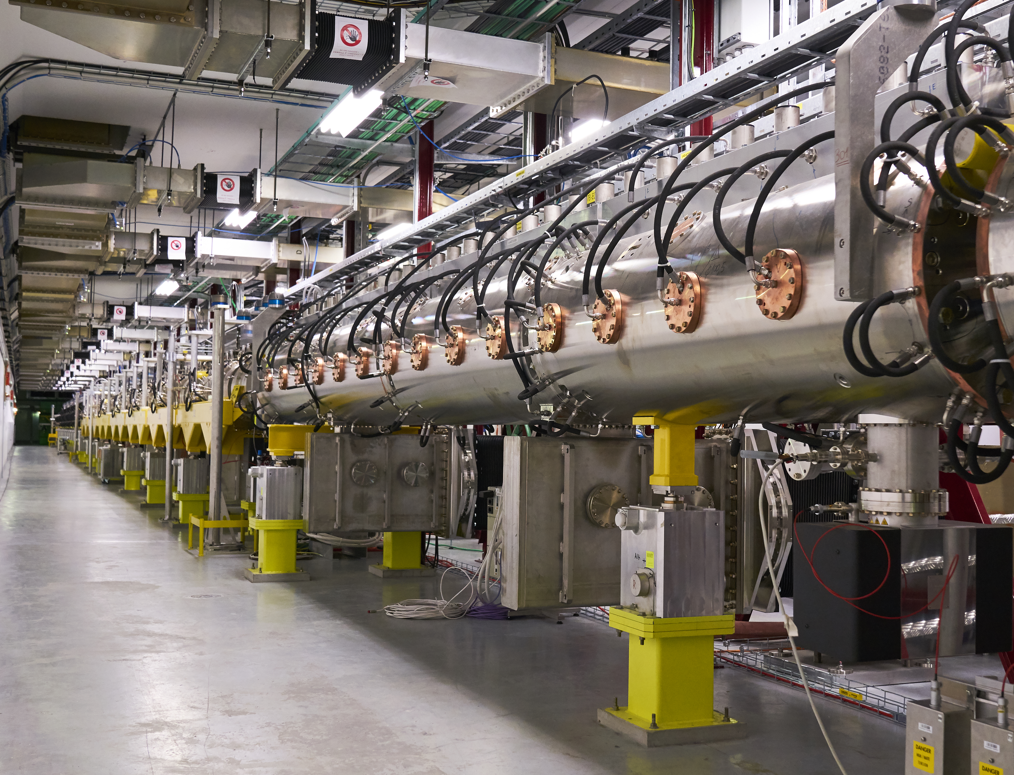
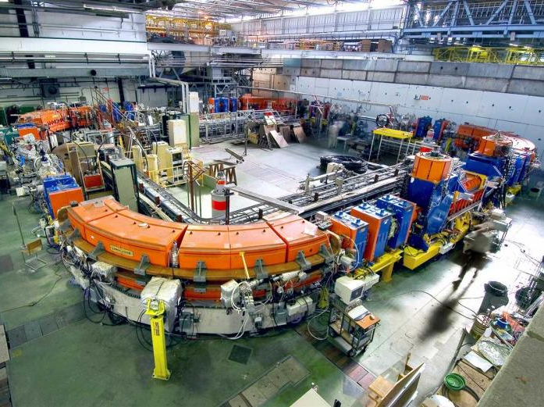
What is an accelerator made of?
Linac4
LEIR

Slide 7
What is an accelerator made of?
Particle accelerators are either linear or circular
Source
Need equipment to:
Accelerate the particles
Bend and steer the beam
Focus the beam
Observe and measure its characteristics
Inject in and extract from the accelerator
Notes:
Linear = the particle only go through once while in the circular they go around for some time (@ CERN from 1 to a few seconds)
Purpose => Accelerate => need eqp to accelerate and give the right structure to the beam
But need to:
Focus (linear and circular)
Bend and steer (mainly circular)
Observe and measure
Inject in and extract from accelerator

Slide 8
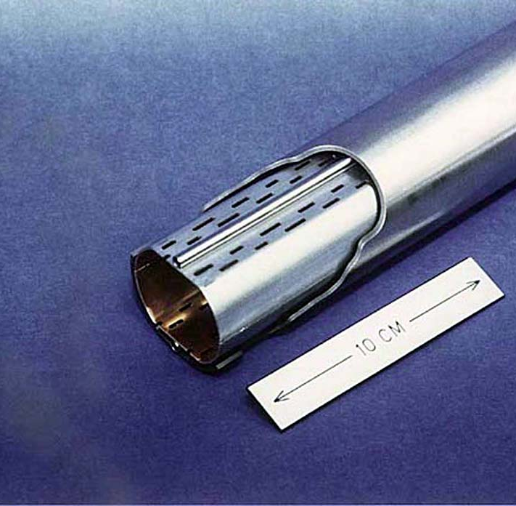
What is an accelerator made of?
A beam pipe in which the beam circulates
+
Elements in and around the pipe to:
  Steer and focus the beam
  Accelerate the beam and give it structure
  Measure the beam
  Inject and extract the beam
  …
Oversimplified view !!

Slide 9
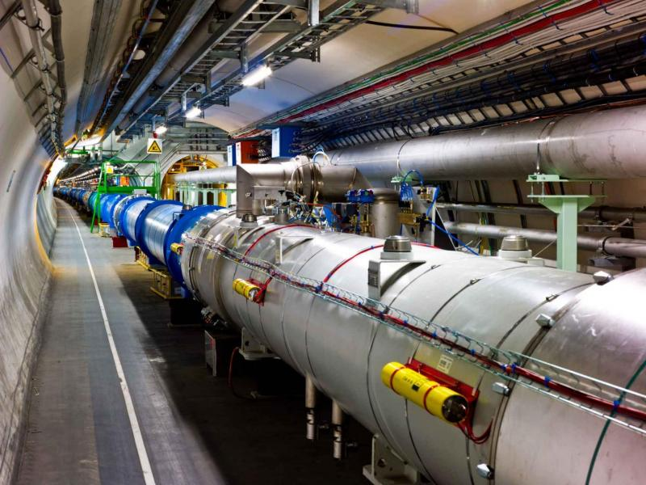
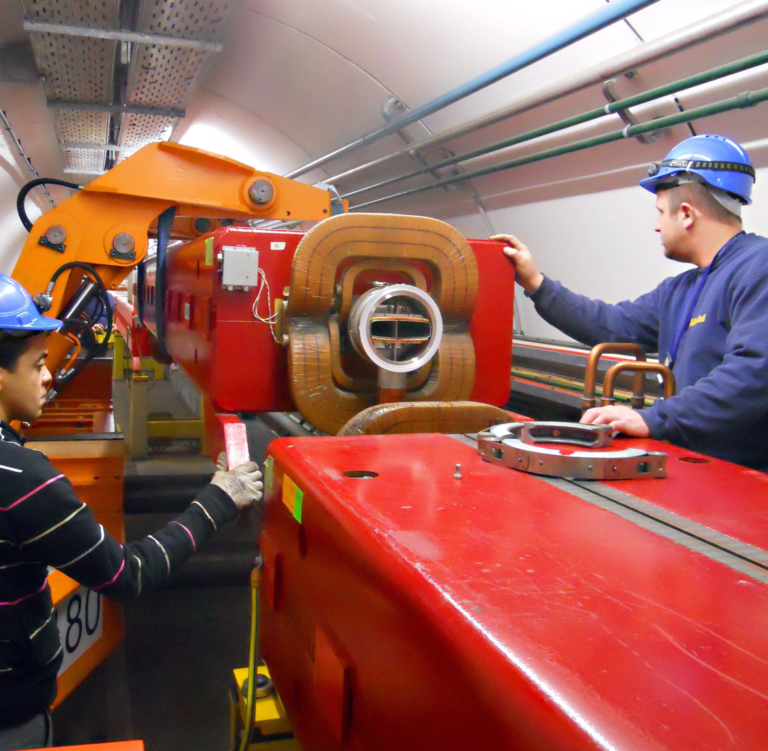
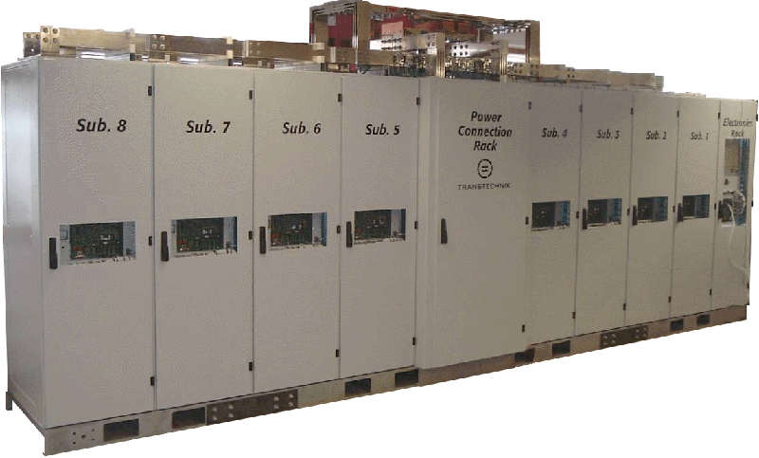
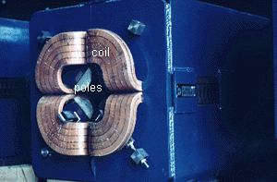
What is an accelerator made of?
A beam pipe in which the beam circulates
+
Elements in and around the pipe to:
  Steer and focus the beam
  Accelerate the beam and give it structure
  Measure the beam
  Inject and extract the beam
  …
Oversimplified view !!
20.5 kA / 18 V

Slide 10
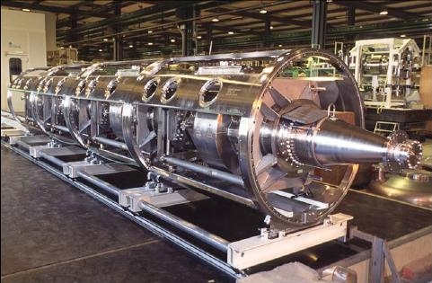
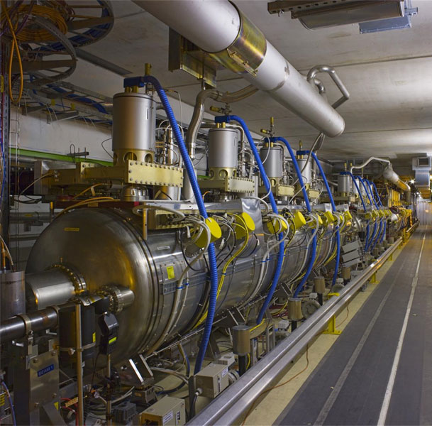
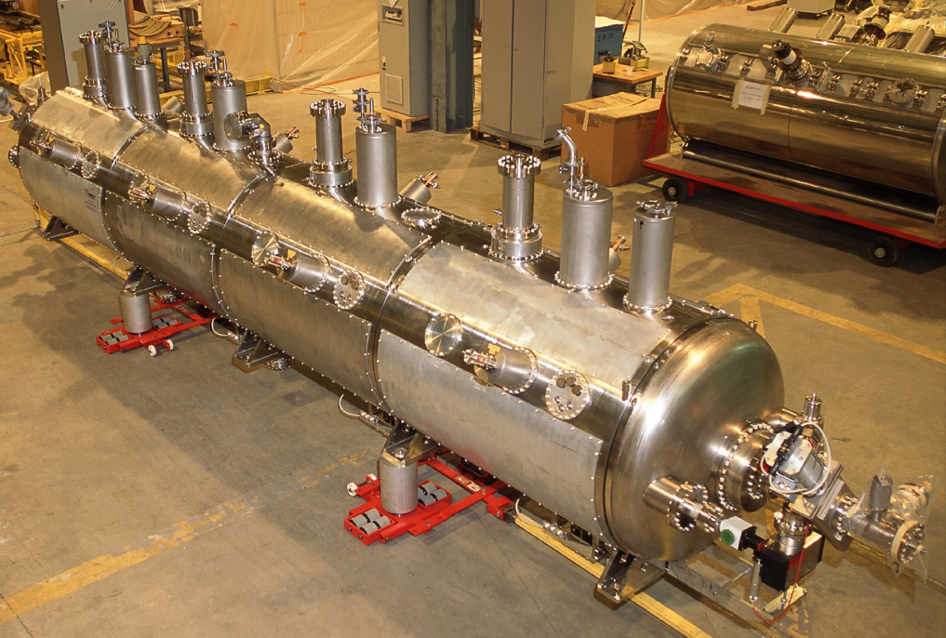
What is an accelerator made of?
A beam pipe in which the beam circulates
+
Elements in and around the pipe to:
  Steer and focus the beam
  Accelerate the beam and give it structure
  Measure the beam
  Inject and extract the beam
  …
Oversimplified view !!

Slide 11
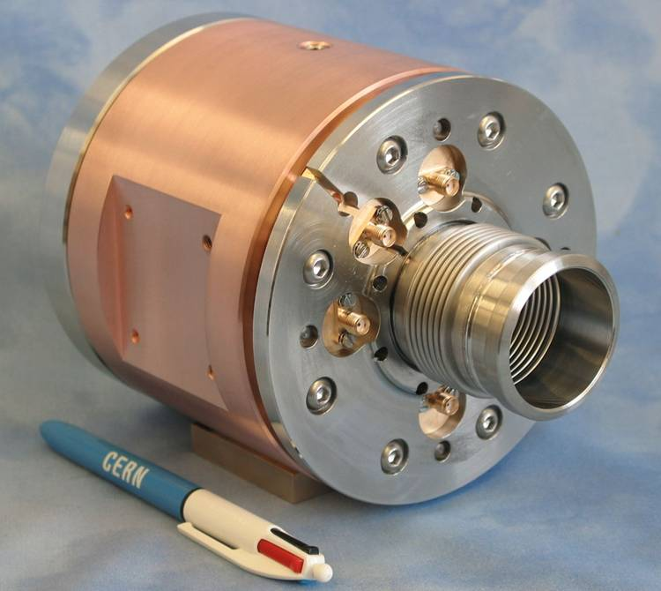
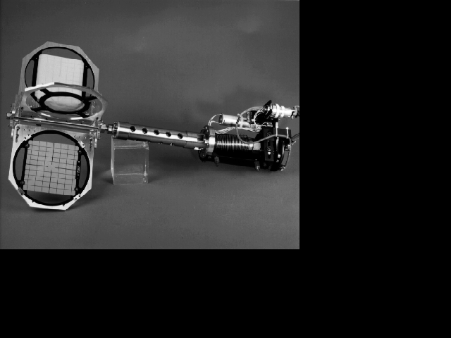
What is an accelerator made of?
Beam Loss Monitor
Beam Position Monitor
Profile screen
A beam pipe in which the beam circulates
+
Elements in and around the pipe to:
  Steer and focus the beam
  Accelerate the beam and give it structure
  Measure the beam
  Inject and extract the beam
  …
Oversimplified view !!

Slide 12
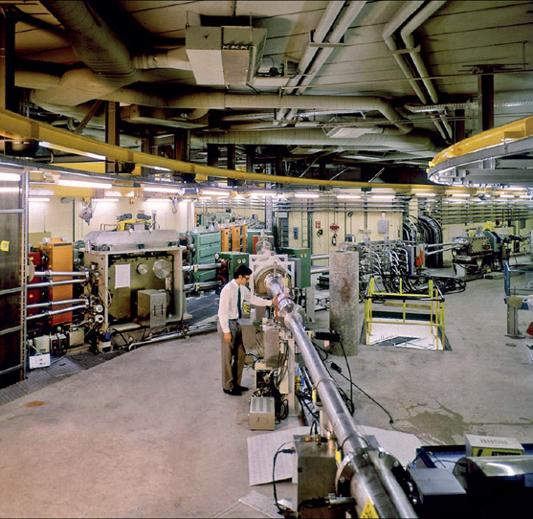
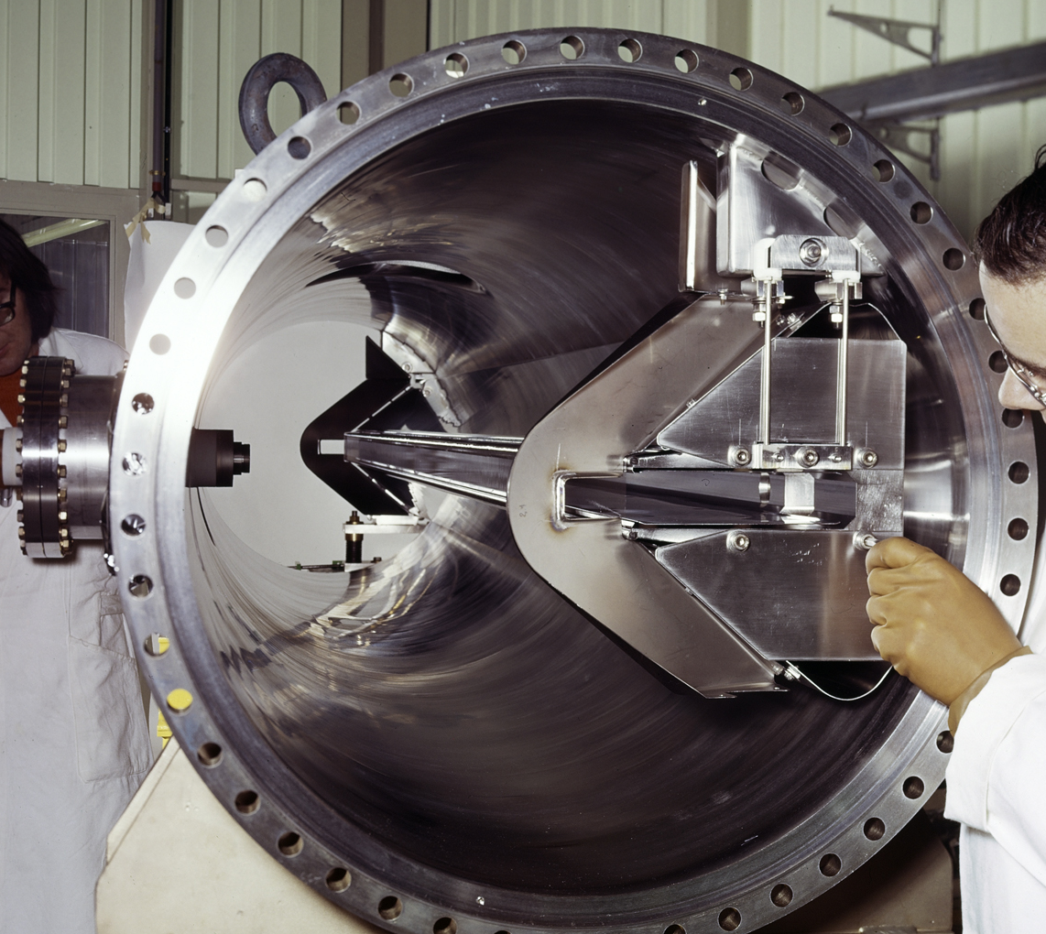
What is an accelerator made of?
Septum
Transfer line
A beam pipe in which the beam circulates
+
Elements in and around the pipe to:
  Steer and focus the beam
  Accelerate the beam and give it structure
  Measure the beam
  Inject and extract the beam
  …
Oversimplified view !!

Slide 13
Why a Control System?
﻿Particle accelerators are made of many components to control and monitor the beams produced.
The physicists and operators need to be able to remotely control and monitor these elements ➔ this is the role of the Control System.
Notes:
The Control System's job is to provide to the physicists and operators a means to interact remotely with all the accelerator equipment:

Slide 14
Control System Requirements
Notes:
3 mins 30

Slide 15

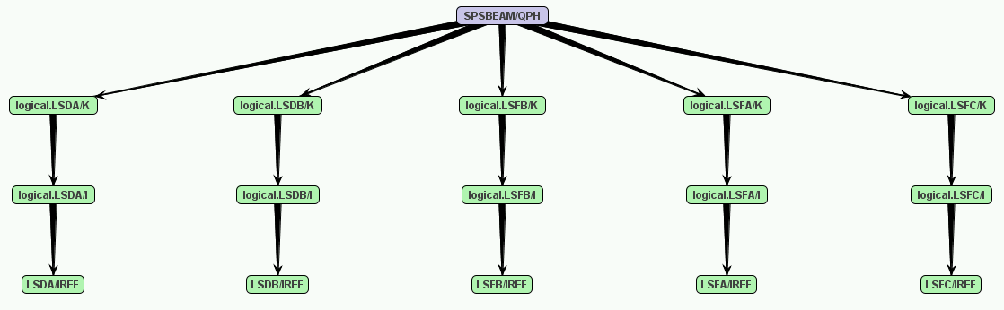
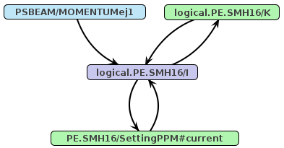
Control System Key Requirements
Act on accelerator elements (settings & states)
  Minimum: direct access to the hardware values
  Ideal:
    Model-driven control to work at a higher level
    Global transactional synchronisation

Slide 16
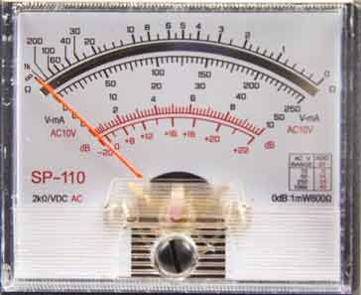
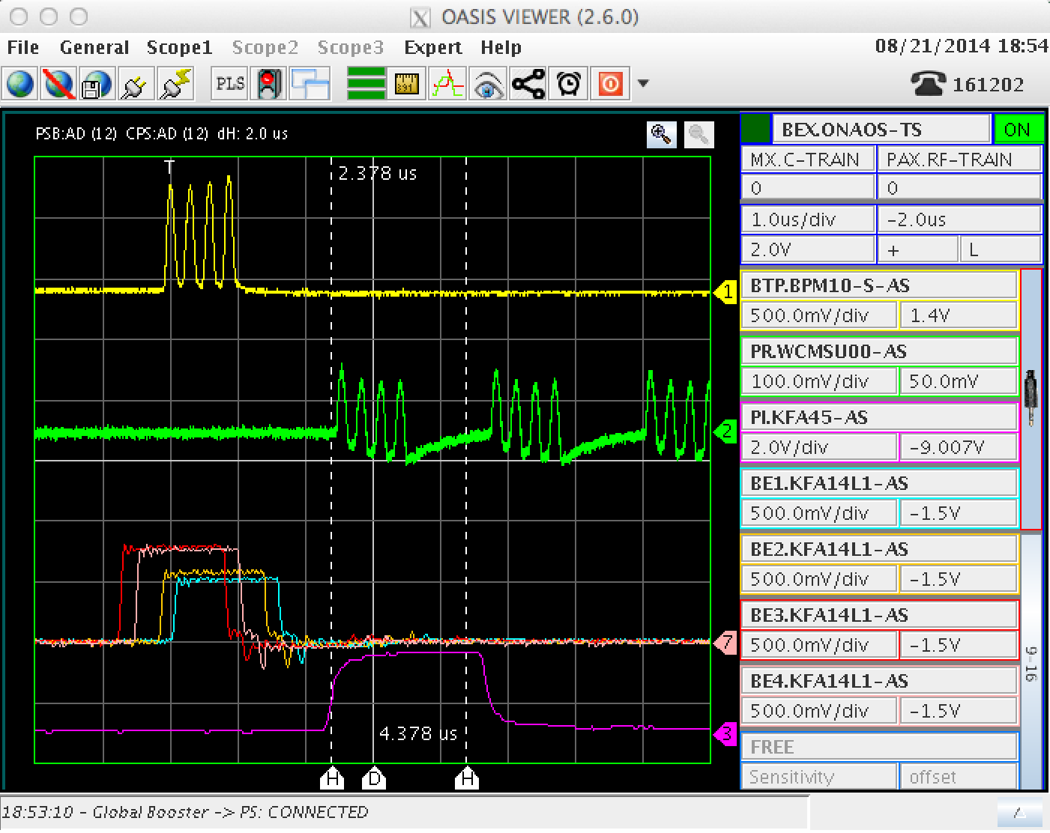
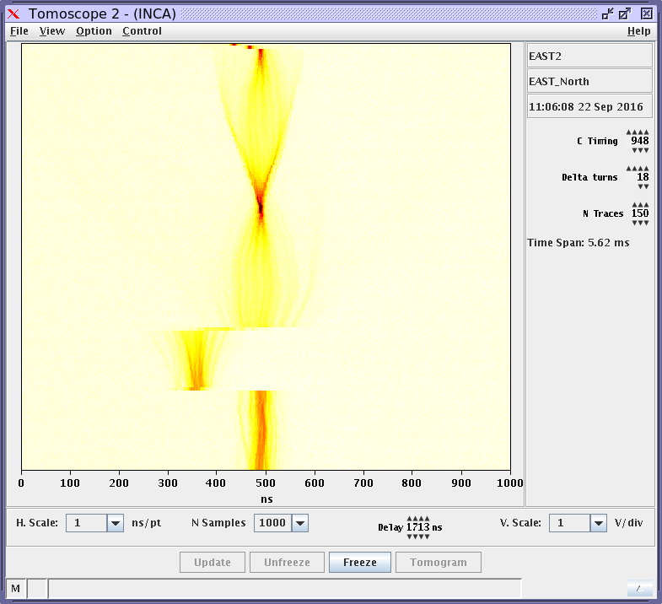
Control System Key Requirements
Monitor the elements (instruments & actuators)
  Minimum: Display raw acquisitions
  Ideal: Time-tagged, coherent acquisitions, post-processing for quick detection of abnormal situations
Notes:
Quick detection: e.g. power converter out of the tolerance

Slide 17
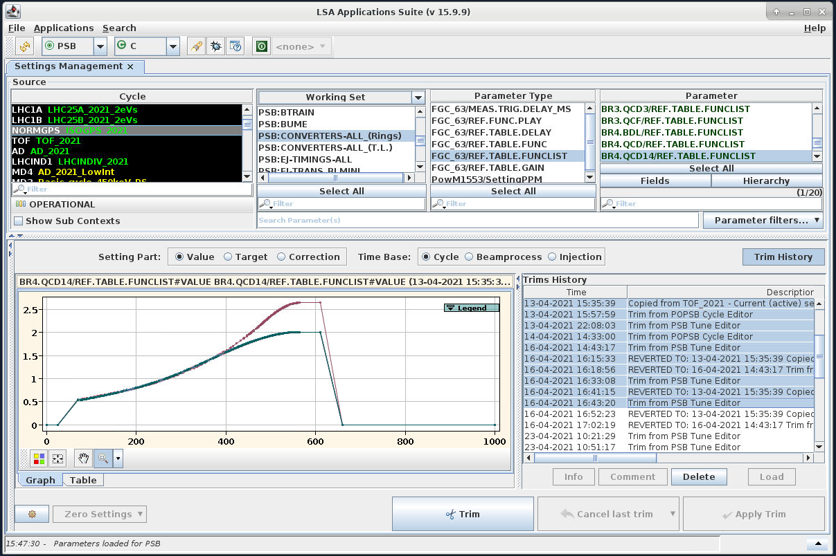
Control System Key Requirements
Long-Term Memory of Settings & Acquisitions
  AKA Logging
  Accelerator performance & post-mortem analysis, fine tuning of the machines
  Minimum: structured time-series in a simple format (CSV, SDDS, etc.)
  Ideal: Years of data (settings & acquisitions) with performant data extraction & analysis tools

Slide 18
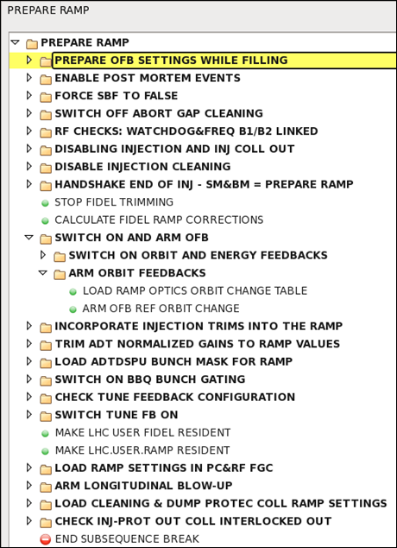
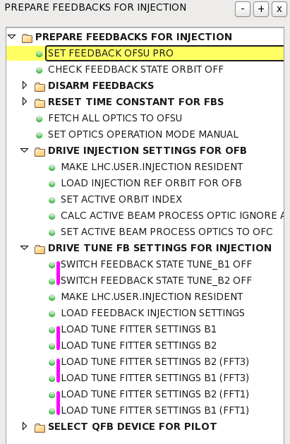
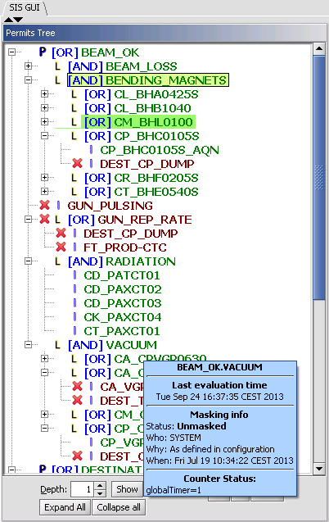
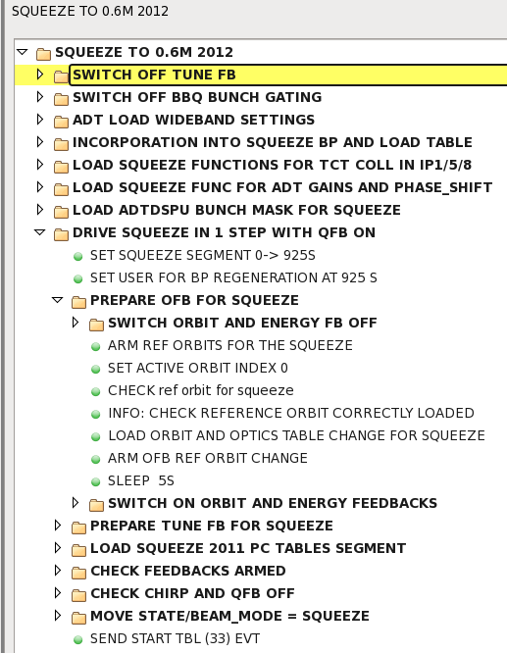
More Control System Requirements
Automation
  Generate initial values, play sequences, feedback loops, etc.
  Minimum: Non-interactive scripts
  Ideal: Model-driven generation, flexible sequencer (almost like a debugger), automated actions (decision tree, machine learning)

Slide 19
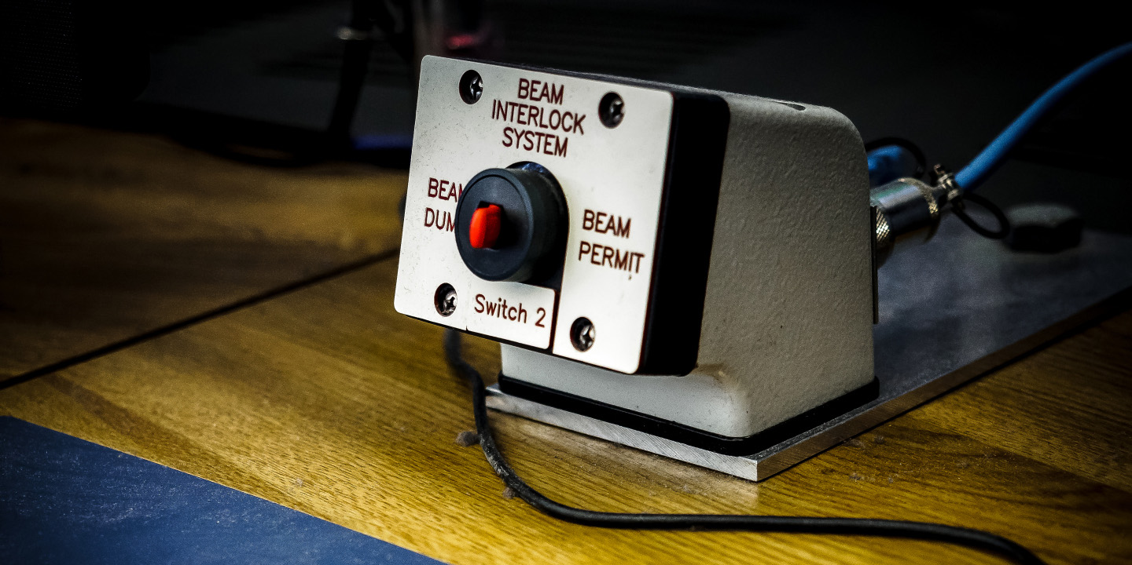
More Control System Requirements
Safety for machine protection & operational availability
  Minimum: Machine interlock to protect the hardware
  Ideal: High-level fast-reaction interlocks and role-based access to prevent the wrong action at the wrong time
Notes:
Protect the equipment and the personnel

Slide 20
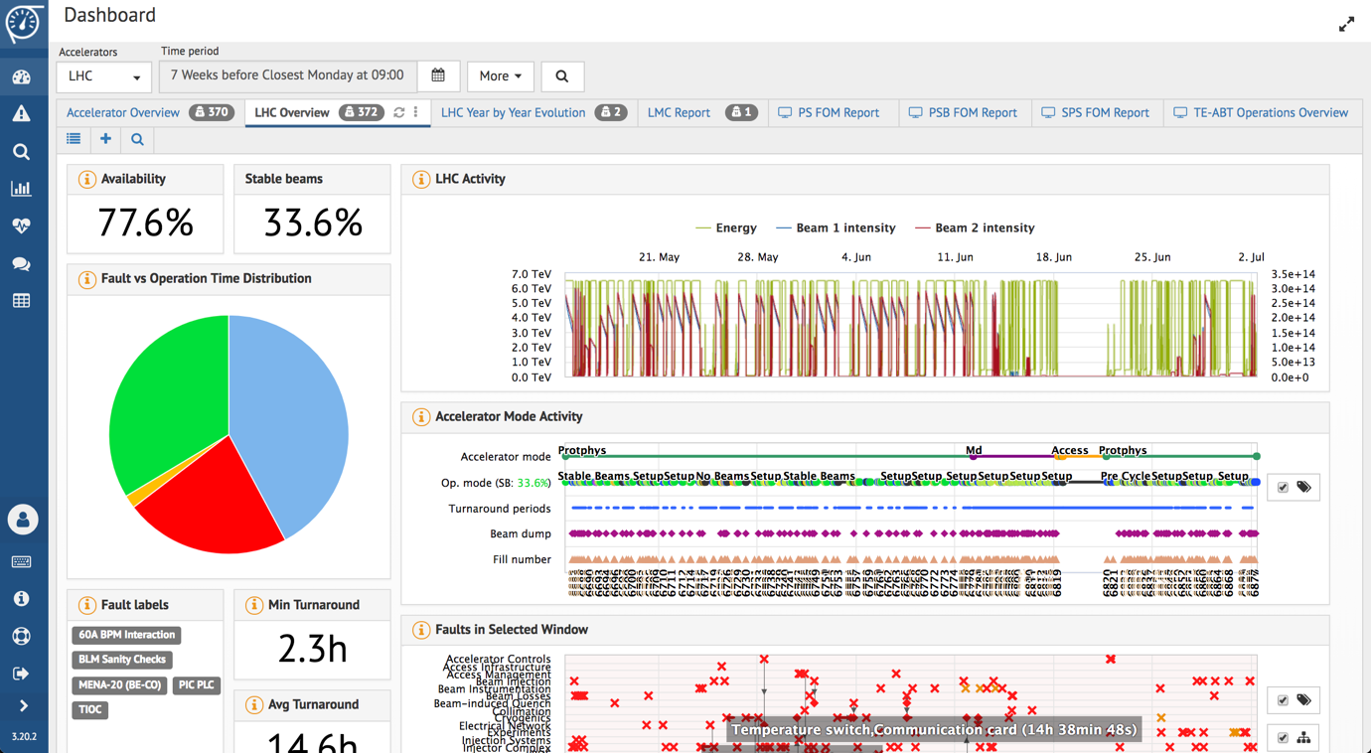
More Control System Requirements
Diagnostics
  Detection, identification, and follow-up of problems in the controls infrastructure
  Minimum: Non-interactive status screens
  Ideal: Online monitoring, remote interventions (e.g. power cycle), failure prediction (Machine Learning), analysis tools

Slide 21

And many more…

Slide 22
Controls Complexity
Many requirements from physicists and operators
Accelerators made of many elements
  Early accelerators, e.g. Proton Synchrotron (PS), were small
    < 5’000 devices
  Latest accelerators, e.g. LHC, are much more complex to operate
    30’000+ elements
The Control System’s job is to hide the complexity and help you to do your job as efficiently as possible.

Slide 23
Implementation Philosophy
Notes:
Guiding principles to help us to make choices
20 mins

Slide 24
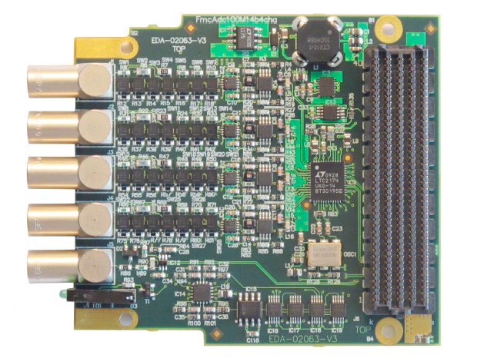
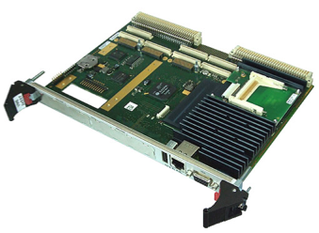
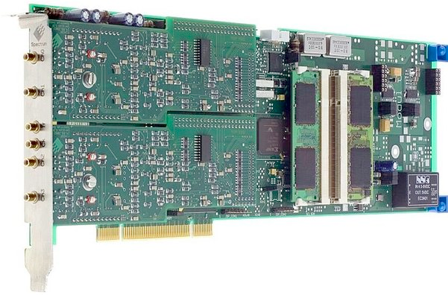
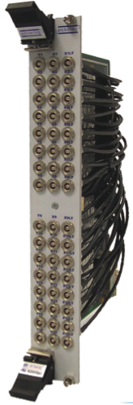
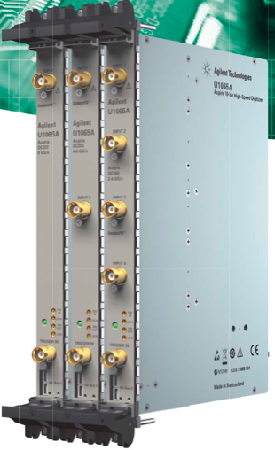
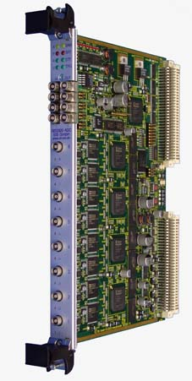
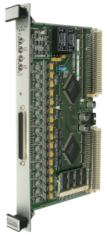
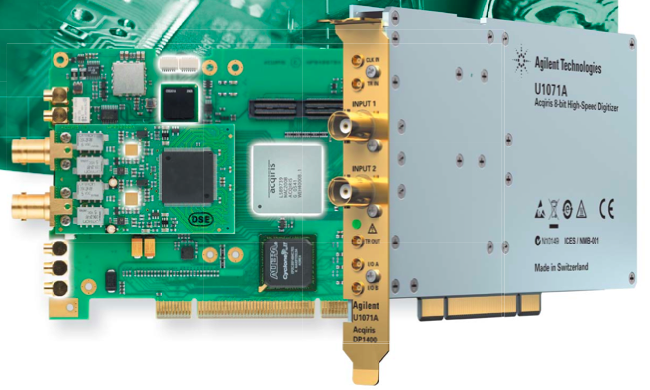
Implementation Philosophy - Hardware
As much as possible:
Apply vertical industrial control system solutions
  PLCs for industry-like process control (electricity, cooling & ventilation, vacuum, cryo)
Restrict home-made HW development to specific applications
  Beam optics controls (i.e. all power converters),
  Injection and Extraction systems,
  Beam instrumentation,
  RF,
  Collimation,
  Timing Systems,
  Etc.
Base the HW architecture on available standards and Commercial Off-The-Shelf (COTS)
  Standards for complex embedded I/O systems with high performance demands
  COTS electronic modules for generic features (CPUs, serial controller boards, ADCs, etc.)
  COTS desktop PCs & servers for control rooms and application servers
  Standard fieldbuses for applications requiring real-time features and radiation hardness (e.g. WorldFIP), and less stringent applications (Profinet/Ethercat)
  Standards for cost-effective I/O systems for networking (fieldbus controllers)
  GPS for time stamping and overall accelerator synchronization
Don’t Reinvent The Wheel !!

Slide 25
Implementation Philosophy - Software
As much as possible:
Apply vertical industrial control system solutions
  Supervisory Control and Data Acquisition Systems (SCADA) for commands, graphical user interfaces, alarms, etc. of industrial systems
Rely on common technologies and tools
  Important for aspects such as recruitment, education & training
  DBs & Storage solutions (e.g. Hadoop)
  Communication protocols
  Monitoring solutions used in the industry (e.g. ICINGA)
Privilege Open-Source Software
  Avoid vendor lock-in
  Control license cost
  Manage the Total Cost of Ownership (TCO)

Slide 26
A bit of History
Notes:
Why is the current control system not conform to the principles given before?
History !

Slide 27
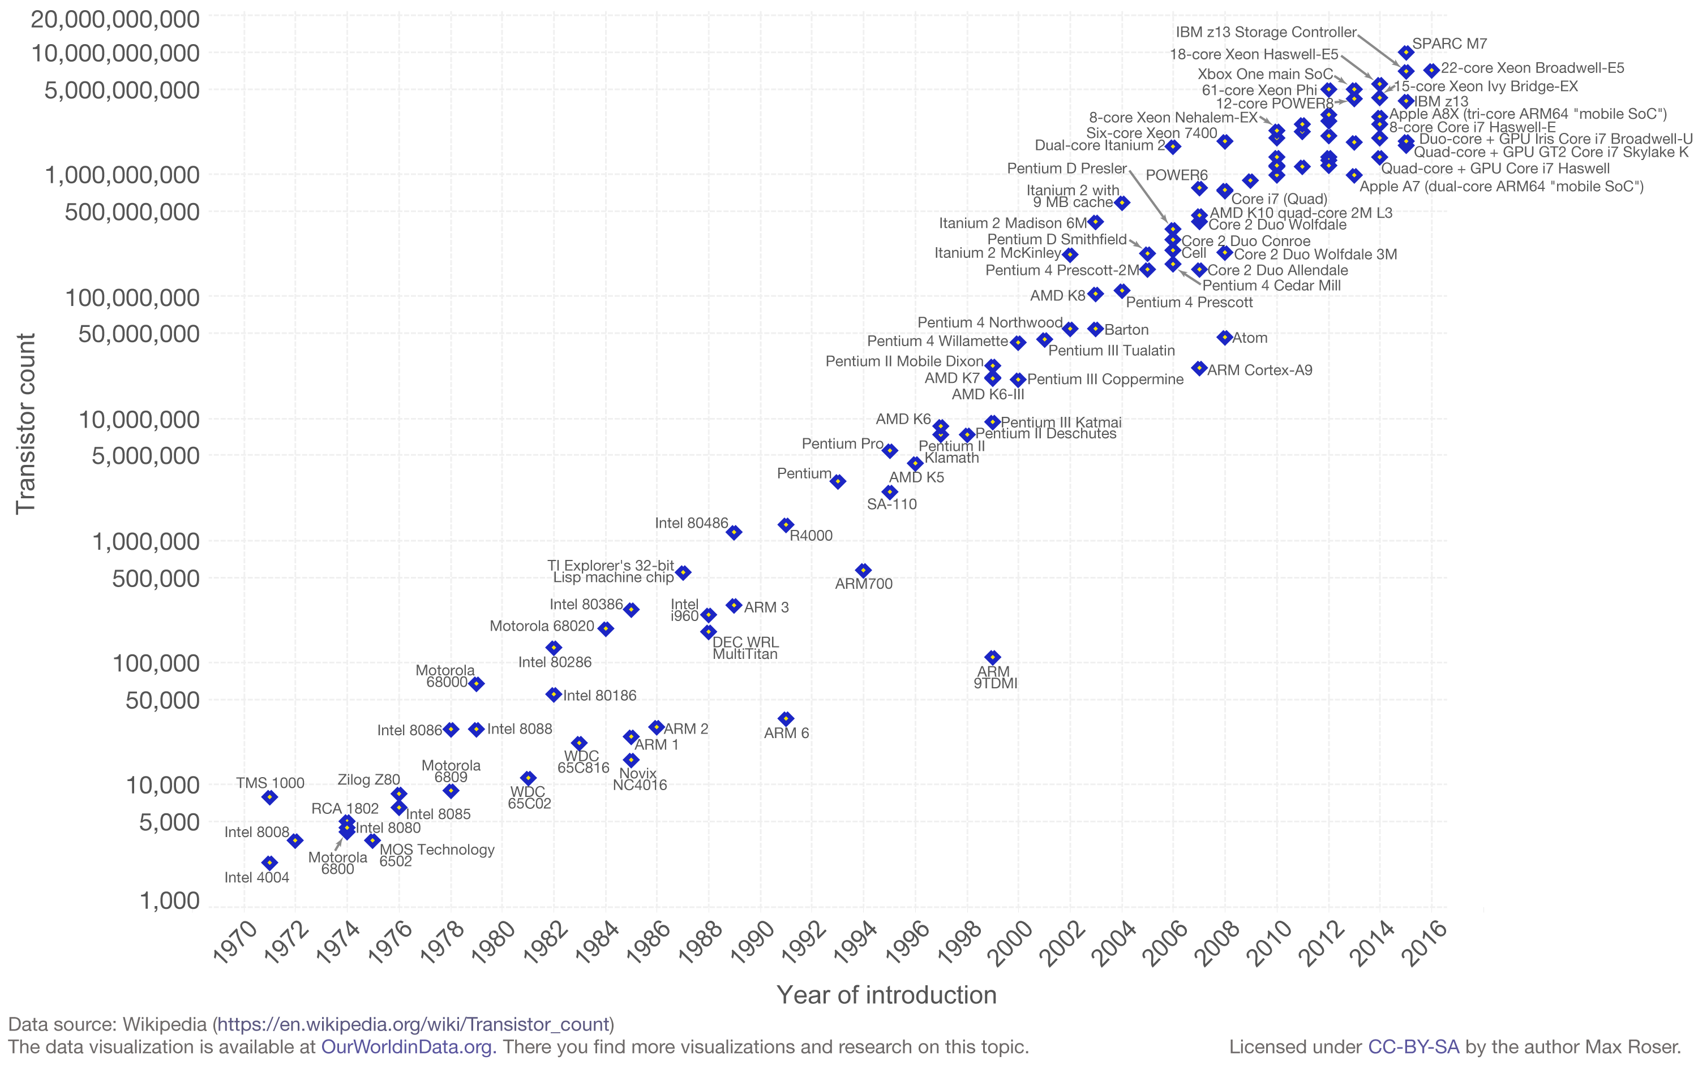
Moore’s Law
Modern days
Early days
Prehistory

Slide 28
Control System Prehistory
Accelerators are small and overall less complex (e.g. no superconducting magnets)
  No more than a few thousands of devices to control
No computing infrastructure and limited possibility to model
Actuator and monitors are physically in the local control rooms (e.g. buttons, knobs, analogue oscilloscopes, etc.)

Slide 29
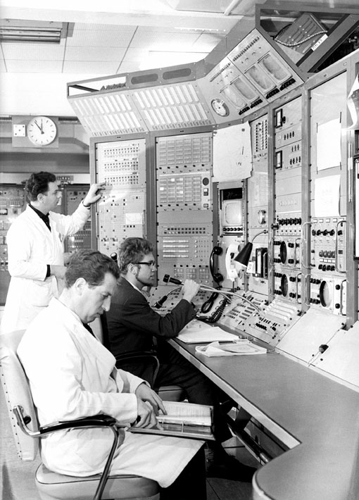
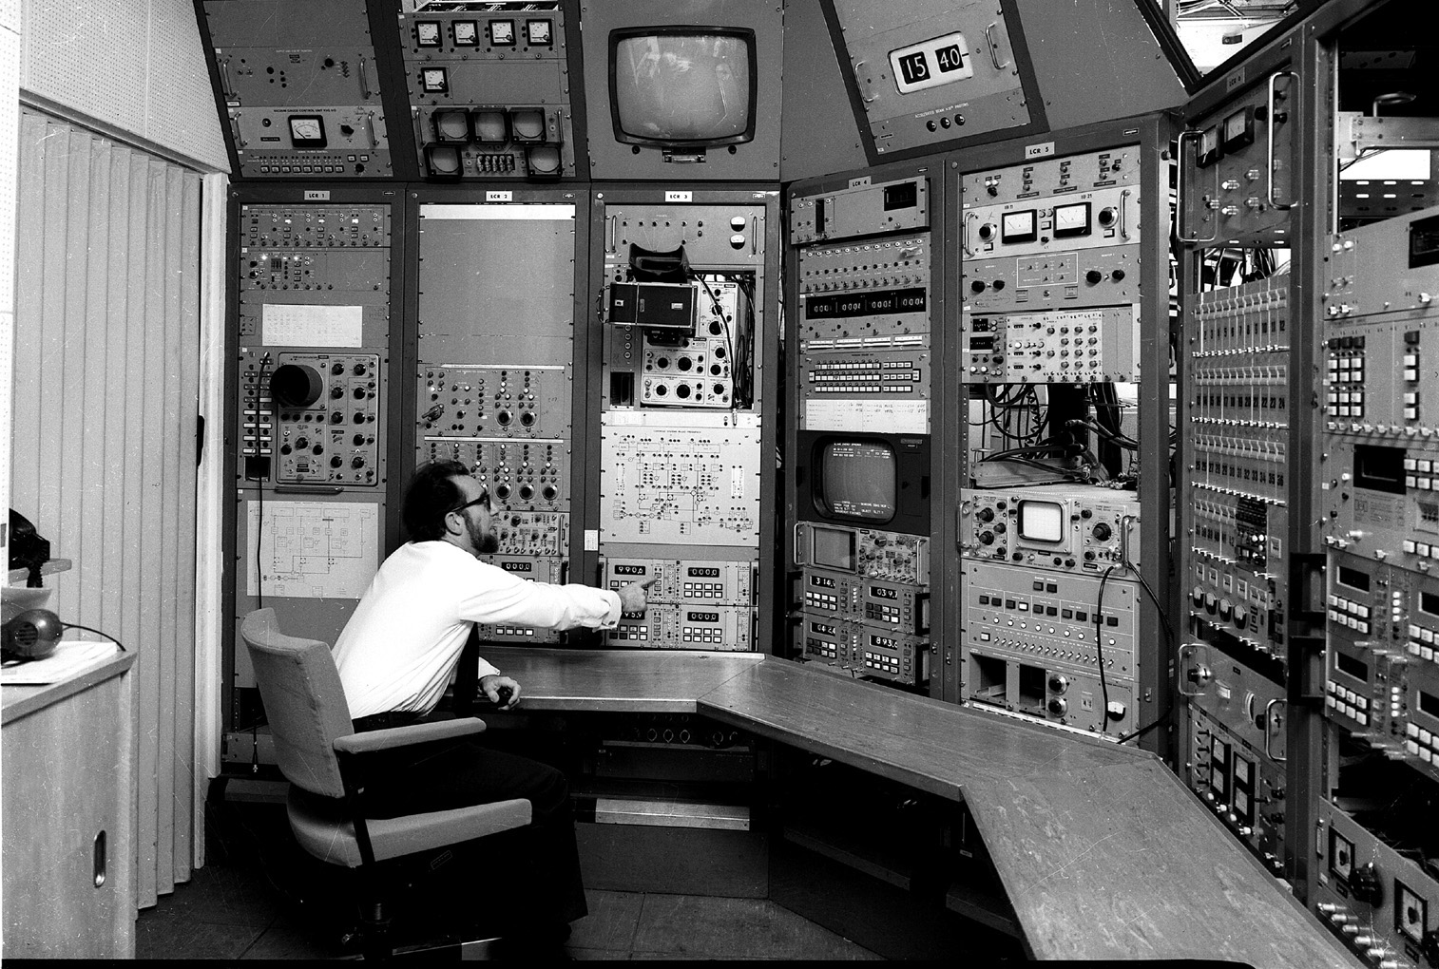
Control System Prehistory

Slide 30
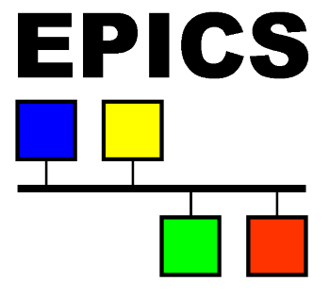


The Early Days
Beginning of remote controls
Still limited by the available performance
Lack of standards and common frameworks → more DIY and custom solutions
Emergence of several controls solutions, aiming at different types of accelerators (at first)
  EPICS (driven by US labs),
  Tango (driven by ESRF (Fr) – synchrotron light sources)
  CERN¹
¹ non-exhaustive list
Notes:
Concepts are similar but yet with important differences. Some solutions are better suited to certain types of accelerators. For example, difficult to use EPICS on CERN accelerators due to the fast changing beams produced.

Slide 31

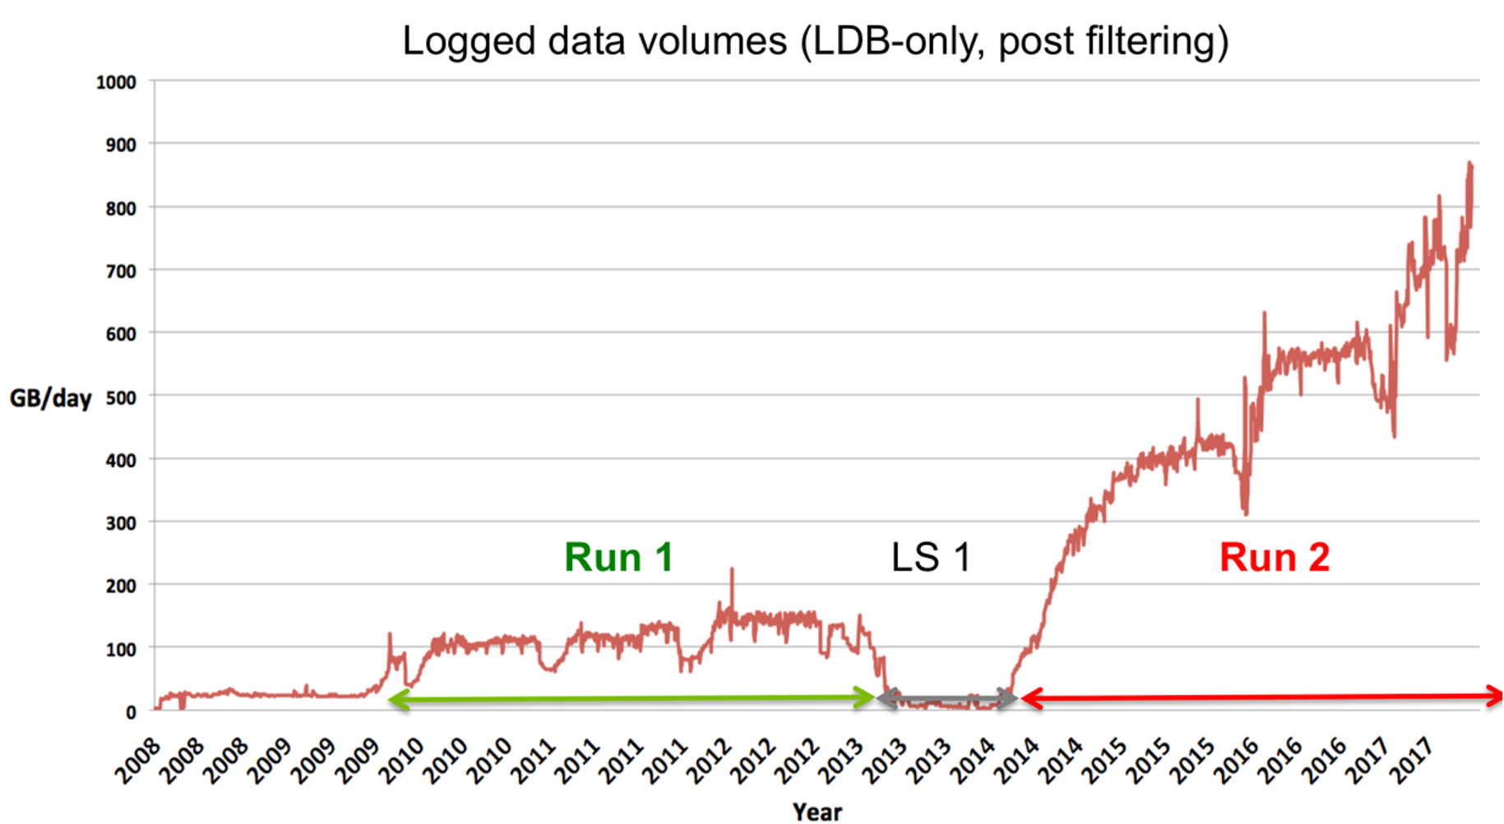
Modern days
Hardware has become powerful
  E.g. embedded systems at CERN in late 90s had 64 MB of RAM; Nowadays, they have 8 GB
  Most of the needs are covered
  Yet, users want more and more data (turn-by-turn acquisitions, big-data solution for the long-term storage, etc.)
Software industry has become a major actor worldwide.
  We can rely on many readily available technologies that open the doors to much more powerful systems
We still need to integrate and customise them to the very specific domain of particle accelerator controls
  Not all solutions are appropriate;
  Need to remember accelerator controls ≠ selling plane tickets
  Mastering the different solutions with their evolution, limitations, etc. is a major challenge
  The rhythm of updates is no longer under our control. E.g. recent Linux CentOS changes

Slide 32
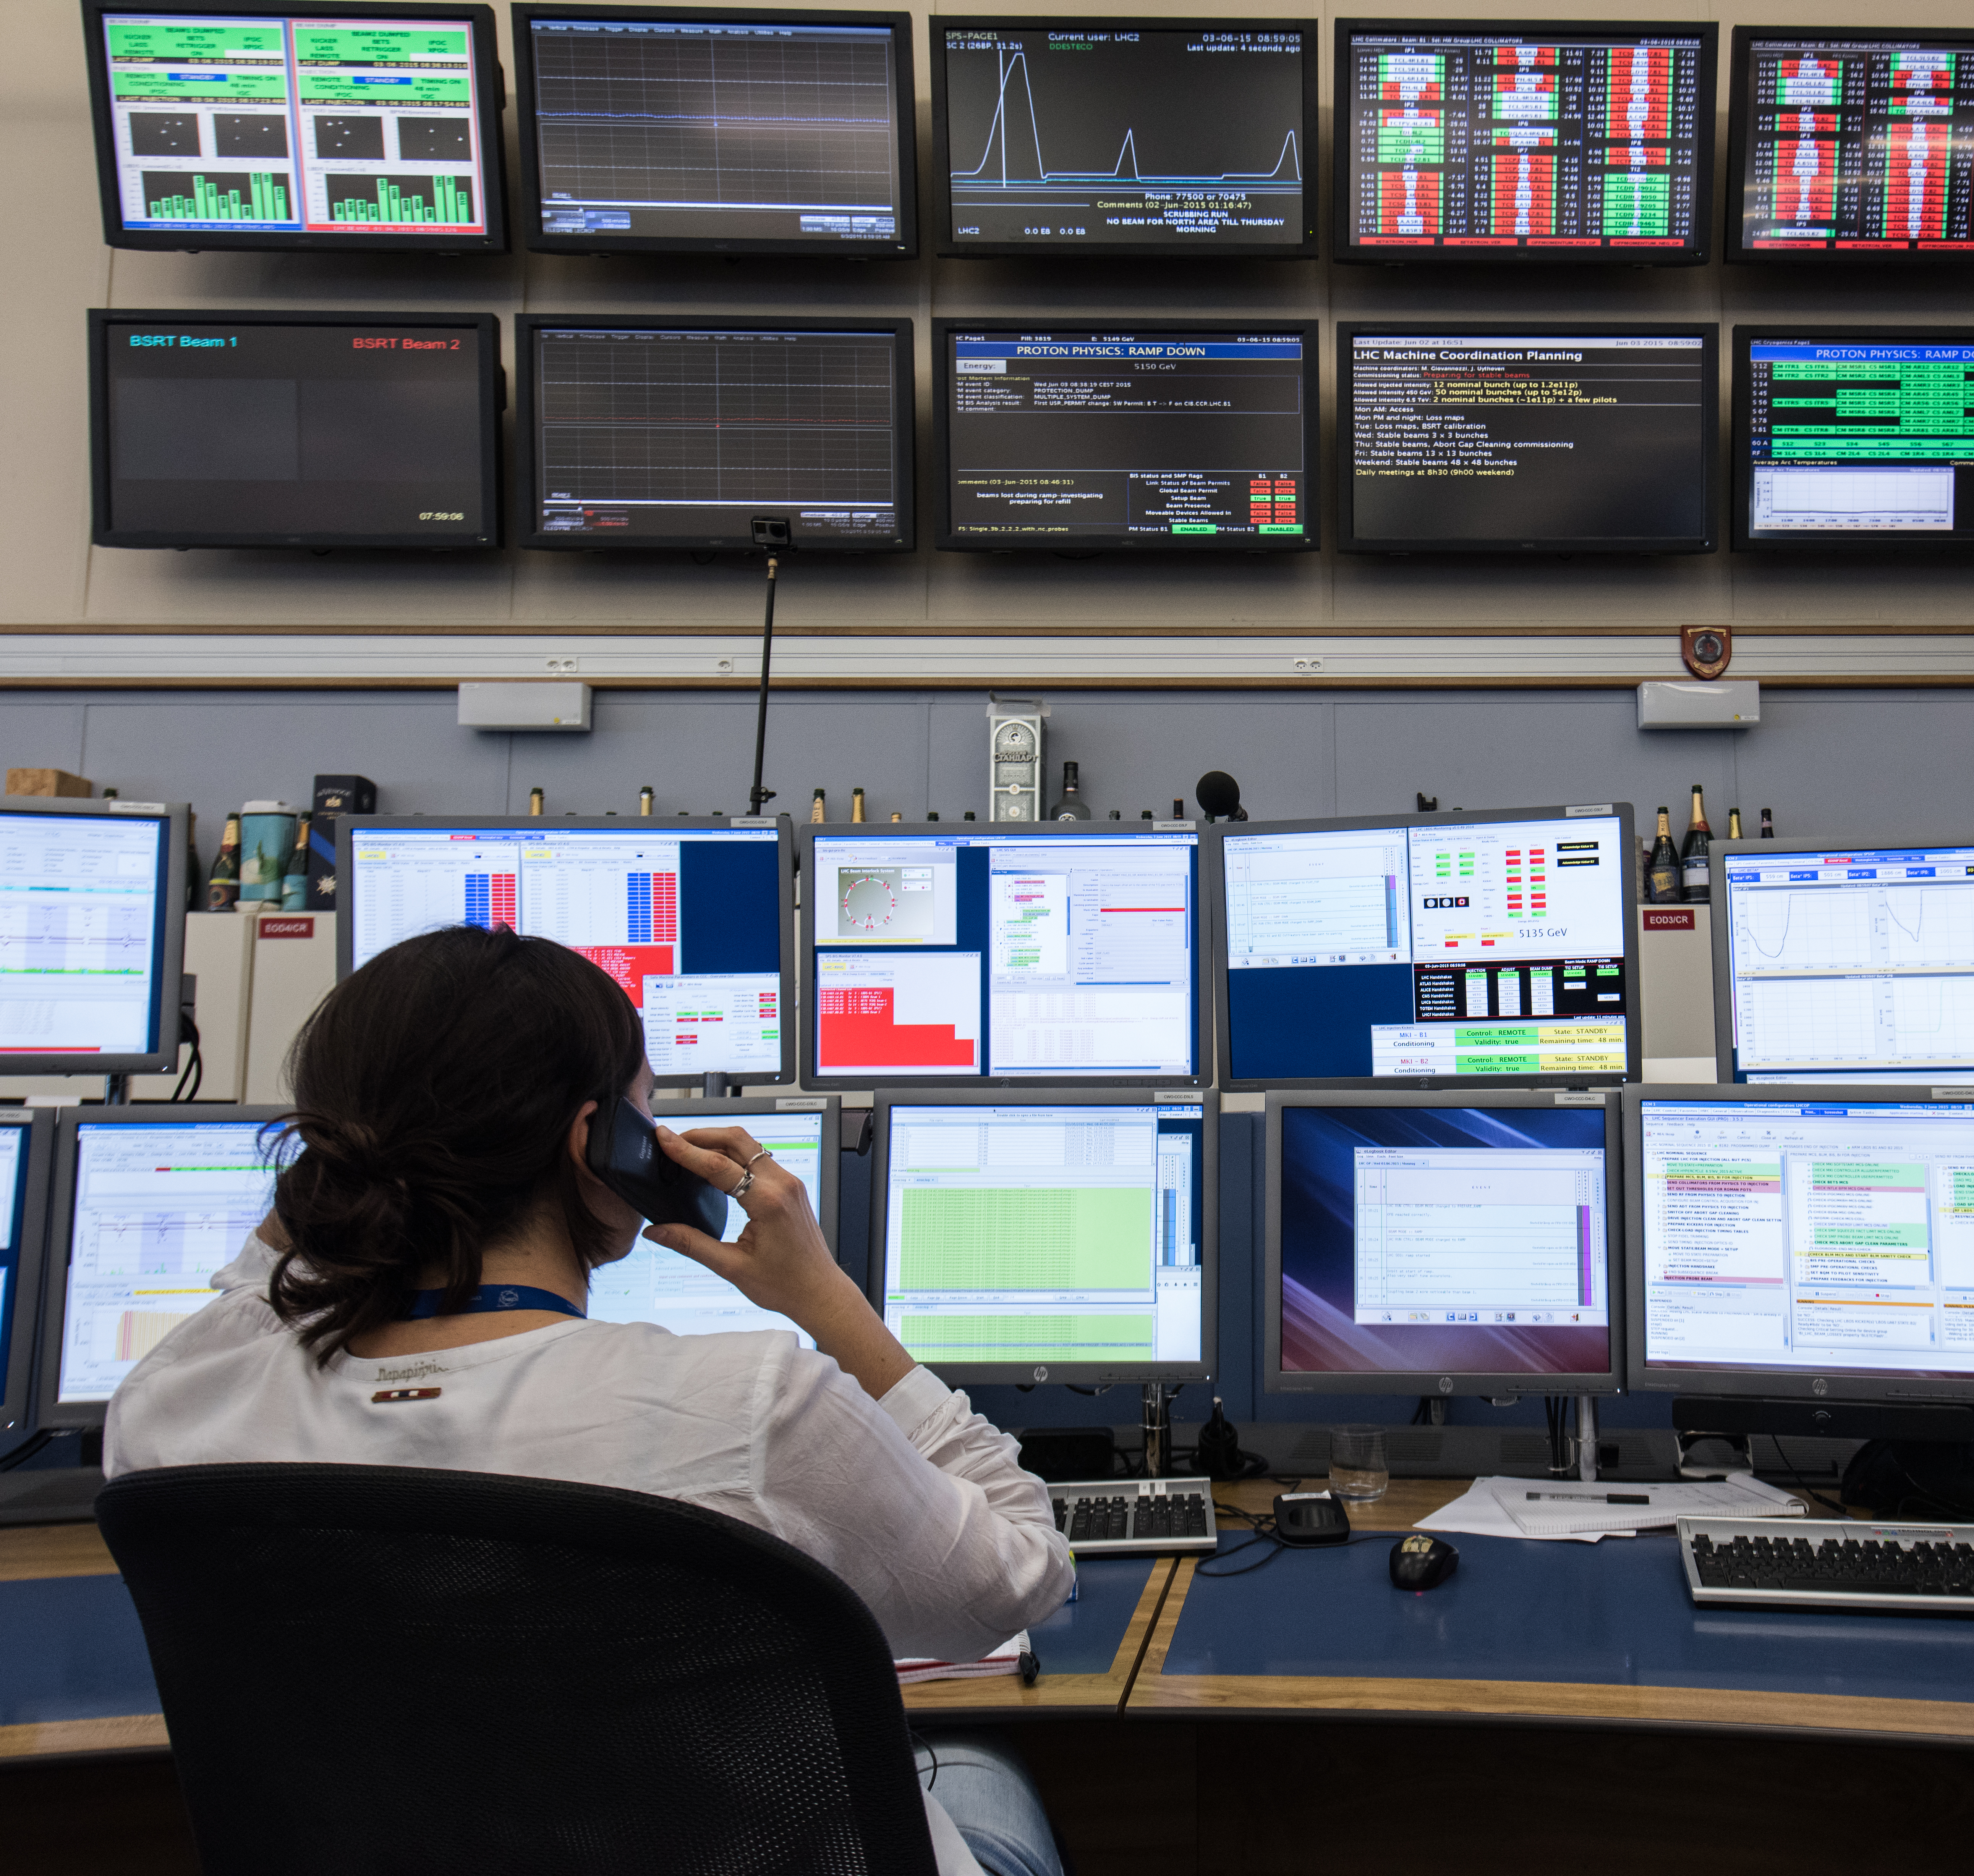
50 years of technology evolution

Slide 33
High-Level Architecture
of a modern control system
Notes:
30 mins

Slide 34
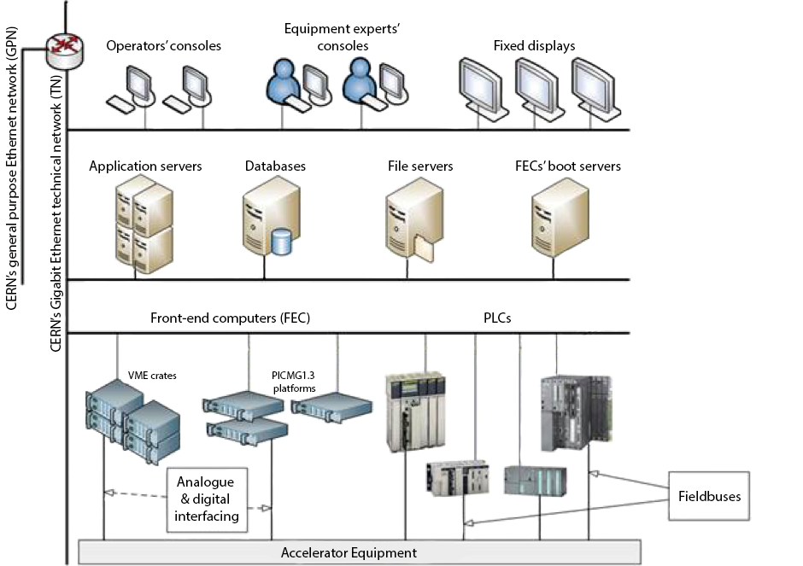

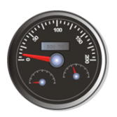
High-Level Hardware Architecture
Client Tier
Tip of the iceberg
Keywords:
Console
Terminal
Server Tier
Central computing infrastructure
Keywords:
Back-End Computer (BEC)
Resource Tier
Electronics close to the accelerator
Keywords:
Front-End Computer (FEC)
Notes:
HW – 3 tiers but going for a physical 4 tier w/ the DIOT

Slide 35
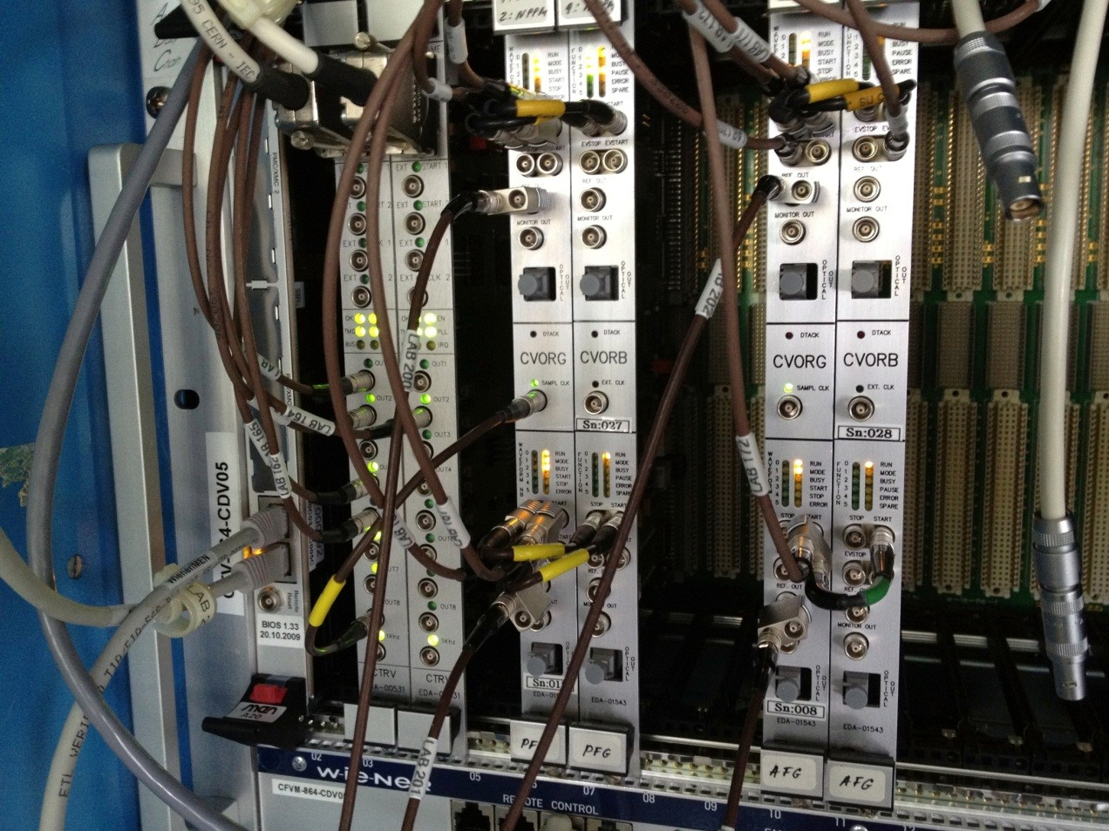
High-Level Hardware Architecture
Resource Tier
Open enclosures
  Easy access
  Better cooling and power available
  But expensive
Closed enclosures
  Possible for simple functions (e.g. fieldbus control)
  Cost effective; when deployed in big number, e.g. LHC power converter control gateways
Notes:
Crate from different standards
VME (VME64, VXS, VXI)
PXI and Pxie
CompactPCI and CompactPCI serial
mTCA and ATCA
Industrial PCs w/ PCI, PCIe
Typically contains
CPU running an OS (Linux, LynxOS, VxWorks, etc.)
Timing receiver (synch and beam scheduling (see JS lecture)
Electronics boards (ADC, field bus controller, complex FPGA-based feedback systems, etc.
Nowadays, the application electronics can be further distributed and installed in DI/OT (radhard or not)
FEC != DIOT as the latter is not (yet) able to run complex sw as in the FEC. In the future, the need of a FEC is uncertain (except in radhard case where simplicity is a req).

Slide 36
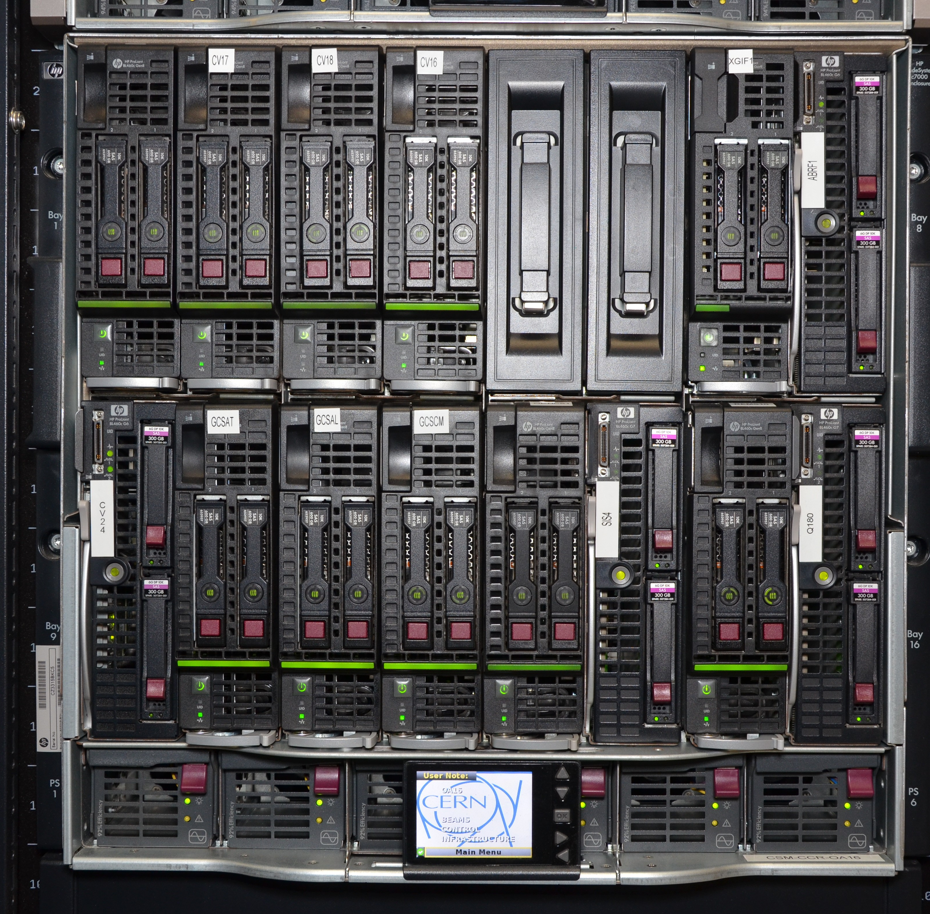
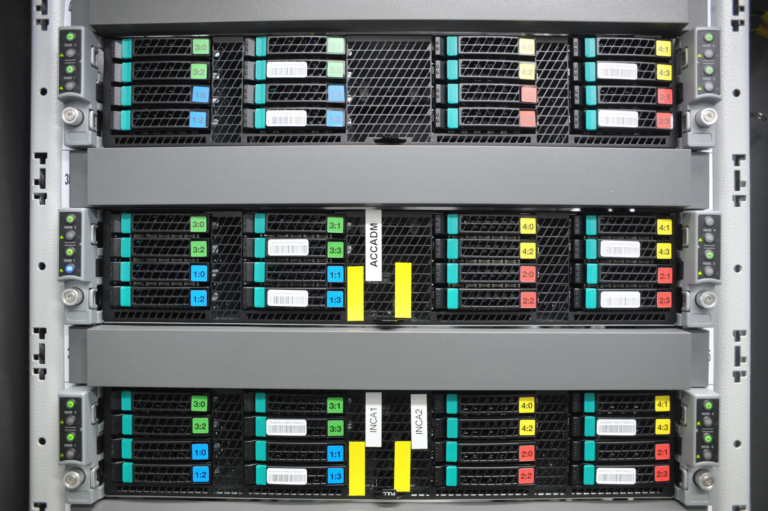
High-Level Hardware Architecture
Middle Tier
IT-Computer-centre type of hardware
High-density
Highly available (redundancy and hot-swap)

Slide 37
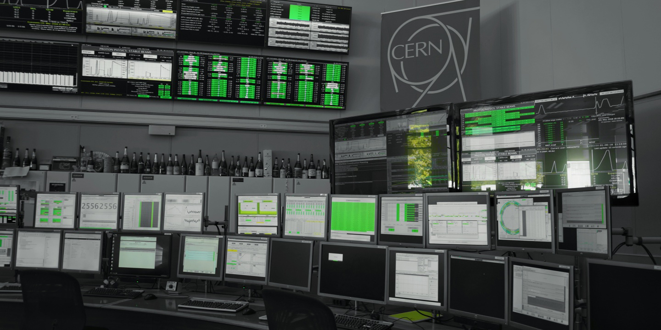
High-Level Hardware Architecture
Control Room Computers
As much as possible COTS desktop PCs but MTBF requirements might be difficult to satisfy
Users expect modern reactive GUIs
Several layers of screens to have as much data as possible available
Wall screens – Non-interactive summary applications
2nd row – Non-interactive detailled applications
Front row – Interactive applications

Slide 38
High-Level Software Architecture
Front-end Tier
Real-time control and acquisition
Limited, local scope
Fast reaction possible (interrupts)
Limited computing power (compared to other tiers)
Equipment processing to provides a high-level view of the hardware
Real-time (RT) applications relies on frameworks, which capture the recuring aspects (react to events, publish new data, etc.) E.g. Front-End Software Architecture (FESA)
Based on technologies closed to the hardware (C for drivers, C++ for RT, etc.)
RT Application
(e.g. Kicker system control)
RT Frameworks
(e.g. FESA)
Device Drivers
(e.g. Timing receiver kernel module)
Operating System
(Linux)
Notes:
FESA (Front-End Software Architecture): CERN’s real-time application fram ework.

Slide 39
High-Level Software Architecture
Business Tier
General purpose services & Specific business logic
Broader scope; able to coordinate the entire accelerator
Powerful computers
Less reactive (network) and at a higher-level of abstraction
Based on technologies that are better suited for high-level business logic (e.g. Java)
Settings Management
(InCA/LSA)
Long-term Logging
(NXCALS)
Automation
(Sequencer, SIS)
Etc.
Notes:
Today the services are deployed “bare metal” but as Remi explains we’re looking at containers and container orchestration
LSA (LHC Software Archeticture): CERN’s settings management system.
NXCALS (CERN Accelerator Logging System): CERN’s long-term storage for acquisitions and, soon, settings.
SIS (Software Interlock System): CERN’s non-real-time interlock system based on software decision trees.

Slide 40
High-Level Software Architecture
Presentation Tier
Graphical applications
Different technologies available
Java Swing, Java FX
Qt, PyQt
Web ecosystem (Angular, View.js, etc.)
Keywords:
Graphical User Interface (GUI)
Command-line interface (CLI)
Controls Middleware & more generic solutions
Controls Middleware
Communication
Accelerator-specific protocols for the lower layers
  Controls Middleware (CMW)
Potentially, more generic technologies for the higher layers
  RMI/JMS
  REST API
  gRPC
  …
Notes:
Presentation layer (see Hermann 14) - In its own slide cite != techno Java, Python, Web and show a few pictures from Hermann

Slide 41
A few examples
And the key components used…
Notes:
41 mins (11 mins 30)

Slide 42


Example 1 – Control
New value = x
GUI
x
Server
x, a, b, c
Database
Oracle Database
x ➔ a, b, c
InCA/LSA Server
a
b
c
FESA Class
RT Application
RT Application
RT Application
Control now!
0x61
0x62
0x63
VMEBus board
Hardware
Hardware
Hardware
Timing System
General Machine Timing (GMT)

Slide 43
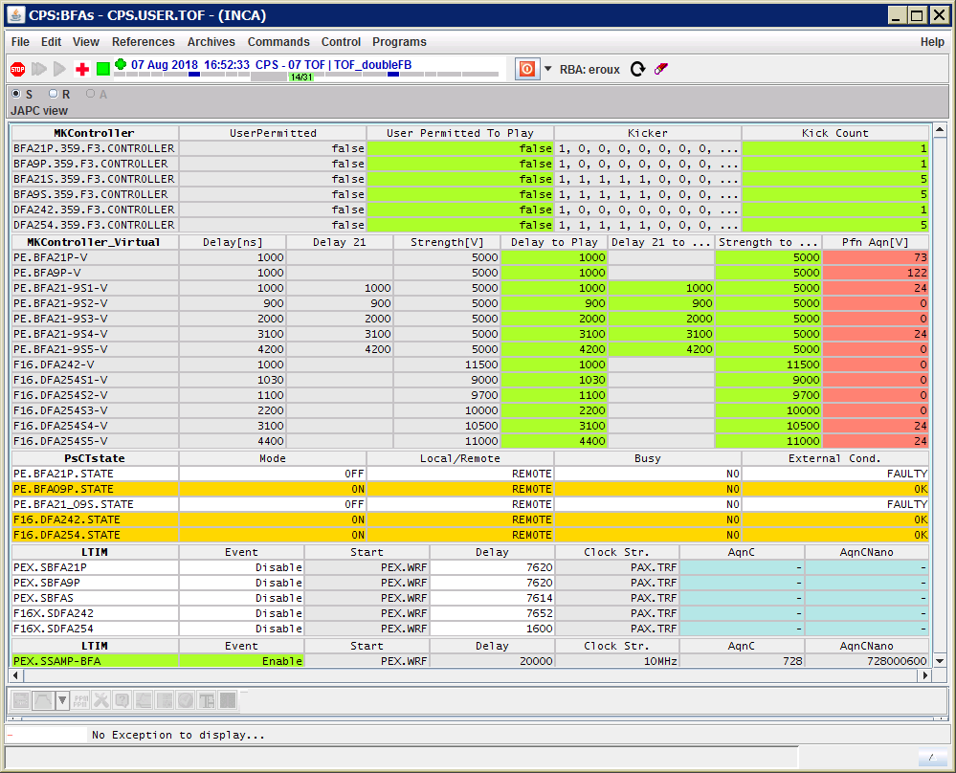
Example 2 – Monitoring
Here are a, b, c, and Everything is OK
GUI
a’, b’, c’ @ t_{i}
UCAP* Server
a @ t_{i}
b @ t_{i}
c @ t_{i}
FESA Class
RT Application
RT Application
RT Application
Read now!
(time = t_{i})
0x61
0x62
0x63
VMEBus board
Hardware
Hardware
Hardware
Timing System
Measure now!
General Machine Timing (GMT)
*UCAP: Unified Controls Acquisition & Processing framework
Notes:
UCAP: Unified Controls Acquisition & Processing framework

Slide 44
Example 3 – Logging
Values on the 06/06/2021 ?
SWAN Notebook
a, b, c @ 06-06-21
a, b, c @
06-06-21
NXCALS
Hadoop
a, b, c @ t_{i}
a @ t_{i}
b @ t_{i}
c @ t_{i}
FESA Class
RT Application
RT Application
RT Application
Read now!
(time = t_{i})
0x61
0x62
0x63
Hardware
Hardware
Hardware
Measure now!
Timing System
General Machine Timing (GMT)
VMEBus board
*SWAN: Service for Web based ANalysis

Slide 45
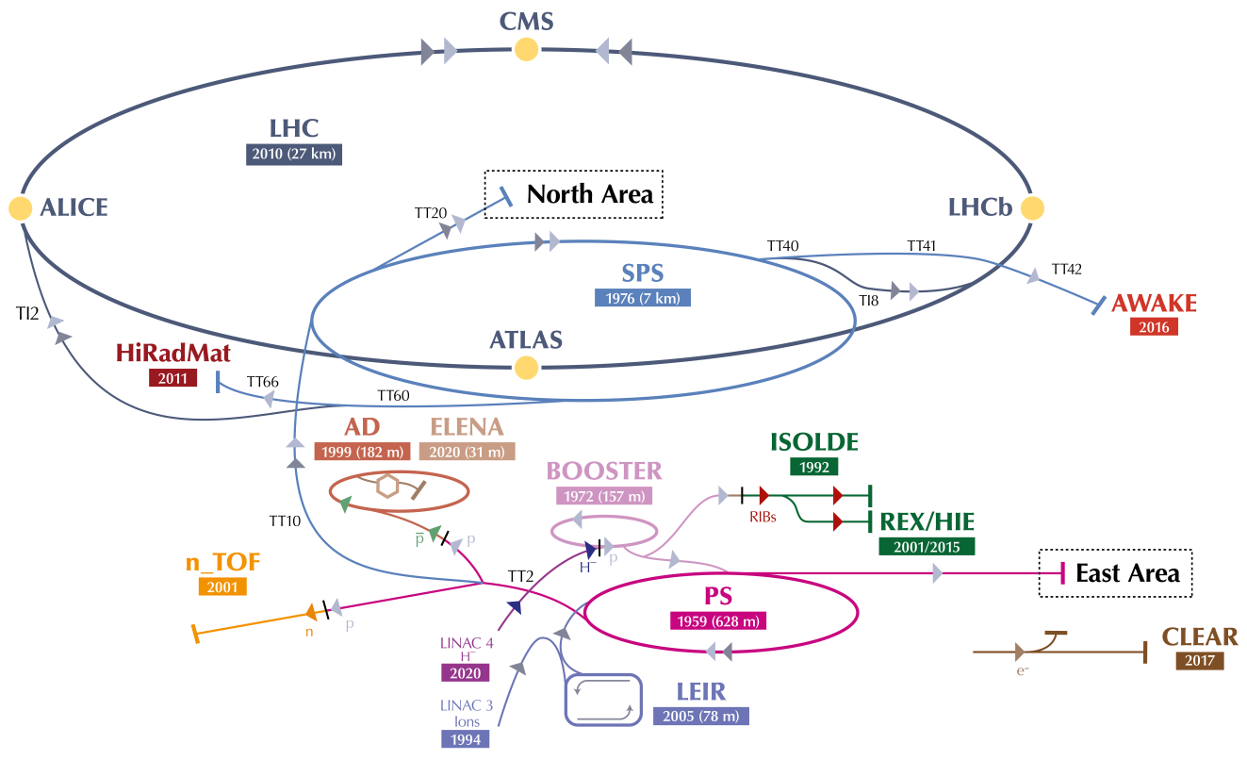


Accelerators Optimisation
Physics
SPS
PS
PSB
Optimise the throughput of the accelerators
New requirements: Change references of almost all equipment from pulse to pulse
The control system must be hard real-time
The central timing system sequences the entire beam production
Physics
Physics
Notes:
Travail a la chaine mais pas le meme fai sceau

Slide 46
Program for Tomorrow…
Review the examples but looking at the technical implementation details
  Which technologies
  Workflows
  Design choices
  Etc.
If possible, review
  The high-level architecture (get used to the names)
  The examples
  The timing system

Slide 47



Want to know more?
CERN
CERN Beams Department (https://beams.cern/)
Introduction to BE-CO Control System, 2019 Edition, S. Deghaye & E. Fortescue, CERN, 2020. (https://cds.cern.ch/record/2748122)
Tango Controls (https://www.tango-controls.org/)
EPICS (https://epics-controls.org/)
Notes:
47 mins (6 mins)

Slide 48
Day 2

Slide 49
Agenda
What is an accelerator made of?
Control System Requirements
Implementation Philosophy
A bit of History
Hardware & Software Architecture
CERN examples & Key Components
Detailed implementations and concepts

Slide 50
High-Level Hardware Architecture
Recap
Client Tier
Tip of the iceberg
Keywords:
Console
Terminal
Server Tier
Central computing infrastructure
Keywords:
Back-End Computer (BEC)
Resource Tier
Electronics close to the accelerator
Keywords:
Front-End Computer (FEC)
Notes:
HW – 3 tiers but going for a physical 4 tier w/ the DIOT

Slide 51
High-Level Software Architecture
Recap
Front-end Tier
Real-time control and acquisition
Limited, local scope
Fast reaction possible (interrupts)
Limited computing power (compared to other tiers)
Equipment processing to provides a high-level view of the hardware
Real-time (RT) applications relies on frameworks, which capture the recuring aspects (react to events, publish new data, etc.) E.g. Front-End Software Architecture (FESA)
Based on technologies closed to the hardware (C for drivers, C++ for RT, etc.)
RT Application
(e.g. Kicker system control)
RT Frameworks
(e.g. FESA)
Device Drivers
(e.g. Timing receiver kernel module)
Operating System
(Linux)

Slide 52
High-Level Software Architecture
Recap
Business Tier
General purpose services & Specific business logic
Broader scope; able to coordinate the entire accelerator
Powerful computers
Less reactive (network) and at a higher-level of abstraction
Based on technologies that are better suited for high-level business logic (e.g. Java)
Settings Management
(InCA/LSA)
Long-term Logging
(NXCALS)
Post-Processing
(UCAP)
Etc.

Slide 53
High-Level Software Architecture
Recap
Presentation Tier
Graphical applications
Different technologies available
Java Swing, Java FX
Qt, PyQt
Web ecosystem (Angular, View.js, etc.)
Keywords:
Graphical User Interface (GUI)
Command-line interface (CLI)
Controls Middleware & more generic solutions
Controls Middleware
Communication
Accelerator-specific protocols for the lower layers
  Controls Middleware (CMW)
Potentially, more generic technologies for the higher layers
  RMI/JMS
  REST API
  gRPC
  …

Slide 54
Use Case 1: Control
Who: PS operator
What: Change the strength of the extraction septum towards the SPS for the Fixed Target beam
Involved controls components:
  InCA/LSA (Setting management)
  CMW (Controls Middleware)
  FESA (Real-time hardware control)
  Timing (Synchronisation)
  In all the examples, we assume all the configuration is already done and we focus on the run-time aspects

Slide 55

Example 1 – Control – High-level
More strength on my extraction septum ➔ 0.02978668
Trim editor
K=0.02978668
Oracle Database
K, Current
InCA Server
K ➔ Current
Current= 15280
FESA Class
Control now!
0x3BB0*
Hardware
Timing System
(GMT)
*not a real value

Slide 56


Example 1 – Control - Communication
Trim editor
Remote Method Invocation (RMI) to call the InCA server
! Limited to Java to Java ➔ ReST
Trim request (new value, context, etc.)
Makerule: Java class to compute parameters based on other parameters, hardware characteristics (calibration curve) and cycle specific values
BEC
InCA Server
Save the new values (K, I, current) along with some contextual info (who, what time, etc.)
Parameter hierarchy
Current values (p, K, I, …)
Name of the Makerule to apply
Mapping between cycle and timing user (“MTE 21” = CPS.USER.SFTPRO1)
Drive the new value by setting the device PE.SMH16 for timing user CPS.USER.SFTPRO1 (Property: SettingPPM)
Database
FEC
FESA Class

Slide 57


Example 1 – Control – Low-level
Controls Configuration DB
Stores the mapping between the device names and the servers hosting them
CCDB is at the heart of our database-driven control system
InCA Server
CMW Directory service
Stores the mapping between the server names and their addresses (TCP://xxx)
Very critical ➔ Redundant
Set request (new value, context, etc.)
CMW-RDA based on ZeroMQ
Supports three basic operations
Get (read)
Set (write)
Subscribe (monitor)
Internal storage
Set Action
New value
FEC
Value (t-1)
FESA Server
Value (t-2)
PE.SMH16
Buffer
Manager

Slide 58
Example 1 – Control – Beam production
Septum
Internal storage
New value
Value (t-1)
FESA RT Action
Value (t-2)
Control now!
Power converter
Extract now!
Timing System
(GMT)
SPS
PS
PSB
t_{ctrl}
t_{extract}

Slide 59
Use Case 2: Acquisition
Who: PS operator
What: Keep an eye on acquisition values of many control devices. The low-level data needs post-processing and will be displayed as a graph in a web page
Involved controls components:
  Timing (Synchronisation)
  FESA (Real-time hardware control)
  CMW (Controls Middleware)
  UCAP (Unified Controls Acquisition & Processing)
  WRAP (Web Rapid Application Platform)
  In all the examples, we assume all the configuration is already done and we focus on the run-time aspects

Slide 60

Example 2 – Monitoring
Here are the losses, everything is OK
GUI
high-level value @ t_{i}
UCAP* Server
a @ t_{i}
b @ t_{i}
c @ t_{i}
FESA Class
FESA Class
FESA Class
Read now!
(time = t_{i})
0x61
0x62
0x63
VMEBus board
Hardware
Hardware
Hardware
Timing System
(GMT)
Measure now!
*UCAP: Unified Controls Acquisition & Processing framework

Slide 61
Example 2 – Monitoring – Low-level acquisition
Rolling Buffer
CMW-RDA updates
New value
t_{cycle}, t_{acq}
FESA Server
Value (t-1)
t_{cycle}, t_{acq}
FESA RT Action
Value (t-2)
t_{cycle}, t_{acq}
- - -
Read now!
Notify for t_{acq}
Timing System
(GMT)
Acquire now!
SPS
PS
PSB
t_{cycle}
t_{acq}
t_{read}

Slide 62





Example 2 – Monitoring – Post-processing
BEC
UCAP Node
SPS
PS
PSB
Device Server
Virtual Device
Standard algorithms
  Aggregators
  Array manipulations
  Basic maths, etc.
  Custom algorithms
  Java +
  Python
t_{cycle}
t_{Inj}
t_{RFon}
t_{split}
t_{ext}
t…
Post-processing algorithm
How to group the incoming data?
Start Cycle timestamp (AKA cyclestamp)
When to trigger the post-processing?
Once all the data is there or after a time-out
How long to wait for late comers?
Configurable time-out
What to do if no data is published?
➔ Out-of-the-box monitoring
Event builder
Data updates
CMW-RDA
Update
CMW-RDA
Update
CMW-RDA
Update
CMW-RDA
Update
FESA Server
FESA Server
FESA Server
….
FESA Server

Slide 63

Example 2 – Monitoring – Diagnostics

Slide 64




Example 2 – Monitoring – Graphical User Interface
WRAP
REST for command/response
HTTP/2 push events for live updates
SWING
Simplified flow
Controls Configuration DB
BEC
Web back-end
server
Stores the configurations of the web dashboards
UCAP Node
Device Server
CMW-RDA updates

Slide 65
Use Case 3: Logging
Who: Accelerator physicist
What: Store acquisition values of many control devices long-term and perform analysis
Involved controls components:
  Timing (Synchronisation)
  FESA (Real-time hardware control)
  CMW (Controls Middleware)
  NXCALS (Data Logging)
  SWAN (Web-based analysis tool)
In all the examples, we assume all the configuration is already done and we focus on the run-time aspects

Slide 66

Example 3 – Logging
Values on the 06/06/2021 ?
SWAN Notebook
a, b, c @ 06-06-21
a, b, c @
06-06-21
NXCALS
Hbase/Hadoop
a, b, c @ t_{i}
Already covered in the previous example
a @ t_{i}
b @ t_{i}
c @ t_{i}
FESA Class
FESA Class
FESA Class
Read now!
(time = t_{i})
0x61
0x62
0x63
Hardware
Hardware
Hardware
Measure now!
Timing System
GMT
*SWAN: Service for Web-based ANalysis

Slide 67


Example 3 – Logging - Ingestion
~20 BEC (48 cores, 512 GB RAM)
NXCALS Cluster
High-Availability (fault tolerant & self healing)
Load balancing
Monitoring (see UCAP)
Data source
Data source
Local storage for 36 hours
Data reliability in case of storage failure
Data source
ETL
Data source
ETL
Data source
Data source
ETL
Ingestion API
To storage
2.5 TB/day
CMW-RDA
Update
CMW-RDA
Update
CMW-RDA
Update
CMW-RDA
Update
FESA Server
FESA Server
FESA Server
….
FESA Server
100s FECs

Slide 68





Example 3 – Logging - Storage
Nov-2021:
~40 servers
1.1 PB logged data
ETL
NXCALS Storage (CERN IT)
ETL
ETL
ETL
Continuous buffered
writes
Recent data
~ last 4-5 days
ETL
ETL
ETL
All of the data
after compaction
Periodic writes
(~2 mins)
Compactor
Once/day

Slide 69


Example 3 – Logging - extraction
Courtesy Ph. Elson
Analysis
NXCALS
Storage
Data
Recent data
Older data

Slide 70
Want to know more?
CERN
CERN Beams Department (https://beams.cern/)
Introduction to BE-CO Control System, 2019 Edition, S. Deghaye & E. Fortescue, CERN, 2020. (https://cds.cern.ch/record/2748122)
Tango Controls (https://www.tango-controls.org/)
EPICS (https://epics-controls.org/)

