Slide 1
FD2-VD CDR Update 1 July 2021
Anne, Marvin, Sandro

Slide 2
Status on first drafts and internal reviews
More reviewers contacted this week (reviewing Vertical_Single_Phase_FD_Technology-25jun.pdf)
We had hoped for comments back by this week, but most will come in around 7/7.
We are sending comments to PoCs as they come in.
DAQ is exception – comments expected tomorrow; we hope to set up meeting for next week
HV - no reviewers have accepted yet
Prototypes – need one more reviewer
Marvin will start drafting Executive Summary
Steve K will work on Project Organization

Slide 3
Discussion with LBNC this week
Agreed to maintain original CDR schedule (to within a couple of weeks).
We will give (at least some) individual chapters to LBNC by mid July; they will skim for things that look problematic.
We will give substantially complete draft to LBNC at end of July.
Their goals:
Start sending their questions/comments back in early September.
At close of mid-Sept LBNC meeting, they finish sending Q/C, and report a “positive statement of progress” to FNAL director.
Our goal: Finalize CDR by late October; LBNC would recommend approval; FNAL director would approve.

Slide 4
More Detail
LBNC will review CDR one time only (starting late July)
No changes to design may be made to document after July submission
Any subsequent changes to design will go into PDR
July draft may include notes in sections for which updates are expected in Sept timeframe (e.g., simulations, demonstrations)
We may send these updates to them by early September
A couple of members will read entire CDR, others read only a chapter

Slide 5
Guidance on Contents
Clearly define a consistent, stable scope in Executive Summary.
Carry the alternates until R&D leads to baseline choice.
For alternates, clarify how they satisfy basic physics needs, and under what conditions each alternate would be used.
In particular: Physics Sec 2.2.2 “PDS Performance” will include performance of backup PDS layout and PDS chapter will describe the backup layout.
“Don’t skimp on chapter 10”: complete and concise description of management structure, the consortia, tech coordination, decision processes, role of executive board, etc. Describe relationships between entities.
Near Detector is also writing CDR – make sure management info is consistent across design reports.

Slide 6
Chapter Review Meetings
Attendees: Chapter PoCs, CET (Marvin, Sandro, Anne), Coordinators (Steve, Marzio)
Others may be requested in some cases
Any FD2-VD people welcome to attend
Will start scheduling, hope for most during week of 12 June
Please let CET know if you will be unavailable during this time
Thanks!

Slide 7
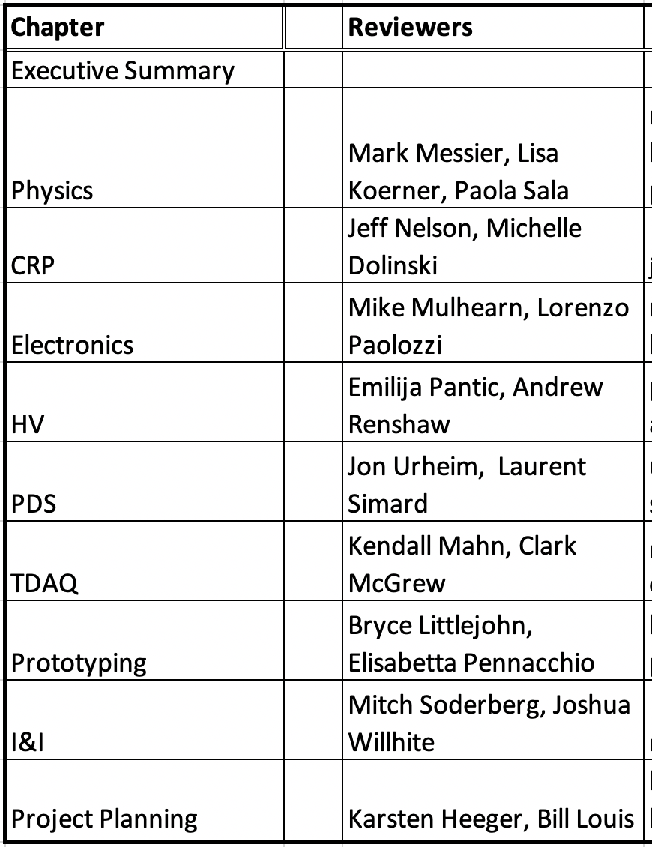
Proposed reviewers by chapter
?
Jane Nachtman, Andrea Zani
?
?
Ben Jones, Stephen Pordes
?
confirmed
?
not confirmed
unable
Claire David
completed
?
not ready

