Slide 1
INSTALLATION SEQUENCE OF WP6A DEVICES: 1 - PRELIMINARY PLANNING
WP6A Follow-up # 7
M. Curylo
HL-LHC WP6A – 07/10/2021

Slide 2
TOPICS DO DISCUSS
Main actions:
Clarification of current situation.
Indication issues to solve (tooling's, support structures etc.).
Proposal of installation sequence due to WP6a needs during LS3 (update global installation sequence if necessary).
Current references:
Version 1 of Installation sequence (WP15), EDMS: 2400939
Preliminary assembly sequence of DFH in the tunnel, EDMS: 2492613
Handling of WP6A equipment in new HL-LHC infrastructure, EDMS: 2157603
Transport and installation of DFX in the LHC underground areas
…

Slide 3
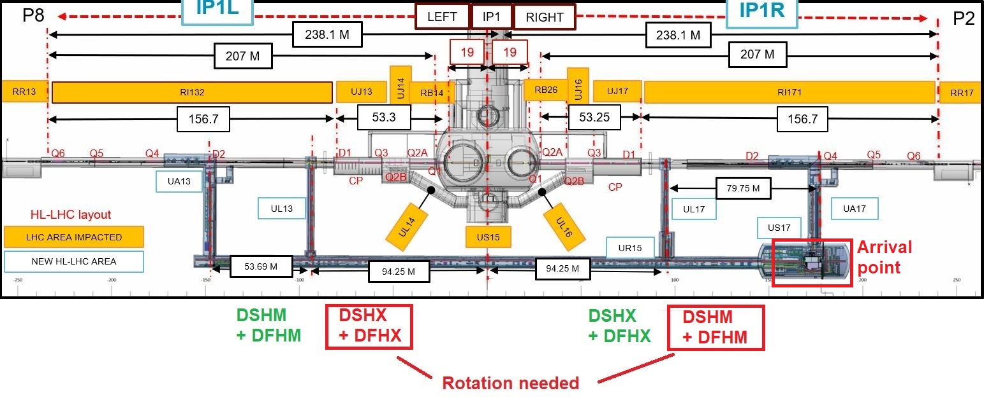
HL-LHC GALLERY OVERVIEW
SEQUENCE TO DISCUSS
WP15 preliminary: 3 4 2 1
(2400939)
WHY NOT : 1 ? 2 ? 3 ? 4 ?

Slide 4
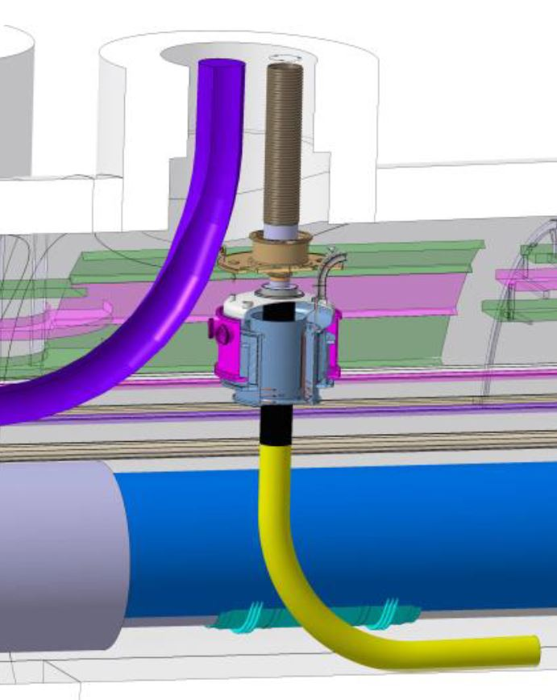
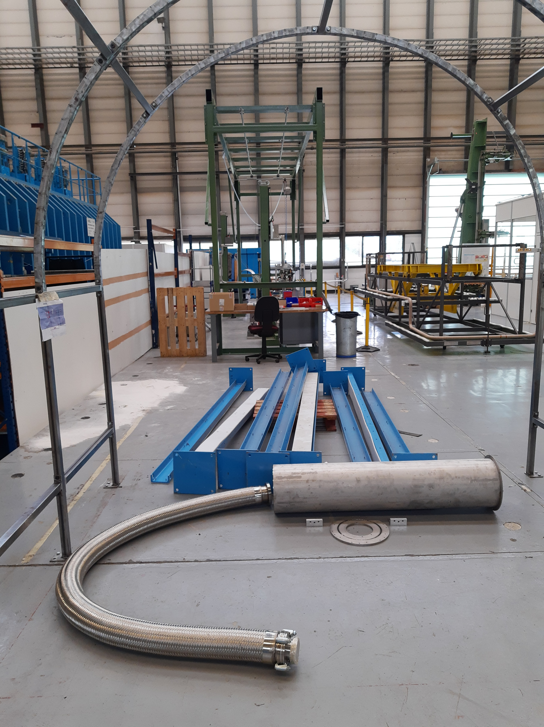
BRAINSTORMING
OPEN POINTS:
Are we sure that M goes first than X ? - STARTING POINT
Installation sequence of DFX in the tunnels … (mock-up plan + DSHm geometry).
- how to remove the security cup of termination inside the core with installed DSHM …

Slide 5
MACHING SECTION
(IF WE MAINTAIN CURRENT PROPOSAL)
GENERAL SEQUENCE
DFHM + DSHM arrives in US cavern. PARALLEL:
Unspooling + rotation (unroller + tractor + cart system). DFM PRE-INSTALLATION
Transport DSHM to core area. SUPPORTS INSTALLATION
Winch operation (termination head rotation). CLAMPS FOR FIXED POINTS
Vertical transport.
DSHM Installation above QXL tray (tray + slide system).
Connection to DFM.
→ DSHX INSERTION
- Wave pattern in LHC tunnel.
- Wave pattern in UL tunnel.
- Insertion into the trenches.
- Wave pattern close to DFH.

Slide 6
Backup slides

Slide 7
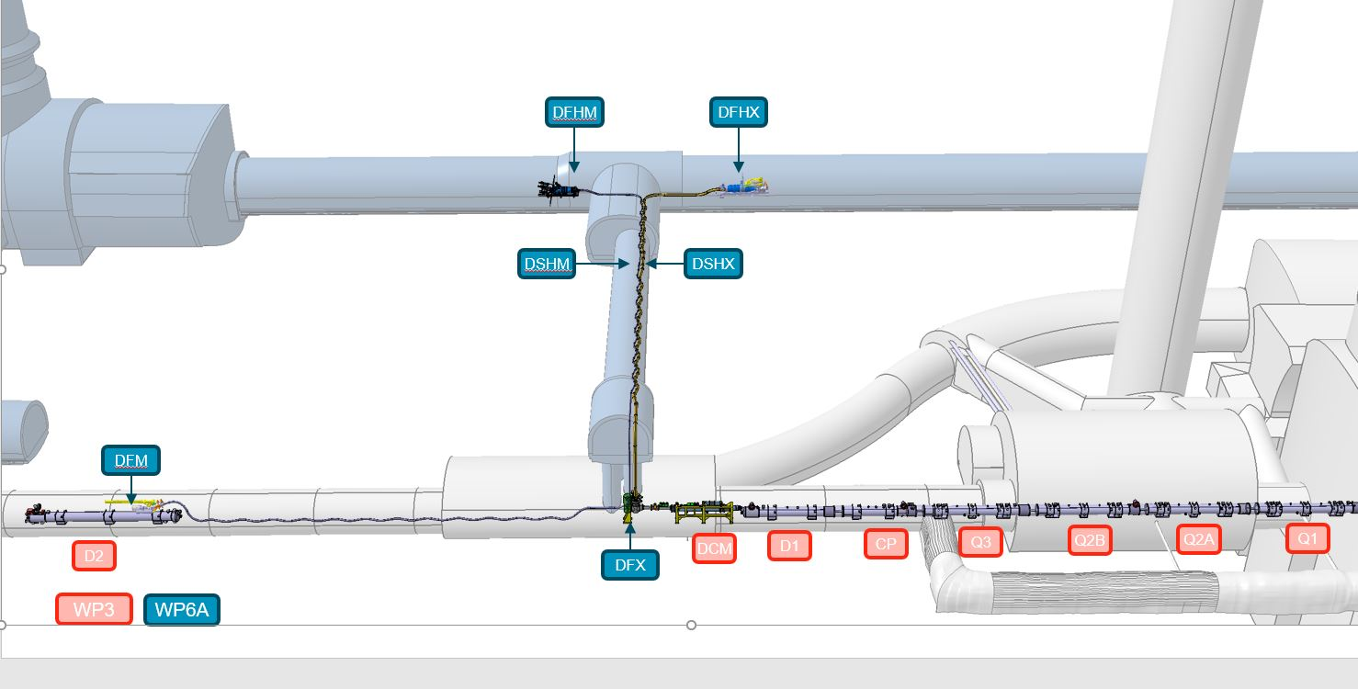
General overview of W6A equipment
IP_R

Slide 8
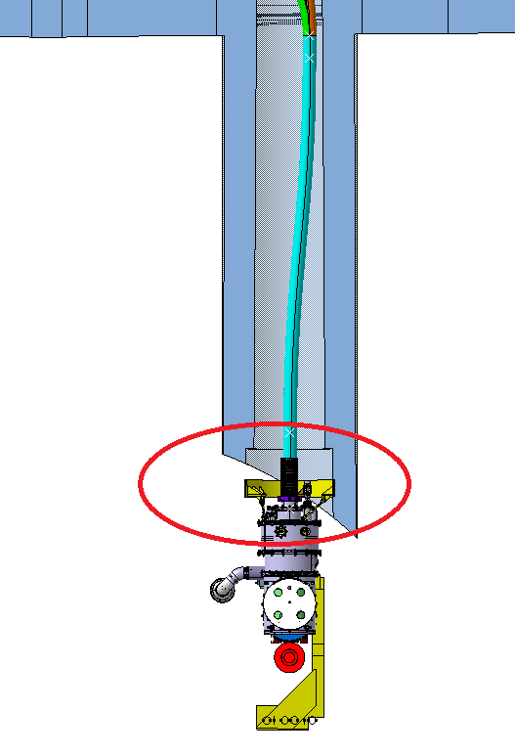
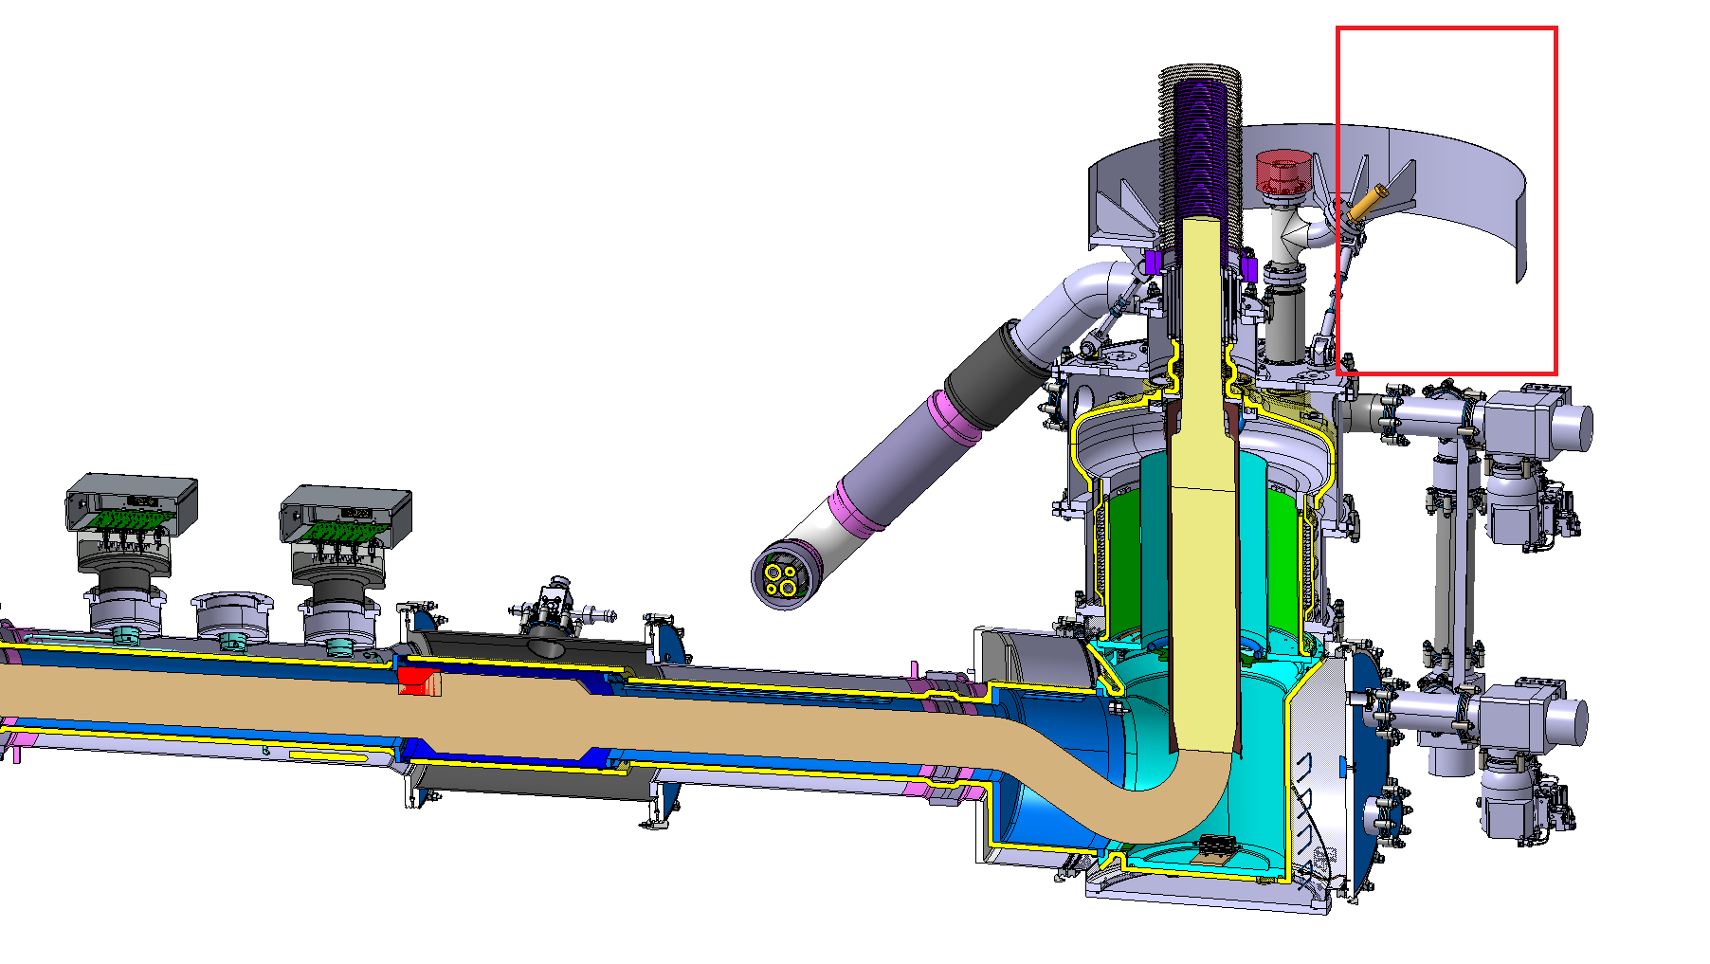
Topic to solve: How to remove protection of DSHX termination when DSHM already installed ?
Updated DFX installation sequence needed.

Slide 9
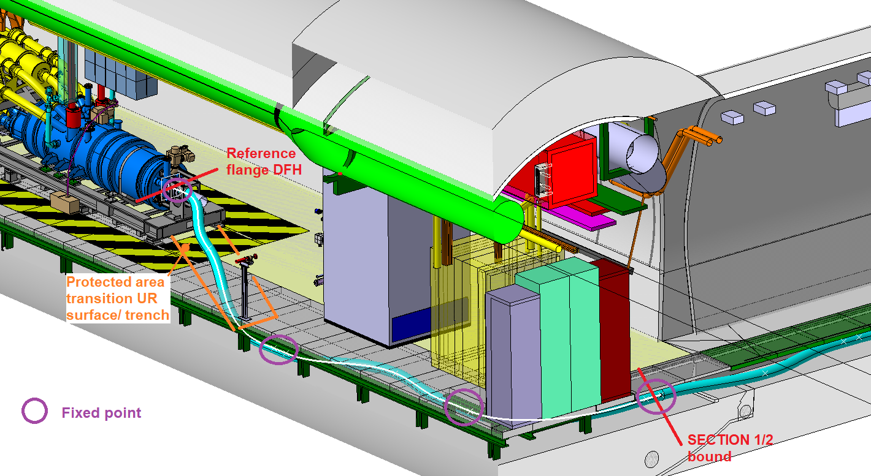
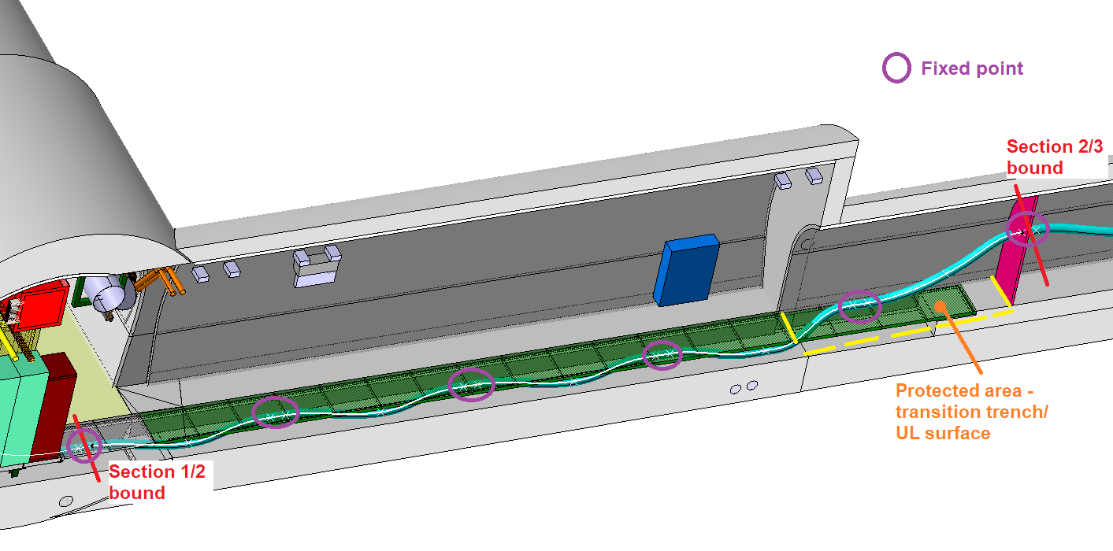
Topic to solve: transition between two levels
(enter/exit from trench)

