Slide 1
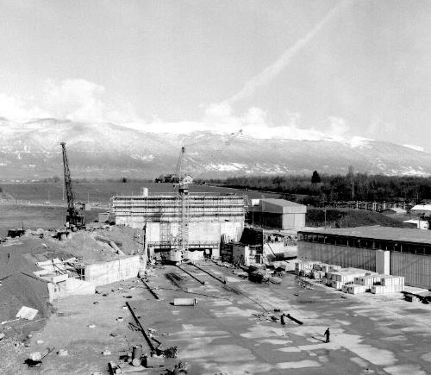
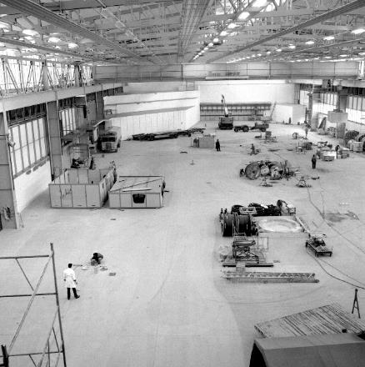
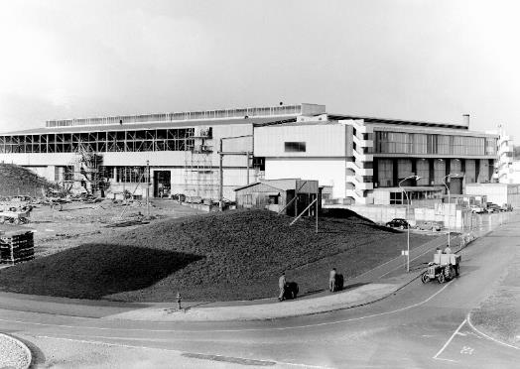

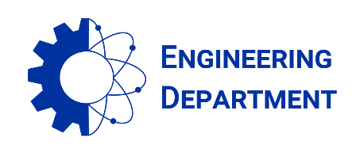
East Area Renovation – EACM report – 06.07.21
East Hall under construction - 1962
B. Rae (BE-EA), on behalf of the project team

Slide 2
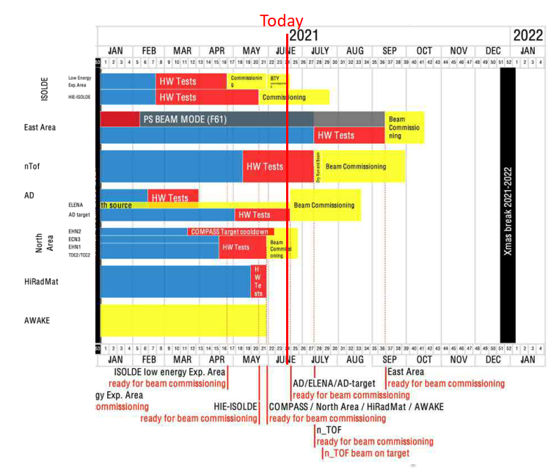
Early restart of T8 approved by IEFC
Initial schedule:
  Ready for beam commissioning : W37
  Physics restart W42
The main change is the early restart of Physics for Irrad and Charm – T8 primary beamline
  Ready for beam commissioning : W34
  Physics restart W38 (on September 20th)
The restart of the secondary beam lines would remain unchanged as from week 42 – on October 18th

Slide 3
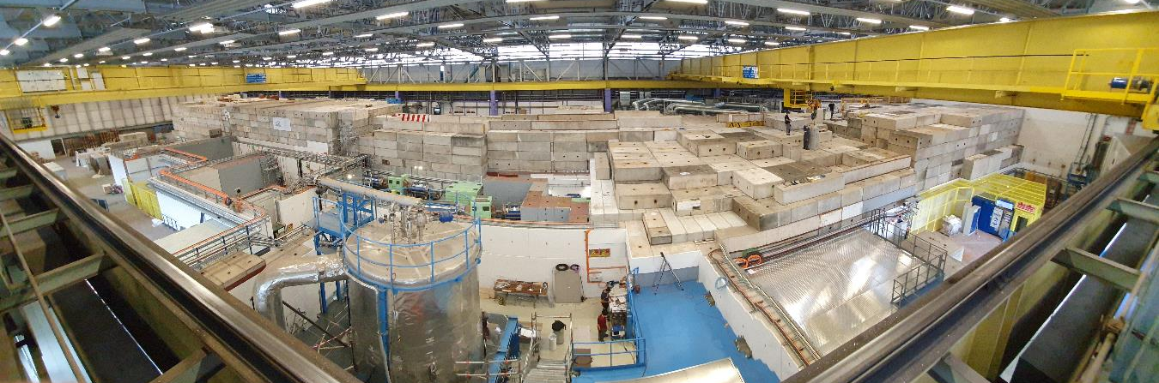
Current situation
T8 will be restarted on September 20th for IRRAD and CHARM
Massive RP shielding ready
Primary area ventilation ready
PAD-MAD in operation
T9, T10 and T11 will be restarted on October 18th for SBA’s
IST’s and HWC in full swing, no showstopper

Slide 4
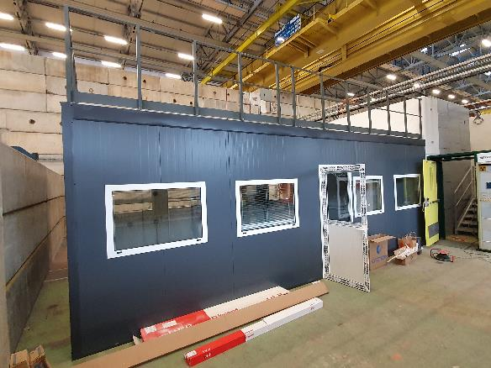
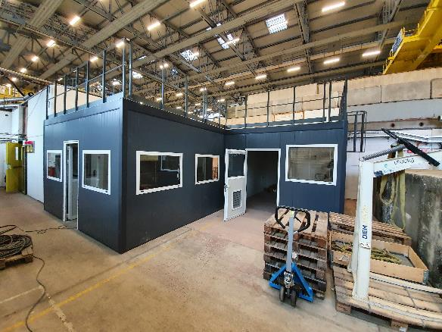
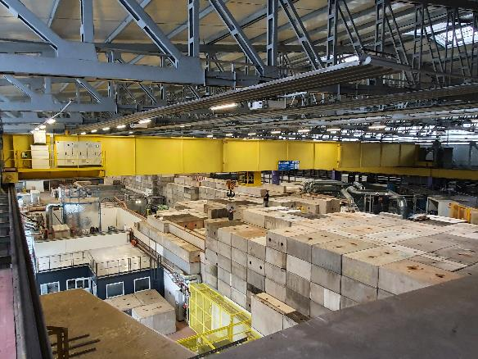
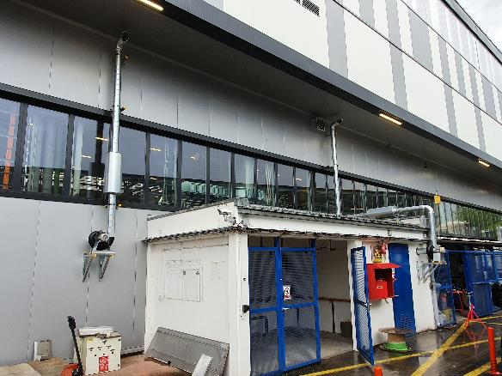
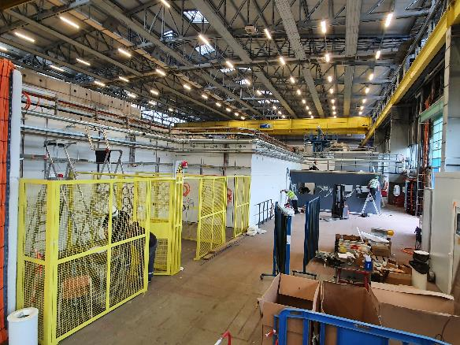
Most recent installation
Control rooms
ATEX ventilation
Gas systems
RP Shielding completion
2 last magnets

Slide 5
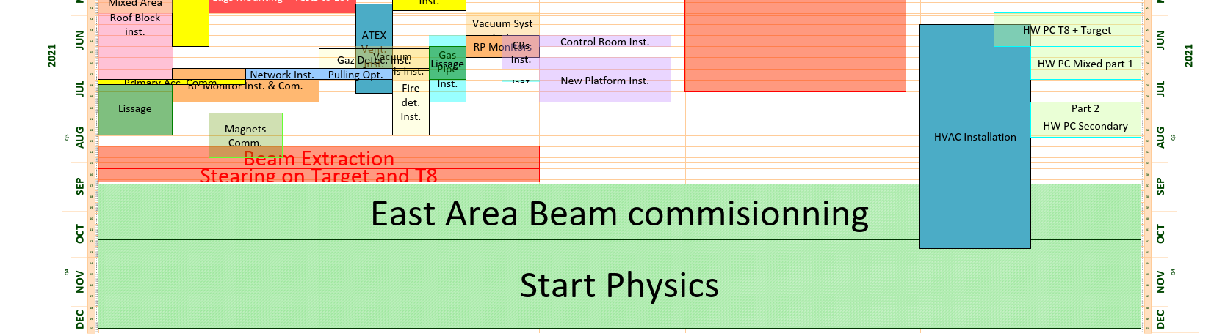
Next steps
Complete ISTs and HWC of T8 beamline
Complete ISTs and HWC of T9, T10, T11 beamline
Coordinate with HSE-RP, BE-OP & BE-EA for the aspects linked to the beam permit for the beam intensity ramp-up
Establish a coordination between IRRAD/CHARM operation team and the EA project/BE-EA physicists

Slide 6

Thanks for your attention !

