Slide 1
Welcome to
http://indico.cern.ch/e/tCSC-autumn-2021
Sebastian Lopienski
CERN School of Computing director

Slide 2


Slide 3
School organization and logistics

Slide 4
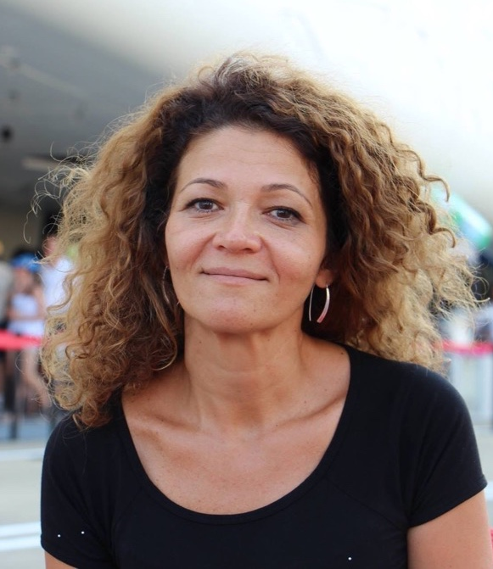
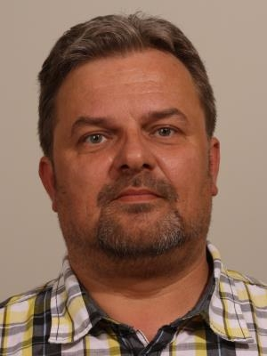
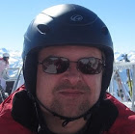
CSC Organizers
Joelma Tolomeo
Administrative Manager
Jarek Polok
Technical Manager
Sebastian Lopienski
Director

Slide 5
COVID-19 measures https://indico.cern.ch/event/1055520/page/23214-covid-19-measures
COVID-free event
  Sanitary pass / COVID certificate must be valid the whole week
  If your pass expires, you will need to take an antigen test:
  Monday, Wednesday and Friday at 8:30 in MEDILS
  Rapid self-test available to everyone, anytime – contact any of the organizers

Slide 6



COVID-19 measures https://indico.cern.ch/event/1055520/page/23214-covid-19-measures
Respect physical distancing
Wear a mask
  lecture room: during direct discussions at the exercise sessions
  food area: while queueing, and getting food and drinks
  in buses, taxis or other shared transport
  in other situations when reasonable (close proximity, indoors etc.)
Disinfect your hands
  food area: before getting the food
  wash your hands often

Slide 7
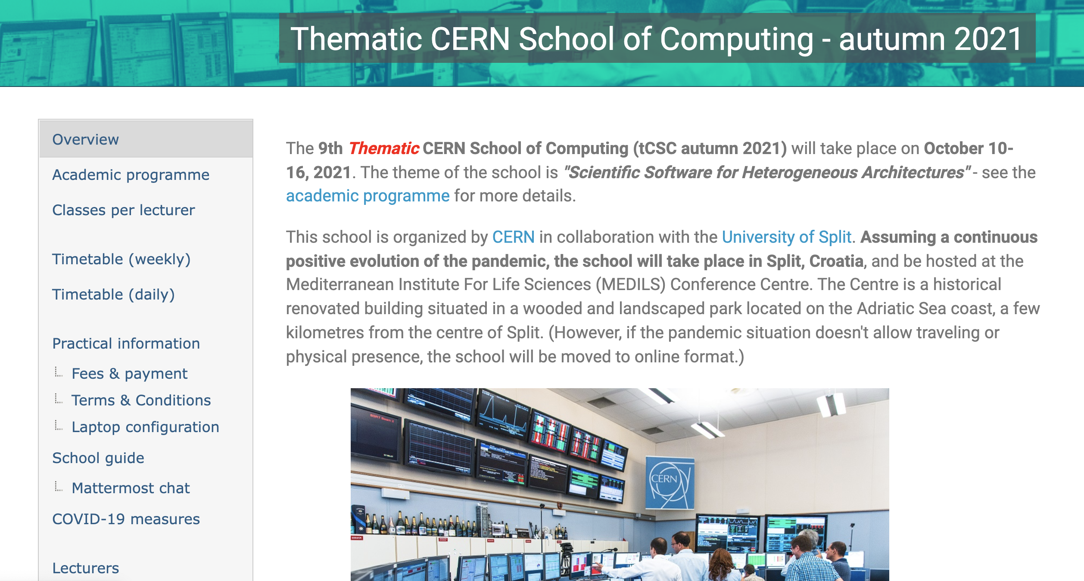
Indico is your friend https://indico.cern.ch/e/tCSC-autumn-2021

Slide 8
Please read the
School guide https://indico.cern.ch/event/1055520/page/23256-school-guide

Slide 9
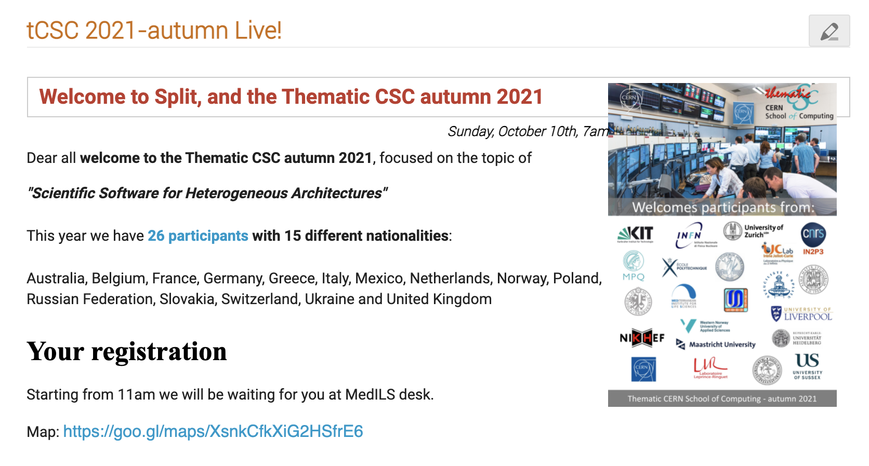
Check the CSC Live page regularly https://indico.cern.ch/event/1055520/page/22803-tcsc-2021-autumn-live

Slide 10
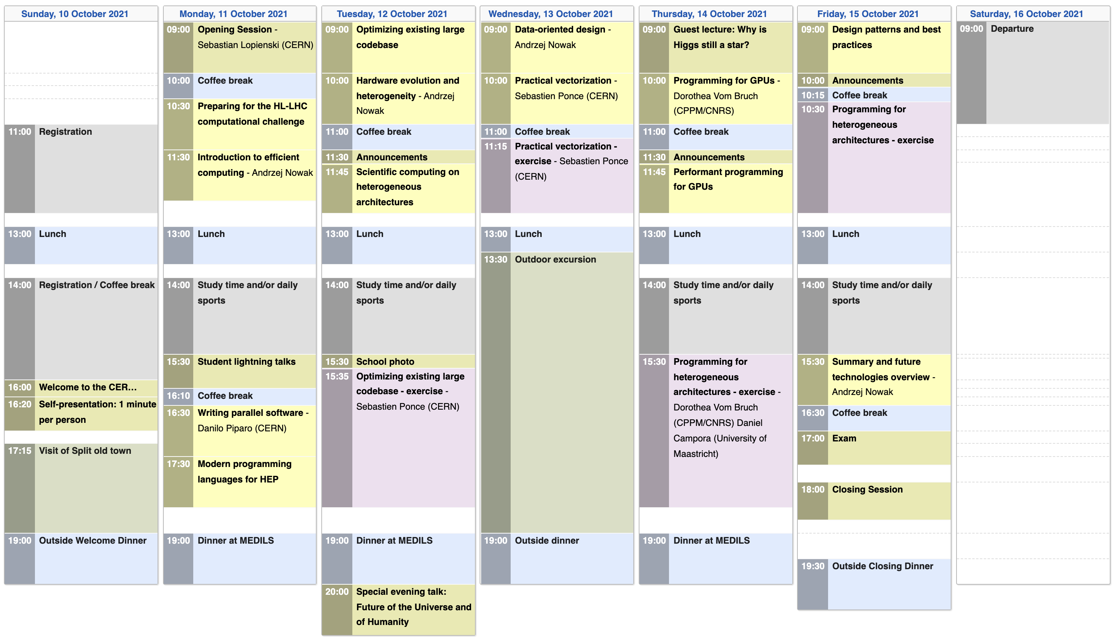
Timetable https://indico.cern.ch/event/1055520/timetable/

Slide 11
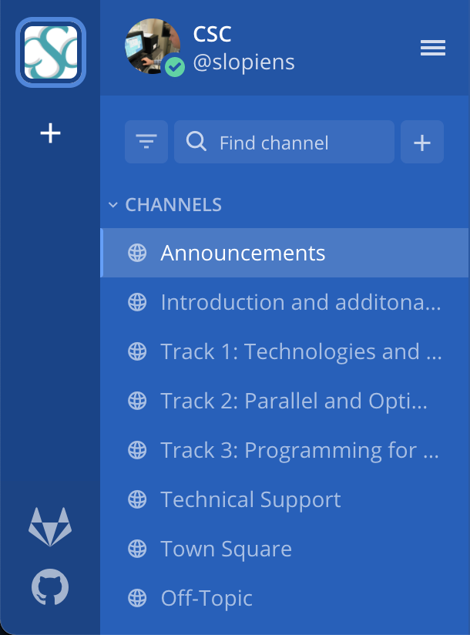
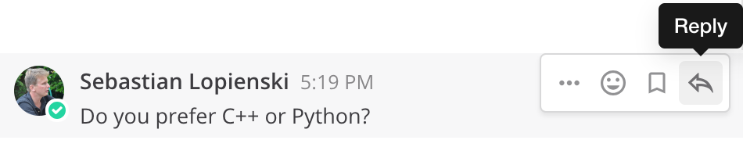
Mattermost is your friend, too https://mattermost.web.cern.ch/csc https://indico.cern.ch/event/1055520/page/23256-school-guide - mattermost
Channels:
A channel for each Track
  to discuss with the speakers and other students
Town square – official communications
Off-topic – any other stuff
(You can create more channels, public or private,
or chat directly with other participants)
Reminder: please use “Reply” button

Slide 12

School booklet
Printed version for those who asked for ot
Electronic version (PDF) Linked from school main page on Indico
(at the bottom)
Contains pictures and short biographies
of all participants

Slide 13

WhatsApp group
Unofficial communication channel
We recommend you to join the group

Slide 14
Participate
CSC Rule #1
Attendance at all lectures and exercises is mandatory
You should attend all meals and coffee breaks
Taking part in social and sports events is optional
  You must let us know whether you participate or not

Slide 15
Be on time
CSC Rule #2
Check what the schedule says:
  “Lecture starts at 9:00” => You must be in the room before 9:00
    Sign the presence sheet beforehand – it will be removed at 9:00
  “The bus leaves at 18:00” => It will leave at 18:00
If you’re late, we won’t wait

Slide 16






Wear your badge
CSC Rule #3

Slide 17
CSC Rule #4
ENJOY AND PROFIT
FROM THE SCHOOL!

Slide 18
Tonight

Slide 19

Tonight (Sunday evening) more on CSC Live page
17:15 buses from MEDILS to the city centre
17:30-19:00 guided walking tour of Split city (have your mark)
19:30 dinner at Bajamonti restaurant
22:00 buses back to MEDILS

Slide 20
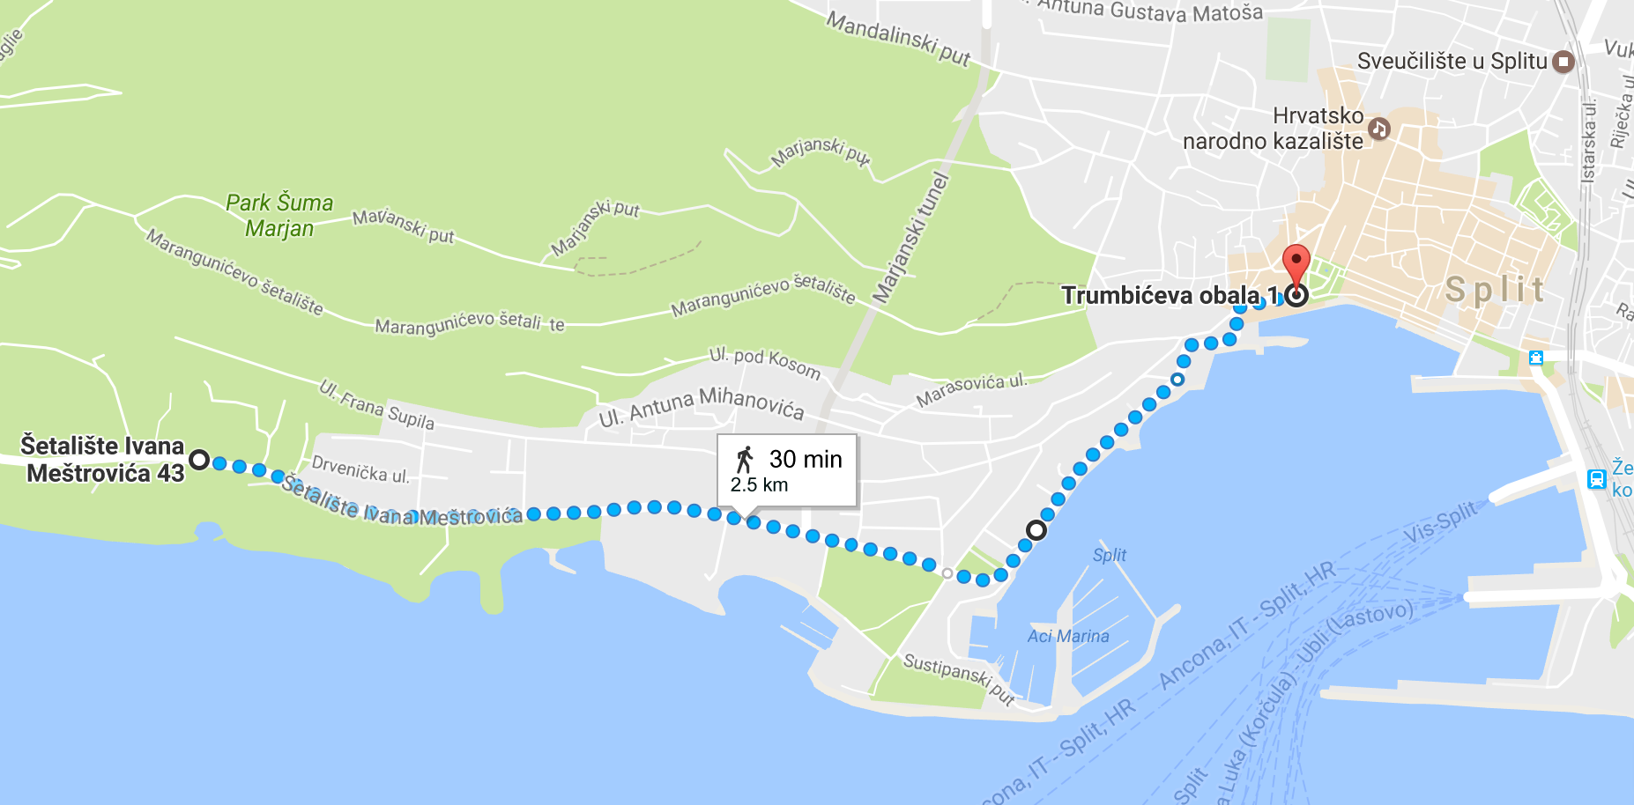
Getting to Split old town
30 minutes walk or 25 HRK Uber / 40 HRK taxi

Slide 21
… and now …
the self-presentation session!

