Slide 1
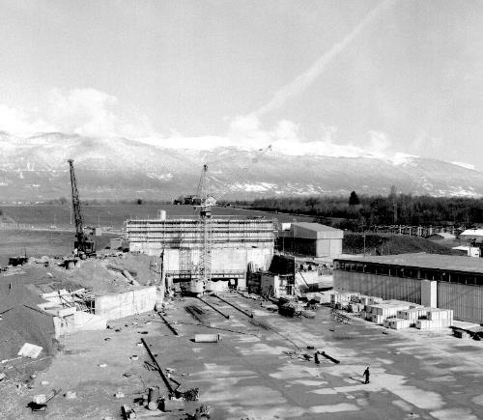
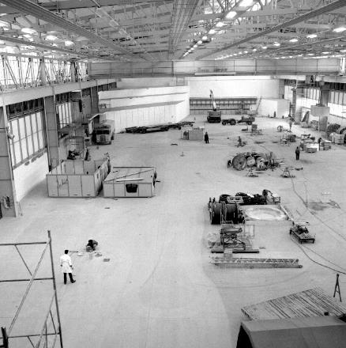
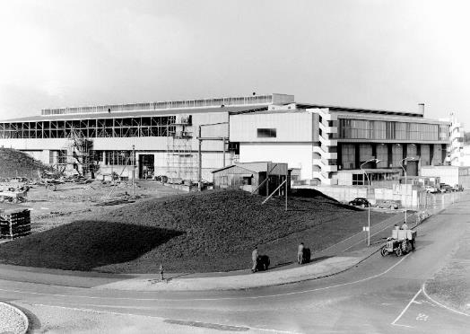

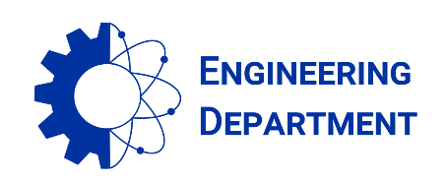
East Area Renovation - News
Project Team #46 on 23.07.2021
East Hall under construction - 1962
S. EVRARD (EN-EA), on behalf of the project team

Slide 2
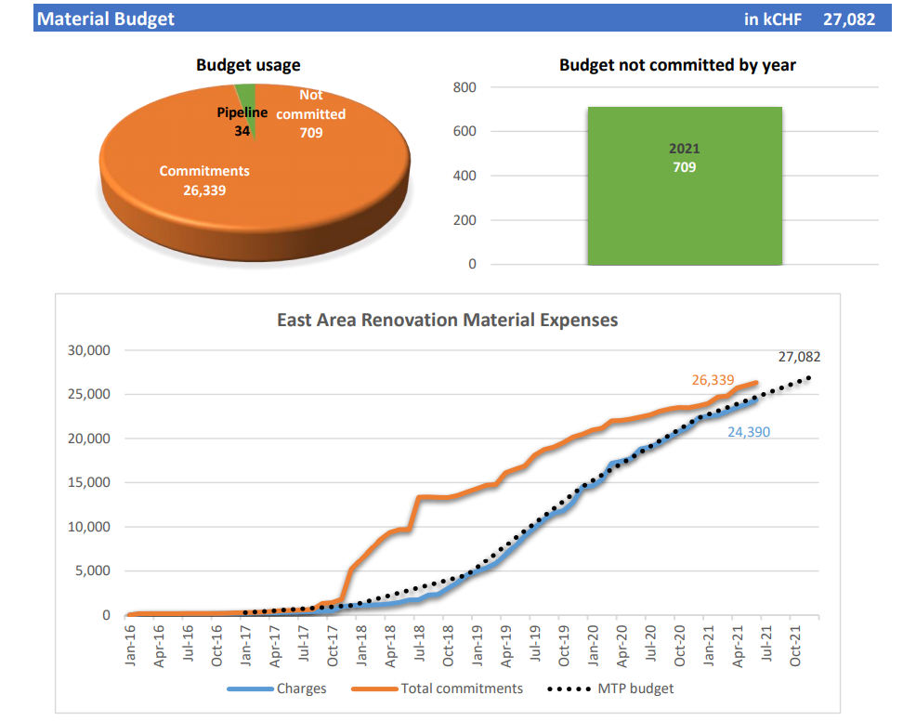

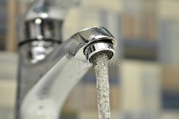
Budget situation on July 1st
Overall material budget: 27.1 MCHF
On July 1st: 97 % committed and 90 % charged
Still 700 kCHF to commit in 2021

Slide 3
Miscellaneous
Project Quality check
  A second inspection has been carried out by the project quality team in the mixted area on June 18th
  https://edms.cern.ch/document/2591498/1
LS2 debriefing day
  Project lessons learned on preparation, execution, deviation handling, tools in view of North Area renovation. EDMS260335
Beam permits → Louis-Frederic’s talk
ISTs and HWC → Filipa’s talk
Beam Commissioning → Denis and Dipamwita’s talks

Slide 4
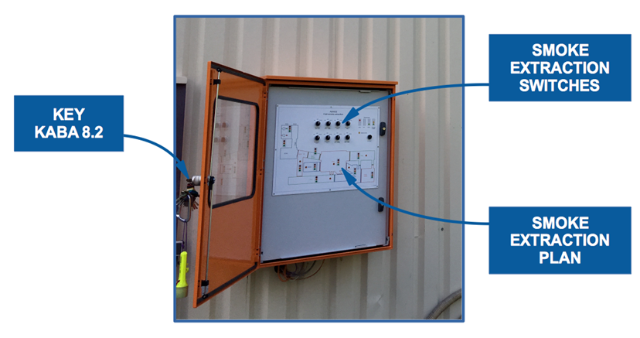
B157 Firemen cubicle
functional schematic
HSE requirements EDMS 1854596
The operation panel shall provide for each smoke extraction zone an individual switch featuring 3 switch positions (AUTO/OFF/DESENFUMAGE) and status signals to account for operation mode and malfunction.
Specific requirements
FRS manual control of 5 ventilations systems:
  Primary area,
  Mixed area,
  ATEX ventilation
  Destratification
  IRRAD/CHARM primary ventilation
Visit on site with SCE Contractor, in operation: deadline end of July
Fire detection
Fire cubicle
Two sectional doors
Design validated
EDMS 2450348 v.1.0
5 ventilations
Command
Skydomes
Status

Slide 5
B157 Firemen cubicle - schedule
Actions | Th 22 | Fr 23 | Mo 26 | Tu 27 | We 28 | Th 29 | Fr 30 | Mo 2 | Tu 3 | We 4 | Th 5 | Fr 6 | Mo9 | Tu 10 | We 11 | Th 12 | Fr 13 | Who
DIC sent to EN-EL |  |  |  |  |  |  |  |  |  |  |  |  |  |  |  |  |  | BE-EA
Electrical drawings |  |  |  |  |  |  |  |  |  |  |  |  |  |  |  |  |  | CCME
Validation drawings |  |  |  |  |  |  |  |  |  |  |  |  |  |  |  |  |  | ALL
Firemen Cab manuf |  |  |  |  |  |  |  |  |  |  |  |  |  |  |  |  |  | CCME
Cable pulling |  |  |  |  |  |  |  |  |  |  |  |  |  |  |  |  |  | EN-EL
Skydome Cab move |  |  |  |  |  |  |  |  |  |  |  |  |  |  |  |  |  | Kingspan
Cable connexion |  |  |  |  |  |  |  |  |  |  |  |  |  |  |  |  |  | CV, AA, ACE
Firemen Cab inst |  |  |  |  |  |  |  |  |  |  |  |  |  |  |  |  |  | CCME
Contractor/CERN tests |  |  |  |  |  |  |  |  |  |  |  |  |  |  |  |  |  | ALL
HSE acceptance |  |  |  |  |  |  |  |  |  |  |  |  |  |  |  |  |  | HSE

Slide 6

Thanks for your attention !

