Slide 1



Secondary Beams Commissioning
East Area
D. Banerjee, J. Bernhard (BE-EA-LE)
23.07.2021

Slide 2
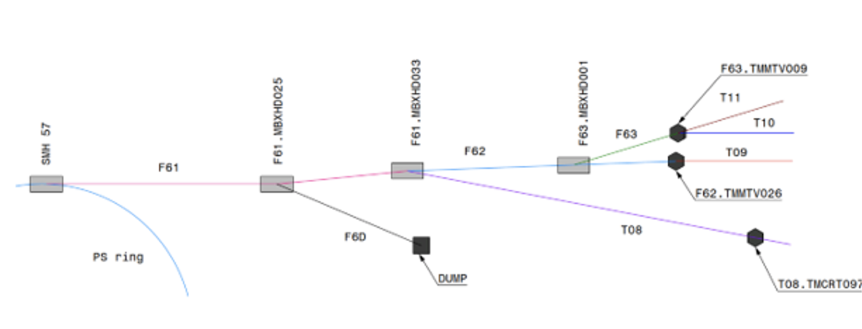
Preparation
The following steps have to be completed to start commissioning:
  Checks for the control of all devices beforehand (CESAR) as well as of beam instrumentation readout.
  Translation of optics to magnet currents and setting-up of configuration files (“beam files”).
  Tests of loading different optic modes (hadron, electron, muon) for the beams.
  Beam permit procedure (including DSO test and check of access system).

Slide 3
Plans for commissioning
After commissioning of primary beams to both targets and signing of the beam permit, commissioning will start with priority on T11, then T09 and T10.
The commissioning itself will start by setting up the beams according to our tuning procedure at the nominal energy for T11, then with highest available energies for T09 and T10 in hadron mode. Extrapolation in steps to the lowest energies will be checked next.
Muon beams in both T09 and T10 and the electron beam in T09 will then be commissioned and the performance of all beam modes will be checked against expectations (i.e. purity, rates, beam spot size, focussing options, different target heads).
If time allows, the low-energy mode with continuous vacuum and removed instrumentation in T09 will be also tested.
A time estimate is usually hard to give as typically in this period issues reveal themselves and need to be solved on the fly. Availability of equipment experts during this time is extremely important.
As soon as everything is commissioned, users can directly start their installation and data taking.

