Slide 1

ECR/Documents for Information and Approval
Silvia Schuh for BE-EA, 2021-07-13

Slide 2
LIST OF DOCUMENTS
Comments before final Approval at next EATM
New Beam Instrumentation for the EA-IRRAD Facility on the T08 Beam line | 2379119 | PSZ-B-EC-0002 v.0.1 | Federico Ravotti

Slide 3
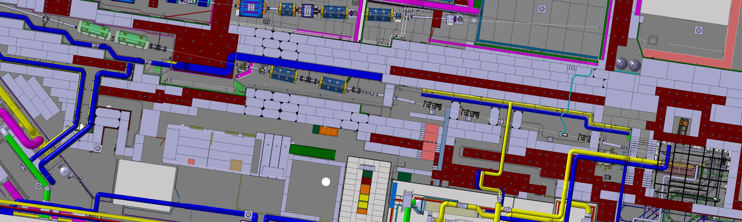
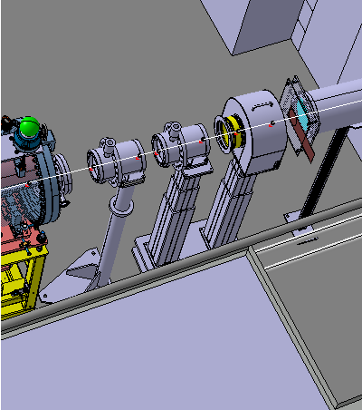
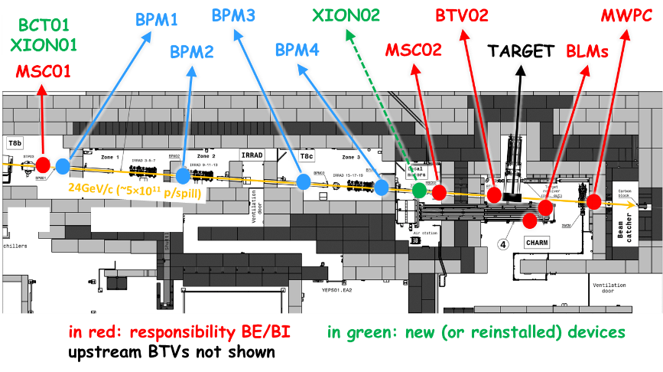
New Beam Instrumentation for the EA-IRRAD Facility on the T08 Beam line
Federico Ravotti
2379119 | PSZ-B-EC-0002 v.0.1
This ECR concerns the upgrade of the beam instrumentation devices on the T08 beamline used for irradiation experiments in EA-IRRAD.
The EA-IRRAD infrastructure in the PS East Area (bld. 157) houses the IRRAD and CHARM facilities, built during the LS1, for proton and mixed-field irradiation experiments, respectively. The layout of the T08 beam line has been modified during LS2, in the framework of the East Area Renovation project, and a set of new beam instruments has been added for EA-IRRAD.
CHARM
T08a
T08b
T08c-IRRAD
A review of the needs and requirements of the T08 beamline beam instrumentation showed that the intensity measurements in the IRRAD/CHARM facility appeared to be difficult. This, in particular when:
operating 24 GeV/c proton beams with low intensity (10⁹-10¹⁰ particles per spill), as required for testing certain types of electronic components or for Radiation Protection studies
operating high-energy heavy ion beams (for which the facility was not specifically designed before LS2)
Improving the beam instrumentation and the intensity measurements in T08 will increase the precision of the dosimetry supplied to the IRRAD/CHARM users during the standard proton operation and will allow the facility to be further developed for heavy ion testing.
BCT01
BPM1
XION01
MSC01
Installation of a new BCT and XION upstream the facility and of the re-installation of the existent XION in between the IRRAD and CHARM. These devices will be mounted on movable telescopic supports.
Seeking comments before final approval at next EATM
NB: current (v0.1), shared cost breakdown being revised.

Slide 4
Thank you!
S. Schuh, EATM Meeting, 2021/06/01

