Slide 1
Summary of NA magnets start-up, issues and outlook for the operation
Philip Schwarz
13.07.2021

Slide 2
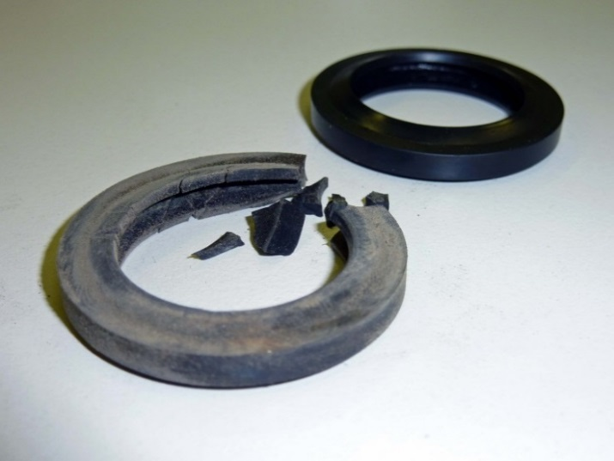
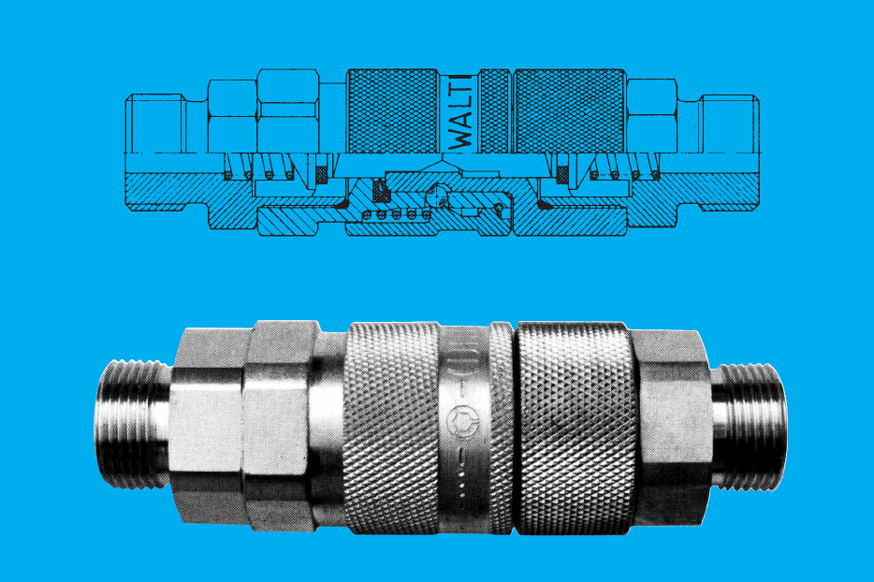
Work performed
TCC2 manifolds replaced to remove gaskets from high radiation area
All other Walther gaskets exchanged as preventive maintenance
Re-configuration of MTR circuits in K12
Certification of 10 magnets for various beamlines (TCC2, PPE144, TT81, TCC8, TT83)
Thermal, polarity and coil-movement inspections executed for all magnets installed in the NA
Walther gaskets in degraded and new condition
Walther quick coupling – gasket location

Slide 3
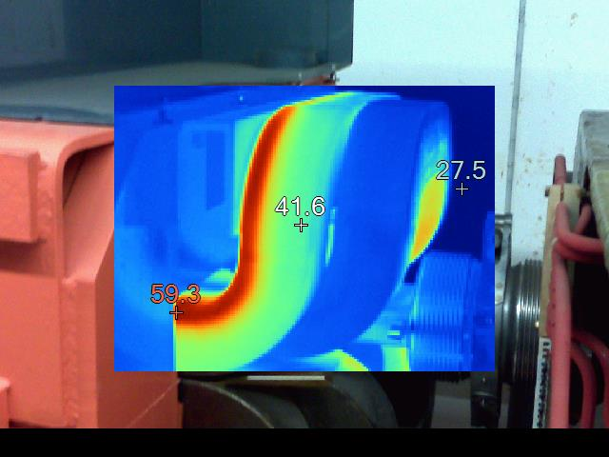
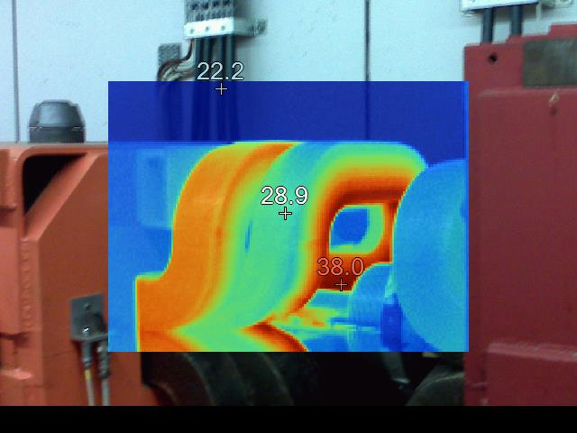
Main problems encountered / resolved
64 Magnets found with moving coils
  39 QNL, 13 MBN, 9 QTA, 1 QTS, MDN & QTL
  All were shimmed during LS2
Overheating of MSN.043022
Two congested filters
Two MBNs with blocked circuits
Few interlock problems
  Loose cables / pins, creating bad contacts
Few overheating magnets due to closed valves
  Please always call TE-MSC before you close a valve connected to a magnet

Slide 4
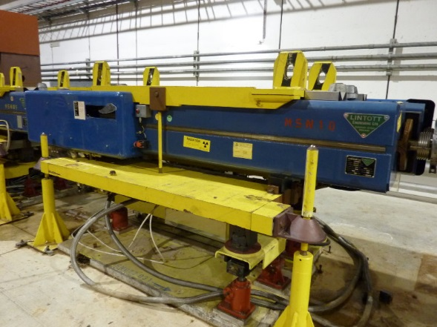
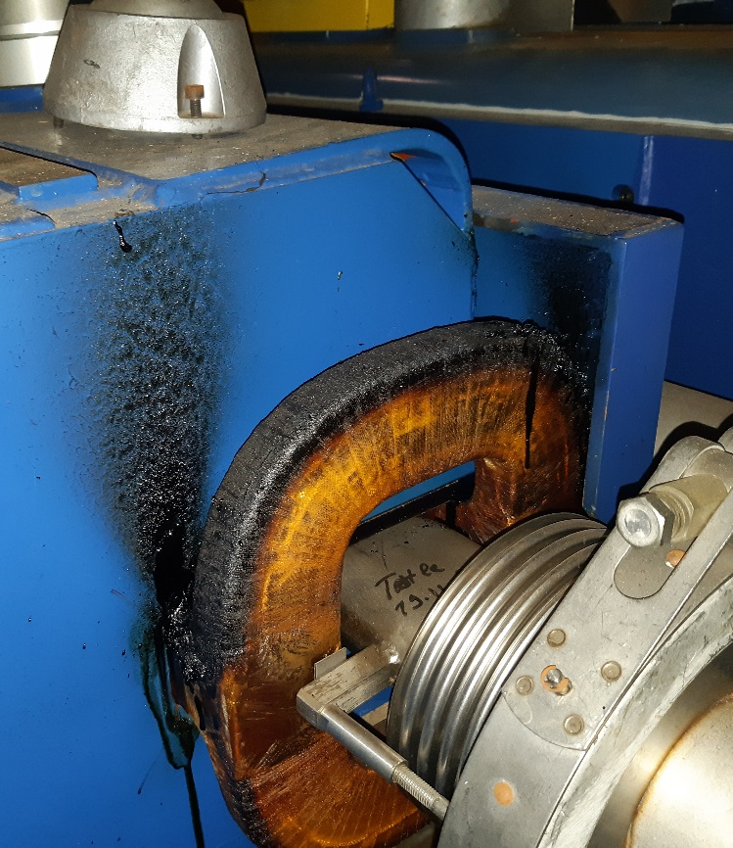
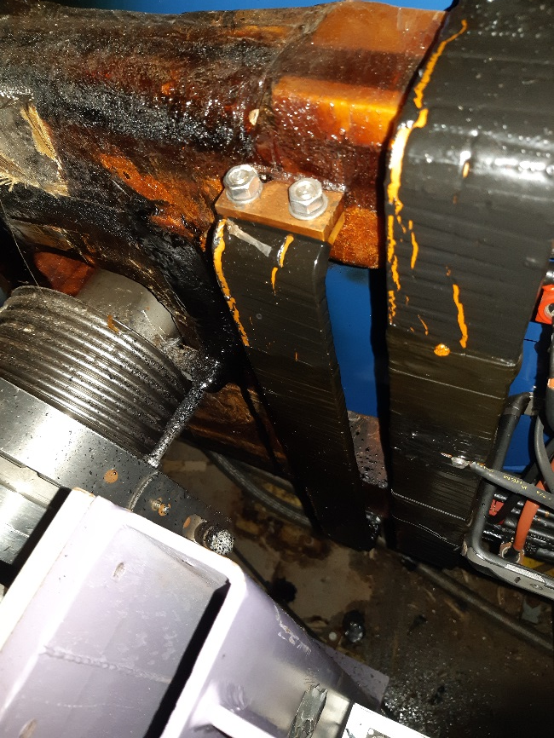
MSN.043022 overheating
MSNH.043022 found with an overheated coil
Preliminary analysis showed:
  After the incident, the magnet was found with a reduced water flow in comparison to the other MSNs in the area
  The most likely cause seems to be reduced/no water flow in some turns of the magnet
  The magnet is not equipped to detect the total absence of cooling flow in one of its circuits due to the position of the thermal-switches
  The magnet was exchanged and the damaged magnet is in 954, showing a dose rate at contact of ~2 mSv / h, so further inspections were not executed yet

Slide 5
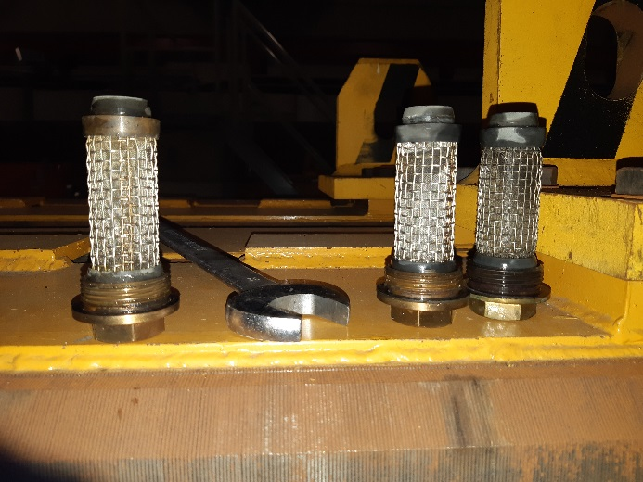
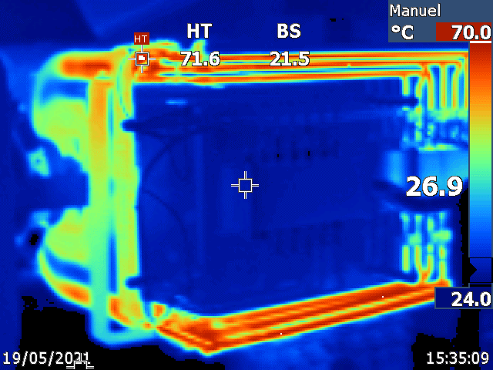
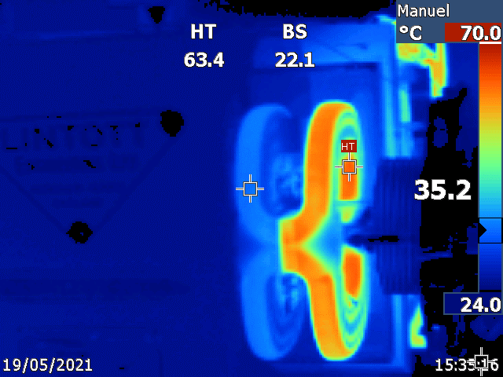
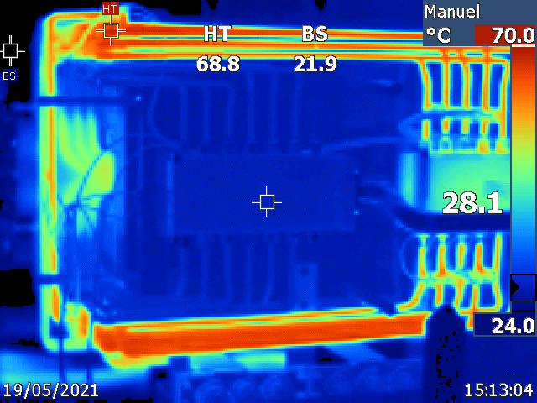
Performed actions on MSNs
Visual inspection revealed no other magnet with signs of overheating / degrading coils
All filters were inspected and exchanged, none of them showing signs of blockage
Verification of water-flow
Installation of additional flow detectors and thermo-switches
Thermal inspection in collaboration with TE-EPC, successfully testing them at 900A RMS

Slide 6
Summary
All NA magnets should be ready for operation
  Preventative maintenance was executed
  All of them were successfully tested
Very tight schedule due to resources being used for other machines beforehand
Possible improvements:
  Longer time between the closure of the main accelerator chain and the restart of the NA
  Reserve some time at the end of the schedule for converter / magnet tests, without accesses during or afterwards (would avoid closed valves and ease up restart)
Contacts:
  https://norma-doc.web.cern.ch/piquet/contacts.html

