Slide 1
Superconducting RF at CERN: overview
Walter Venturini Delsolaro,
on behalf of the CERN SRF community
PBC technology mini workshop: superconducting RF, Tuesday 21 Sep 2021, CERN

Slide 2
Outline
SRF in todays (and future) CERN accelerators
  LHC
  HIE ISOLDE
  HL-LHC
  FCC
SRF infrastructure
R&D
Caveat: I will not be able to cover all CERN SRF in 15 minutes

Slide 3
The SRF community at CERN…
Group photo at the TTC workshop, CERN, 2020

Slide 4
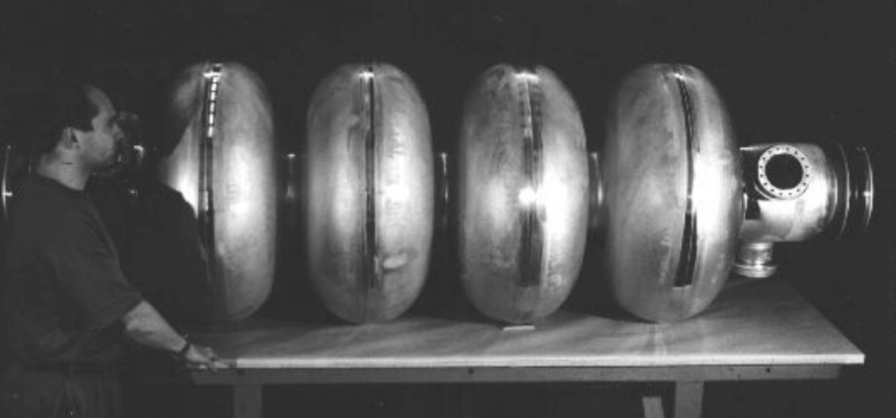
Standing on the shoulders of giants
LEP2 cavity

Slide 5
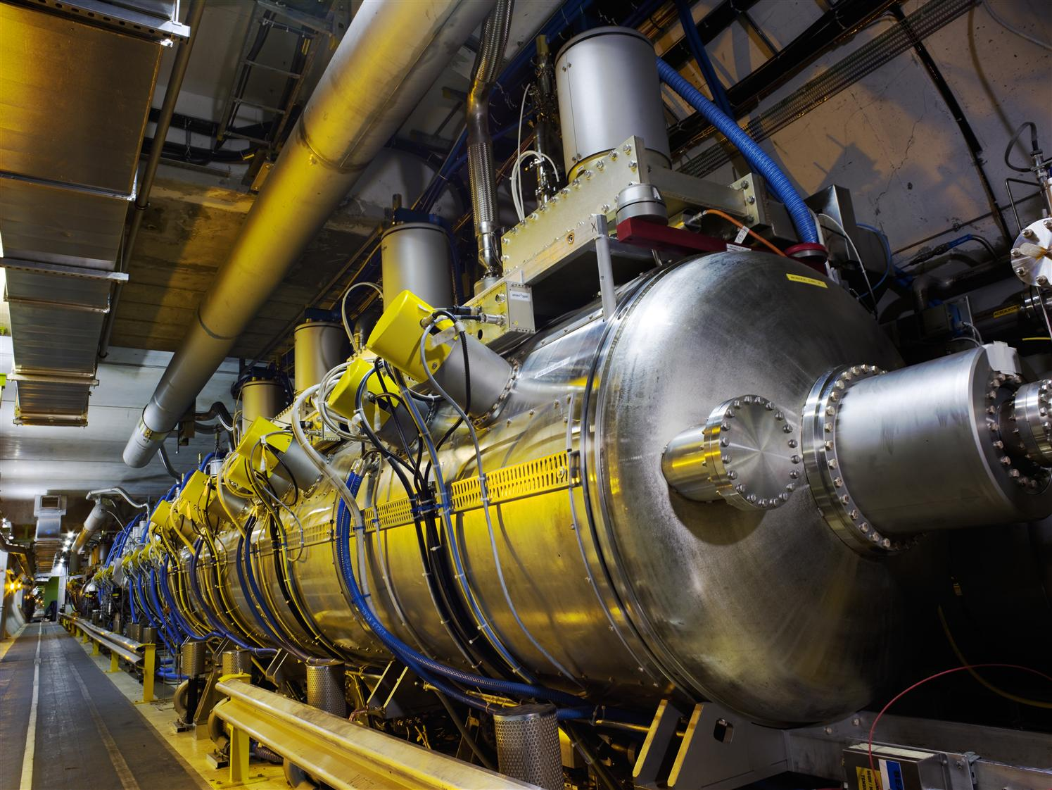
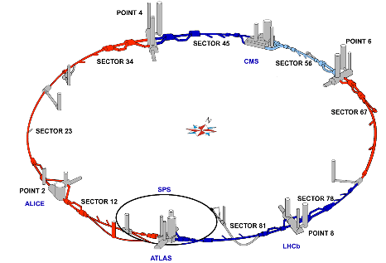
LHC accelerating systems

Slide 6
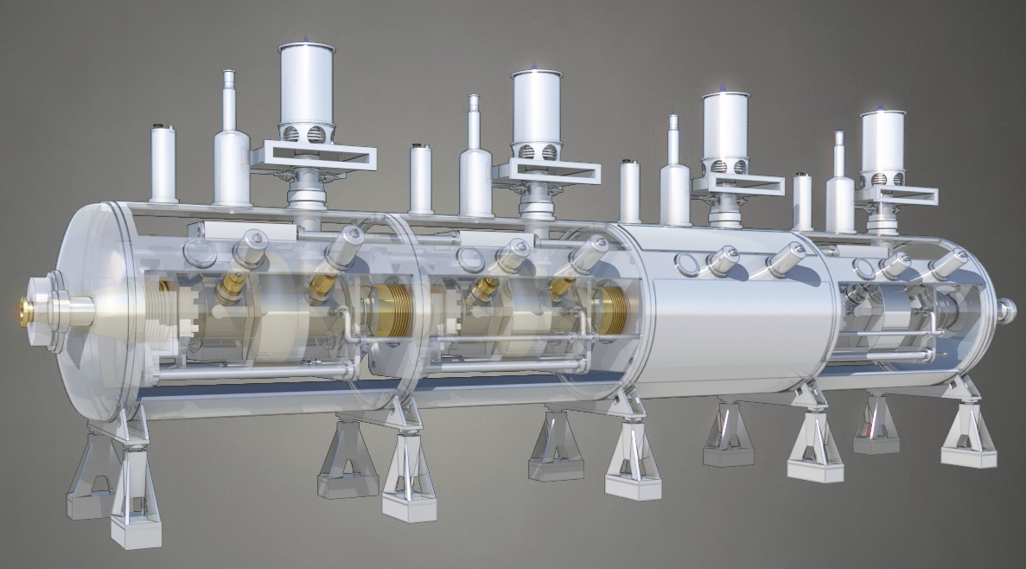
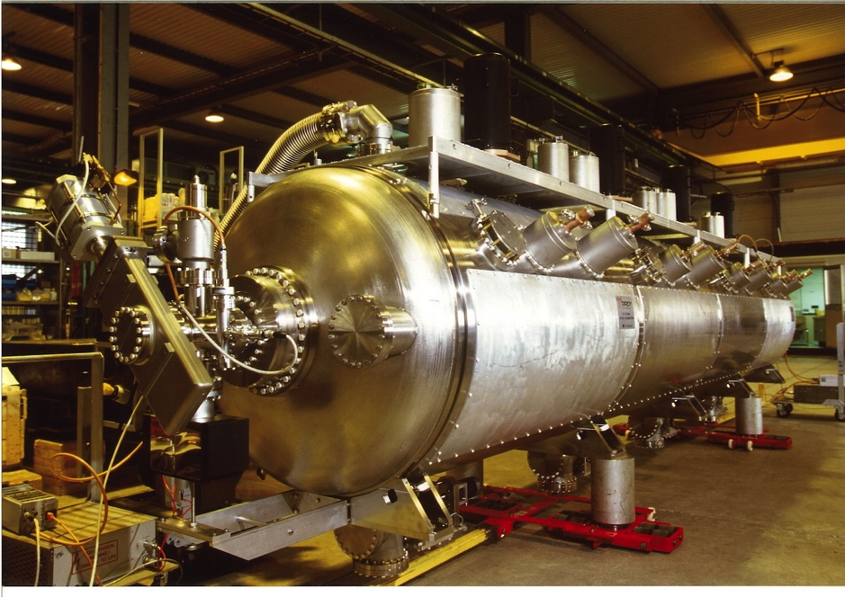
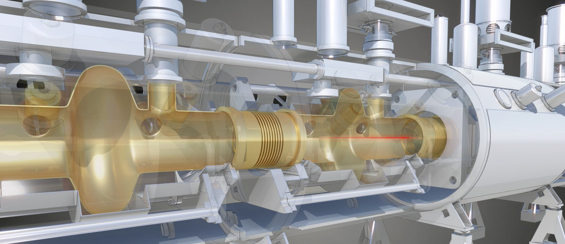
LHC RF Cryomodule
4 cryomodules of 4 cavities
Nb-coated Cu-cavities operating at 4.5 K
8 - 16 MV/beam
400.790 MHz + - 100kHz
1 spare module
1 spare dressed cavity

Slide 7
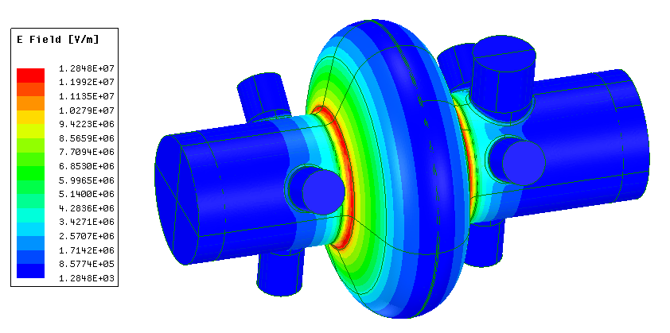
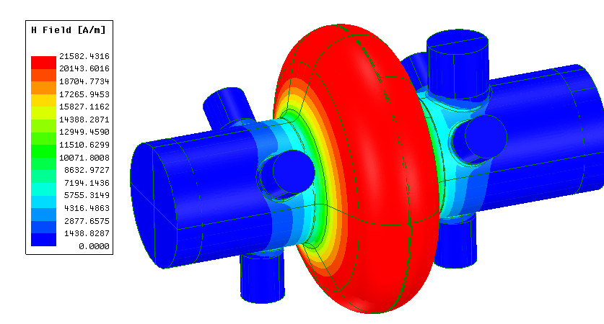
LHC ACS cavity (1/2)
Parameters | Value
Frequency [MHz] | 400.79
Operating temperature [K] | 4.5
Nominal Accelerating Voltage V_{acc} = (E_{acc} x L_{acc}) [MV] | 2
Accelerating length L_{acc} = (n_{cell}.β.λ/2) [m] with β = 1 | 0.374
Accelerating gradient E_{acc} [MV/m] | 5.33
Linac r/Q [Ω] at β=1 | 85.3
Circuit r/Q [Ω] at β=1 | 42.7
G [Ω] | 256.9
Q₀ at operating temperature for R_{BCS}=36.4 nΩ∗ | 7.10⁹
Q₀ at nominal gradient | > 2.10⁹
Cavity dynamic RF heat load [W] | 23.4
E_{pk}/E_{acc} at β=1 | 2.4
B_{pk}/E_{acc} [mT/(MV/m)] at β=1 | 5.08
Max. surface field E_{pk} [MV/m] | 12.85
Max. surface magnetic field B_{pk} [mT] | 27.11
Stored energy [J] at nominal E_{acc} and β=1 | 18.5
Qext | 2 to 6.10⁴
RF power [kW] | 300
0.58 A protons
CW operation
* : Average values from measurements of LHC cavities in the 90’s, and post-processed by A. Miyazaki (presented at the CERN SRF2018 workshop)
F. Peauger

Slide 8
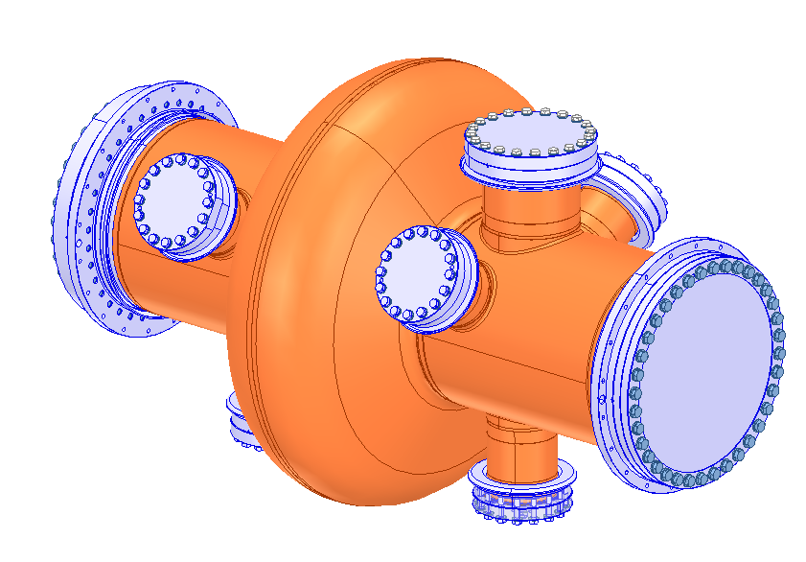
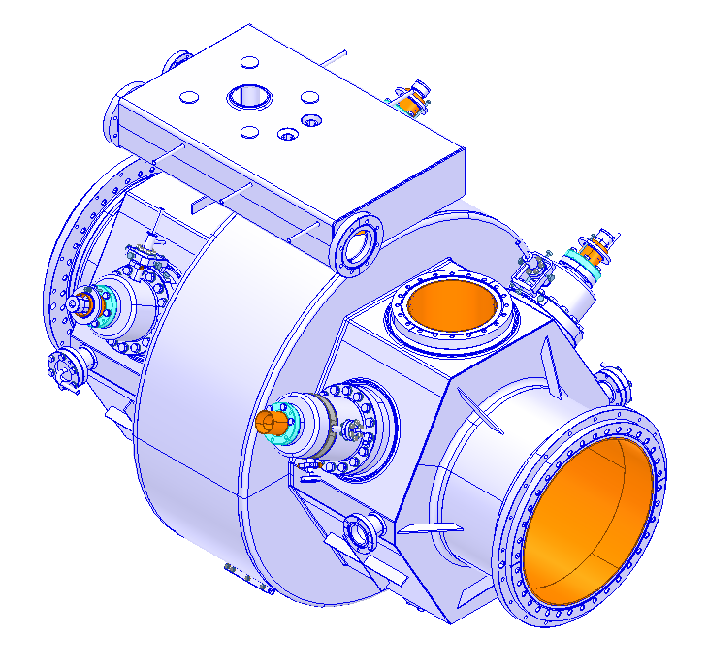
LHC ACS cavity (2/2)
Nb/Cu cavity
Conduction cooling through copper substrate
OFE copper plate shaped by deep drawing or spinning
Electron beam welding and vacuum brazing (flanges)
Stainless steel flanges and helium tank (no bellows)
1 variable FPC
4 x HOM couplers
3 pick-up antenna (2 spares)
Parameters | Value
Cavity thickness [mm] | 2.5
Beam aperture [mm] | 300
Cavity stiffness [kN/mm] | 20
Tuning sensitivity [kHz/mm] | 240
Pressure sensitivity* [Hz/mbar] | -60
Lorentz Force detuning* [Hz/(MV/m)²] | -12.6
Welds
* : measured on bare cavity in vertical test

Slide 9
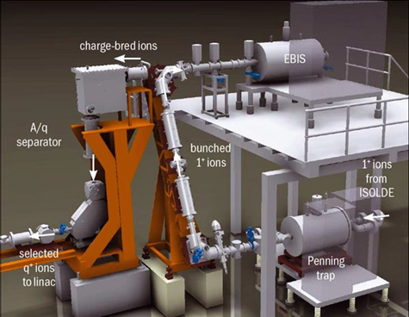
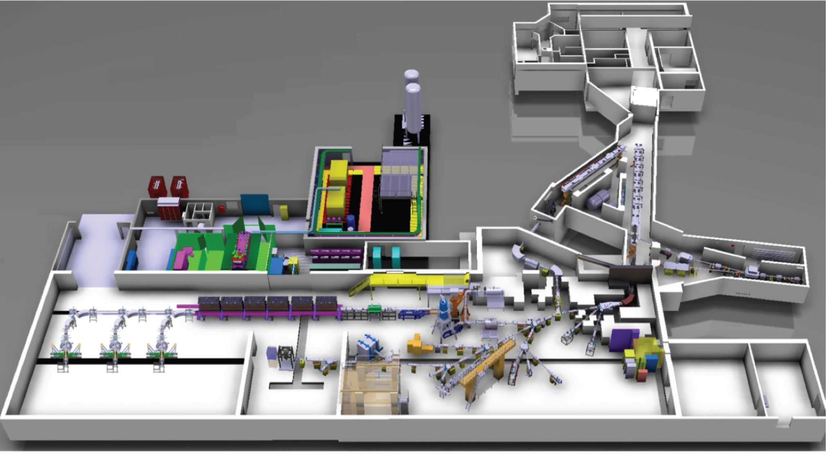
ISOLDE COMPLEX:
Radioactive Ion Beams (RIBs) are produced when the protons impact in one of the two targets in the facility
The RIB of interest is selected in one of the separator lines (GPS, HRS) and transported to a low energy experimental station to be studied
Alternatively, the RIB can be accelerated after it is accumulated and transversely cooled in the REX-TRAP and charge bred in the REX-EBIS
Target
HRS
Target
HIE Linac
REXEBIS
HEBT
REX
BTY
REXTRAP
GPS
SCATTERING
CHAMBER
MINIBALL
Jose Alberto Rodriguez – CERN SRF Workshop – Dec. 1st 2016

Slide 10
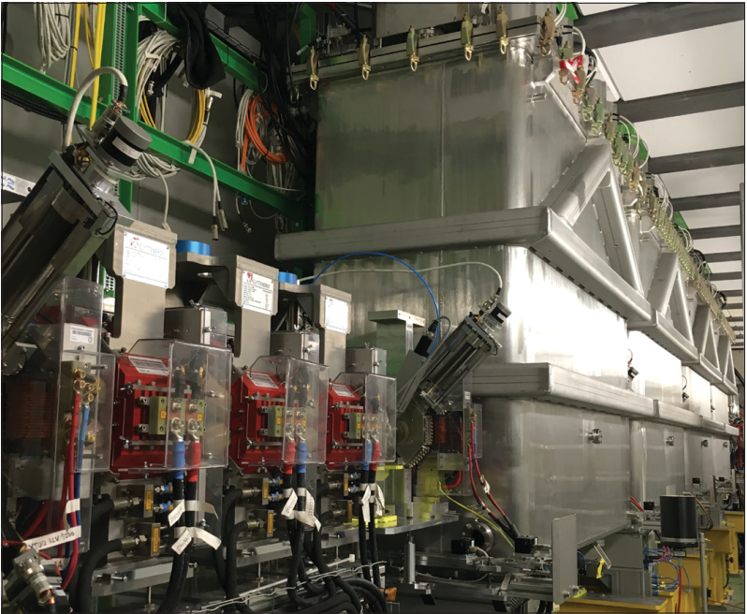
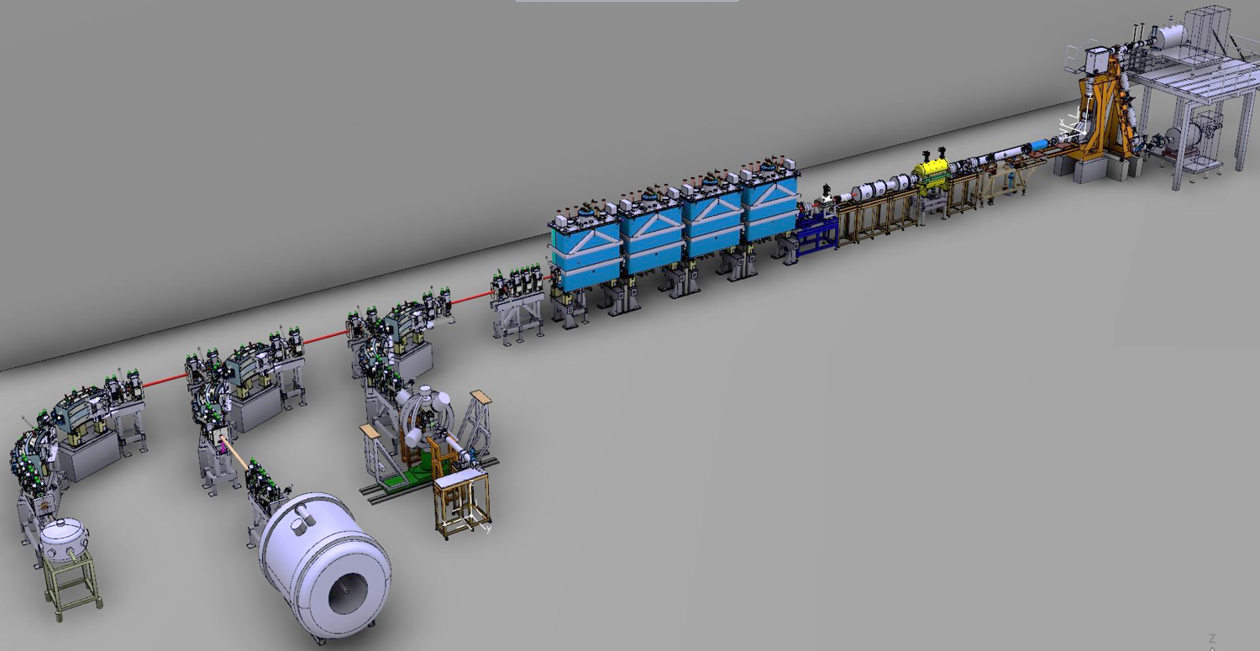


HIE ISOLDE post accelerator
XT01
XT02
Miniball
XT03
Scattering chamber (SEC)
ISOLDE Solenoidal Spectrometer (ISS)

Slide 11
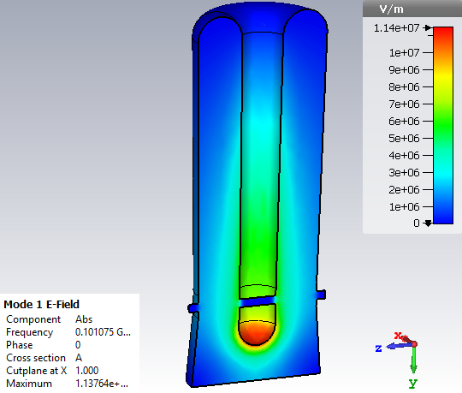
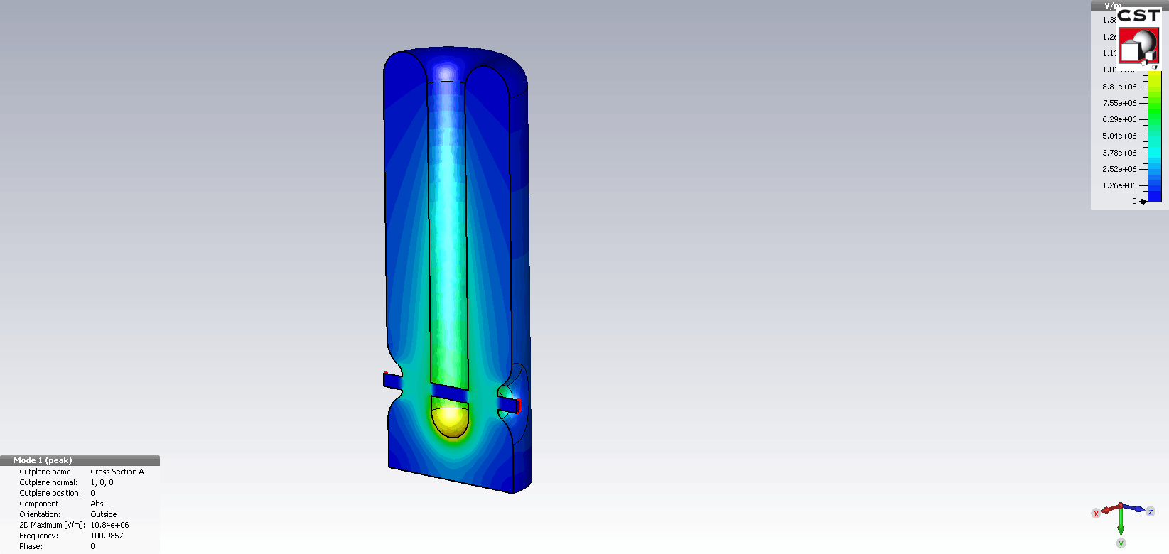
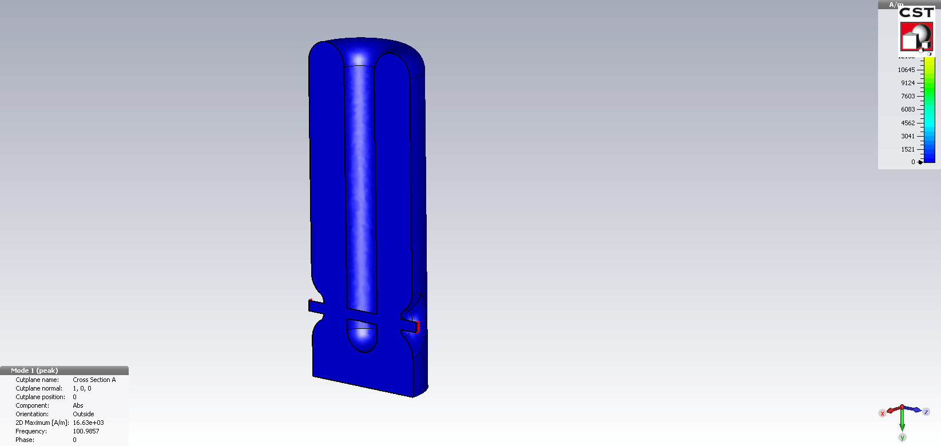
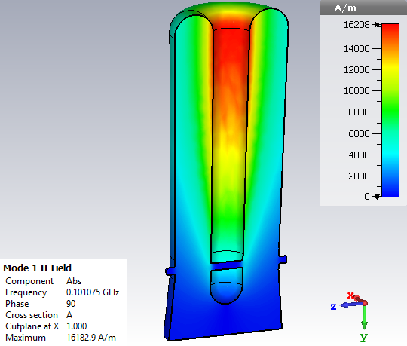
HIE ISOLDE accelerating cavity
Acceleration of heavy ions (A/q=4.5)
Very low beam current
CW operation
QS
QSS
Parameters | QS | QSS
Frequency [MHz] | 101.28
Operating temperature [K] | 4.5
βopt | 0.109 | 0.122
Accelerating gradient E_{acc} [MV/m] | 6 | 6
r/Q [Ω] at βopt | 553 | 502
G [Ω] | 30.3 | 30.1
U/E_{acc}² [J/(MV/m)²] | 0.207 | 0.214
Q₀ at nominal gradient and 10W losses | 4.7e8 | 4.9e8
Cavity dynamic RF heat load for R_{S}=50nΩ [W] | 7.7 | 7.9
E_{pk}/E_{acc} | 5 | 5.3
B_{pk}/E_{acc} [mT/(MV/m)] | 9.6 | 9.3
Max. surface field E_{pk} [MV/m] | 30 | 31.8
Max. surface magnetic field Bpk [mT] | 57.6 | 55.8
Stored energy [J] at nominal E_{acc} | 7.45 | 7.7
E-field
H-field

Slide 12
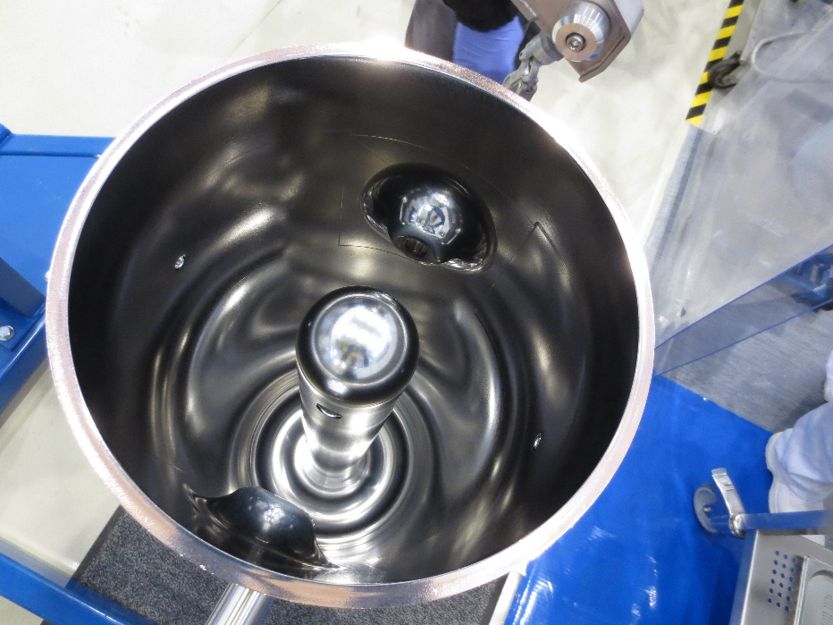
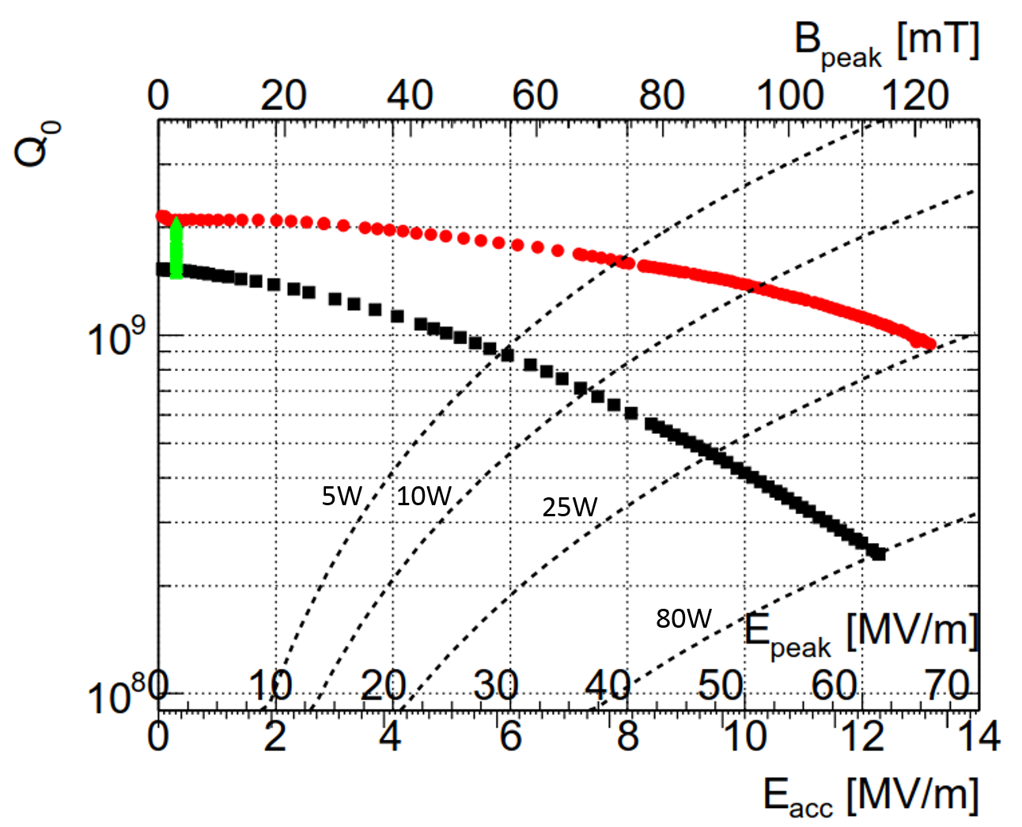
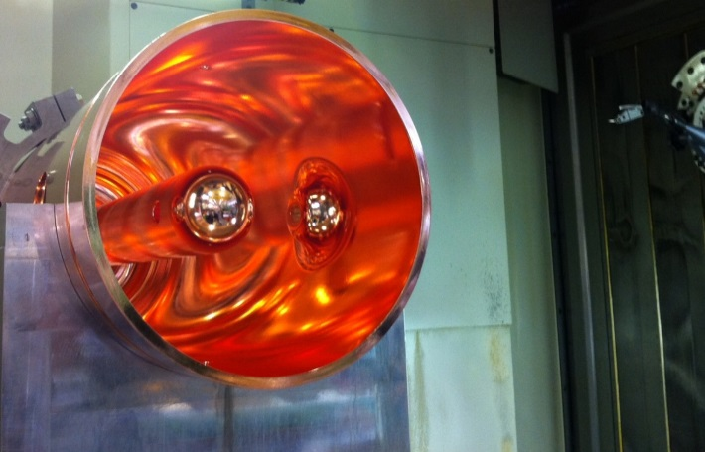
HIE ISOLDE cavity
World record surface fields for Nb/Cu!
2.5 K
4.6 K

Slide 13
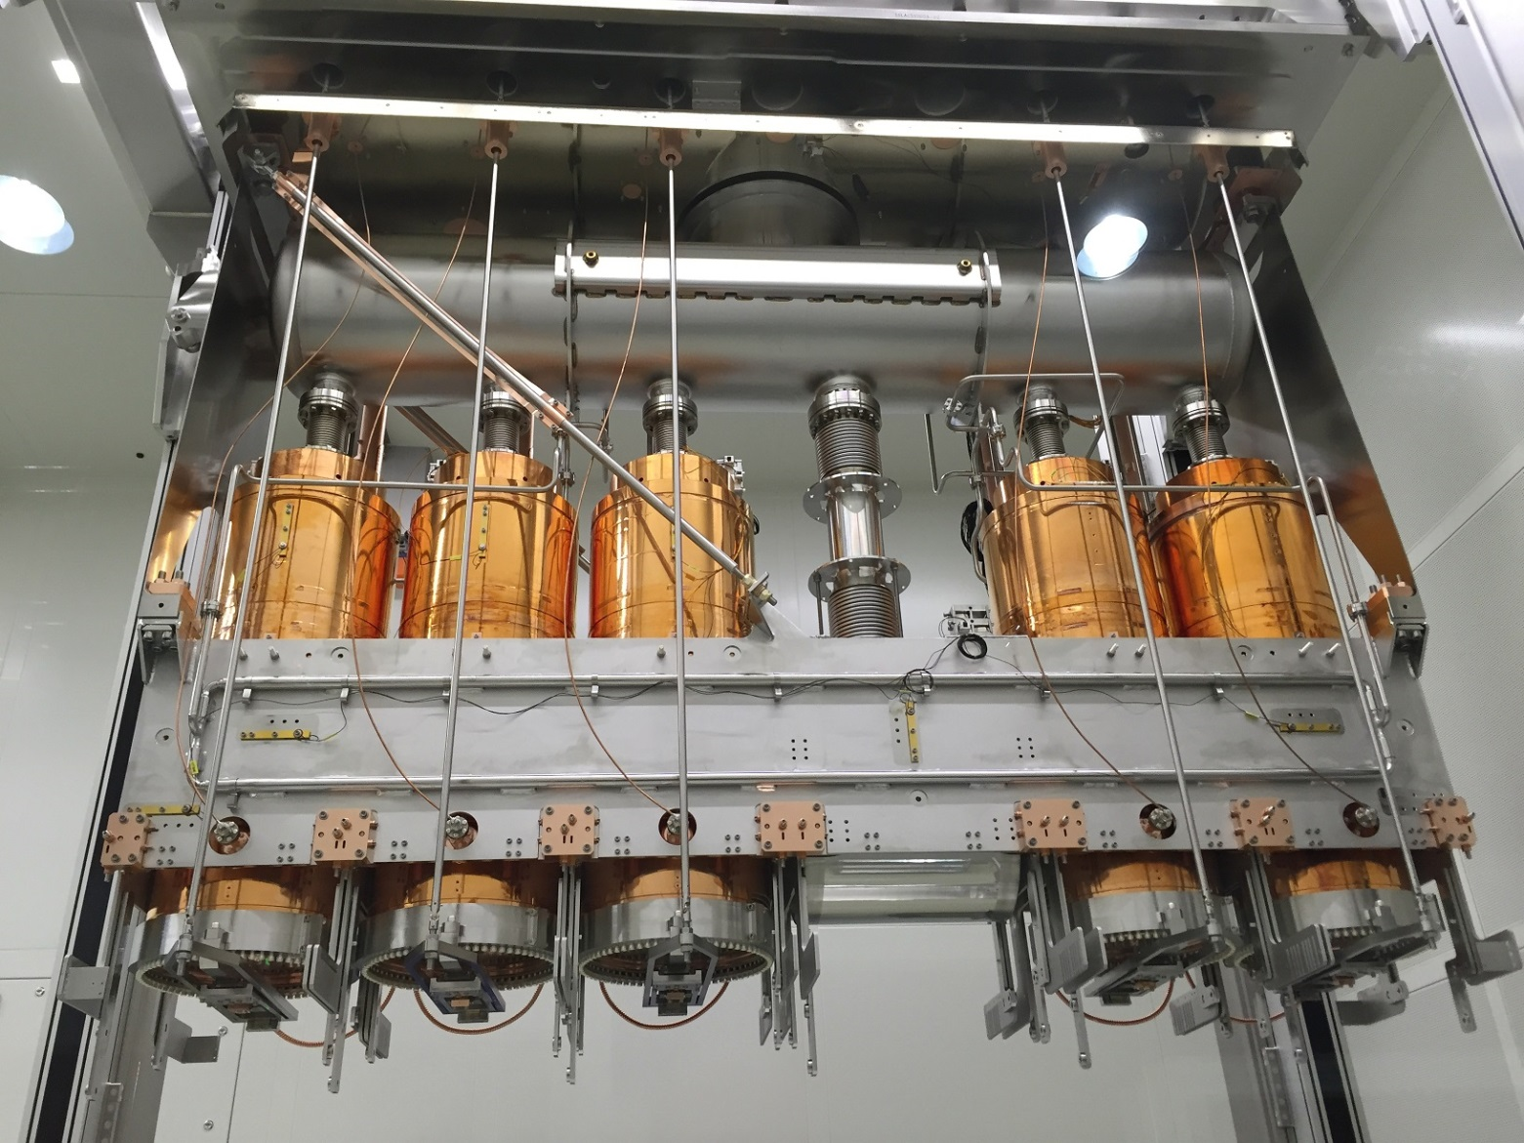
HIE ISOLDE cryomodule

Slide 14

HL-LHC Crab Cavities (WP4)
SM18 Area
Cavity cold testing, clean room facilities & cryomodule qualification
SPS BA6
2 Test Prototype (1DQW, 1RFD)
LHC Point 5 (vertical)
4 DQW CM installed + 1 CM spare
LHC Point 1 (horizontal)
4 RFD CM to be installed + 1 CM spare
*each CM consists 2-cavities

Slide 15
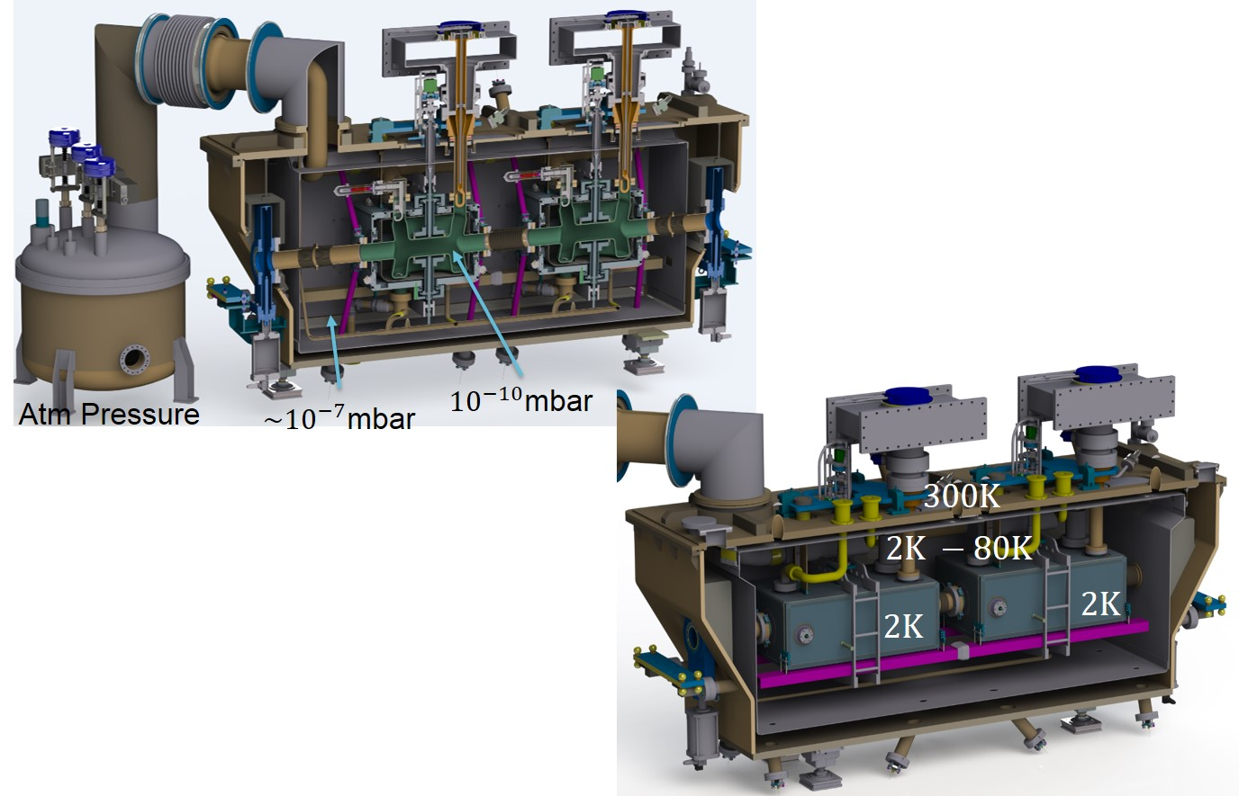


Prototype Cryomodules
Vertical crossing for ATLAS, first one to go to SPS 2018
$$300K$$
Horizontal crossing for CMS
Cavities fabrication starting 2017
$$2K −80 K$$
Rama Calaga @ the 3rd CERN SRF Workshop, 2018

Slide 16
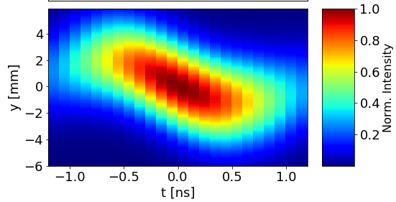
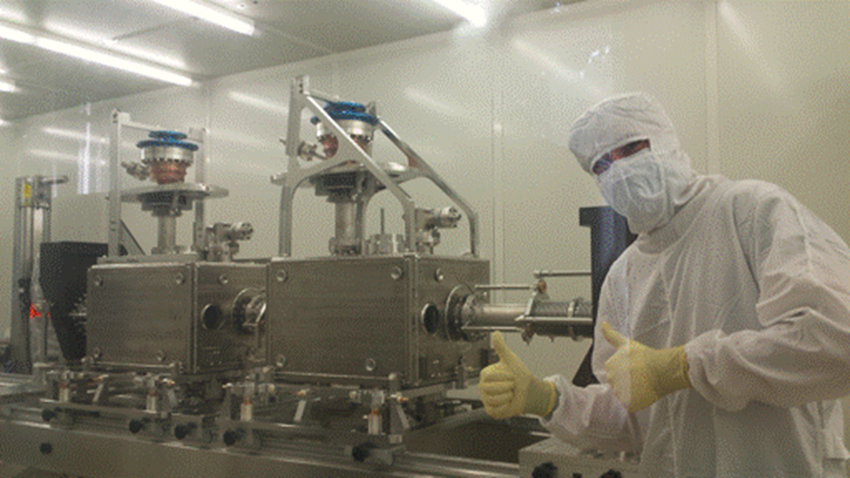
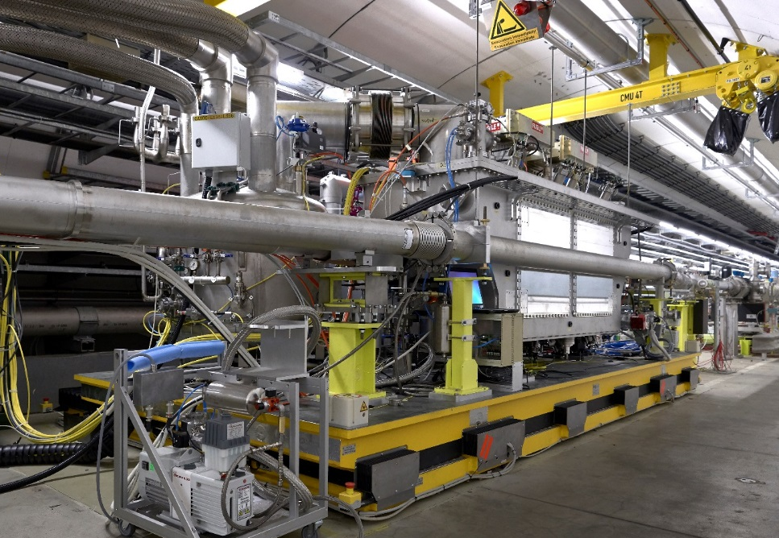
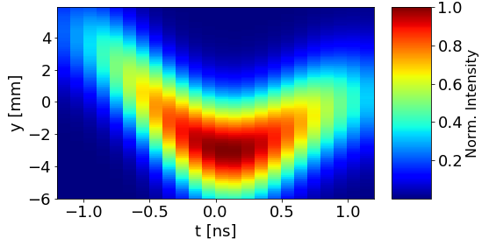
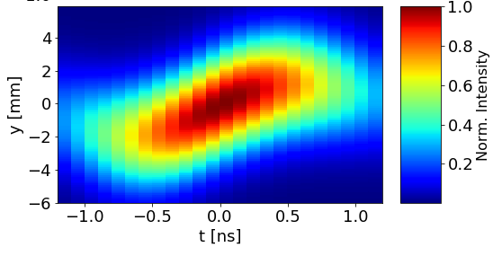
SPS test bed for crab cavities
Crab cavities DQW prototype built and tested in horizontal bunker (picture: cavity string assembly)
Crab cavities DQW cryomodule installed in the SPS
First crabbing of a proton beam
0 Deg
90 Deg
180 Deg
R. Calaga, O. Capatina, F. Gerigk, A. Macpherson, M. Therasse, G. Vandoni

Slide 17
SRF infrastructure
SM18: Clean rooms, RF testing, cryogenics infrastructure
SRF activities span over 3 CERN departments (EN, TE, SY)
Mechanical workshops, metrology, EB welding, chemistry, and sputtering labs, SM18 assembly and test area
Most infrastructures date back from LEP era
New SRF hub under study, to centralize and streamline cavity and cryomodule workflow
Material studies labs
Cryolab
252: Clean rooms, coating benches warm RF lab
Main workshop:, metrology, machining, EB welding
Vacuum surfaces, coating labs
Chemistry lab

Slide 18
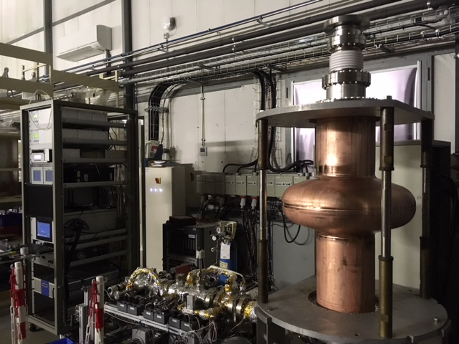
LHC cavity- clean booth and coating bench

Slide 19
HIE ISOLDE clean room
RF vertical test assembly area

Slide 20
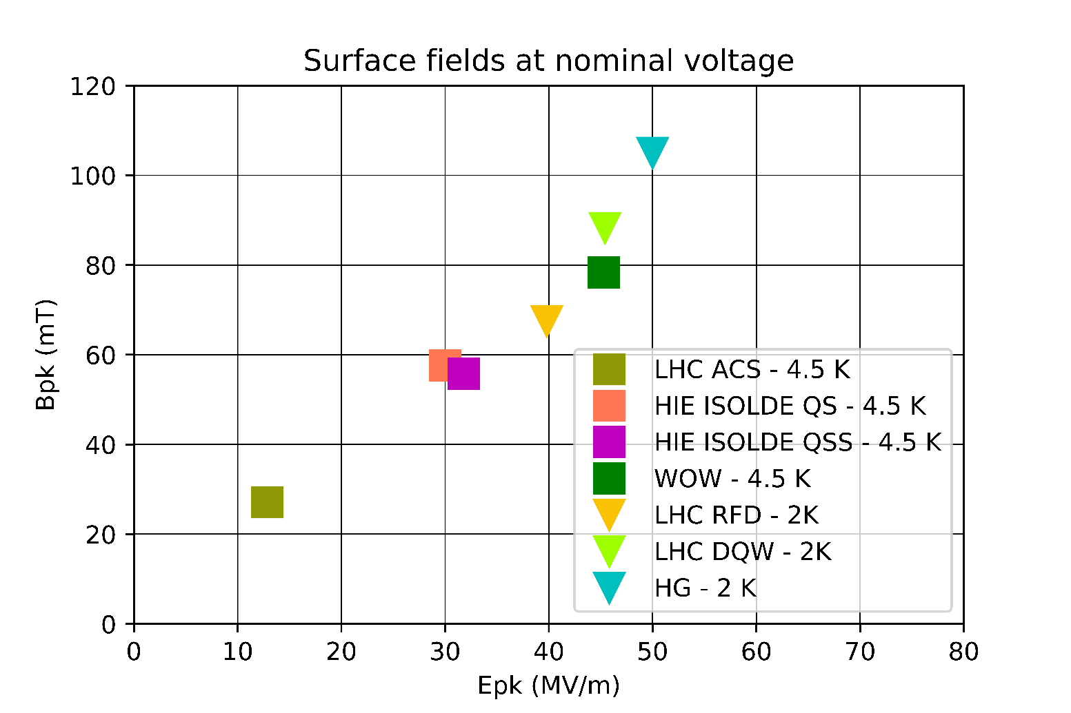
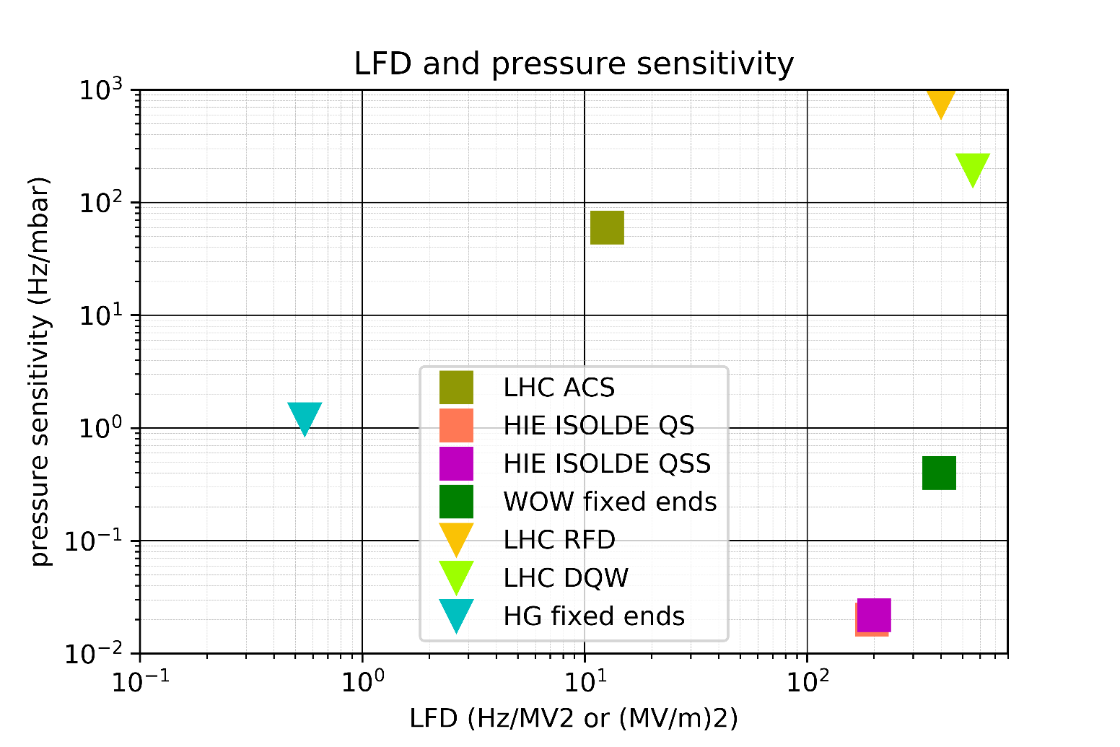
Surface fields and frequency stability
F. Peauger at the 4th CERN SRF workshop, 2019

Slide 21
R&D
R&D is focused on new cavity designs, diagnostics tools, innovative tuning techniques, new cooling schemes, new materials (A15)
Typically R&D has lower priority, after support to operations, approved projects and infrastructures
An important fraction is done under the umbrella of the FCC study
General SRF R/D is also pursued in the context of other projects/activities: for instance, LHC spares etc.

Slide 22
Some examples (or floating ideas)
PERLE: re-use of cryomodule hardware developed for SPL (then stopped) in collaboration with CNRS
Collaboration with SOLEIL on passive Nb/Cu cavities for beam manipulation
Particle discrimination for AMBER in the North Area with RF separation
Muon collider (requires SRF for the proton driver and for the high energy muon acceleration)
Axion detection with SRF cavities
…

Slide 23
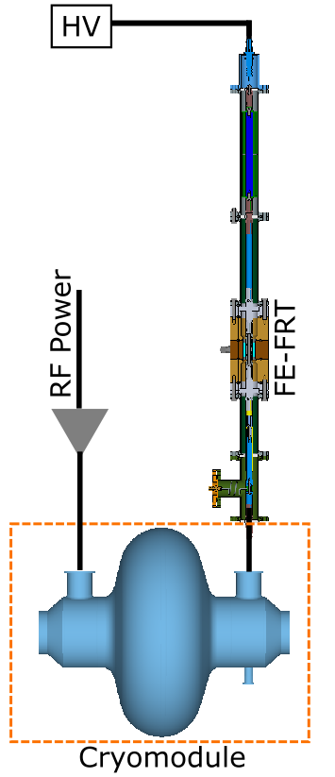
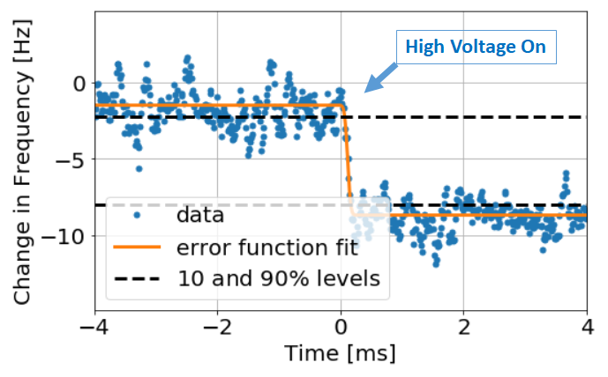
Fast Reactive Tuner
Frequency tuned by a coupled voltage-controlled reactance on shorted transmission line, with new ultra fast ferro-electric material
Proof of principle done at CERN on a real SRF cavity, compensation of microphonics
Potential application in HL-LHC
A. Macpherson et al.

Slide 24
SRF material R/D: core tasks and tools
Problem of the breakdown in components of the surface resistance
ADVANCE THE FUNDAMENTAL UNDERSTANDING OF THE SURFACE RESISTANCE
Magnetic and electric field limitations
of SRF materials
Explore estimators of R_{s} from surface characterizations
1.3 GHz programs
Sample studies
Quadrupole resonators
Explore estimators of R_{s} from measurements of DC superconducting properties: Tc, ΔTc, Bc1, Bc2, χ’, χ’’, etc.
RF measurements: accuracy and resolving power (i.e. transients)
Diagnostics tools aimed at disentangling the components of Rs on real cavities: thermometry, magnetic field mapping
Optical inspections of real cavities

Slide 25
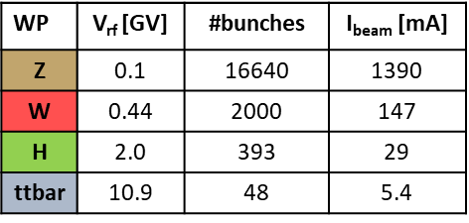
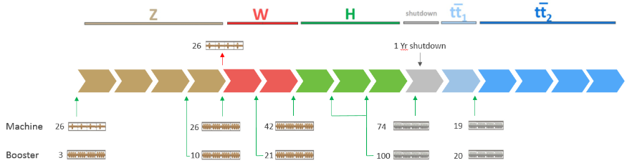
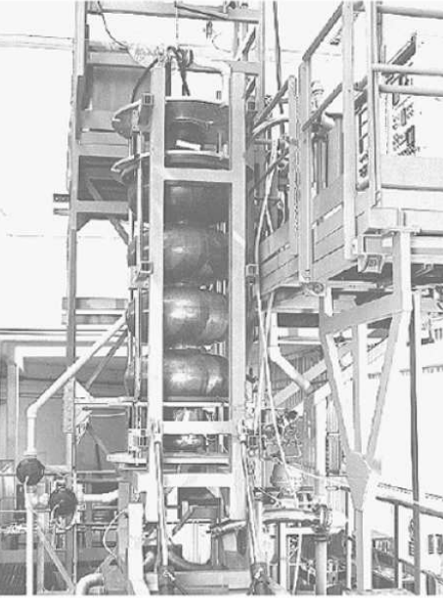
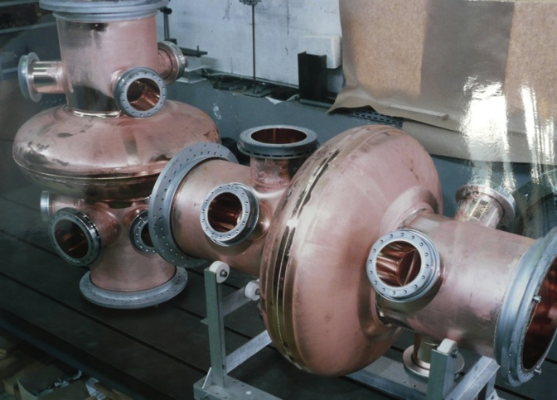
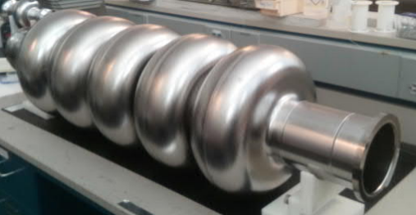
FCCee RF system baseline
Designed for fixed synchrotron radiation power of 50 MW per beam
Elliptical shape
400 MHz 1-cell cavities
Nb/Cu, 4.5 K
104 cavities
Eacc=5 MV/m
1 MW /cav
4 cav./cryom.
Re-used for FCC-hh
400 MHz 4-cell cavities
Nb/Cu, 4.5 K
408 cavities
Eacc=10 MV/m
1 MW to 200 kW per cav.
4 cav./cryom.
800 MHz 5-cell cavities
bulk Nb, 2 K
852 cavities
Eacc=20 MV/m
200 kW/cav.
4 cav./cryom.
LHC
Jlab
LEP
CDR FCC-ee: The Lepton Collider, 2019

Slide 26
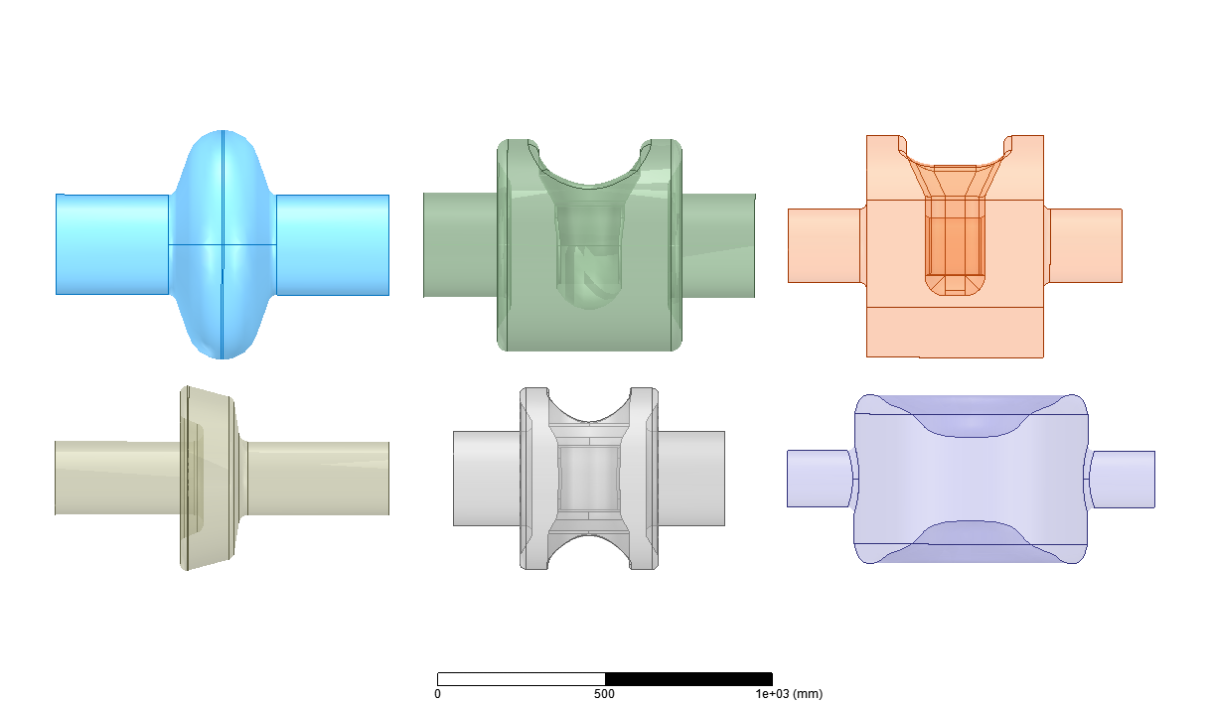
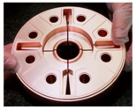
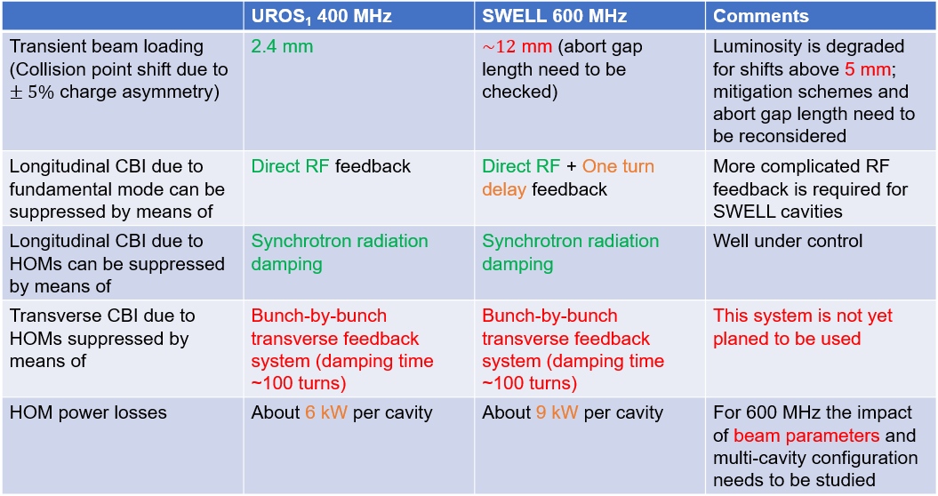
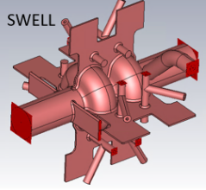
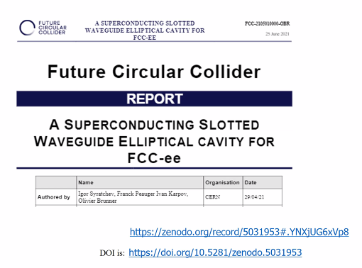

3/7/2021
O. Brunner - SRF Summary
Challenging the baseline
O. Brunner, FCC week 2021
LHC
QWR Ver1
QWR Ver2
Re-entrant
Spoke
HWR
F. Peauger
Alternative cavity design study initiated in Nov. 2020
  CLIC expertise applied to SRF -> Slotted Waveguide Elliptical (SWELL) cavity operating at ~ 600 MHz ¹
  Beam dynamics studies -> ~ 600 MHz conceivable for Z machine 1-cell UROS1 and 2-cell SWELL cavity types
¹ The SWELL cavity concept was published in 2010 by Z.Liu and A. Nassiri (Beijing U., ANL)
I. Karpov

Slide 27
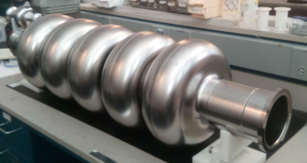
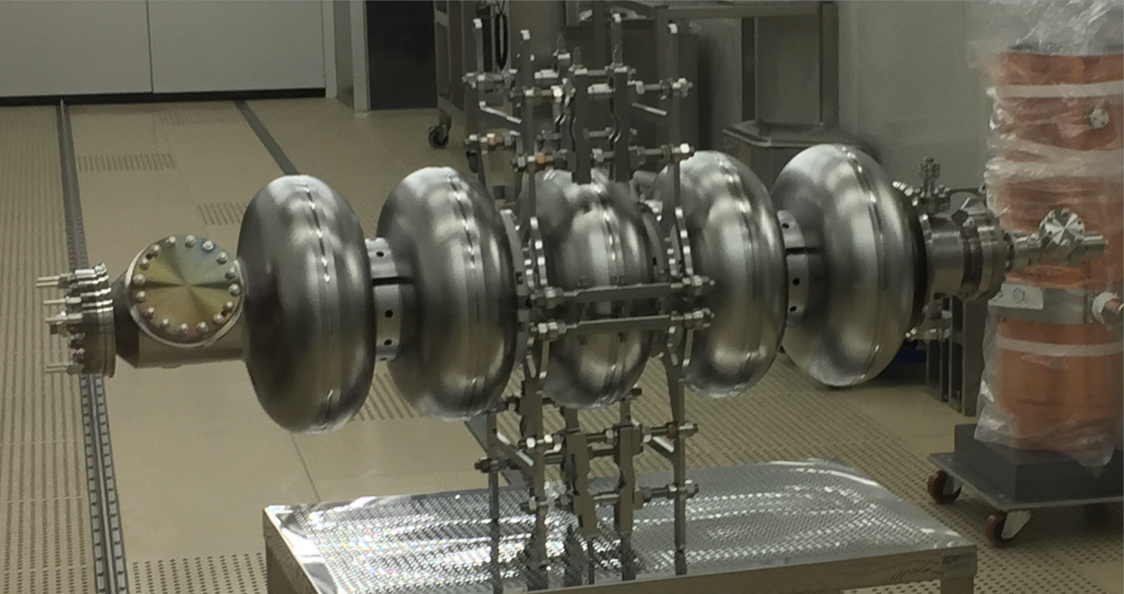
Bulk Nb program
JLAB
CERN
FCC 802 MHz 5-cell performance at 2K
Eacc = 31 MV/m & Q0 = 2x1010
Cavity Quench limited (Bpk ~ 130 mT)
HG 704 MHz 5-cell performance at 2K
Eacc = 29.7 MV/m & Q0 = 1.4 x1010 Cavity not quench limited
Frank Marhauser & team @ JLAB

Slide 28
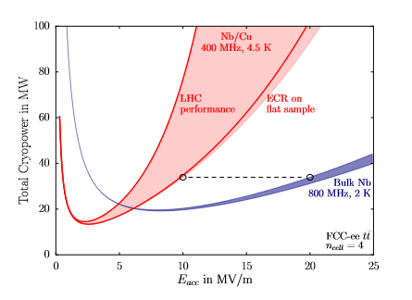
Performance goals: a moving target
R/D ongoing at CERN (joint effort between groups MME-VSC-RF) during the last years to push performance of Nb/Cu using 1.3 GHz mono cells, which are the international standard for SRF
Preliminary survey of materials and performance goals was done during CDR phase (S. Aull et.al, Report number: CERN-ACC-2018-0019)→
Nb/Cu HIPIMS coatings displayed optimized R_{BCS} below 300 nΩ at 4.5 K, 1.3 GHz, and low Q-slope
HIE ISOLDE seamless QWR reached 120 mT at 100 MHz→ no special field limits for Nb/Cu
By simple scaling and reasonable assumptions on R_{res} we can aim to Rs=50-90 nΩ (~3-5 10⁹ ) at 400 MHz, 10 MV/m and 4.5 K
Performance targets and breakeven points are being reviewed for all frequencies considered for FCC, including 600 MHz, based on the recent developments of the 1.3 GHz program

Slide 29
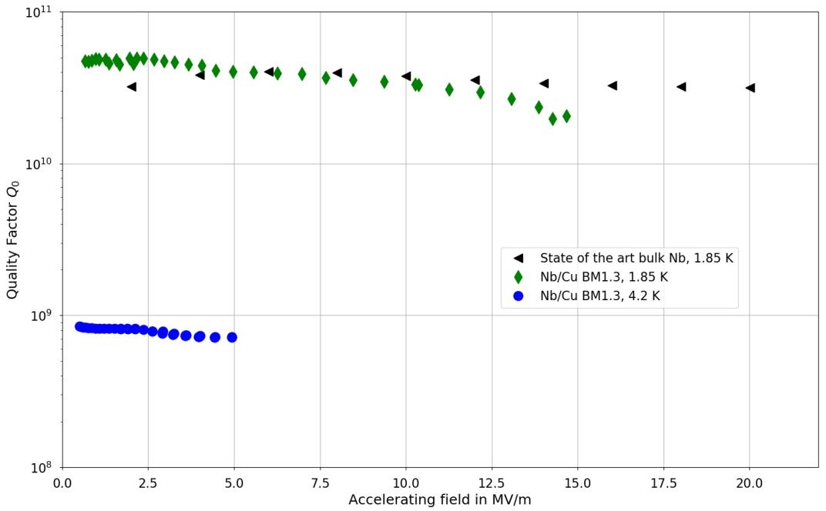
Recent progress in 1.3 GHz Nb/Cu program
Progress slowed in recent years by poor copper substrates
HIPIMS coating on seamless (machined out of the bulk), electro-polished copper cavity
Q slope mitigated, comparable with bulk Nb up to 15 MV/m
Test was stopped by administrative limits at Cryolab
More cavities in the pipeline

Slide 30
Summary
Great tradition in SRF at CERN
SRF cavities key elements in past and present CERN accelerators
Infrastructure consolidation efforts in recent years, being continued
R/D focused on CERN scenarios for future accelerators
Vital and enthusiastic local SRF community contributing to worldwide efforts

