Slide 1
A proposal for an HTS accelerating cavity
Walter Wuensch and Sergio Calatroni
plus, on the axion cavity side, Babette Dobrich and Jessica Golm
PBC SRF miniworkshop
21 September 2021

Slide 2
Introduction
We propose to build a highly novel RF accelerating structure that brings together three distinct developments that have occurred in recent years:
Operation of high-gradient accelerating structures built in halves and quadrants
Demonstrations of the increase in high-gradient performance of cryo-cooled copper structures
High Q HTS microwave cavities for axion detectors
A linac based on such structures could potentially:
Operate at very high gradient
Require a significantly reduced number of RF power sources (klystron/modulator units)
Have a lower overall power consumption than existing linacs
This is not strictly a PBC subject could be developed in a collaboration between PBS and the accelerator sector and benefit all concerned.

Slide 3
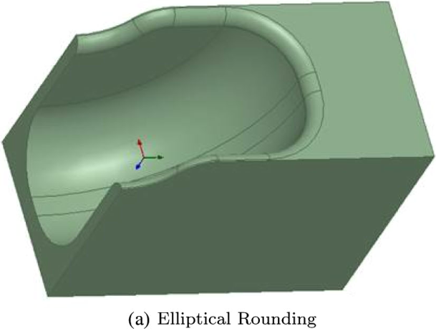
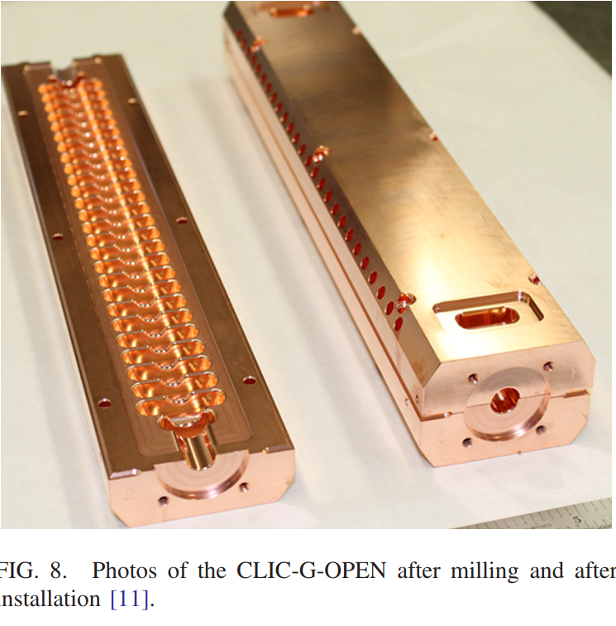
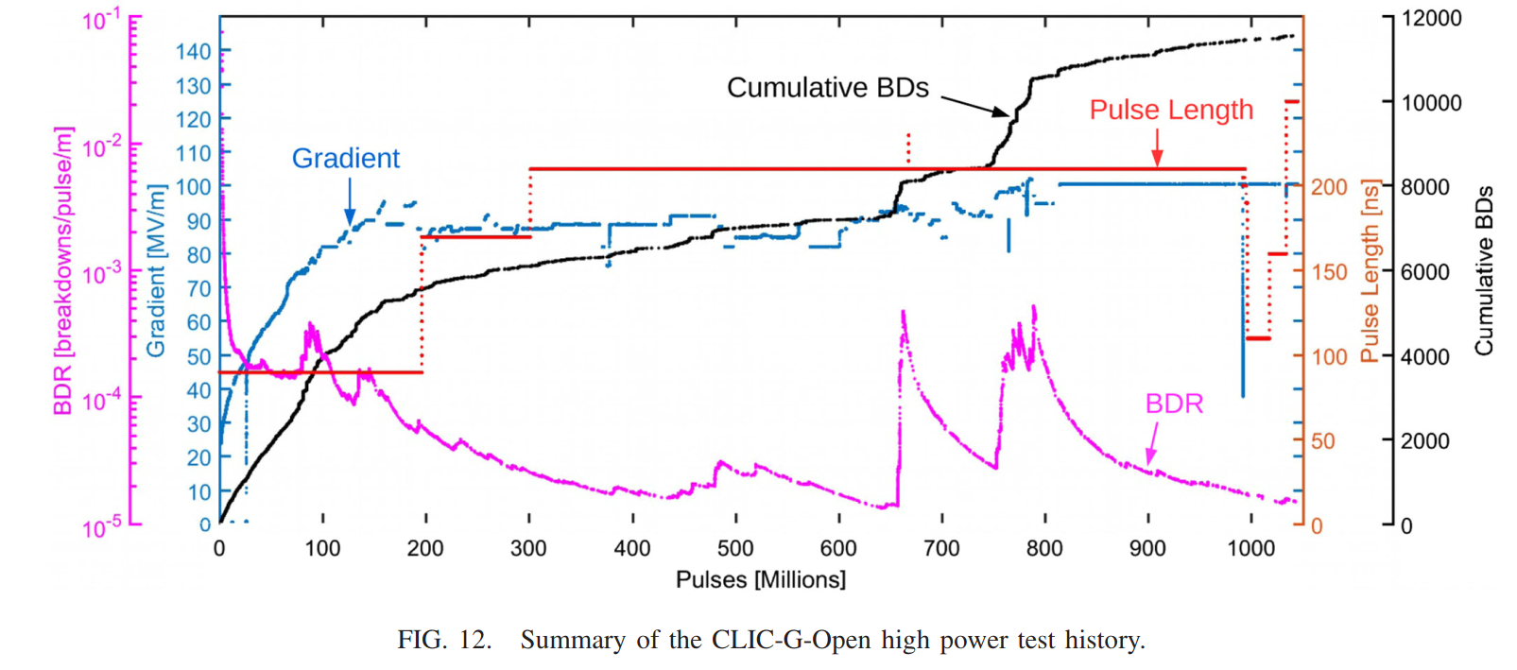
The basic ideas – structures in halves and quadrants
https://doi.org/10.1103/PhysRevAccelBeams.21.061001
There are more examples!

Slide 4
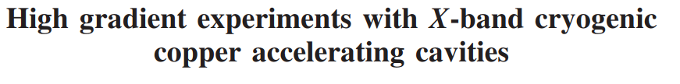
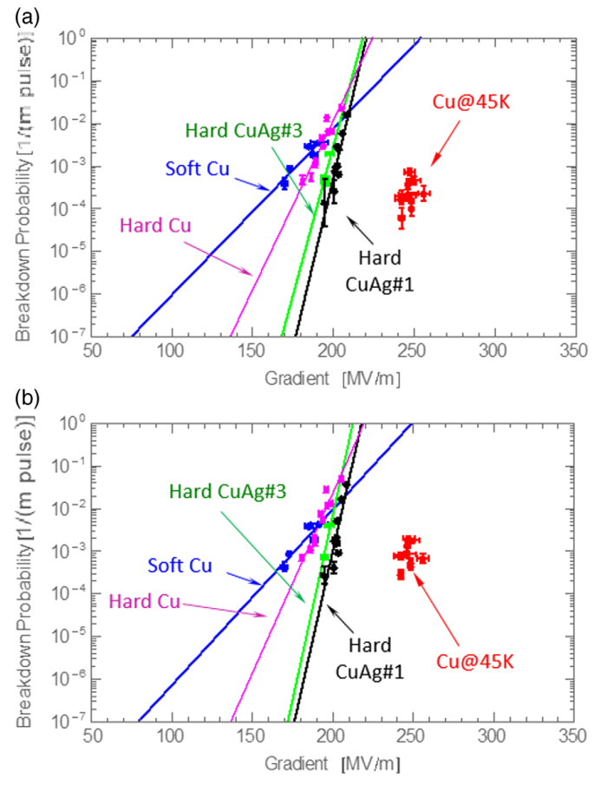
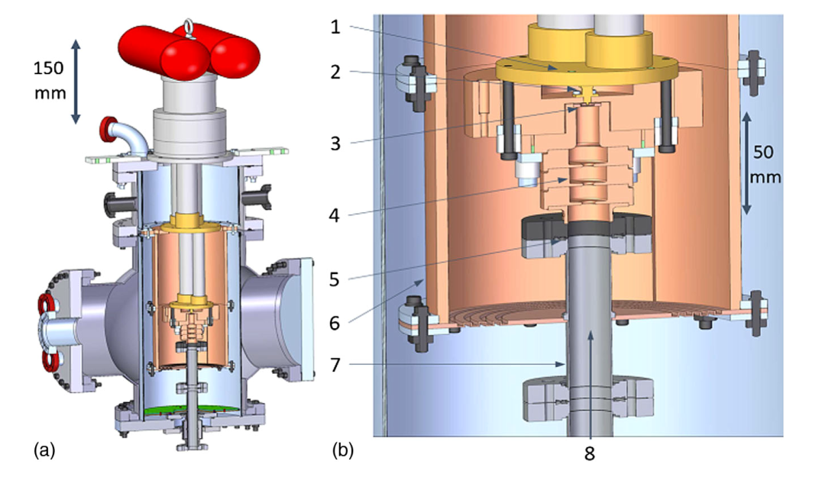
The basic ideas – Cryo-cooled copper 1
https://doi.org/10.1103/PhysRevAccelBeams.21.102002

Slide 5
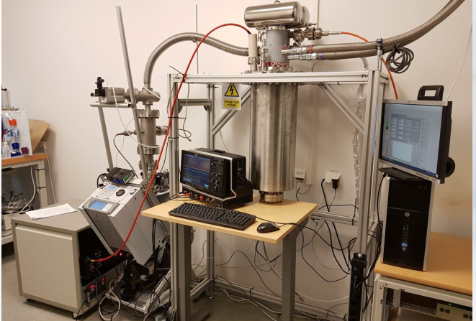
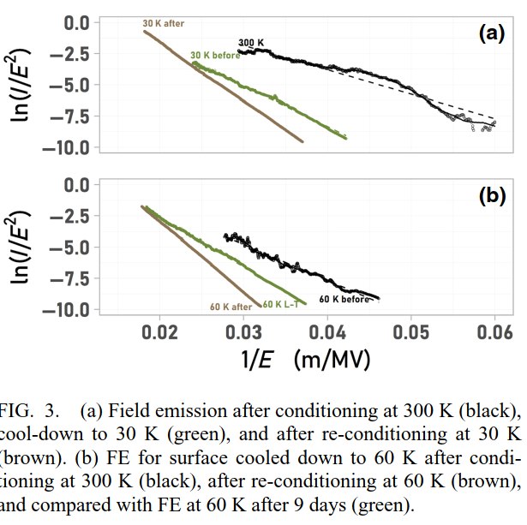
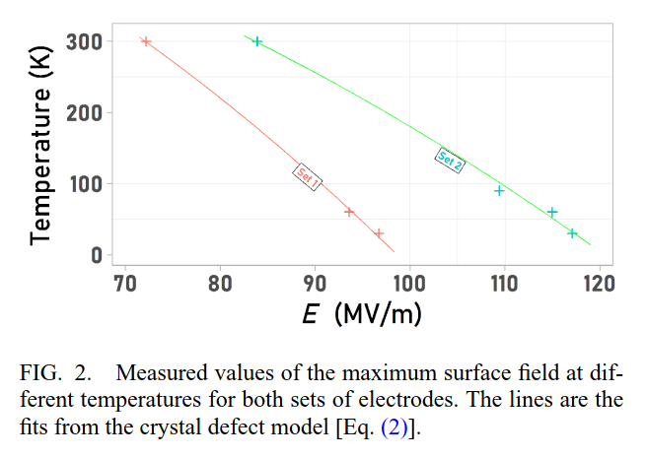
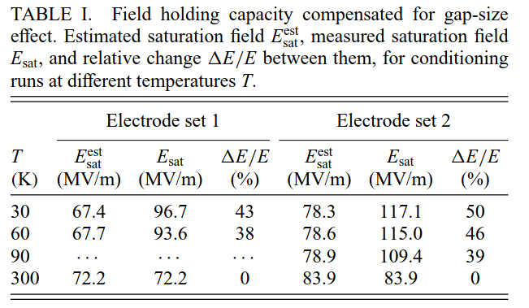
The basic ideas – Cryo-cooled copper 2
https://doi.org/10.1103/PhysRevApplied.14.061002

Slide 6
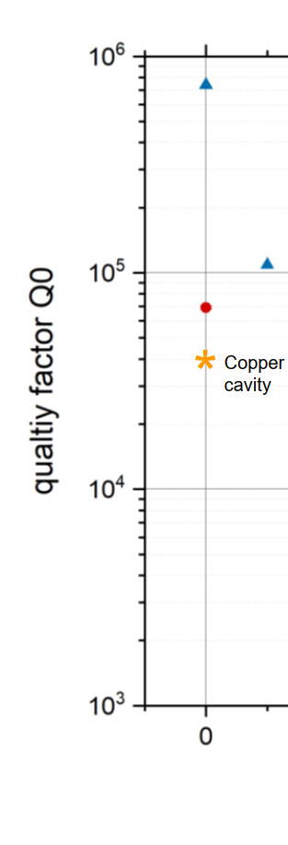
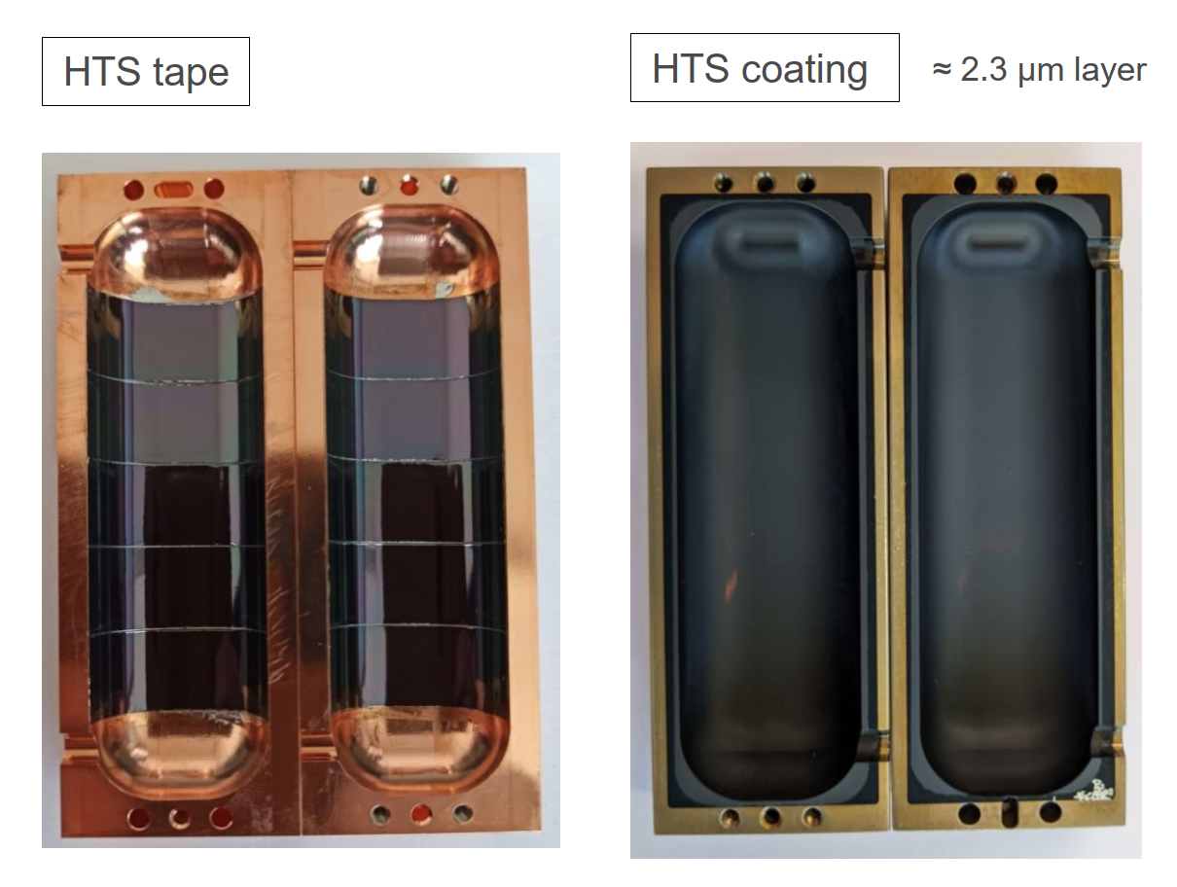
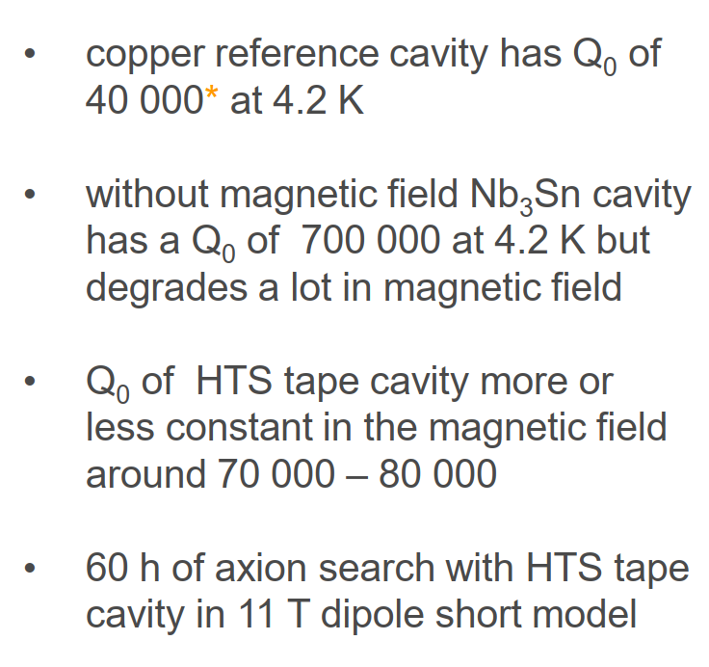
The basic ideas – HTS microwave cavities
Material from Jessica’s presentation
Measurement underway…

Slide 7
Synthesis 1
Copper accelerating structures cooled in the range temperatures of temperatures of 50-70 °K show an increase in gradient of 20 to 50 % compared to room temperature. Excellent!
Cryo also show an increase in Q of around 2.5 for GHz-range cavities (anomalous skin effect). This reduces the number of RF power sources by the same factor (in a low beam loaded linac). Excellent!
But overall power consumption higher due to Carnot efficiency (power factor of a bit over 10 for 80 °K system, 2.5 improvement in Q and about 30 % RF power production efficiency).

Slide 8
Synthesis 2
Implementation of an HTS coating has the potential to give an additional factor – would be reflected in the number of power sources and make the system more efficient than at room temperature! For example SwissFEL might only need less than 3 or 4 rather than 25 klystrons (details need to be worked out)…
Existing HTS axion and accelerating cavity fabrication layouts (halves and quadrants) are the same, although the latter has a somewhat more complicated geometry. Discussion with company required.

Slide 9
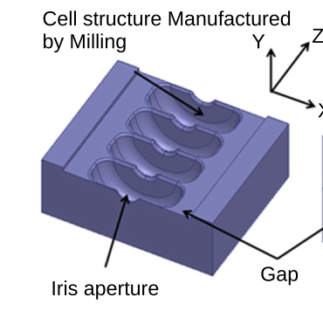
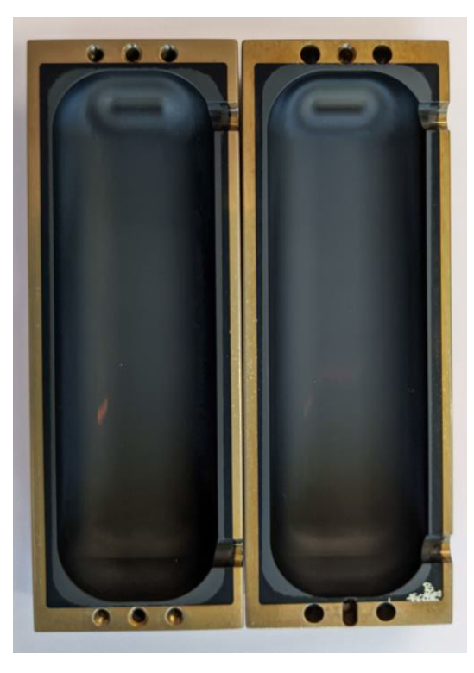
Implementation
Copper in high electric field region
HTS in high magnetic field region
3 or 12 GHz for high power test in CLIC test stands.
A key open question is how the HTS will behave at high-power. Can it be even put in the high electric field region?

Slide 10
Organization
This project is interesting for:
PBC for continued development of HTS coatings for axion detectors.
CLIC for potential route to higher gradient and higher efficiency
Accelerator technology generally. HTS accelerating structures would be a new technology for the field and open new parameter space for optimizing many types of accelerating structures. This demonstrator would the first ever!

Slide 11
First try at a cost:
50 kCHF for coated cavity
75 kCHF for cryostat and cryo-cooler
50 kCHF for RF network
2-3 years of a fellow for RF design, experimental setup, experimentation
…order 500 kCHF total

Slide 12
Thank you for your attention!

