Slide 1
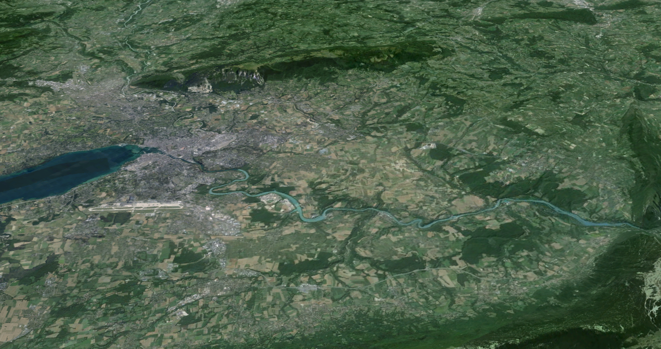






HTS coatings for FCC and beyond
Future Circular Collider (FCC)
Geneva
PS
SPS
LHC
Joffre Gutierrez Royo*
A. Romanov, G. Telles, N. Lamas, P. Krkotic, J. O’Callaghan, X. Granados, E. Garcia-Tabarés, M. Taborelli, P. Chiggiato, P. González, I. Korolkov, R. Miquel, F. Perez, M. Pont, T. Puig, S. Calatroni
PBC technology minworkshop: superconducting RF
Tuesday Sep 21, 2021
*jgutierrez@icmab.es
Notes:
I will present the work developed by a consortium formed by these groups towards providing a solution for the FCC-hh beam-screen chamber issue. The FCC-hh is the most ambitious post LHC scenario envisioned by CERN. At the end of this presentation I will also show another possible application for these novel coatings.

Slide 2
Outline
1 – Coated Conductors in a nutshell
2 – CCs vs Cu: R_{s}(H) in the GHz range
3 – How we coat surfaces with CC
4 – Potential gain and ¿pitfalls? of CCs below the GHz range

Slide 3
Outline
1 – Coated Conductors in a nutshell
2 – CCs vs Cu: R_{s}(H) in the GHz range
3 – How we coat surfaces with CC
4 – Potential gain and ¿pitfalls? of CCs below the GHz range

Slide 4






Coated Conductors are commercially available
with different widths in Km length
Ag ~ 2 μm
REBCO HTS ~ 1 – 3 μm
Cu ~ 20 μm
Buffers ~ 0.2 – 1 μm
Metallic Substrate ~ 30 – 100 μm
T_{c} ≈ 91 K
H_{c2} (4.2K) > 100 T
H_{irr} (4.2K) > 60 T

Slide 5
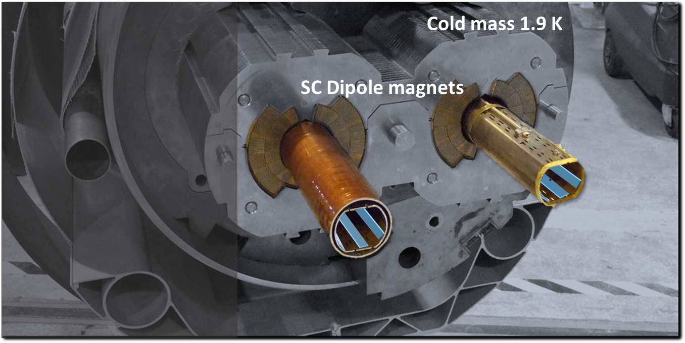

CCs offer excellent opportunities for high-energy physics
CCs as low-impedance coating for the FCC-hh beam-screen chamber
FCC working conditions:
16 T, 40 – 60 K, 1 GHz & 25 A peak

Slide 6
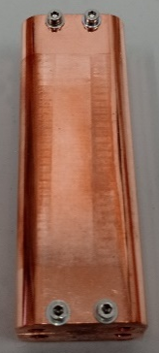
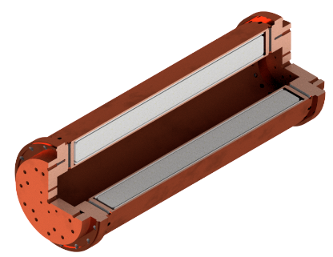

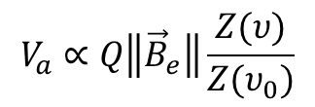
CCs offer excellent opportunities for high-energy physics
CCs as low-impedance coating for the FCC-hh beam-screen chamber
FCC working conditions:
16 T, 40 – 60 K, 1 GHz & 25 A peak
CCs as low-impedance coating for cold DM axions
Opportunities for the BASE detector in the kHz – MHz range
Higher than Cu Q-value RADES halsocopes @ GHz
$$V_{a}∝Q\left\|{\vec{B}}_{e}\right\|\frac{Z(υ)}{Z(υ_{0})}$$
P α B_{e}²QVG
  High Q →T = 4.2K
  &
  High B_{e}

Slide 7
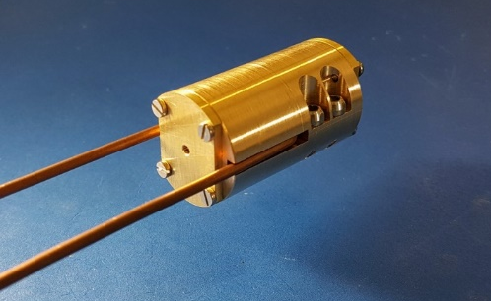
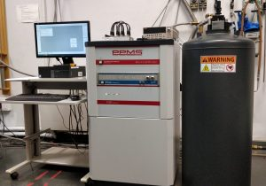

Z_{s} characterization is done with a 8 GHz cavity Hakki-Coleman resonator
Operating in the $TE_{011}$ mode
Compatible with ICMAB cryostats:
25mm Ø bore 9 T magnet
50mm Ø bore 16 T magnet

Slide 8
Outline
1 – Coated Conductors in a nutshell
2 – CCs vs Cu: R_{s}(H) in the GHz range
3 – How we coat surfaces with CC
4 – Potential gain and ¿pitfalls? of CCs below the GHz range

Slide 9
R_{s} of state-of-the-art CCs outperforms FCC Cu in the GHz range
CCs as low-impedance coating for the FCC-hh beam-screen chamber
T = 50 K, ν = 8 GHz
FCC Cu
FCC working conditions: 16 T, 40 – 60 K, 1 GHz & 25 A peak
Outperform Cu R_{s} under FCC working conditions
Withstanding induced image currents
Preventing magnetic field disturbance → Segmented REBCO-Cu hybrid coating
REBCO
T. Puig et al, Supercond. Sci. Technol. 32 (2019)

Slide 10
REBCO CCs support high-currents at high-magnetic fields
CCs as low-impedance coating for the FCC-hh beam-screen chamber
FCC working conditions: 16 T, 40 – 60 K, 1 GHz & 25 A peak
Outperform Cu R_{s} under FCC working conditions
Withstanding induced image currents
Preventing magnetic field disturbance → Segmented REBCO-Cu hybrid coating
T. Puig et al, Supercond. Sci. Technol. 32 (2019)
REBCO is a HTS and a high-field superconductor

Slide 11
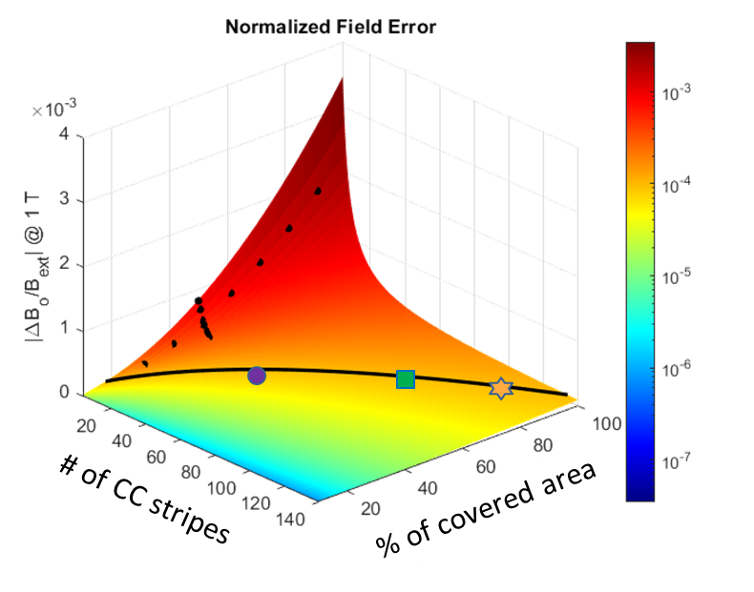
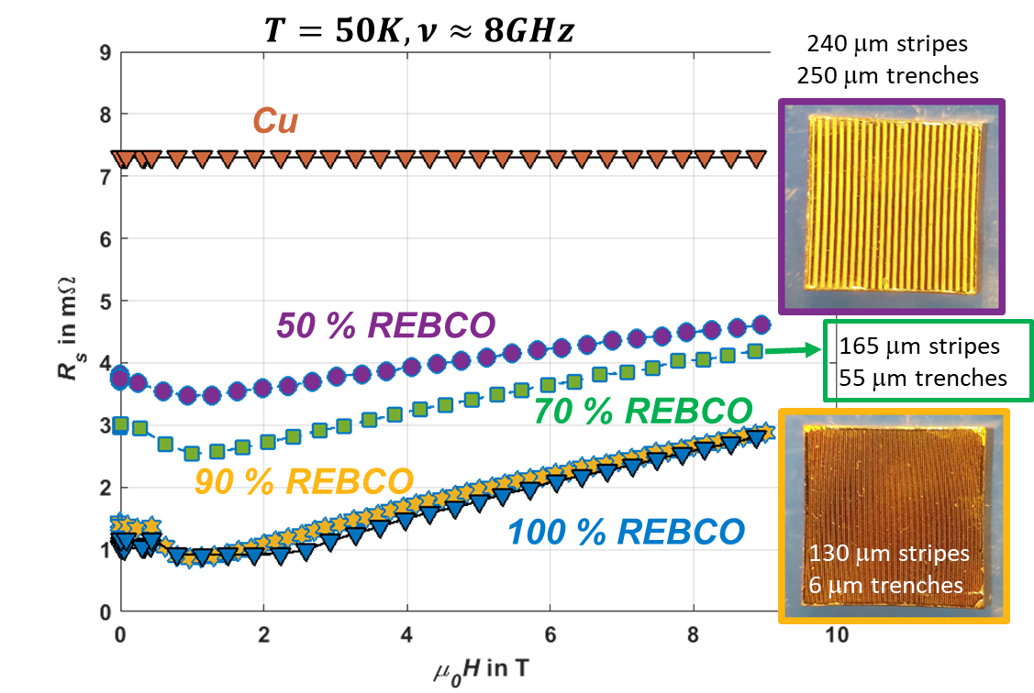
A segmented REBCO-Cu hybrid coating doesn’t disturb H and keeps good R_{s}
CCs as low-impedance coating for the FCC-hh beam-screen chamber
FCC working conditions: 16 T, 40 – 60 K, 1 GHz & 25 A peak
Outperform Cu R_{s} under FCC working conditions
Withstanding induced image currents
Preventing magnetic field disturbance → Segmented REBCO-Cu hybrid coating
G. Telles et al, to be submitted
(G. Telles @ EUCAS 2021, Field Quality and Surface resistance studies for the FCC beam screen. Materials IX, ID: 441)

Slide 12
The improvement in R_{s} is higher at lower temperatures
T = 50 K, ν = 8 GHz
T = 10 K, ν = 8 GHz
REBCO
REBCO
DM Axion detection cavities operate at 4.2K, further benefiting from REBCO

Slide 13
Outline
1 – Coated Conductors in a nutshell
2 – CCs vs Cu: R_{s}(H) in the GHz range
3 – How we coat surfaces with CC
4 – Potential gain and ¿pitfalls? of CCs below the GHz range

Slide 14
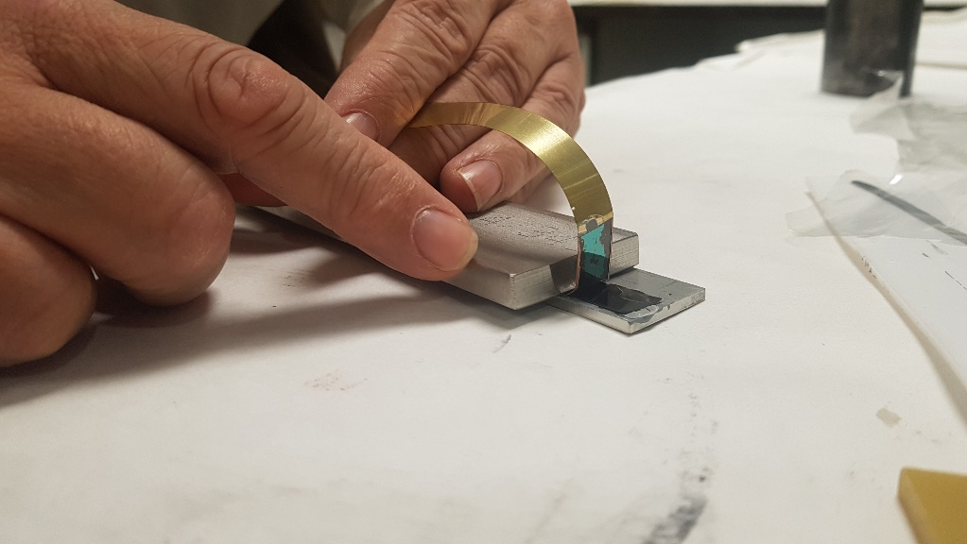
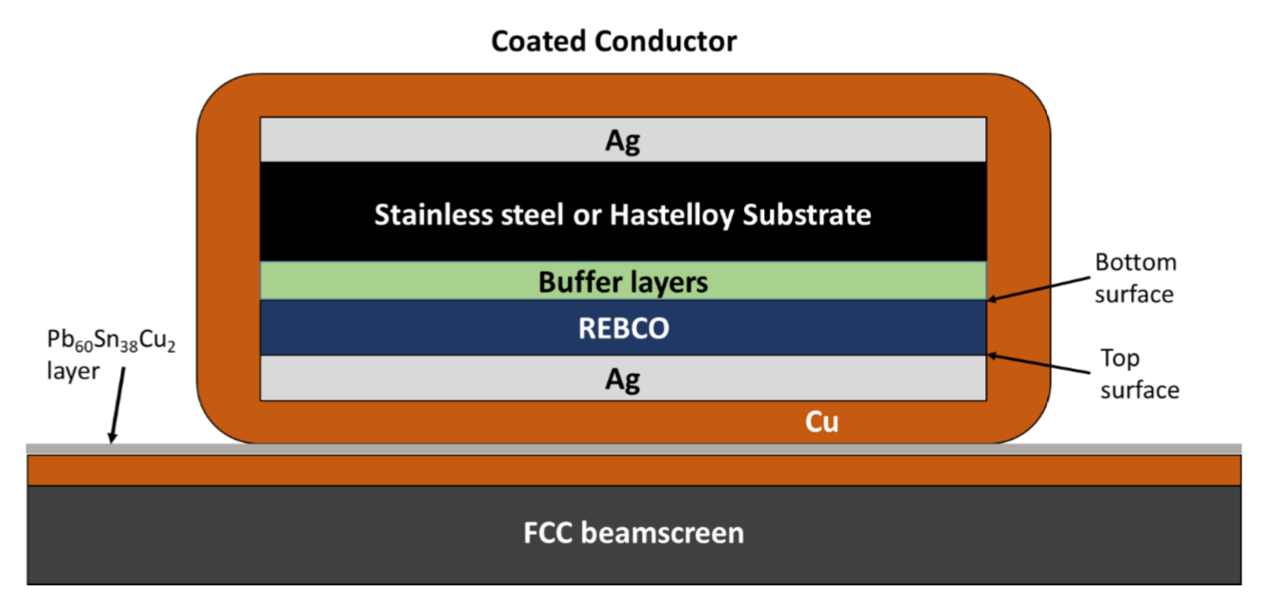
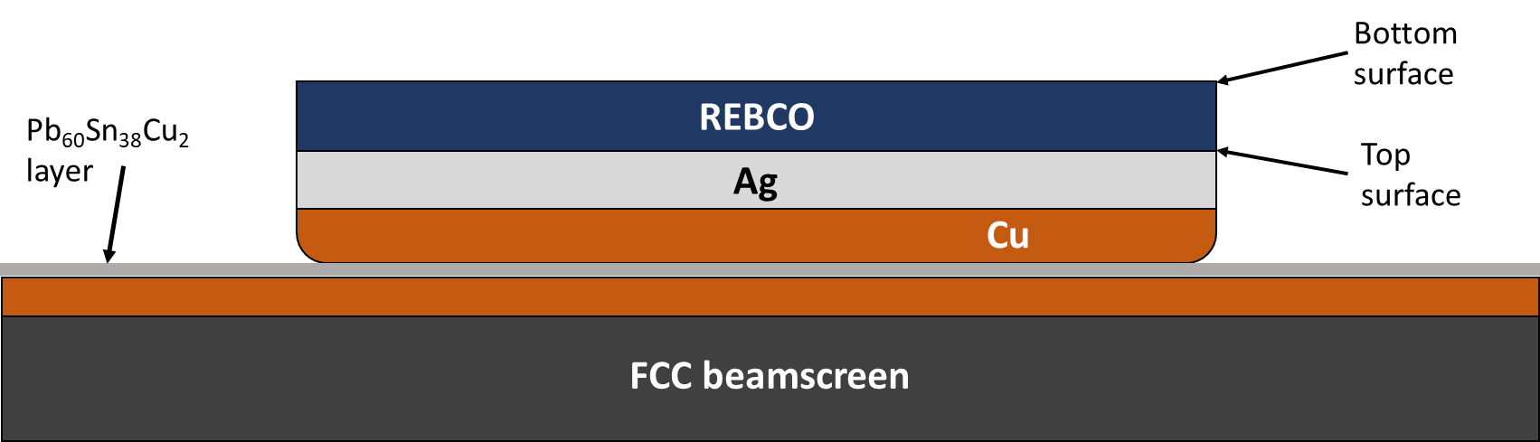
Two-step delamination technique for large surface coatings with CCs
Attach
Welding of CC on top of a surface
Delamination
Mechanical peeling
A. Romanov & G. Telles, to be submitted
Technology is easily scalable

Slide 15
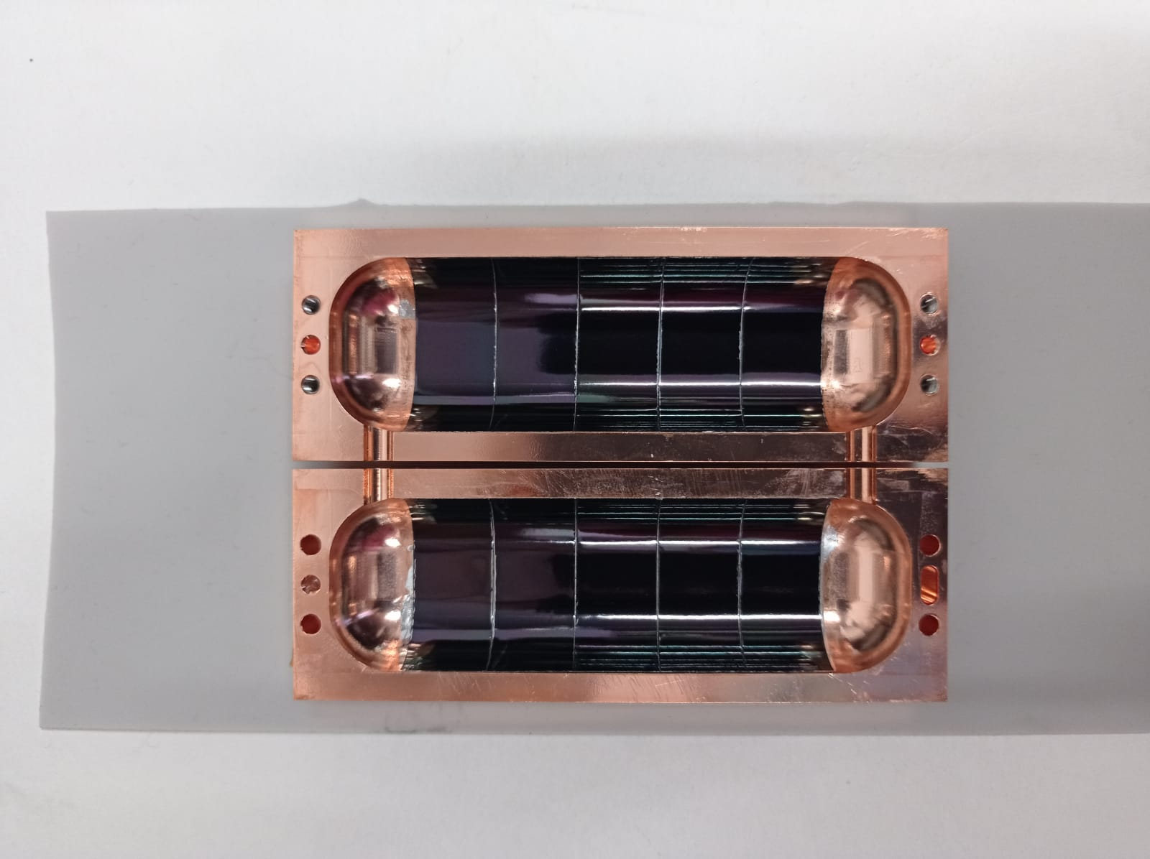
Proof-of-concept:
CC coated RADES haloscope shows a 50% in-field Q improvement
P α B_{e}²QVG
  Curvature
  R9 mm
With some R&D efforts we made it work on curved surfaces
  CC coated Axion cavity Cu only
  Q(0T, 4.2K) ~ 80k
  Q(11T, 4.2K) ~ 60k vs Q(11T, 4.2K) ~ 40k

Slide 16
Proof-of-concept:
A R9 mm bending radius was a bit too much for the CC used
P α B_{e}²QVG
T = 10 K, ν = 8 GHz
RADES haloscope Cu
  Curvature
  R9 mm
RADES haloscope CC
REBCO
  CC coated Axion cavity Cu only
  Q(0T, 4.2K) ~ 80k
  Q(11T, 4.2K) ~ 60k vs Q(11T, 4.2K) ~ 40k

Slide 17
Proof-of-concept:
Now we can coat R9 mm curvatures with nominal R_{s} values
P α B_{e}²QVG
T = 10 K, ν = 8 GHz
RADES haloscope Cu
  Curvature
  R9 mm
RADES haloscope CC
REBCO vs REBCO after R9 mm bent
  CC coated Axion cavity Cu only
  Q(0T, 4.2K) ~ 80k
  Q(11T, 4.2K) ~ 60k vs Q(11T, 4.2K) ~ 40k
We have learnt a big deal: In a near future we will be able to coat < R9 mm

Slide 18
Outline
1 – Coated Conductors in a nutshell
2 – CCs vs Cu: R_{s}(H) in the GHz range
3 – How we coat surfaces with CC
4 – Potential gain and ¿pitfalls? of CCs below the GHz range

Slide 19
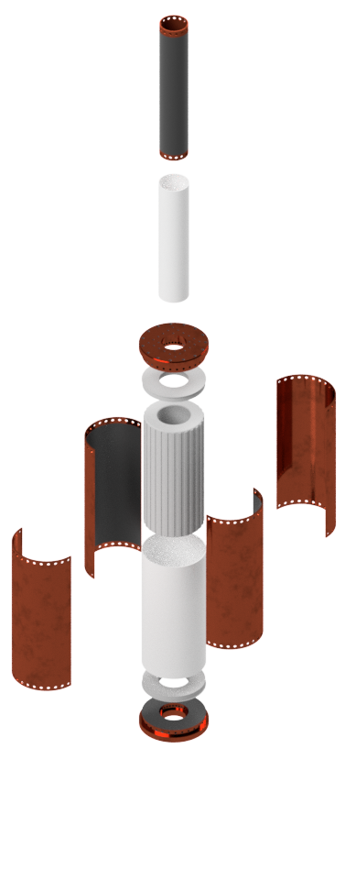
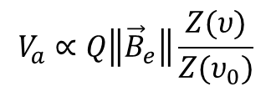
BASE opportunity: Enhanced Q and operating at higher magnetic fields
BASE detector (exploded)
Resonant NbTi coil
$$V_{a}∝Q\left\|{\vec{B}}_{e}\right\|\frac{Z(υ)}{Z(υ_{0})}$$
  ν₀ = 50 kHz- 200 kHz
Opportunities
Coat the cavity with CCs → Increase Q
Make a resonant REBCO coil → Work at 100 MHz & high-Q (low-rf loss) in fields up to 10 T

Slide 20
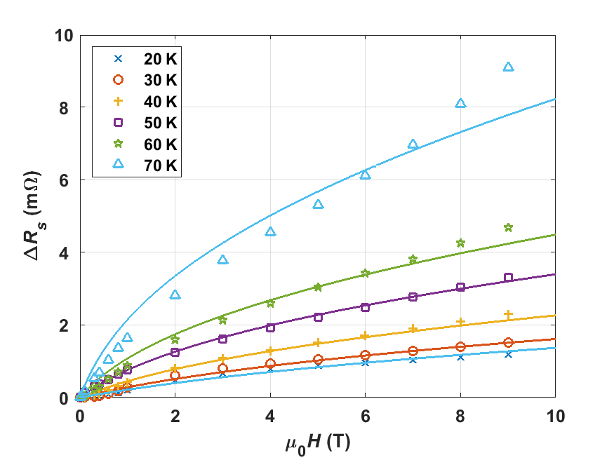

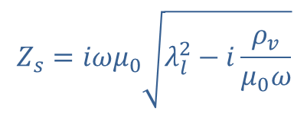
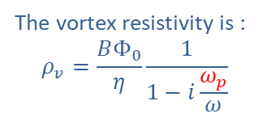

At high magnetic fields, vortices dominate Z_{s}
The G-R model shows excellent agreement with experiments
The Gittleman-Rosenblum model
ν = 8 GHz
The vortex resistivity is :
$$ρ_{v}=\frac{BΦ_{0}}{η}\frac{1}{1−i\frac{ω_{p}}{ω}}$$
$\text{solid} \text{lines}≡$ GR model
Fitting parameter
With $η=1.45\frac{φ_{0}B_{c2}}{ρ_{n}}$
$$Z_{s}=iωμ_{0}\sqrt{λ_{l}^{2}−i\frac{ρ_{v}}{μ_{0}ω}}$$
We can reconstruct Z_{s} and make predictions
A. Romanov, et al. Scientific reports 10 (2020)

Slide 21
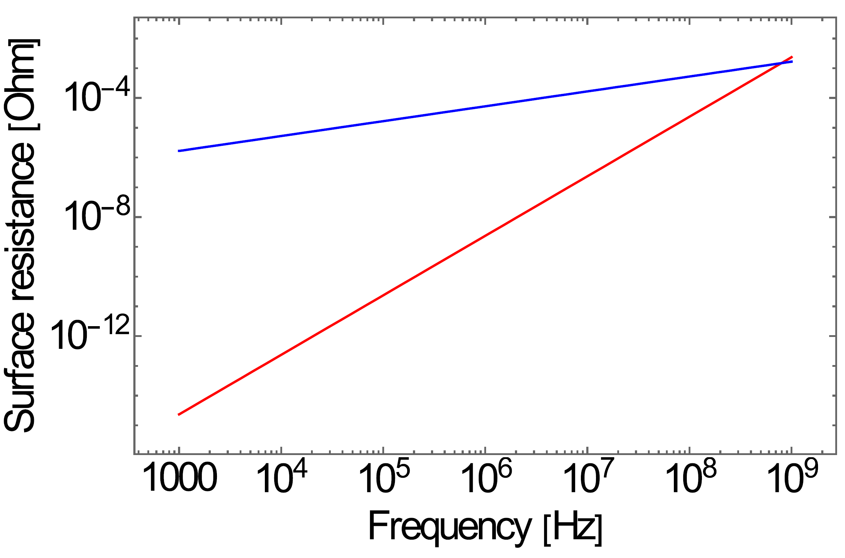
CC’s R_{s} greatly outperforms that of Cu in the MHz range and below
R_{s} REBCO estimation with G-L model
FCC Cu
RRR100 Cu
Cu
RRR1000 Cu
REBCO
factor 1250 – 3000
T = 4.2 K, ν = 100 MHz
Calatroni and Vaglio, IEEE Transactions on Applied Superconductivity, 27 (2017)
REBCO
The lower we go in frequency, the bigger the R_{s} gain will be!
But…

Slide 22

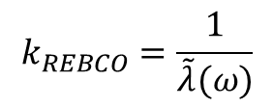
We need to take into account the effective surface impedance of a multilayer system
Stack
$$Z_{Stack}= Z_{REBCO}\frac{Z_{metals}+iZ_{REBCO}tan⁡(k_{REBCO}t_{REBCO})}{Z_{REBCO}+iZ_{metals}tan⁡(k_{REBCO}t_{REBCO})}$$
$$k_{REBCO}=\frac{1}{\tilde{λ}(ω)}$$
RF field penetration depth
A. Romanov, et al. Scientific reports 10 (2020)
If k_{REBCO}t_{REBCO} >> 1
Z_{Stack} ≈ Z_{REBCO}
Can we fulfil this condition < GHz range?

Slide 23



It will be advisable to characterize CCs in the MHz range
If k_{REBCO}t_{REBCO} >> 1
Z_{Stack} ≈ Z_{REBCO}
In the MHz
$$k_{REBCO}=\sqrt{\frac{{μ_{0}ω}_{0}B_{c2}}{2ρ_{n}B}}$$
$$\frac{1}{\tilde{λ}(ω)}=k_{REBCO}= \frac{μ_{0}ω}{Z_{REBCO}(ω)}$$
for $ω≪ω_{0}$:
REBCO @4.2K
ν₀ = 40 – 60 GHz
ρ_{n} = 5 – 30 μΩcm
B_{c2} = 80 – 120 T
t_{REBCO} ≈ 1.5 – 3 μm
Experiment @ B = 10 T
k_{REBCO}t_{REBCO} = 3 – 15
A. Romanov, et al. Scientific reports 10 (2020)
our experience in the GHz range 3 – 15 is enough as not to see Z_{metals}

Slide 24
Conclusions
CCs are very appealing materials for high-frequency & high-field applications due to their low R_{s} , high “H_{c2}” and high currents under magnetic field.
REBCO CCs coatings provide a solution for the FCC-hh beam-screen chamber.
We have demonstrated that cavities coated with REBCO have a higher Q-value in the GHz range under magnetic fields up to 11T. Potentially obtaining a factor >5 gain in Q factor as compared to Cu.
In the MHz range (and below) REBCO CC can provide a factor >1000 improvement in R_{s}(H) as compared to Cu. An in-depth study of REBCO’s microwave response in this range is needed.

Slide 25

A word on Copper’s R_{s}
$$δ=\sqrt{\frac{2ρ}{ωμ}}$$
https://www.copper.org/resources/properties/cryogenic/

Slide 26
A word on Copper’s R_{s}
$$δ=\sqrt{\frac{2ρ}{ωμ}}$$
Copper
Copper
OFH Copper
OFH Copper
VP Copper
VP Copper
Going beyond RRR ~ 100 for Cu coatings is hard

Slide 27
A word on Copper’s R_{s}
$$δ=\sqrt{\frac{2ρ}{ωμ}}$$
Copper
Copper
OFH Copper
OFH Copper
VP Copper
VP Copper
For accelerator components RRR ~ 100 Cu coatings should be achievable

Slide 28
A word on Copper’s R_{s}
T = 10 K, ν = 8 GHz
Copper
OFH Copper
VP Copper
R_{s} of state-of-the-art CCs outperforms even OFH Cu in the GHz range

Slide 29
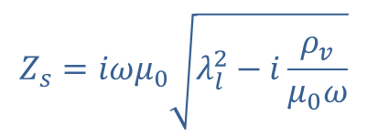

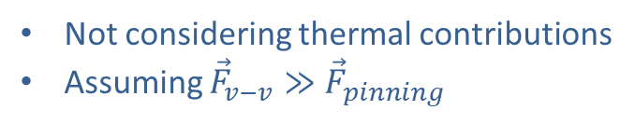
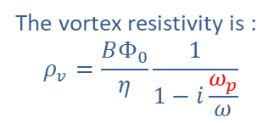




The Gittleman-Rosenblum model
describes the microwave response of the mixed state
The Gittleman-Rosenblum model in a nutshell
Flux tube lattice
Not considering thermal contributions
Assuming ${\vec{F}}_{v−v}≫{\vec{F}}_{pinning}$
$$d$$
The vortex resistivity is :
$$ρ_{v}=\frac{BΦ_{0}}{η}\frac{1}{1−i\frac{ω_{p}}{ω}}$$
$$\vec{B}$$
Equation of motion for fluxons:
Fitting parameter
$$m\ddot{x}+η \dot{x}+kx=J_{rf}Φ_{0}$$
With $η=1.45\frac{φ_{0}B_{c2}}{ρ_{n}}$
$$Z_{s}=iωμ_{0}\sqrt{λ_{l}^{2}−i\frac{ρ_{v}}{μ_{0}ω}}$$
$${\vec{J}}_{rf}$$

