Slide 2
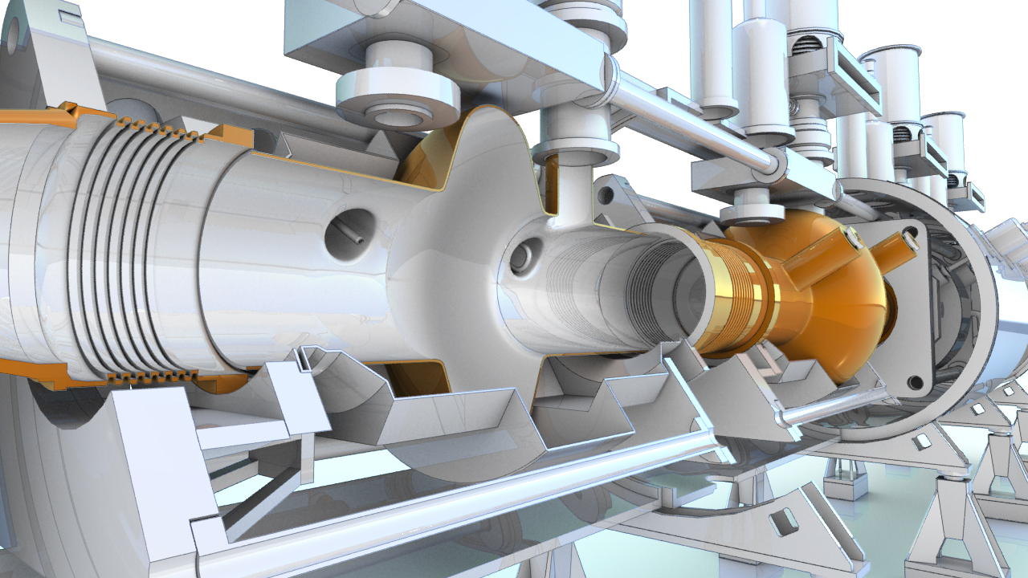

SRF Coatings at CERN
PBC technology mini workshop: superconducting RF – 21st September 2021
G. Rosaz (TE-VSC), on behalf of FCC SRF WP3

Slide 3

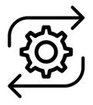



Outline
Infrastructures
Processes
R&D activities
Achievements
Beyond

Slide 4
Mandate
Develop superconducting thin films – focus on low T_{c} (s-wave) for SRF cavities
Investigate alternative materials – Nb₃Sn, V₃Si …
Design coating devices for complex geometries
Develop suitable surface treatments in view of high performance
Coat SRF cavities for CERN accelerator complex (LHC, HIE-ISOLDE) and for external collaboration.

Slide 5
Infrastructures

Slide 6

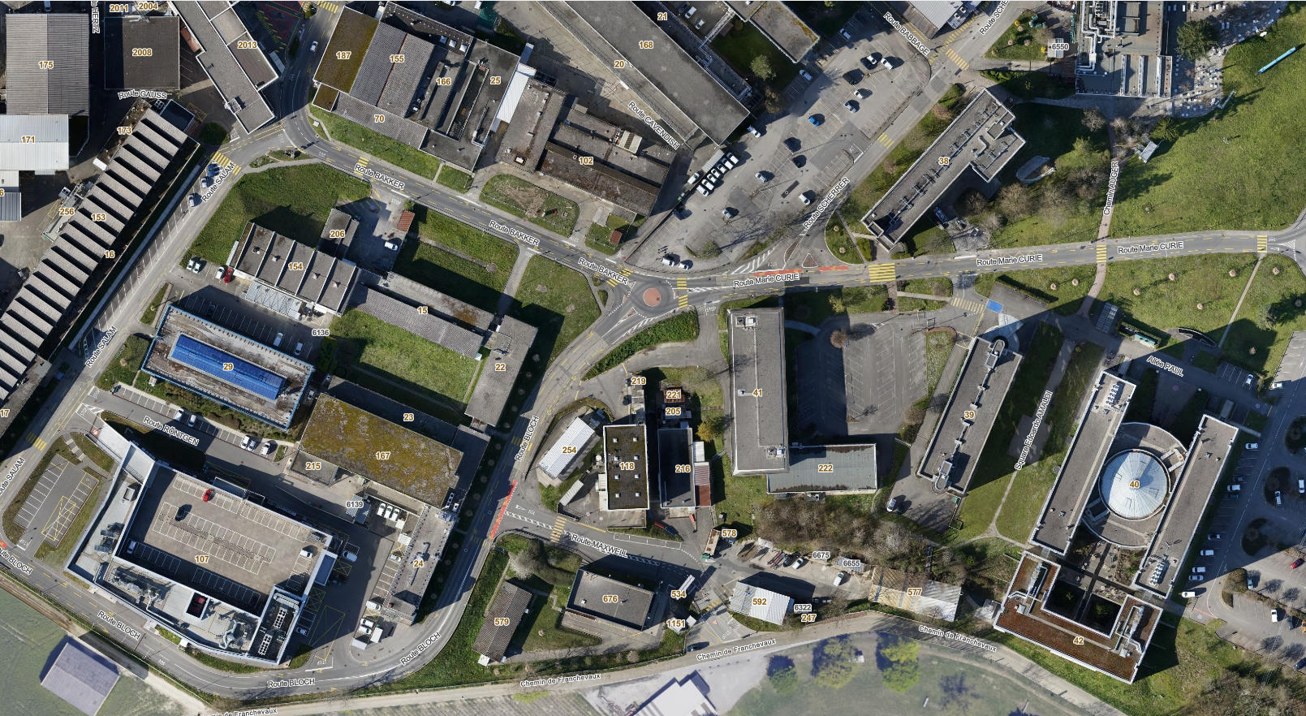
Surface Preparation
118
107

Slide 7
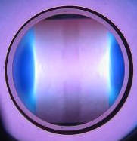
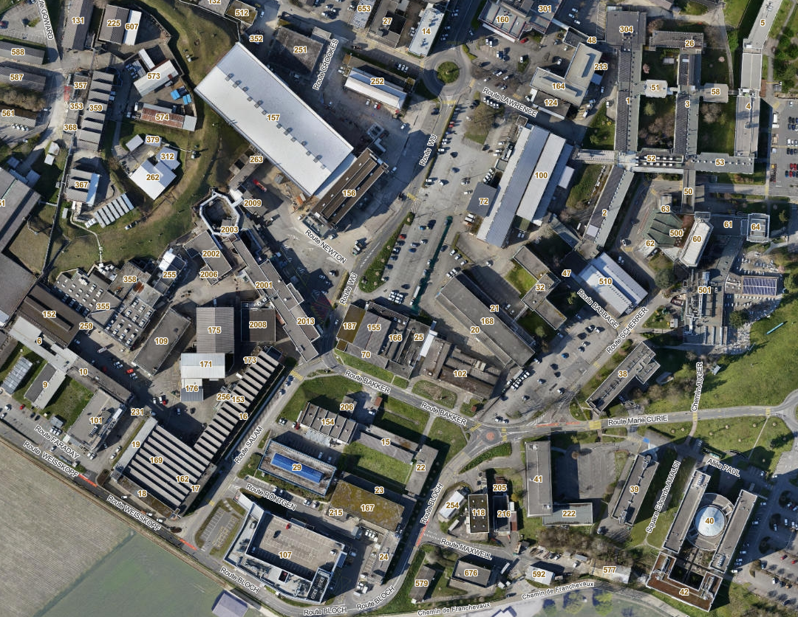
Coatings
252
101

Slide 8
Processes

Slide 9
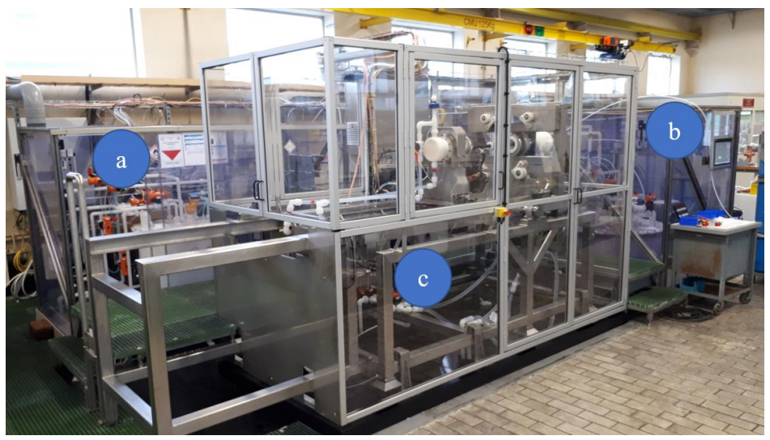
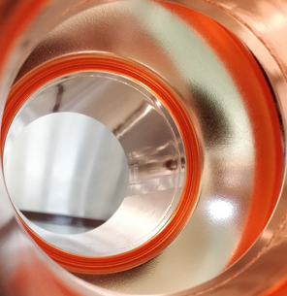
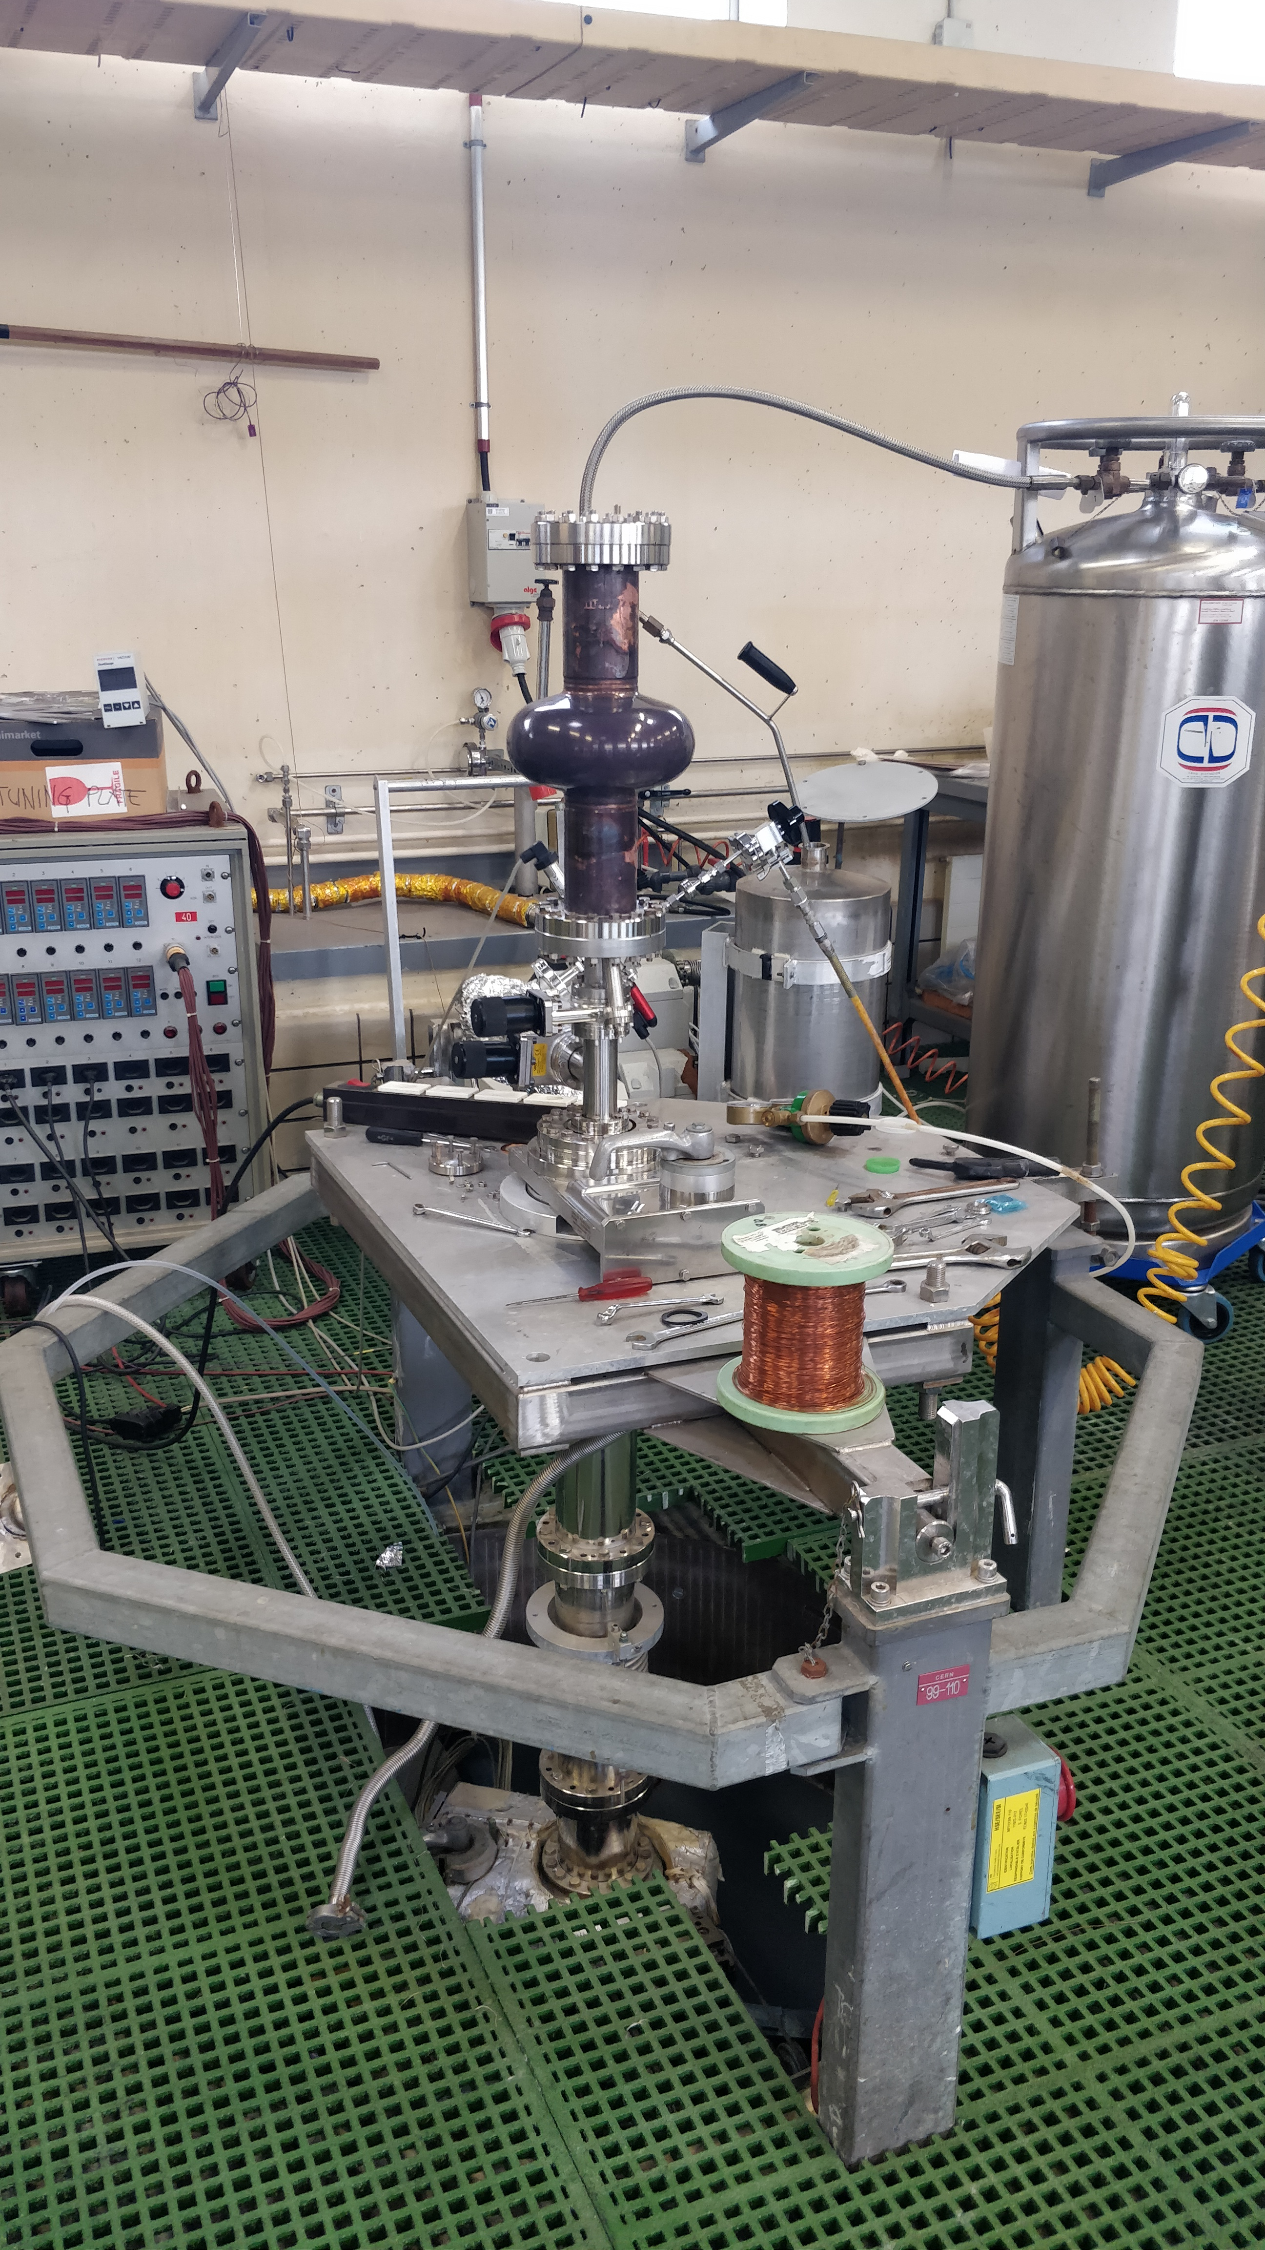
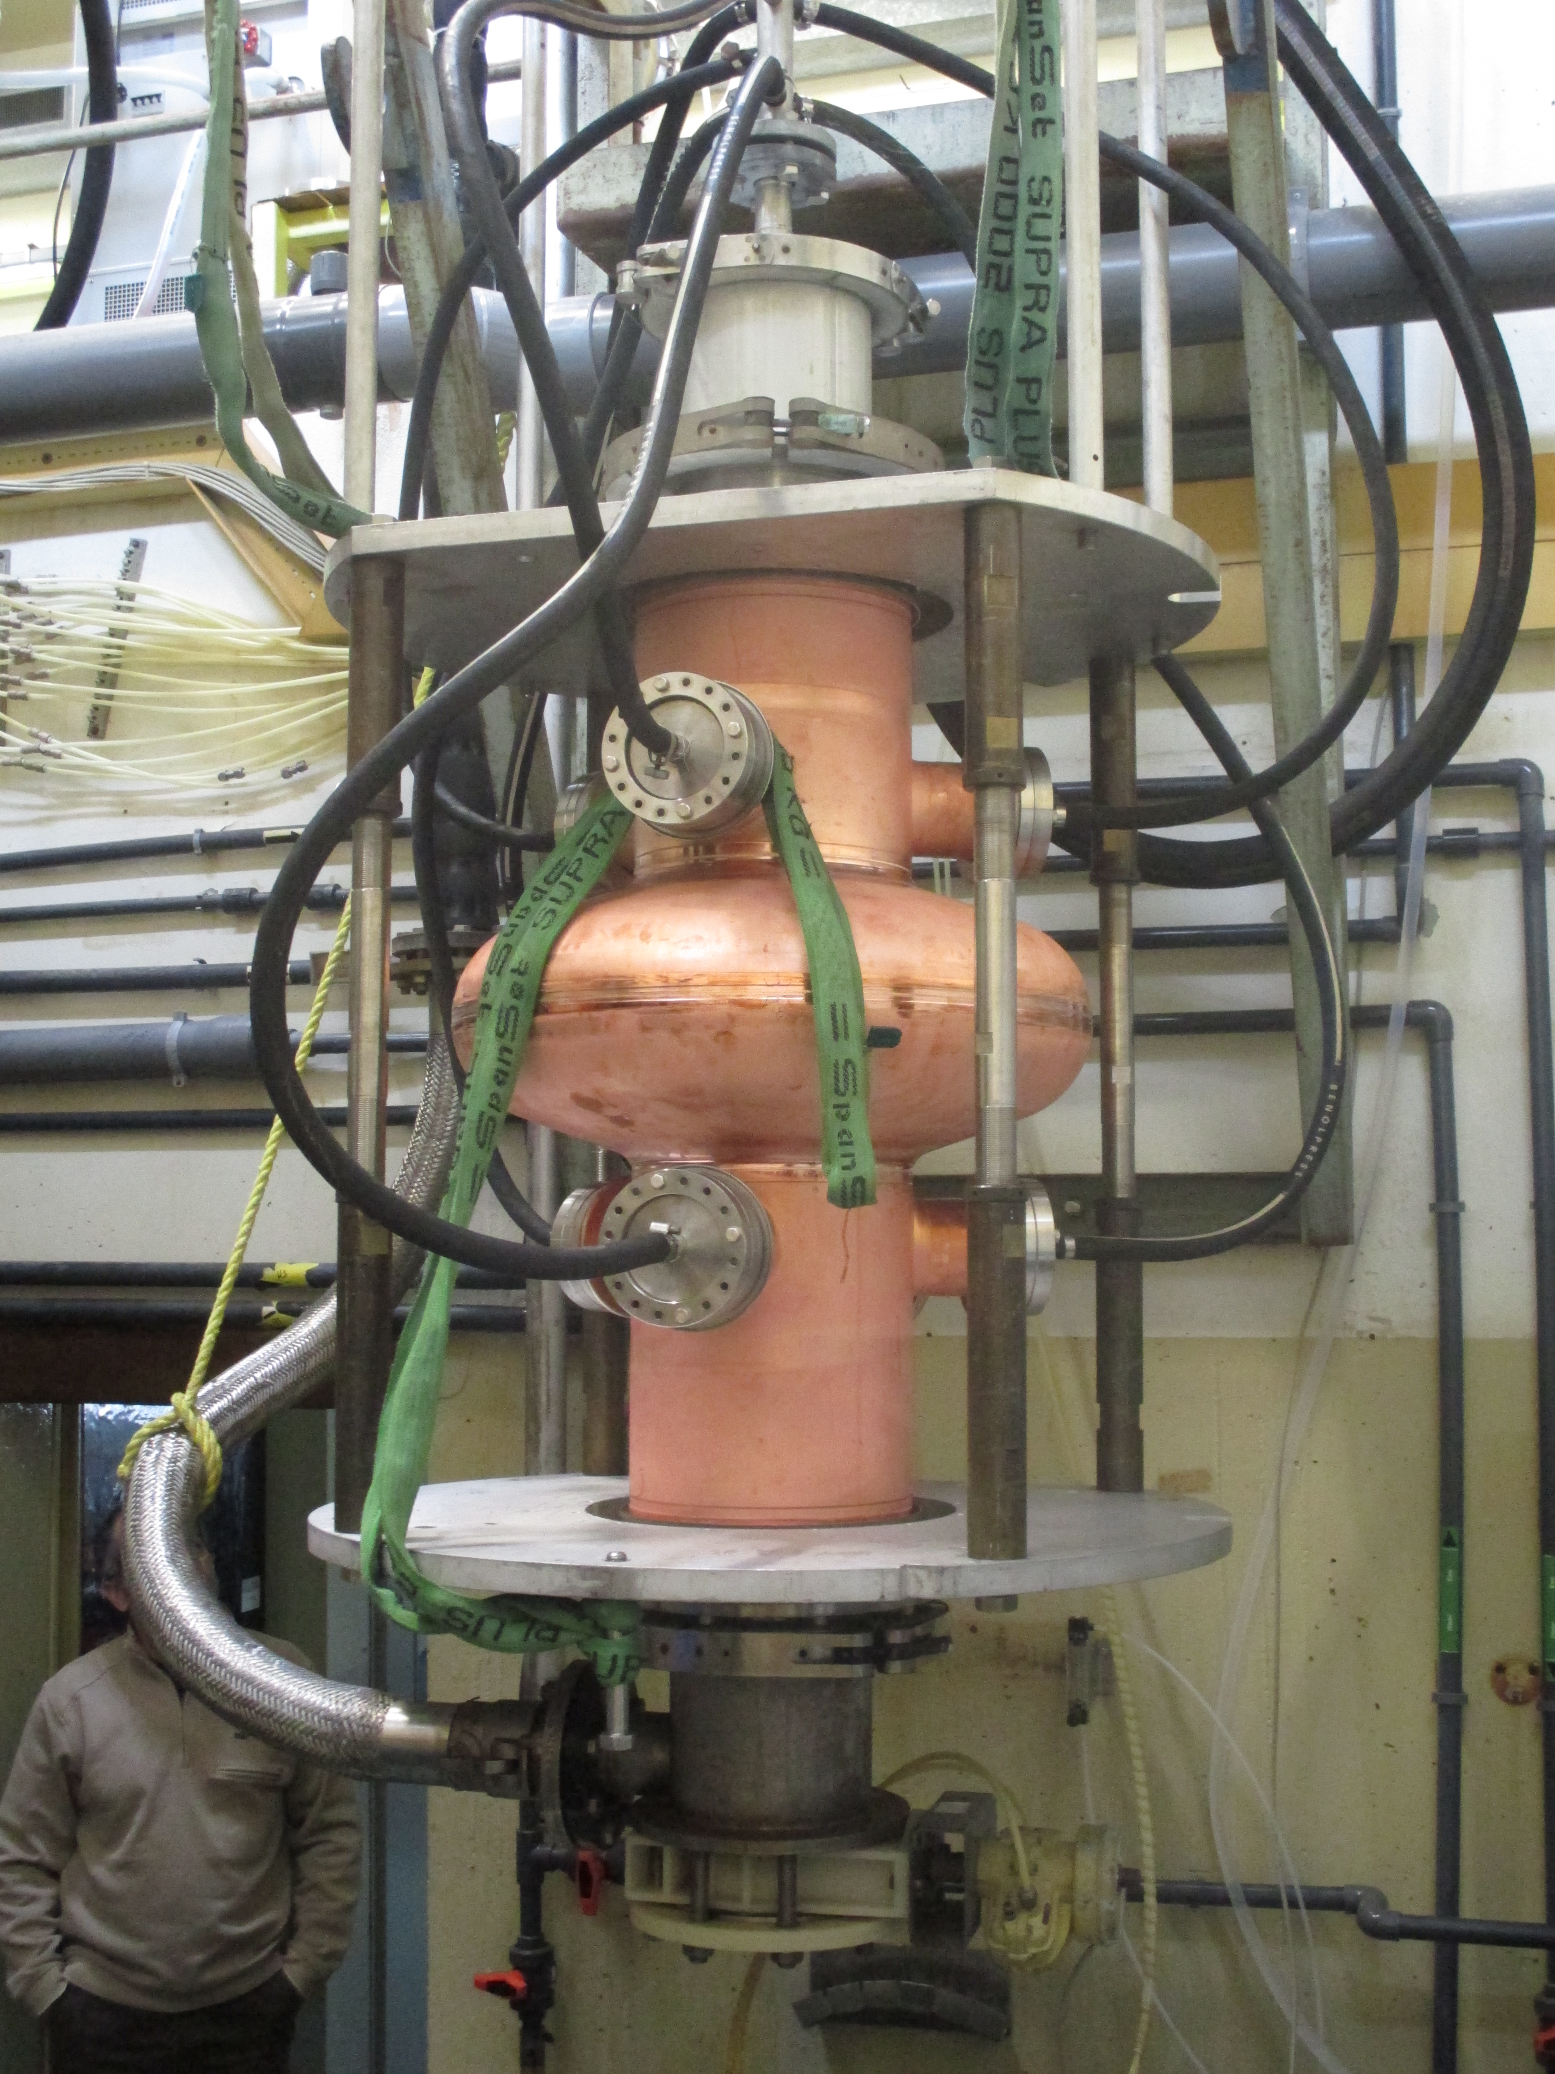
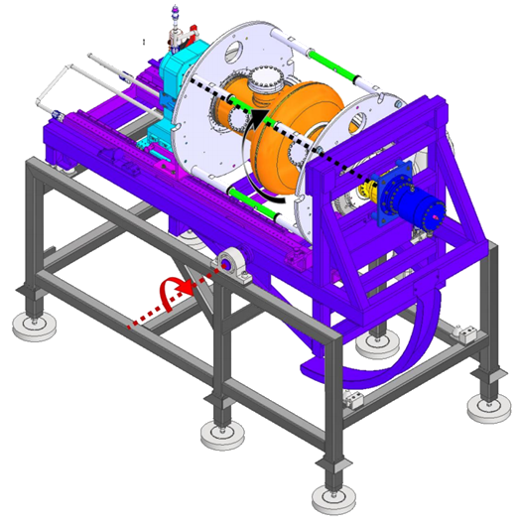
B.118 (surface preparation)
Nb and Cu surface treatments
Cu
  SUBU (chemical polishing)
  Electropolishing
  High Pressure Water Rinsing
SUBU

Slide 10
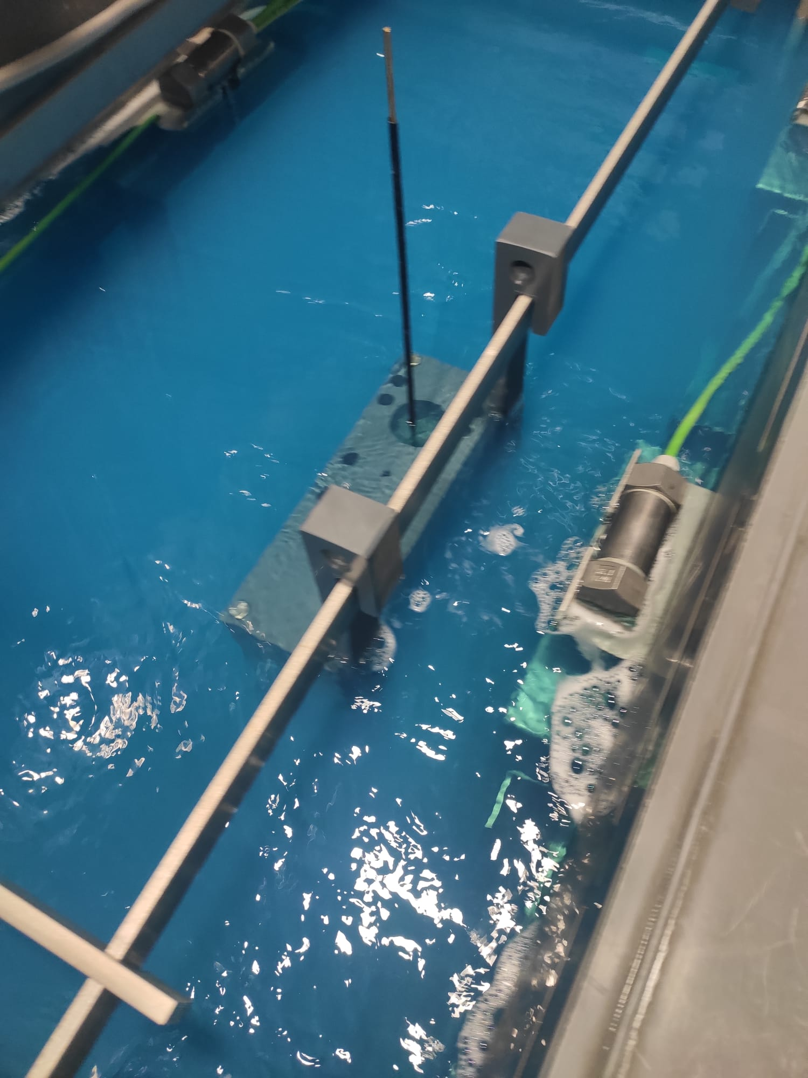
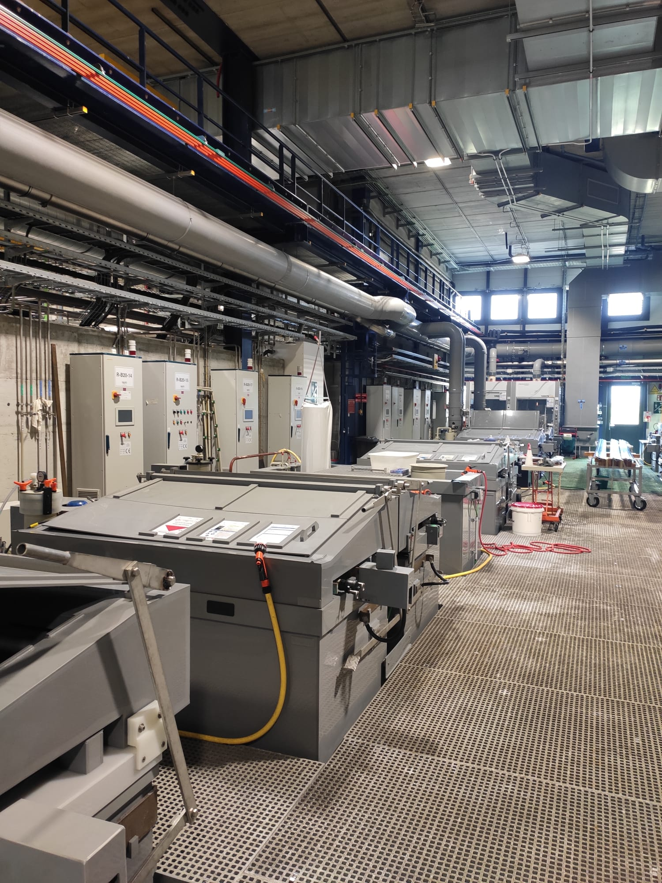
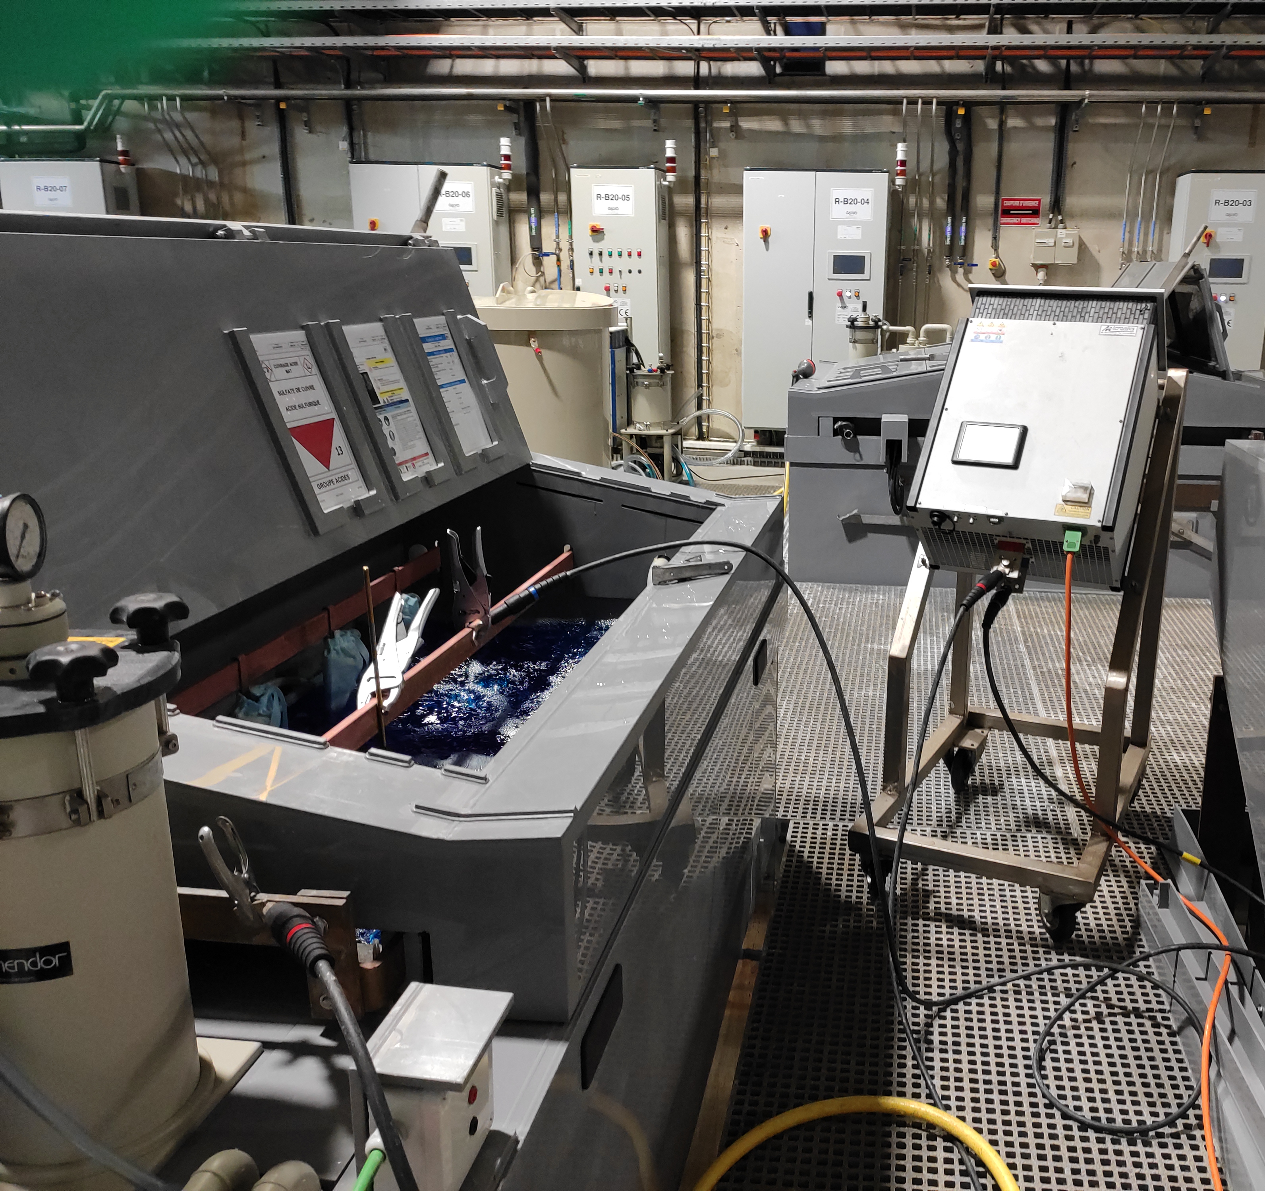
B.107 (surface preparation)
Degreasing
Pickling
Passivation
Electroplating
Degreasing
Pickling
Electroplating

Slide 11
Coating techniques
Physical Vapor Deposition
  Pure Material Target / Alloyed targets
  UHV
  Temperature: from 100°C up to 800°C
Diode Sputtering
Ar (10⁻¹ mbar)

Slide 12
Coating techniques
Physical Vapor Deposition
  Pure Material Target / Alloyed targets
  UHV
  Temperature: from 100°C up to 800°C
Diode Sputtering
Ar (10⁻¹ mbar)

Slide 13
Coating techniques
Physical Vapor Deposition
  Pure Material Target / Alloyed targets
  UHV
  Temperature: from 100°C up to 800°C
Diode Sputtering
Ar (10⁻¹ mbar)

Slide 14
Coating techniques
Physical Vapor Deposition
  Pure Material Target / Alloyed targets
  UHV
  Temperature: from 100°C up to 800°C
Diode Sputtering
Ar (10⁻¹ mbar)
Simple set-up
High working pressure

Slide 15
Coating techniques
Physical Vapor Deposition
  Pure Material Target / Alloyed targets
  UHV
  Temperature: from 100°C up to 800°C
Diode Sputtering
Magnetron Sputtering
Ar (10⁻¹ mbar)
Ar (10^{-4/-3} mbar))
Simple set-up
High working pressure

Slide 16
Coating techniques
Physical Vapor Deposition
  Pure Material Target / Alloyed targets
  UHV
  Temperature: from 100°C up to 800°C
Diode Sputtering
Magnetron Sputtering
Ar (10⁻¹ mbar)
e⁻
Ar (10^{-4/-3} mbar))
Simple set-up
High working pressure

Slide 17
Coating techniques
Physical Vapor Deposition
  Pure Material Target / Alloyed targets
  UHV
  Temperature: from 100°C up to 800°C
Diode Sputtering
Magnetron Sputtering
Ar (10⁻¹ mbar)
e⁻
Ar (10^{-4/-3} mbar))
Simple set-up
High working pressure

Slide 18
Coating techniques
Physical Vapor Deposition
  Pure Material Target / Alloyed targets
  UHV
  Temperature: from 100°C up to 800°C
Diode Sputtering
Magnetron Sputtering
Ar (10⁻¹ mbar)
e⁻
Ar (10^{-4/-3} mbar))
More complex set-up
Temperature control required on cathode
Higher coating rate
Lower contamination
Simple set-up
High working pressure

Slide 19
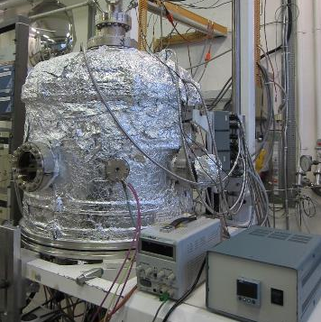
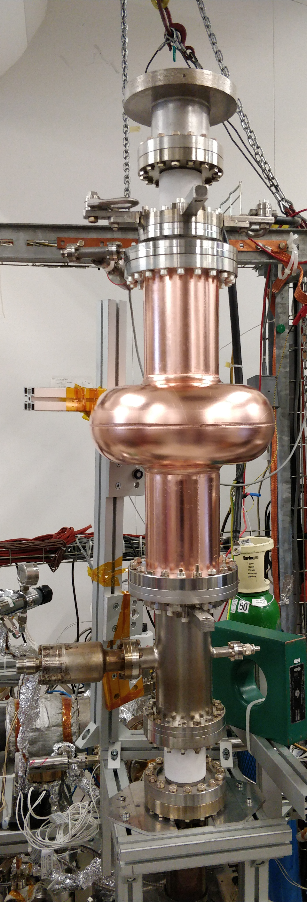
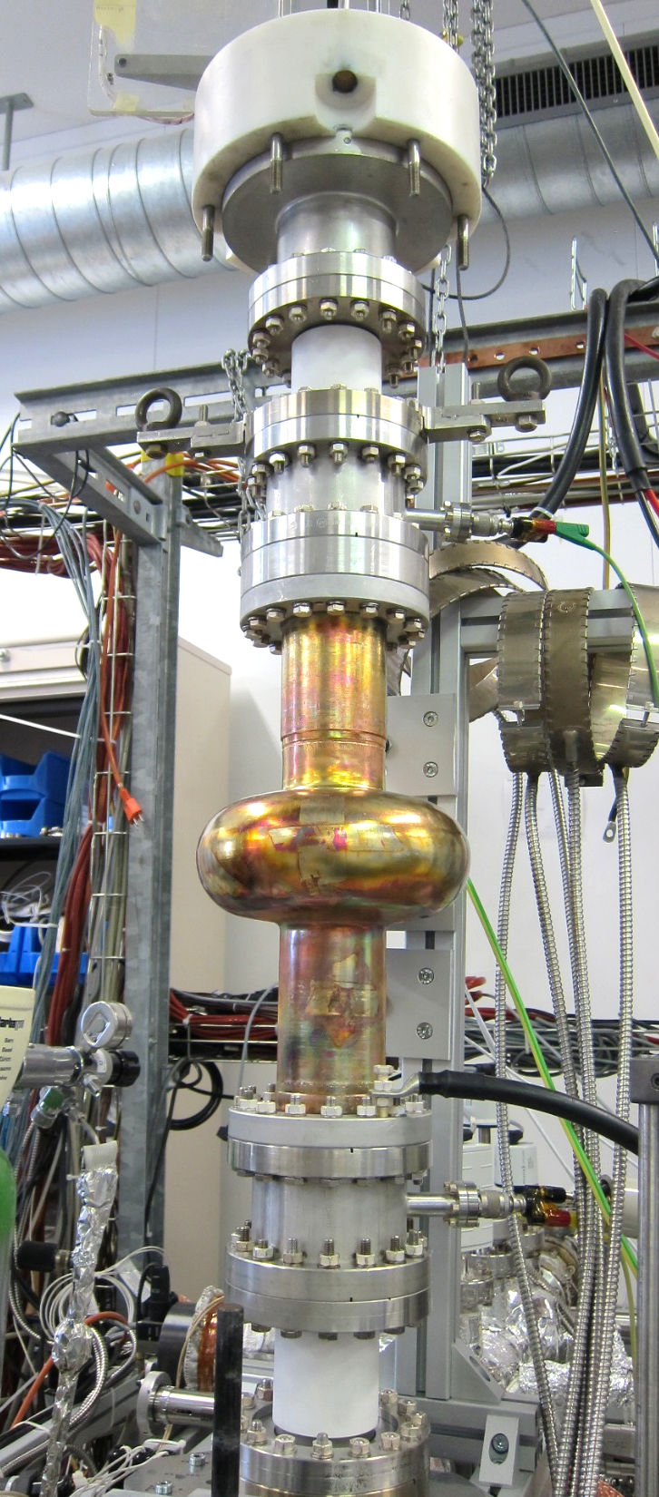
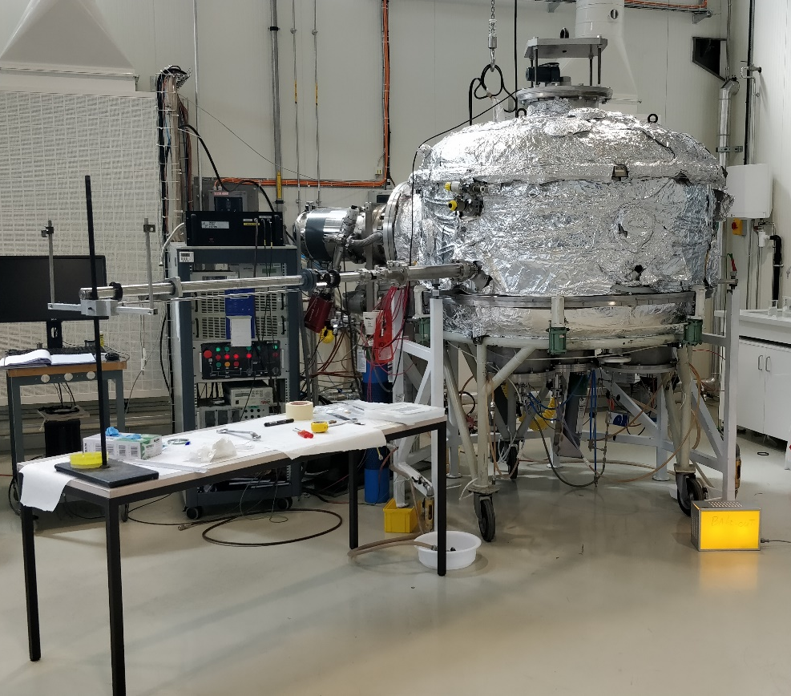
B.101 (coating)
3 coating setups
  2 for samples R&D
  1 for 1.3GHz / 800 MHz cavities

Slide 20
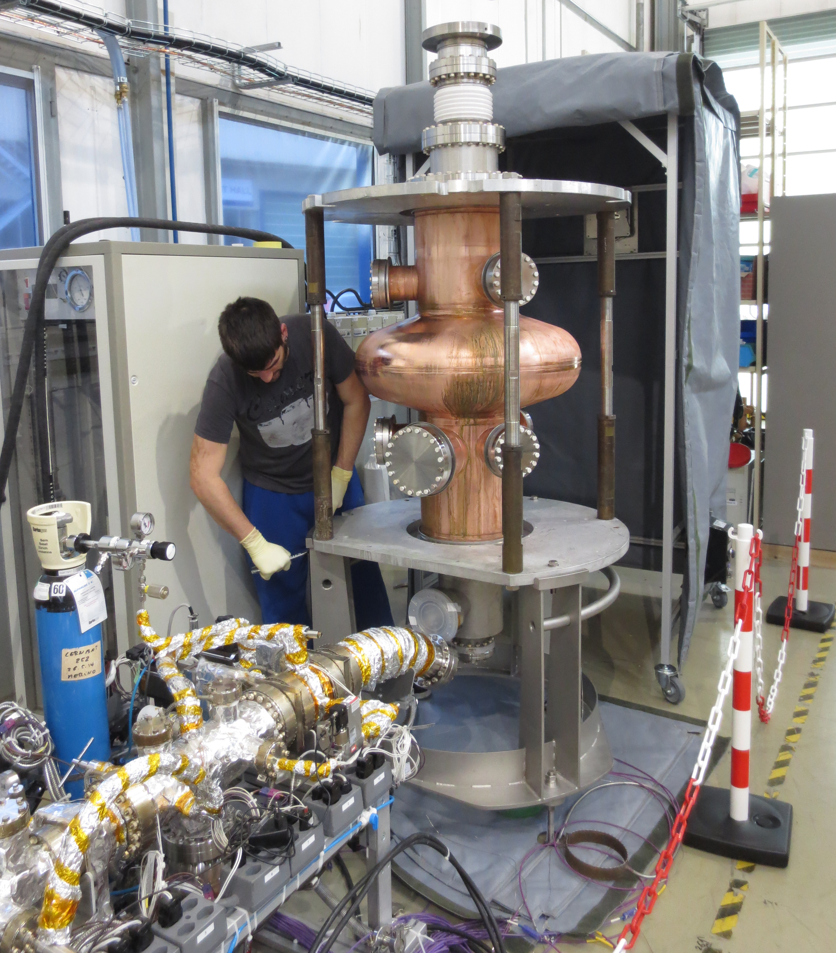
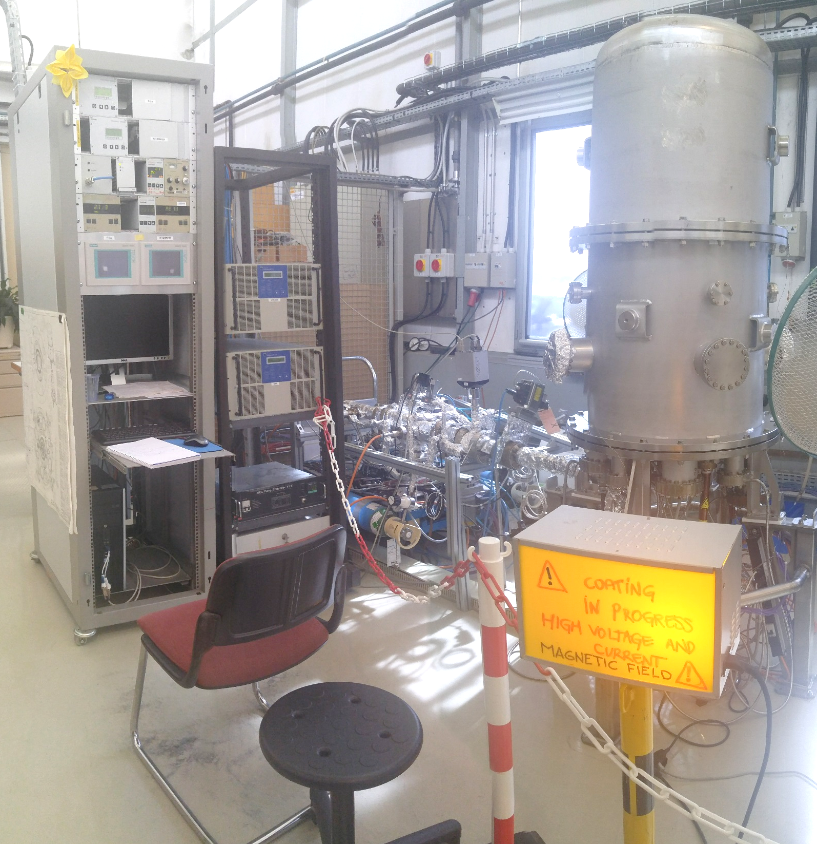
B.252 (coating)
2 coating setups
Dedicated to Cavities production
  HIE-ISOLDE
  LHC

Slide 21
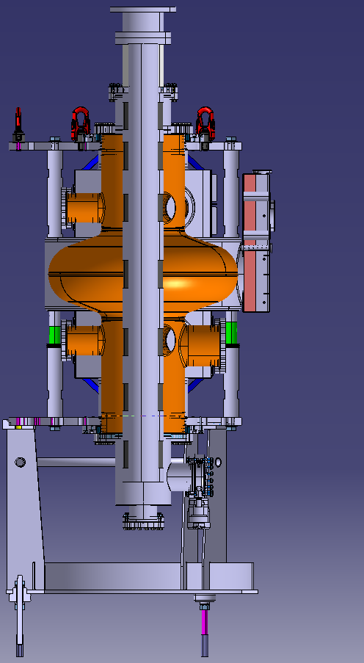
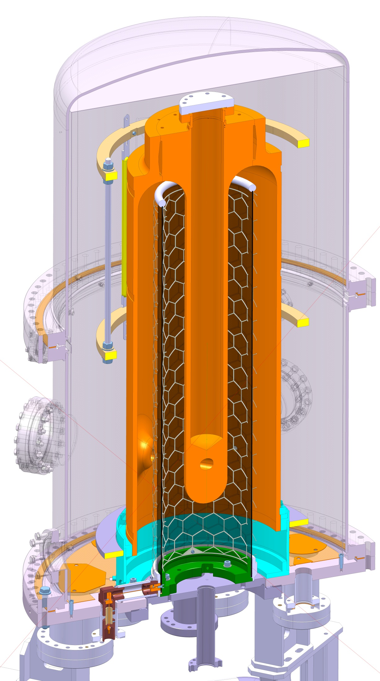
B.252 (coating)
2 coating setups
Dedicated to Cavities production
  HIE-ISOLDE
  LHC
Cathode
Magnet
Coating apparatus schematic

Slide 22
R&D Activities

Slide 23
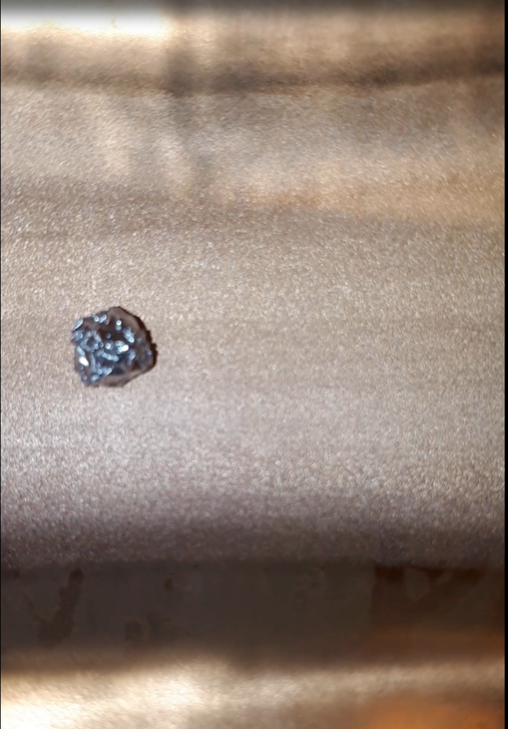
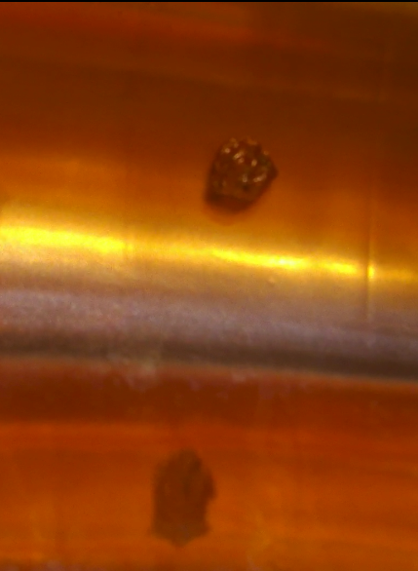
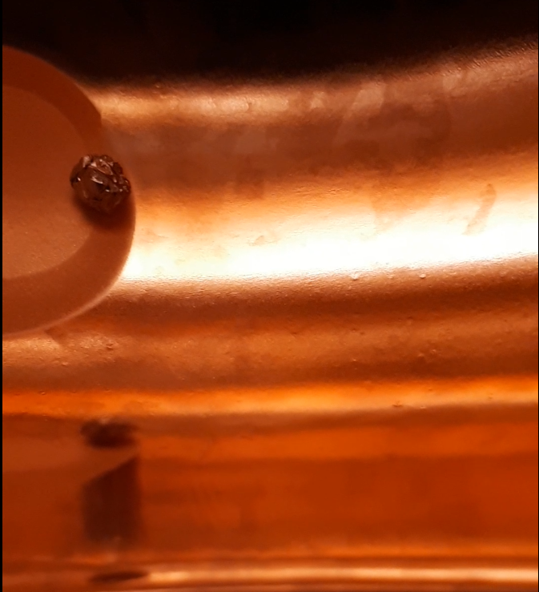
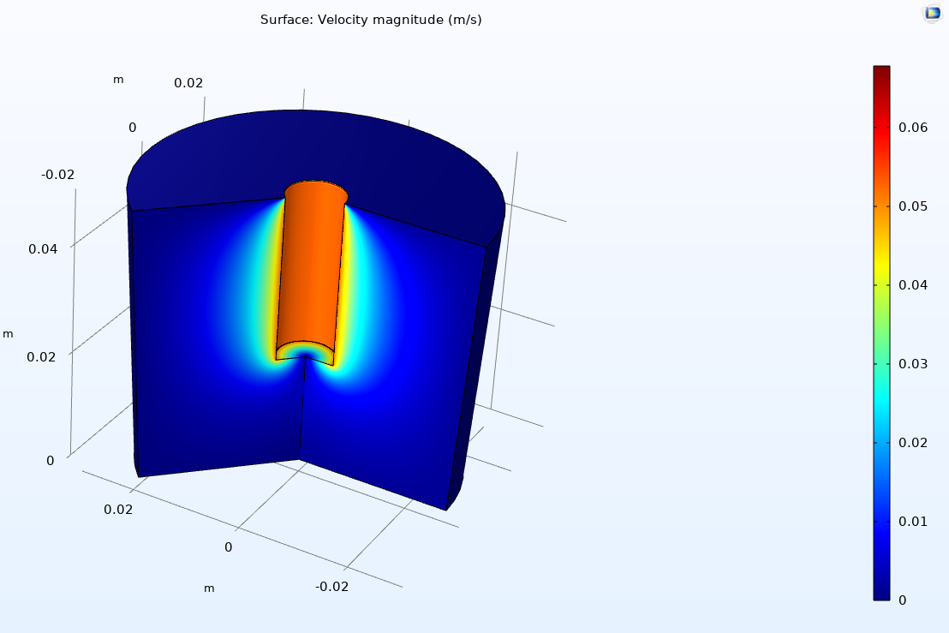
Surface treatments
Electropolishing
12 V, 1 rpm
Horizontal EP
12 V, 0.5 rpm
Horizontal EP
10 V, 0 rpm
Vertical EP
TE/VSC seminar on EP
Velocity magnitude distribution (m/s)
Process optimization on 1.3GHz cavities
Scale-up to larger objects (400MHz)

Slide 24
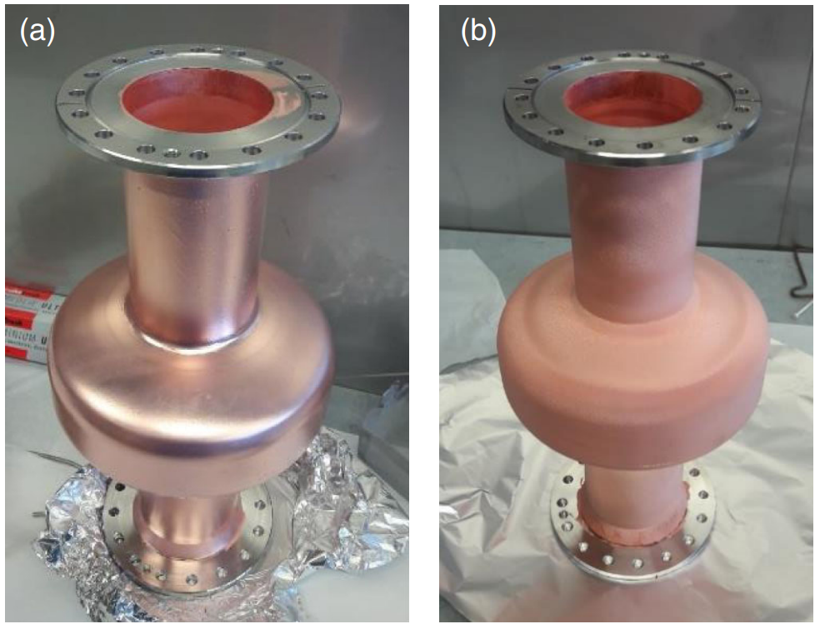
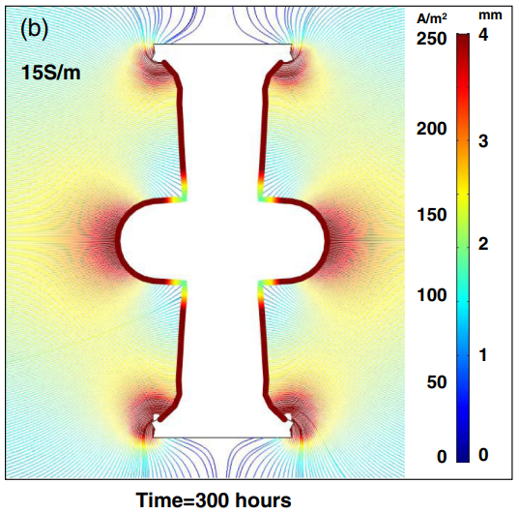
Surface treatments
Electropolishing
Electroforming
12 V, 1 rpm
Horizontal EP
12 V, 0.5 rpm
Horizontal EP
10 V, 0 rpm
Vertical EP
L. Lain Amador et al, Electrodeposition of copper applied to the manufacture of seamless superconducting rf cavities, Phys. Rev. Accel. Beams 24, 082002
TE/VSC seminar on EP
Velocity magnitude distribution (m/s)
Process optimization on 1.3GHz cavities
Scale-up to larger objects (400MHz)

Slide 25
Coatings
1.3GHz cavities
Samples
Investigation of High Power Impulse Magnetron Sputtering
DCMS : Direct Current Magnetron Sputtering
HiPIMS: High Power Impulse Magnetron Sputtering
Voltage/ Current
Voltage/ Current
Time
DCMS
HiPIMS
Parameter (unit) | Range
Pulse duration (us) | 1-200
Frequency (Hz) | 20-500
Power (kW) | 100 peak, 2 avg
Gas | Ar, Kr
Pressure (mbar) | 8.10⁻⁴-5.10⁻²

Slide 26
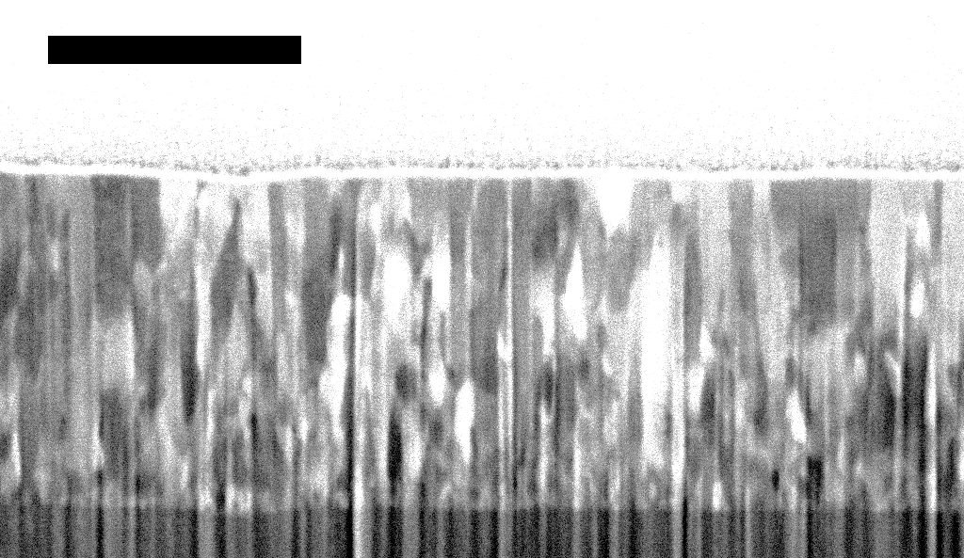
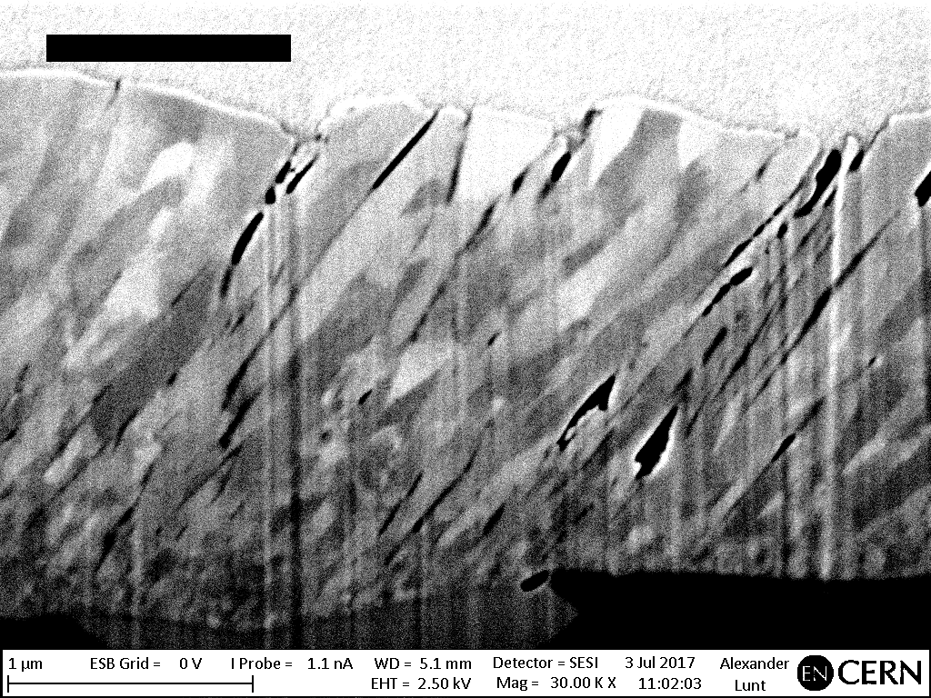
Coatings
1.3GHz cavities
Samples
Investigation of High Power Impulse Magnetron Sputtering

Slide 27
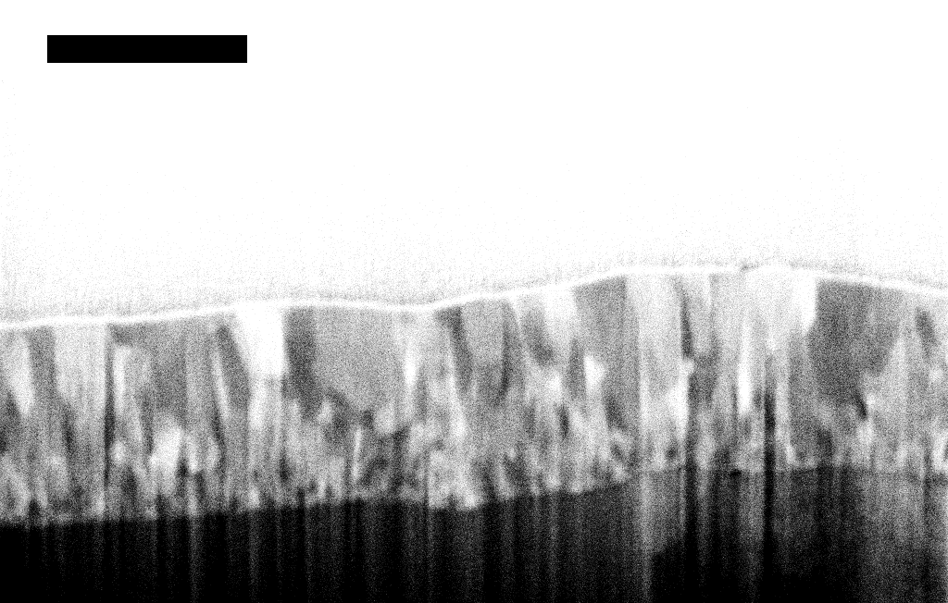
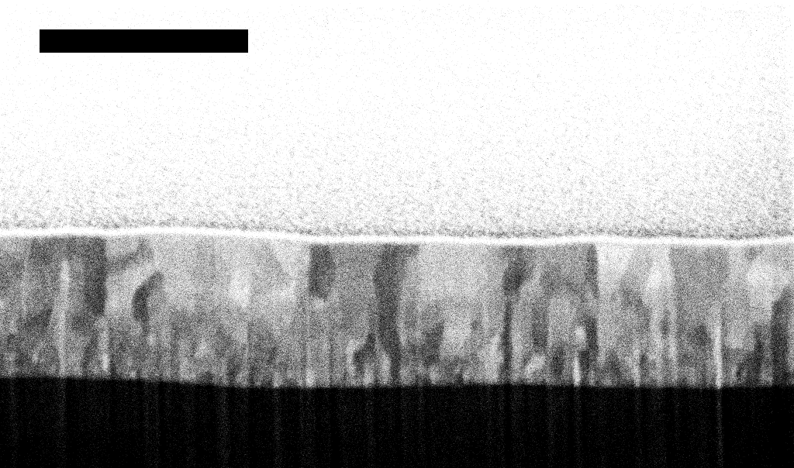
Coatings
1.3GHz cavities
Samples
Investigation of High Power Impulse Magnetron Sputtering

Slide 28

Coatings
1.3GHz cavities
Samples
Investigation of High Power Impulse Magnetron Sputtering
Modulation of the critical current density = Modification of pinning strength in the layers

Slide 29
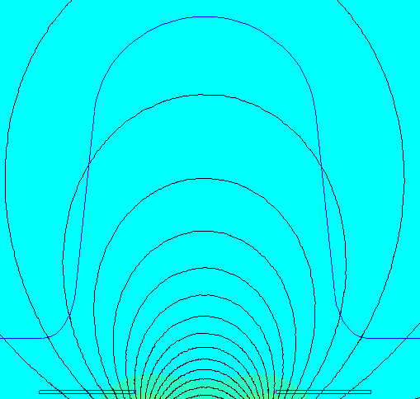
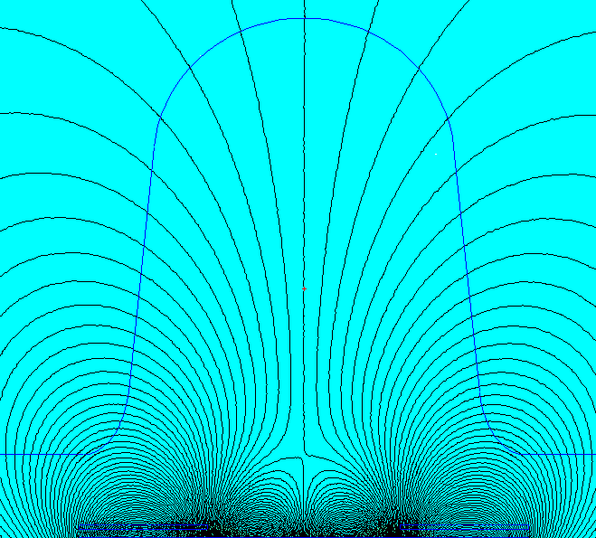
Coatings
1.3GHz cavities
Samples
Simulations
Investigation of High Power Impulse Magnetron Sputtering
Magnetostatic for source design

Slide 30
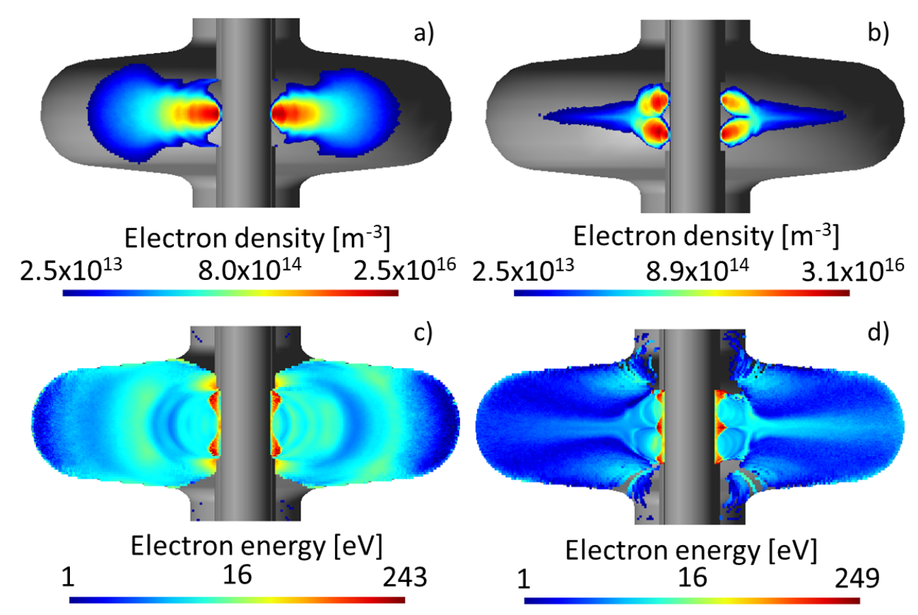
Coatings
1.3GHz cavities
Samples
Simulations
Investigation of High Power Impulse Magnetron Sputtering
Magnetostatic for source design
PIC-MC + KMC simulations
Plasma discharge
Transport
T. Richard PhD thesis

Slide 31
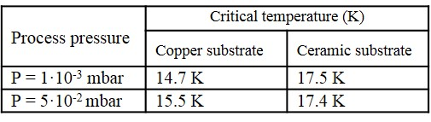
Coatings
1.3GHz cavities
Samples
Simulations
Alternative Materials (Nb₃Sn)
Investigation of High Power Impulse Magnetron Sputtering
Growth temperature and annealing effect

Slide 32
Coatings
1.3GHz cavities
Samples
Simulations
Alternative Materials (Nb₃Sn)
Investigation of High Power Impulse Magnetron Sputtering
Use of diffusion barrier layer enhancing T_{c}
Growth temperature and annealing effect
E. A. Ilyina et al, Development of sputtered Nb3Sn films on copper substrates for superconducting radiofrequency applications, SUST, 32, 3 2019

Slide 33
Achievements

Slide 34
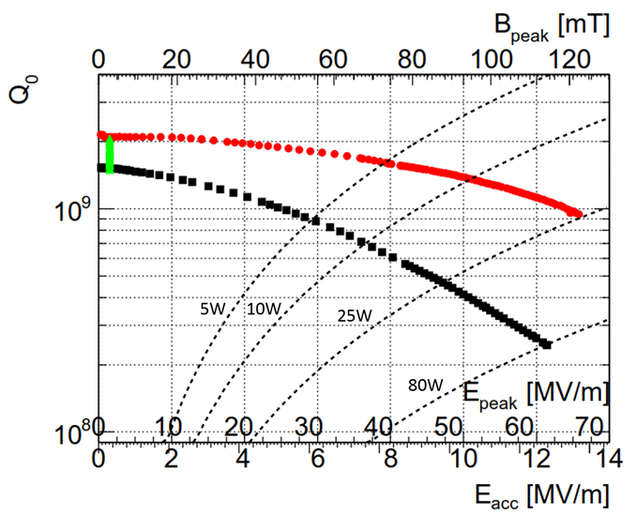
Achievements
HIE-ISOLDE
B_{res}= 50 mG
Highest field ever reached by a Nb/Cu cavity
(~30MV/m in elliptical shape)

Slide 35
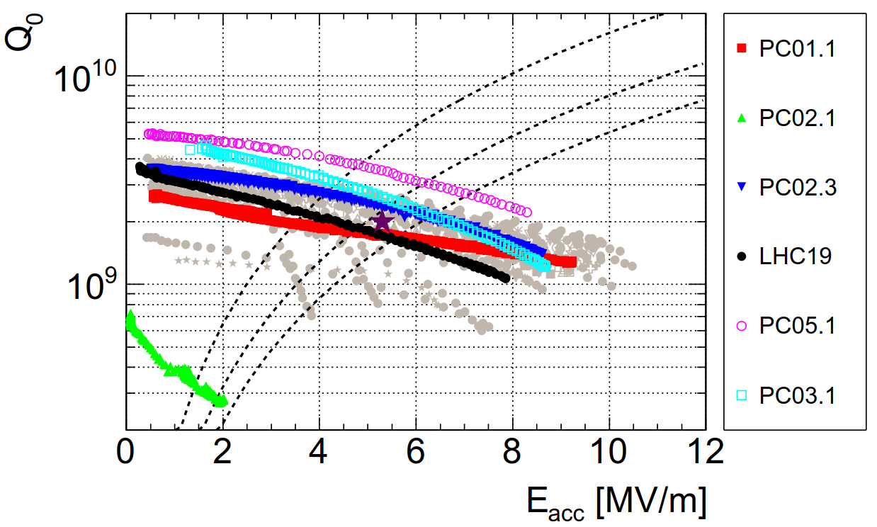
Achievements
HIE-ISOLDE
LHC
B_{res}= 50 mG
T= 4.5 K
Highest field ever reached by a Nb/Cu cavity
(~30MV/m in elliptical shape)
Spare program has shown improved performance vs baseline

Slide 36
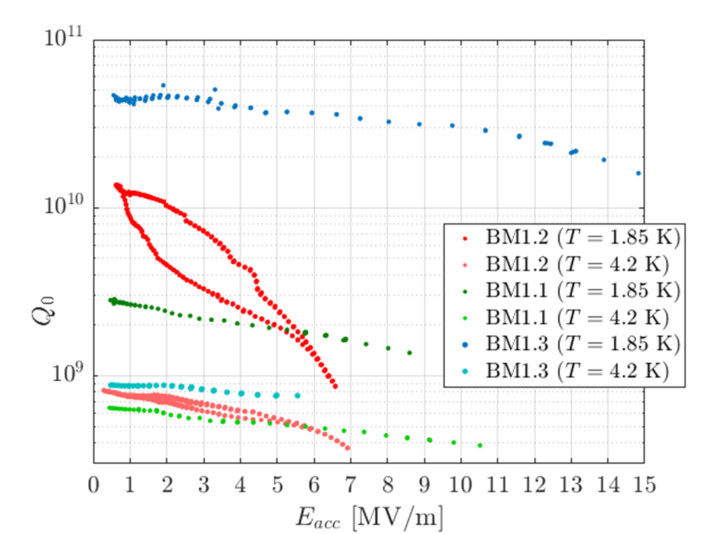
Achievements
1.3GHz
A15 (Nb₃Sn)

Slide 37
Achievements
1.3GHz
A15 (Nb₃Sn)
STATE OF THE ART Nb/Cu

Slide 38
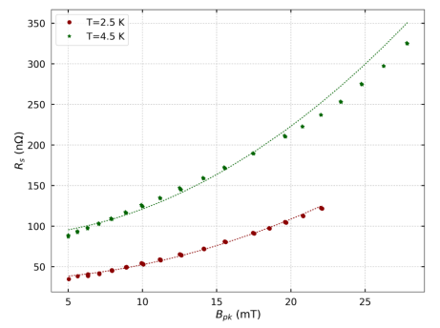
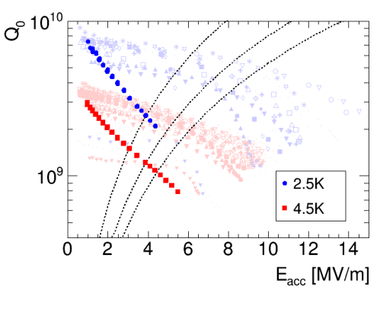
Achievements
1.3GHz
A15 (Nb₃Sn)
STATE OF THE ART Nb/Cu

Slide 39
Achievements
1.3GHz
A15 (Nb₃Sn)
STATE OF THE ART Nb/Cu
VERY PROMISING STARTING POINT
OPTIMIZATION ON-GOING

Slide 40
Beyond

Slide 41
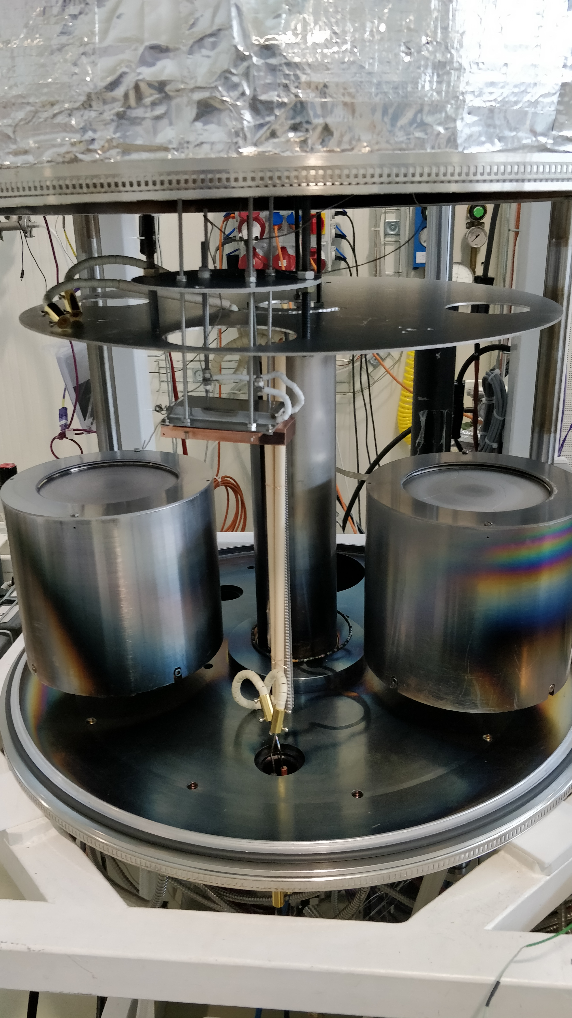
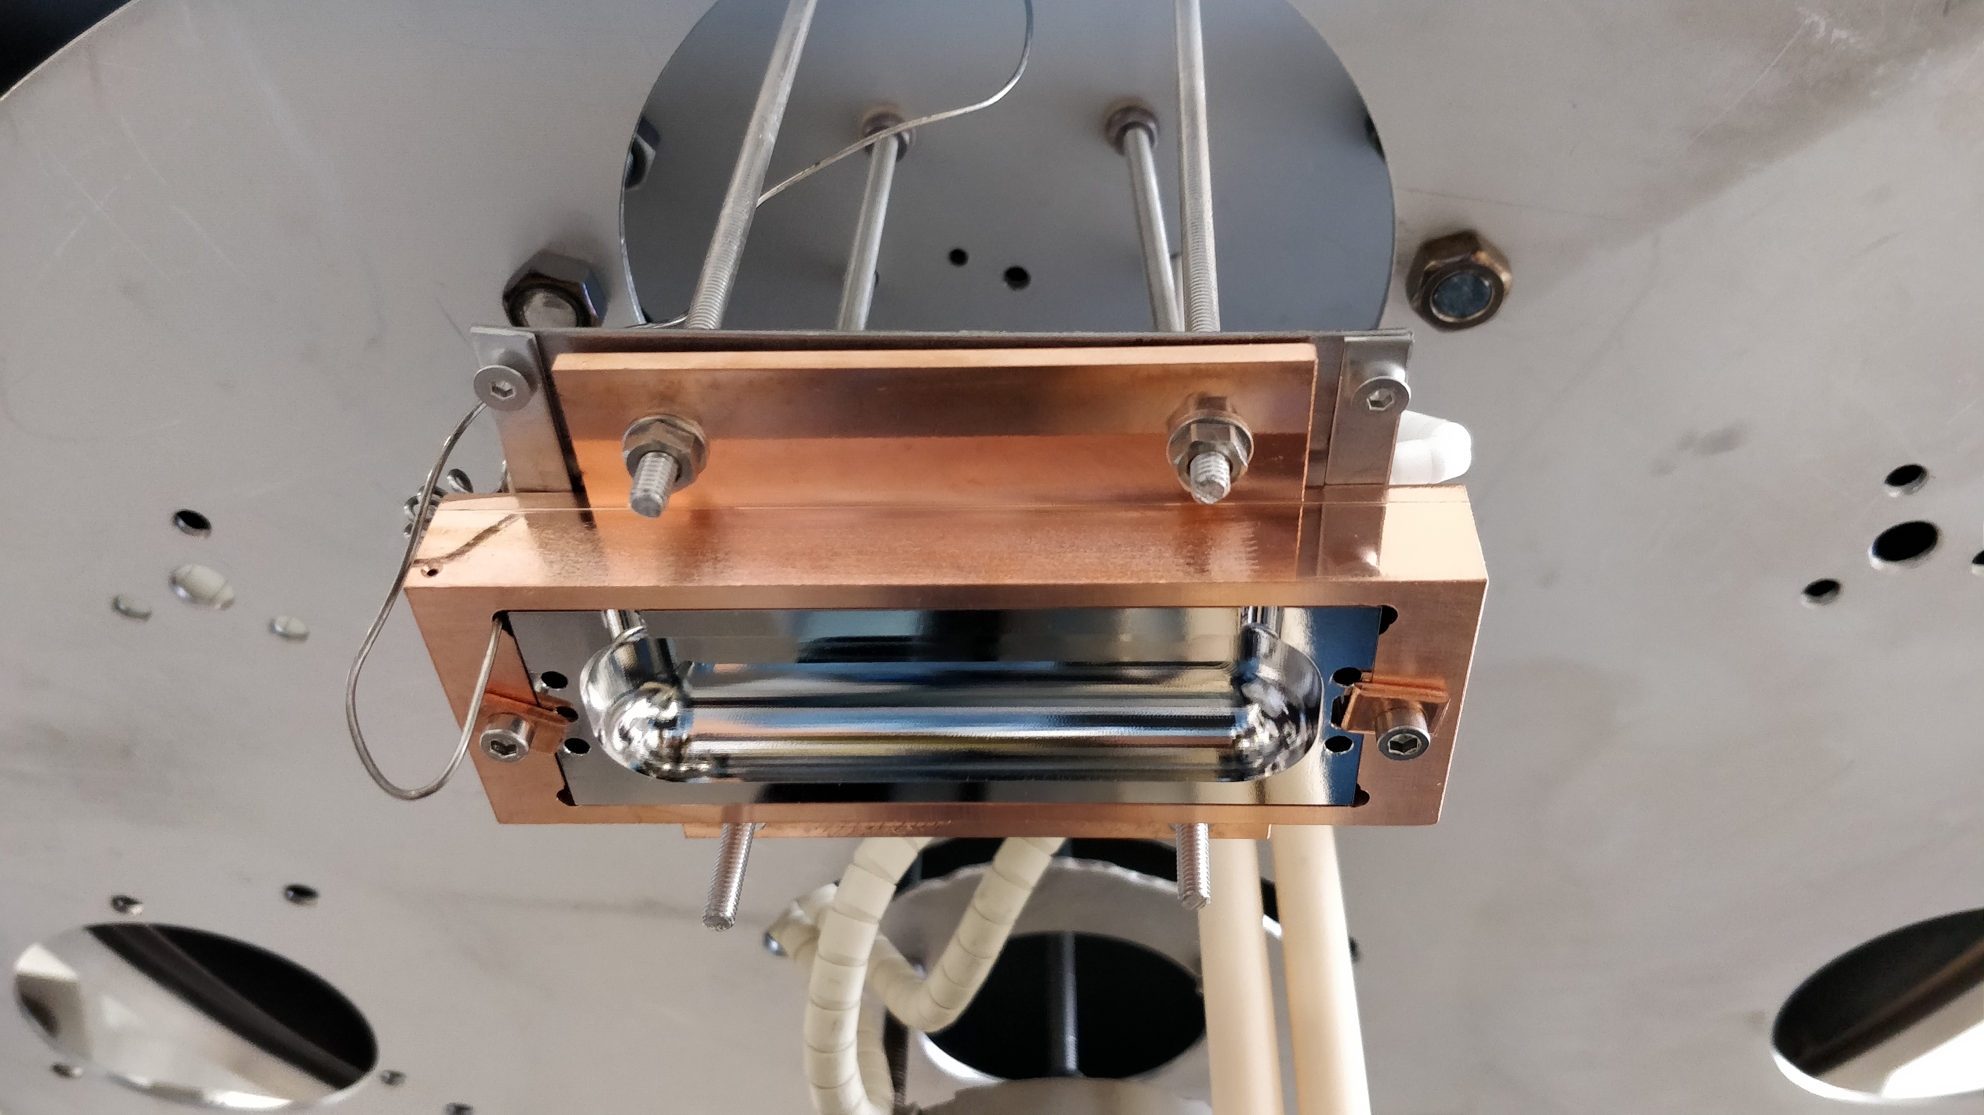
Beyond
RADES Cavity coating with Nb₃Sn
Customized holder and heater.
Cf: J. Golm presentation
Other materials?

Slide 42

Conclusion
Strong know-how gained regarding surface treatments dedicated to SRF surfaces
Coating techniques capable of providing very low surface resistance materials
Expertise in coating systems/processes design
On-demand customization (e.g. RADES cavity)
Current application targets low J_{c}
Pinning efficiency can be tuned (ions energy, impurities etc.)

Slide 43
Thank you for your attention
(interested by a lab tour? give a call)

