Slide 2
SRF for axion haloscopes
Sergio Calatroni - CERN

Slide 3
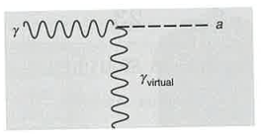
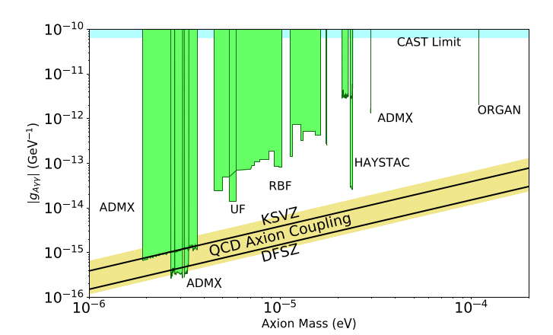
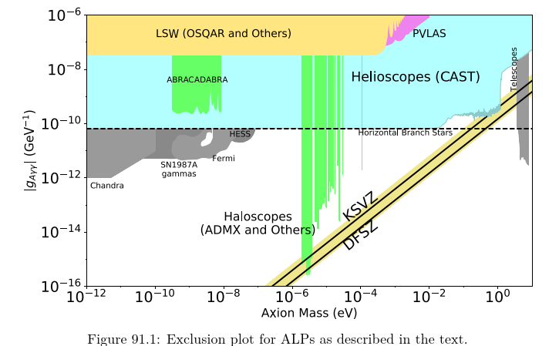

Exclusion plots
$$ℒ=g_{aγγ}a\vec{E}⋅\vec{B}$$
E must be parallel to B
Photon frequency (E=hν) (GHz)
1
10
Source: The Review of Particle Physics

Slide 4
Summary
Where and how could SRF be used for axion detection?
  “Sikivie” like RF cavities: axion + (B) photon → (RF) photon
    (ADMX), RADES (previous talk by J. Golm), QUAX, BASE (see last talk by S. Ulmer)
  “Light shining through a wall”: (RF) photon → axion → (RF) photon
    DarkSRF, (Multimode pumping, Bogorad et al.)
  “Heterodyne” type experiments: axion + (RF) photon → (RF) photon
    See next talk, D’Agnolo et al.
I will then focus on two aspects, relevant for all these experiments:
SRF in a magnetic field, and nonlinearities

Slide 5
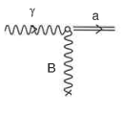
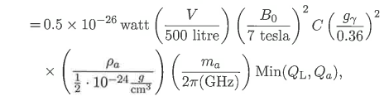
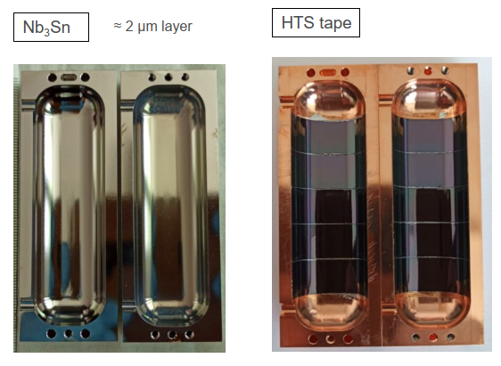
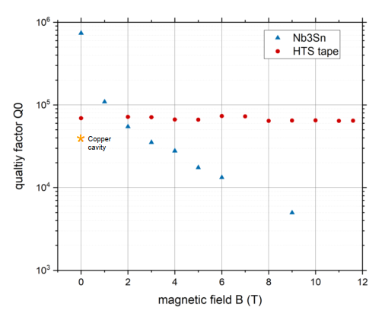
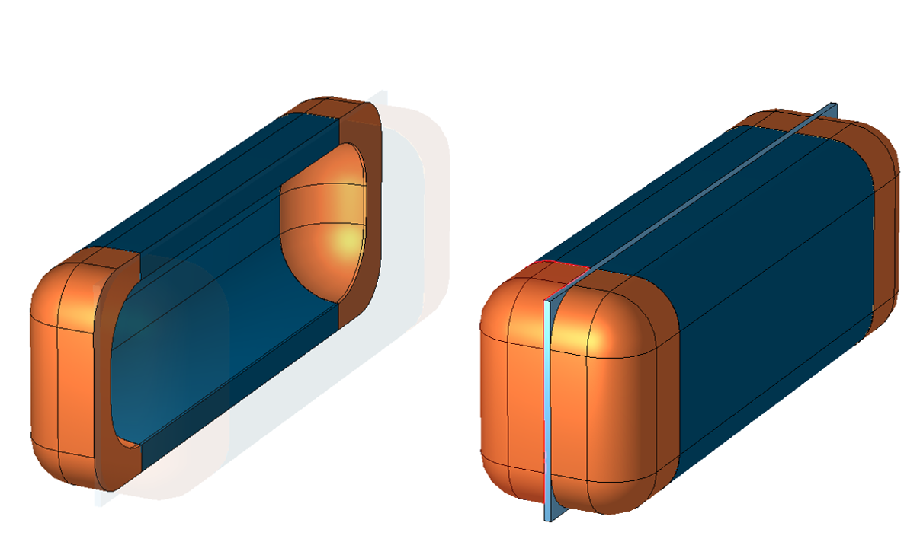
Axion conversion in an RF cavity I
P_{a}
Note:
no need for cavity Q_{L} to be larger than Q_{a} ~10⁶
Source: Particle Dark Matter, G. Bertone ed.
See talk by J. Golm earlier today

Slide 6
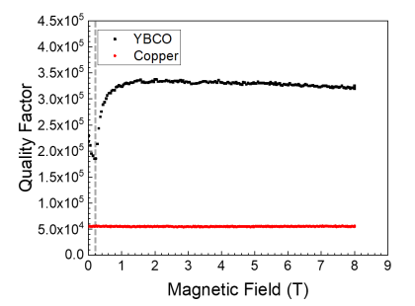
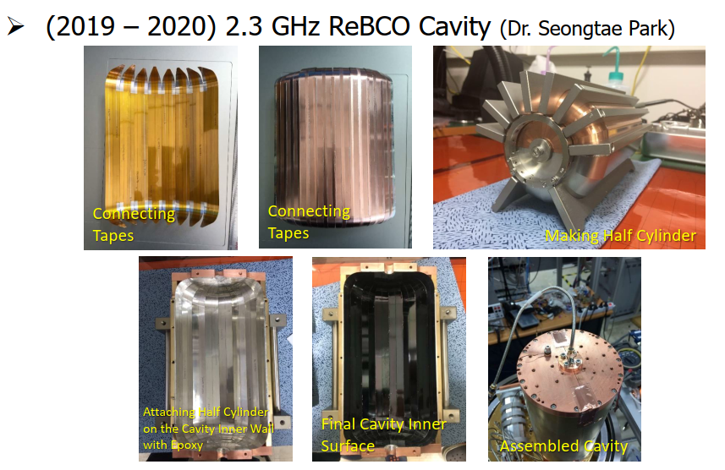
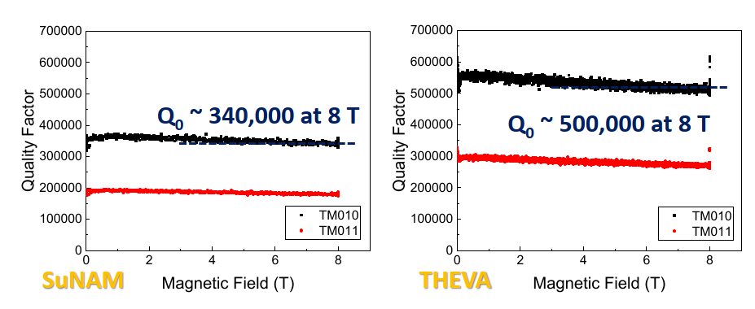
Axion conversion in an RF cavity II
REBCO tape glued on Al segmented cavity @ 7 GHz
7 GHz
J_{RF} parallel to B
2.3 GHz
2.3 GHz
CAPP: Patras Workshop 2021

Slide 7
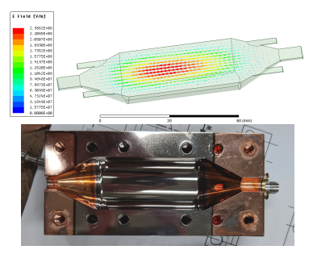
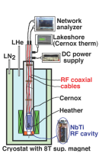
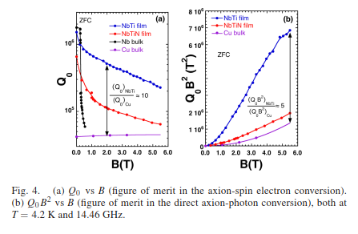
Axion conversion in an RF cavity III
NbTi / NbTiN – Cu cavity @ 14.46 GHz
Fit of depinning frequency: NbTi = 44 GHz, NbTiN = 26 GHz
(Nb₃Sn from literature : 3-4 GHz)
(REBCO from literature = 20-100 GHz)
QUAX a-γ (KLASH), arXiv:1903.06547v1 and IEEE TAS 29 (2019) 3500605

Slide 8
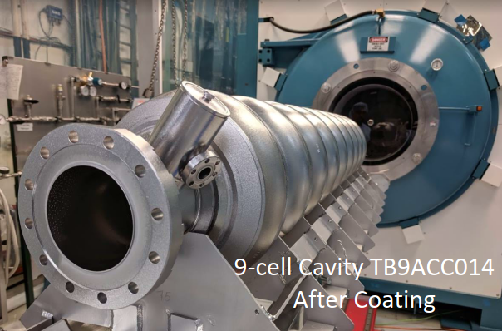
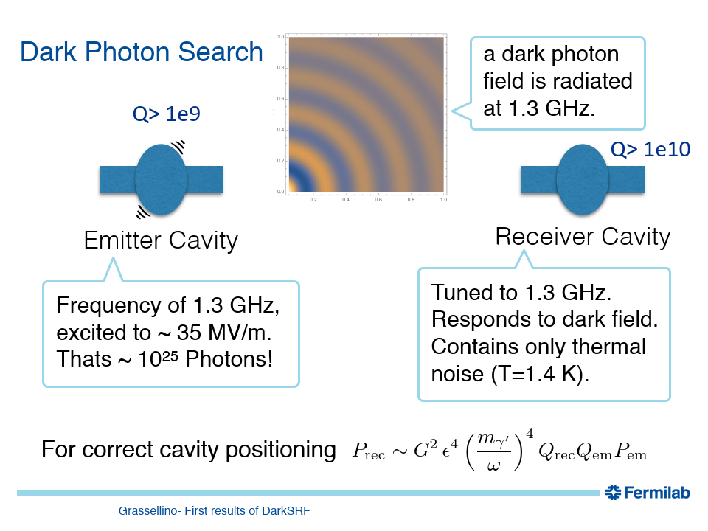
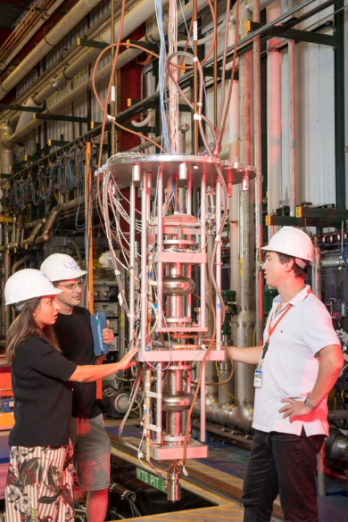
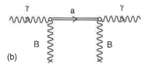
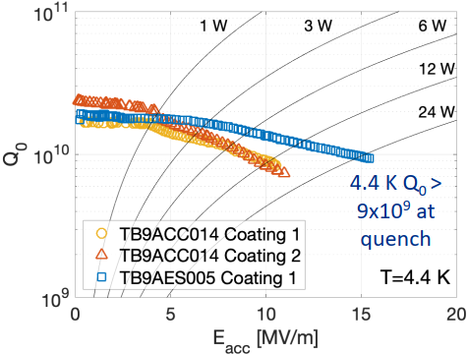
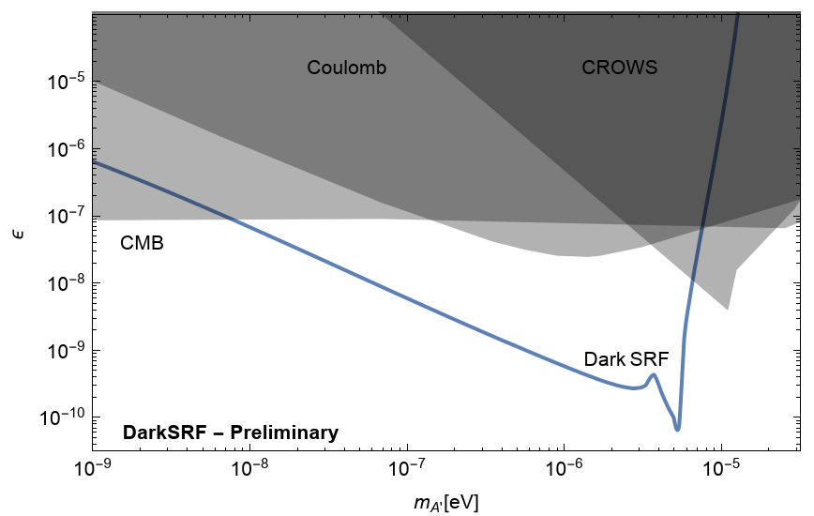
One slide on FermiLab
Axion conversion in Nb₃Sn cavity
DarkSRF: light through wall
1.3 GHz cavity (650 MHz)
A. Romanenko: ECFA meeting

Slide 9

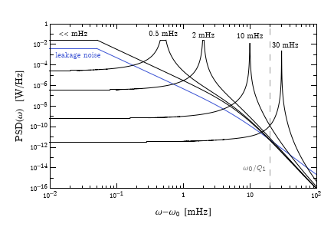
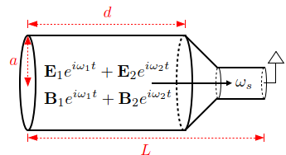
One slide on heterodyne, intermodulation
See talk by R. T. D’Agnolo!
Intermodulation
(Use the RF resonance as a “pump mode”, coupling with a small-mass axion would generate a “signal” within the resonance bandwidth)
(Needs an SRF cavity with high-field, high-Q)
Axions create nonlinearities in Maxwell’s equations.
Pumping two different modes of a cavity, will generate a signal third mode by intermodulation
(Needs an SRF cavity with high-field, high-Q)
A. Berlin et al.: arXiv:2007.15656v1
Z. Bogorad et al.: arXiv:1902.01418v2

Slide 10
Superconductivity and SRF relevant to axion searches
SRF in a magnetic field

Slide 11
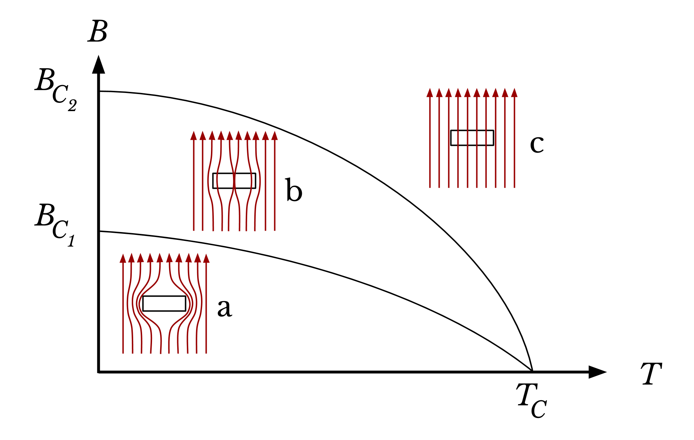
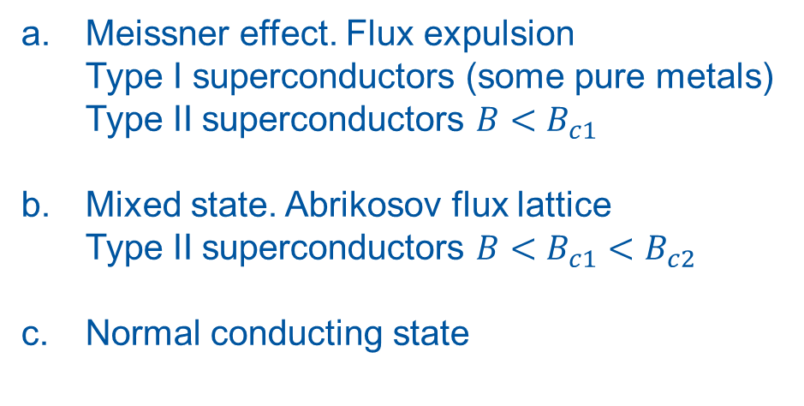
Superconductors in a magnetic field
Meissner effect. Flux expulsion
Type I superconductors (some pure metals)
Type II superconductors $B<B_{c1}$
Mixed state. Abrikosov flux lattice
Type II superconductors $B<B_{c1}<B_{c2}$
Normal conducting state
Image source: wikipedia

Slide 12
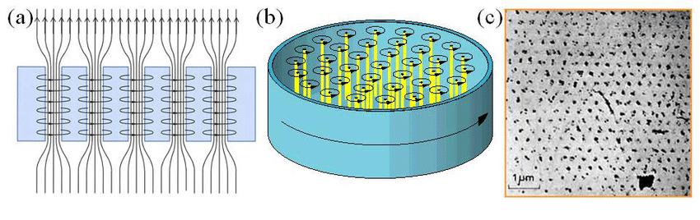
Flux lines
Flux lines arrange in a hexagonal pattern of flux quanta ($Φ_{0}=\frac{h}{2e}$), minimizing the free energy.
The number density N [m⁻²] of flux quanta is such that $B=NΦ_{0}$. They repel each other.
A material defect reduces locally the superconductivity. The flux quantum tends to occupy this region to further minimize energy, distorting the lattice, at the expense of a slight increase of elastic energy of the flux lattice. This phenomenon is called flux pinning
Image source: link

Slide 13
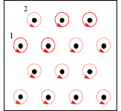
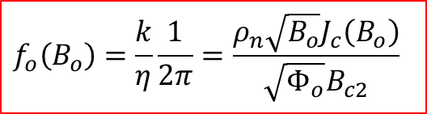

Some theory background: fluxon motion in RF
Simplified model, neglecting thermally activated flux creep.
B field is normal to the surface
The motion of the rigid fluxon lattice behaves as a harmonic damped oscillator with quadratic potential
An oscillating Lorentz force F is generated on the flux lattice
k ↔ pinning
$$F$$
The RF current J_{RF} is parallel to the surface
The “depinning frequency”
$$f_{o}\left(B_{o}\right)=\frac{k}{η}\frac{1}{2π}=\frac{ρ_{n}\sqrt{B_{o}}J_{c}\left(B_{o}\right)}{\sqrt{Φ_{o}}B_{c2}}$$
Gittleman and Rosenblum: Phys Rev. Lett. 16, 734 (1966)
Calatroni and Vaglio, IEEE Trans. Appl. Supercond. 27 (2017) 3500506
Coffey, Clem PRL 67, 386 (1991)
Brandt PRL 67 2219 (1991)
Silva et al, PRB 78, 094503 (2008)

Slide 14
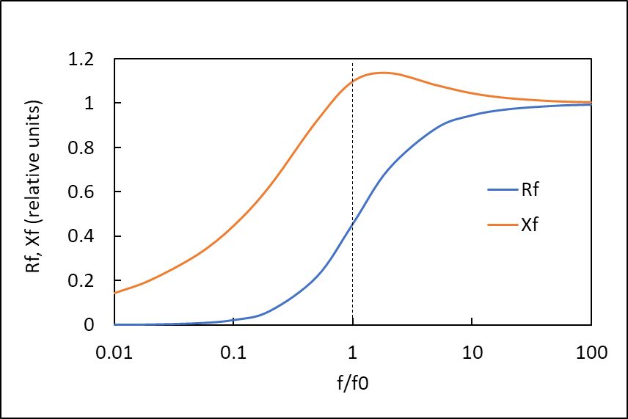
Effect of magnetic field: fluxon losses in RF
Surface resistance, reactance due to vortex motion
Fluxon losses dominate, thus we should choose f_{resonance} < f_{depinning}
The total surface resistance scales as f²

Slide 15
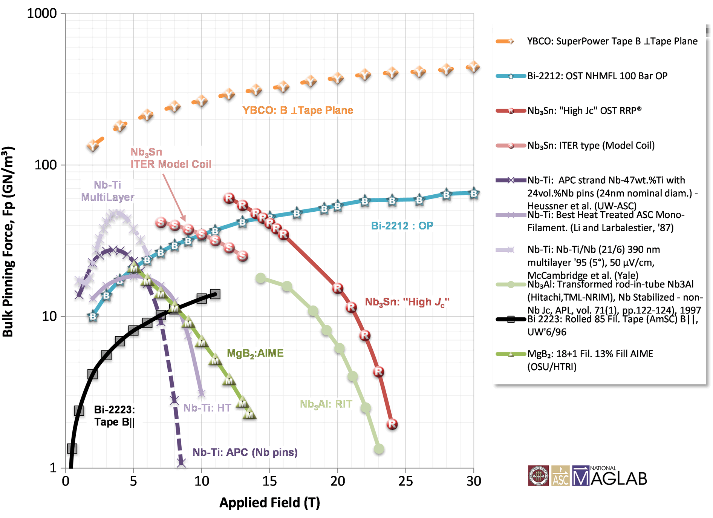
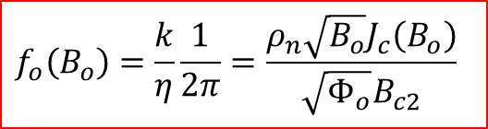
To use an SRF cavity in a magnetic field
$$f_{o}\left(B_{o}\right)=\frac{k}{η}\frac{1}{2π}=\frac{ρ_{n}\sqrt{B_{o}}J_{c}\left(B_{o}\right)}{\sqrt{Φ_{o}}B_{c2}}$$
Materials must have a high Jc, i.e. strong pinning (strongly dependent on fabrication process)
Image source: National High Magnetic Field Laboratory

Slide 16
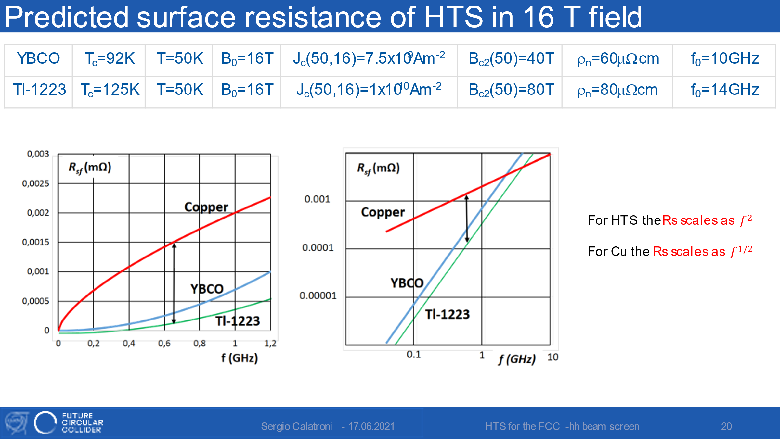
Frequency dependance
HTS for the FCC beam screen studies: reduction of beam coupling impedance
At low enough frequency (compared to depinning frequency), SRF has an advantage compared to (cold) copper
The crossing point is experiment-dependent and field-dependent

Slide 17
Superconductivity and SRF relevant to axion searches
Non-linearities

Slide 18
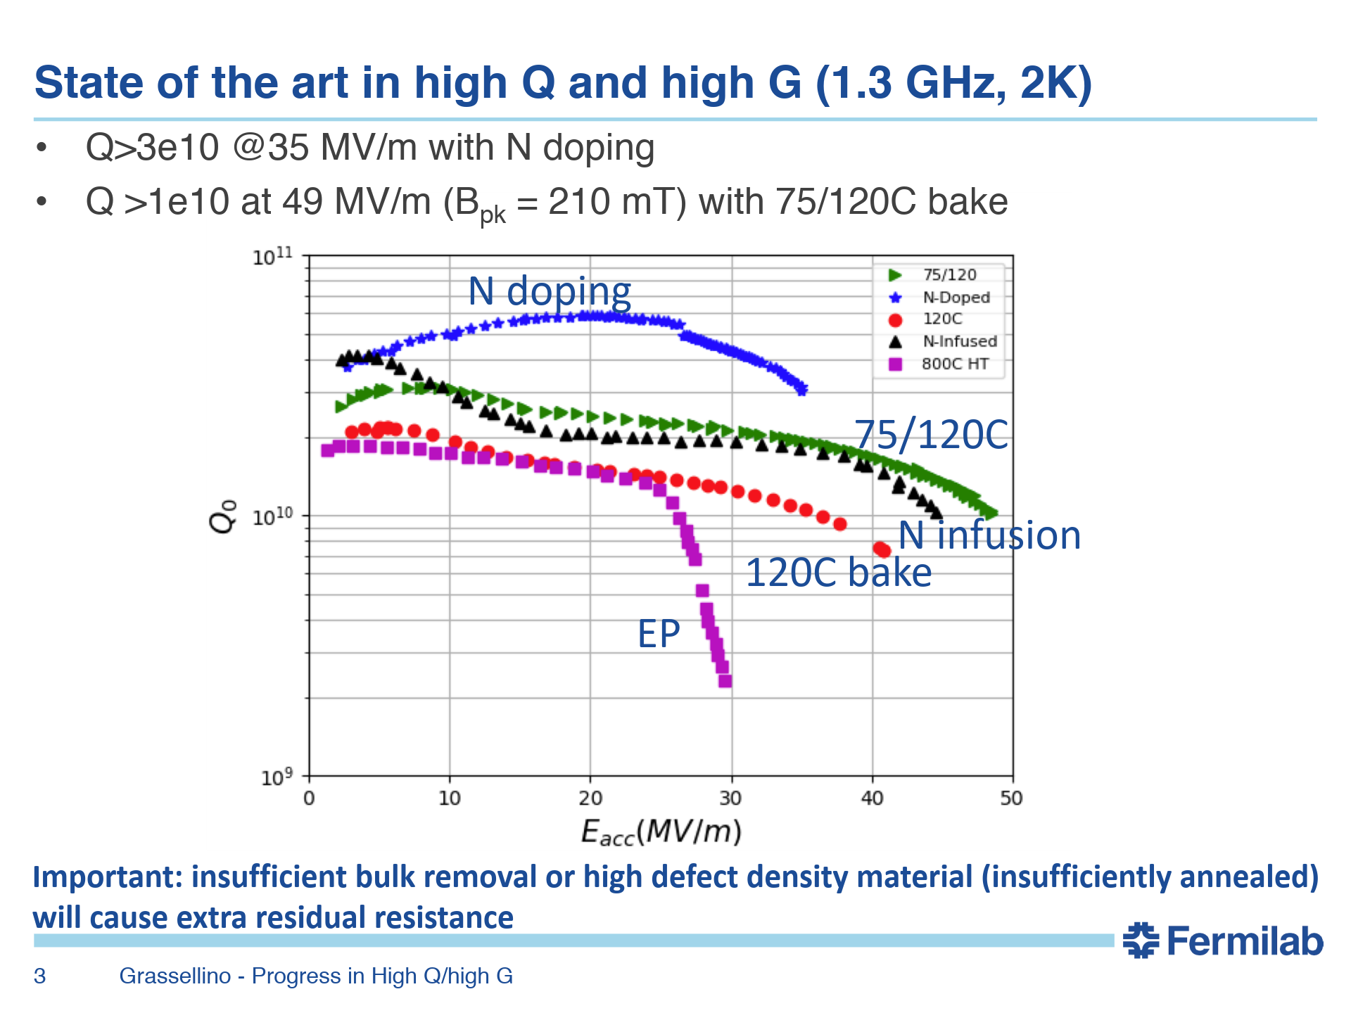
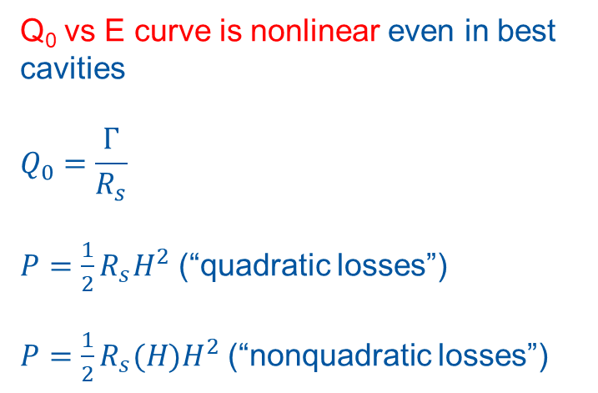
Q factor of SRF cavities
Q₀ vs E curve is nonlinear even in best cavities
$$Q_{0}=\frac{Γ}{R_{s}}$$
$P=\frac{1}{2}R_{s}H^{2}$ (“quadratic losses”)
$P={\frac{1}{2}R}_{s}(H)H^{2}$ (“nonquadratic losses”)

Slide 19
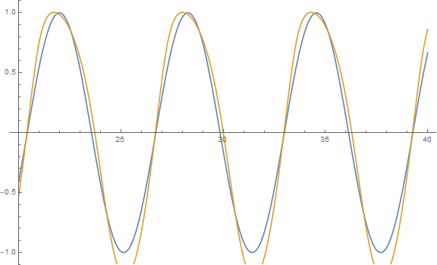
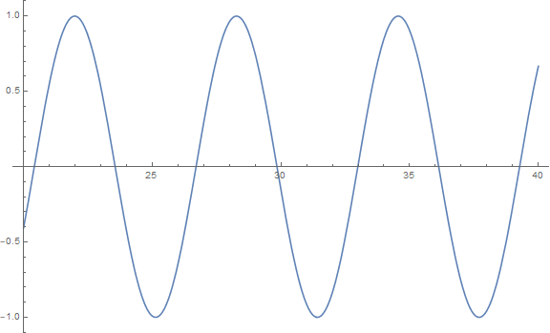


Example of RLC circuit
Standard series RLC circuit
Nonlinearity in R(I) creates distortion → “harmonics”, intermodulation
Not to forget same happens (+ noise) in the measurement hardware…
$$L\frac{d^{2}}{{dt}^{2}}I\left(t\right)+R\frac{d}{dt}I\left(t\right)+\frac{I}{C}=ωV_{0}sin⁡(ωt)$$
$$L\frac{d^{2}}{{dt}^{2}}I\left(t\right)+R(I)\frac{d}{dt}I\left(t\right)+\frac{I}{C}=ωV_{0}sin⁡(ωt)$$

Slide 20
Questions ?

Slide 21
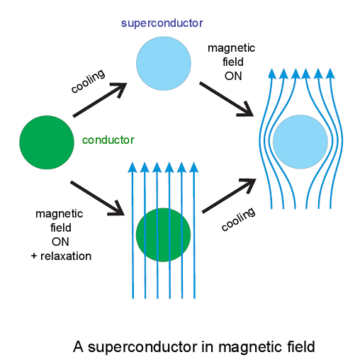
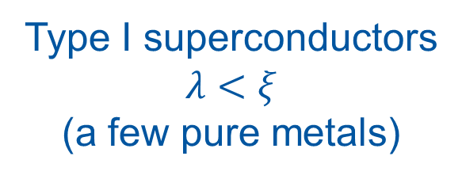
Type I superconductors
$$λ<ξ$$
(a few pure metals)

Slide 22
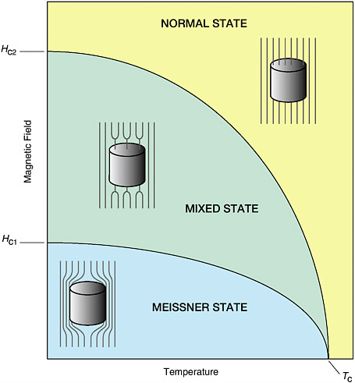
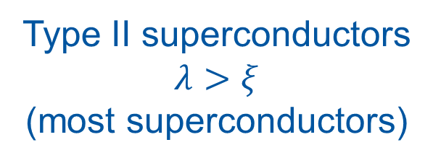
Type II superconductors
$$λ>ξ$$
(most superconductors)

Slide 23
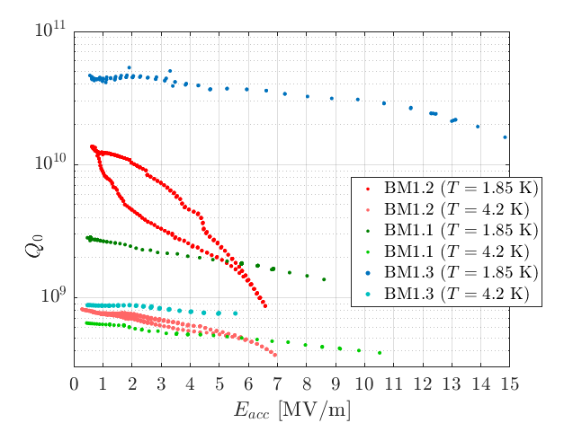
Nb/Cu at 1.3 GHz

