Slide 1










Geneva – "PBC technology" workshop
Superconductivity in BASE and BASE haloscope
Stefan Ulmer
RIKEN
2021 / 02 / 11

Slide 2
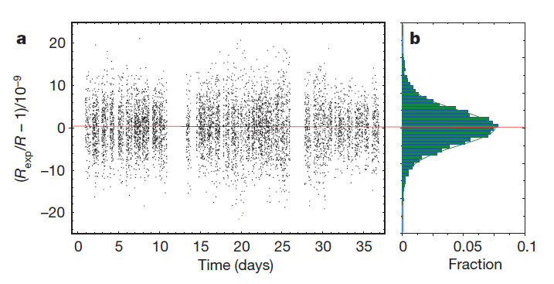
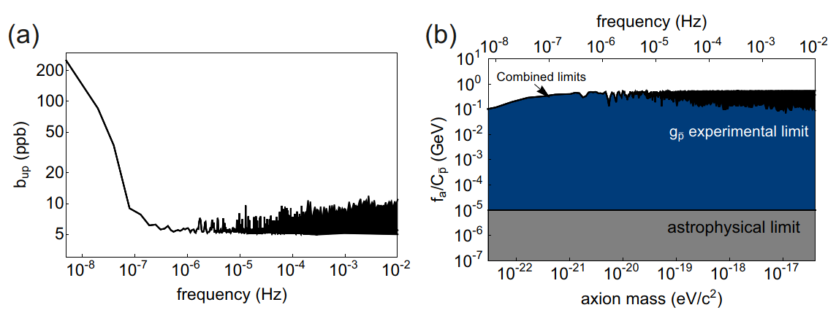
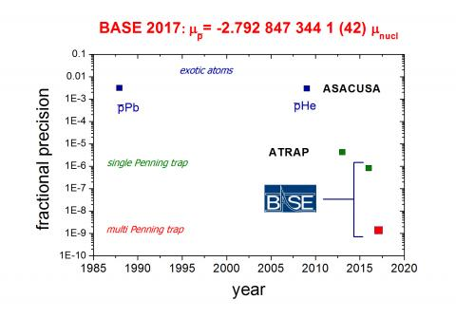
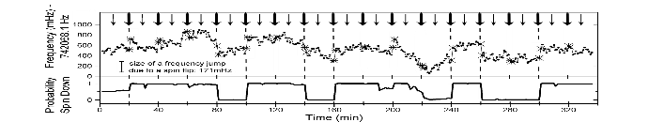
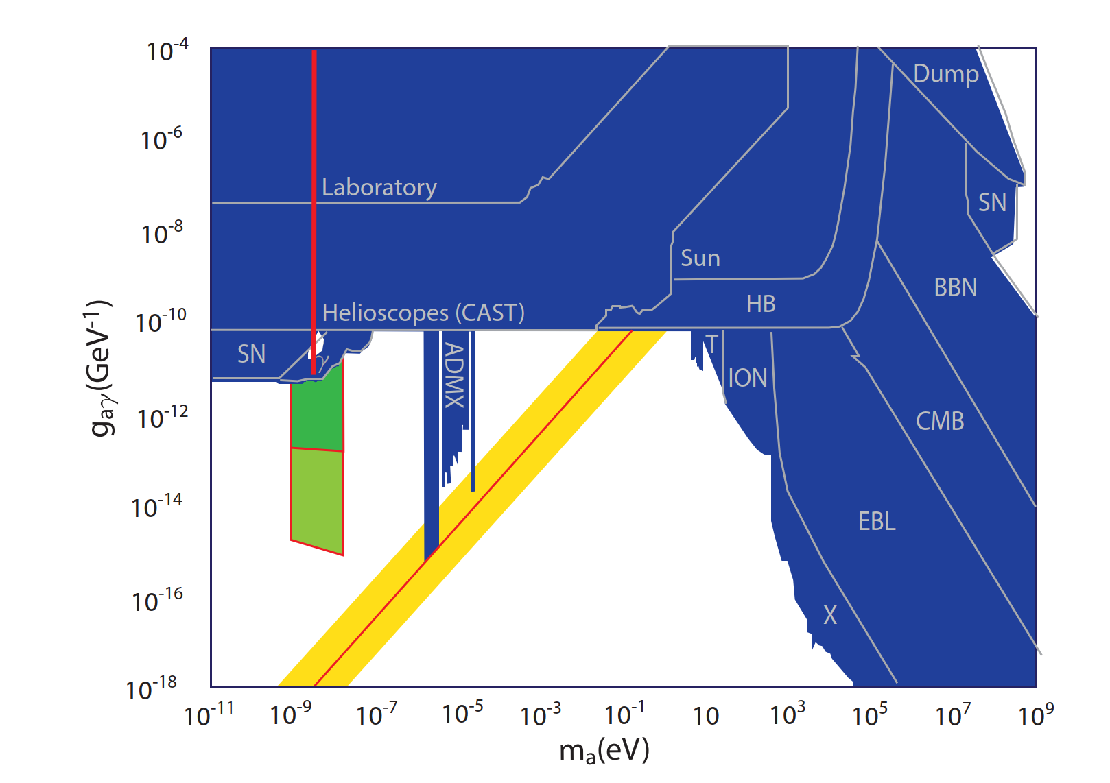
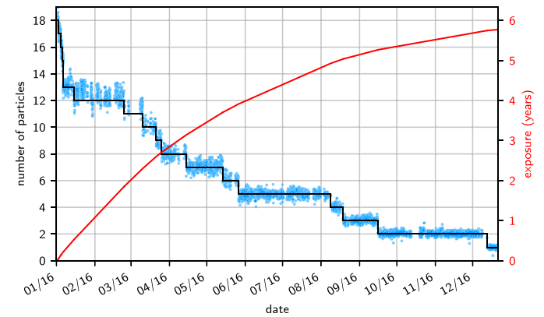
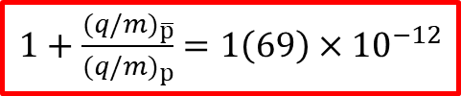
BASE-Physics Overview
Observation of spin flips with
a single trapped proton
Precise CPT test with baryons
Most precise antiproton/proton
g-factor measurments
Dark Matter / Antimatter Interaction
S. Ulmer, et al., Nature 524, 196 (2015)
C. Smorra et al., Nature 575, 310 (2019)
G. Schneider et al., Science 358, 1081 (2017).
C. Smorra et al., Nature 550, 371 (2017)
First limits on dark matter / antimatter coupling, orders of magnitudes mo stringend than astrophysics limits.
S. Ulmer, et al., PRL 106, 253001 (2011)
A. Mooser, et al., PRL 110, (2013)
$1+\frac{{(q/m)}_{\overline{p}}}{{(q/m)}_{p}}$ $=1\left(69\right)×{10}^{−12}$
Application of the double
Penning-trap technique
FIP detection
J. Devlin et al., Phys. Rev. Lett. 126, 041301 (2021)
Rexp,c = 1.001 089 218 755 (64) (26)
Proton:
To be improved by another factor of 10 to 100
g/2 = 2.792 847 344 62 (82)
30-fold improvement compared to previous measurement
Reservoir trap for antiprotons
Antiproton:
C. Smorra, et al., Int. Journ. Mass Spec. 389, 10 (2015).
S. Sellner et al., NJPhys. 19, 083023 (2017)
Single particle detection systems used to constrain the volume of dark matter radio (in a narrow mass band)
g/2 = 2.792 847 344 1 (42)
3000-fold improvement compared to previous measurement
A. Mooser, et al., PLB 723, 78 (2013)
80-fold improved limits on directly constrained antiproton lifetime
Testing CPT invariance with single particles in Penning traps / protons and antiprotons

Slide 3
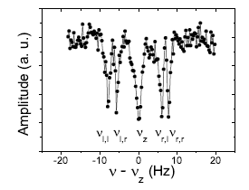
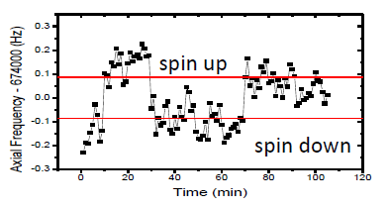
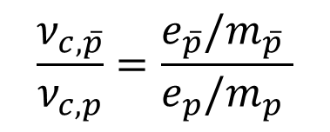
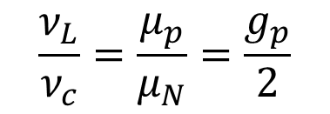
Measurements in Precision Penning traps
Cyclotron Motion
Larmor Precession
g: mag. Moment in units of
nuclear magneton
simple
difficult
$$\frac{ν_{c,\overline{p}}}{ν_{c,p}}=\frac{e_{\overline{p}}/m_{\overline{p}} }{e_{p}/m_{p} }$$
$$\frac{ν_{L}}{ν_{c}}=\frac{μ_{p}}{μ_{N}}=\frac{g_{p}}{2}$$
S. Ulmer, A. Mooser et al. PRL 107, 103002 (2011)
S. Ulmer, A. Mooser et al. PRL 106, 253001 (2011)
Determinations of the q/m ratio and g-factor reduce to measurements of frequency ratios -> in principle very simple experiments –> full control, (almost) no theoretical corrections required.
High Precision Mass Spectrometry
High Precision Magnetic Moment Measurements

Slide 4
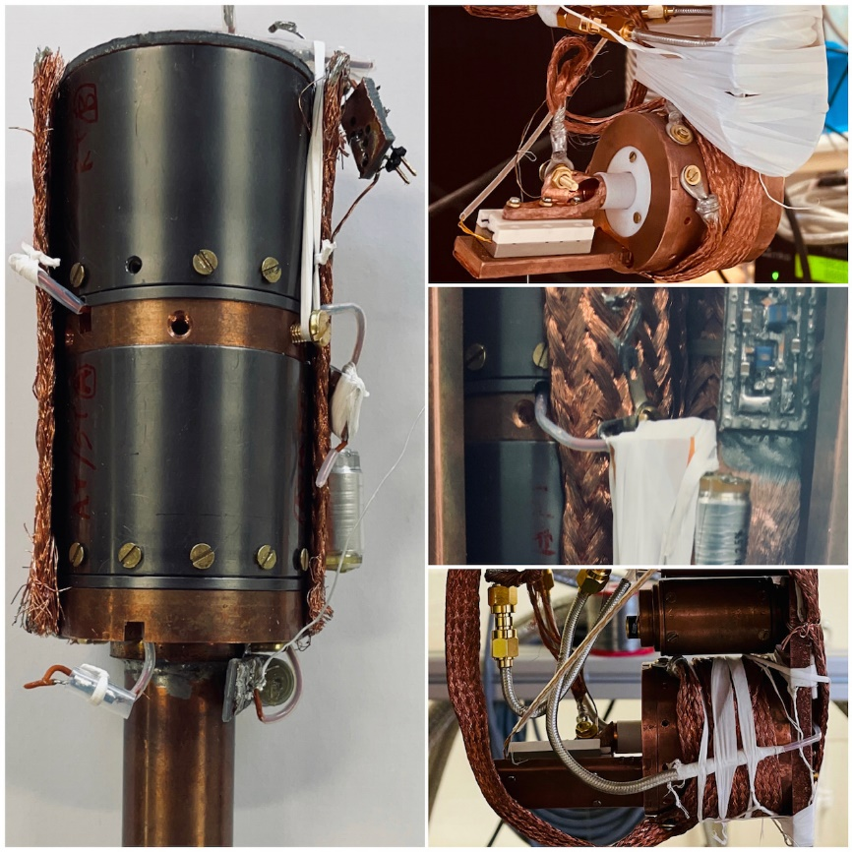
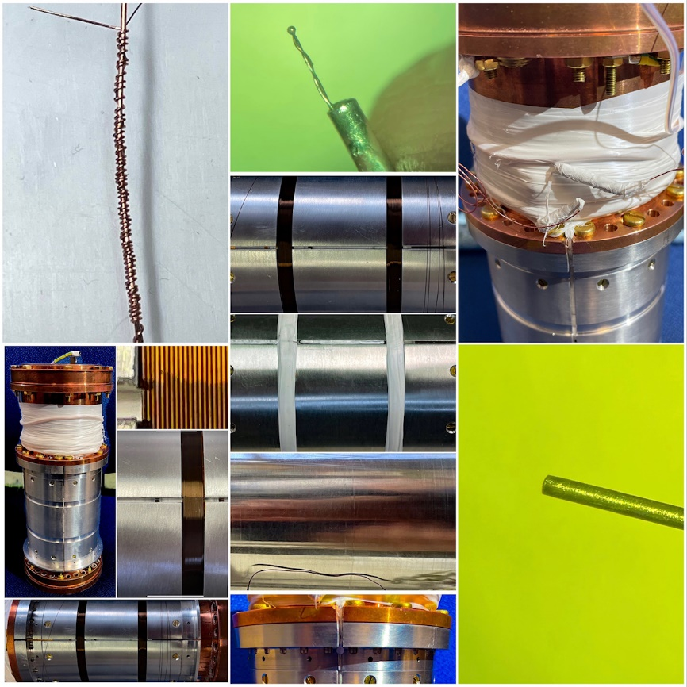
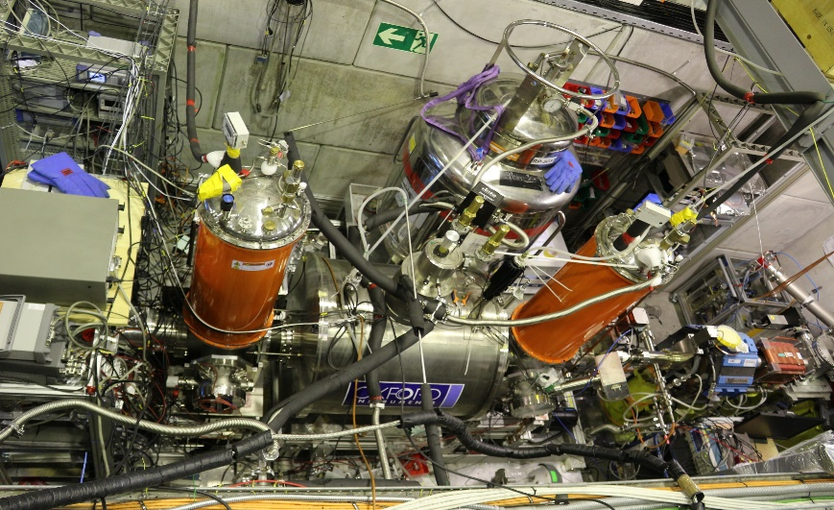
Superconductivity in BASE
Single particle detection systems
Superconducting Magnets
Magnetic Shielding and Shimming
Developers of world class detectors
Users of ultra stable persistent devices
Developers of excellent shielding systems

Slide 5

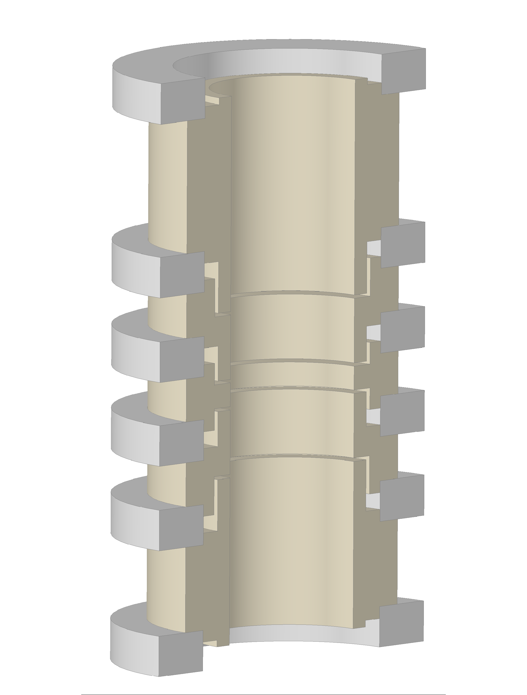
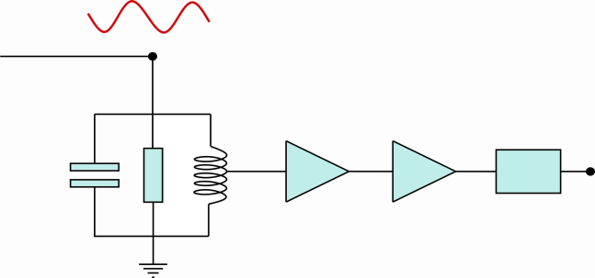
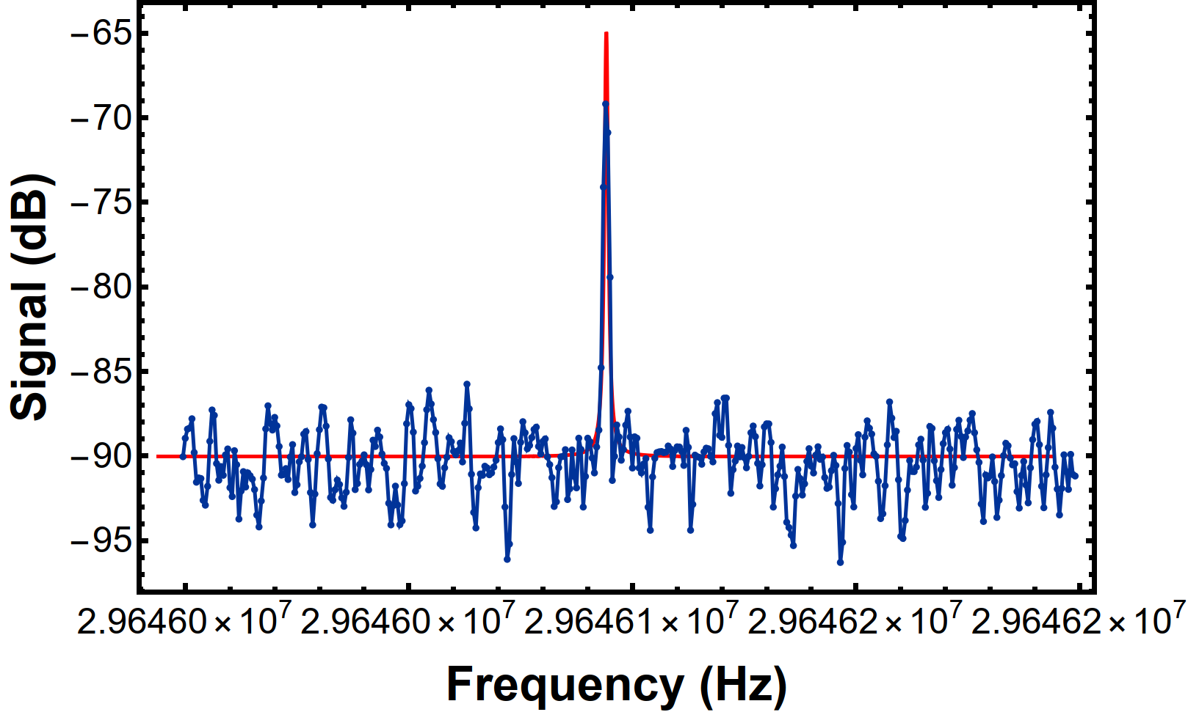
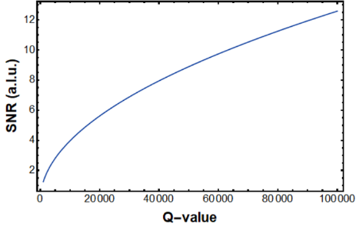
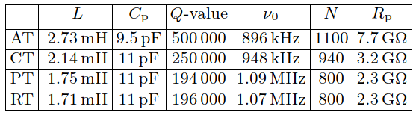
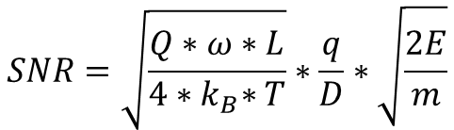
Single Particle Detection Systems
Particle oscillates in a Penning trap
Oscillation induces image currents, that produce voltage drops over resistors (fA currents)
Use superconducting inductance to compensate parasitic capacitance of the trap system.
Requires high-Q superconducting inductors.
Low noise electronics
C_{p}
R_{p}
L_{p}
Amp
Amp
FFT
resonator
$$SNR=\sqrt{\frac{Q∗ω∗L}{4{∗k}_{B}∗T}}∗\frac{q}{D}∗\sqrt{\frac{2E}{m}}$$
Single particle
Experience on frequency ranges 100kHz to 100 MHz
Concept allows test of fundamental symmetries on the parts per trillion level

Slide 6
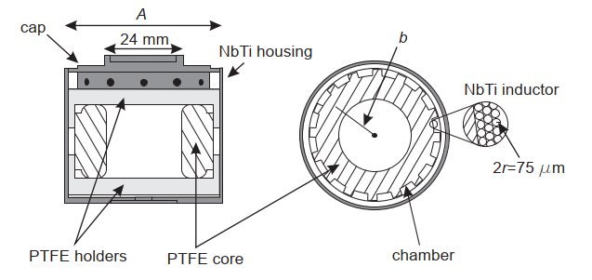
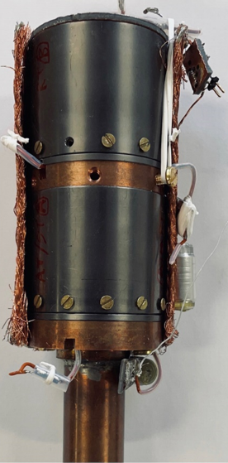
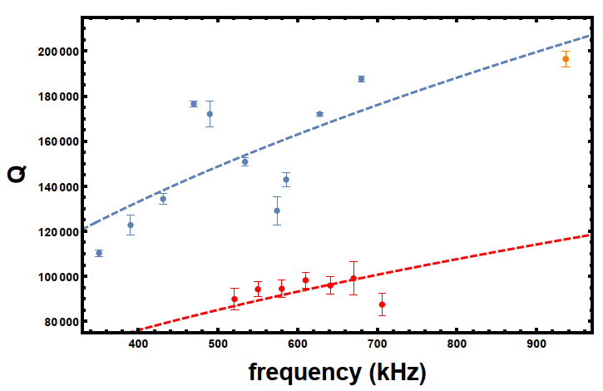
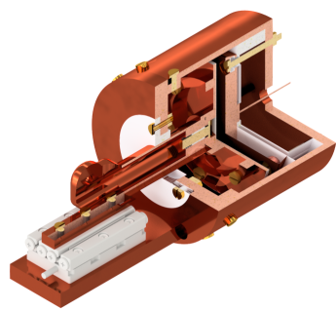
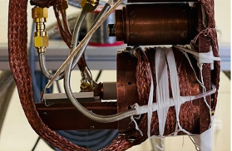
Technology Transfer & Advice
Frequency band which is under control is at a level of 100kHz to 100MHz
Detectors 100kHz to 1MHz with Q up to 500000 available
Design of toroid geometries with diameters up to 100mm
Recently: high Q tuneability device developed, with bandwidth of 350 kHz to 1MHz at Q>100000
Relevant for single particle experiments, axion searches, NMR pickups, ultra sensitive magnetometry etc.

Slide 7
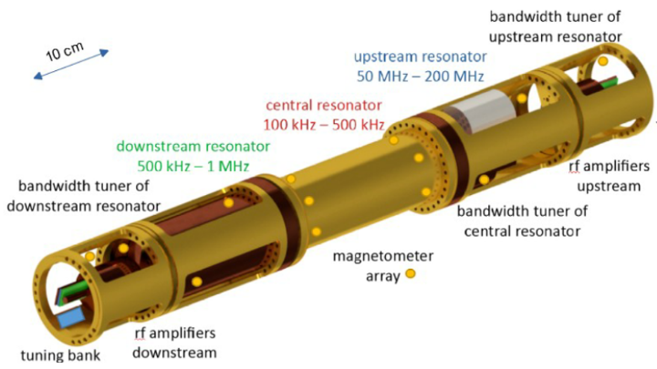

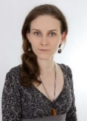


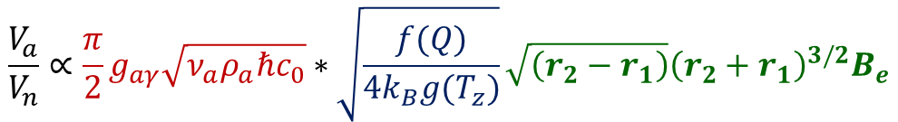
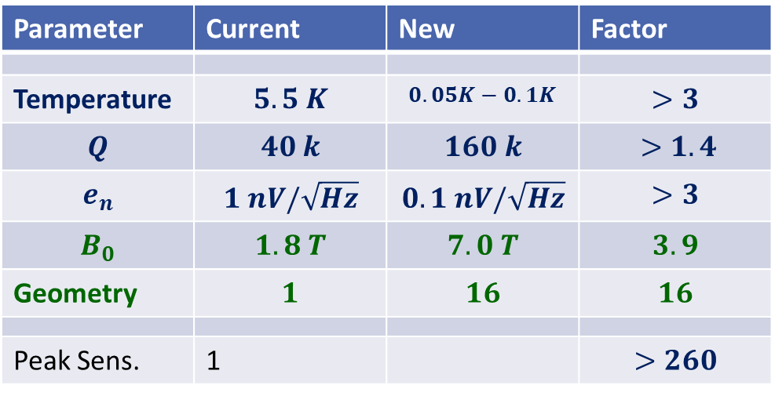
Future Projection
With a purpose-built experiment we should be able to improve sensitivity considerably
$$\frac{V_{a}}{V_{n}}∝\frac{π}{2}g_{aγ}\sqrt{ν_{a}ρ_{a}ℏc_{0}}∗\sqrt{\frac{f(Q)}{4k_{B}{g(T}_{z})}}\sqrt{\left(r_{2}−r_{1}\right)}{\left(r_{2}+r_{1}\right)}^{3/2}B_{e}$$
Devlin et al., BASE,
Phys. Rev. Lett. 126, 041301
Parameter | Current | New | Factor
Temperature | $$5.5 K$$ | $$0.05K−0.1K$$ | $$>3$$
$$Q$$ | $$40 k$$ | $$160 k$$ | $>1.4$
$$e_{n}$$ | $$1 nV/\sqrt{Hz}$$ | $$0.1 nV/\sqrt{Hz}$$ | $$>3$$
$$B_{0}$$ | $$1.8 T$$ | $$7.0 T$$ | $$3.9$$
Geometry | $$1$$ | $$16$$ | $$16$$
Peak Sens. | 1 |  | $$>260$$
Laser cooled
resonators
Bandwidth-gain: x 3000
Technologies available to build such an experiment / discussion with IAXO started

Slide 8
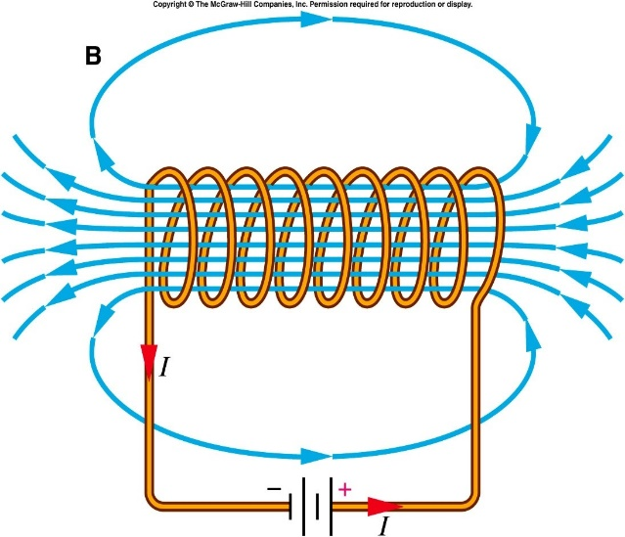
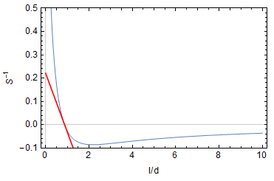
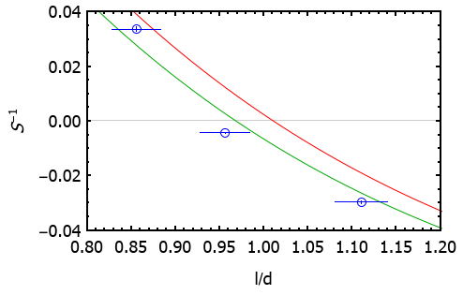
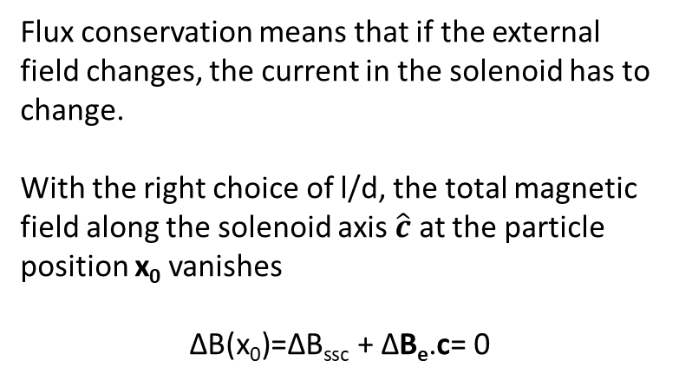

Self Shielding coil (SSC)
B_{solenoid}
Flux conservation means that if the external field changes, the current in the solenoid has to change.
With the right choice of l/d, the total magnetic field along the solenoid axis $\hat{c}$ at the particle position x₀ vanishes
$$\text{Δ}\text{B}\text{(}\text{x}\text{0}\text{)=}\text{Δ}\text{B}\text{ssc}\text{ +} \text{Δ}\text{B}\text{e}\text{.}\text{c}\text{= 0 }$$
B_{e}
d
l
A
Inverse shielding factor of single solenoid
as a function of l/d
For a perfectly aligned coil, the cyclotron frequency shifts according to
Y=-0.25(l/d-0.876)
$${Δν}_{c}=\frac{q}{2πm}\left(S^{−1}{ΔB}_{e,z}\right)$$
G. Gabrielse and J. Tan, J. Appl. Phys 63 (10)

Slide 9
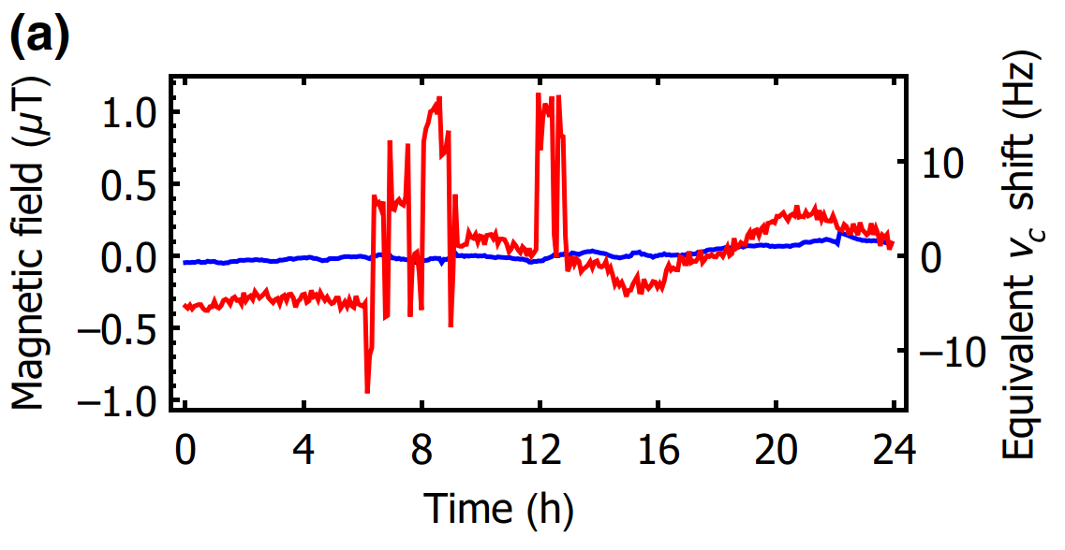
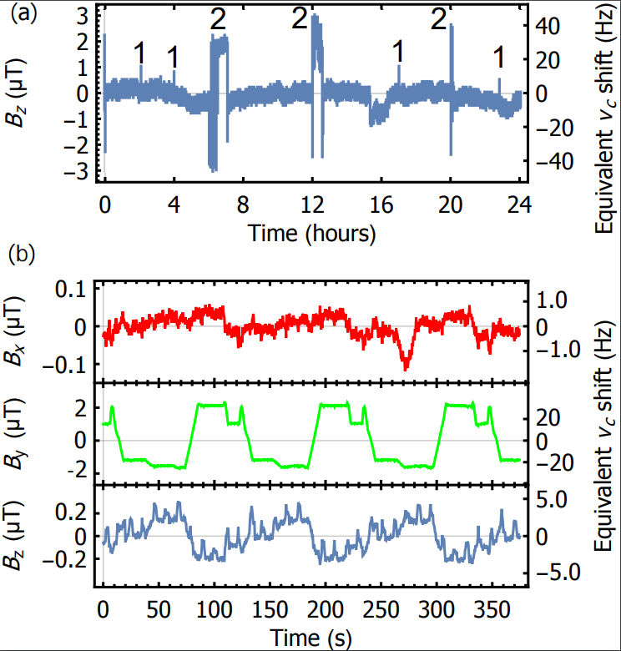
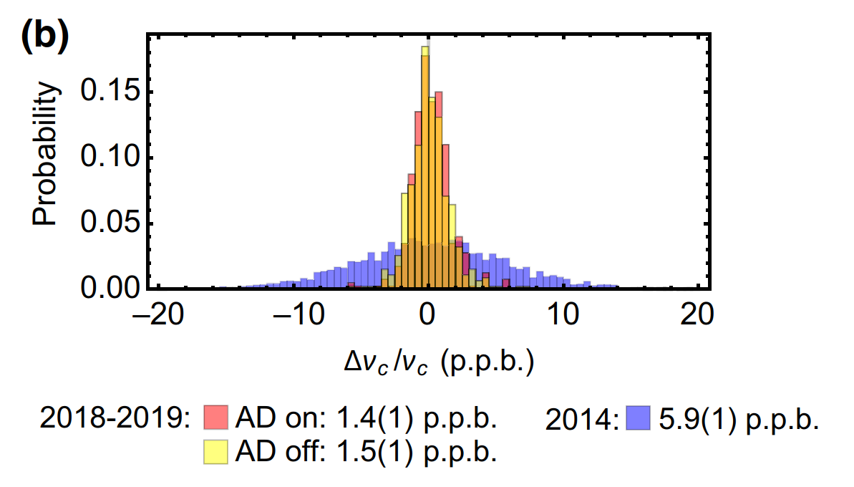


Performance for fields along AD direction
AD fluctuations along all 3 axes
Shielding of crane field
External field
change
$ν_{C}$ change
Performance with AD on/off compared to 2014
Experiment does not stop working if crane moves
limited
by
measurement
noise
Expertise in designing ML SSC systems
Persistent joints for SSC’s
Currently looking for methods to improve persistent joints for high current shim-coils.
AD field noise not resolvable at 1.5 ppb level

Slide 10
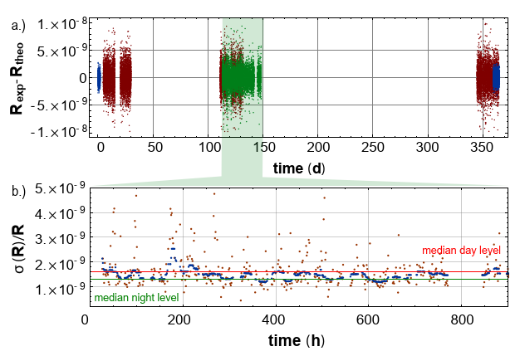
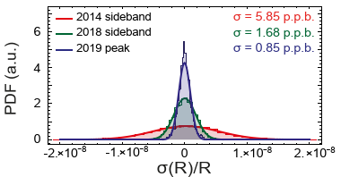
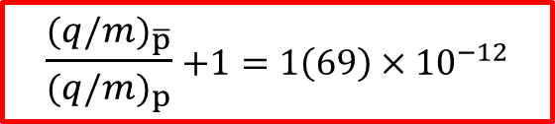
BASE Measurements – Proton to Antiproton Q/M
Result of 6500 proton/antiproton Q/M comparisons:
Rexp,c = 1.001 089 218 755 (69)
$\frac{{(q/m)}_{\overline{p}}}{{(q/m)}_{p}}$ $+1=1\left(69\right)×{10}^{−12}$
Stringent test of CPT invariance with Baryons.
Consistent with CPT invariance
S. Ulmer et al., Nature 524 196 (2015)
New measurement:
  Acquired 35000 frequency ratio measurements over 1.5 years, distributed over the sidereal year.
  Used two measurement methods, tunable axial detector to suppress systematics, and a rebuilt apparatus
Rexp,c,1 = 1.001 089 218 763 (23)
Rexp,c,2 = 1.001 089 218 7XX (20)
Final data analysis is work in progress
BASE, in preparation (2021)

Slide 11

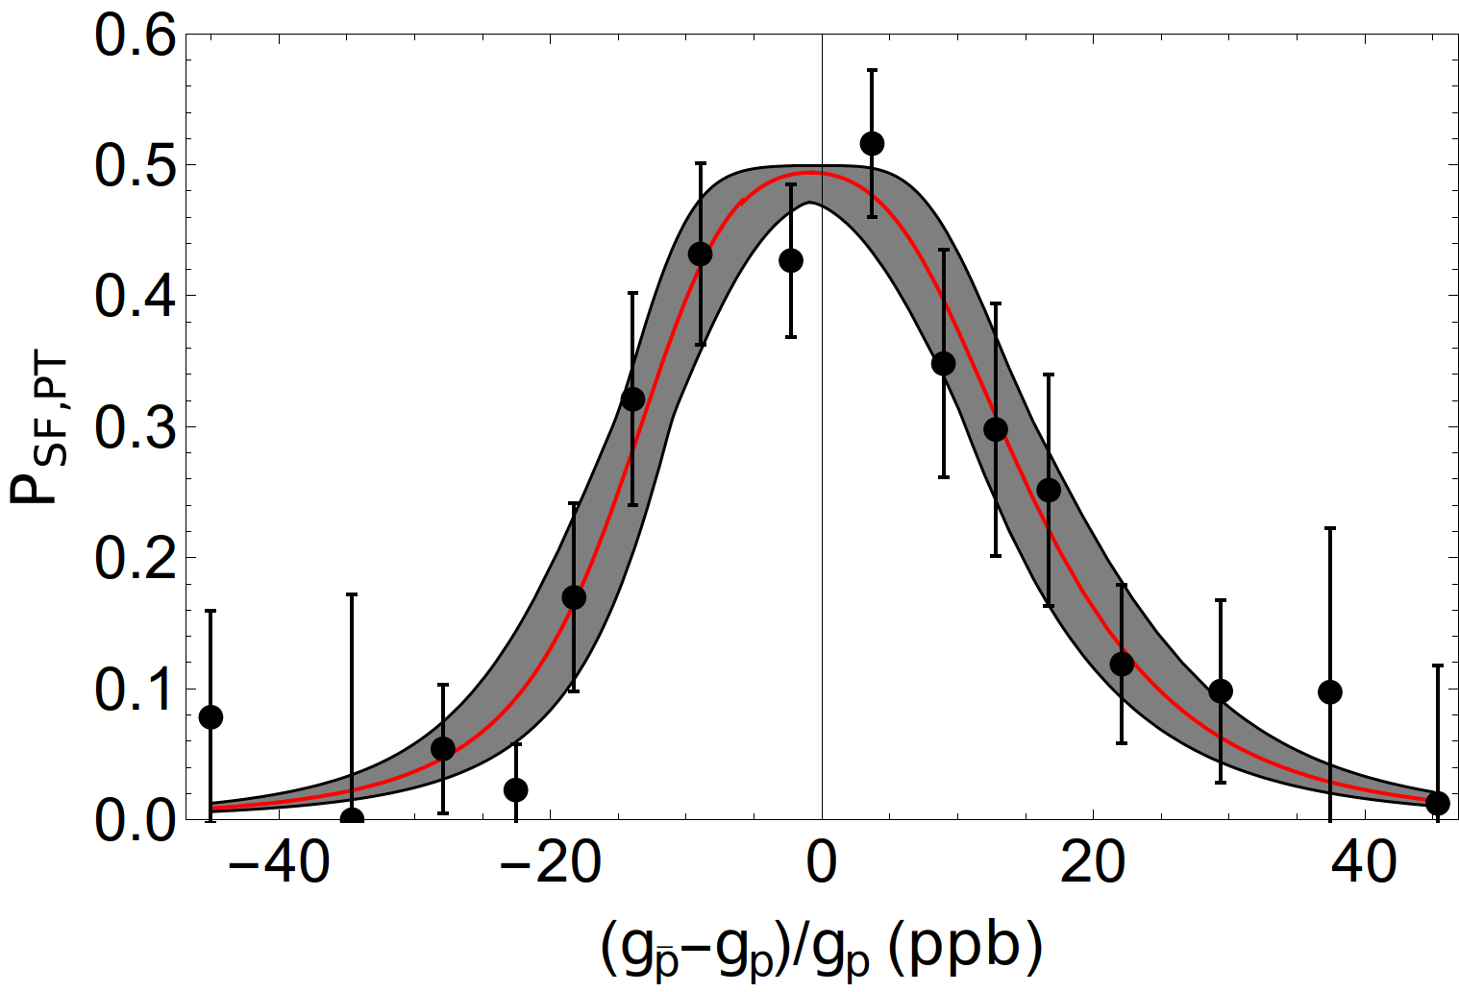
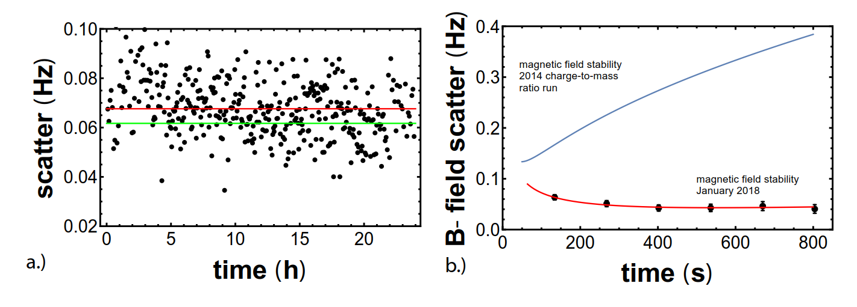
Summary and Outlook
In BASE technologies exist to develop high-Q detection LC circuits with Q>500000 at frequencies up to 1 MHz
Expertise with high-Q small scale detectors up to 100MHz (Q = 10000)
Self shielding systems with S > 500 developed
BASE 2016
BASE 2017

Slide 12
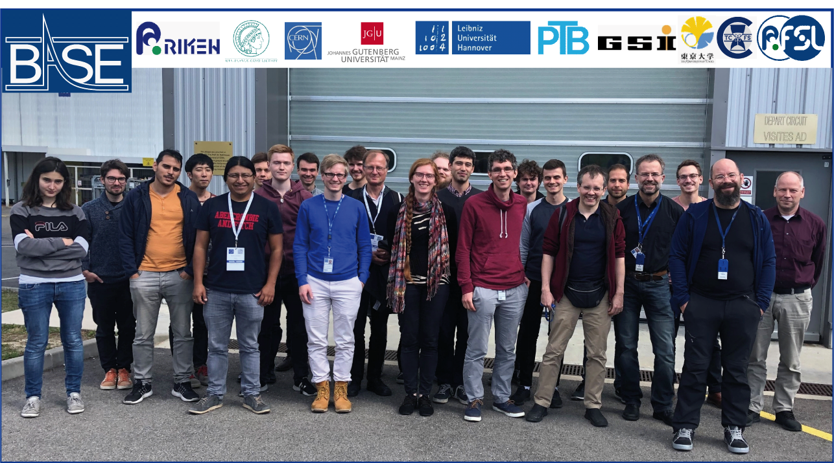

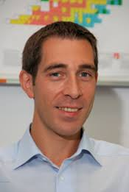
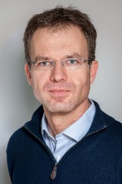
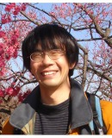

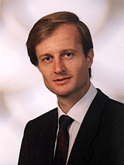
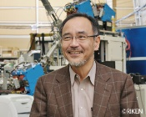

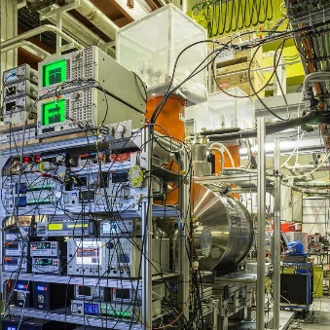

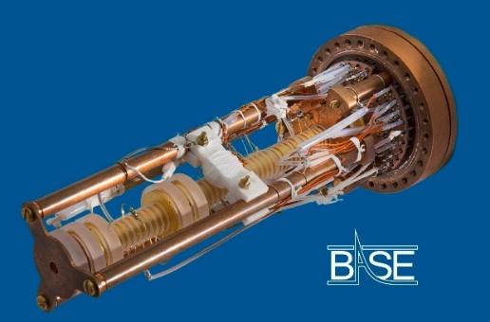
Thanks for your attention

