Slide 1



The LHC: How does it work?
NNV
Profielwerkstukreis
4 – 8 oktober 2021
Accelerating Science and Innovation
Jan Uythoven, CERN
Notes:
1

Slide 2
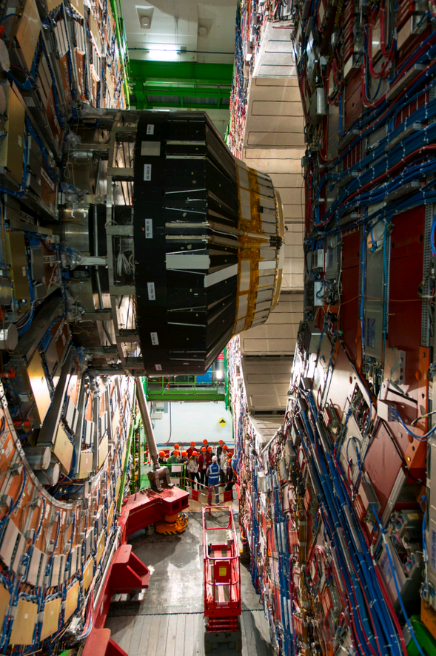
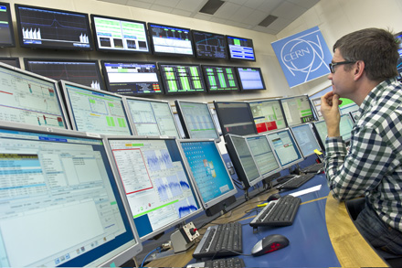
How does the accelerator work?
  Magnets
  Radio Frequency
  …
Energy in the beam
The future
Compact Muon Solenoid
Cern Control Centre

Slide 3


Slide 4
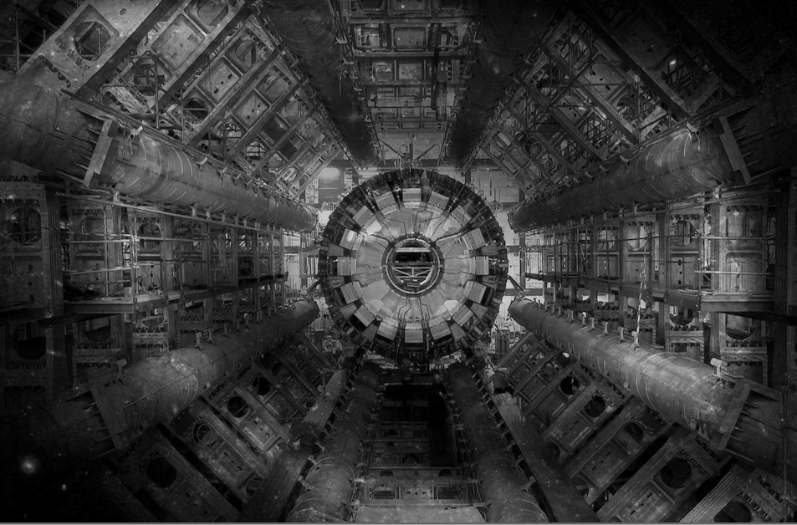
The LHC
Very big
Very cold
Very high energy

Slide 5
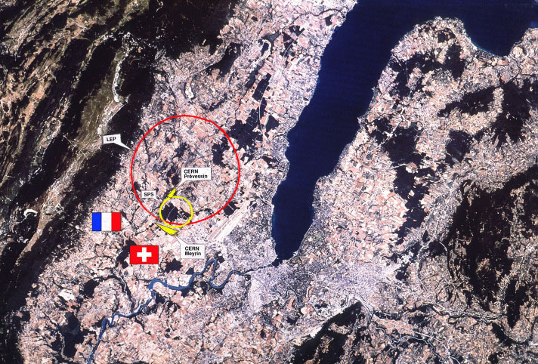

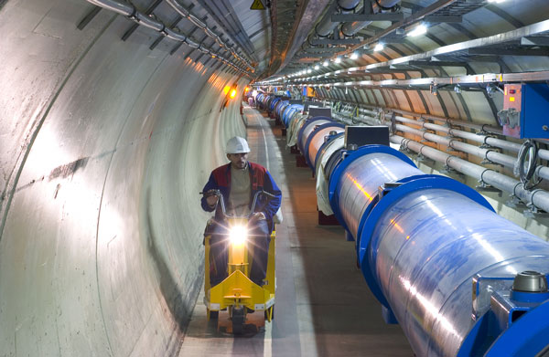
The LHC
Two beams of trillions of protons race around the 27 km ring at 0.999999991 times the speed of light in opposite directions…
So a particle goes around the LHC 11’000 times per second !

Slide 6

LHC tunnel
Circumference = 26.7 km
Depth = 70-140 m
Slope = 1.4 %

Slide 7
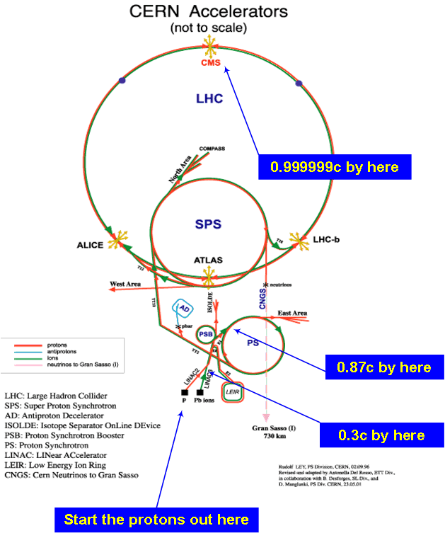
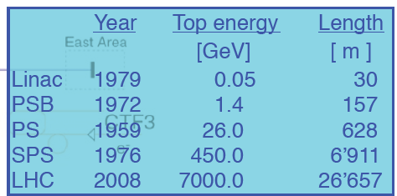
LHC Injector Chain
New Linac4 in 2020: H⁻
0.16
2.0
Normal operation with protons, but every year few weeks of operation with heavy ions (Pb⁸²⁺)
7

Slide 8
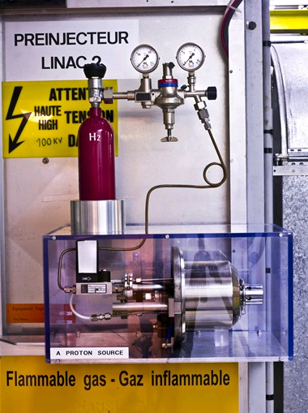
Where do the Protons come from?

Slide 9
Basic ingredients of a particle accelerator
Magnetic field to
  Bend the beam around the circle (dipole magnets)
  Keep the particles together (quadrupole magnets = lenses)
Electric field to accelerate the particles
  Very fast varying electric fields = Radio Frequency cavities

Slide 10
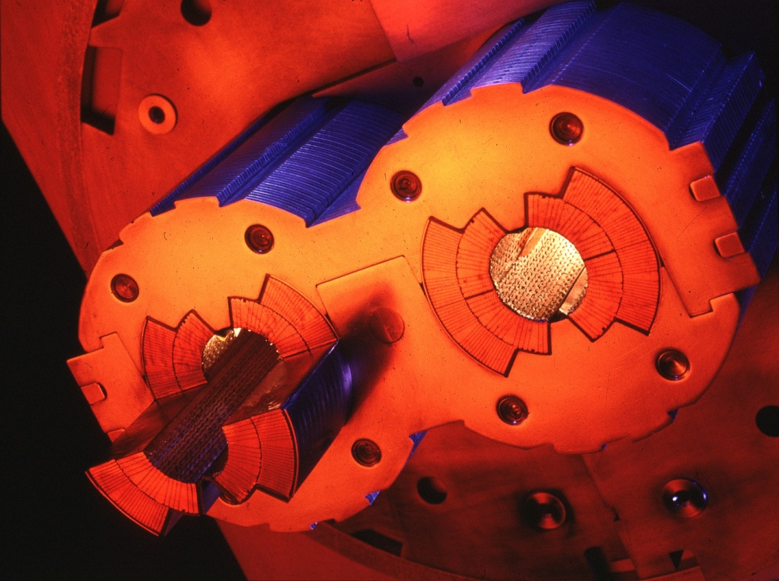
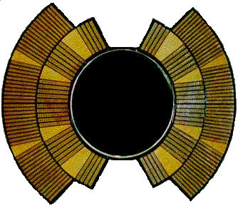
Dipole Magnets
Bend the beam around the circle
Number of dipoles 1232
Dipole field at 450 GeV 0.535 T
Dipole field at 7 TeV 8.33 T
Bending radius 2803.95 m
Main Dipole Length 14.3 m
Openings (full aperture) 56 mm
I
I
I
B
SUPERCONDUCTING!
Cooled with superfluid helium at 1.9 K

Slide 11
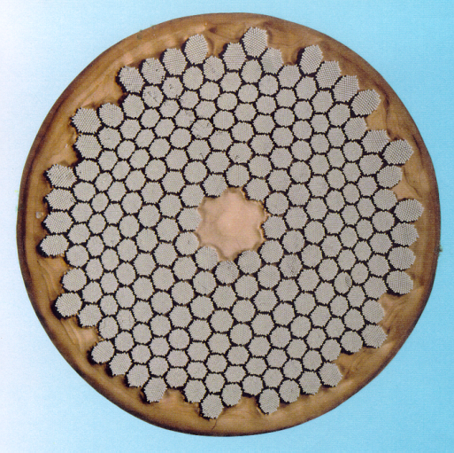
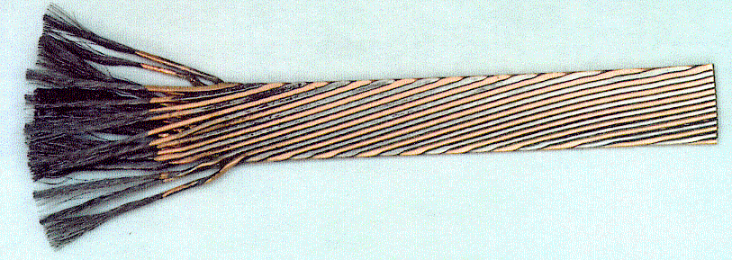
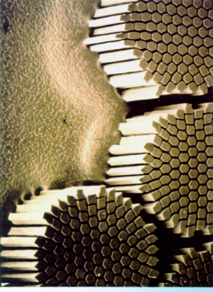
The superconductor
Niobium-titanium Rutherford cable
Strand
Cable
Filament
Used 1200 tonnes/7600 km of cable
Single cable carries current up to 12 kA

Slide 12
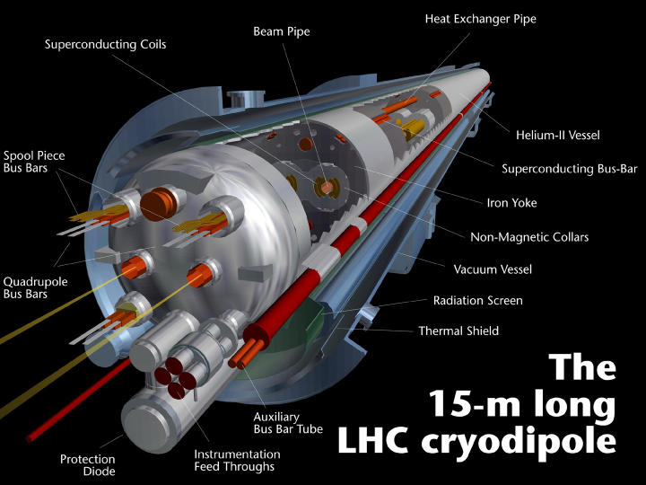
More than just some coils…
12

Slide 13
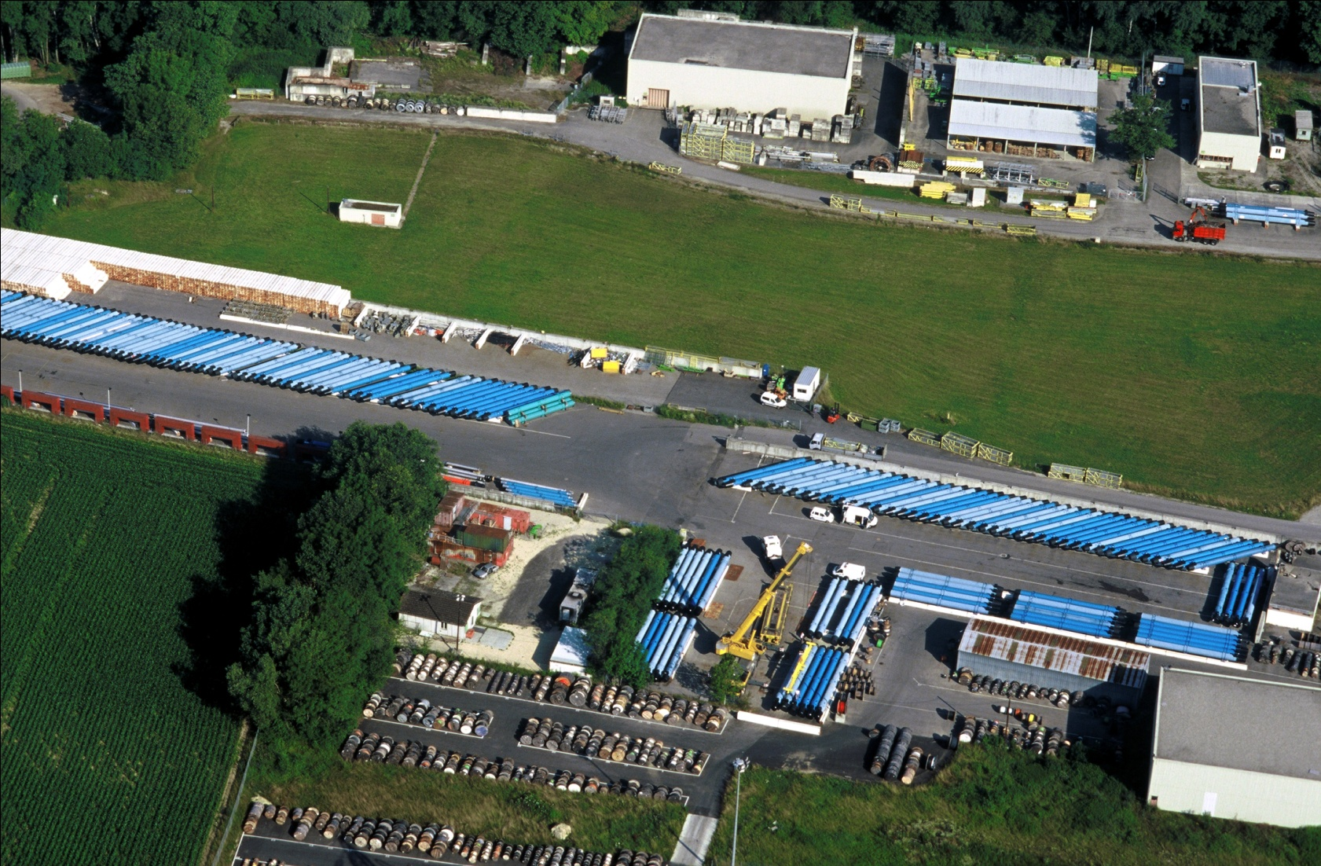
During construction: Dipoles all over

Slide 14
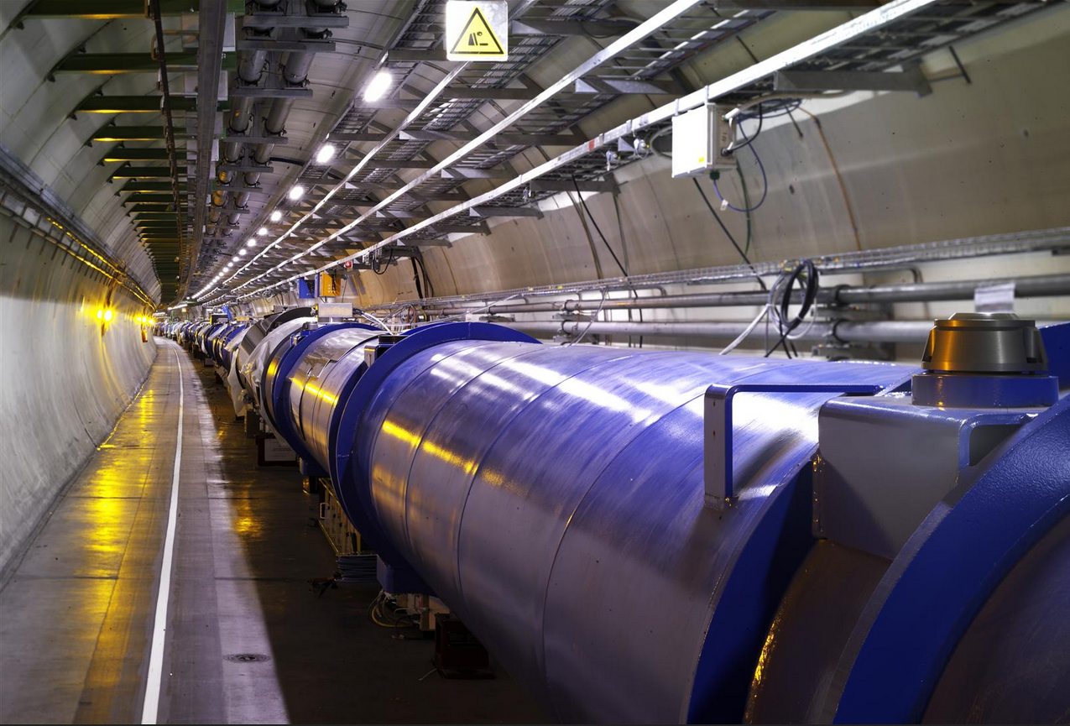
In the LHC tunnel
?
?
?
?
?

Slide 15
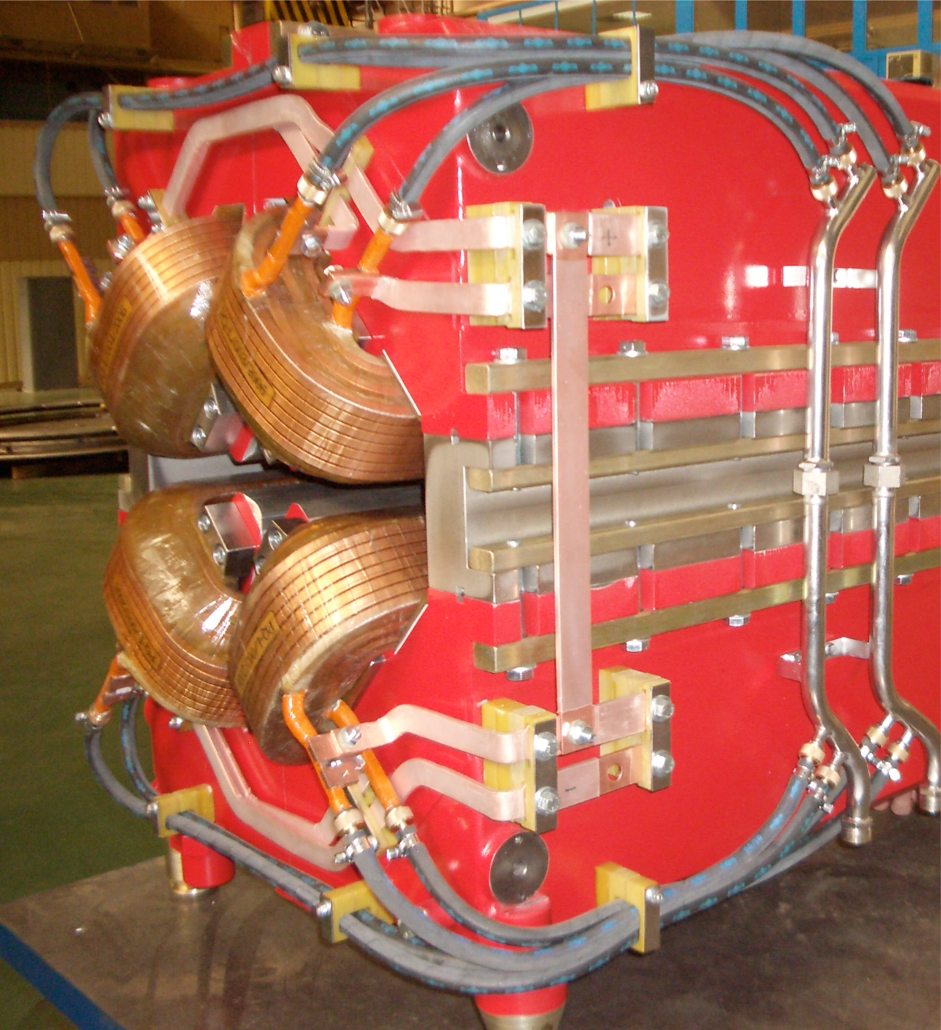
Beam is divergent
Many particles many initial conditions
Vertical
displacement
→ s
Many different angles
Quadrupole magnet

Slide 16
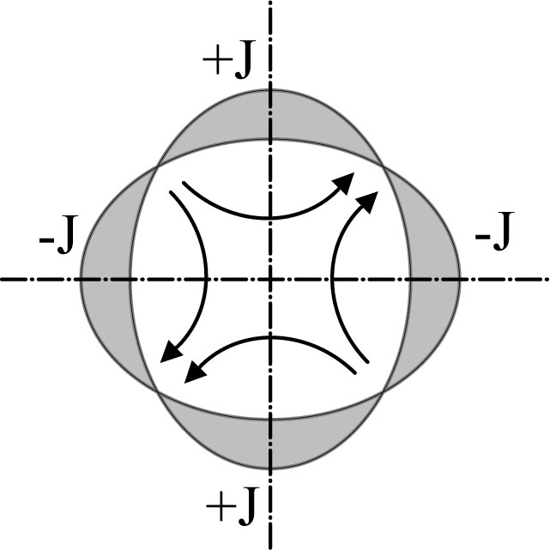
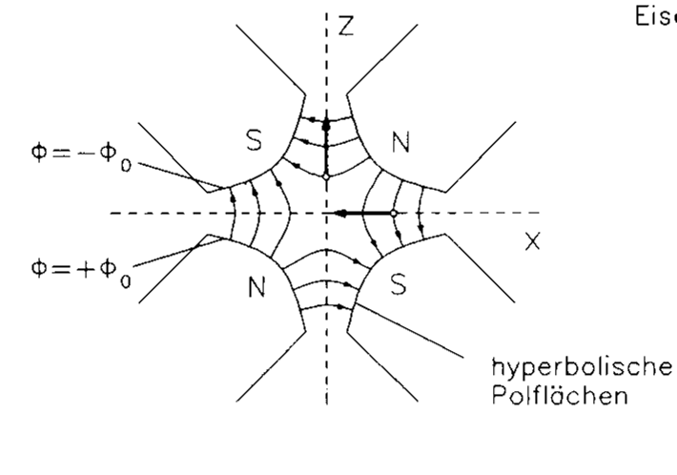
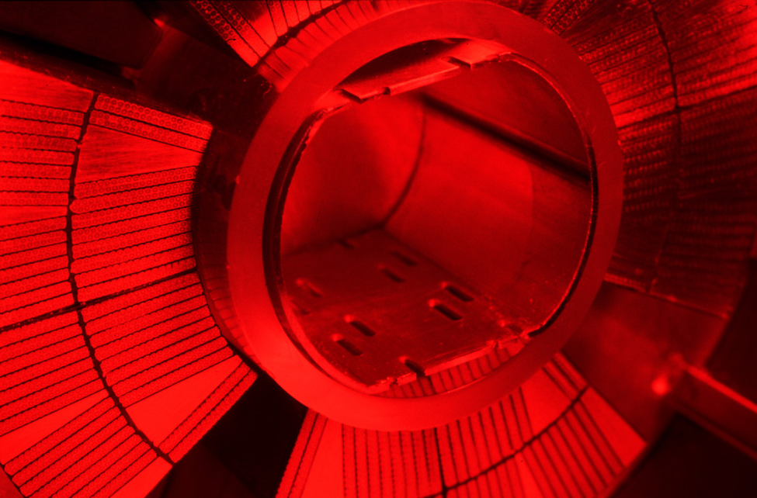
Quadrupole magnets
A quadrupole magnet will focus in one plane and de-focus in the other.
Convention: a “focusing” quadrupole focuses in the horizontal plane

Slide 17
Alternate gradient focusing
x
s
The general linear magnet lattice can be parameterized by a ‘varying spring constant’, K=K(s).
K(s) describes the distribution of focusing strength along the lattice and is periodic.
(and similarly for the vertical plane y)
This is Hill’s equation.

Slide 18
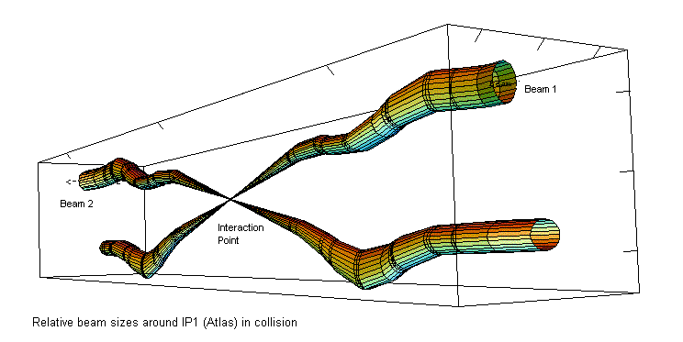
Squeeze
Beam 1
Beam 2
Focus beam down to very small sizes in the experiments
using quadrupole magnets

Slide 19
Accelerating the Particles
LHC: beams with an energy of 6.5 TeV
=
6 500 000 000 000 V
Tera Giga Mega kilo

Slide 20
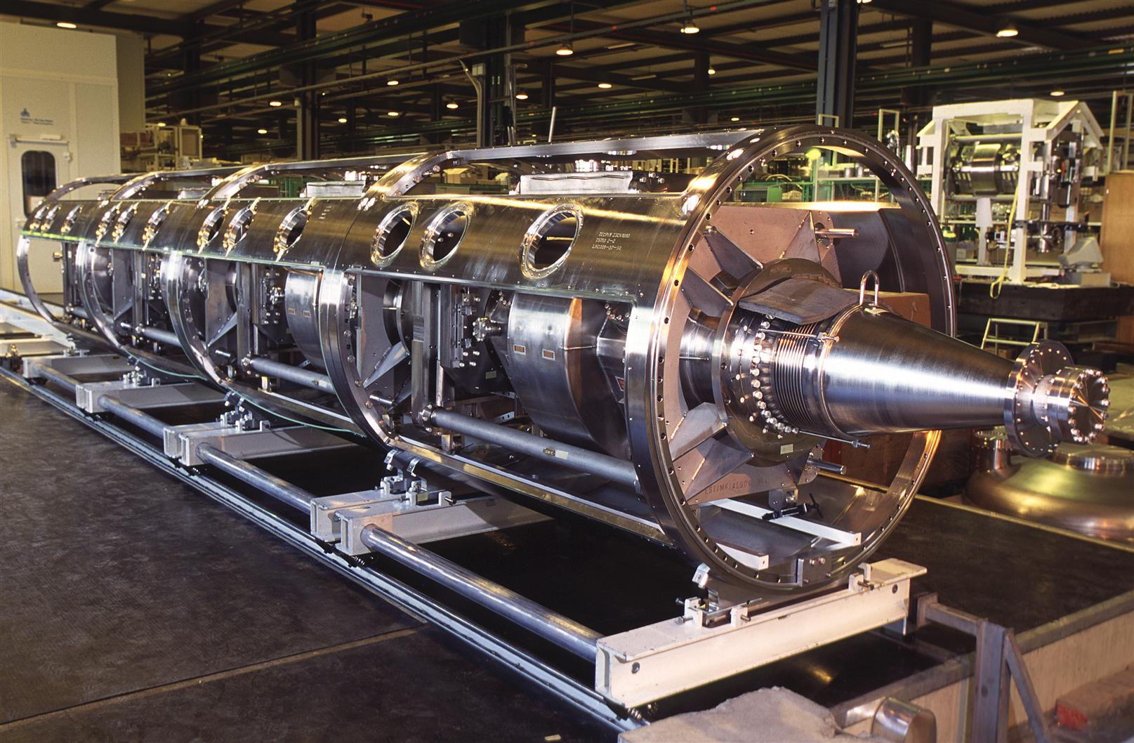
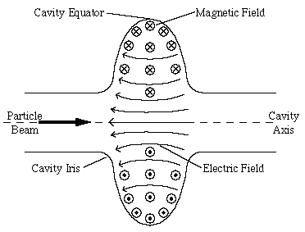
Radio Frequency Cavities
RF = Oscillation of field at 400 MHz (Radio Frequency)
Use the Electrical Field at each passage
4 cavities/module - 2 modules/beam - 16 MV (5.5 MV/m)
Superconducting to reduce Beam Impedance
4 Cavity RF Module

Slide 21
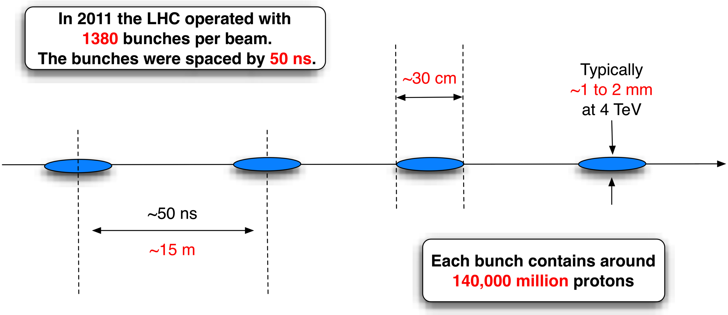
Lots of bunches
In 2017 the LHC operated with 2300 bunches per beam, separated by 25 ns
Transverse size typically 1 mm
25 ns = 7.5 m

Slide 22
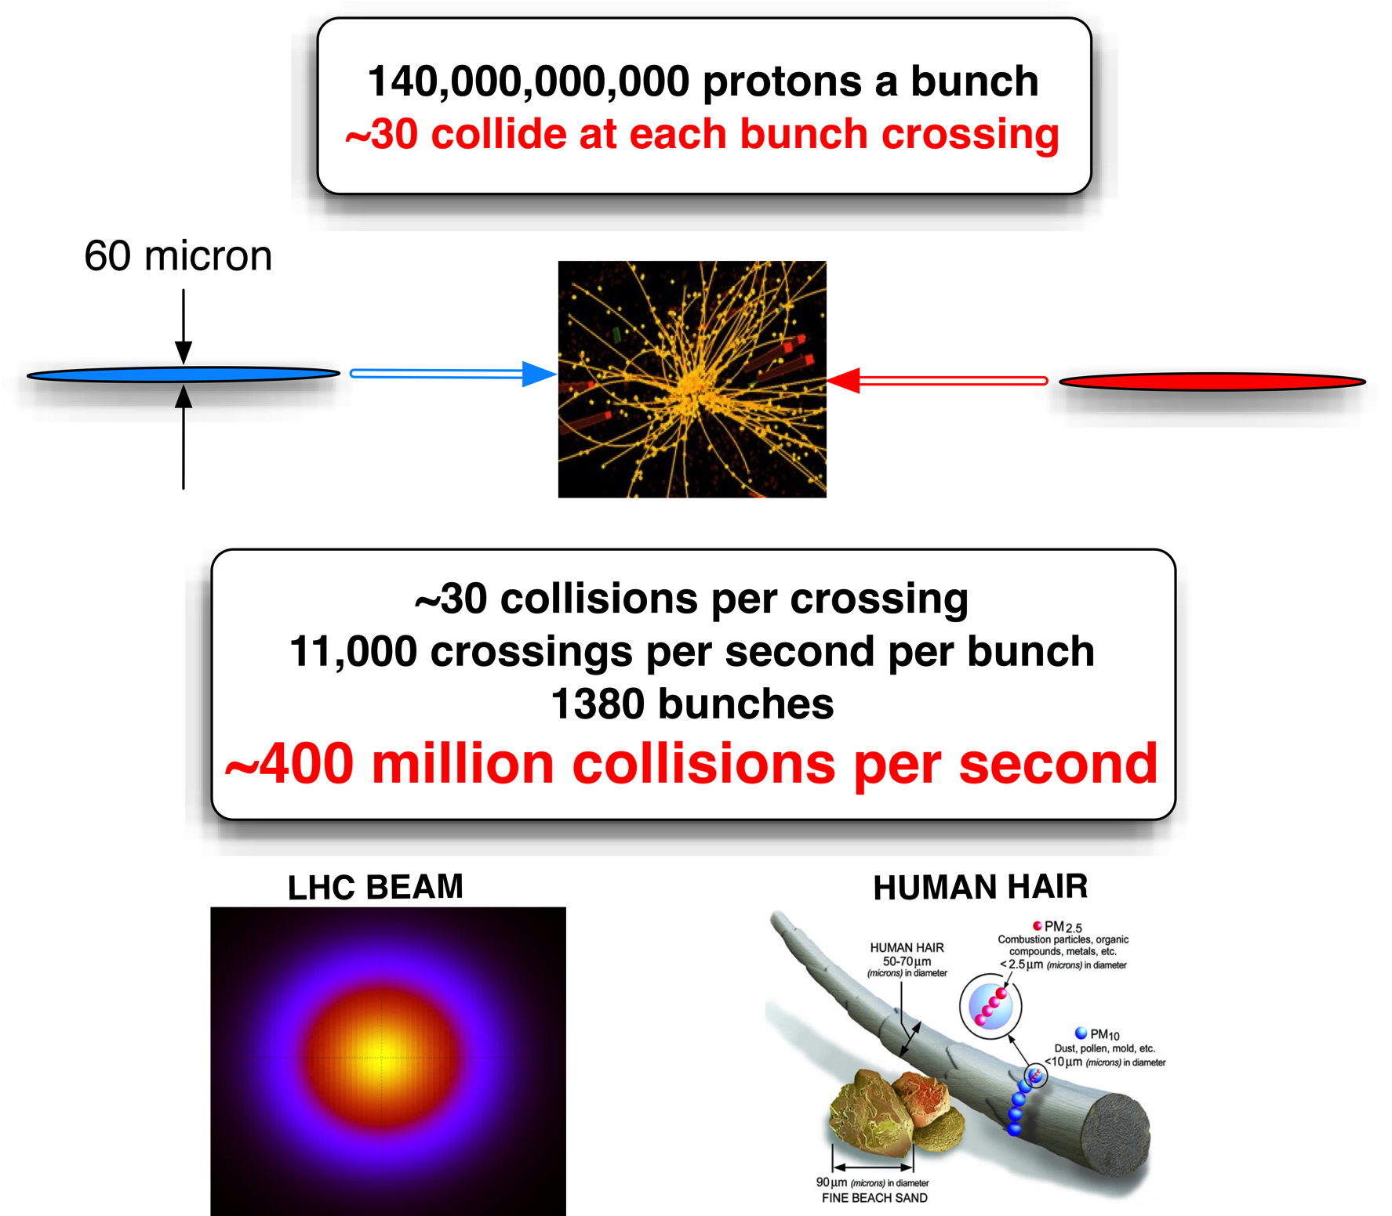
12 micron
Up to 50 collisions per crossing
11’000 crossings per second
2200 bunches per beam (2016)
1 Billion Collissions Per Second → GRID

Slide 23
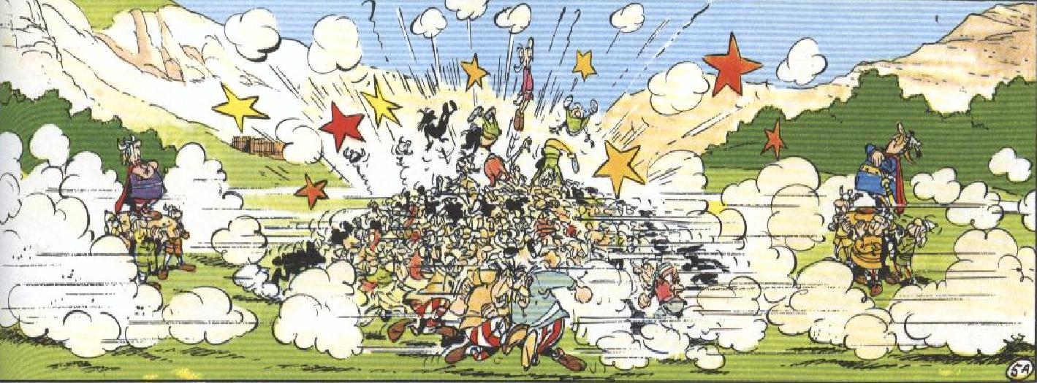
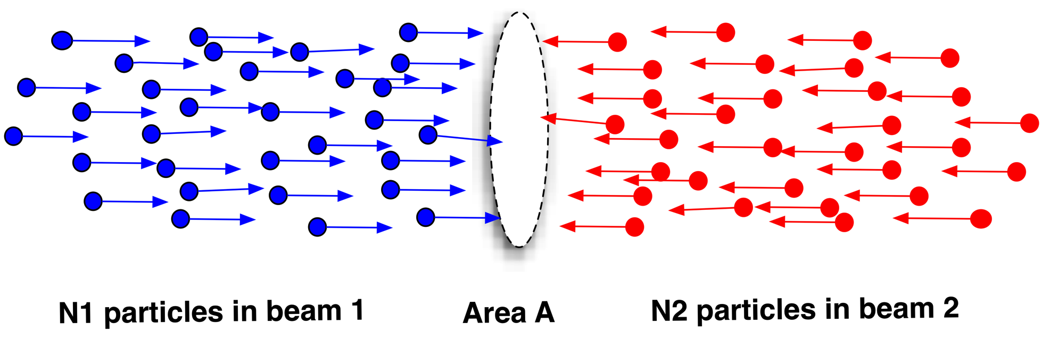
Luminosity

Slide 24

Energy in the Beam
Electric Energy (RF cavity) → Kinetic energy
E-beam | 6.5 TeV = 6.5e12 eV
1 eV | 1.6e-19 Joules
Number of bunches | 2300
Number of protons per bunch | 1.3e11 protons
Energy | 311 MJoules
What would be the speed of a car to have the same kinetic energy ?

Slide 25
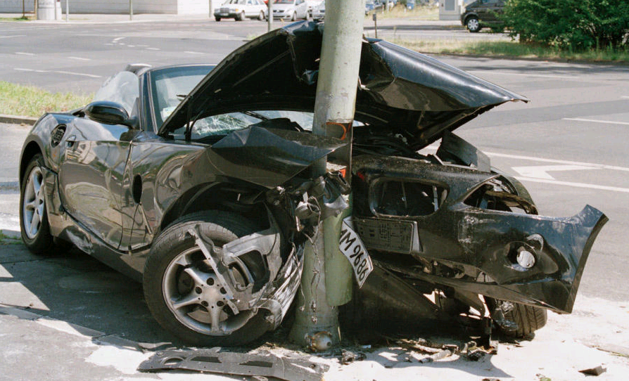
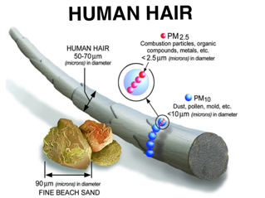
Car Versus Beam
Electric Energy of the beam → Kinetic energy
E-beam | 6.5 TeV = 6.5e12 eV
1 eV | 1.6e-19 Joules
Number of bunches | 2300 (for 2016)
Number of protons per bunch | 1.3e11 protons
Energy | 311 MJoules
Kinetic Energy of the car
Mass car | 1800 kg
Kinetic energy | 306 MJoules
V | 583 m/s
V | 2100 km/h
But at the size smaller than a hair ….

Slide 26
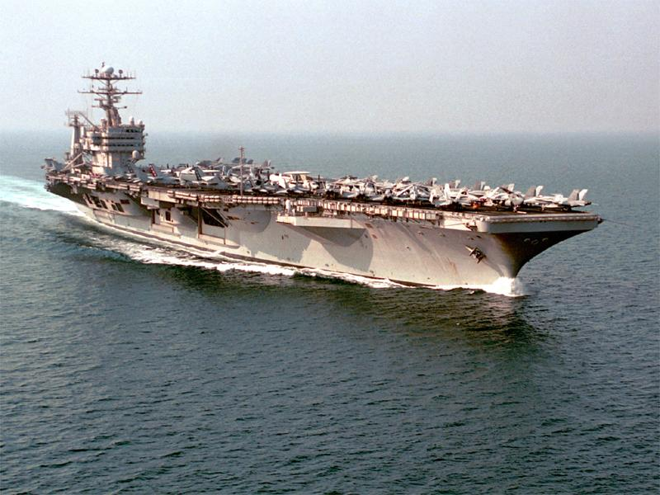
Don’t break the machine!
Energy per beam up to 360 MJ
British aircraft carrier at 12 knots
Thread through a very cold, very dark, very small hole...
26
26

Slide 27
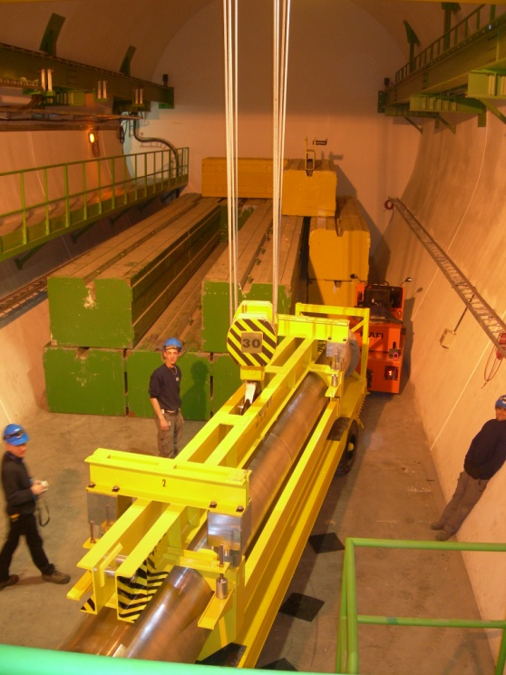
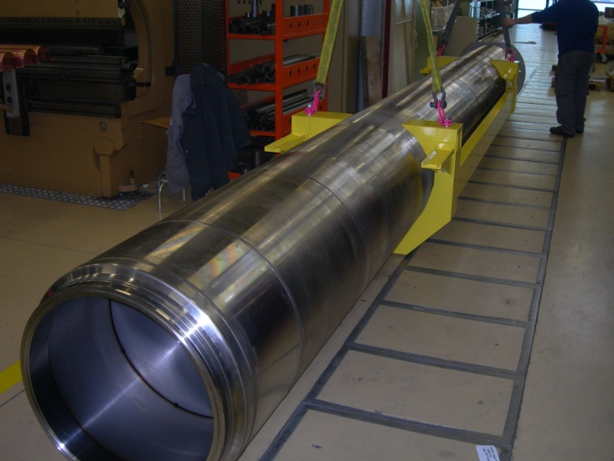
Beam dump block (TDE)
700 mm ∅ graphite core, with graded density of 1.1 g/cm³ and 1.7 g/cm³
12 mm wall, stainless-steel welded pressure vessel, at 1.2 bar of N₂
Surrounded by ~1000 tonnes of concrete/steel radiation shielding blocks
0.7 m
3.5 m
3.5 m
beam
1.7 g/cm³
1.1 g/cm³
1.7 g/cm³
27
27

Slide 28
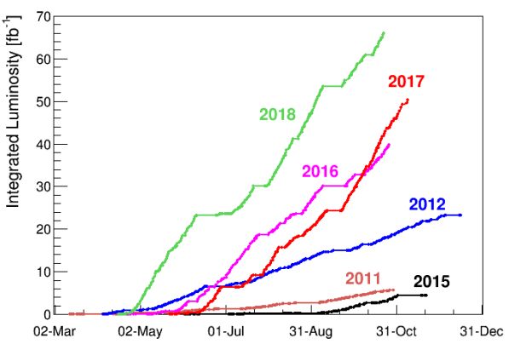
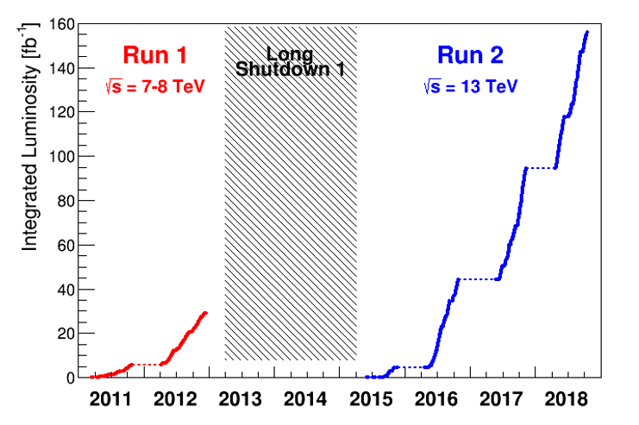
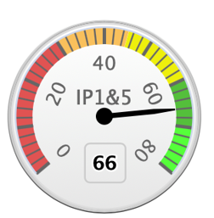
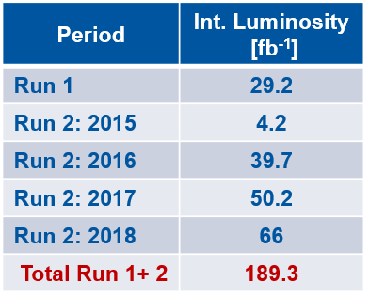
It is all about Luminosity
2018

Slide 29
Luminosity
N | Number of particles per bunch
k_{b} | Number of bunches
f | Revolution frequency
σ* | Beam size at interaction point
F | Reduction factor due to crossing angle
ε | Emittance
ε_{n} | Normalized emittance
β* | Beta function at IP

Slide 30
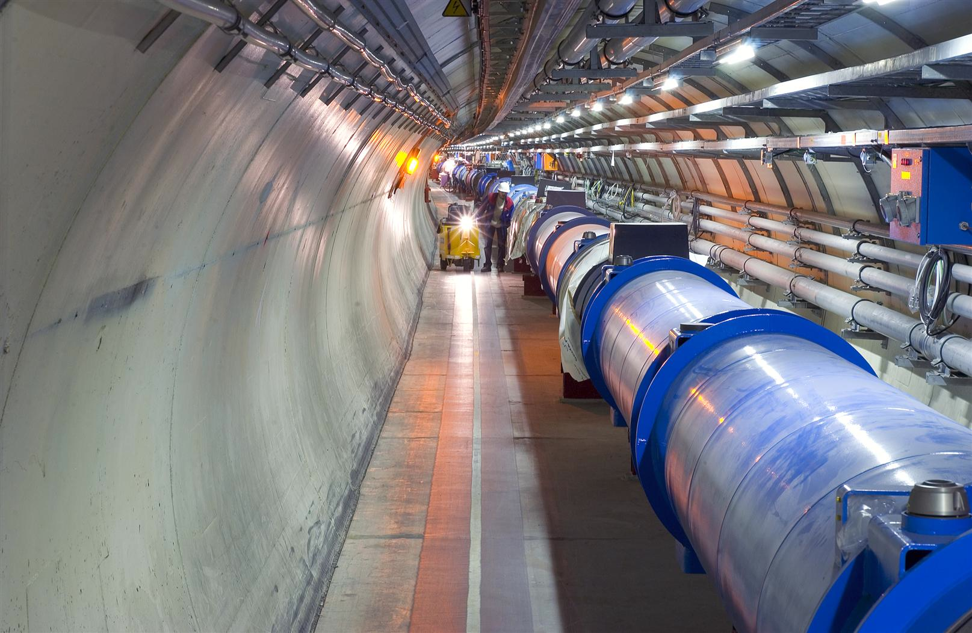
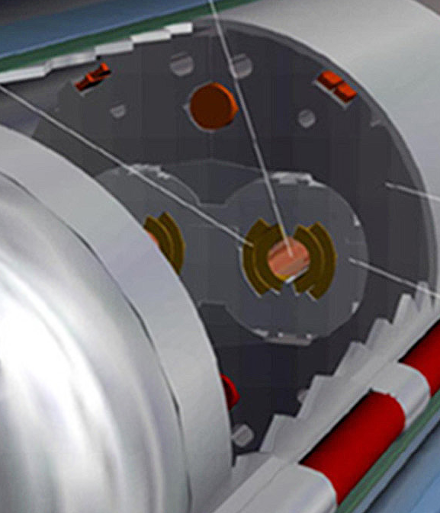
Quench Limit of LHC Super-Conducting Magnets
Nominal design at 7 TeV
Beam
360 MJ
56 mm
SC Coil: quench limit
5-30 mJ/cm³

Slide 31
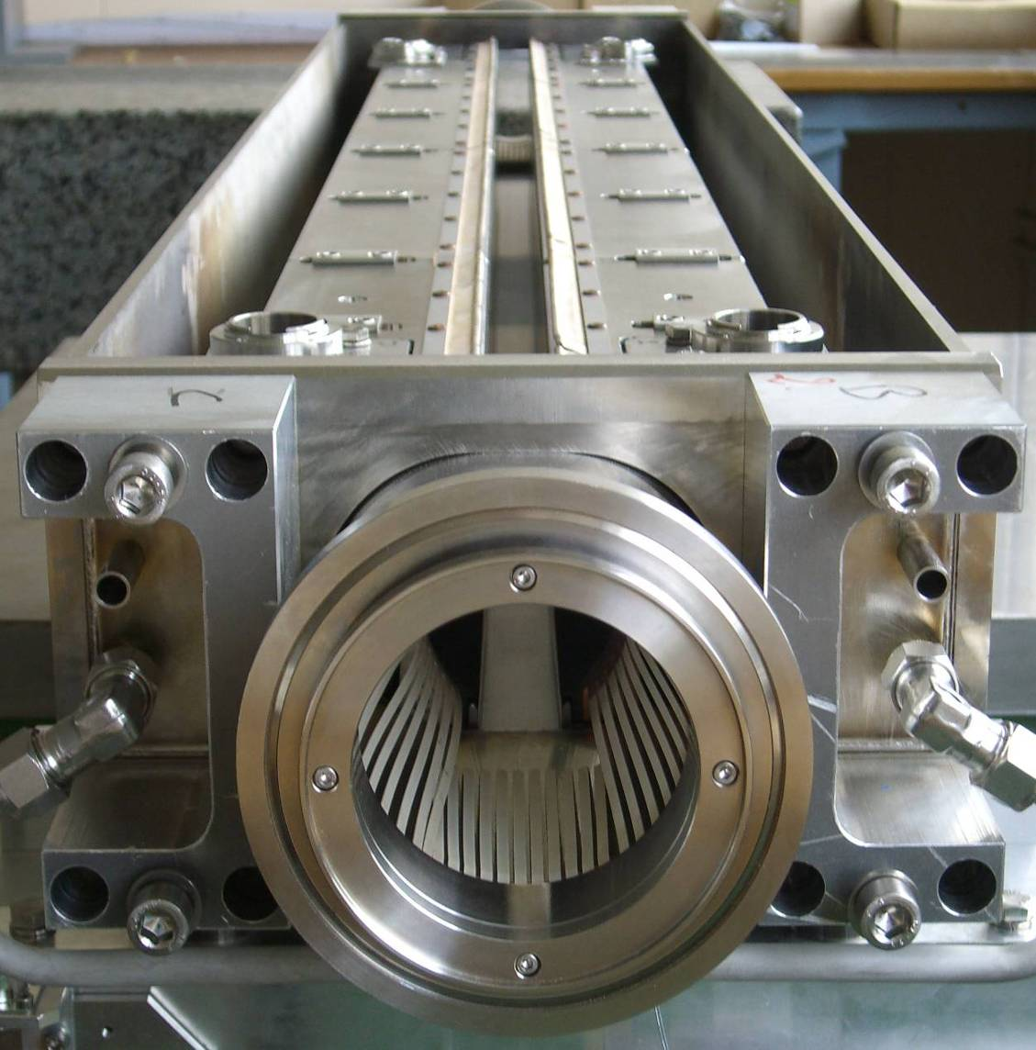
Collimation
1.2 m
Almost 100 collimators and absorbers.
Alignment tolerances < 0.1 mm to ensure that over 99.99% of the protons are intercepted.
Primary and secondary collimators are made of reinforced graphite – robust.
beam
31
31

Slide 32
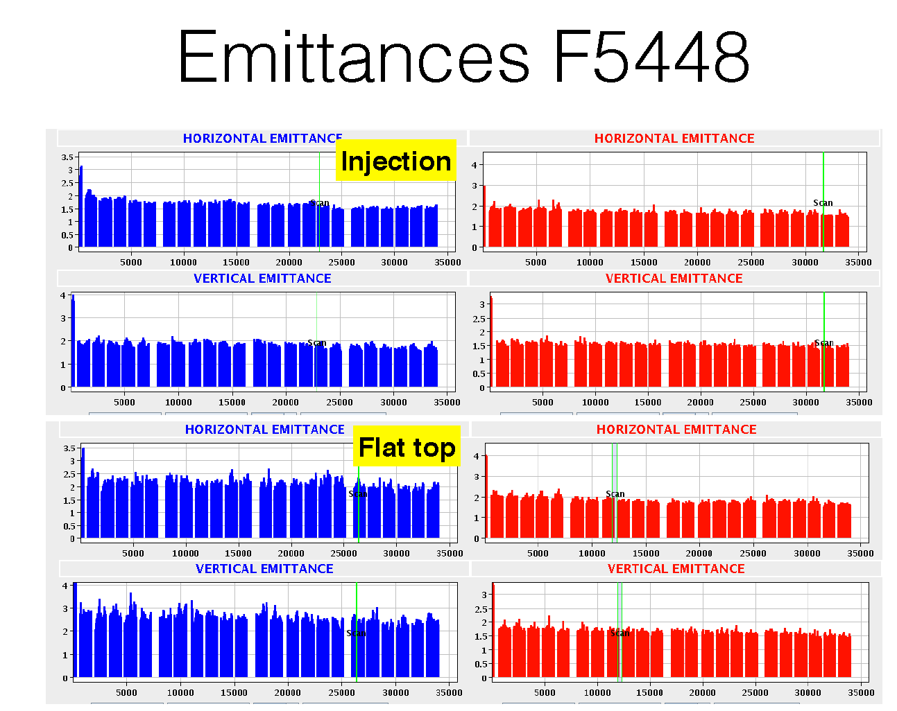

Slide 33
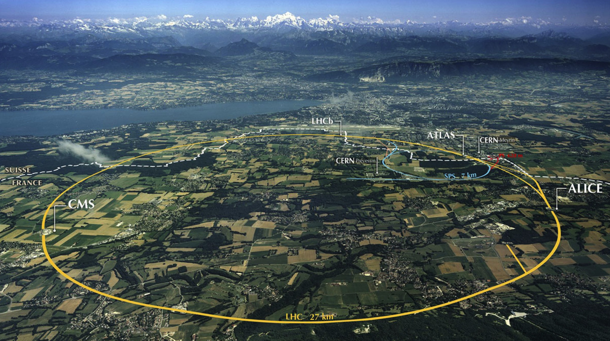
LHC: big, cold, high energy
Collimation
Injection B2
Beam dumps
Injection B1
Collimation
RF
1720 Power converters
> 9000 magnetic elements
7568 Quench detection systems
1088 Beam position monitors
~4000 Beam loss monitors
120 tonnes of Helium, down to 1.9 K
360 MJ stored beam energy per beam
11 GJ total stored energy in magnetic systems

Slide 34

Machine Elements
Magnets: guidance and transverse ‘stability’
  Dipoles, Quadrupoles, Sextupoles, Octupoles
Radio Frequency – Longitudinal motion
  Acceleration
  Feedback
Injection and Beam Dumping Systems
  Fast Pulsed Magnets (‘Kicker Magnets’)
  Septum Magnets
  Beam dump block
Machine Protection
  Collimation System, other absorbers, Interlock Systems
Beam Diagnostics & Protection
  Beam Position, Beam Loss Monitors, Tune Measurement, Synchrotron Light Measurements, Beam Size Measurements
Cryogenics & Vacuum

Slide 35
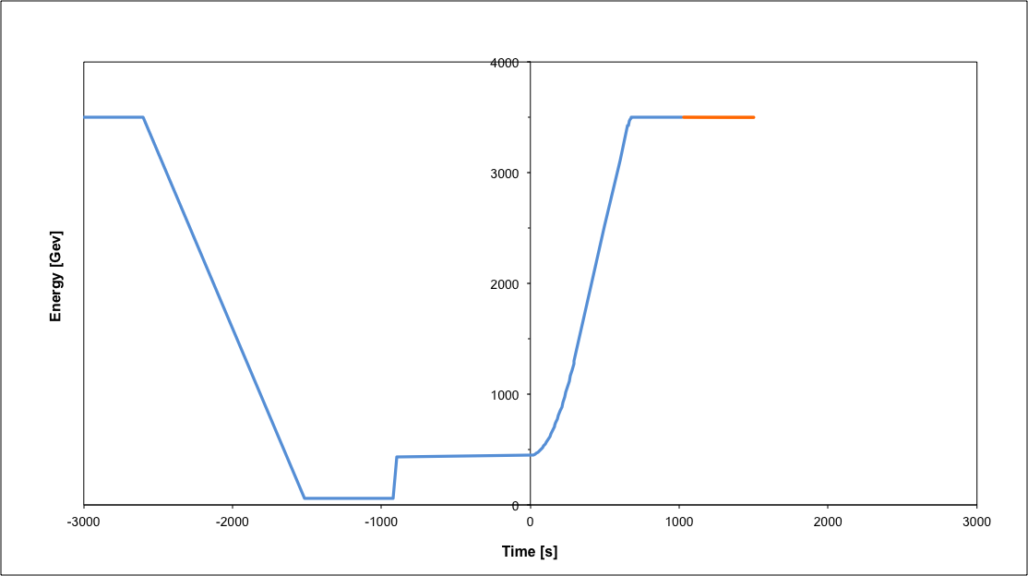
Operational cycle
Beam dump
Squeeze
Stable beams
Collide
Ramp
Ramp down/precycle
Ramp down | 35 mins
Injection | ~30 mins
Ramp | 12 mins
Squeeze | 15 mins
Collide | 5 mins
Stable beams | 0 – 30 hours
Injection
Turn around from stable beams to stable beams - 2 to 3 hours on a good day, followed by Stable Beams, average 6 hours.

Slide 36
Luminosity
Beam intensity

Slide 37
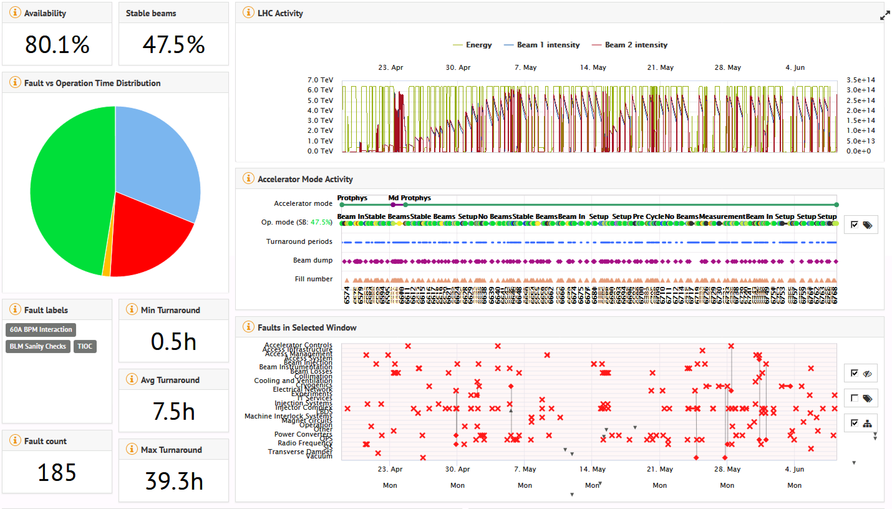
Machine Performance 2018

Slide 38
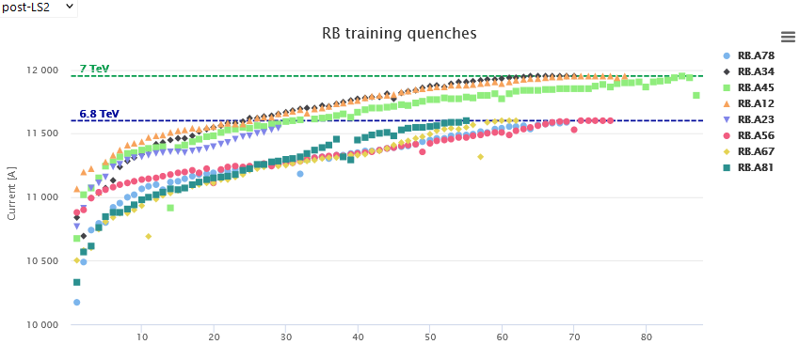
Magnet Training to reach 7 TeV Beam Energy
‘Nominal’
6.8 TeV
Present Operation
6.5 TeV = Operation <= 2018
During the training after LS2 (2021) we needed 3x a sector warm-up – delay of about 3 months each time, partly in parallel

Slide 39
Number of quenches needed to reach 7 TeV
We have had 274 magnet training quenches from 2008-2018 and 614 magnet training quenches in 2021.
 | 12 | 23 | 34 | 45 | 56 | 67 | 78 | 81
#Q to reach 11600 A (6.8 TeV) (including flat-top quenches at 11600 A) | 0 | 23 | 0 | 0 | 0 | 0 | 42 | 0
#Q to reach 11950 A (7 TeV) (starting at 11600 A) | 0 | 70 | 0 | 0 | 71 | 54 | 67 | 53
#Q at 11950 A flat-top | 0 | 6 | 0 | 1 | 5 | 5 | 5 | 4
A total of about 65 magnet quenches (corresponding to about 55 circuit quenches) are still needed to bring S23 and S78 to 6.8 TeV.
A total of about 340 magnet quenches (corresponding to about 280 circuit quenches) are still needed to bring the remaining 5 sectors from 6.8 to 7 TeV.
We calculated a 63 % probability for another sector warm-up if we continue training to 7 TeV → Experiments want to run → Run at 6.8 TeV

Slide 40
Magnet Training to reach 7 TeV Beam Energy
6.8 TeV
‘Nominal’
6.8 TeV
Present Operation
6.5 TeV = Operation <= 2018
During the training after LS2 (2021) we needed 3x a sector warm-up – delay of about 3 months each time, partly in parallel

Slide 41
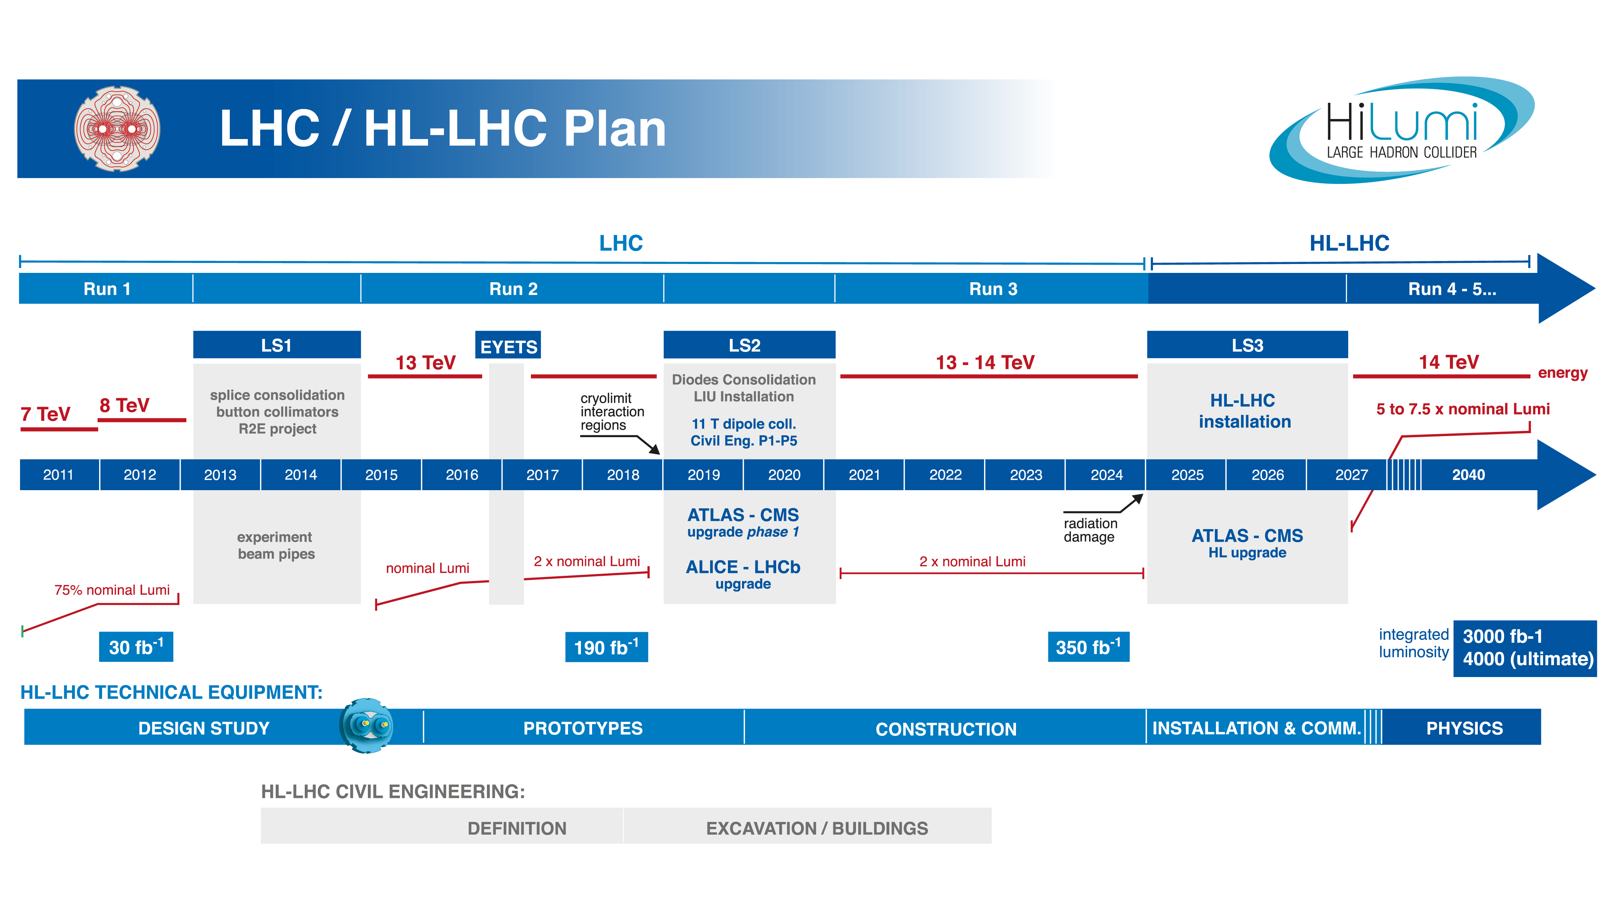
What’s Next ?
High-Luminosity LHC
13.6 TeV
Injectors upgrade and LHC civil engineering
HL-LHC upgrade

Slide 42
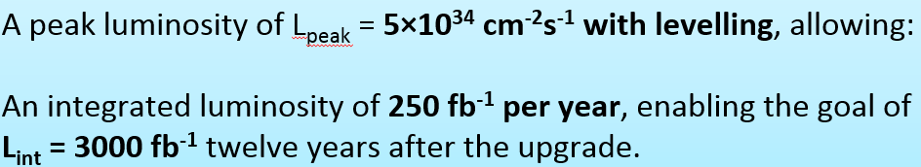
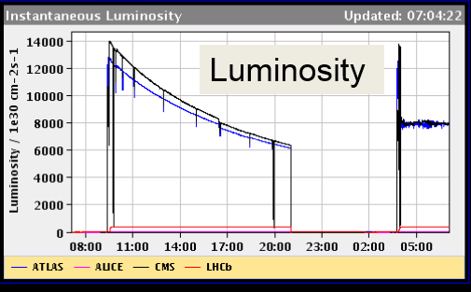
HL-LHC
Luminosity so far

Slide 43
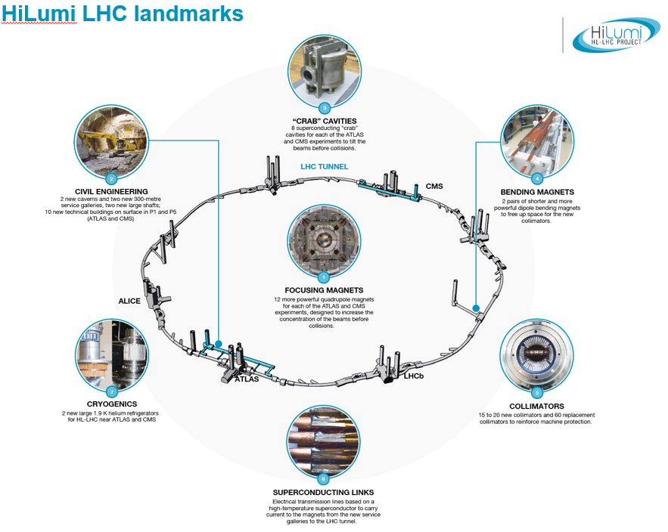
11 T dipoles (compared to 8.3 T)

Slide 44
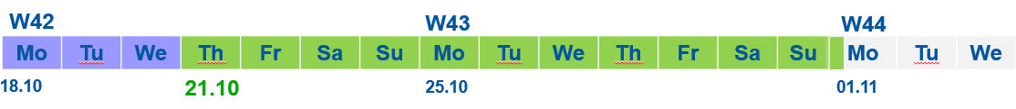
In Two Weeks from Now
Beams again in the LHC after > 2.5 years
Two week long beam test period:
Machine checkout : 3 days (estimated).
Beam operation : 11 days, end 01.11.2021 @ 6AM followed by radio protection survey.

Slide 45
Beam test outline
Assumes availability ≈ 70-80%
Circulate both beams
Instrumentation and tools setup
Little flexibility on workflow
Activities must follow defined order
6-7 days
Optics meas. & correction
Collimation setup & global aperture
Nominal bunch setup
Local apertures
Collisions build on setup work, expected around day 7
Interleaved data taking & machine activity periods
3-4 days
Collision setup
Machine tests
Collisions

Slide 46
The Future @ CERN after the HL-LHC

Slide 47
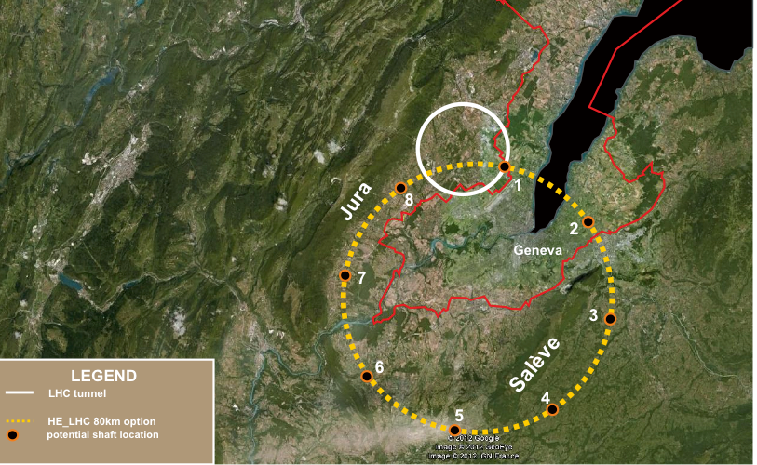
80-100 km tunnel infrastructure in Geneva area – design driven by pp-collider requirements
with possibility of e+-e- (TLEP) and p-e (VLHeC)
FCC (Future Circular Colliders)
15 T ⇒ 100 TeV in 100 km
20 T ⇒ 100 TeV in 80 km

Slide 48


Slide 49


CLIC near CERN: e+e- Collider
Tunnel implementations (laser straight)
Central MDI & Interaction Region

Slide 50









Slide 51
Bedankt voor jullie aandacht !
Accelerating Science and Innovation
Notes:
51

Slide 52
SPARE SLIDES

Slide 53

CMS: heavier than the Eifel tower

Slide 54

ATLAS: large as a building of 5 floors

Slide 55

ALICE: very sensitive, optimised for ion collisions

Slide 56

LHCb: asymmetric, B-physics

Slide 57

Aim of the game
We want to deliver maximum number of collisions at the maximum beam energy for maximum physics reach
E = m ⋅c ²

Slide 58


The Higgs field gives mass to other particles

Slide 59

Why is the Higgs so special?

Slide 60

Reduced Energy – the history
10th September 2008: First circulating beams – all smiles

Slide 61



Reduced energy – the history
19th September 2008: electrical arc ruptured bus-bar interconnection during tests without beam – violent He blow-off

Slide 62


Reduced energy – the history
Major damage over a few hundred meters. Back in operation 1 year later.

Slide 63


2013 – 2014: Long Shutdown to repair defective connections between superconducting magnets
2015: Restart with beam energy of 6.5 TeV

Slide 64

Next 10 years
Followed by many years of HL-LHC running
The LHC has a long future ahead ….

Slide 65

The HL-LHC Project
New IR-quads Nb₃Sn (inner triplets)
  New 11 T Nb₃Sn (short) dipoles
  Collimation upgrade
  Cryogenics upgrade
  Crab Cavities
  Cold powering
  Machine protection
  …
Major intervention on more than 1.2 km of the LHC

Slide 66



















High Luminosity LHC Participants

Slide 67
































CLIC Collaboration
29 Countries – over 70 Institutes
Accelerator
collaboration
Detector
collaboration
Accelerator + Detector collaboration

Slide 68





CERN: Particle Physics and Innovation
Interfacing between fundamental science and key technological developments
CERN Technologies and Innovation
Accelerating particle beams
Detecting particles
Large-scale computing (Grid)
Notes:
68

Slide 69






Medical Application as an Example of Particle Physics Spin-off
Combining Physics, ICT, Biology and Medicine to fight cancer
Hadron Therapy
Tumour Target
Leadership in Ion Beam Therapy now in Europe and Japan
Protons
light ions
Accelerating particle beams
~30’000 accelerators worldwide
~17’000 used for medicine
X-ray
protons
>70’000 patients treated worldwide (30 facilities)
>21’000 patients treated in Europe (9 facilities)
Imaging
PET Scanner
Clinical trial in Portugal for new breast imaging system (ClearPEM)
Detecting particles
Notes:
69

Slide 70





CERN Education Activities
Latin American School
Natal, Brazil, 2011
Arequipa, Peru, 2013
NEW:
Asia-Europe-Pacific School of High-Energy Physics
Fukuoka, Oct 2012
India, 2014
Scientists at CERN
Academic Training Programme
Young Researchers
CERN School of High Energy Physics
CERN School of Computing
CERN Accelerator School
CERN School of Physics
Hungary, June 2013
Physics Students
Summer Students
Programme
CERN Teacher Schools
International and National Programmes

Slide 71









August 2008
First injection test
November 29, 2009
Beam back
August, 2011
2.3e33, 2.6 fb⁻¹
1380 bunches
September 10, 2008
First beams around
June 28 2011
1380 bunches
October 14 2010
1e32
248 bunches
4 July, 2012
1380
6 June, 2012
6.8e33
2008
2009
2010
2011
2012
November 2010
Ions
March 30, 2010
First collisions at 3.5 TeV
September 19, 2008
Disaster
Accidental release of 600 MJ stored in one sector of LHC dipole magnets
18 June, 2012
6.6 fb⁻¹
to ATLAS & CMS
LHC Timeline

Slide 72

The highlight of a remarkable year 2012

Slide 73


Nobel Prize in Physics 2013
The Nobel Prize in Physics 2013 was awarded jointly to François Englert and Peter W. Higgs "for the theoretical discovery of a mechanism that contributes to our understanding of the origin of mass of subatomic particles, and which recently was confirmed through the discovery of the predicted fundamental particle, by the ATLAS and CMS experiments at CERN's Large Hadron Collider”.

Slide 74


The Worldwide LHC Computing Grid
Tier-0 (CERN): data recording, reconstruction and distribution
nearly 160 sites,
35 countries
~250’000 cores
Tier-1: permanent storage, re-processing,
analysis
173 PB of storage
> 2 million jobs/day
Tier-2: Simulation,
end-user analysis
10 Gb links
An International collaboration to distribute and analyse LHC data
Integrates computer centres worldwide that provide computing and storage resource into a single infrastructure accessible by all LHC physicists

Slide 75


Verification of Dump Protection
Image of the dumped beam
Switch off the RF
  Debunching fills the abort gap
Dump Beam
  Loss in point 6 on absorber elements
  Some losses collimation
  Clean at experiments:
  factor 1 : 10 000
Measured Beam losses around the whole Machine
Rest of the machine is clean
Dump
Collimation
75
75

Slide 76



Only one way to safely get rid of the beam
LHC Beam Dumping System
TCDQ
Extraction Kickers
2 x 15 Systems
10 Dilution kickers MKB
TCDS
76
76

Slide 77
Beam dump block (TDE)
700 mm ∅ graphite core, with graded density of 1.1 g/cm³ and 1.7 g/cm³
12 mm wall, stainless-steel welded pressure vessel, at 1.2 bar of N₂
Surrounded by ~1000 tonnes of concrete/steel radiation shielding blocks
0.7 m
3.5 m
3.5 m
beam
1.7 g/cm³
1.1 g/cm³
1.7 g/cm³
77
77

Slide 78
Extraction kicker – Abort Gap
Within 3 turns of dump request
Synchronised
dump trigger
Extraction kicker MKD deflection
LHC
Beam
3.0 μs
particle-free
abort gap
78
78

Slide 79

At every dump: Check the Extraction Kickers
3 µs ‘Abort Gap’ without beam
79
79

Slide 80

At every dump: Check the Dump Pattern
80
80

Slide 81

At every dump: Check the Beam Losses
81
81

Slide 82
Protection against ‘Kicker Sweep’
Beam in the Abort Gap
Asynchronous beam dump → quench or damage
  Several failures possible (synchronisation, MKD erratic)
Precautionary measures include:
  TCDS (fixed) – 6 m long diluter protects extraction septum
  TCDQ/TCS (mobile) – 7 m long diluter kept at about 7-8 σ from the beam at all times
82
82

