Slide 1
Advances in Magnetic Measurements
– Avatars and Twins
Stephan Russenschuck, 07.2021

Slide 2
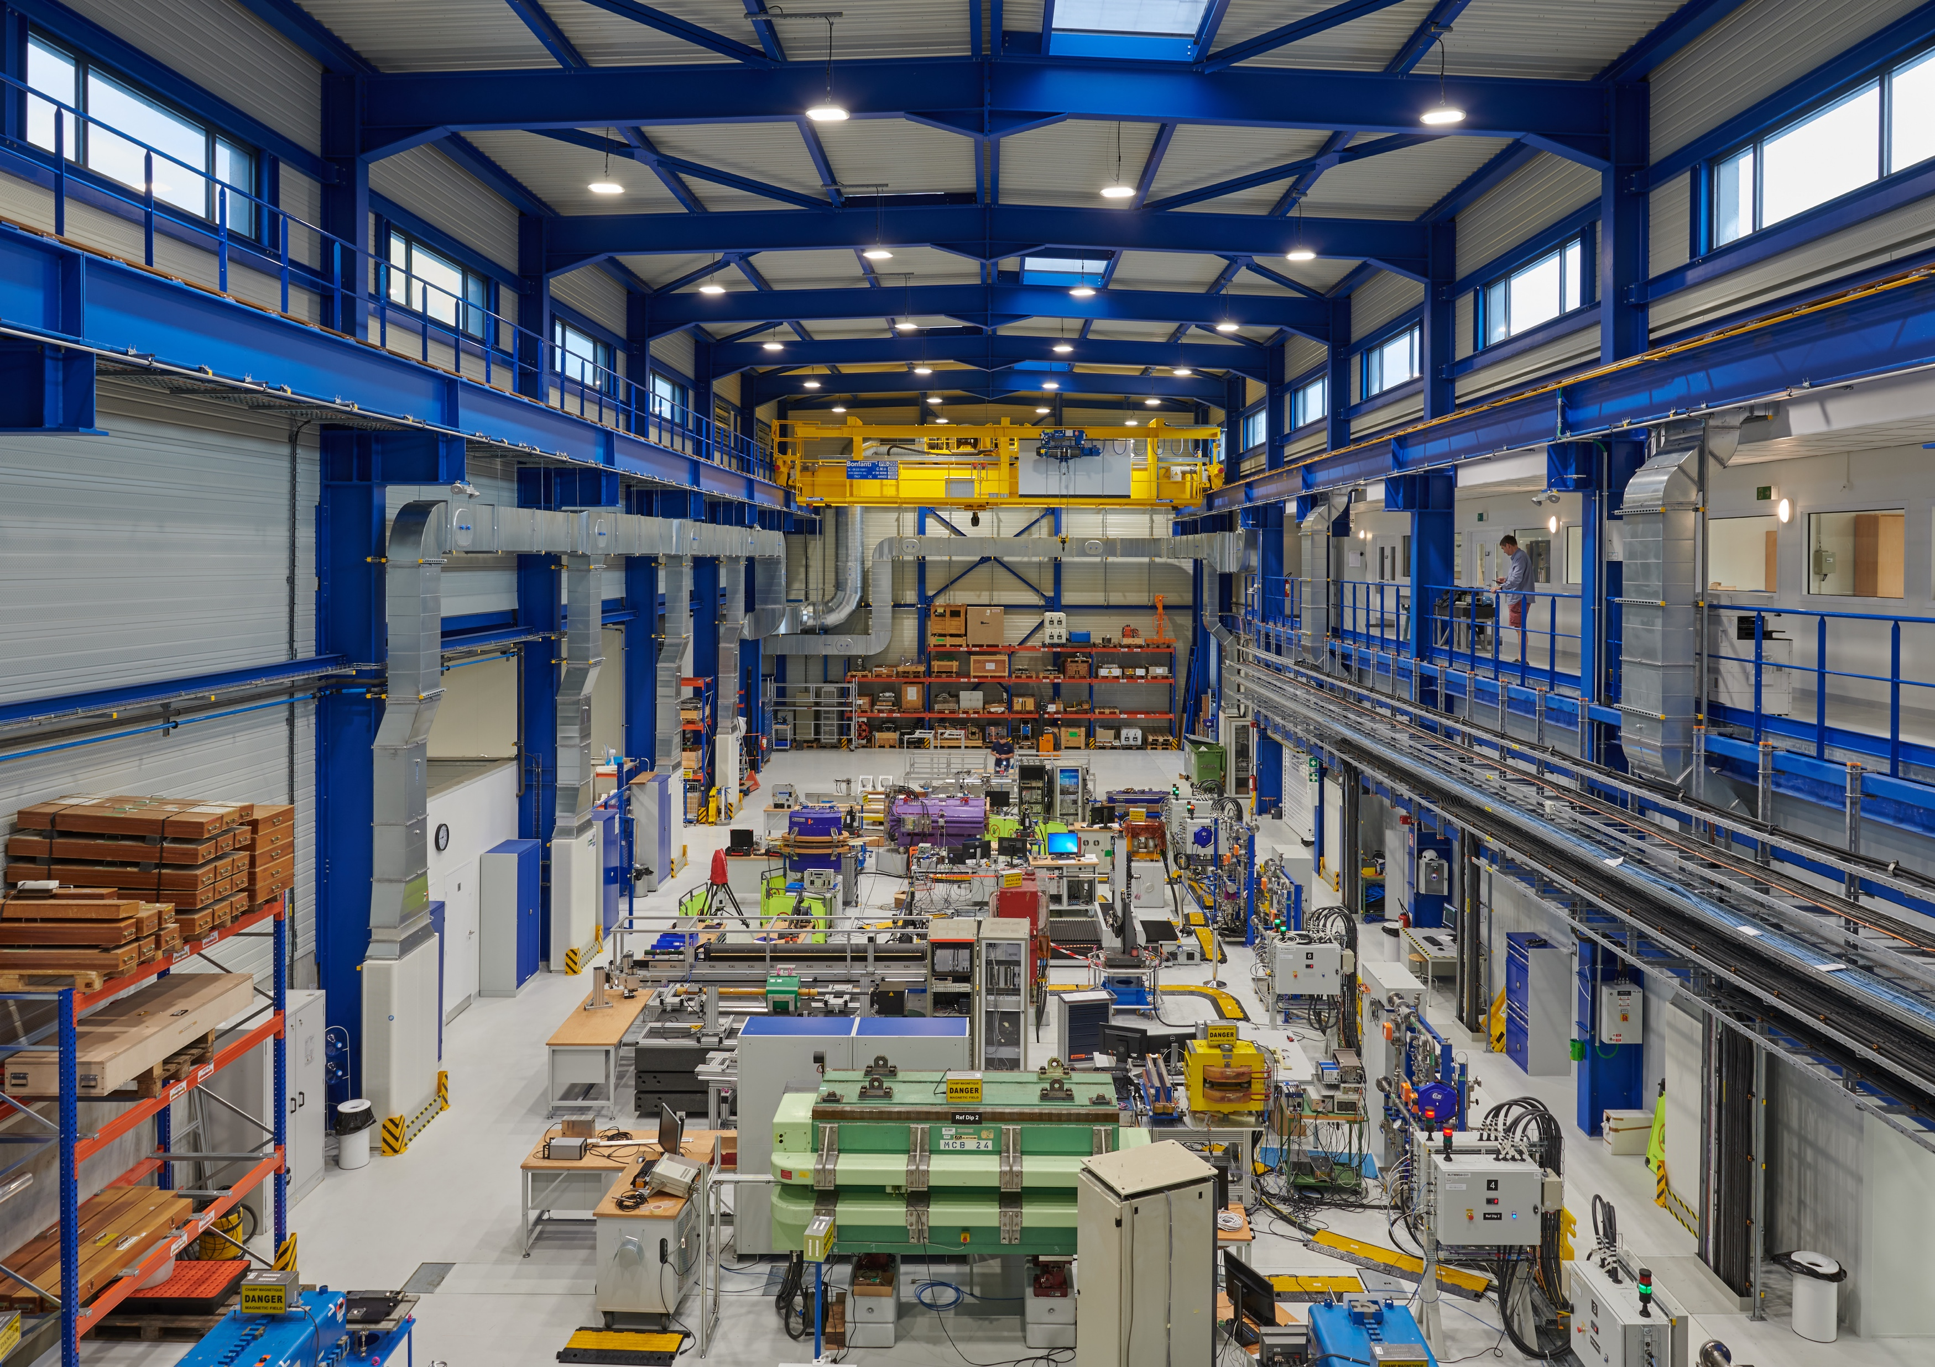
The Measurement Laboratory 311
Air-condition system (1.4 + 0.4 MCHF)
Avoid stratification (laser applications)
Air speed < 0.4 m/sec (laminar)
+- 2 ºC in large hall, +- 0.4 ºC in “measuring room”
Power converter cluster,
motorized switches,
PLC interlocked distribution
feedboxes

Slide 3
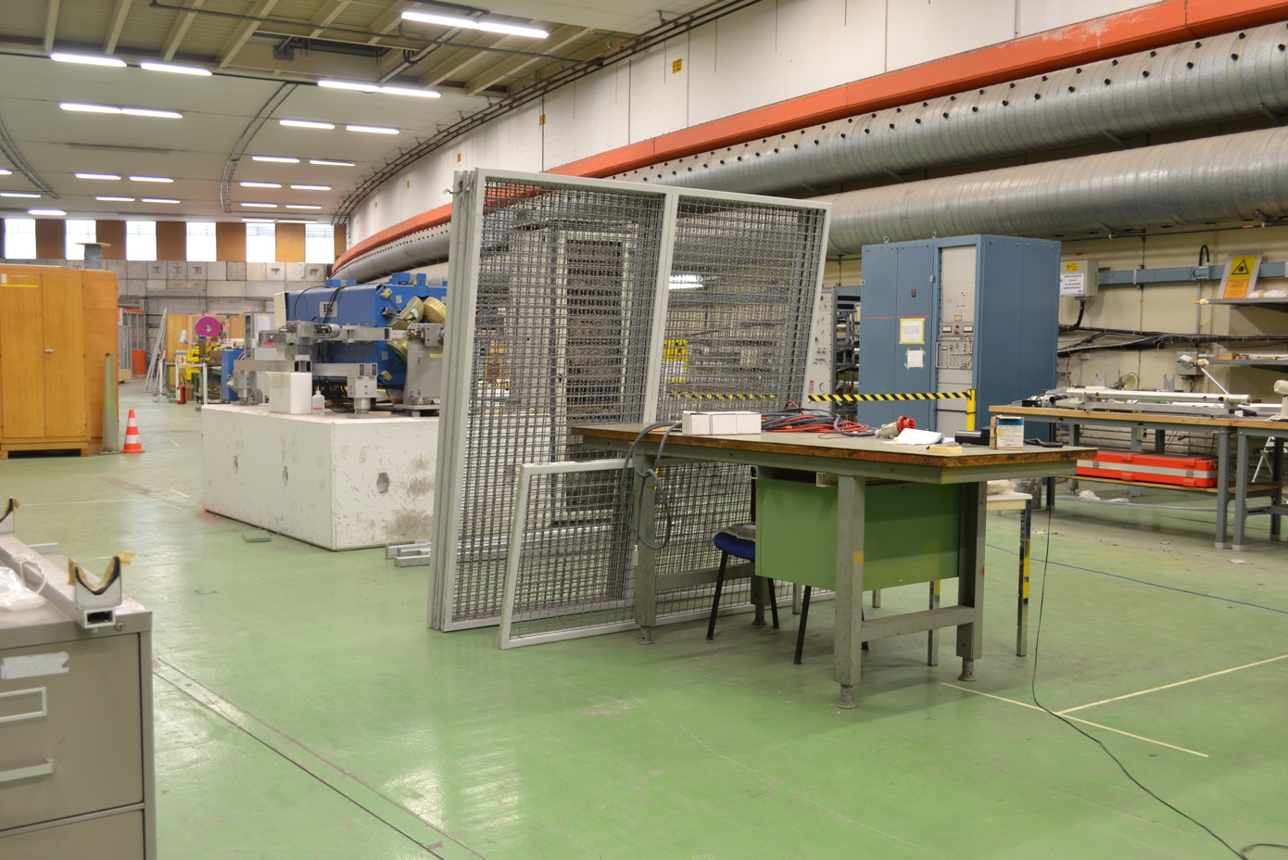
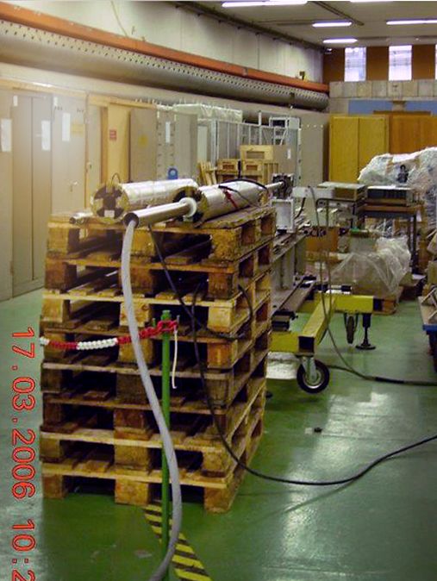
Environment: We Have Come a Long Way
ISR-Tunnel Segment: The most stable environment at CERN

Slide 4
The Measurement Paradigm
Measurements for design
  Material properties and design choices
  Software and model validation
  Dynamic effects
Measurements for magnet production
  Prototype qualification
  Quality assurance (error tracking); acceptance testing
  Magnet to magnet reproducibility (check tolerances)
  Shimming
  Requalification after repair
Measurements for accelerator operation
  Field description (feed forward compensation)
  Field quality (resonances)
  Online monitoring (pre-cycling)

Slide 5
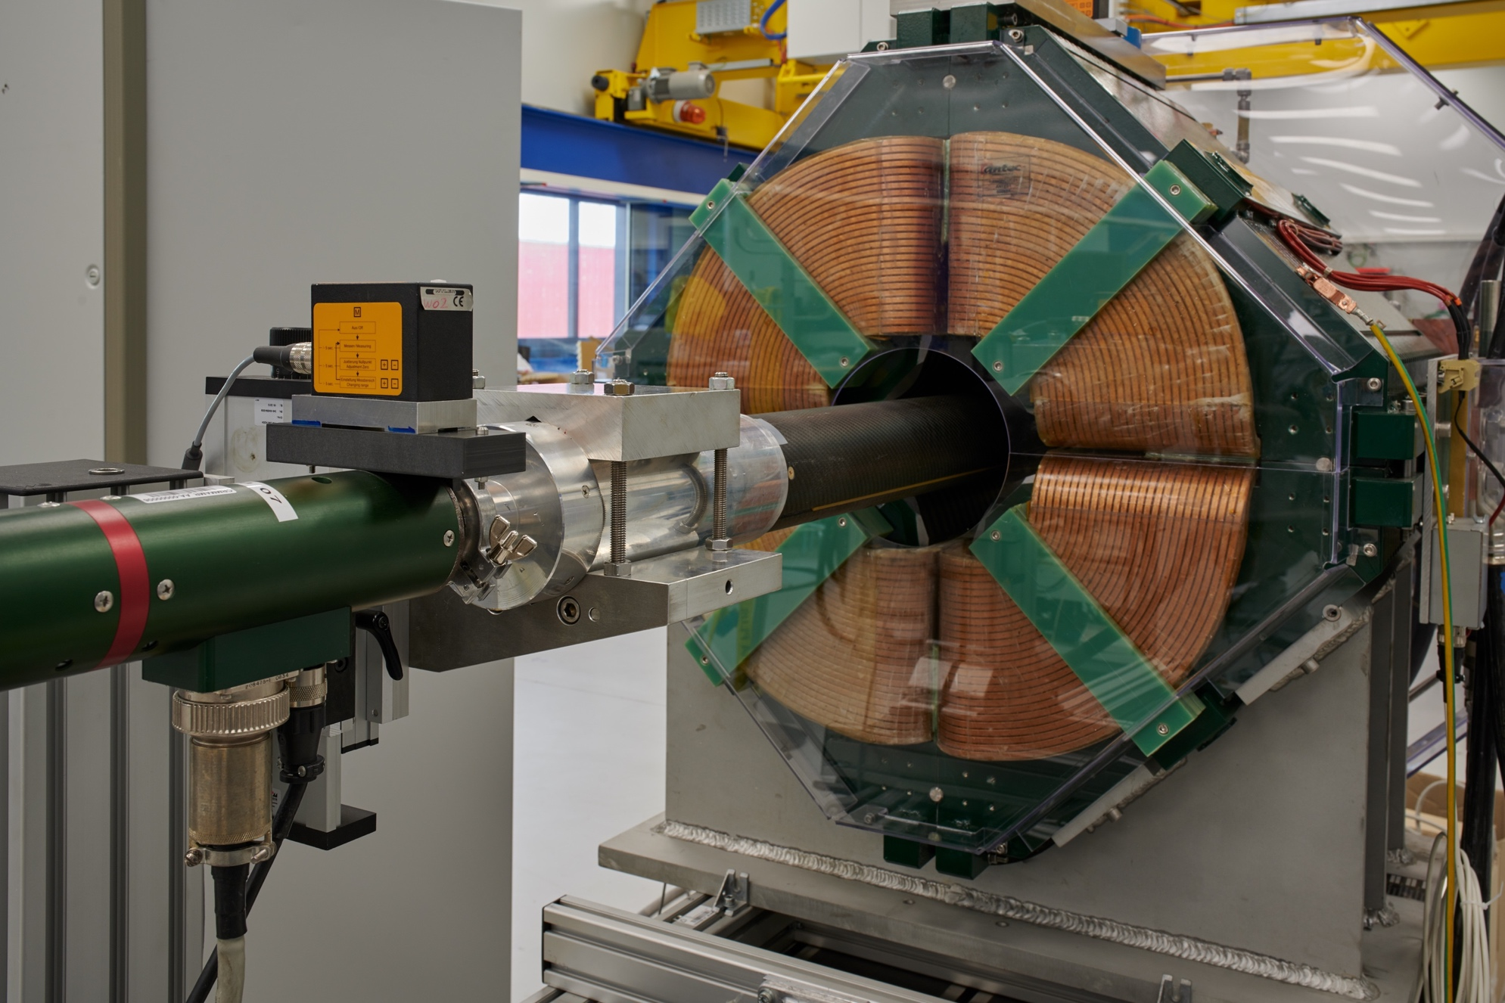
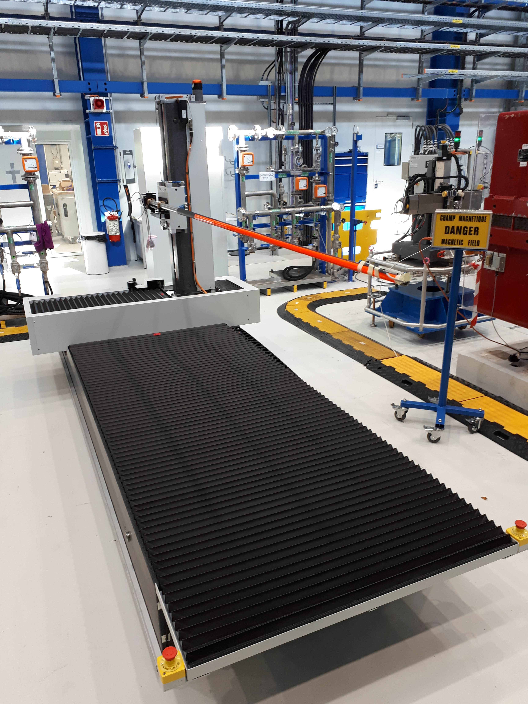
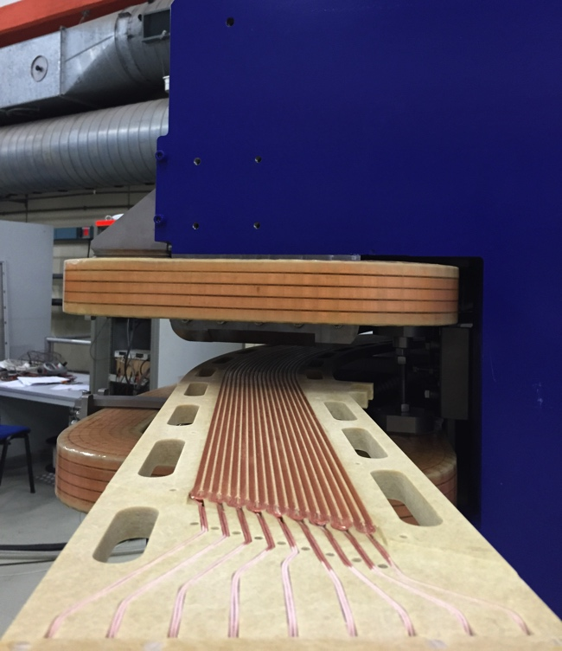
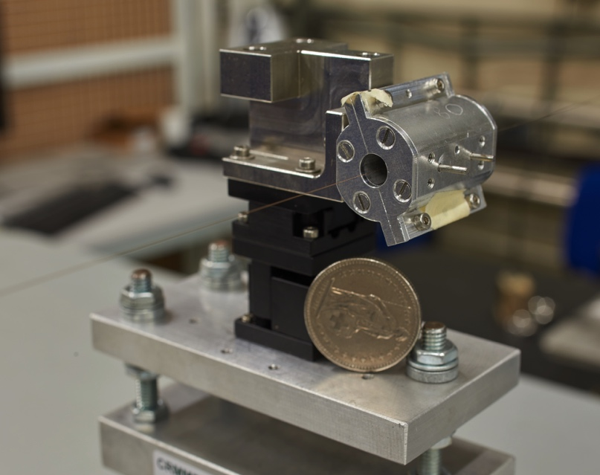
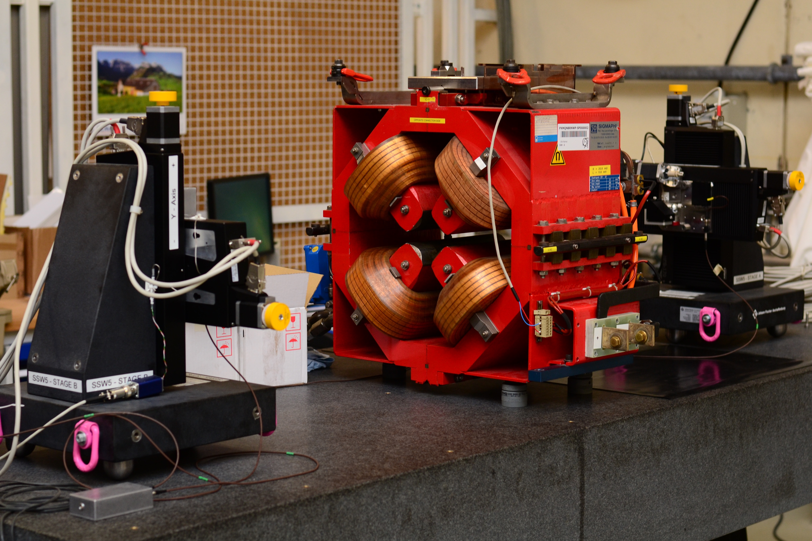
Magnetic Measurement Techniques
Rotating coil systems
Stretched-wire
3D Hall mapper
Stationary induction-coil
magnetometers

Slide 6
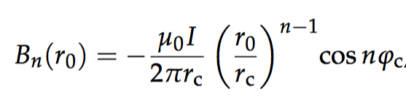

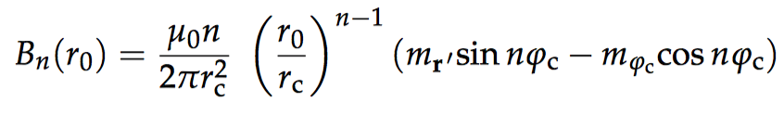
The Avatar and Twin (1)
Modeling errors
Num. magnet model (design)
Physical object (magnet)
Materia/geom. parameters
Discretization errors
Pre-processing
(meshing)
Test and magnetic
measurement
Capture noise
Numerical errors
Matrix solving
Raw signal
(integrated
voltages)
Read-out noise
Approximation errors
Post-processing
Processed
signal (harmonics,
flux density, VI)
Intrins., approx., gross errors
?

Slide 7
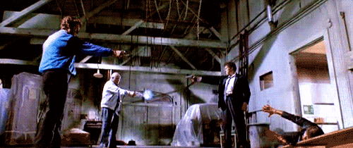
Beam Physicists, Magnet Designers, and Measurement Engineers
Everybody believes in measurements, but the measurement engineer himself.
Nobody believes in field simulations, but the field computation expert himself.
Establish a C³ coherence between requirements for the three parties

Slide 8
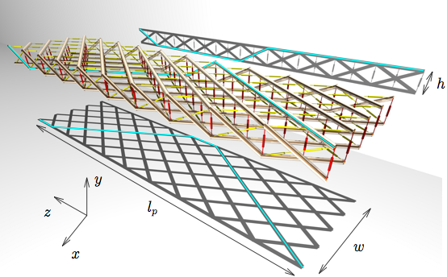
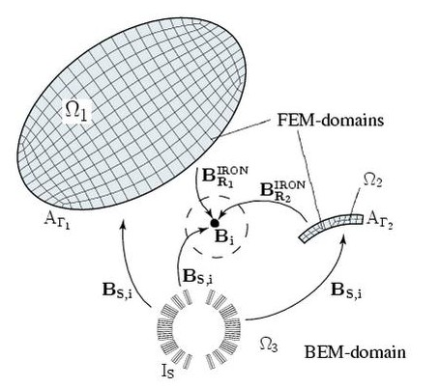
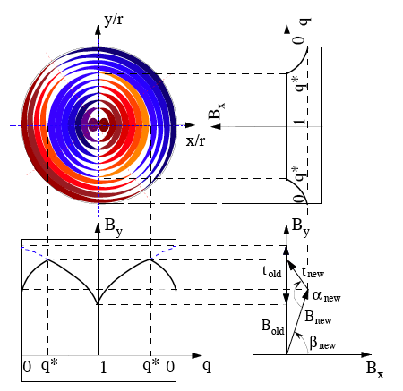
BEM-FEM Coupling and Dynamic Effect Calculation in ROXIE
10⁻⁴ predictive properties

Slide 9
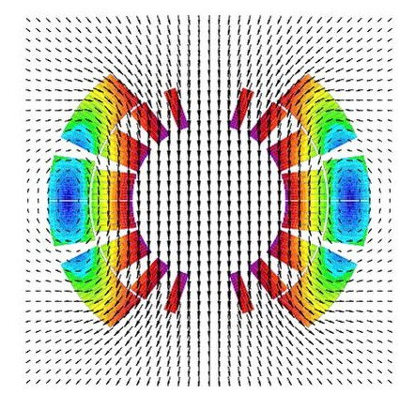
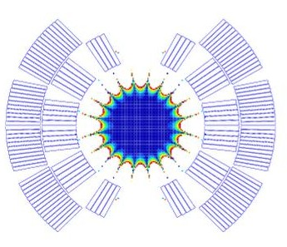
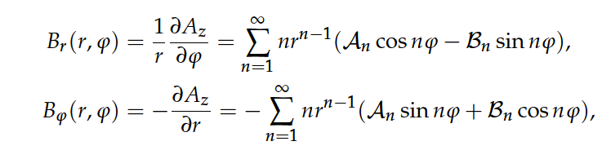
2D Field Harmonics
2D Field map Good field region

Slide 10
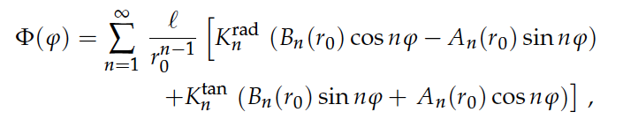
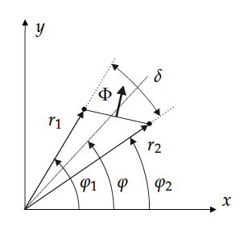
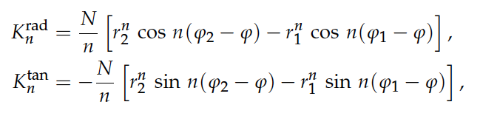
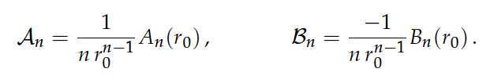
Rotating Coil Measurements

Slide 11
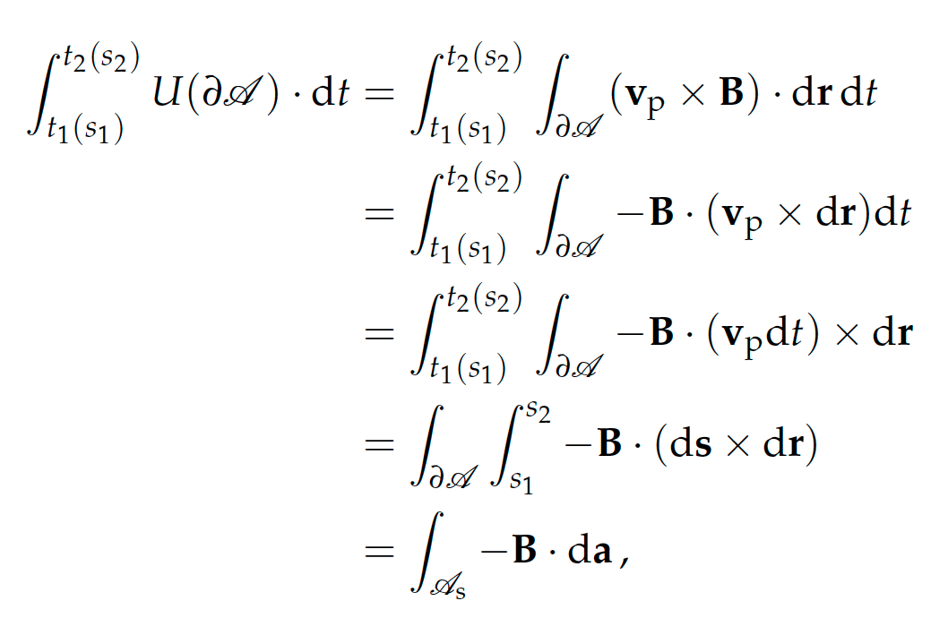
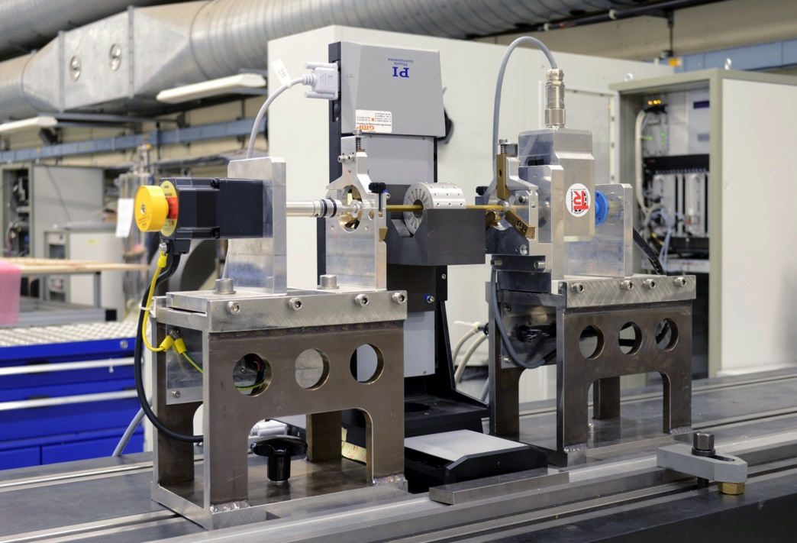
Reparametrization to Arc Length
Low drift, low-noise amplifier = resolution of 10 nVs
One cycle = 1 – 10 s
1024 trigger points for discrete Fourier transform

Slide 12
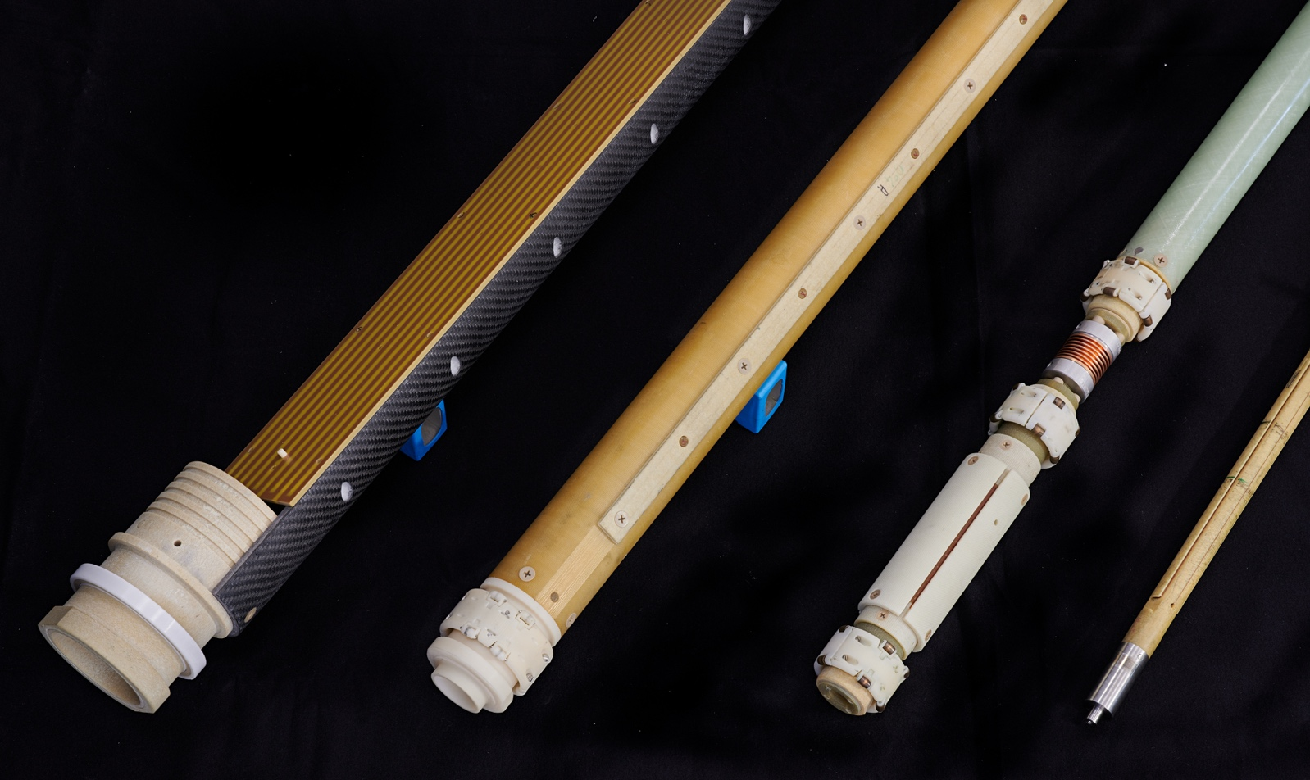
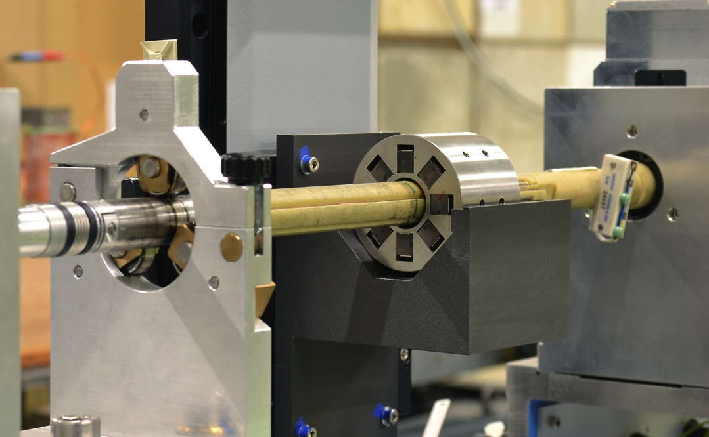
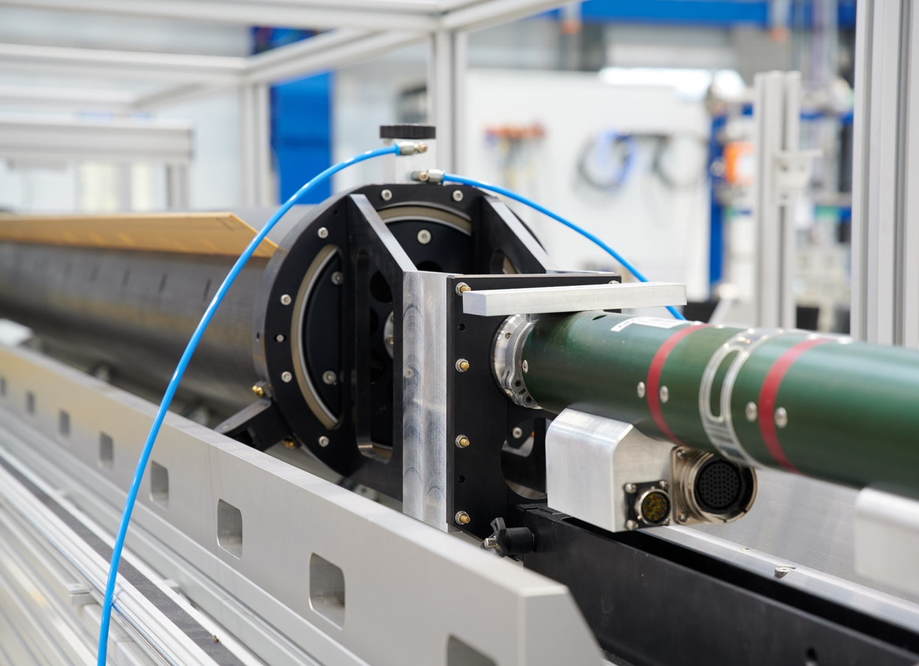
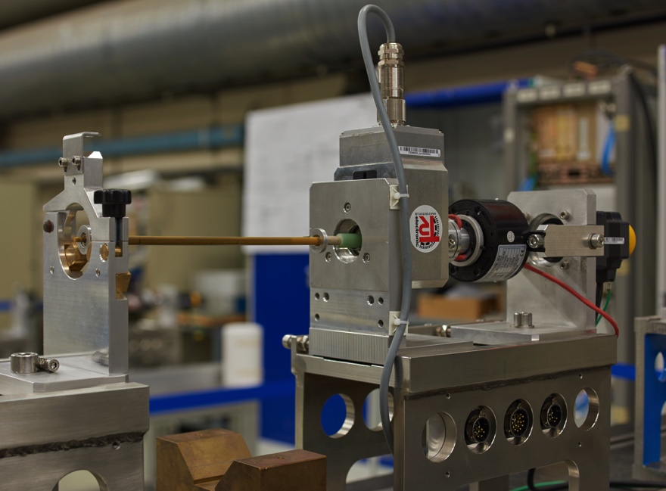
Rotating Coil Systems
380 mm
8 mm

Slide 13
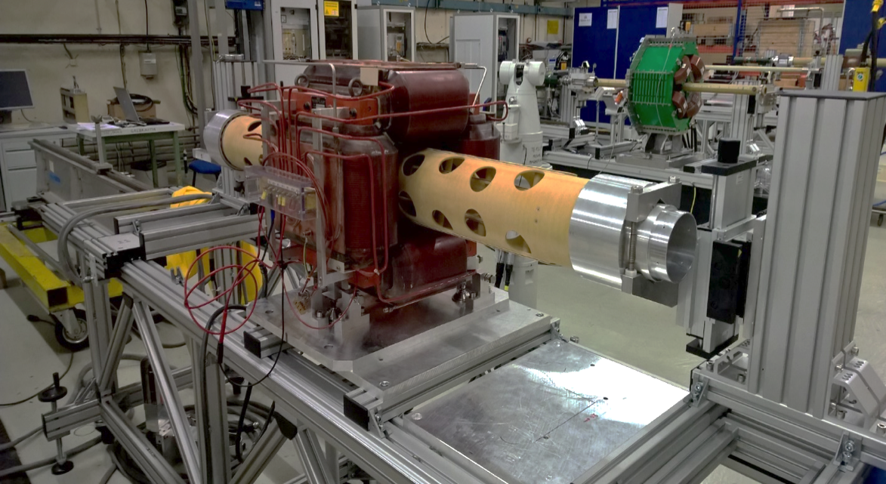
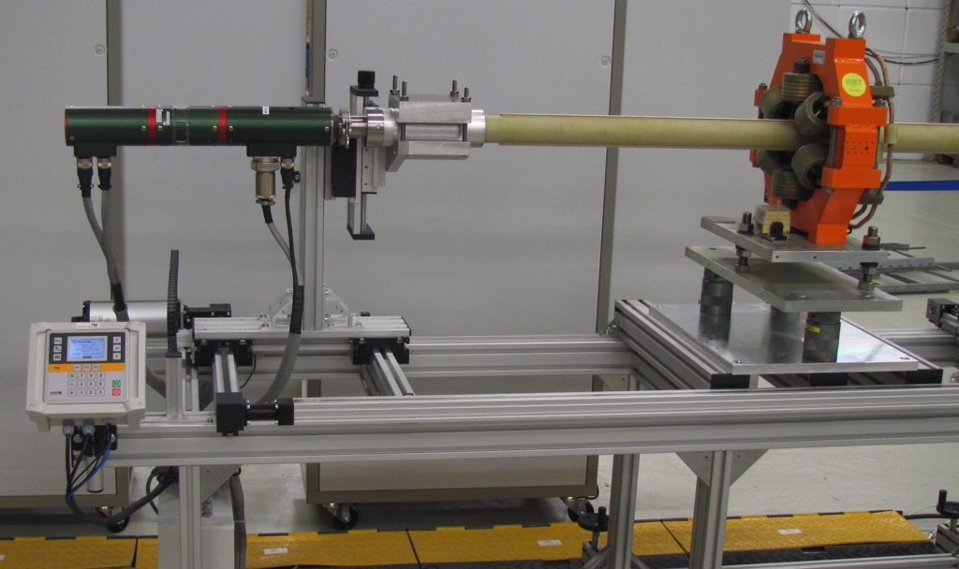
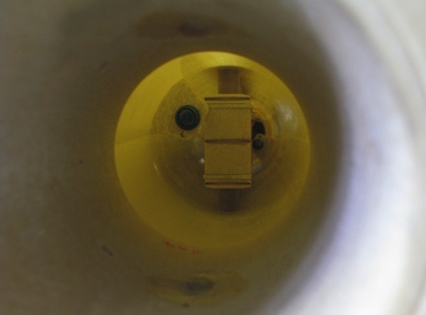
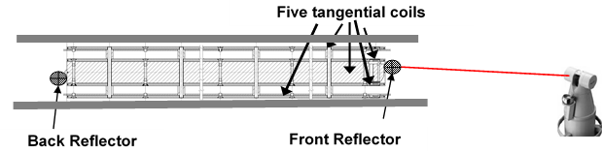
Sensors and transducers for magnetic measurements: rotating coils
Horizontal stations room temperature
Optical targets installed at both coil ends → measurement of the rotation axis

Slide 14
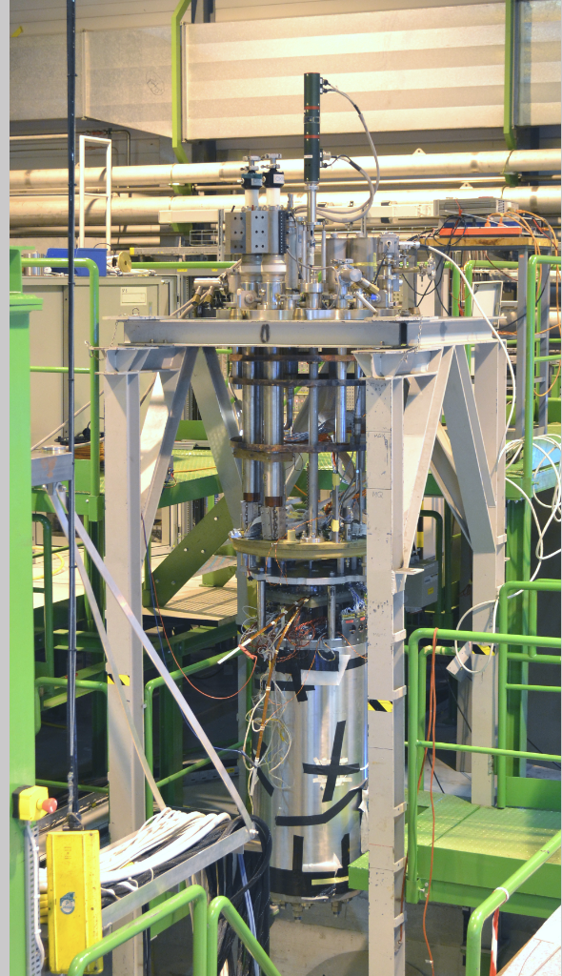
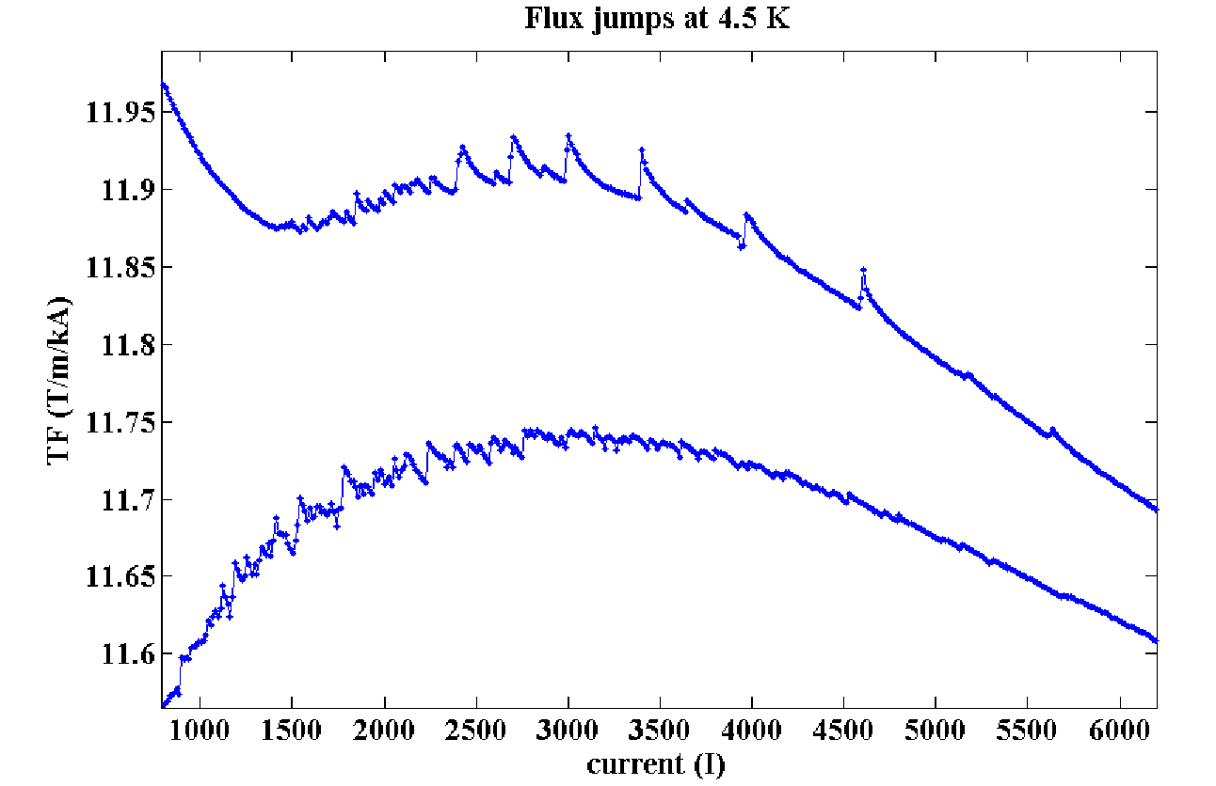
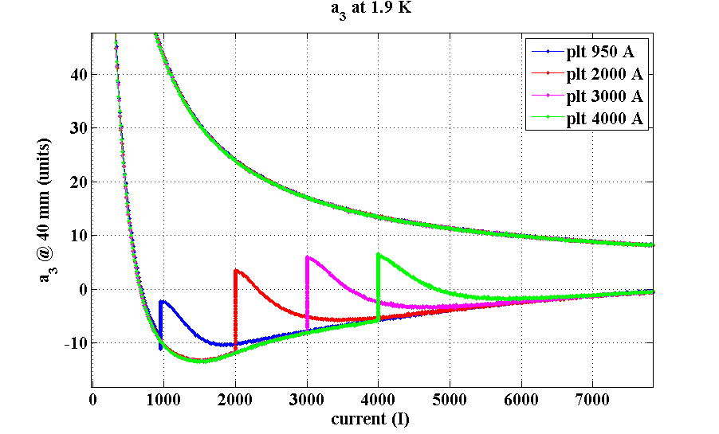
Measurements of Dynamic Effects in SC Magnets
Using the FAME system and the FFMM framework with acquisition rates of up to 8 Hz
Flux jumps at 4.5 K
Superconducting magnetization decay and snapback on non-allowed multipole a3 (at 1.8 K)

Slide 15
The Avatar and Twin (2)
Modeling errors
Num. magnet model (design)
Physical object (magnet)
Materia/geom. parameters
Num. model (as built)
Discretization errors
Pre-processing
(meshing)
Test and magnetic
measurement
Capture noise
Numerical errors
Matrix solving
Raw signal
(integrated
voltages)
Read-out noise
Approximation errors
Post-processing
Processed
signal (harmonics,
flux density, VI)
Intrins., approx., gross errors
RMS
Parameter identification (non-linear optimization)

Slide 16
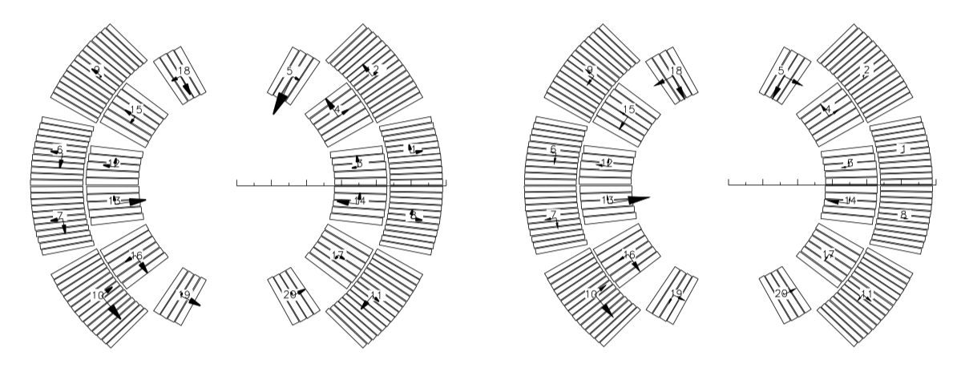
Tracing manufacturing errors

Slide 17
Uncertainty Mitigation Measures (Systematic Errors and Gross Errors)
Calibration: to establish the transfer function of a given instrument by comparison with a reference instrument of known accuracy
  cross-checks with instruments of comparable uncertainty to gain confidence or eliminate gross errors
  in-situ calibration: use the magnet to be tested as the reference via a previous measurement with a reference instrument
Traceability: an unbroken chain of comparisons, each with a stated uncertainty, from a measurement to a primary standard.
  Fundamental concept to certify a measurement; maintaining systematic records, databases, documented procedures

Slide 18


The Problem Setting
Operations management
Project management and
Business intelligence
Client
NC magnet
MM requests
SC magnet
Processed data
Released data
Material
Raw data
FSU job request
FFMM config.
MM report
Bench preparation
Client
Kanban Board
Kn
Calibration data
Traveller
NORMA
EDMS
MTF
MM Equipment
Asset management
Database “management”

Slide 19
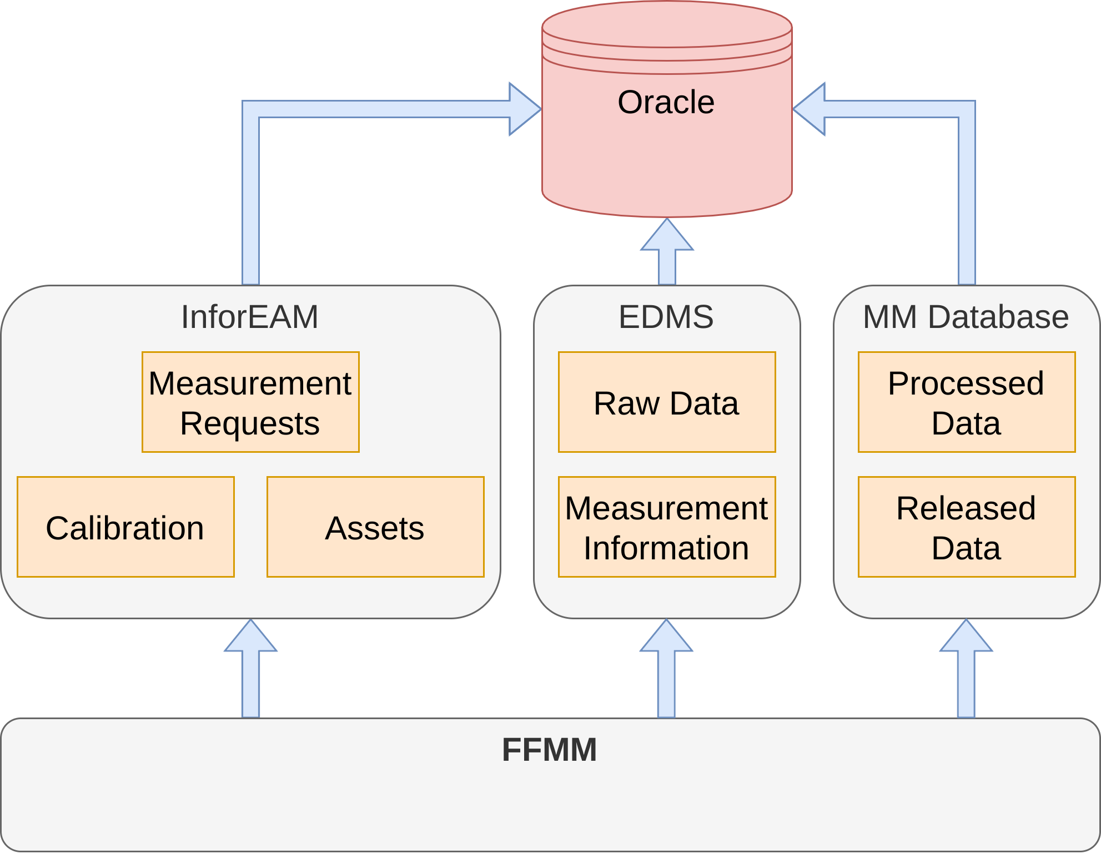


Mitigation Measures (Systematic and Gross Errors)
Web-services
(XML (Soap))
Text-file
SQL
Flexible C++ Framework for Magnetic Measurements

Slide 20
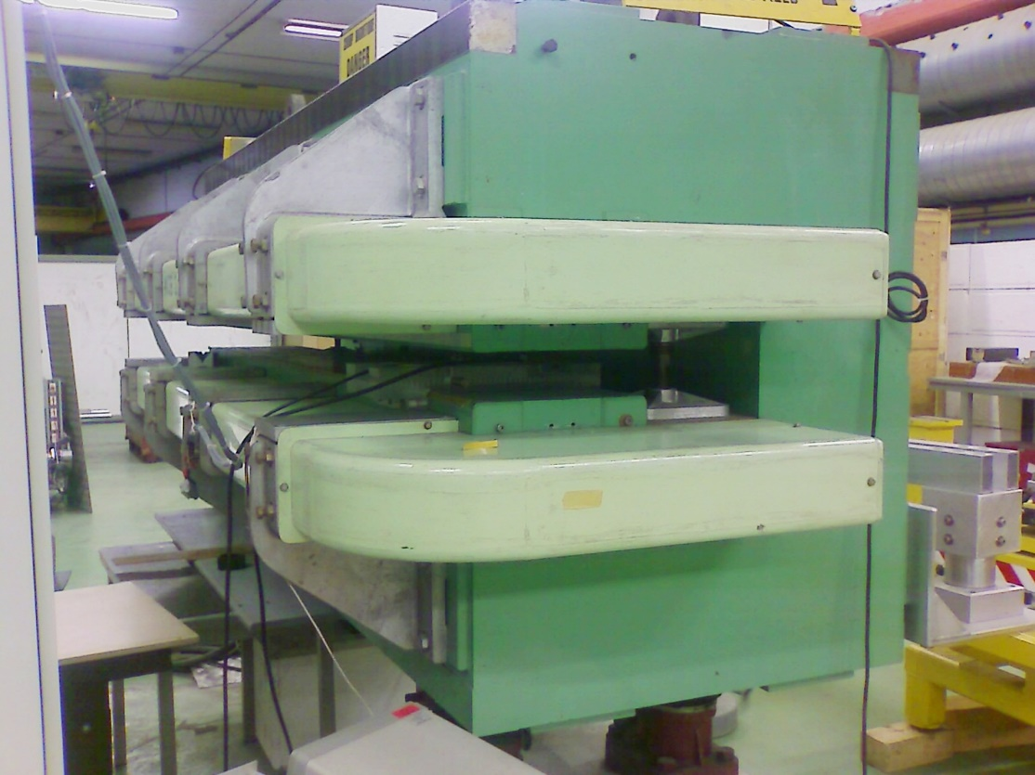
Calibration: CERN Dipole Field Reference
Old CERN ISR bending dipole, cycled up to 1 T in a rigorously reproducible way
Yearly mapping to establish field profile, averages and reproducibility
We map By, but since the field is not perfectly uniform we have also Bx, Bz
→ the resulting (small) error is propagated to all instruments calibrated in this reference !
high precision NMR probe used to map the field

Slide 21
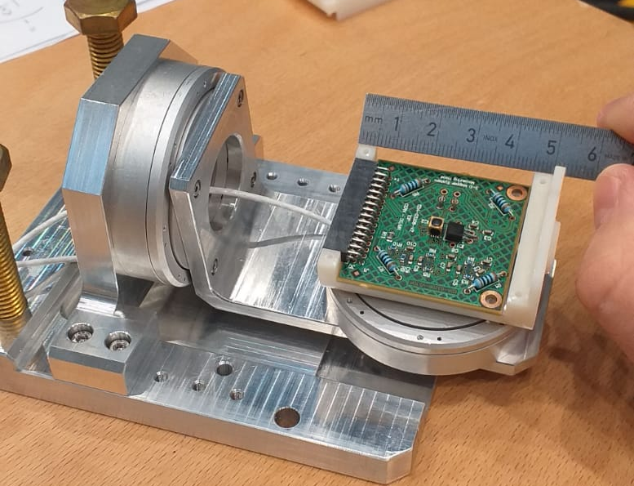
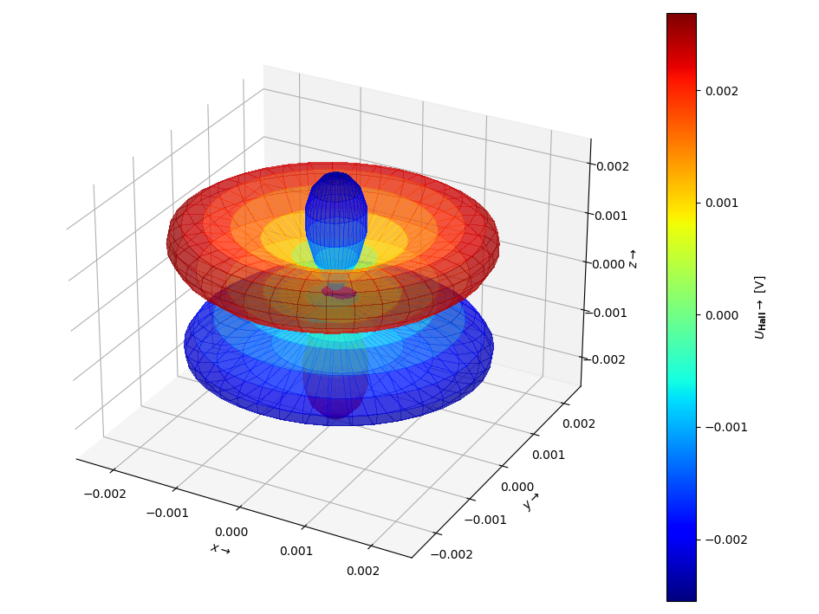
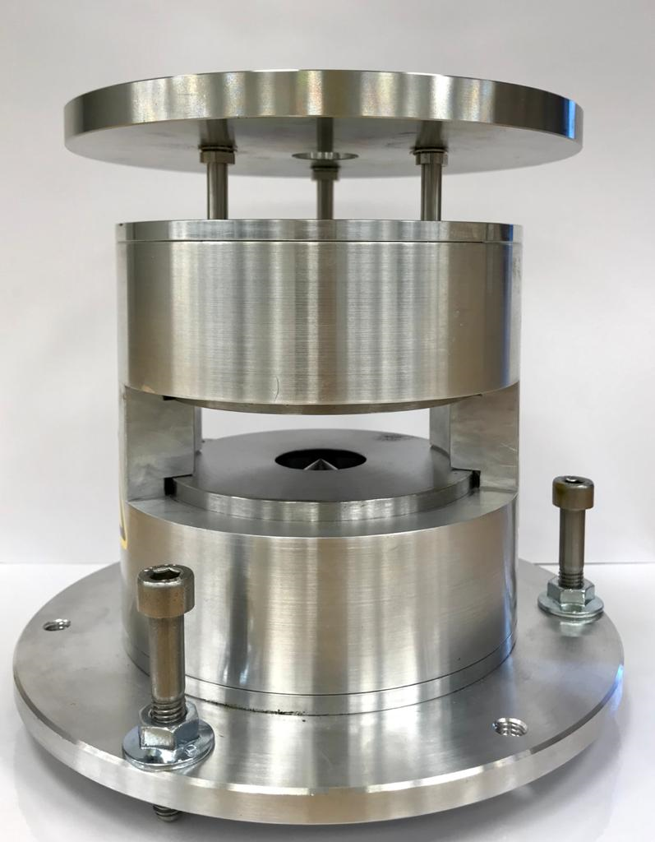
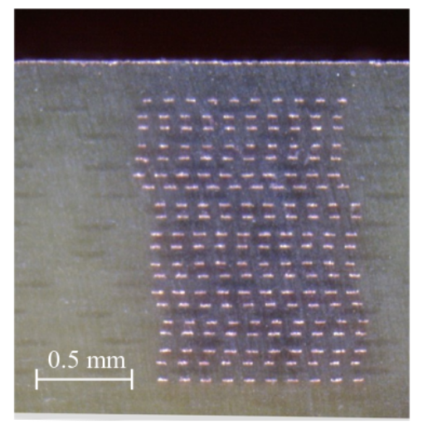
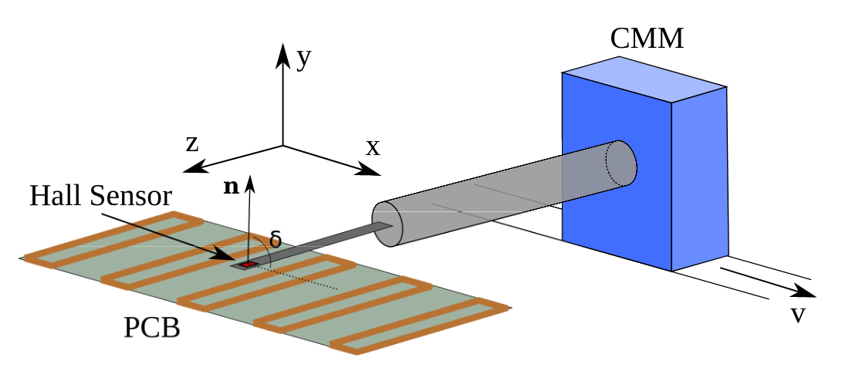
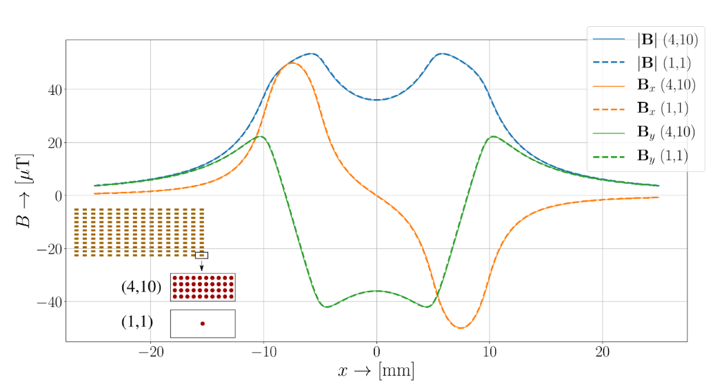
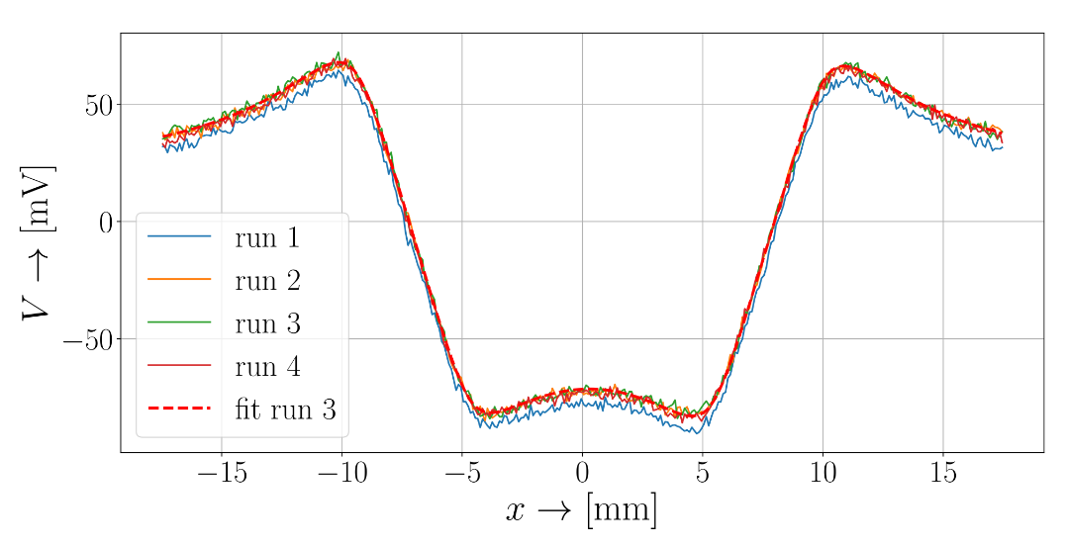
Sensor and PCB coil calibration

Slide 22
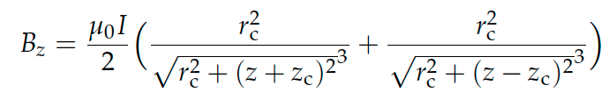
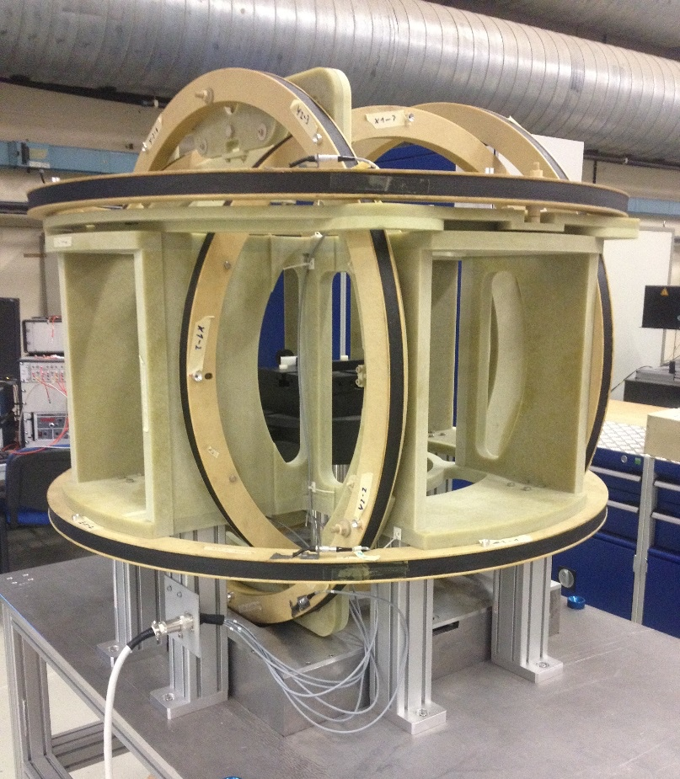
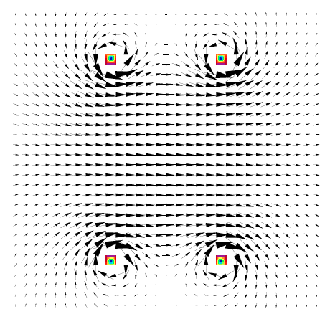
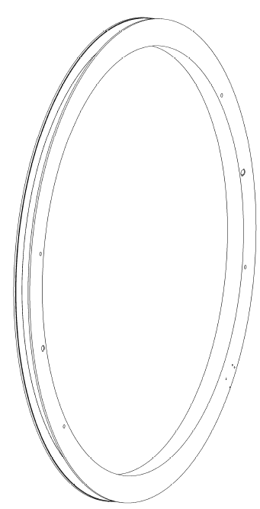
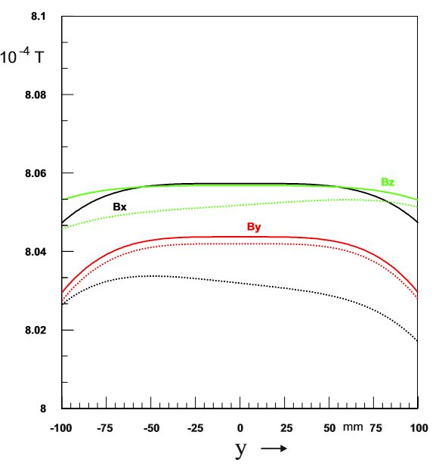
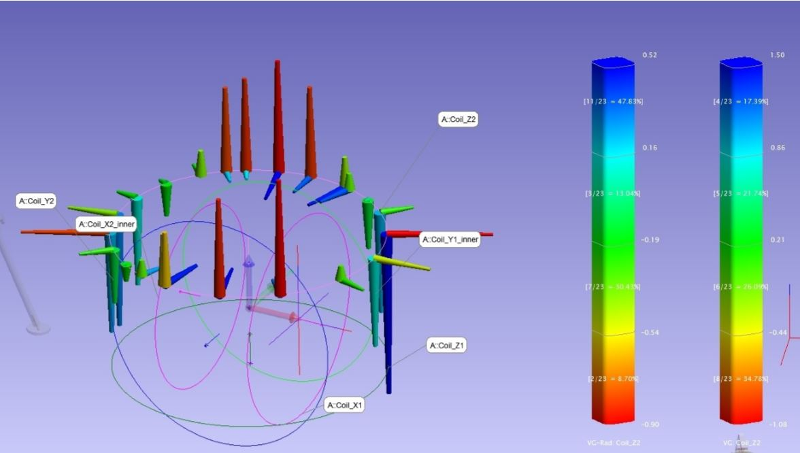
3D-Helmholtz-Coil
α
c_{f}
Parallelism
c_{a}
Biot-Savart's law for computing the magnetic flux density
Effect of construction errors on field < 10⁻⁶
Flatness

Slide 23



Magnetic Measurements with Hall Sensors in Cryomagnet
PCB with 5 coils and 5 Hall probes mounted in magnet aperture

Slide 24


Cold-Calibration of Hall Sensors
10 % !
Calibration to compensate the transversal field inhomogeneity, f_{n}(B) = F

Slide 25



Cross-Calibration by Integrating the Induced Quench Voltage
Integrator drift: 0.5% over 60 s on average

Slide 26


Stair-Step Cycles (On Central Hall Sensor)
Induction and damping of interstand coupling currents in high TC superconducting magnet

Slide 27





Riemann Lebesque Lemma
The Fourier coefficients tend to zero as n goes to infinity
Simulations
Measurements
Always plot your results in logarithmic scale

Slide 28

Going Big (FAIR SuperFRS multiplet)
Diameter 380 mm

Slide 29


Geometric Oversampling

Slide 30



Combining Radius Scaling and Feed-Down (Analytical Continuation)
c
c

Slide 31






Matrix Conditioning
κ
N Number of multipoles in small coil
I Number of measurement positions
For 15 multipoles reconstructed on r₀
r_{c}/r₀

Slide 32

Results: 8 Positions, 8 Harmonics on the Small Coil

Slide 33

The Avatar and Twin (3)
Modeling errors
Num. magnet model (design)
Physical object (magnet)
Physical state
Regularity conditions of the
magnetic field
Test and magnetic
measurement
Capture noise
Magnetic flux
density in Ω
Raw signal
(integrated
voltages)
Read-out noise
Observation function
Harmonics on large radius
Processed
signal (harmonics,
flux density, VI)
Intrins., approx., gross errors
Overdetermined
(Mapping)
Field inversion

Slide 34



Going small

Slide 35




Stretched-Wire Systems

Slide 36




Stretched Wire Measurements
Map of Second Wire Resonance
Stretched wire
Oscillating wire
Vibrating wire

Slide 37


Solenoid Center and Axis (Vibrating)
Force distribution requires vibration at the second resonance too add up consistently

Slide 38


Linear Regression in the Line Search Procedure
Resolution in the μm range
Uncertainty 20 μm

Slide 39





Multipole Measurements (Oscillating)
Measure the oscillation amplitudes on K rulings of a cylindrical domain.
Develop into a Fourier series.
Compare coefficients

Slide 40
Local Field Distribution

Slide 41


Pseudo-Multipoles (Fourier Bessel Series)

Slide 42


The Leading Term is NOT the Measured One

Slide 43



Search Coils Must be Isoperimetric

Slide 44


The Avatar and Twin (4)
Modeling errors
Num. magnet model (design)
Physical object (magnet)
Avatar
Physical state
Boundary Sources (FEM / BEM), Snapshots)
Test and magnetic
measurement
Capture noise
Magnetic flux
density in Ω
Raw signal
(integrated
voltages)
Read-out noise
Observation function
(Voltages, flux increments) including uncertainties
Processed
signal (harmonics,
flux density, VI)
Intrins., approx., gross errors
Properties of the Equation system | Method | Application
Diagonal | Orthogonal proj. | Harmonic fields
Square | Collocation | Boundary data
Overdetermined | Least-squares | Mapping
Underdetermined | Bayesian inference | Sensor fusion
Field inversion

Slide 45


The Avatar of the Faser Magnet

Slide 46


Grid Map versus Boundary Data

Slide 47

Mid-Plane Field

Slide 48



The Moving Fluxmeter
For FAIR
For NA64

Slide 49




Avatar (Generalized Field description)

Slide 50






Solenoidal Field Transducer

Slide 51





Combined Function Magnets (CERN PS)
Strongly coupled
excitation circuits
No 10⁻⁴ predictive model
Remanent field ≈ 0.2%
Figure-of-eight loop
to control B₂
FMR field
marker
4 pole face windings
affecting B₁ to B₅
Fluxmeter
for gradient
measurements

Slide 52

PS Beam Stability Test at Injection
  CNGS
  CNGS
  CNGS
Specific powering cycles (CNGS) lead to reproducible radial positioning errors
from relative field changes on the order of 10⁻⁵

Slide 53
The Avatar and Twin (5)
Modeling errors
Num. magnet model (design)
Physical object (magnet)
Twin
Design, constr, calibration of field transducer
Model Order Reduction
Avatar
Physical state
Boundary Sources (FEM / BEM), Snapshots)
Test and magnetic
measurement
Capture noise
Magnetic flux
density in Ω
Raw signal
(integrated
voltages)
Read-out noise
Model-based system engineering
Value-shop model and asset management
Observation function
(Voltages, flux increments) including uncertainties
Processed
signal (harmonics,
flux density, VI)
Intrins., approx., gross errors
Mode updating by proper orthogonal decomposition
Model assurance criterion

Slide 54






Twin (data-driven modelling)
$J$ simulated
$J$ reconstructed
Stefano Sorti

