Slide 1

DT-DI Magnet Activities
Xavier Pons – on Behalf of DT-DI
Friday, July 23, 2021

Slide 2
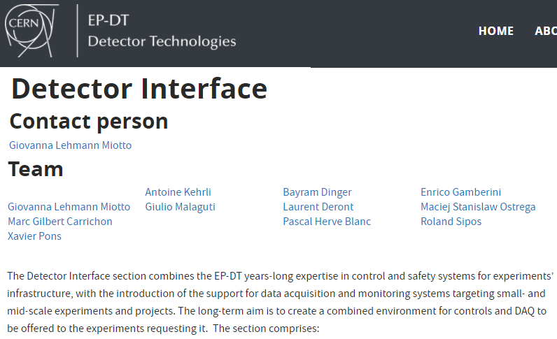




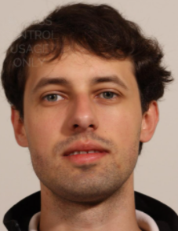


## % Allocated to Detector Projects
Marco Boretto
Patricia Mendez
Jarl Pettersen
Martin Zemco
Yann Donon
Wojciech Brylinski
Adam Abed
Florian Till
Jens Noerby
Soon: Christian Schultz
## % Allocated to Magnet Control Project MCP M&O
ATLAS
ALICE, M1
LHCb
CMS, Various
Comp, M1, ATL Various
Laurent
Xavier
Pascal
Giulio
Maciej
Sylvain
Jarl

Slide 3
Status and activities of the LHC Experimental magnets
Overview
ALICE: Solenoid & Dipole
LHCb: Dipole
CMS: Solenoid
ATLAS: Solenoid & Toroids
Status and activities of the Non-LHC Experimental magnets
AEGIS
Compass
M1
VERTEX – NA61: Vertex 1 & Vertex 2
MORPURGO
DT-DI Magnet R&D Projects
B180 test bench
Strain gauges mass-acquisition system
Rad Hard Vacuum Measurement
ATLAS Vacuum Control System upgrade
Magnet Safety System evolution

Slide 4
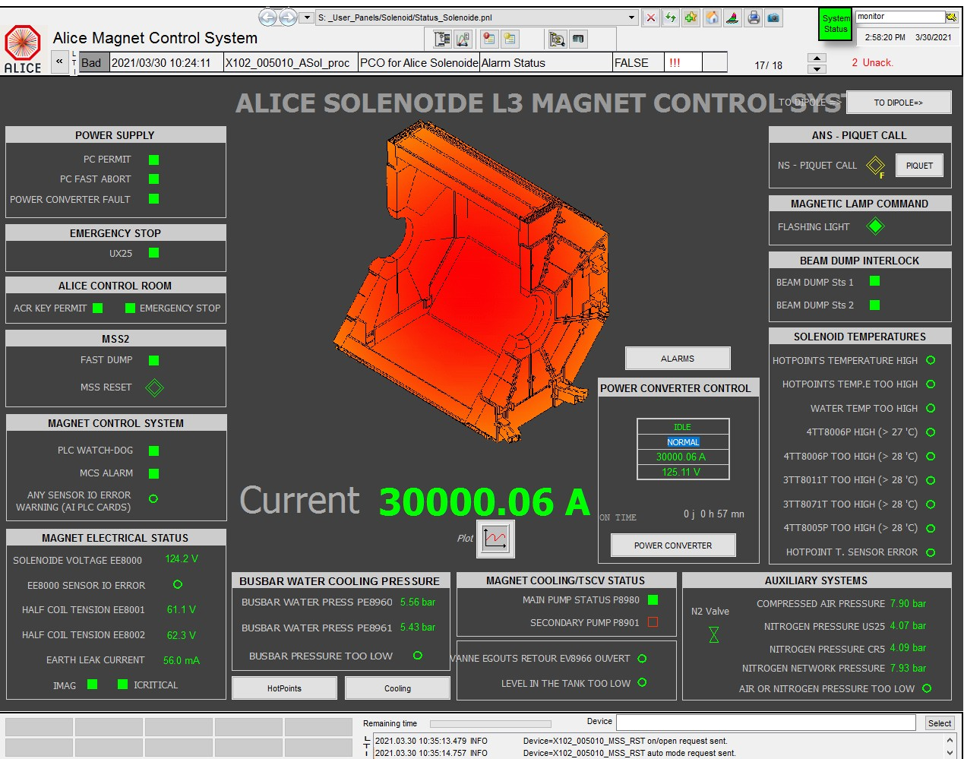
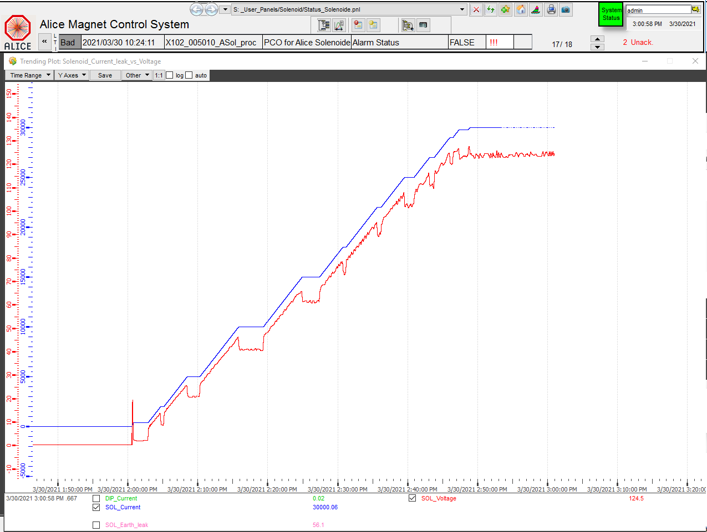
ALICE
Magnets (Solenoid & Dipole) are ready for operation after the LS2 upgrades
DT-DI finished the LS2 tasks: upgrade of the PLC of the Magnet Control System
Solenoid tested to nominal 30/03/2021 another test is scheduled on 08/2021
ALICE Solenoid Main WINCCC OA Supervisor Panel
ALICE Solenoid ramp up on 30/03/2021

Slide 5
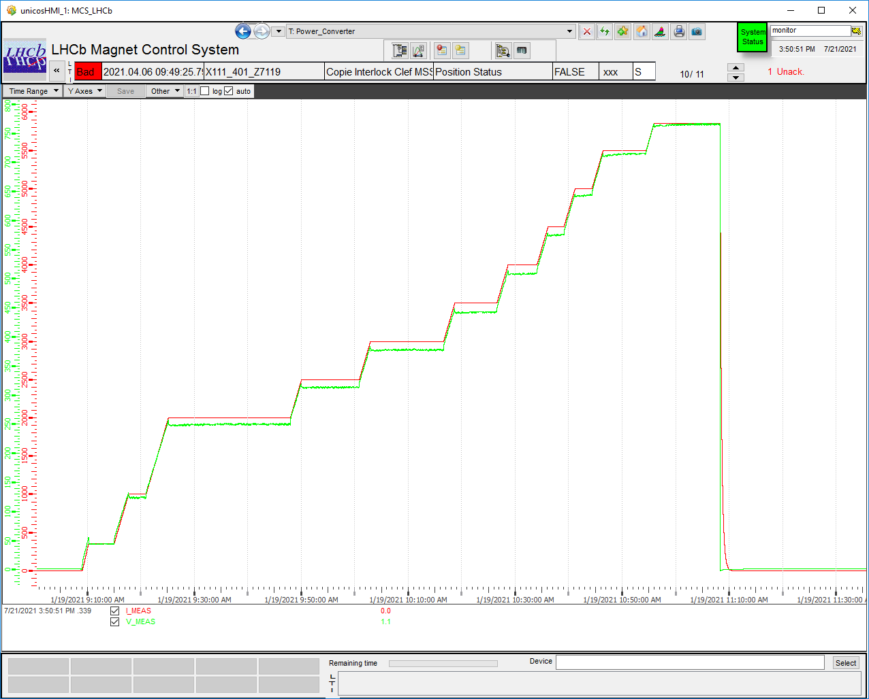
LHCb
Dipole is ready for operation after the LS2 upgrades
Dipole tested to nominal 19/01/2021
DT-DI finished the LS2 tasks: upgrade of the PLC of the Magnet Control System
Still pending the validation of the MSS
Magnet Safety System update which includes
the monitoring of the coil voltages and the
quality of this voltage provided by the Power
Converter. This validation requires nominal current
LHCb ramp up on 19/01/2021

Slide 6
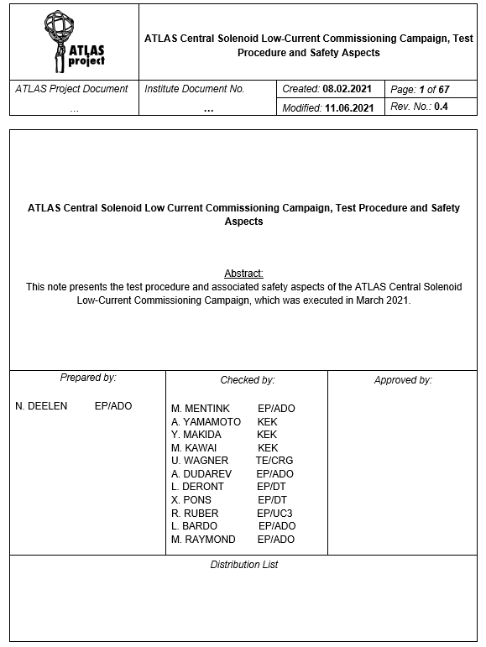
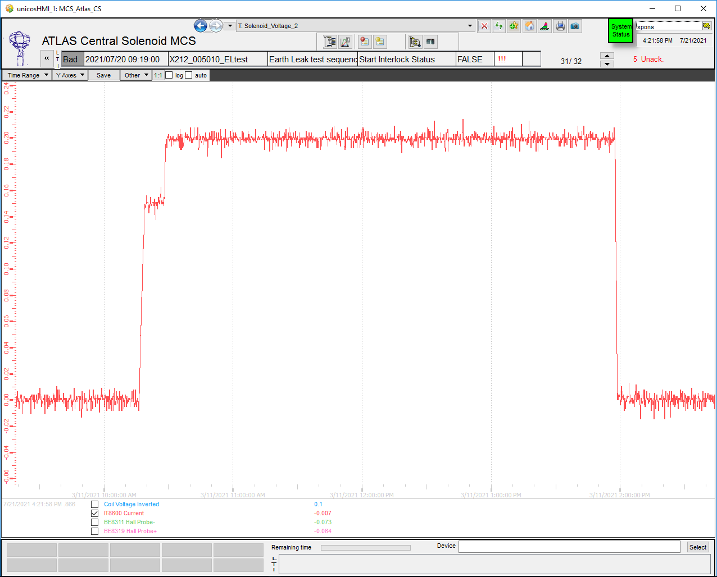
ATLAS Solenoid
Solenoid is ready for operation after the LS2 upgrades
Solenoid low current test on 11/03/2021, nominal scheduled 01/2022
ATLAS Solenoid low current test 11/03/2021
Solenoid Test Procedure 03/2021

Slide 7
ATLAS Toroids
Toroids are not yet ready for operation
Major maintenance operations are already completed
The PLC replacement of the Magnet Control System has been done.
Still pending:
        Commissioning: MCS an instrumentation
        Current Leads flow regulation tuning
        Snubber implementation
        MSS battery maintenance and instrumentation calibration
Nominal scheduled 01/2022

Slide 8
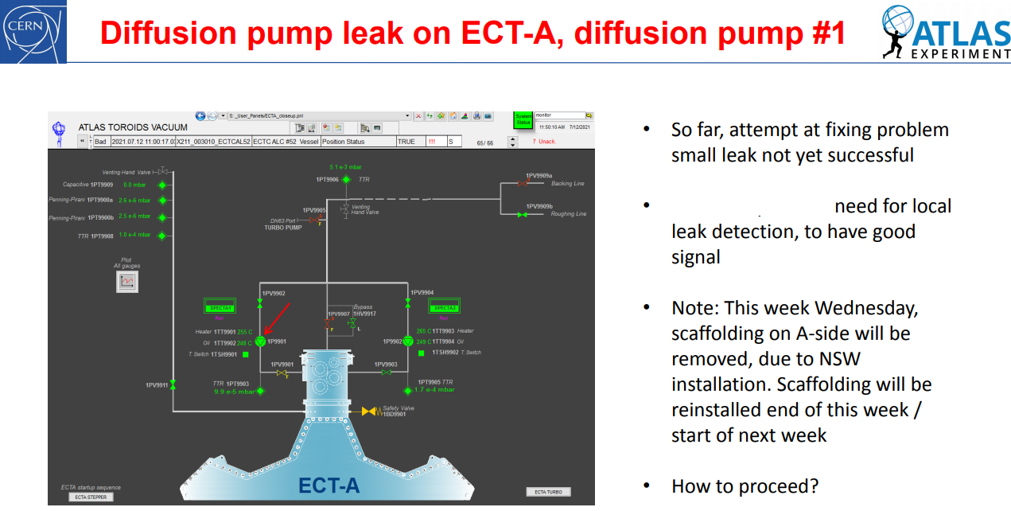
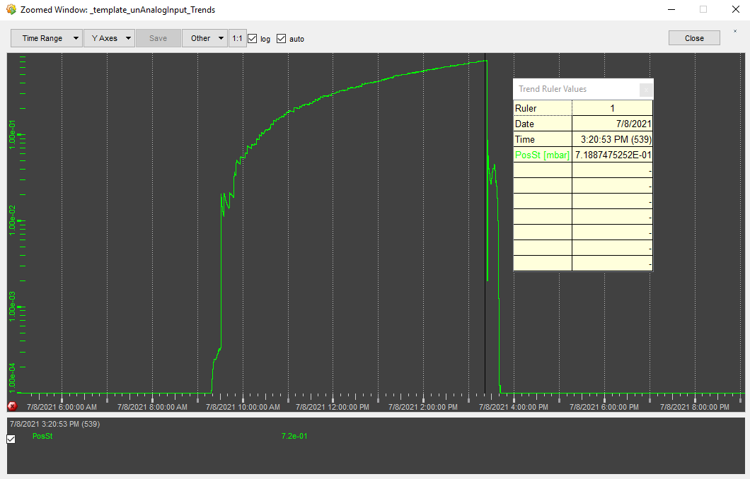
ATLAS Toroids
Recently, during the LS2 regular maintenance operations a leak has been observed in a diffusion pump (1P99001) in the End Cap Side A
After many interventions the cause of this leak is still unknown
DT-DI is collaborating closely with ATLAS in order to fix this issue

Slide 9
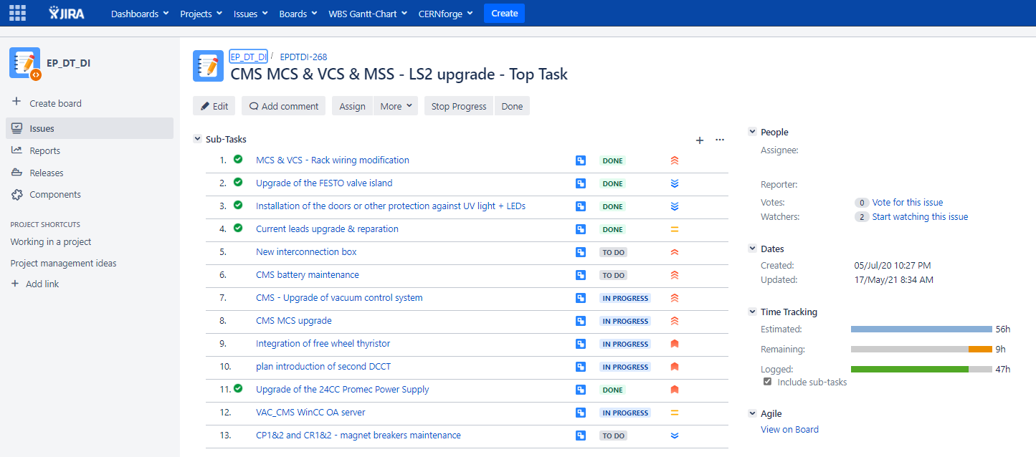
CMS Solenoid
DT-DI is deeply involved in the modifications, upgrades and repairs of the CMS Magnet
Major tasks are the PLC replacement of the Magnet Control System and Magnet Vacuum Control System which already done and only the commissioning is pending
After the installation of the diffusion pumps and connections to the power converter, DT-DI can proceed with the commissioning of systems

Slide 10
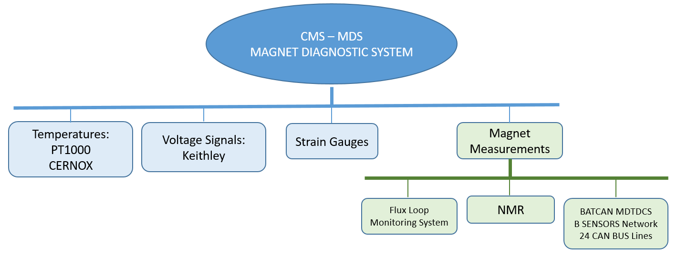
CMS Solenoid – Magnet Diagnostic System
DT-DI is recovering and upgrading the complete Magnet Diagnostic System from CE Saclay
The final specifications of this system were provided by Saclay on 07/2021
DT-DI is assigning a student from Danish program to this project starting from 08/2021
DT-DI is also recovering a complex and complete magnet measurement system from CMS

Slide 11
Non LHC Experimental magnet status
AEGIS – Ready, PLC of the Magnet Control System upgraded.
Compass – Ready, commissioned and calibrated and tested up to nominal
M1 – Ready, commissioned and calibrated and tested up to nominal
Vertex 1 and Vertex 2 – Ready, instrumentation calibration needed before operation
Morpurgo - Ready, instrumentation calibration needed before operation

Slide 12
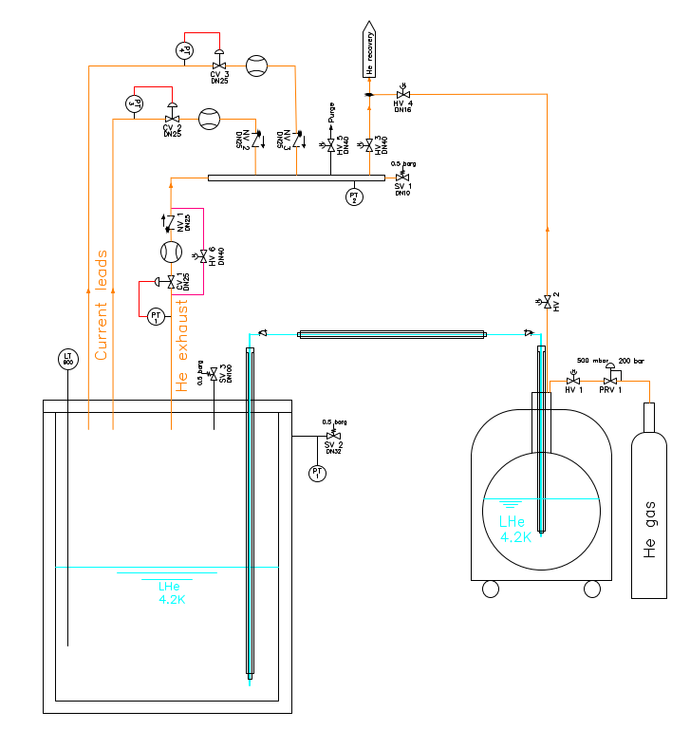
R&D Activities – B180 Test Bench
Two project at Building 180 and led by ATLAS
1st – Current Leads mass flow control setup
The aim of the project is to find the best hardware solution and regulation techniques option for the optimal mass flow control of the current leads
DT-DI is supporting with controls implementation
1st PID for B180 Current lead test setup

Slide 13
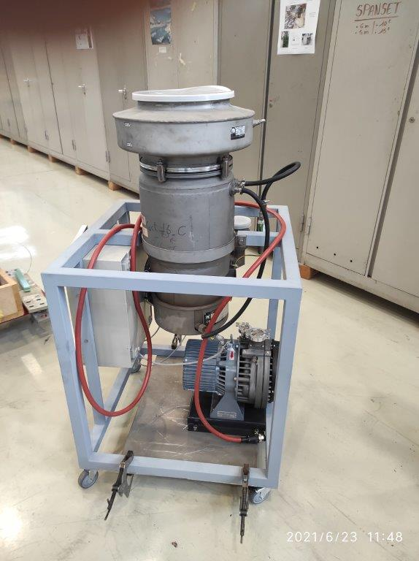
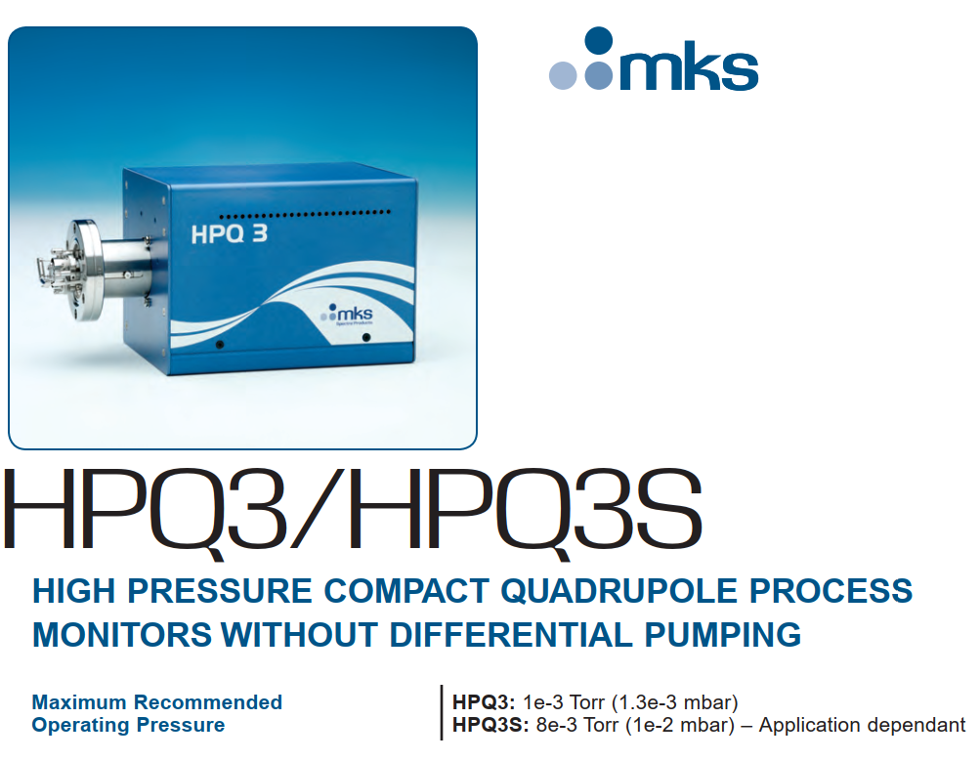
R&D Activities – B180 Test Bench
2nd – Diffusion pump performance setup
Because the precedents of the CMS diffusion pump setup with ATLAS preparing a setup with a diffusion pump and primary pump group in order to :
Test the performance of the diffusion pump
To explore the possibility of measuring/detect the H2O level/background in the backing line of the diffusion pump with a high pressure mass spectrometer RGA
The controls and the RGA is supported by the DT-DI M&O budget
Diffusion pump + Primary pump B180 setup

Slide 14
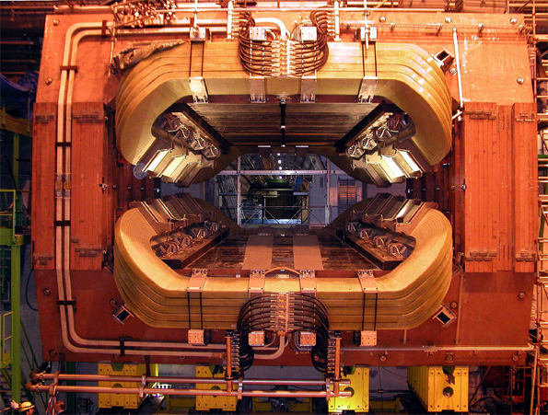
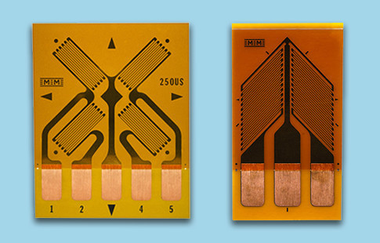
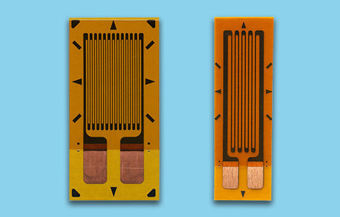
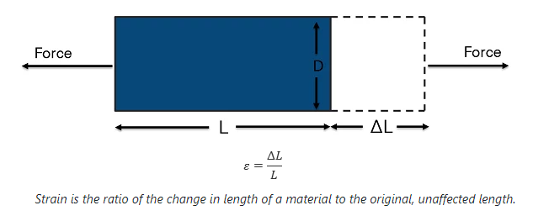
R&D Activities – Strain gauges mass-acquisition system
Due to the mechanical issues in the LHCB magnet but also for CMS MDS upgrade; a large number of strain gauges are installed for measuring the mechanical stress/deformation.
A correct readout device for these sensors is expensive.
DT-DI has received the request for developing a acquisition system for measuring large number of strain gauge.
DT-DI is allocating a student from the Danish program for developing this system with reasonable cost.
Rosette Strain Gauges
LHCb Dipole
Strain Gauges

Slide 15
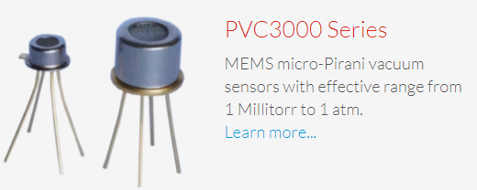
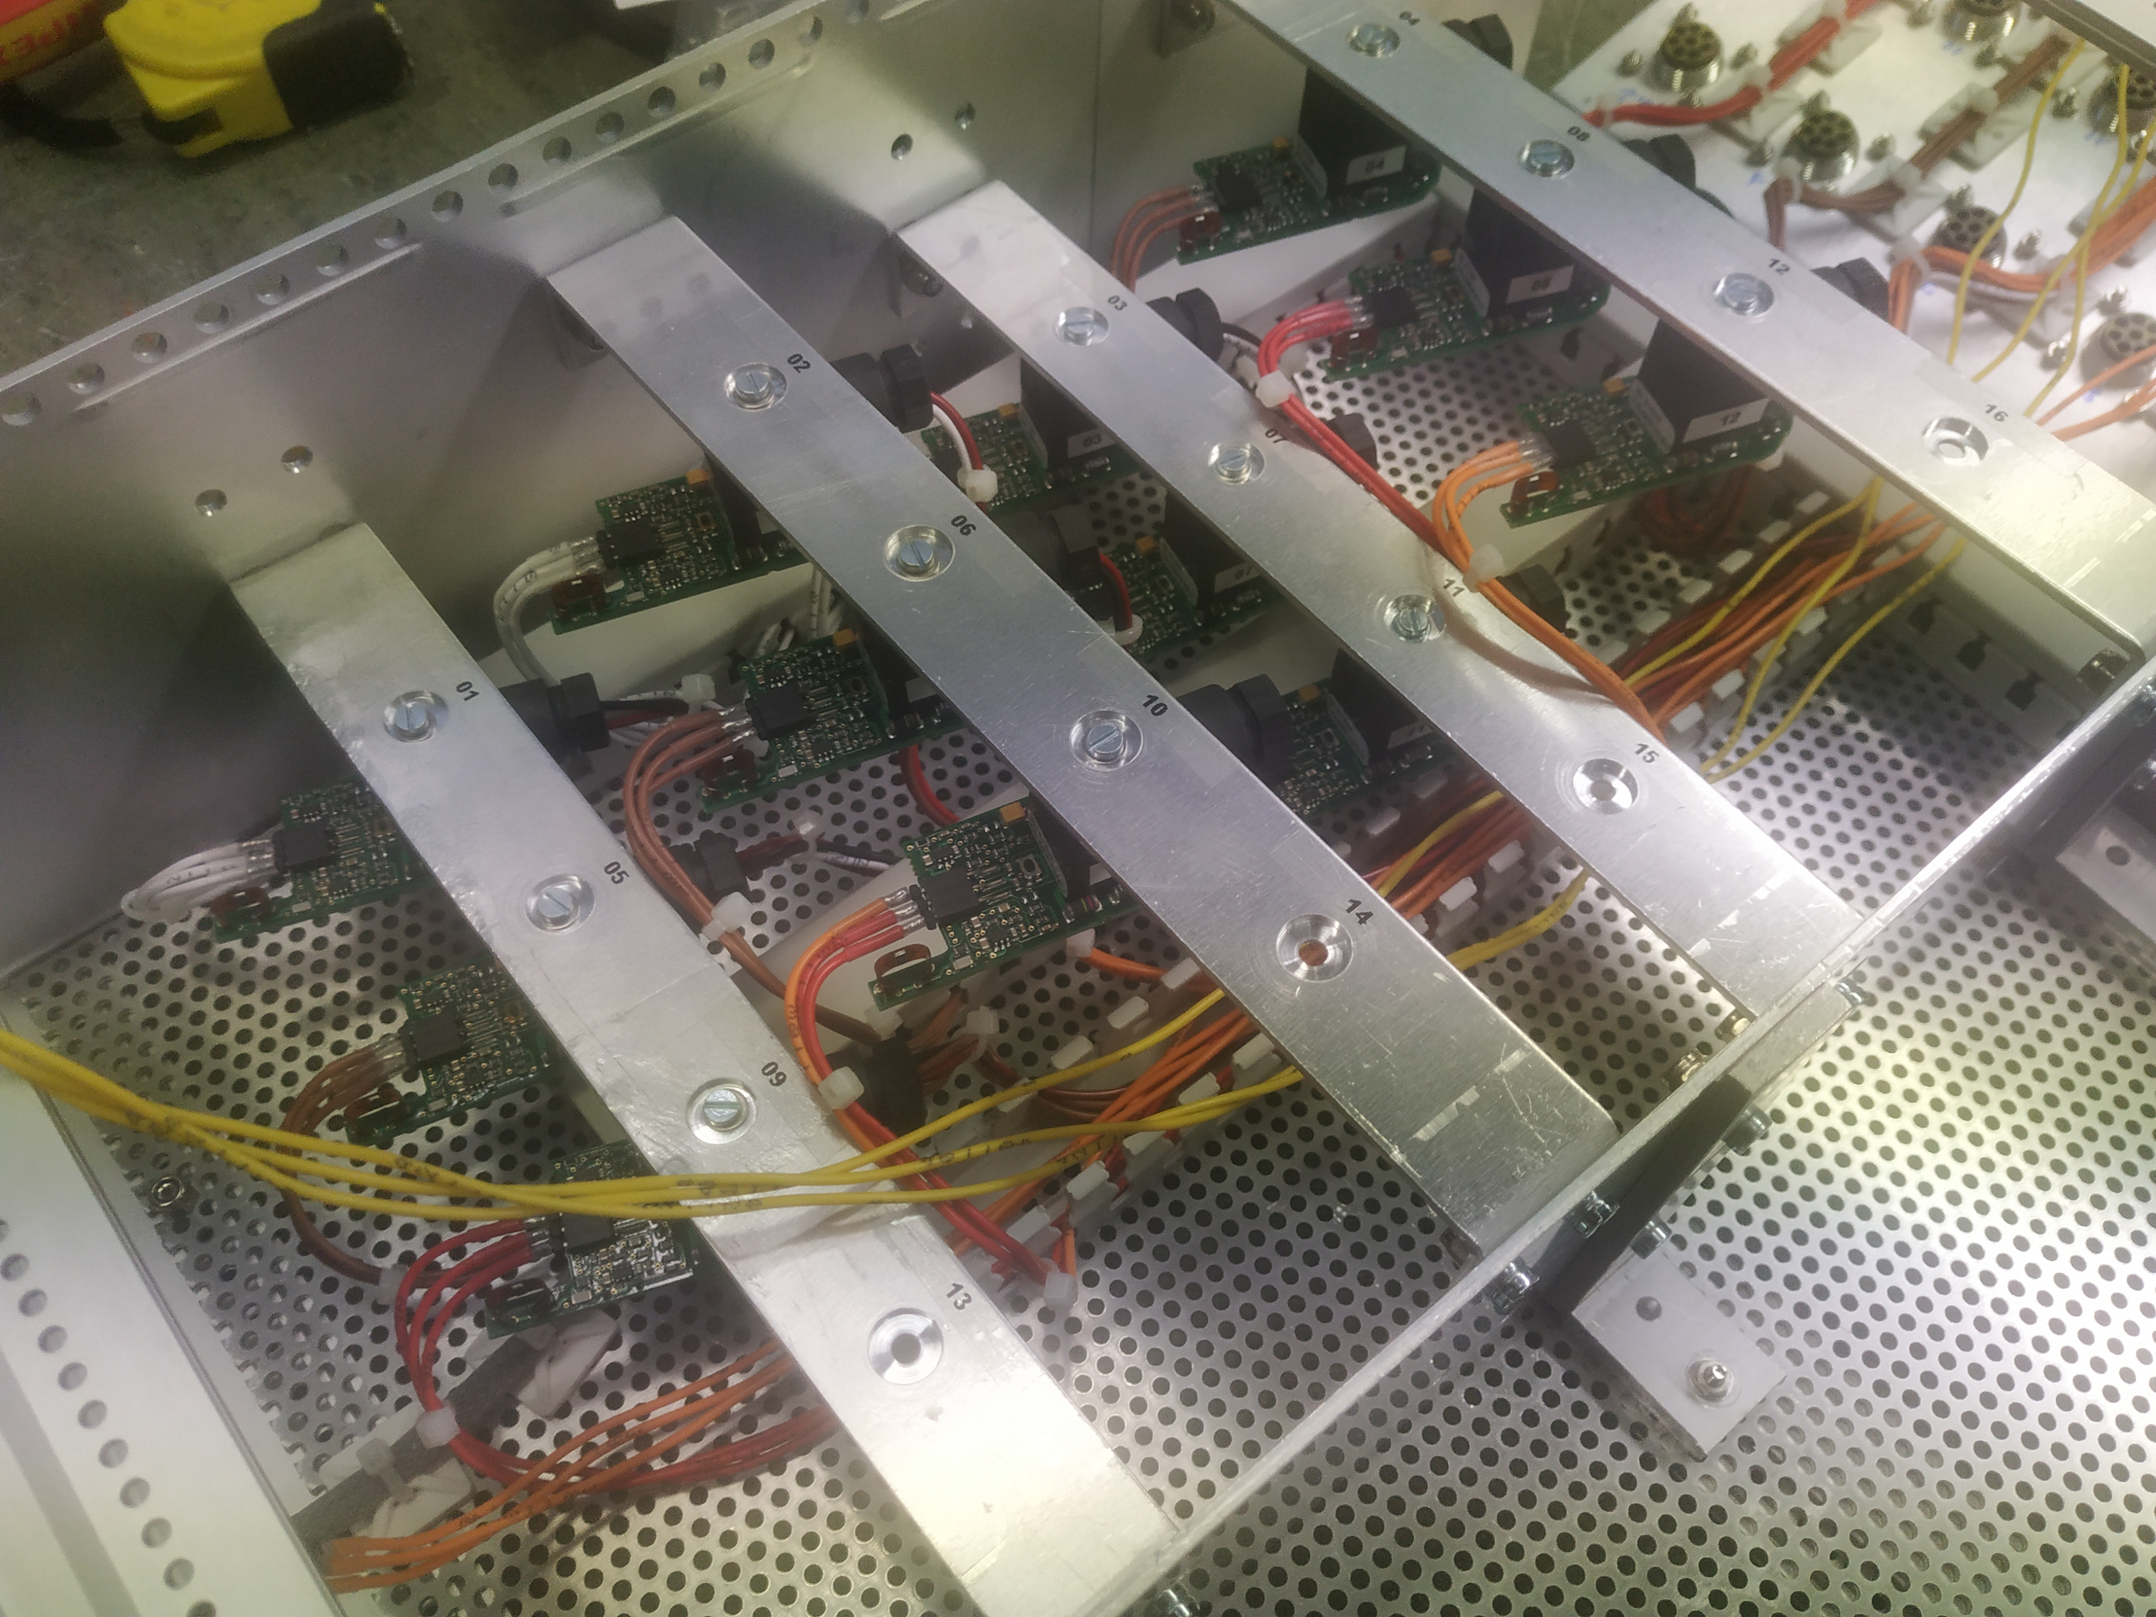
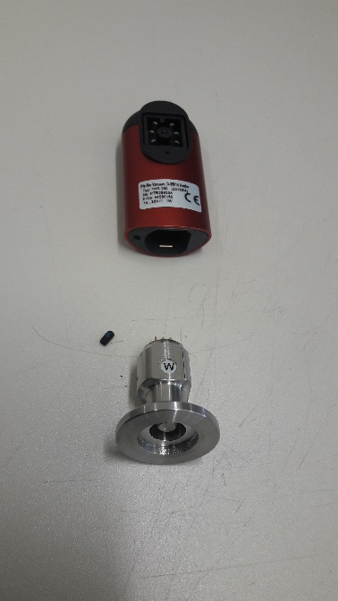
R&D Activities – Rad Hard Vacuum Measurement
The standard Pirani sensors: Pfeiffer, Leybold,… with integrated electronics are very sensitive to radiation.
The alternative are the Pfeiffer-LHC radiation hard Pirani sensors with remote electronics which are quite expensive e.g. 7 kCHF for VELO detector or evaluated 55 kCHF for SciFi detector transfer lines.
The idea is to test the low cost Pirani head, in B180 setup?
Developing the interface for controls
Finally test them in radiation
From POSIFA Company
SciFi – 16 Pfeiffer Standard Pirani gauge with remote electronics in DT-DI crate

Slide 16
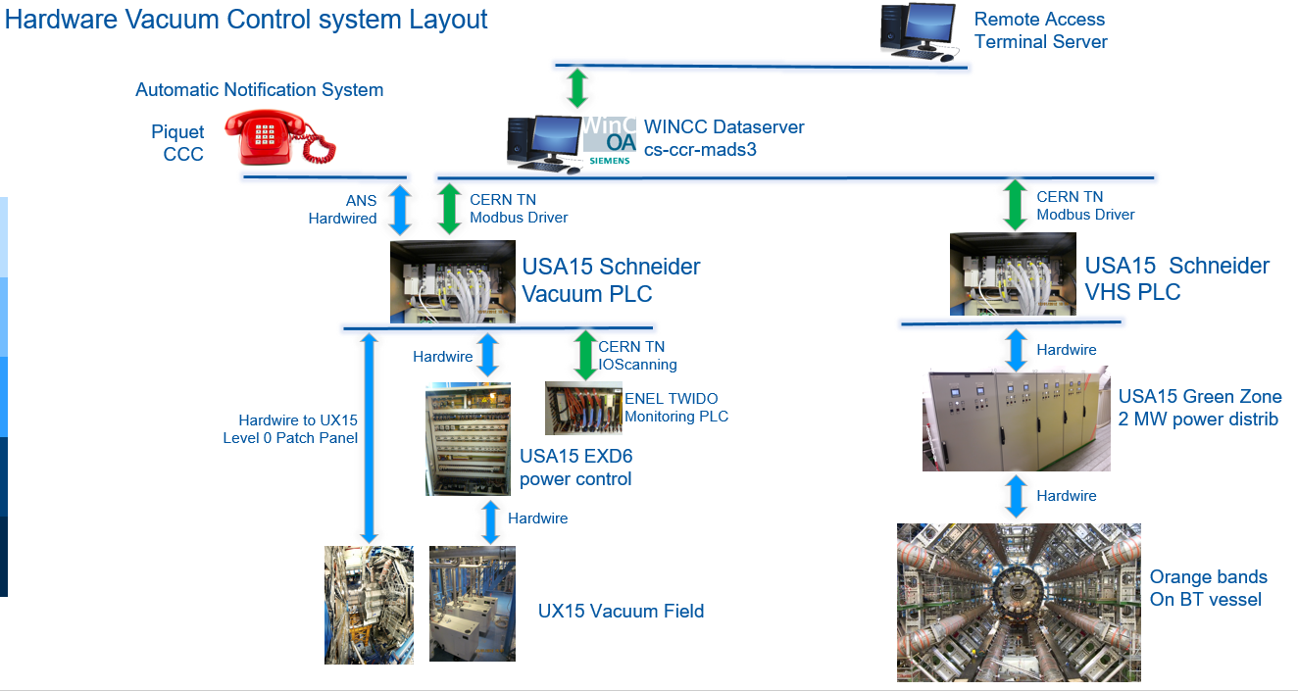
R&D Activities – ATLAS Vacuum Control System upgrade
The Vacuum control system of the CMS and ATLAS magnet are highly sensitive system.
They can be stopped only in short and controlled periods.
Due to the circumstances, CMS is applying the upgrade of the control system, PLC replacement, in a comfortable way.
This not the case for ATLAS

Slide 17
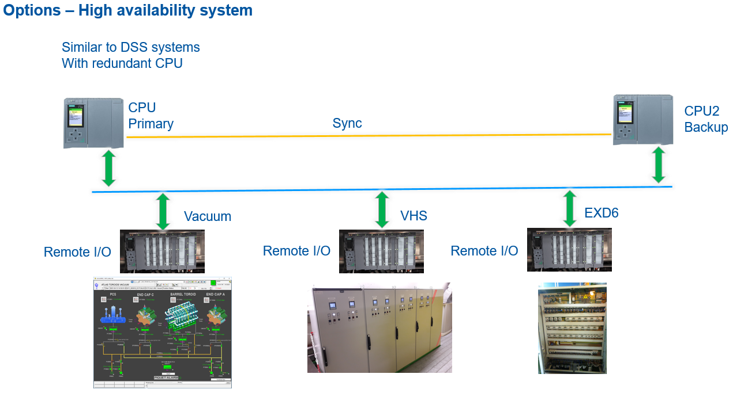
R&D Activities – ATLAS Vacuum Control System upgrade
DT-DI is preparing the upgrade of the ATLAS Vacuum control system for the LS3, replacing the present PLC.
One of the options that DT-DI is exploring and presented to ATLAS is the implantation of new Vacuum Control system based on High Availability PLC’s
This High Availability is achieved by the installation of redundant CPU’s, similar to the DSS in the LHC experiments.

Slide 18
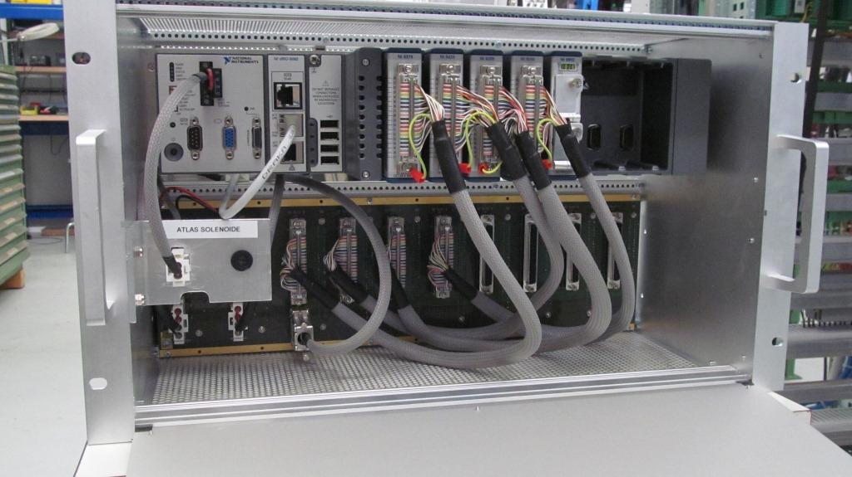
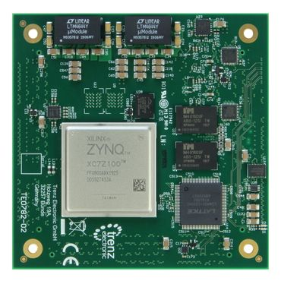
R&D Activities – Magnet Safety System evolution
The Magnet Safety 2 strongly relies on National Instruments CompactRIO – FPGA technology and LabView Software with the present advantageous CERN prices and licensing policy.
This may change, specially the licensing policy.
DT-DI has to close monitor this situation and to consider the option by using standard/commercial solutions towards to MSS3
MSS2 crate – Equipped with National Instruments CompactRIO-FPGA
High-Performance Xilinx Zynq Z-7100 FPGA+ARM

Slide 19
Last

