Slide 1
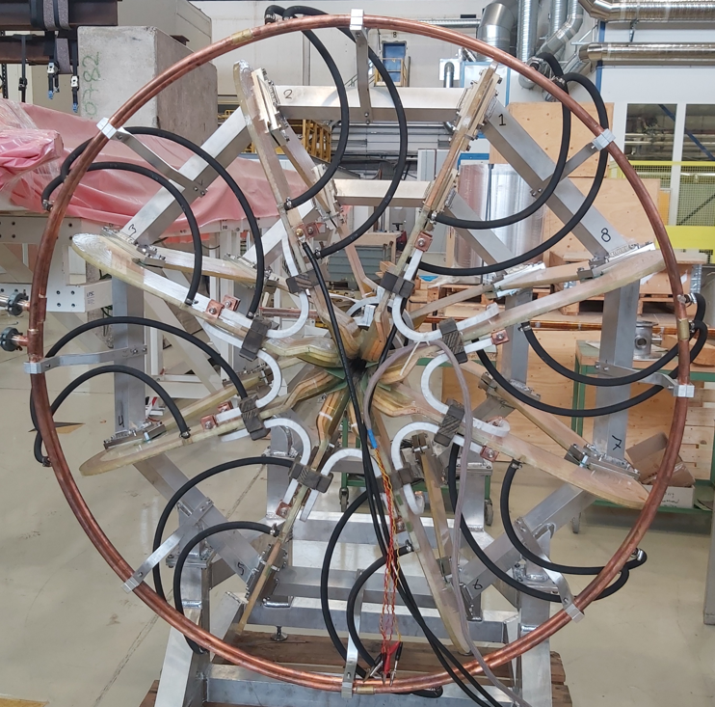
First Measurements on the NA60+ Demonstrator
Matthias Mentink, Michela Neroni, Alexey Dudarev, Igor Titenkov, Pierre-Ange Guidici, Francois Garnier, Hans Danielsson, Alexandre Perez, Piet Wertelaers, Helder Da Silva, Philippe Benoit, Burkhard Schmidt, CERN
Enrico Scomparin, Gianluca Usai, Paulo Mereu, Marcellino Tuveri, INFN
21 - 07 - 2021

Slide 2
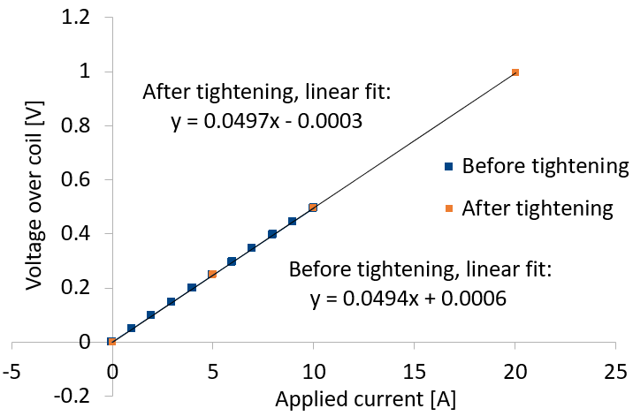
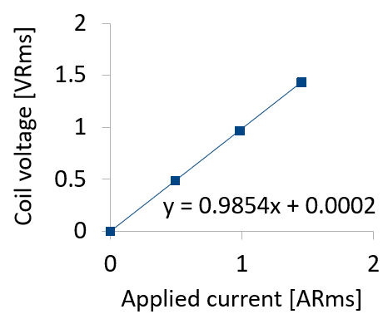
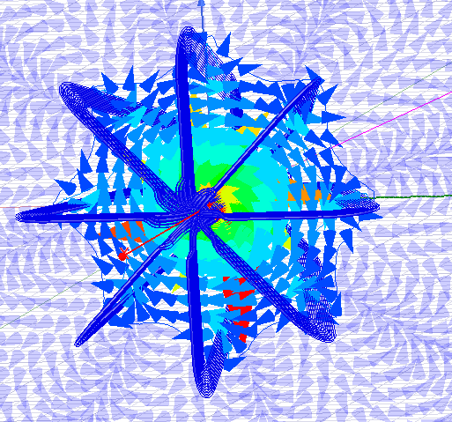
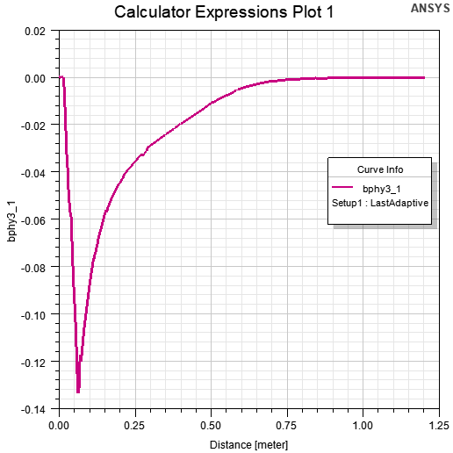
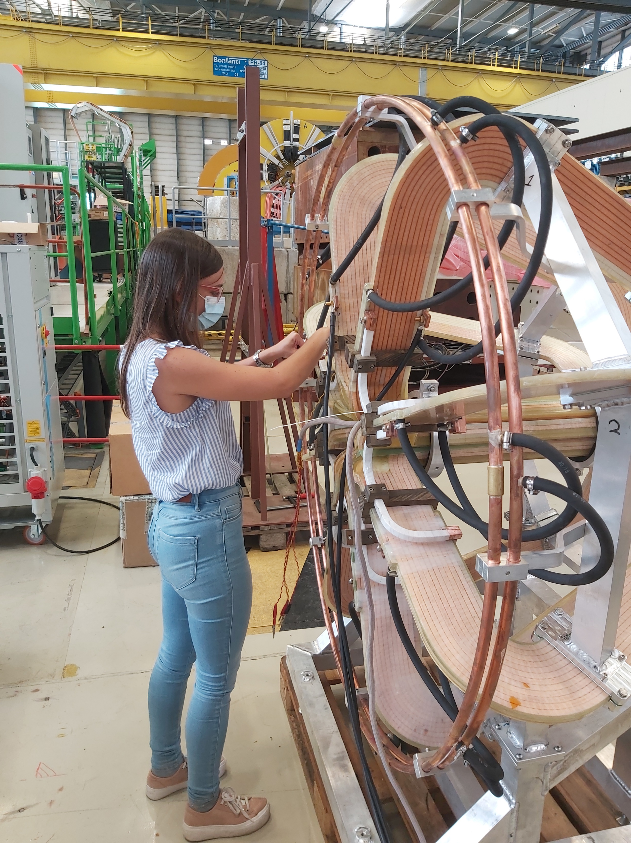
First Measurements on the NA60+ Demonstrator
Z_{Coil} = ((2πfL)² + R_{Coil}²)^{0.5}
f = 50 Hz
Simulation
Magnetic field [T]
Measurement
Simulation (H. da Silva)
First measurements, without water cooling and with I_{Applied} ≤ 20 A
Measured resistances:
  Total resistance: 49.7 mΩ
  Coils: (6.110 ± 0.023) mΩ, busbars: (0.0375 ± 0.0044) mΩ
  Joints: Wide range, from 1.1 µΩ to 144 µΩ
Inductance, measurement: 3.08 mH, consistent with simulation (3.11 mH)
Magnetic field (one measurement): Consistent with simulation, within experimental uncertainty
Next steps:
  Improve joint connections
  Add water cooling & test at 400 A

