Slide 1
Cern Week 2 Report:
Kostantin Andreas Jacoby

Slide 2
Goals For Past Week
Investiagte and Validate K-omega model
Introducing Viscous Heating and Full Boyancy Effects
Introduce 3D Model
Introduce Cern Material Values

Slide 3
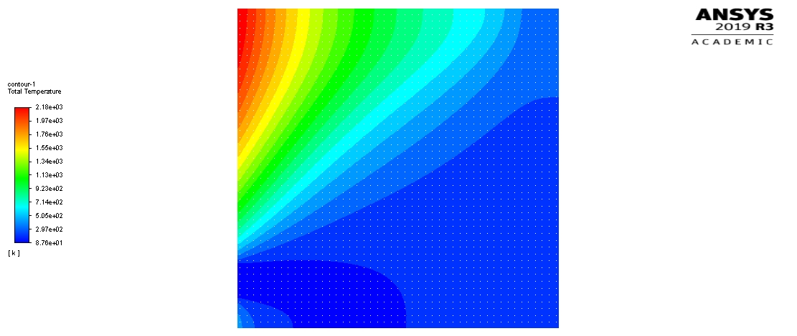
Full Buoyancy Effects
On
Off
K-e model are two equation models: Kinetic Energy and Dissipation equations, full buoyancy effects introduces bouyancy into the dissipation equation (very recent update, not fully understood and not stable or considered valid) .

Slide 4
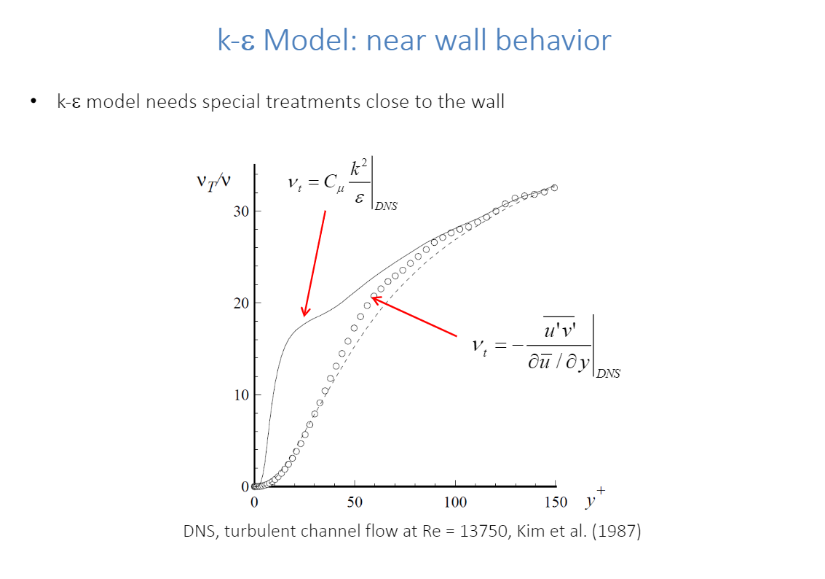
Limitations of k-e

Slide 5
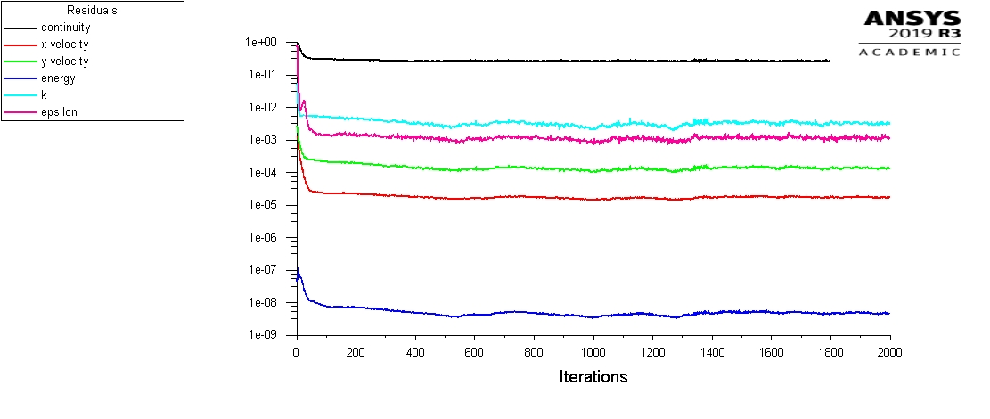
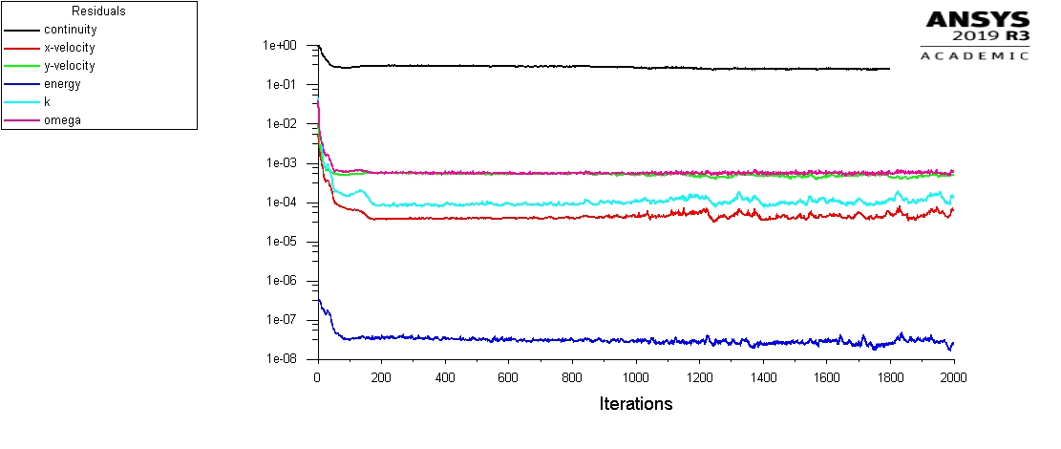
K-epsilon vs K-omega
Convergence issues possibly due material value limitations:
Allow for values outside of range (above 150 [K] or bellow 83.9 [K]) (extrapolation with given polynomial)
Use other material relations if possible outside calculated limits (Boussinesq if non constant)
Alter Relaxation Factors

Slide 6
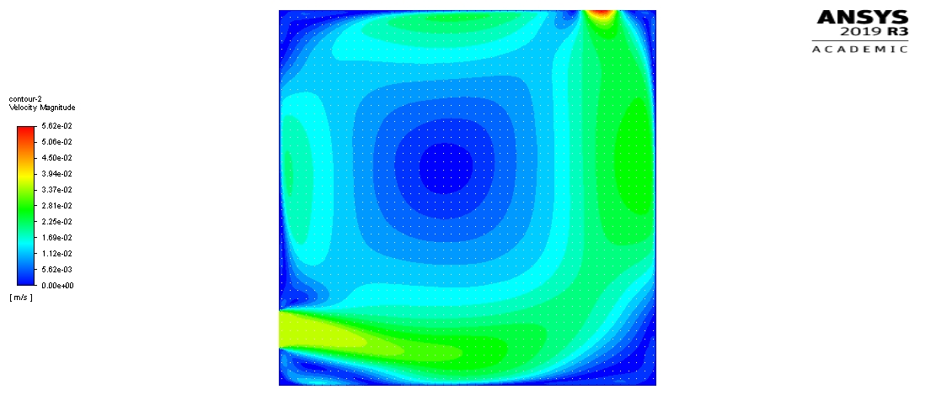
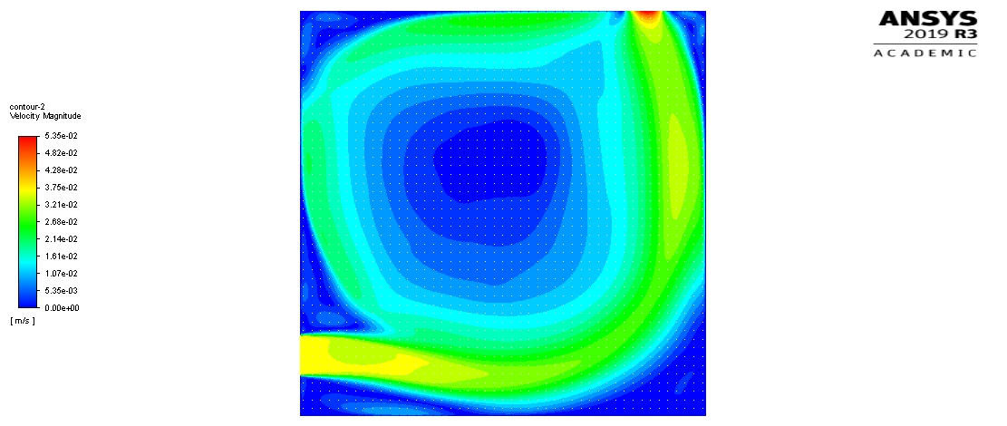
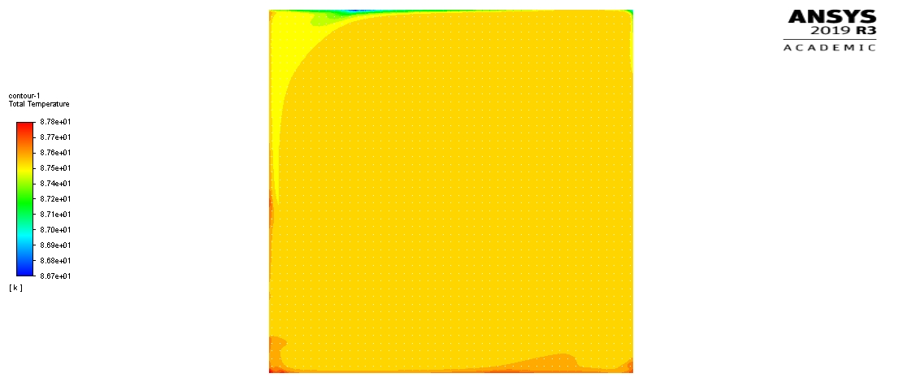
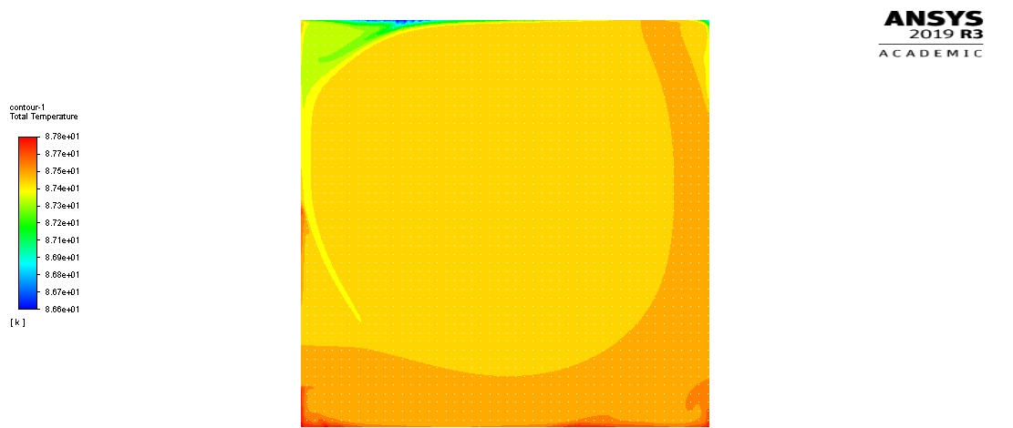
K-epsilon vs K-omega (if forced convection dominates)

Slide 7
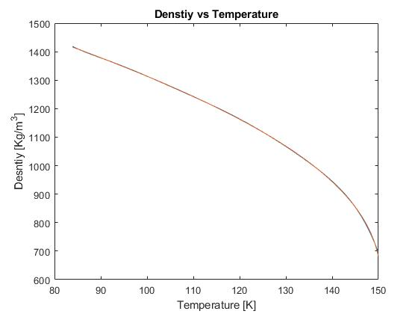
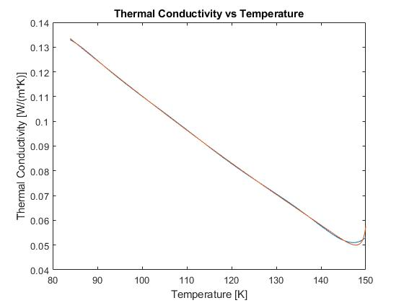
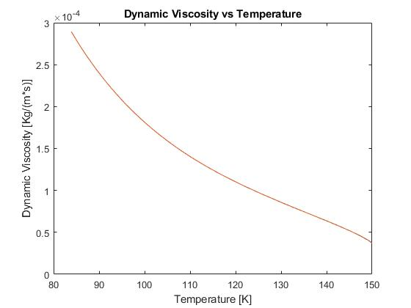
Material Values
Limited to 145 [K]

Slide 8
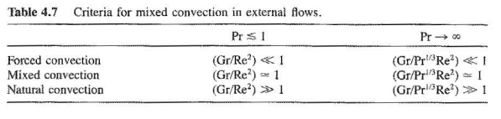
Forced vs Natural Convection
Forced
K-epsilon
K-omega
Natural
Scale-Adaptive Simulation (SAS)
Detached Eddy Simulation (DES)
Large Eddy Simulation (LES)
Relationship for External Flows:
Mills

Slide 9
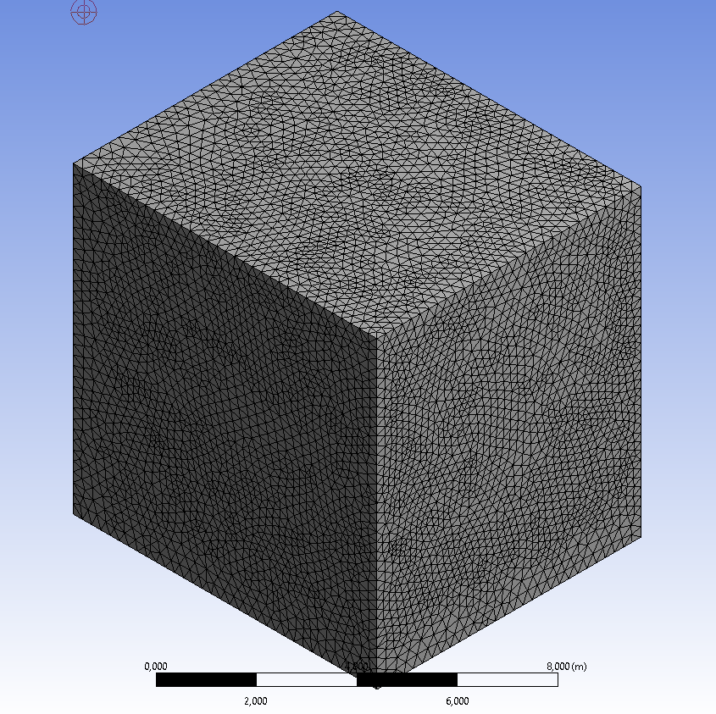
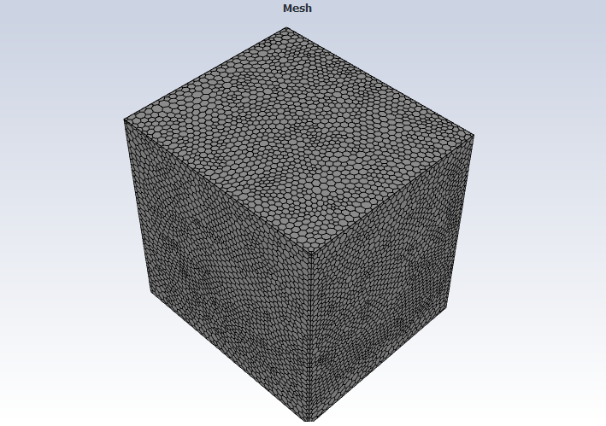
3D Model Mesh: Tetra to Polyhedral Mesh

Slide 10

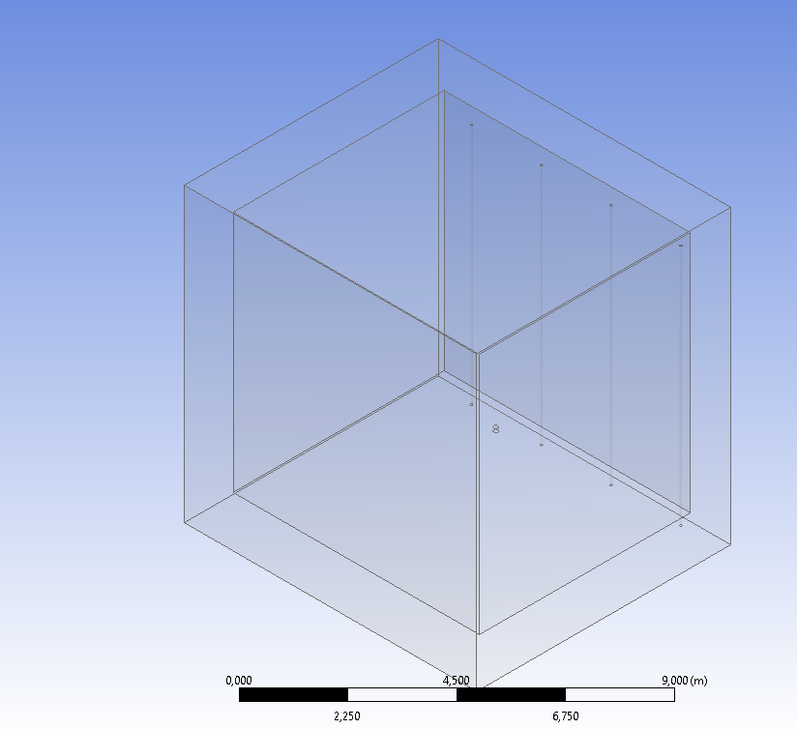
Surfaces for 3D Model

Slide 11
Goals for this Week
Run 3D model
Adjust Surfaces for 3D Model
Impliment Internal Heating into 3D model
Possible Difficulties:
Resolving an adiquate mesh requires large RAM 125GB
Implementing walls that allow fluid to pass is very difficult, best solution might be implementing a volumetric heat source (requires external functions and 3rd party software – not very easy)

