Slide 1
Cern Week 3 Report:
Kostantin Andreas Jacoby

Slide 2
Goals for past Week
Run 3D model
Adjust Surfaces for 3D Model
Impliment Internal Heating into 3D model

Slide 3
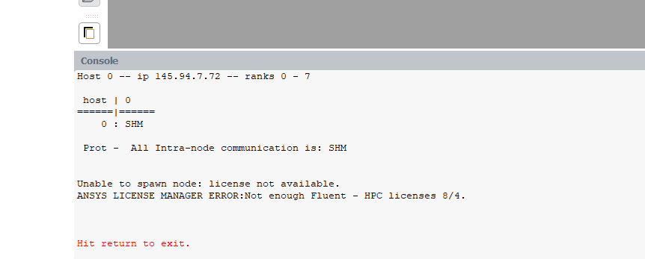
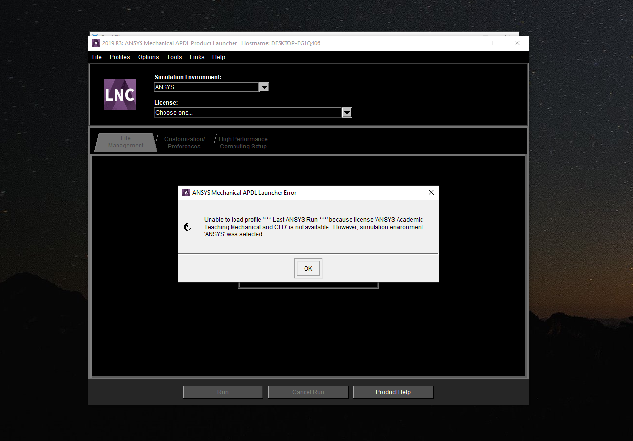
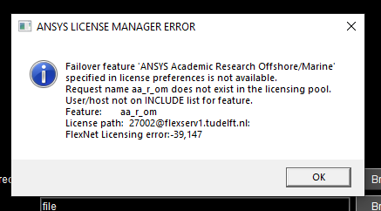
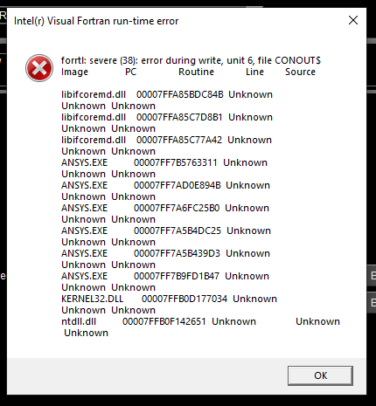
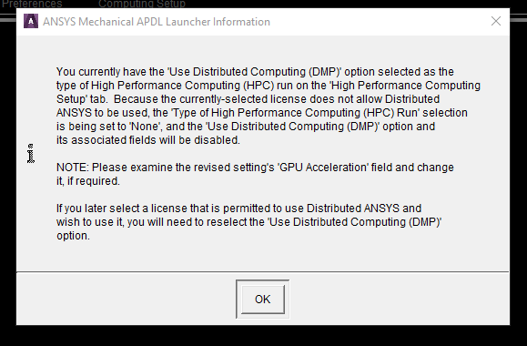
Lisensing Issues

Slide 4
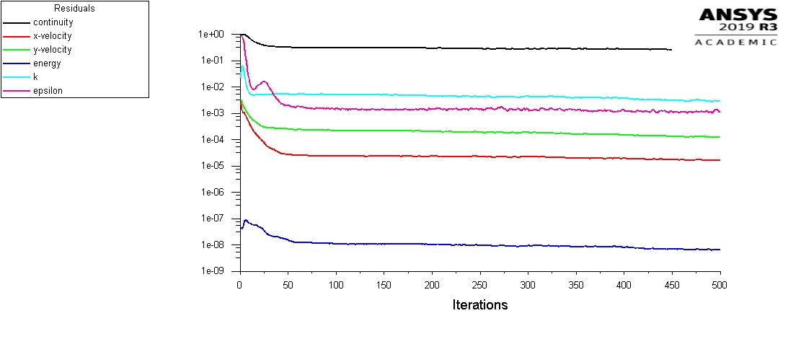
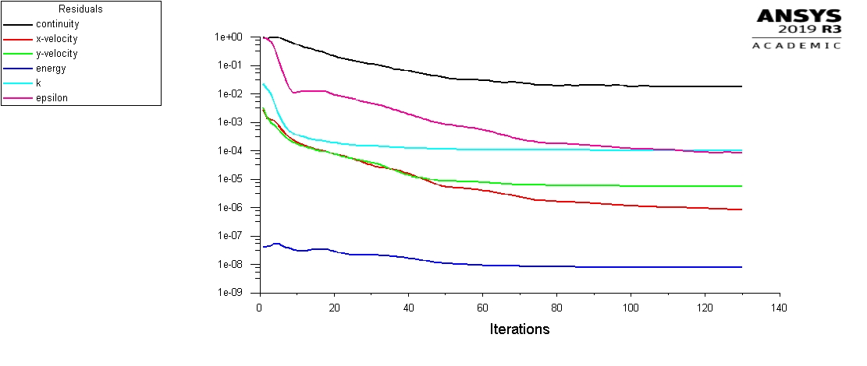
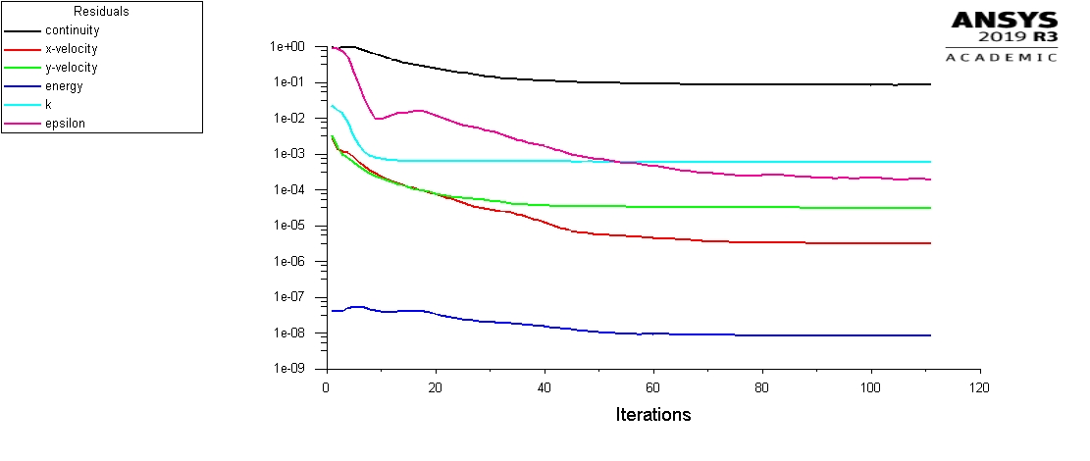
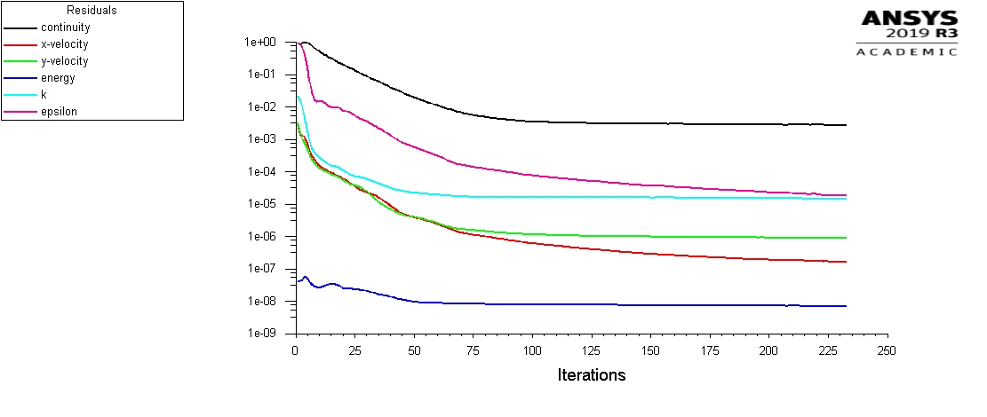
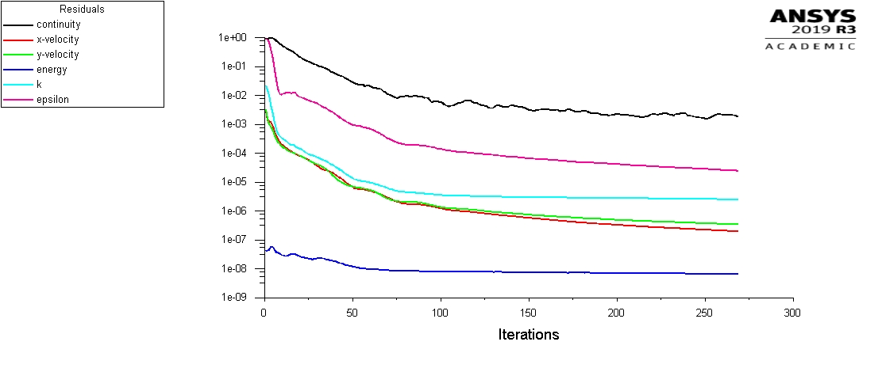
Material Value Polynomial Order (Only Density Altered)
8
6
7
5
4

Slide 5
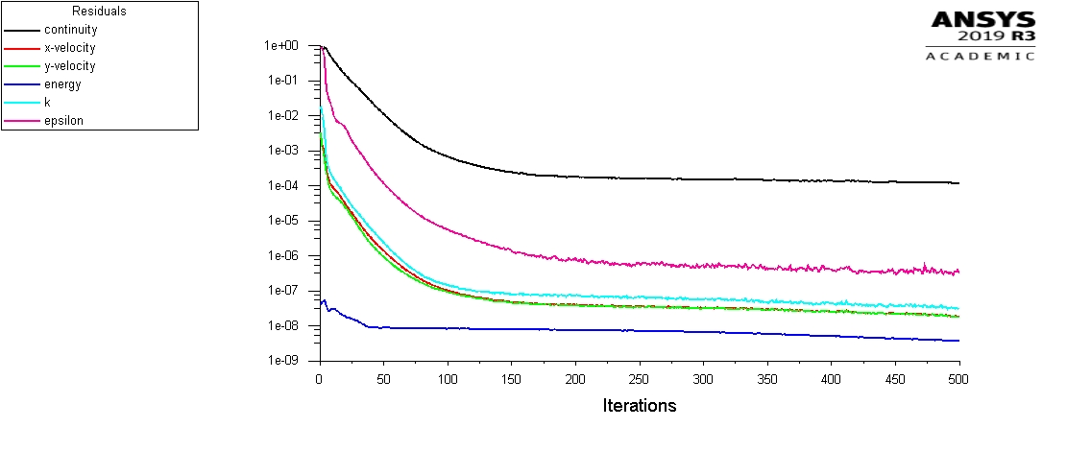
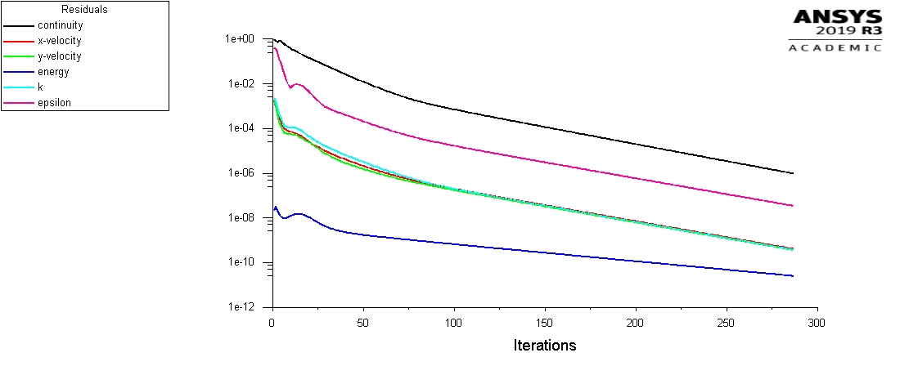
Material Value Polynomial Order
Constant Denstiy
Polynomial 8th Order
Constant Material Properties

Slide 6
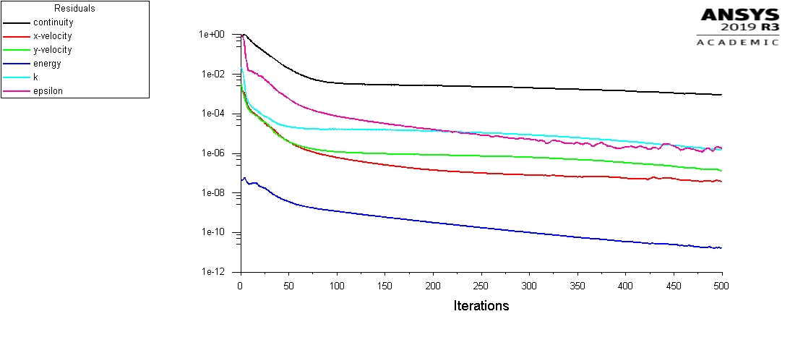
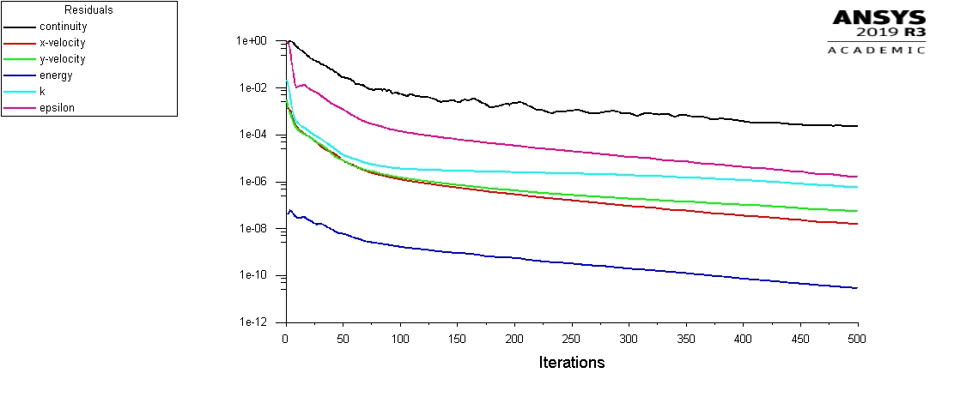
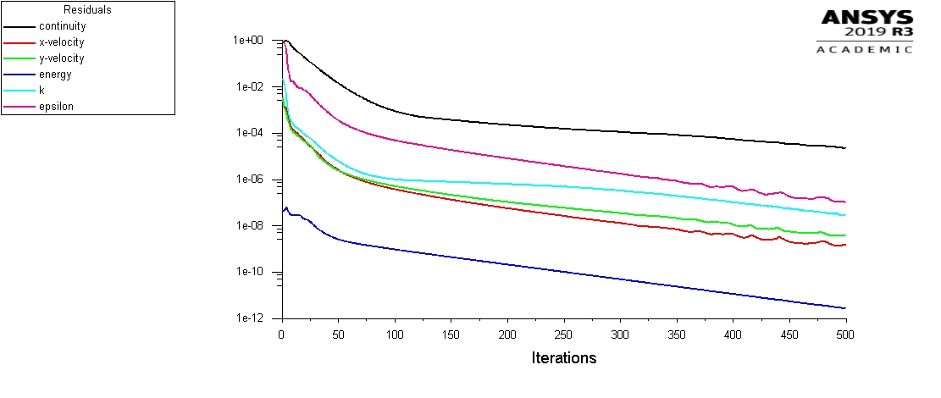
Material Value Polynomial Order (All Values)
4
3
2

Slide 7
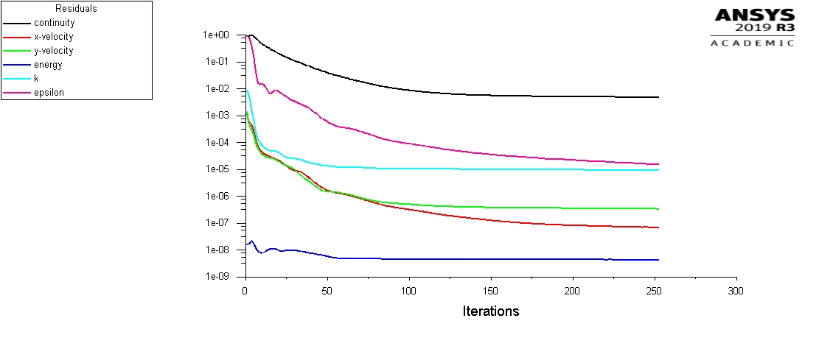
Mesh Dependancy
Element Size: 0.00015
Element Size: 0.00025

Slide 8
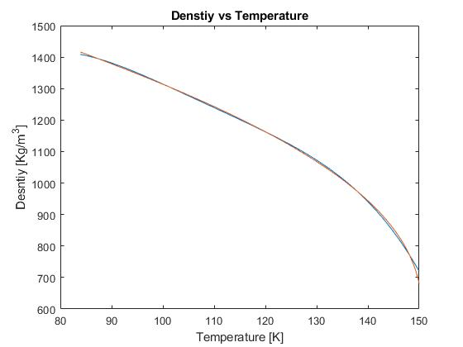
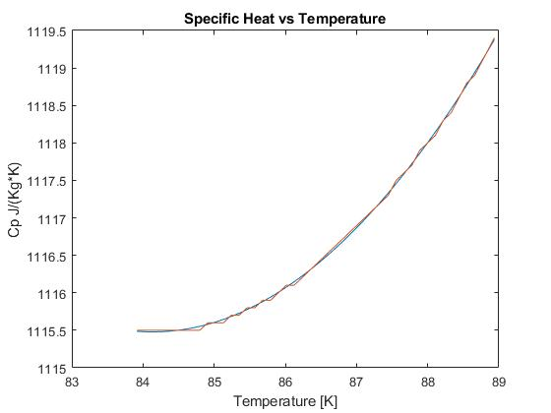
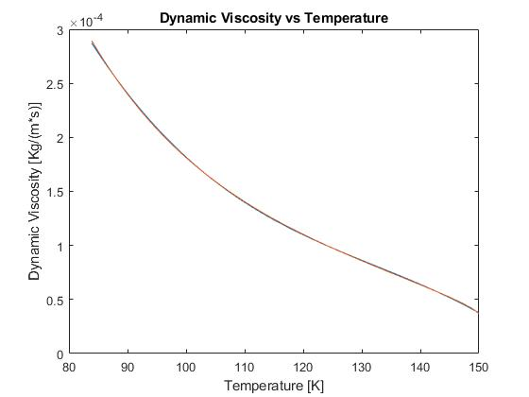
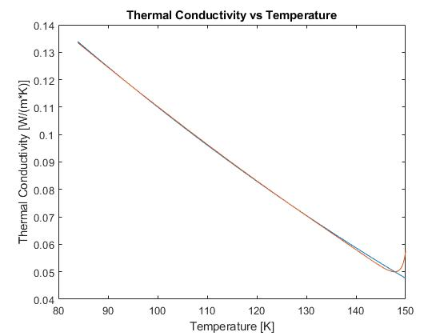
Final Material Properties
4th Order
2nd Order
Improvments:
Split the Desntiy and Dynamic Viscosity into three different ranges of lower order.
3rd Order
2nd Order

Slide 9
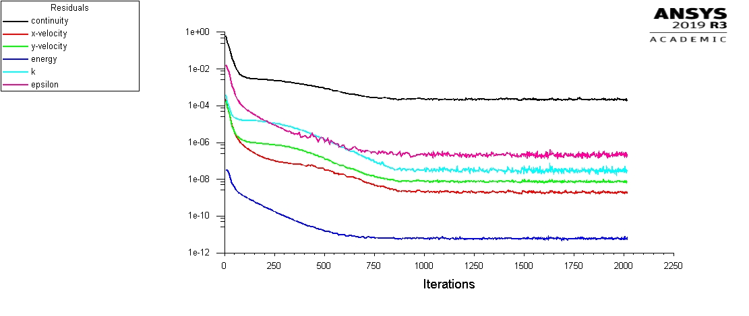
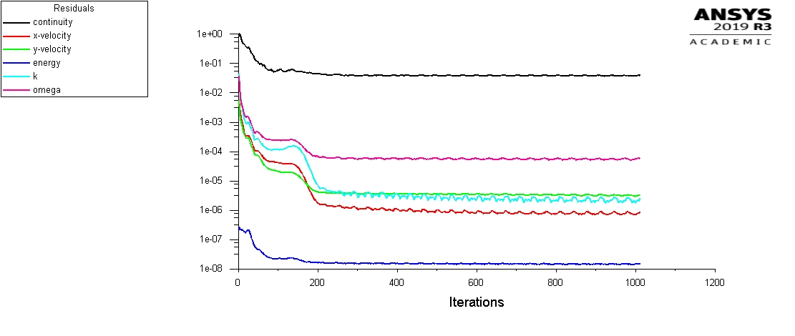
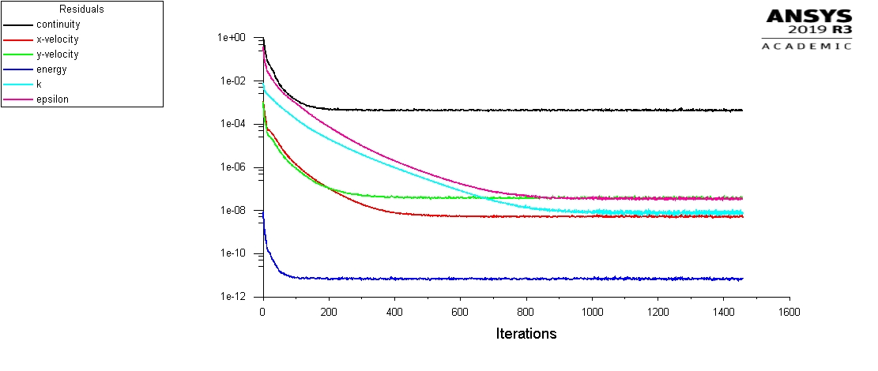
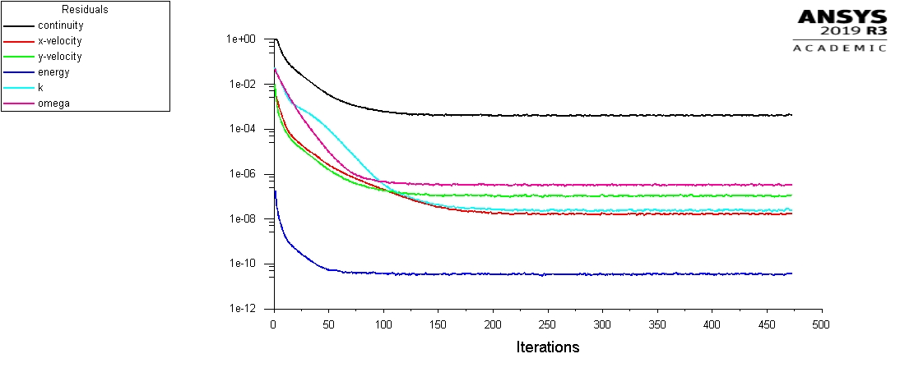
Convergence New Material Values
Stationary k-e
Stationary k-omega
Transient k-e
Transient k-omega

Slide 10
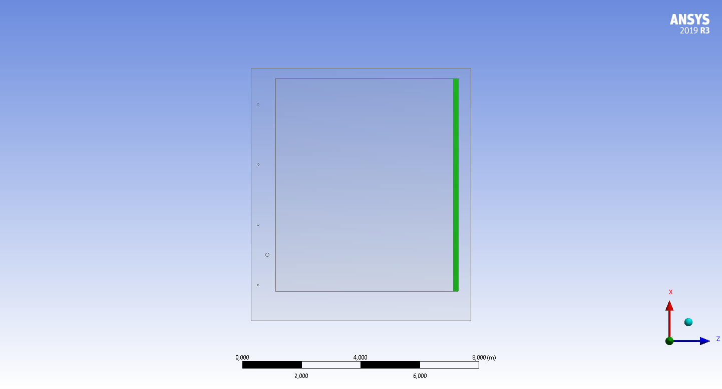
3D Geometry: Split Transparent Wall APA

Slide 11
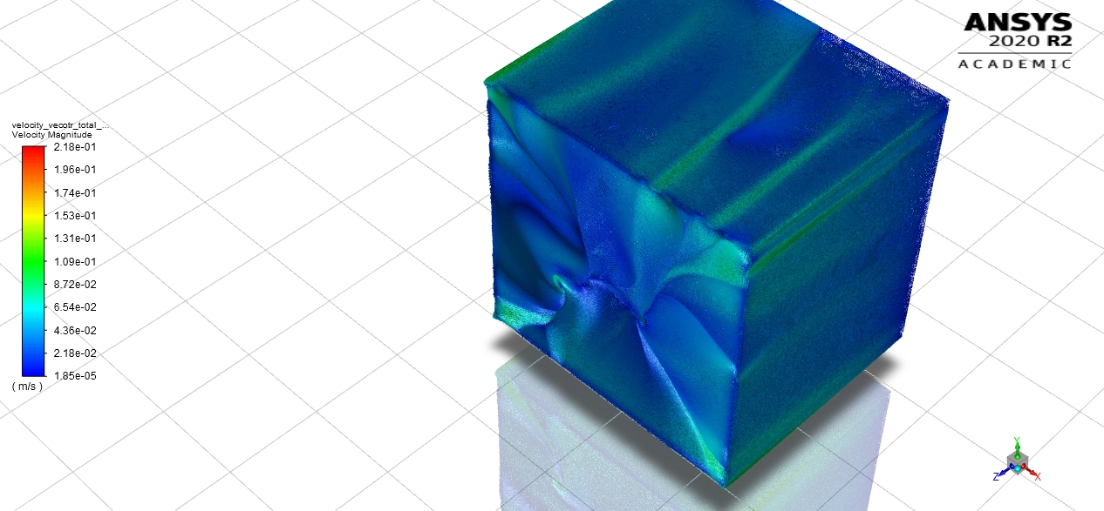
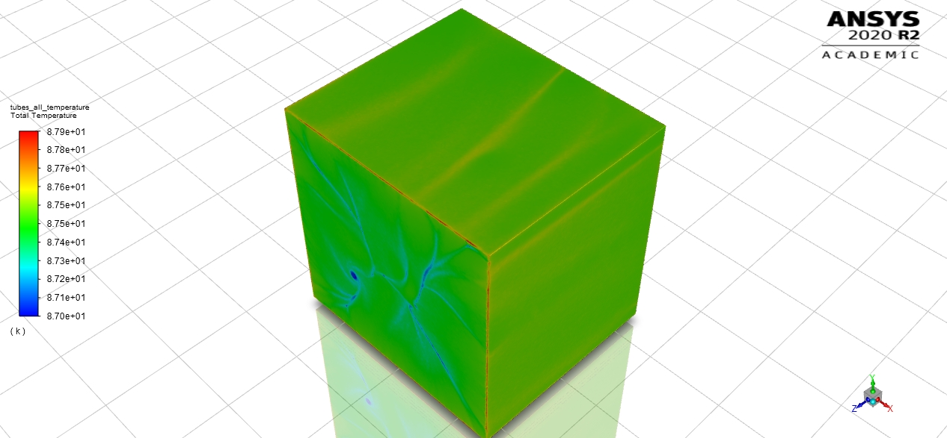
3D Geometry: (No APA Split or Heating (Jan’s Model))

Slide 12
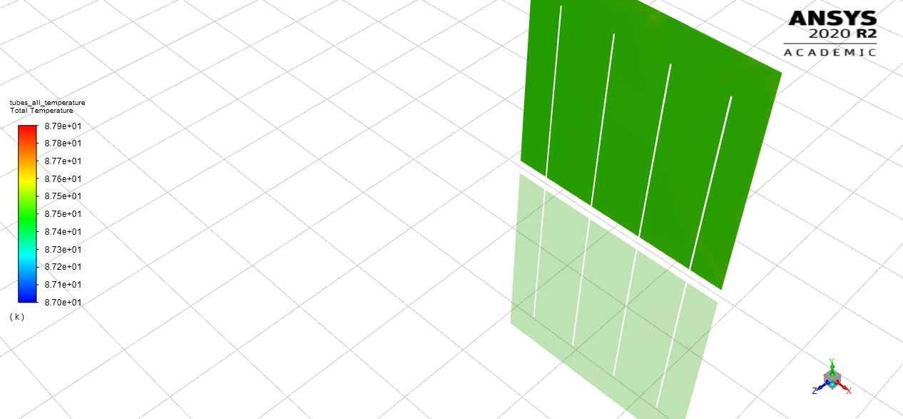
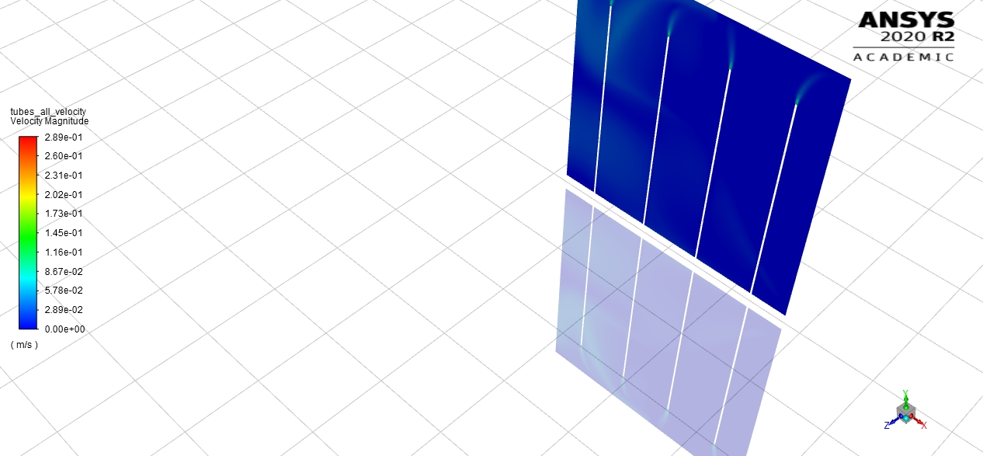
3D Geometry: (No APA Split or Heating (Jan’s Model))
Temperature 4 Inlets
Velocity 4 Inlets
Error in the temperature rendering

Slide 13
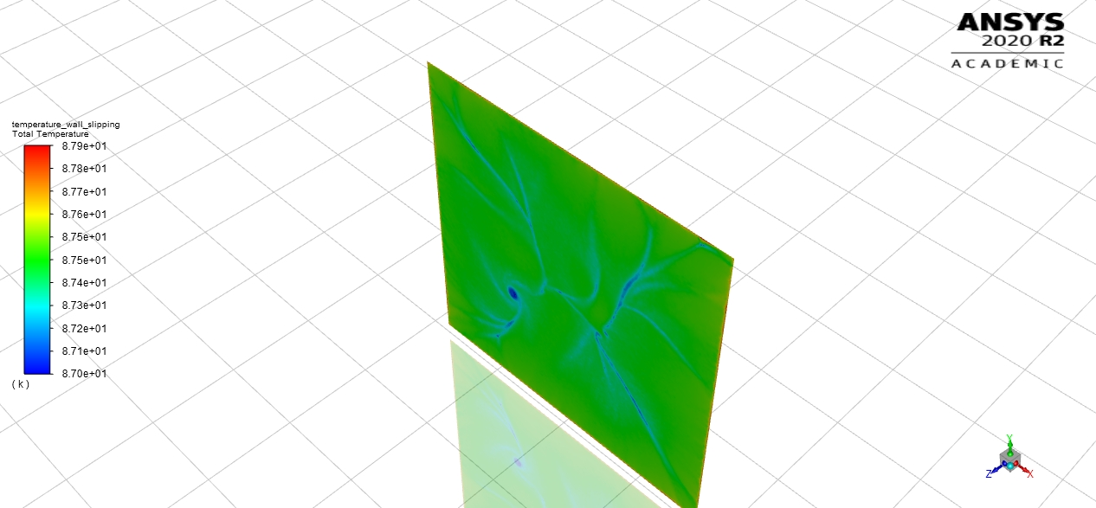
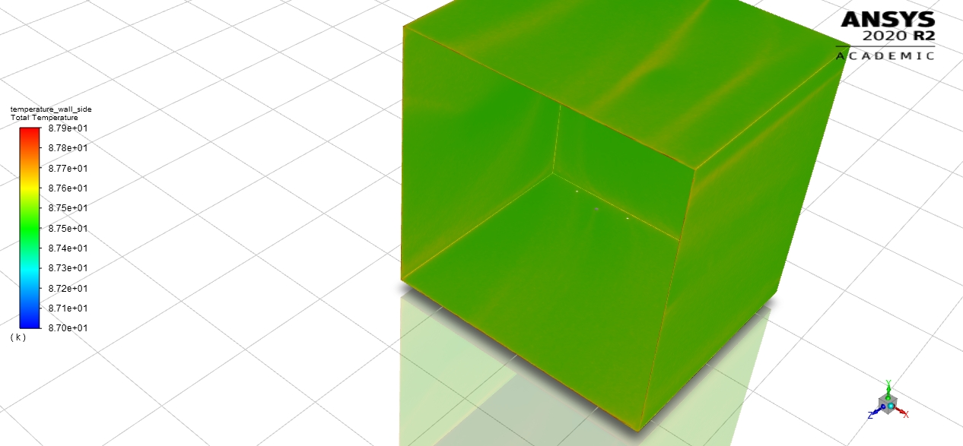
3D Geometry: (No APA Split or Heating (Jan’s Model))
Slipping Wall
CS Wall

Slide 14
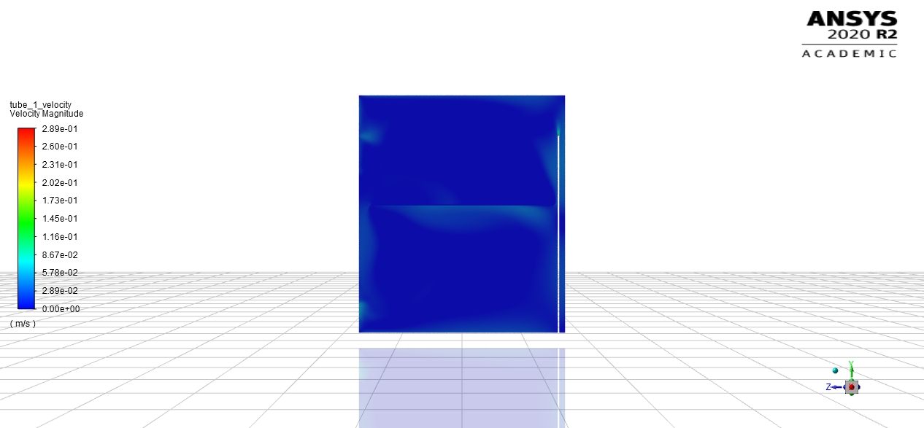
3D Geometry: (No APA Split or Heating (Jan’s Model))
Tube 1:

Slide 15
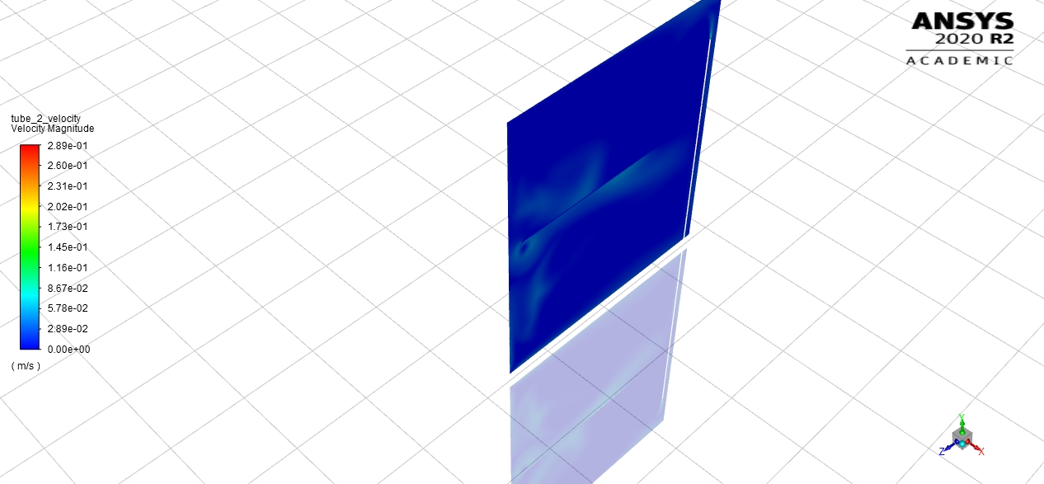
3D Geometry: (No APA Split or Heating (Jan’s Model))
Tube 2:

Slide 16
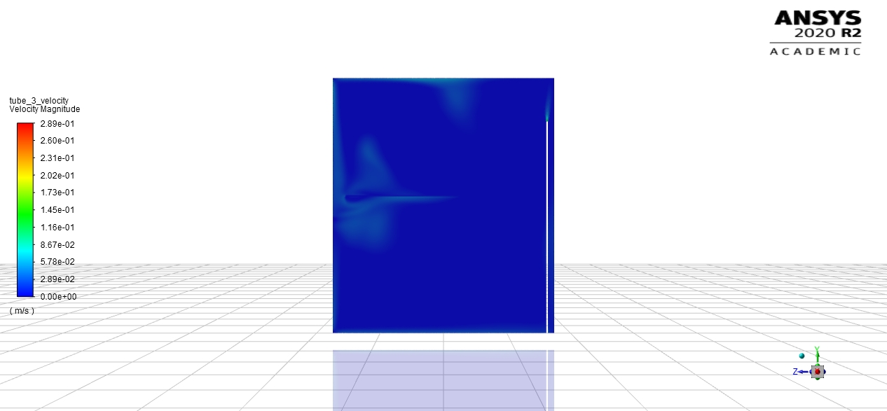
3D Geometry: (No APA Split or Heating (Jan’s Model))
Tube 3:

Slide 17
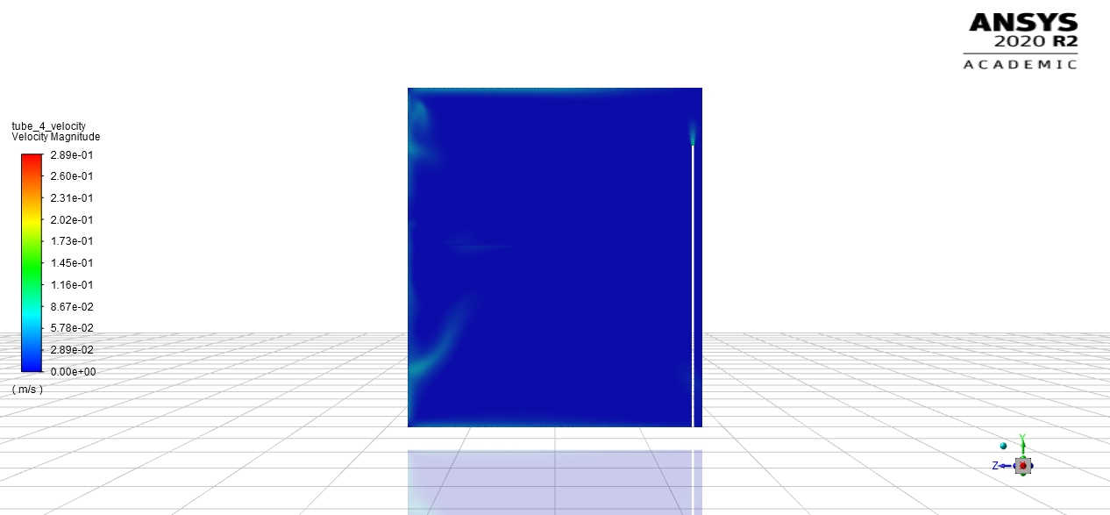
3D Geometry: (No APA Split or Heating (Jan’s Model))
Tube 4:

Slide 18
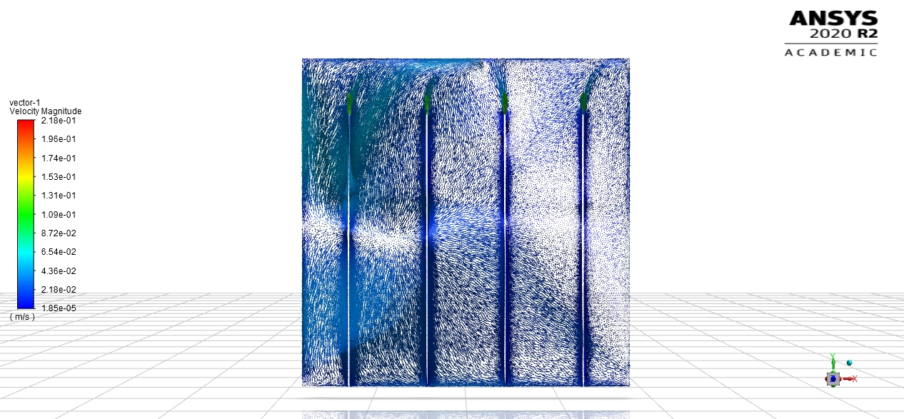
3D Geometry: (No APA Split or Heating (Jan’s Model))
Velocity Vectors 4 tubes:

Slide 19
Goals for Next Week
Play with outlet boundry conditions (2D) to help improve continuity convergence
Run 3D model with APA Heating
Research into partially permiable walls
Calculate heat flux through tubes
Find maximum possible elements allowed for 120 GB of ram (limit to 110 GB)
Split higher order polynomials into different subsections of lower order polynomials
Set initial bulk temperature at 87.3 [K]
Construct single tube simualtion

