Slide 2
10th Beam Telescopes and Test Beams Workshop
20-24 June 2022

Slide 3
Commissioning and First Run for the CERN Proton Irradiation Facility (IRRAD) after the Long Shutdown 2
Blerina Gkotse (CERN EP-DT) on behalf of the IRRAD Team

Slide 4
Outline
CERN Irradiation Facilities and Long Shutdown 2 (LS2) Upgrades
IRRAD Upgrades:
  T8 Beam Instrumentation
  Technical Area
  IRRAD Software and Hardware Infrastructure
Beam Commissioning and IRRAD runs 2021-22
European Projects associated to IRRAD
Summary

Slide 5
Outline
CERN Irradiation Facilities and Long Shutdown 2 (LS2) Upgrades
IRRAD Upgrades:
  T8 Beam Instrumentation
  Technical Area
  IRRAD Software and Hardware Infrastructure
IRRAD Commissioning and runs 2021-22
European Projects associated to IRRAD
Summary

Slide 6
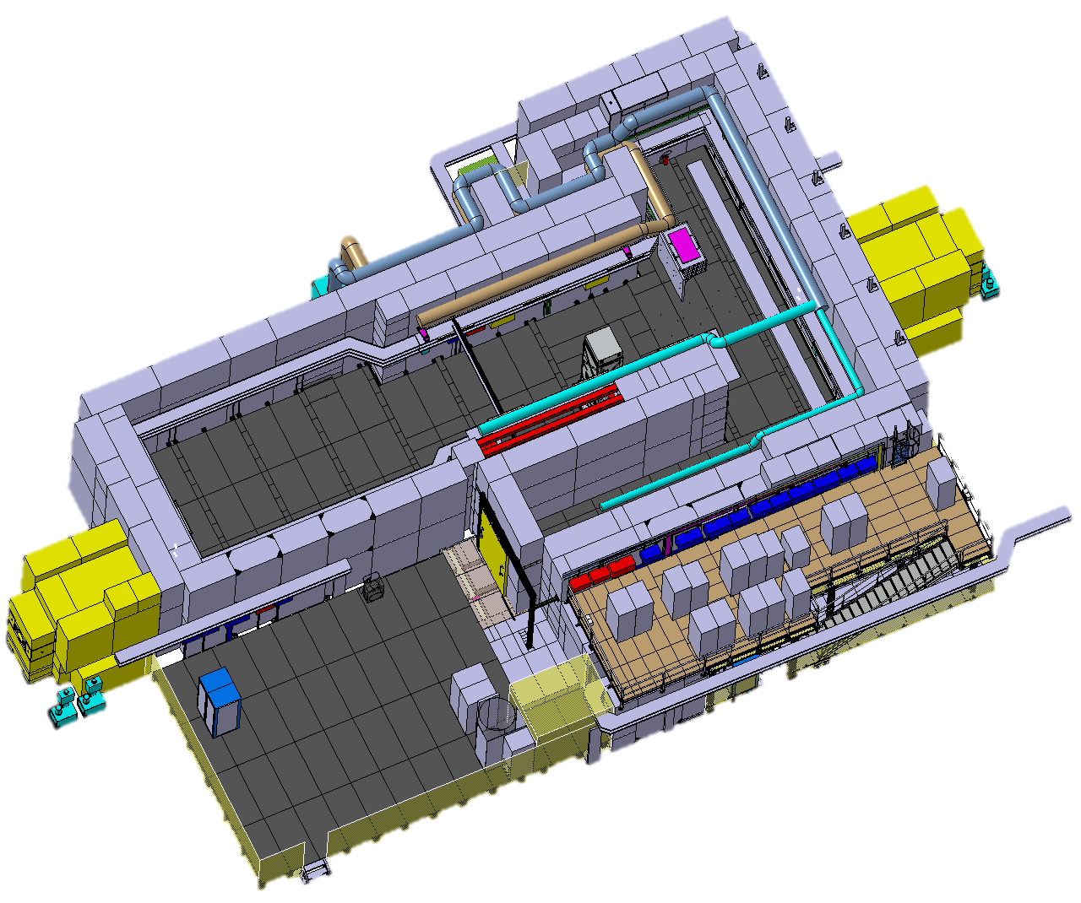
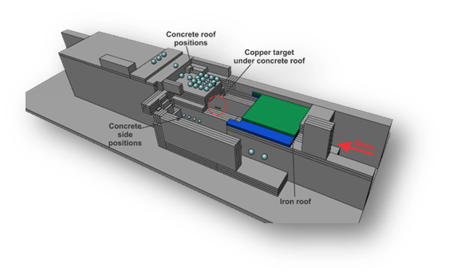
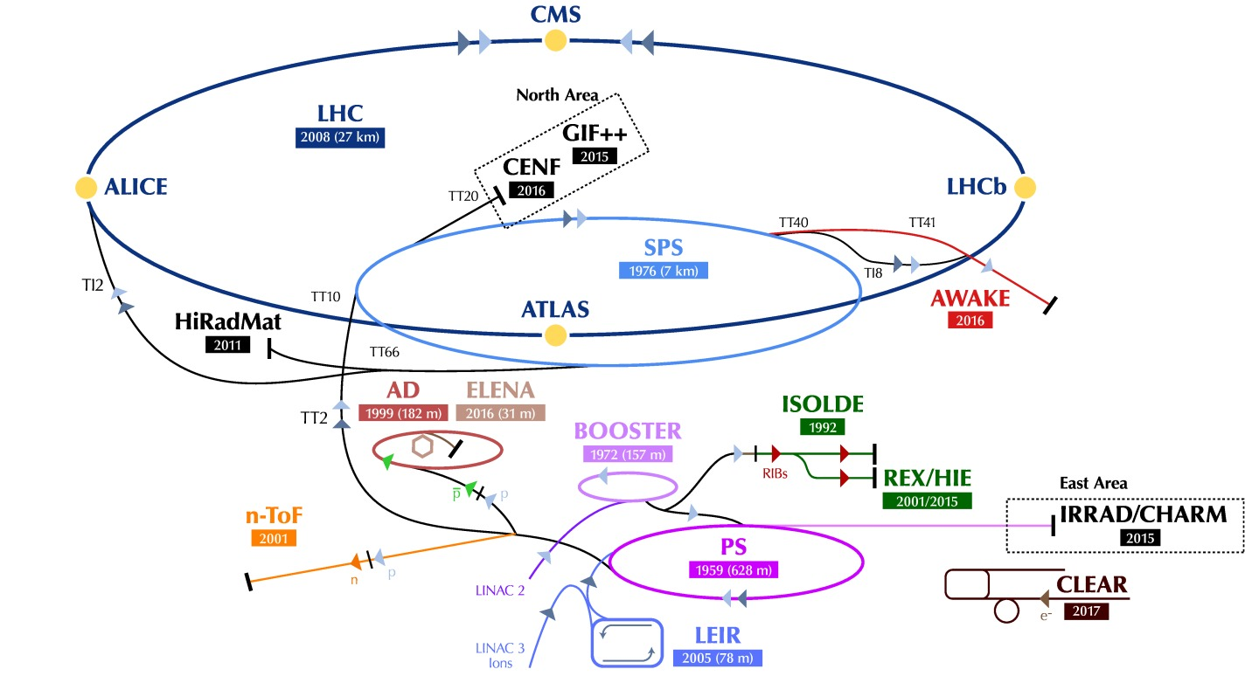
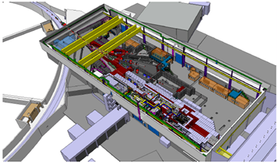
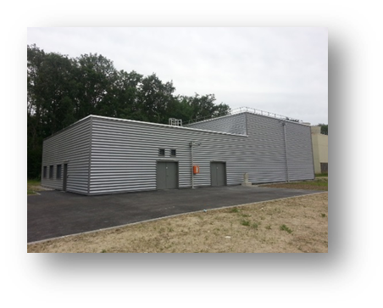
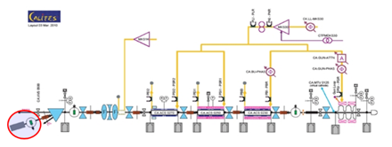
CERN Irradiation Facilities
Presentation from M. Jaekel
GIF++
(gamma + muons)
CERF
(mixed
field)
CALLAB
(irradiation sources)
IRRAD
(protons)
CHARM
(mixed field)
VESPER (electrons)

Slide 7
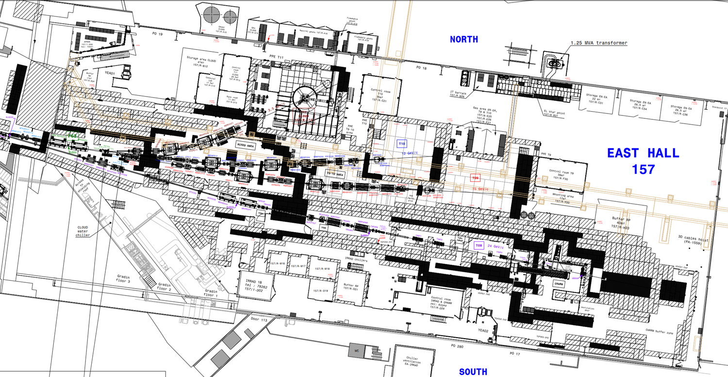
Long Shutdown 2 Upgrades
T8 Beam Instrumentation
IRRAD Software and Hardware Infrastructure
T08
CHARM
Presentation from D. Banerjee
IRRAD
Technical Area

Slide 8
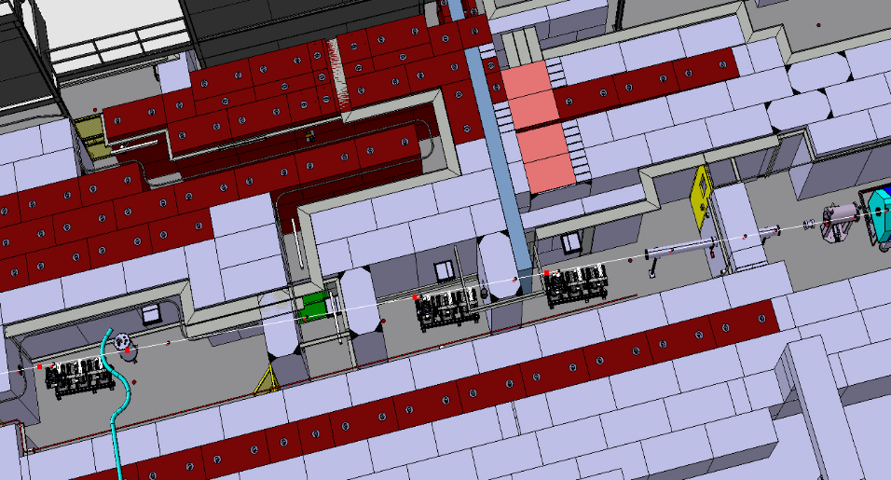
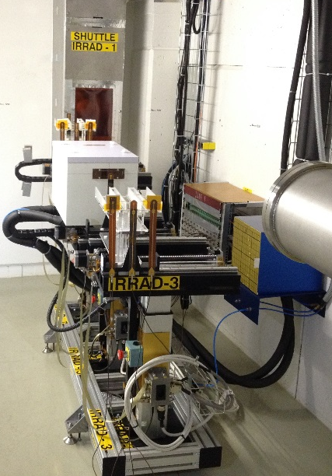
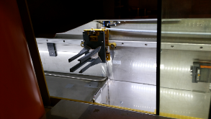
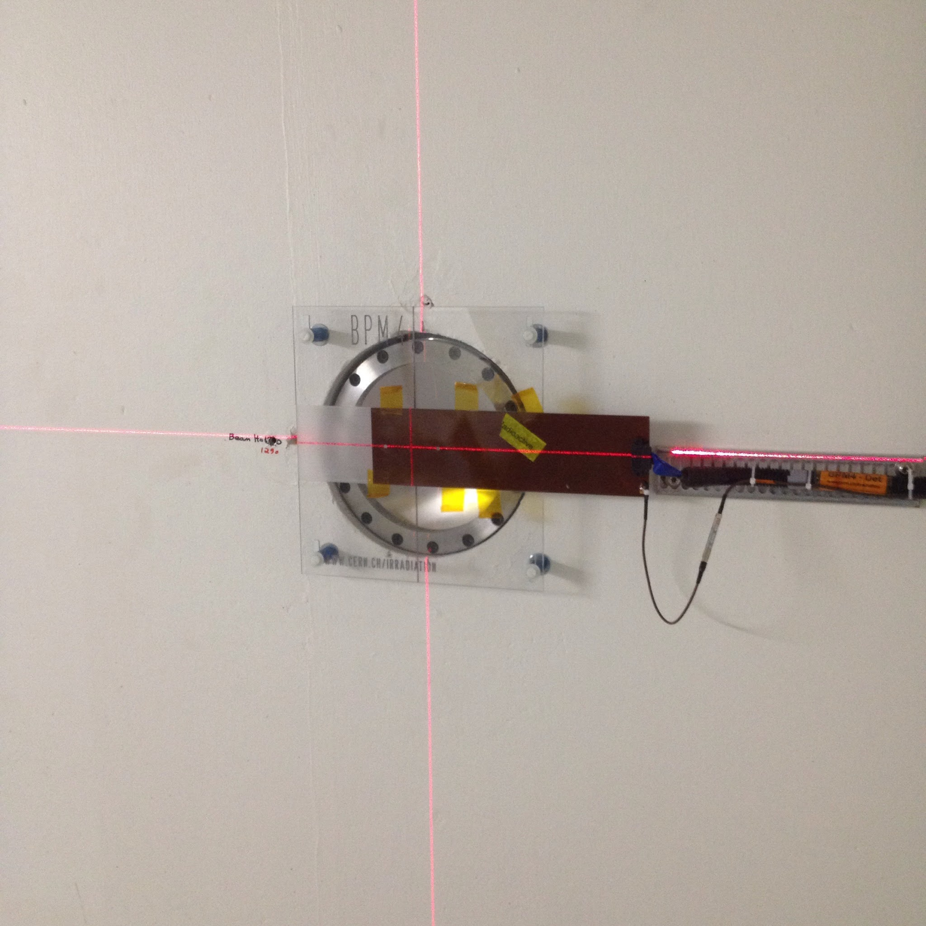
CERN Proton Irradiation Facility (IRRAD)
cern.ch/ps-irrad
24 GeV/c, 400 msec, 5e11 p/spills, 12x12 mm² FWHM
IRRAD Tables
Cryostat
with LHe 1.9 K
Shuttle System
Tracking
detectors
BEAM
Calorimetry
detectors
Electronics/full
detector systems
30m
Beam Profile
Monitors (BPM)

Slide 9
Outline
CERN Irradiation Facilities and Long Shutdown 2 (LS2) Upgrades
IRRAD Upgrades:
  T8 Beam Instrumentation
  Technical Area
  IRRAD Software and Hardware Infrastructure
Beam Commissioning and IRRAD runs 2021-22
European Projects associated to IRRAD
Summary

Slide 10
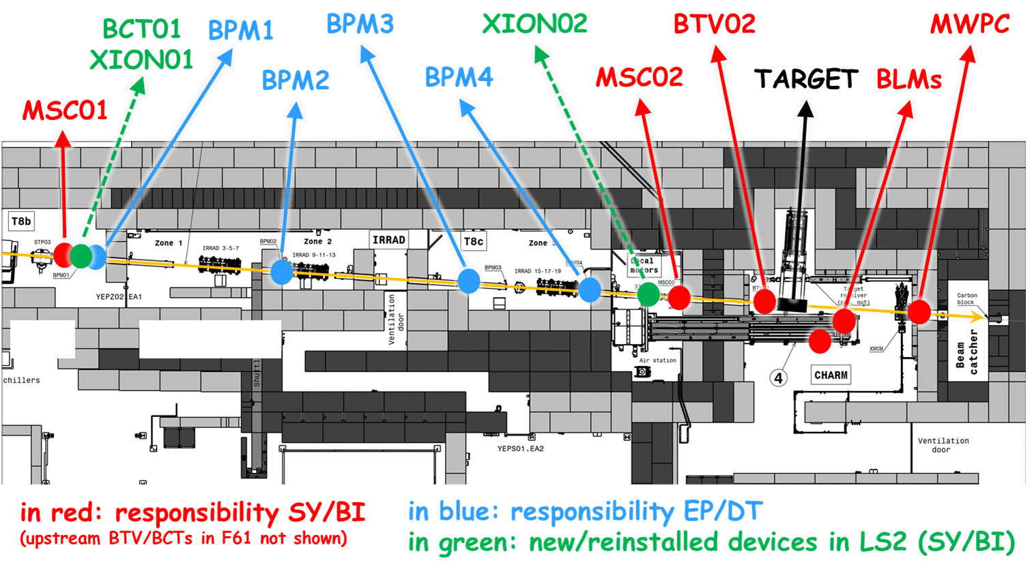
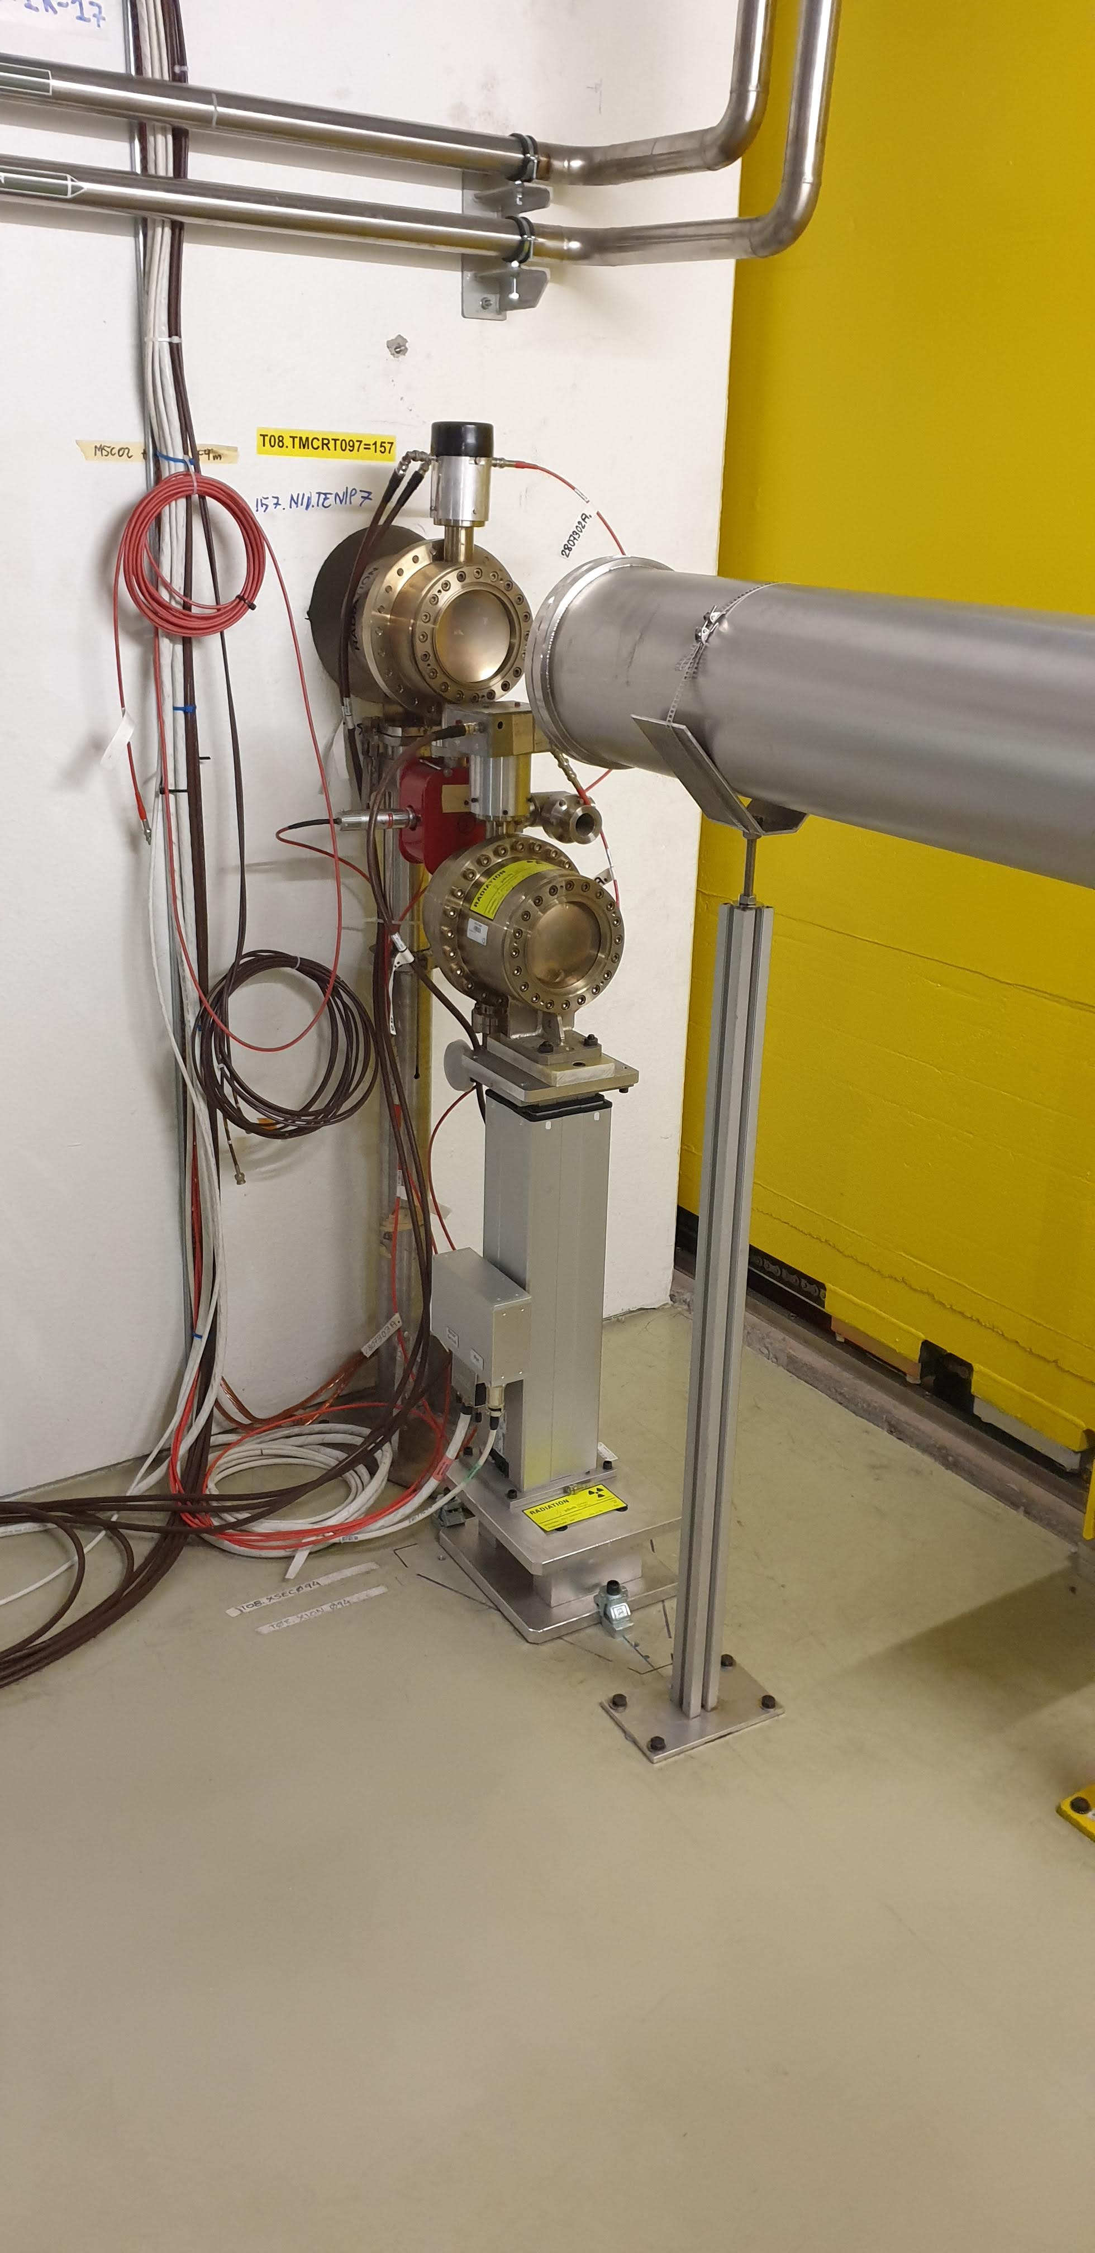
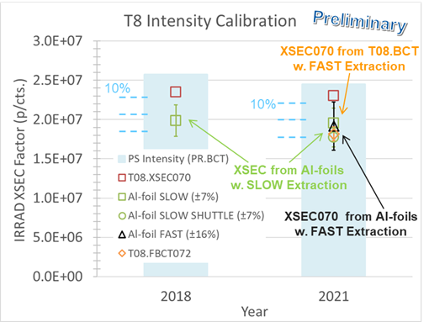
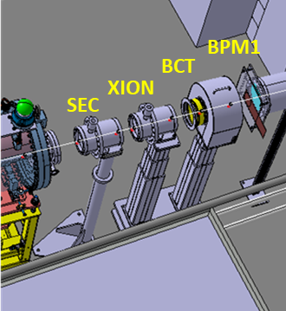
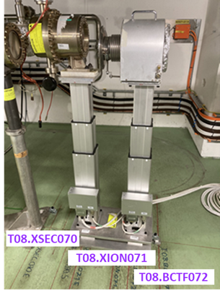
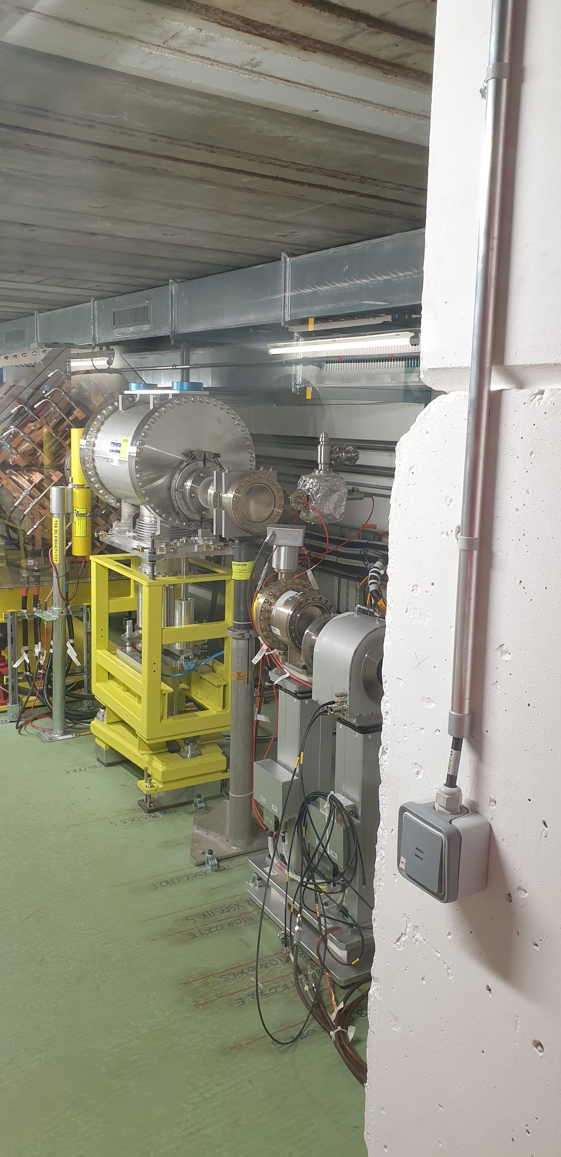
Beam Instrumentation Upgrade
XION02
XION01 and BCT01

Slide 11
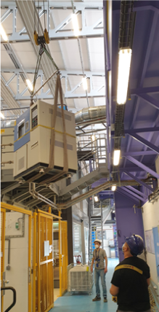
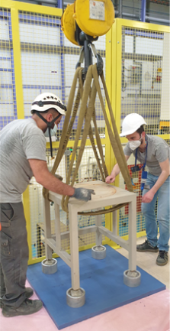
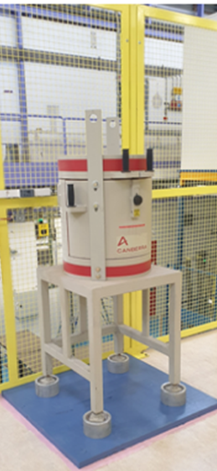
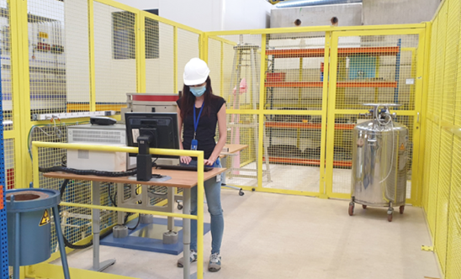
IRRAD Technical Area Upgrade
  Completing and equipping the new IRRAD Technical Area & Measurement Lab

Slide 12
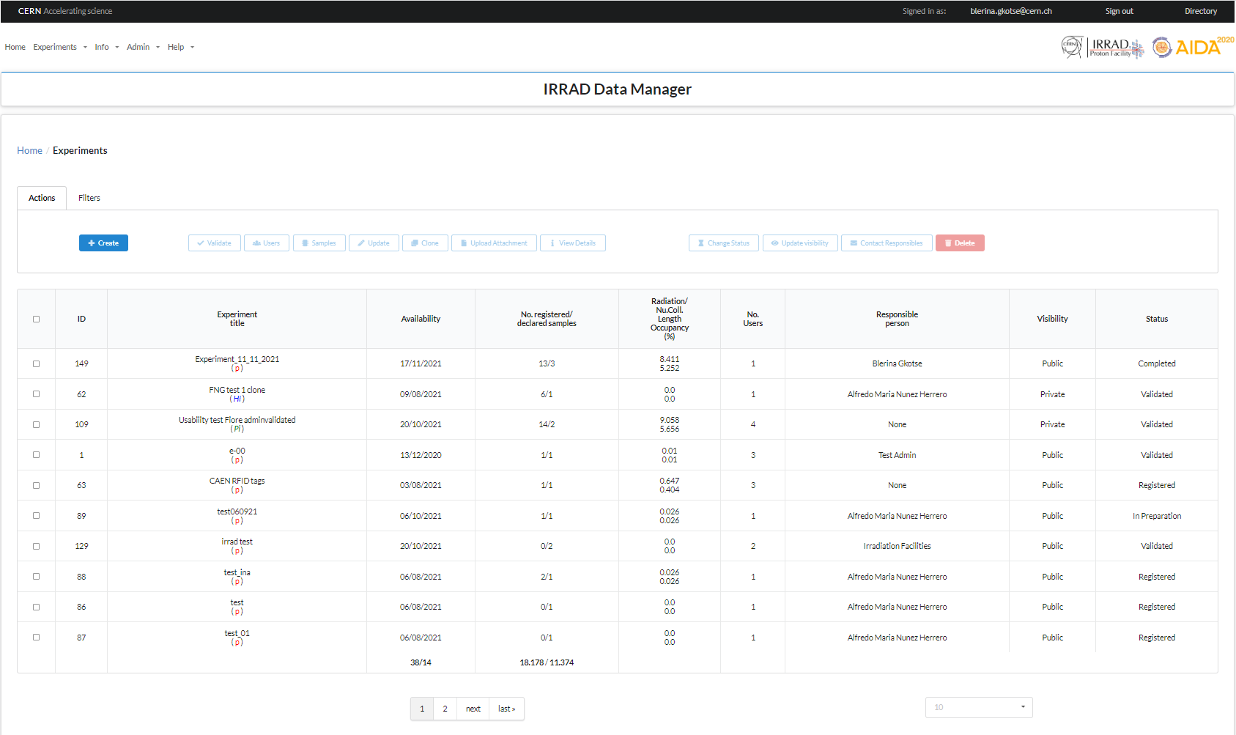
IRRAD Data Manager (IDM) Upgrades
The IRRAD platform to register your irradiation experiment and samples
Upgrades:
  Several improvements and bug fixing
  New User Interface style
  Documentation finalized: https://edms.cern.ch/document/2664569/
  GitLab repository https://gitlab.cern.ch/irrad1/irrad-data-manager
Register your experiment at:
https://irrad-data-manager.web.cern.ch
More details at: https://ps-irrad.web.cern.ch/ps-irrad/
IRRAD Data Manager
A. Nunez, Technical Student
(Spain)

Slide 13
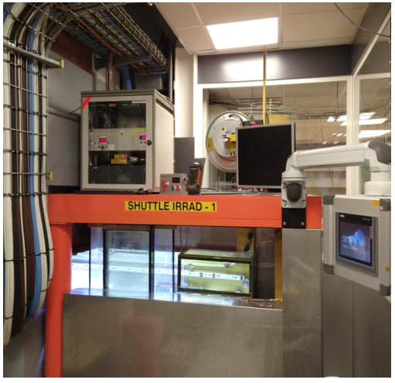
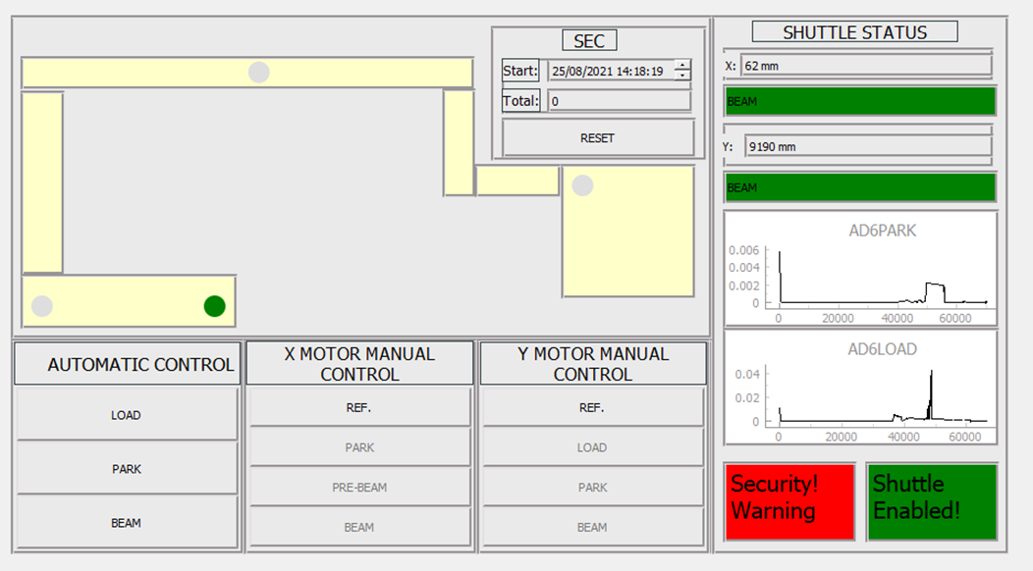
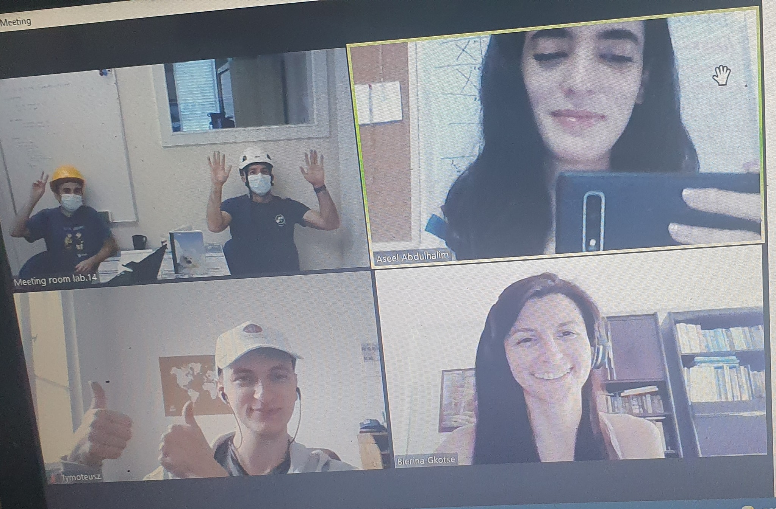
IRRAD Shuttle Control System
Python-based IRRAD Shuttle Motor Control Application
based on pyQT (python) as for the IRRAD Tables (2020)
compatible with Windows and Linux
IRRAD SHUTTLE
IRRAD Remote Summer Students’ team
Aseel
Abdulhalim (Palestine)
Tymoteusz Ciesielski
(Poland)
IRRAD SHUTTLE INTERFACE

Slide 14
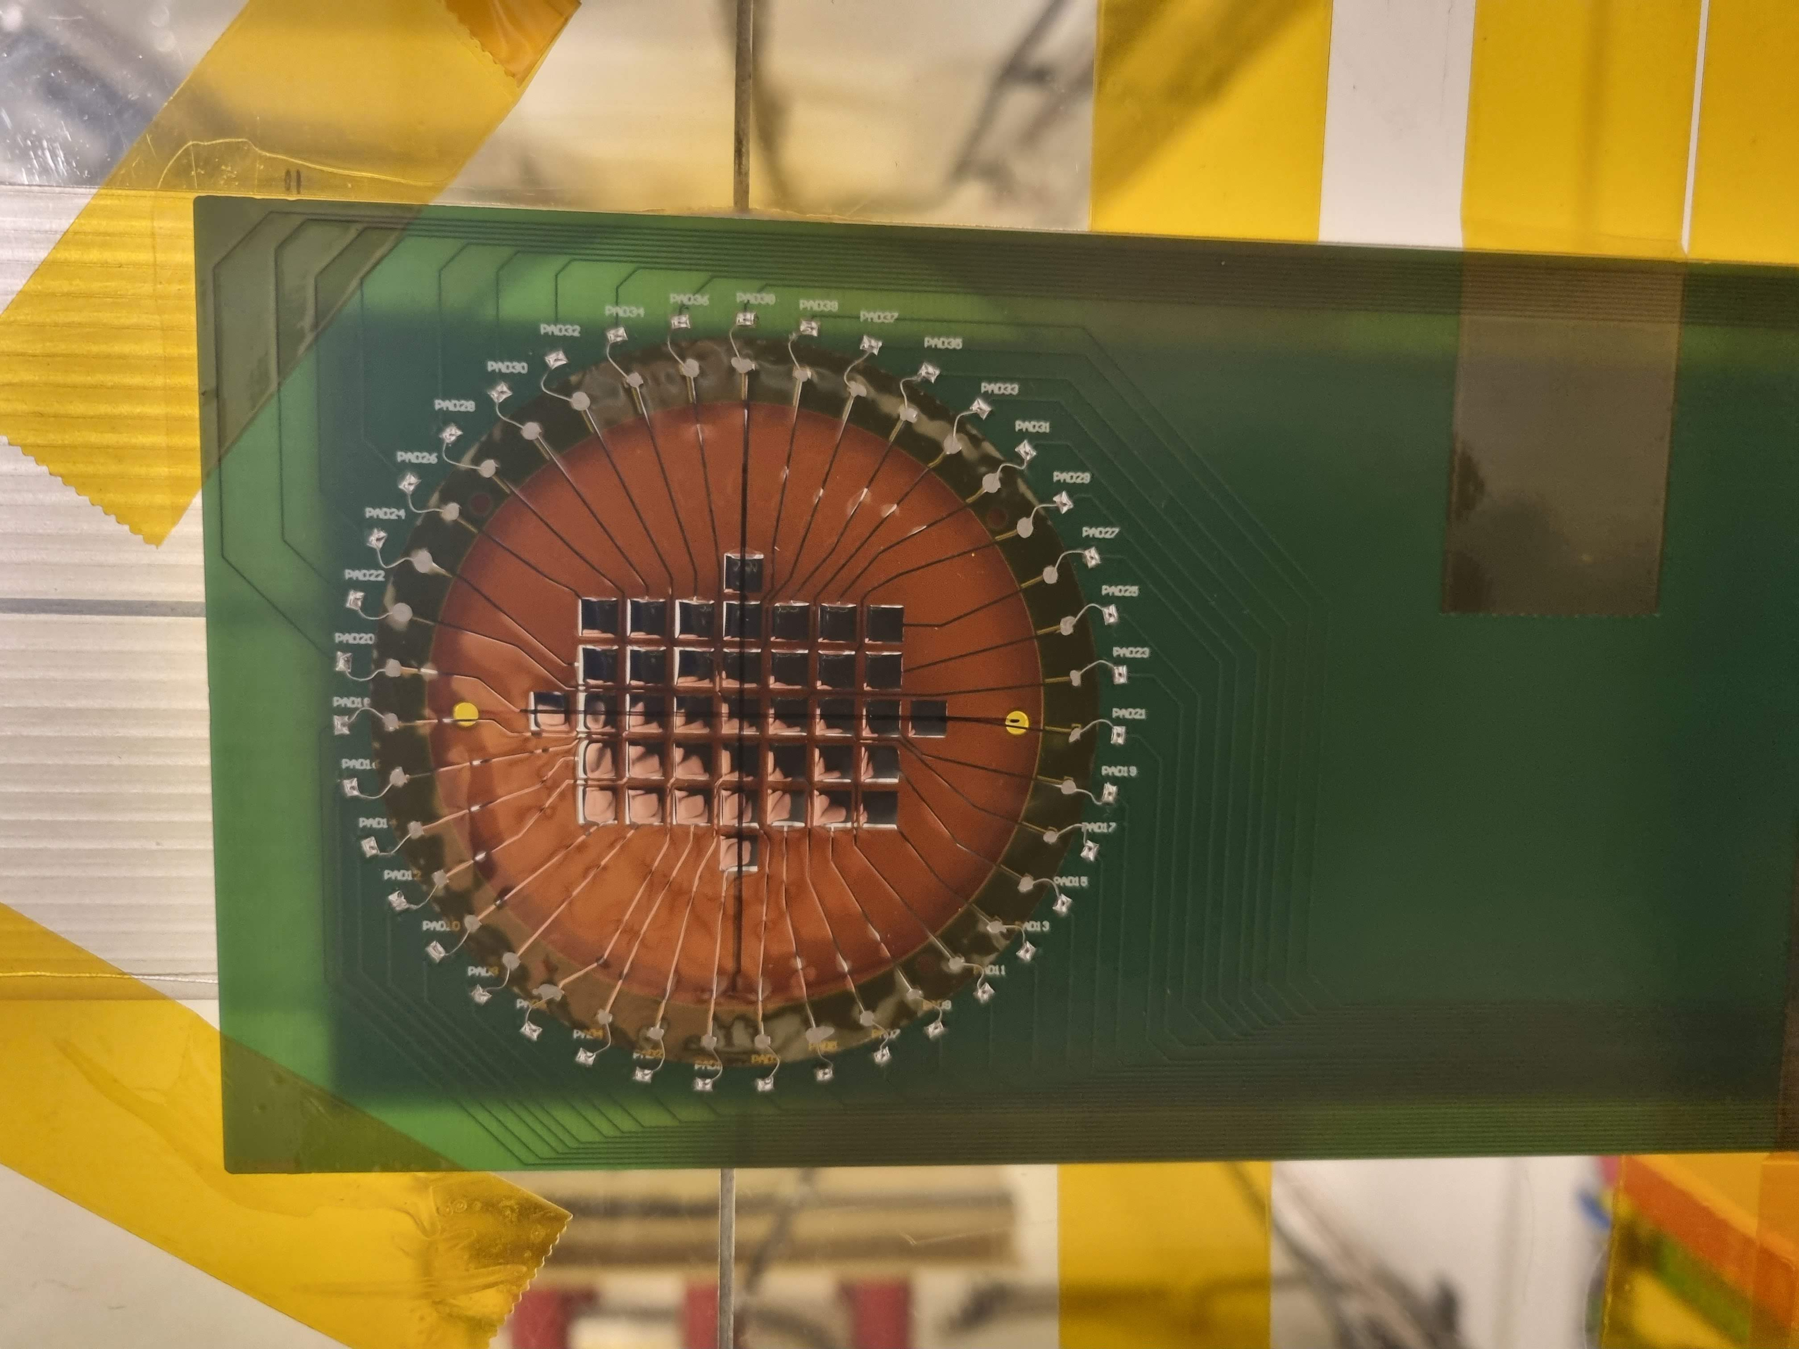
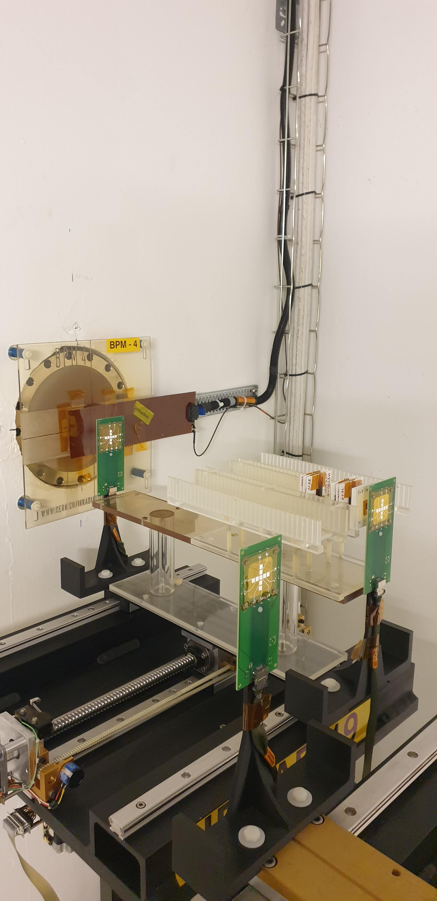
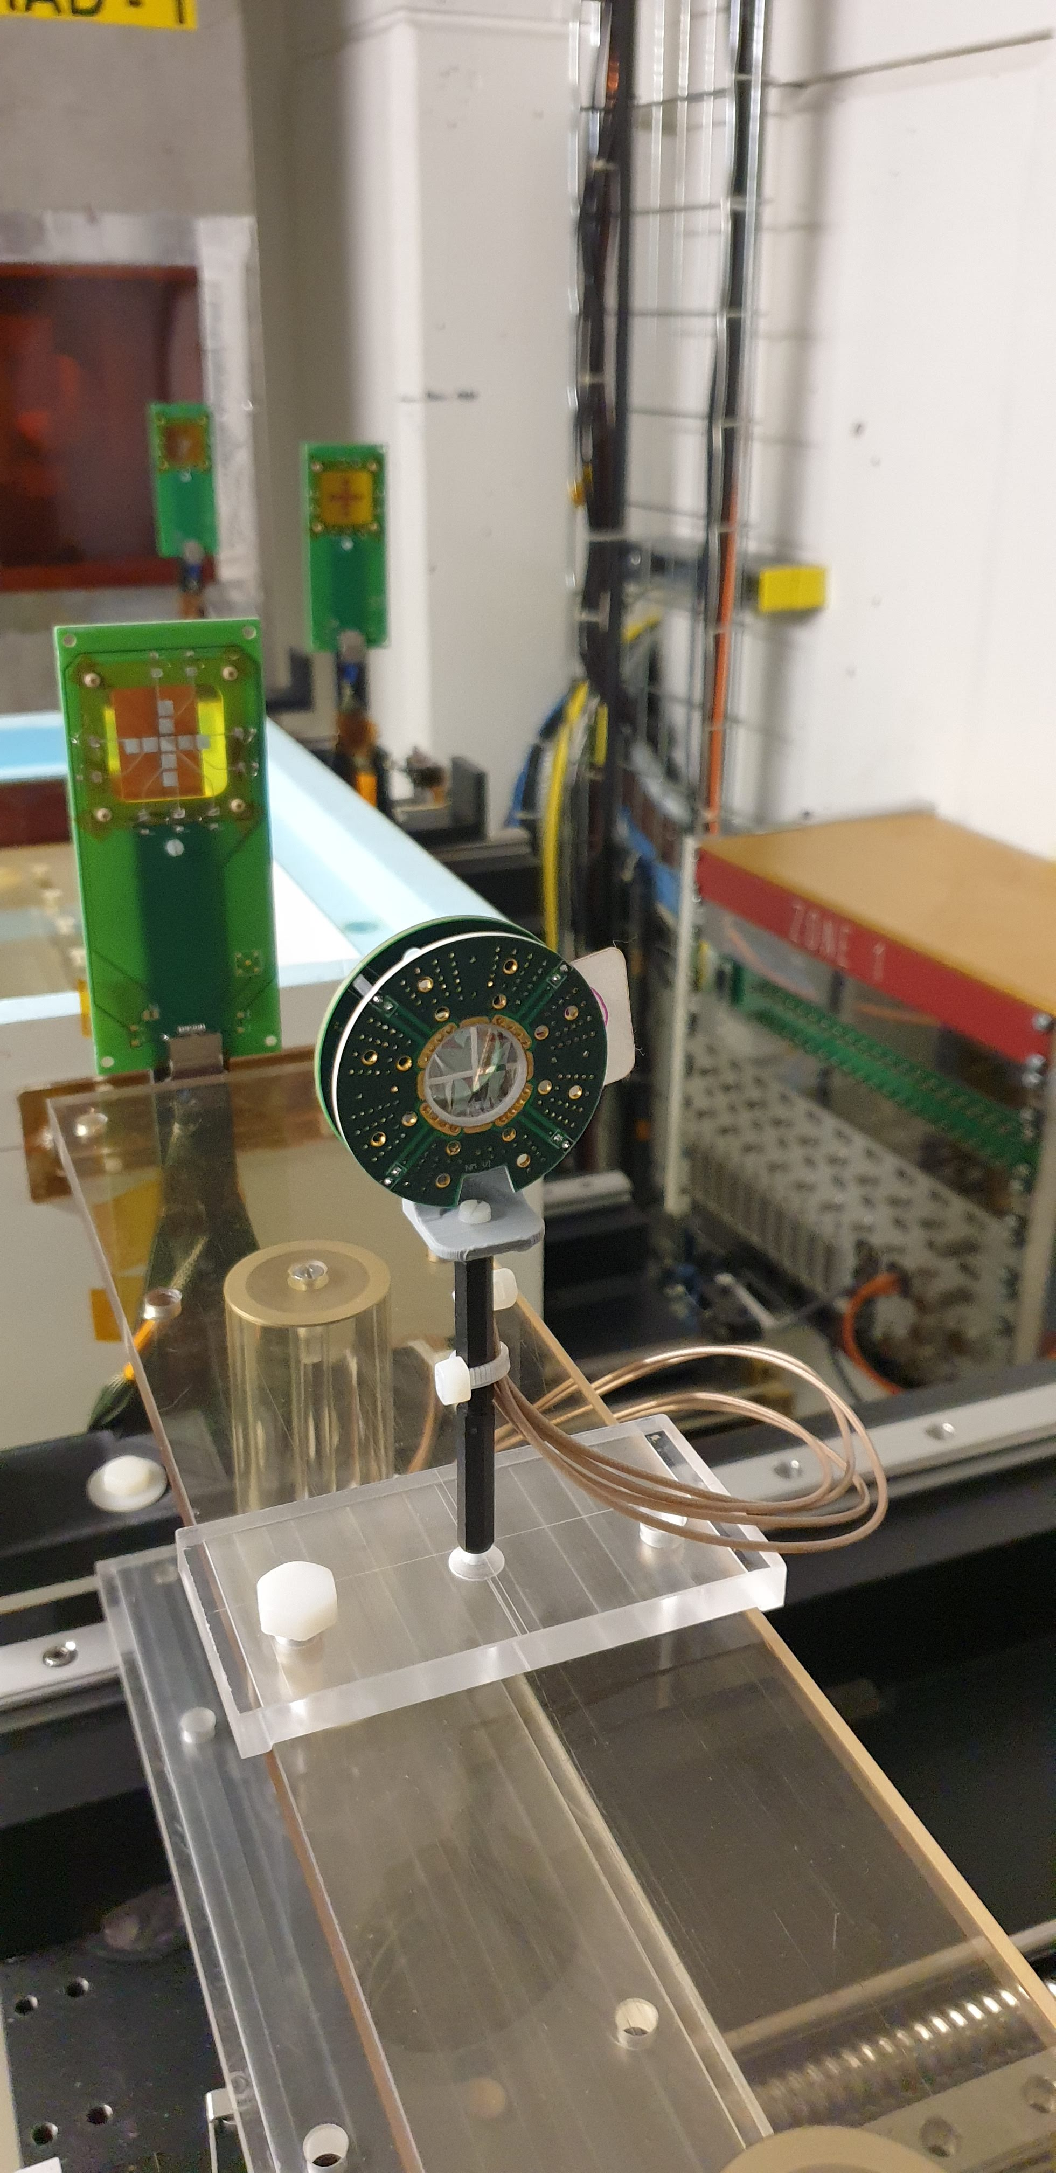
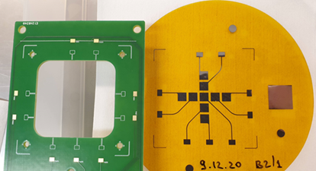

IRRAD Beam Profile Monitors Upgrade
  Innovative Beam Profile Monitors:
  new mini-BPM Al/Kapton (0.3/25μm) produced, tested in IRRAD, now operational
  large pattern micro-BPM Al/Kapton (0.2/25μm): first prototype tested, new production ongoing
40channel micro-BPM device
New mini-BPMs

Slide 15
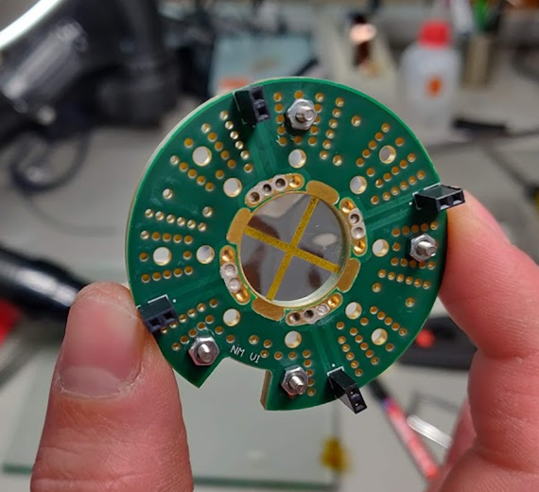



Ultra Thin Beam Position Monitors
  Support the development of nano-BPM for AD Al/Parylene (10/100nm) for keV range
mini-BPM
mini-BPM
nano-BPM
nano-BPM
See N. Minafra’ s presentation on Wednesday
© N. Minafra, M. Doser, R. Caravita
IRRAD Experiment

Slide 16
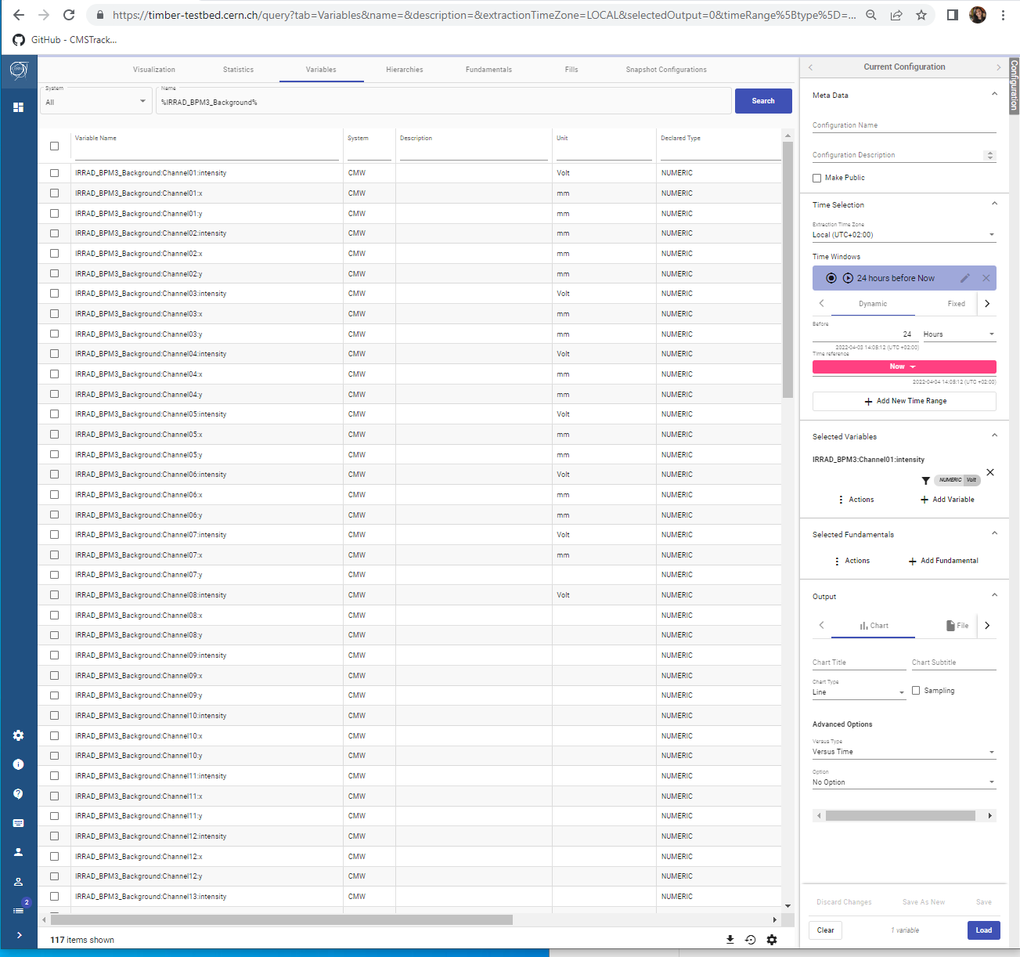
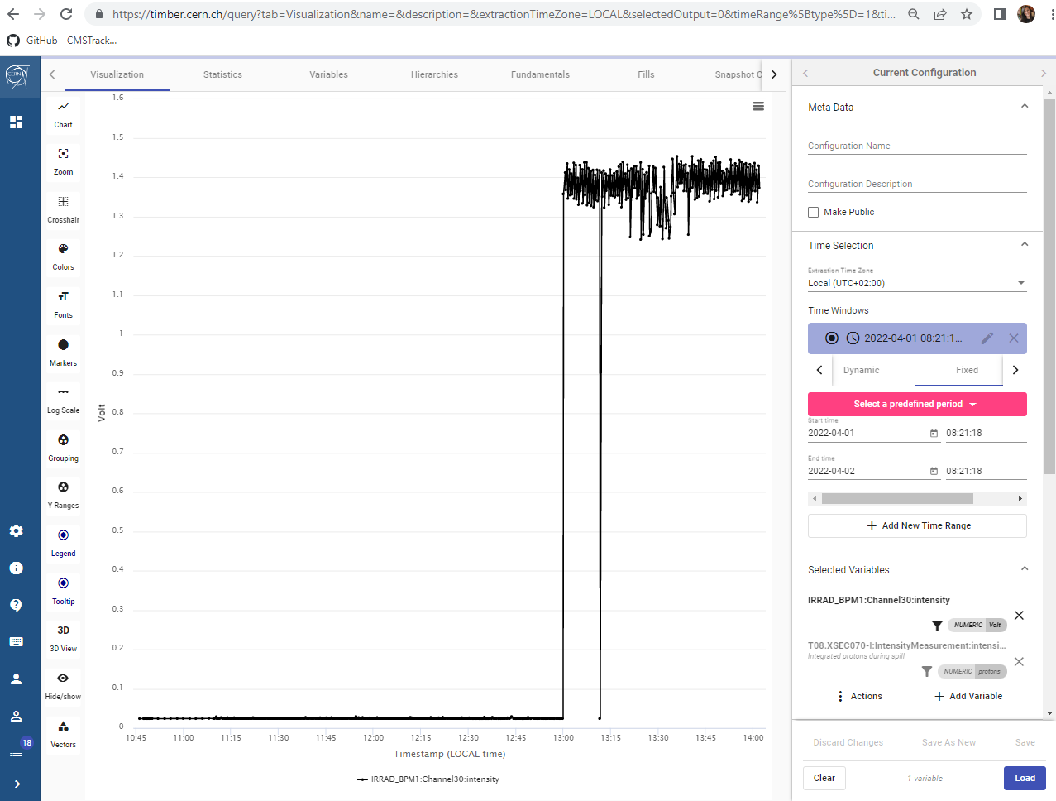
BPM Software Architecture Upgrade
Beam Profile Monitor (BPM) data:
logged in NXCALS (CERN Logging System)
published in Timber in real-time (https://timber.cern.ch – accessible only from CERN)
Allowing for further beam corrections by CERN Control Center (CCC)

Slide 17
Outline
CERN Irradiation Facilities and Long Shutdown 2 (LS2) Upgrades
IRRAD Upgrades:
  T8 Beam Instrumentation
  Technical Area
  IRRAD Software and Hardware Infrastructure
Beam Commissioning and IRRAD runs 2021-22
European Projects associated to IRRAD
Summary

Slide 18
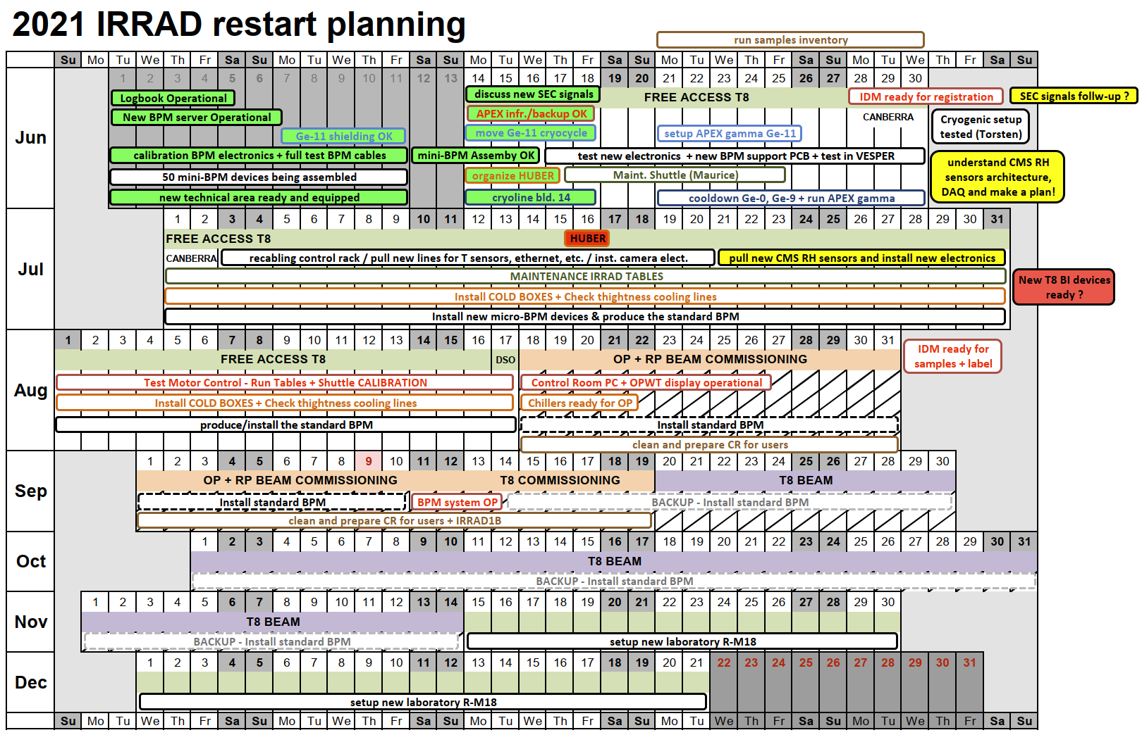

IRRAD Restart
Complete LS2 activities
Commission new Beam Instrumentation
Update Safety Docs, Safety Trainings
(https://ps-irrad.web.cern.ch/ps-irrad/safety.php )
Define COVID procedures and install air recirculation systems control rooms
New IRRAD e-log from BE-OP
Restoring BI signals to IRRAD
…
Mandatory Safety Training

Slide 19
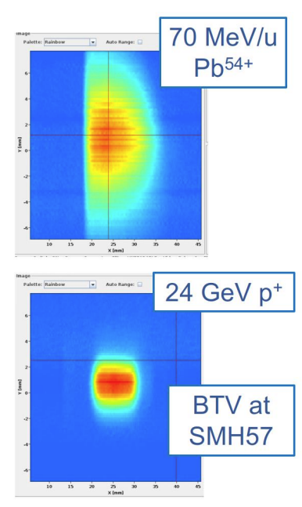
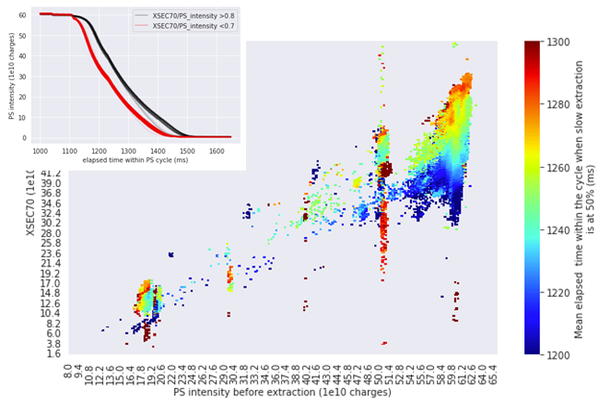
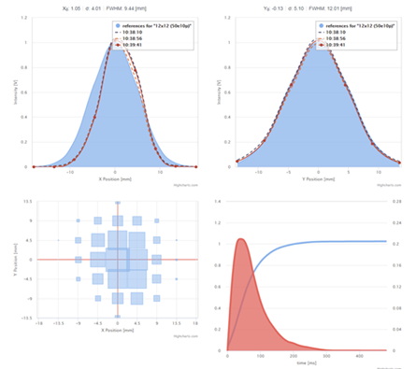
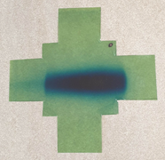
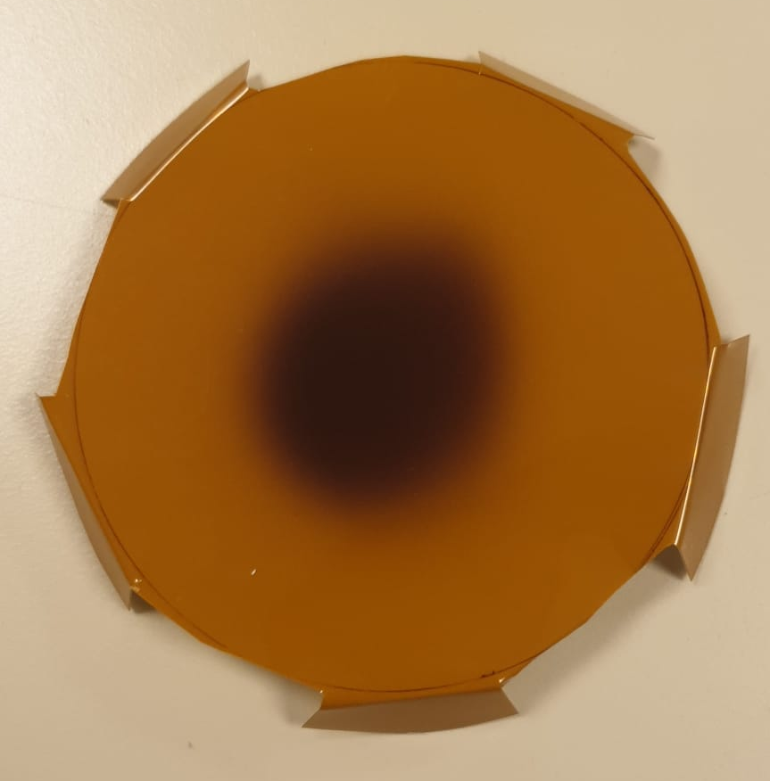
Beam Commissioning 2021
INTENSITY TRANSMISSION STUDIES
T08 BEAM
PROFILES
© M. Fraser (25/10)
Beam instrumentation commissioning & tests in collaboration with SY-BI
Optics studies to reduce the proton beam losses
High Energy Heavy Ion beam steered down T8 with several intensity flavours (CHIMERA) – 2 weeks of HI run Nov.-Dec. 2022

Slide 20
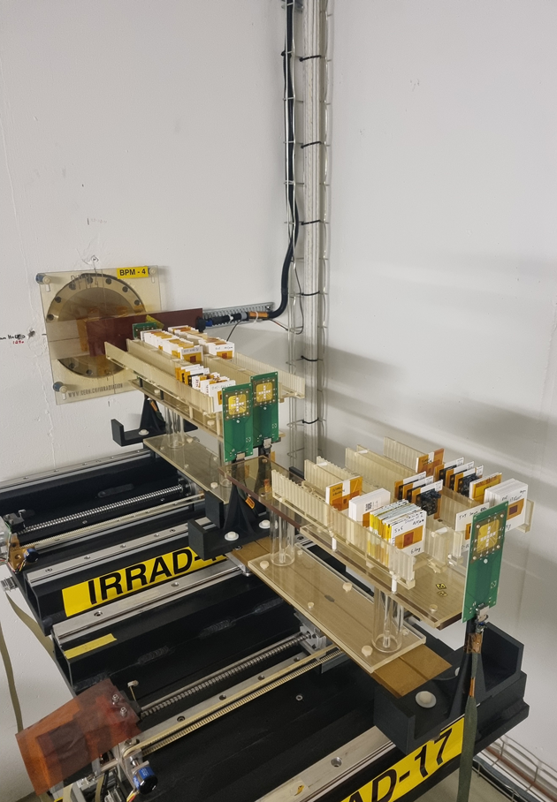
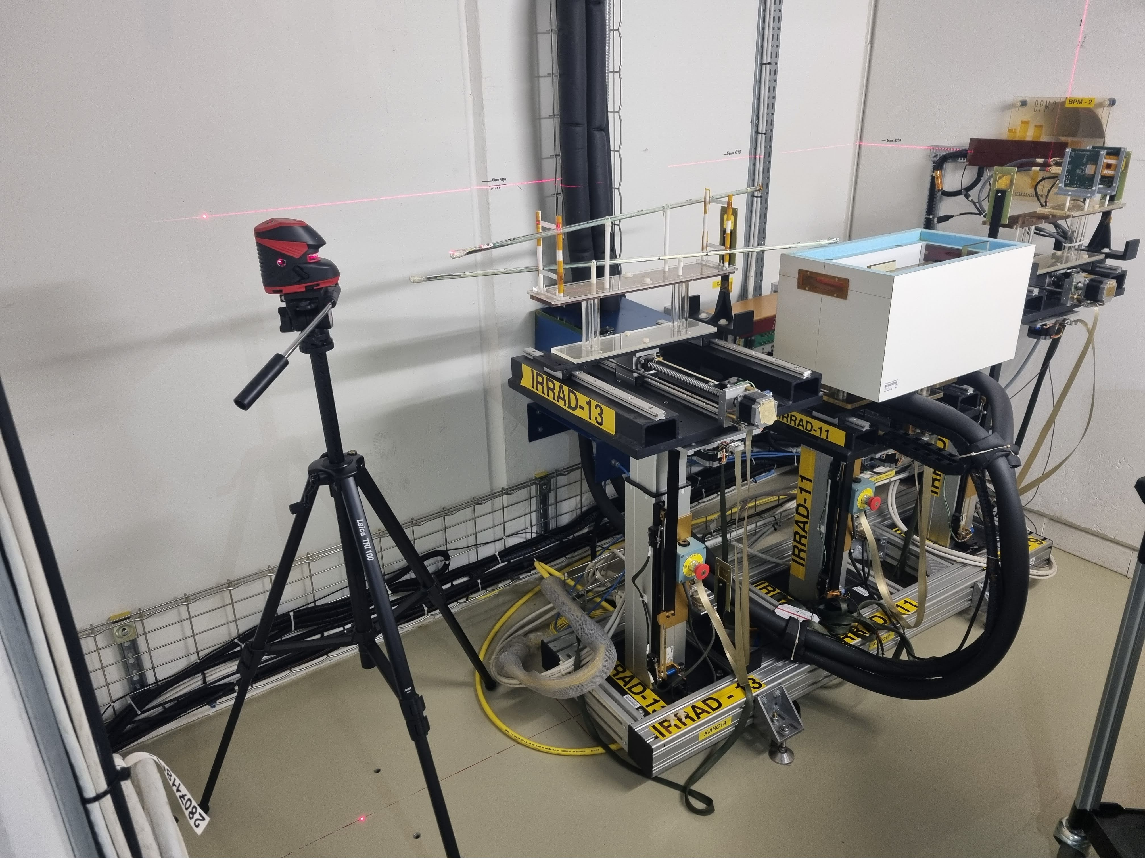
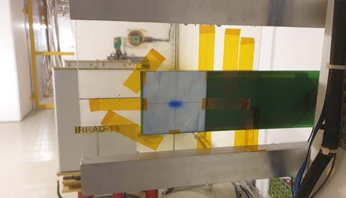
IRRAD User Run 2021
  8 weeks run
  18 experiments completed
  190 samples irradiated
  Priority was given to beam commissioning
Dosimetry & alignment verification measurements in IRRAD Zone 3
Samples installed in IRRAD Zone 2
Samples installed in IRRAD Zone 3

Slide 21
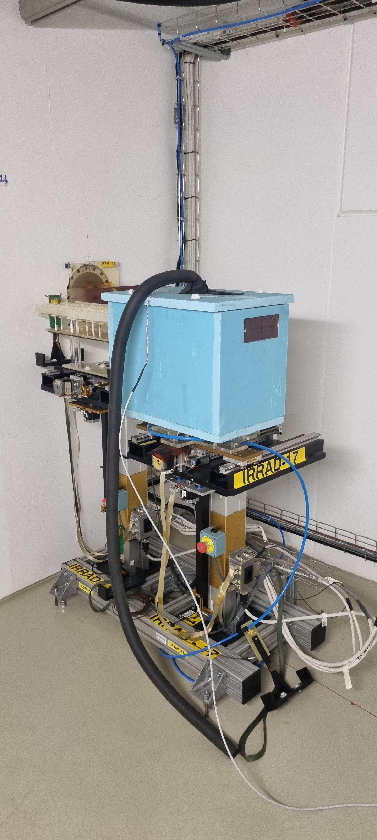
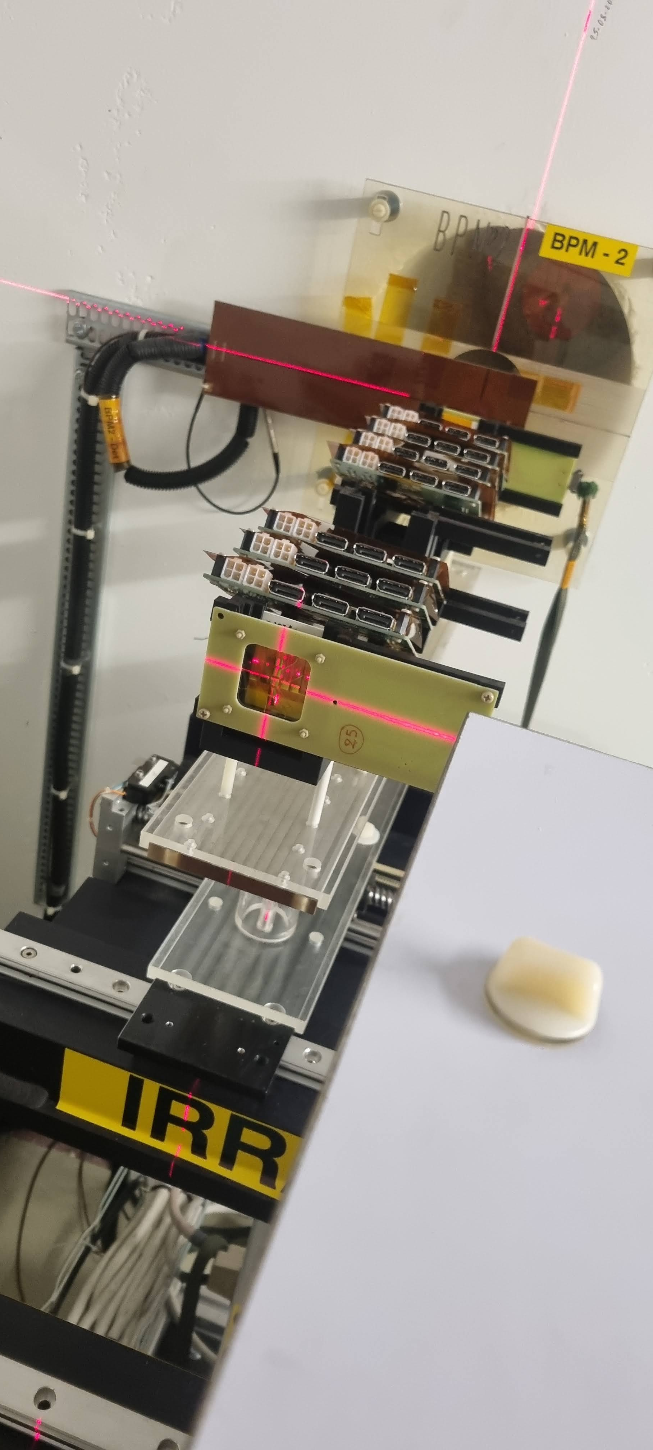
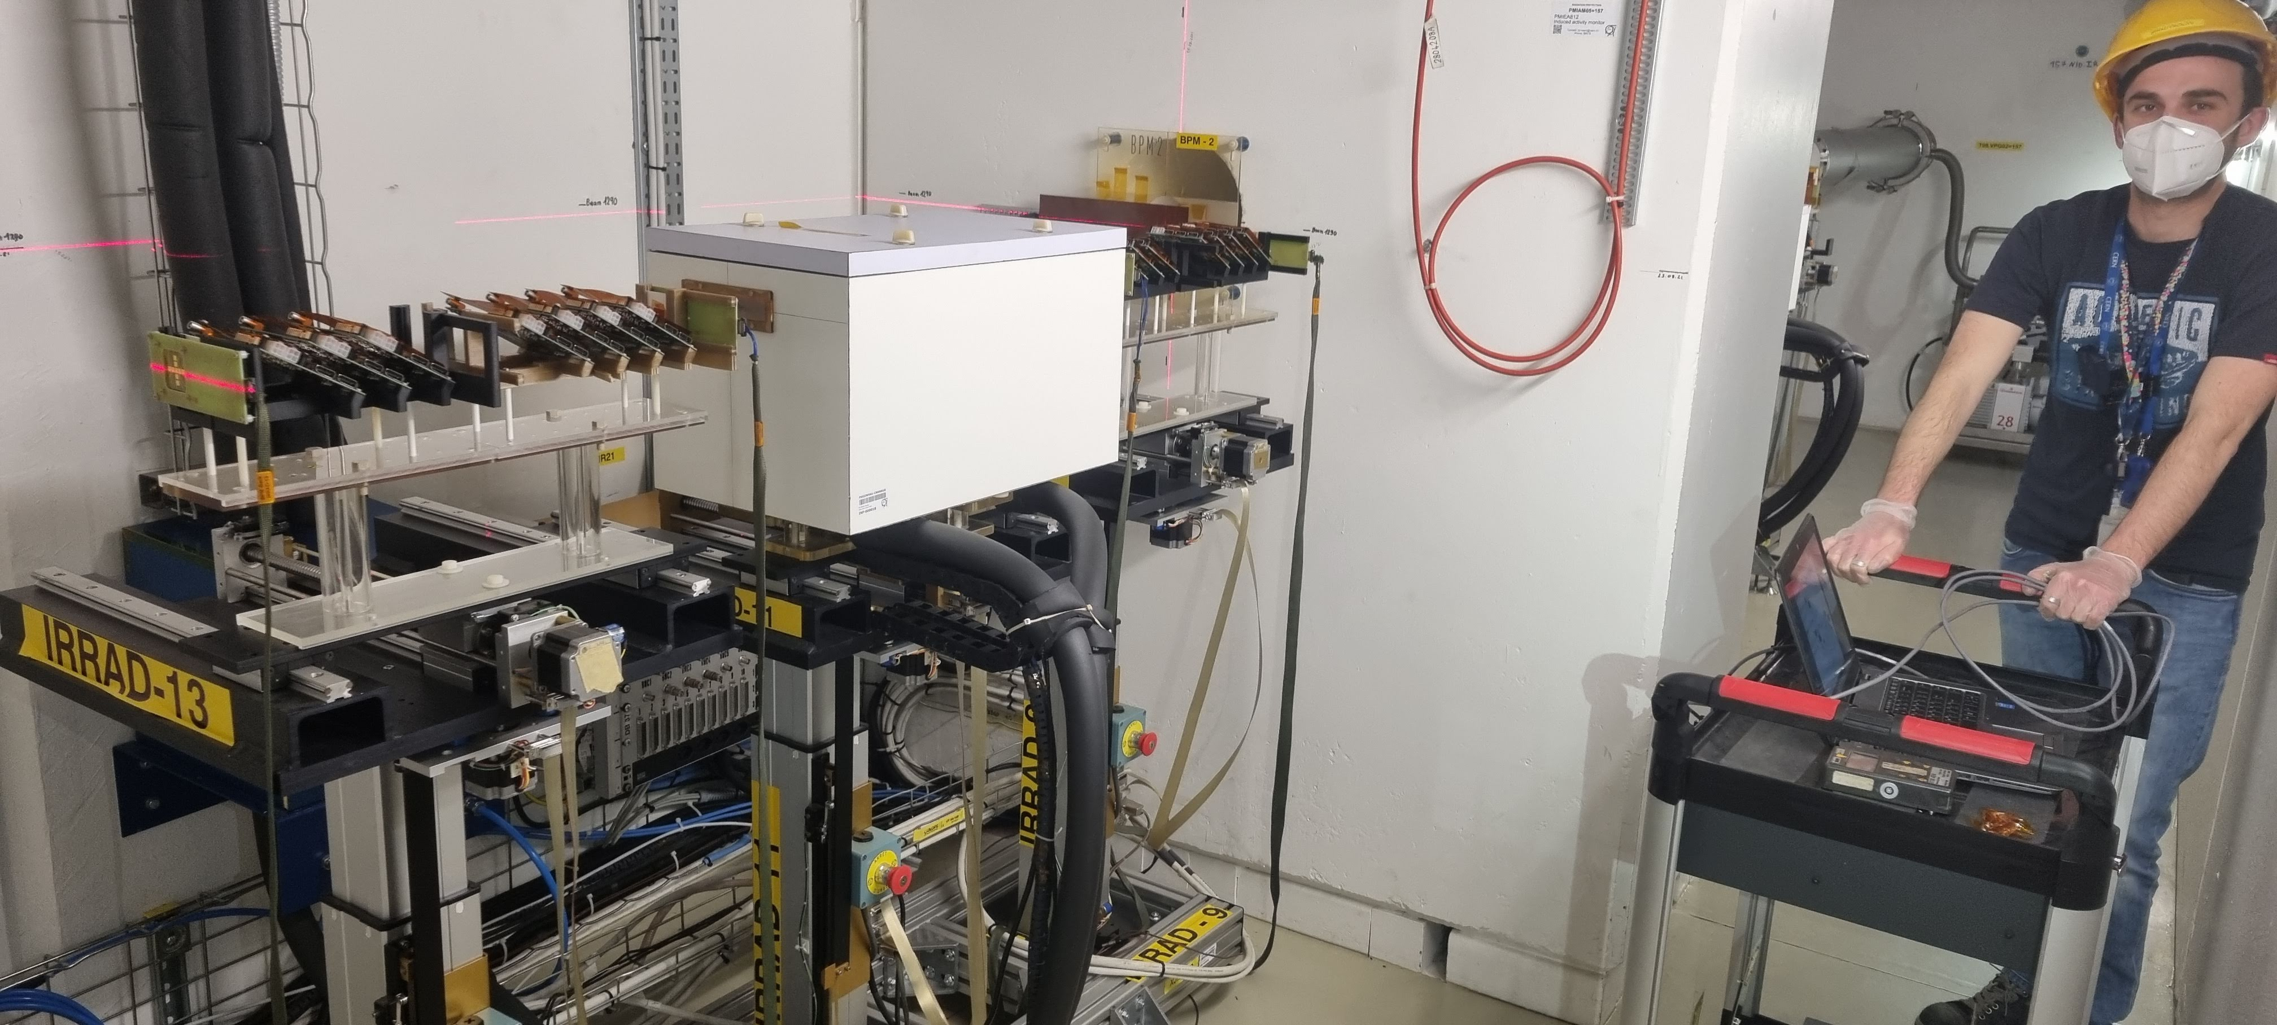
IRRAD Run 2022
From March to December
18 experiments registered in IDM, and more being discussed
  7 completed
  5 ongoing
  6 being prepared and scheduled
~300 samples registered in IDM
  231 being irradiated
IRRAD cold-box with VORTEX system for long-run experiments
IRRAD Zone 2 samples and micro-BPM2
IRRAD Zone 2 samples setup

Slide 22
Outline
CERN Irradiation Facilities and Long Shutdown 2 (LS2) Upgrades
IRRAD Upgrades:
  T8 Beam Instrumentation
  Technical Area
  IRRAD Software and Hardware Infrastructure
IRRAD Commissioning and Runs 2021-22
European Projects associated to IRRAD
Summary

Slide 23



European Projects Associated to IRRAD
Started April 2021
Started June 2021
To start September 2022

Slide 24

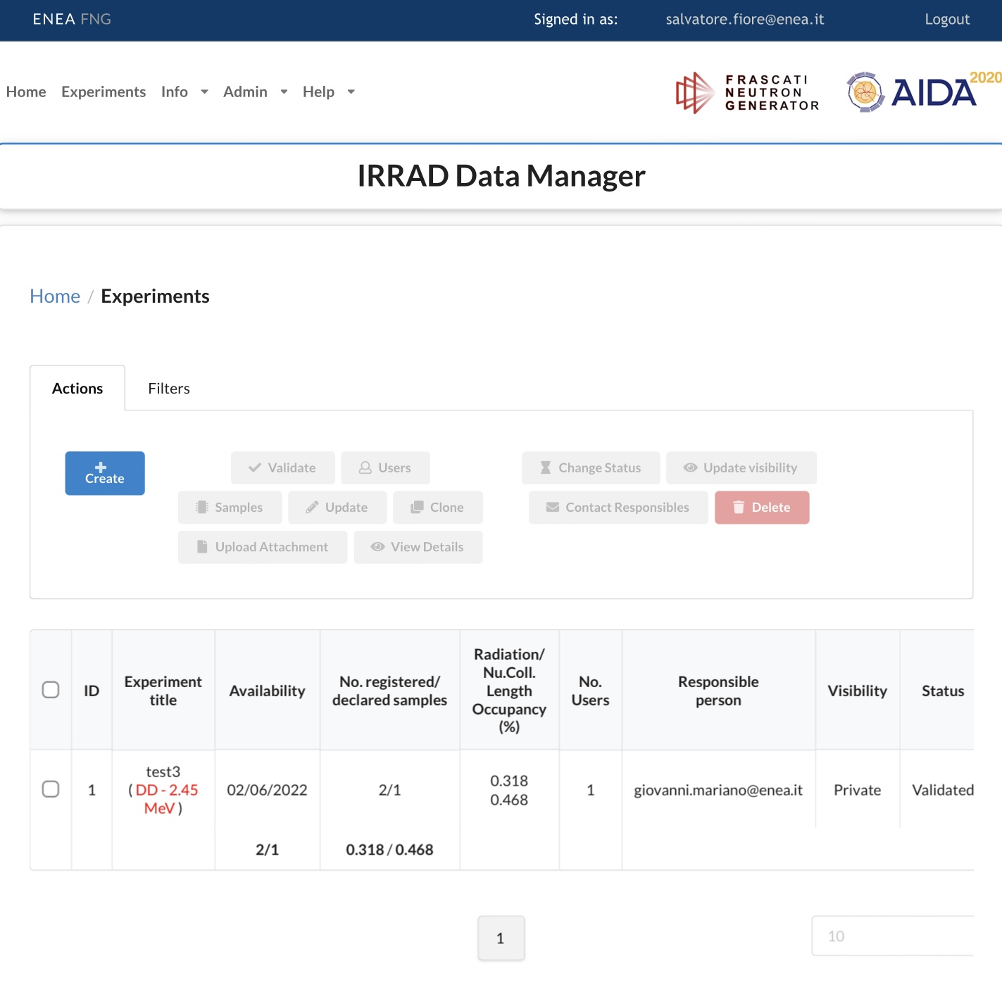
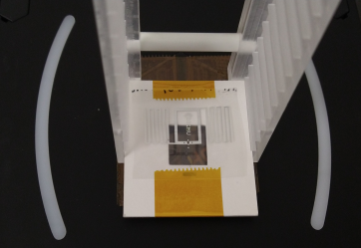
AIDAinnova
  Advancement and Innovation for Detectors at Accelerators
  Leading Task 4.3: Common tools for irradiation facilities quality control
  Generalisation of IRRAD Data Manager for ENEA-FNG and GIF⁺⁺
  Prototype of integrated system for induced activation and traceability data management
  Dosimetry calibration set for cross-comparison of irradiation facilities by evaluation of Non-Ionizing Energy Loss (NIEL)
RFID measurements after irradiation experiment
IRRAD Data Manager
IDM for ENEA-FNG

Slide 25

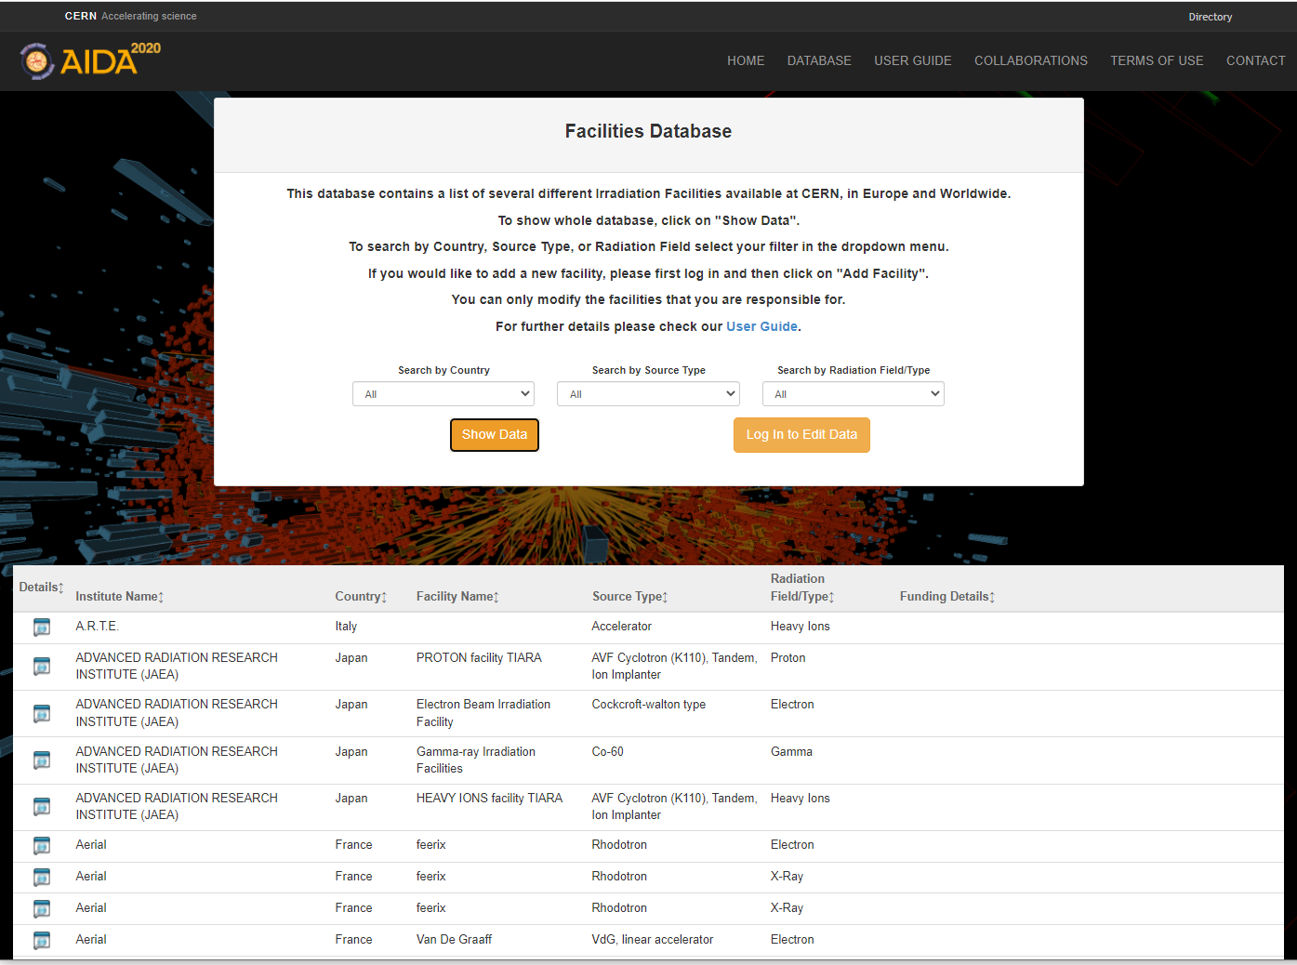
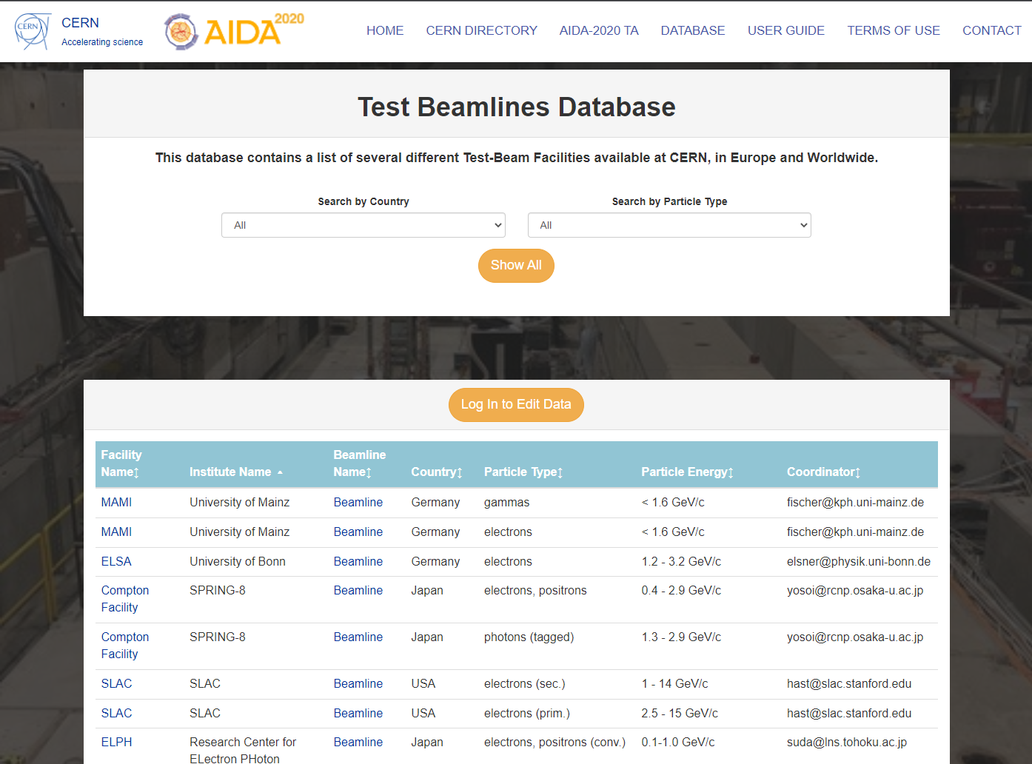
Irradiation and Test Beam Facilities DBs
Two separate but similar platforms for researching information about the test beam and irradiation facilities
Maintained by the facility coordinators
https://irradiation-facilities.web.cern.ch
https://test-beam-facilities.web.cern.ch/

Slide 26
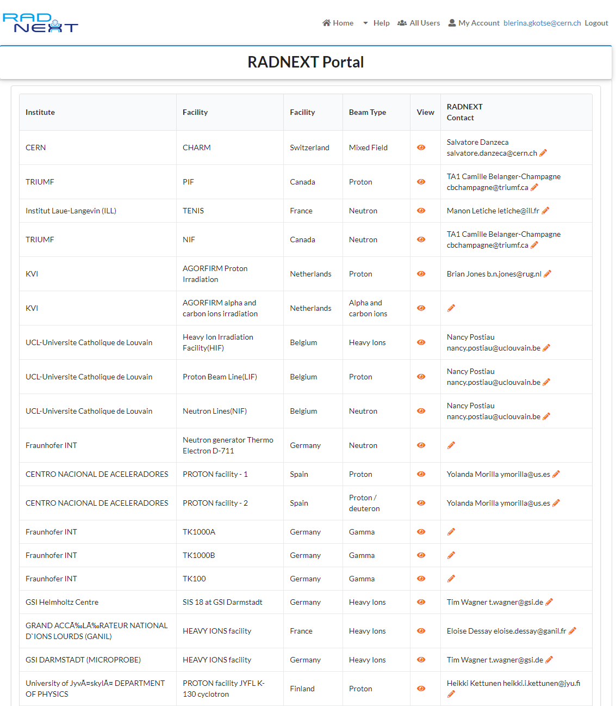
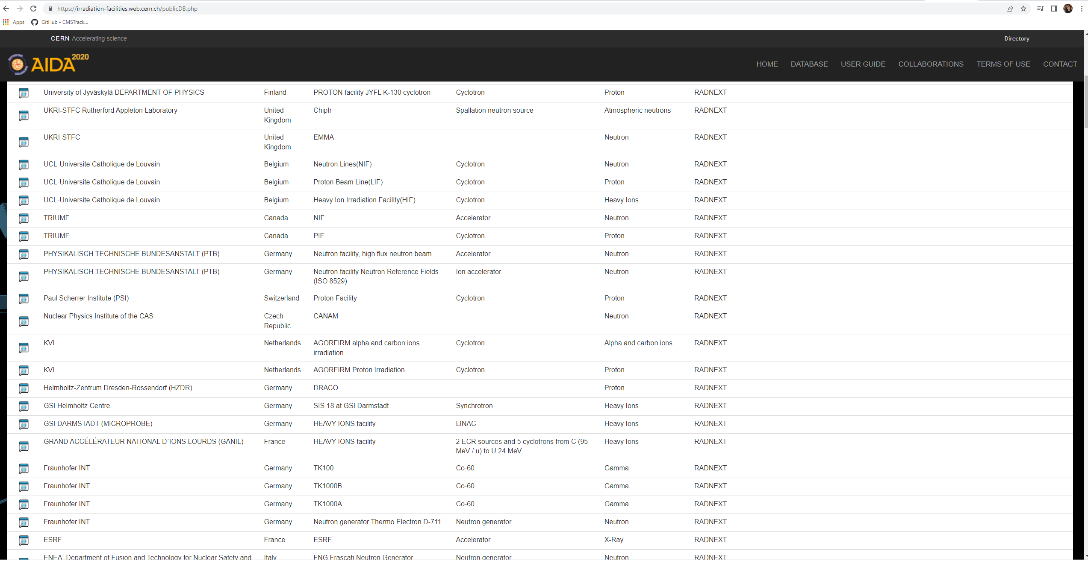
RADNEXT Facilities
Accessibility to irradiation facilities for research on radiation effects in electronics
A network of irradiation facilities
Transnational access to irradiation facilities
RADNEXT Facilities included in the irradiation facilities DB

Slide 27


RADNEXT Facilities and Transnational Access
Transnational Access provides beam time for experiments:
Calls open every 3 months (call currently open)
A dedicated web portal for proposal submission was developed
(https://radnext-ta-portal.web.cern.ch)
Beam time assigned after review of the proposals and facility availability
Irradiation Experiment Proposal form
Proposals’ view

Slide 28


EURO-LABS
A consortium of thirty-nine Research Infrastructures (RIs) from twelve countries in Europe
First joint EU proposal between Nuclear Physics, HEP accelerators and HEP detectors
Transnational Access to IRRAD and GIF++
Foreseen to start 1st September 2022
*Paolo Giacomelli https://indico.cern.ch/event/1104064/contributions/4797462/

Slide 29
Summary
T8 Beam Instrumentation and IRRAD Upgrades
Beam commissioning completed
IRRAD Run 2022 ongoing
Irradiation and Test Beam Facilities DBs fully functional and being kept updated in the best effort
New European projects and Transnational Access:
  RADNEXT network already available
  IRRAD and GIF++ available soon through EURO-LABS

Slide 30


