Slide 1
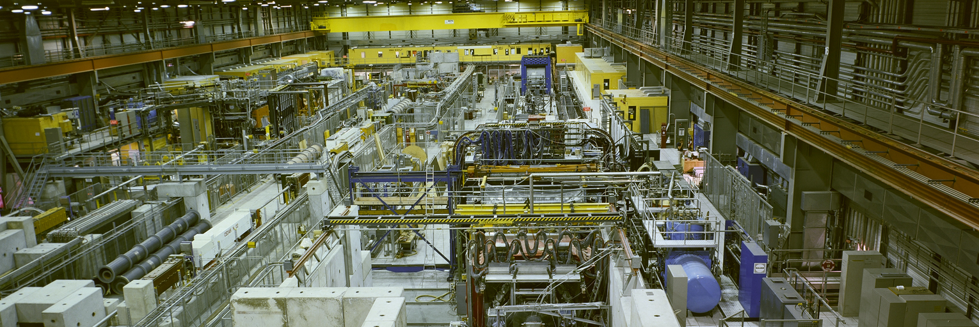

Beam Generation for Test Beams
Alexander Gerbershagen

Slide 2
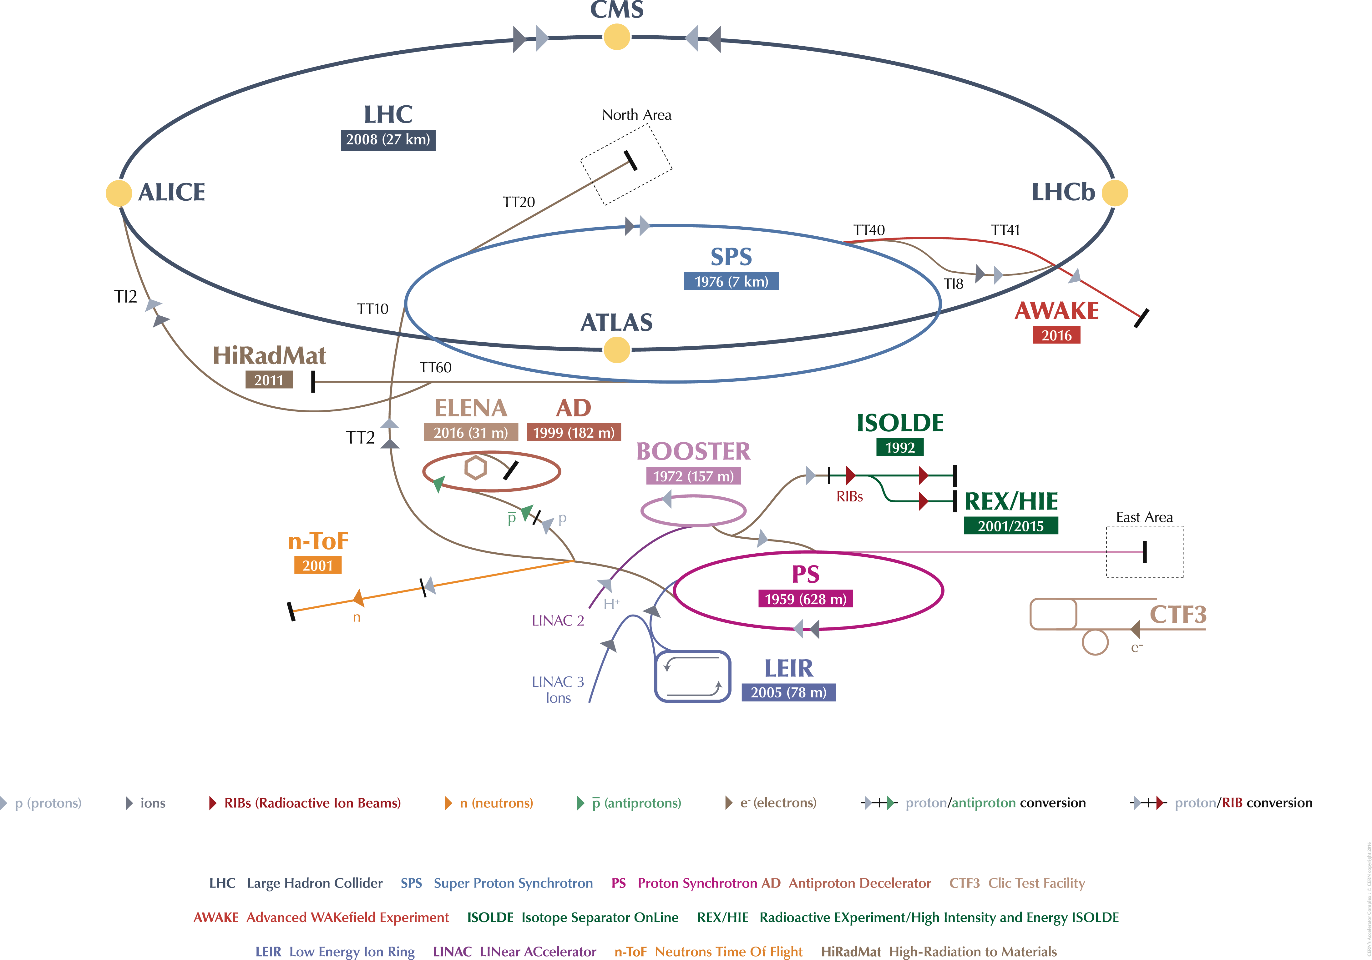
Overview
  Introduction: Purpose and users
  Examples of test beam facilities
  Targets and particle production
  Secondary/tertiary beam lines

Slide 3
Introduction: Purpose and Users

Slide 4
Purpose and Users
Secondary Beam Areas (SBA) are hosting:
FT experiments: COMPASS,NA61, NA62, NA63, NA64, CLOUD, …
  Precision studies (QCD, standard model, BSM physics)
  Stable beam conditions for weeks and weeks
Radiation facilities: PARTREC, HiRadMat, Charm, Irrad, GIF++
Test beams:
  Detector prototype tests
  Detector calibration
  e.g. for LHC, linear colliders, space & balloon experiments
  Outreach
  Usually require a large spectrum of beam conditions within few days

Slide 5
Examples of test beam facilities

Slide 6
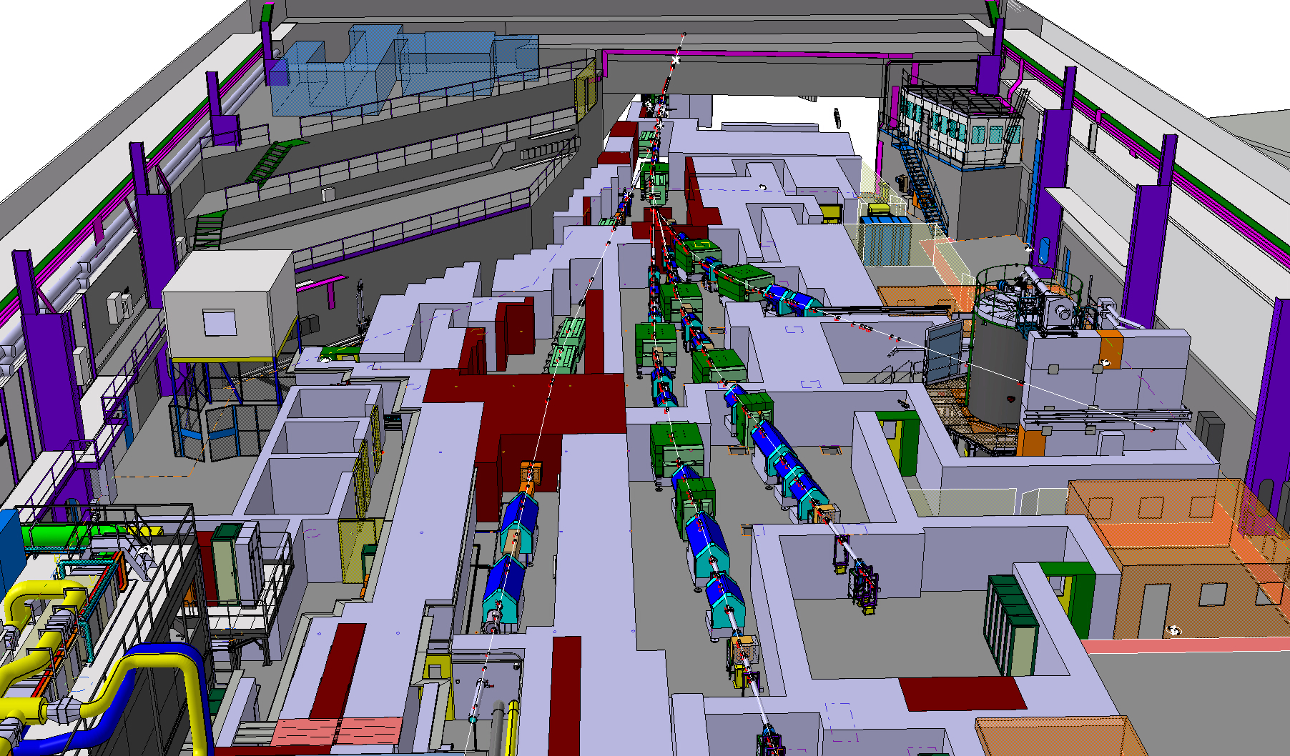
East Area – after renovation

Slide 7
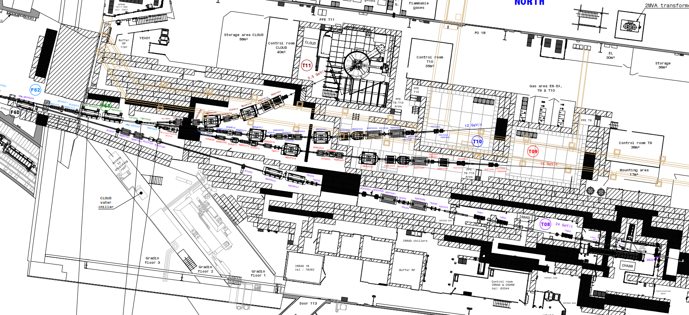
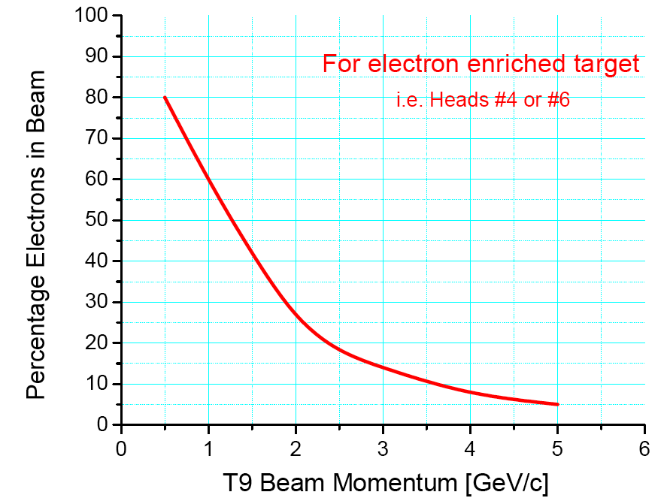

East Area
Area under renovation
-> See presentation by E. Montbarbon/J. Bernhard
Test Beams after LS2
Secondary beams:
  T9: < 0.5 GeV/c – 15 GeV/c
  T10: < 0.5 GeV/c – 12 GeV/c
  Horizontal momentum selection
Particle types and intensity
  Pure electrons, hadrons, muons
  Max. ~5·10⁶ particles per spill
Spill structure from PS
  400ms spill length
  Typically 1 spill every 18s (15bp), more on request
telescope AZALEA in T10
Quick access from control room to experimental area
(< 1 minute)
Short cables
T11
T10
T9
CHARM
IRRAD

Slide 8
CERN North Area Beamlines
NA61
H2
T2
NA64
H4
T2 wobbling
H6
T4
H8
T4 wobbling
P42
K12
T10
NA62
T6
P6
COMPASS
M2

Slide 9
North Area beamlines characteristics
Primary mode Secondary mode
Parameters | T2 |  | T4
Beam Line | H2 | H4 | H6 | H8
Maximum Momentum [GeV/c] | 400 / 360 | 400 / 330 | - / 205 | 400 / 360
Maximum Acceptance [µSr] | 1.5 | 1.5 | 2 | 2.5
Maximum Δp/p [%] | ± 2.0% | ± 1.4 % | ±1.5% | ±1.5%
Maximum Intensity / spill * (Hadrons / Electrons) | 10⁷/10⁵ | 10⁷/10⁶ | 10^{7 **}/10⁵ | 10^{7 **}/10⁵
Available Particle Types | Primary protons*** OR pure electrons OR mixed hadrons (pions, protons,kaons)
Other / Special requests | sba-physicists@cern.ch & sps.coordinator@cern.ch
* Imposed by Radio Protection, and not available to every zone
** In some zones can be elevated up to 10⁸ subject to certain restrictions
*** Not available in H6
Nota Bene : The particle momenta in H2/H4 and in H6/H8 are coupled. Send your beam request and discuss in advance with the SPS coordinator and the responsible liaison physicists.

Slide 10
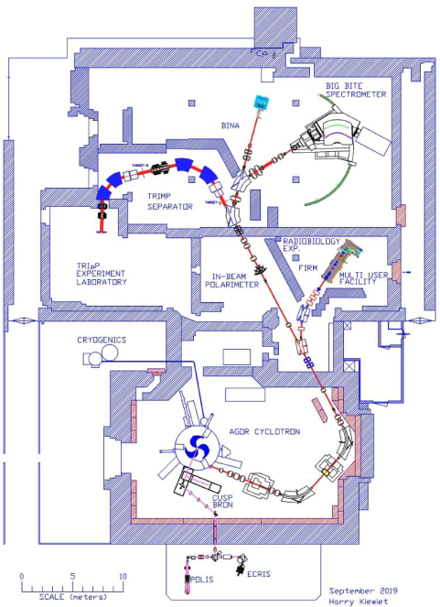
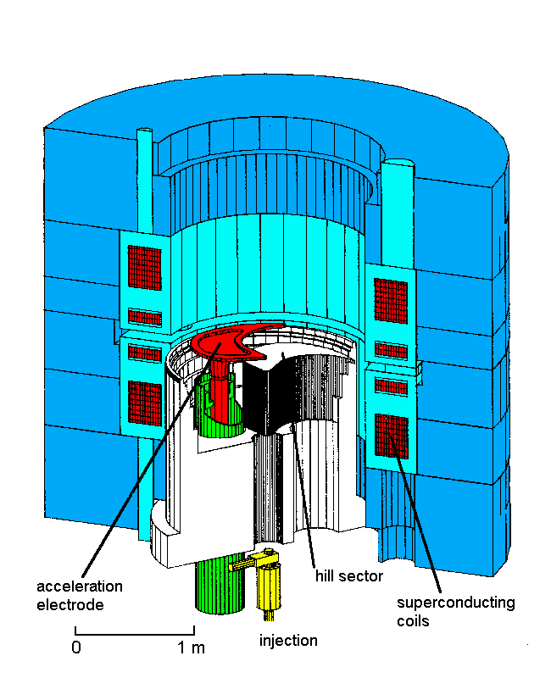
PARTREC – Accelerator and Facility
Superconducting AGOR cyclotron is a multi-particle, variable energy AVF-cyclotron
Operational since 1996
3 halfwave RF cavities, 24 - 62 MHz; h = 2, 3 or 4
Three external ion sources (two ECR sources for heavy ions, multi-cusp source for light ions) are axially injected
Extraction
  300 - 500 turns depending on harmonic mode
  extraction radius 870 - 890 mm depending on E/A
  turn separation at extraction 2 - 3 mm ~ beamwidth

Slide 11
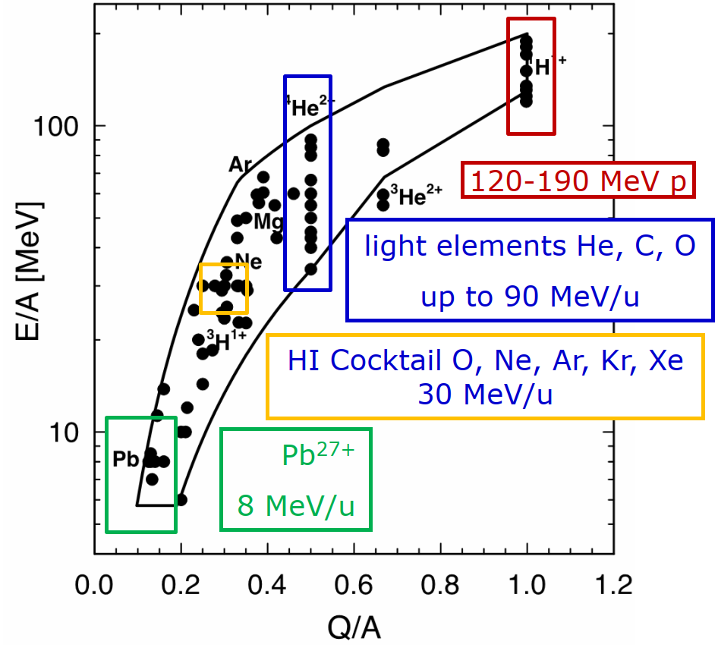
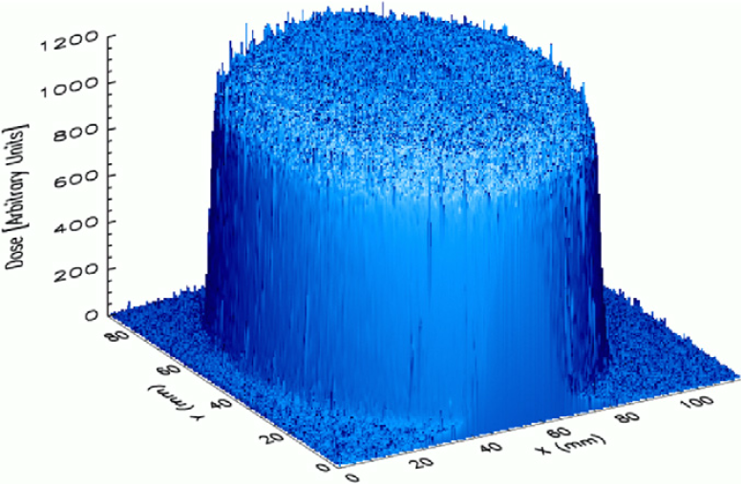
PARTREC – Beam Delivery
AGOR can deliver beams of all elements up to Xe
 | Protons | Ions
Kinetic energy (MeV/amu) | ≤ 190 | ≤ 90 for C and O ≤ 30 for all up to Xe
Attainable flux (particles per s) | > 10¹³ | ≤ 10¹³ for Ne ≤ 10¹¹ for heavier ions
Field size (cm²) | ≤ 10 x 10 (scanned beam) ≤ 8 x 8 (scattered beam) | ≤ 7 x 7 for light ions (scanned beam) ≤ 3 x 3 for heavy ions (scanned beam)
Field homogeneity | ± 2 % (scattered beam) ± 1 % (scanned beam) | ± 2 % (scattered beam) ± 1 % (scanned beam)
Beam requests: irradiations.partrec@umcg.nl

Slide 12
Targets and particle production

Slide 13
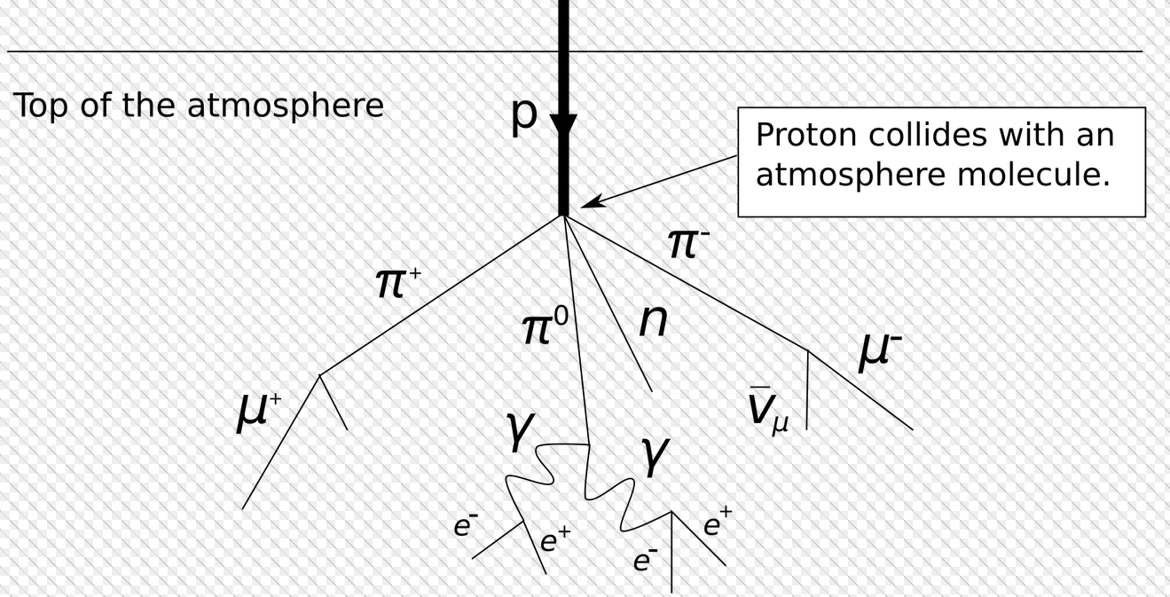
Targets and particle production
Principle taken from cosmic radiation
  Primary proton beam initiating hadronic cascade
  Always followed by an electro-magnetic cascade

Slide 14
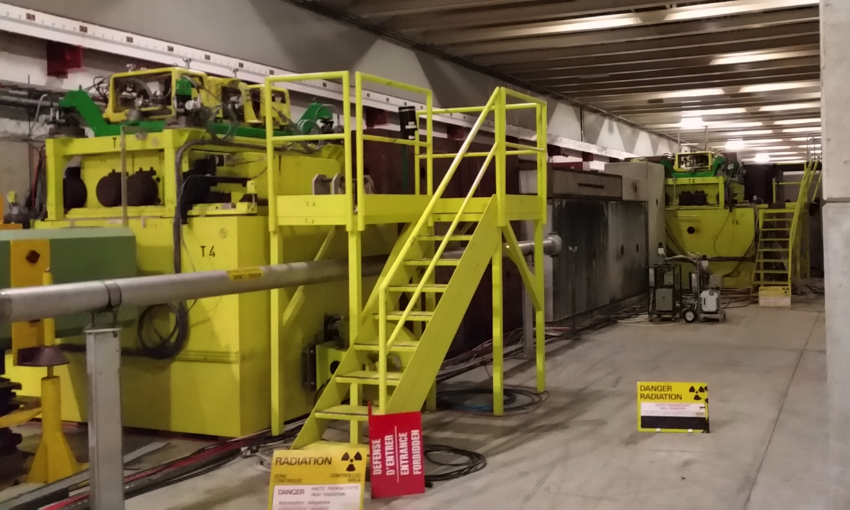
Targets and particle production
Principle taken from cosmic radiation
Particles are produced in a large momentum range
SPS beam

Slide 15
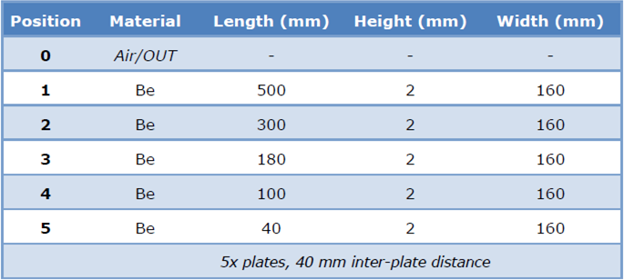
Target length and production rates
Beryllium has
  radiation length X₀ = 35.3 cm,
  nuclear interaction length λ_{I} = 42.1 cm,
    => high X₀/λ_{I} ratio
  low density (1.848 g/cm³)
  high melting point (1560 K)
The e/π ratio increases approx. linearly with the target length
Hadrons
  are produced via p + N -> hadron (rate ~ L)
  reabsorbed (rate ~ e^{-L})
  => Overall rate ~ Le^{-L} (maximum at L≈ λ_{I})
Electrons are mainly produced via
  p + N -> π⁰ -> γ γ (rate ~ L)
  γ converts to e⁺ + e⁻ (rate also ~ L)
  reabsorbed (rate ~ e^{-L})
  => Overall rate ~ L² e^{-L} (maximum at L ≈ 2λ_{I})
  L²e^{-L}
  Le^{-L}
  Production rate
  Length of beam propagation in material (L)

Slide 16
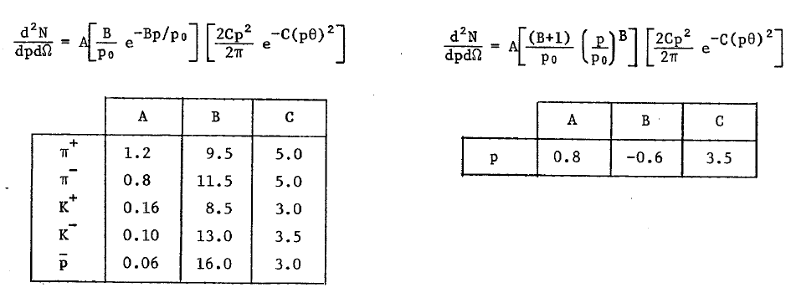
Targets and hadron production
Atherton parameterisation (CERN 80-07):
with primary momentum p₀ and production angle θ
Flux per solid angle [steradian], per interacting proton, and per dp [GeV/c]
θ = 0 mrad
Note: Valid for primary interactions only! Extrapolation for momenta below 60 GeV/c

Slide 17
Secondary / tertiary beam lines

Slide 18
Beamlines
Experiments and test beams require “clean” beams with high purity (one particle type) and small momentum spread
Beam lines design (“optics”)
  Collect produced particles from target
  Select momentum
  Select particle type
  Transport beam to experiment
  Select beam spot size for experiment

Slide 19
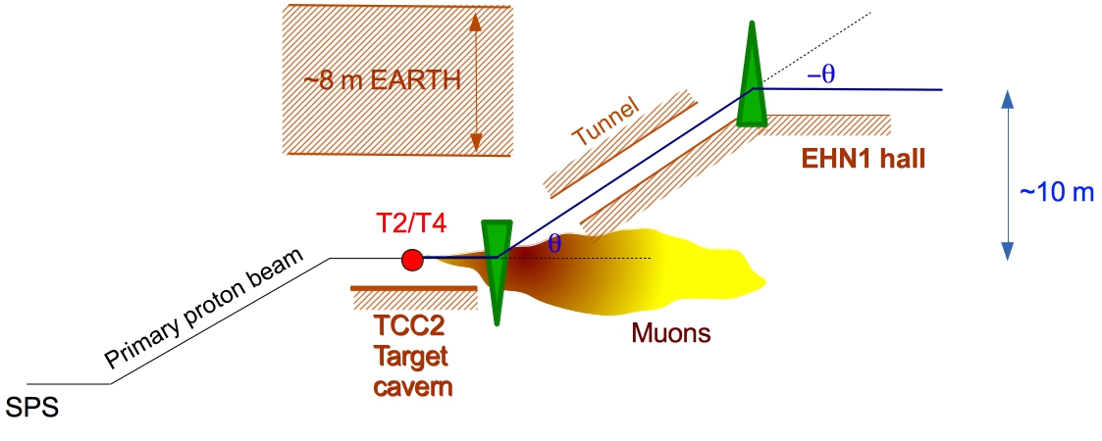
NA beamline design considerations
NA beams were originally (end of 1970’s) designed for the fixed target experiments. Design considerations were
    Muon range (absorb underground)
    Charged pion lifetime
    Momentum selection (2∙10⁻⁴)

Slide 20
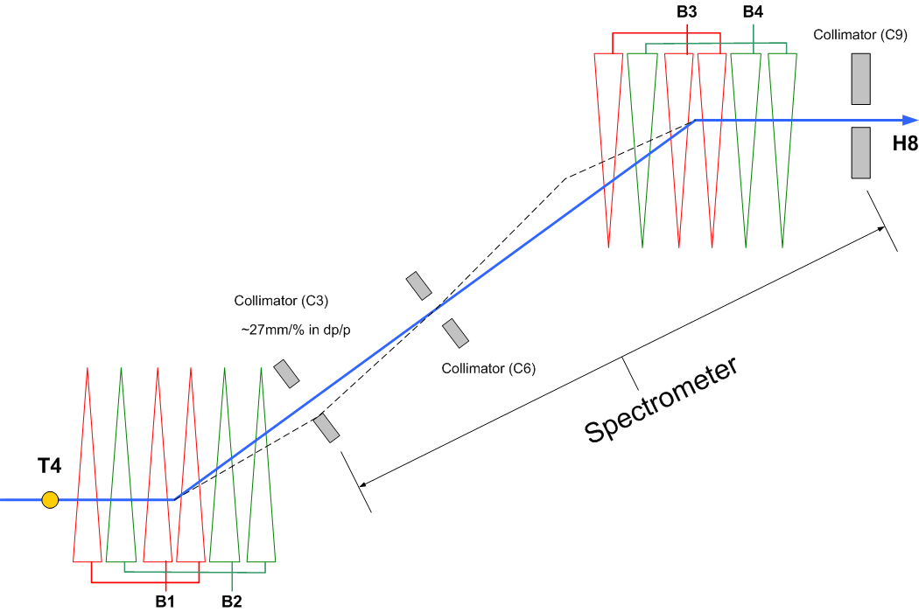
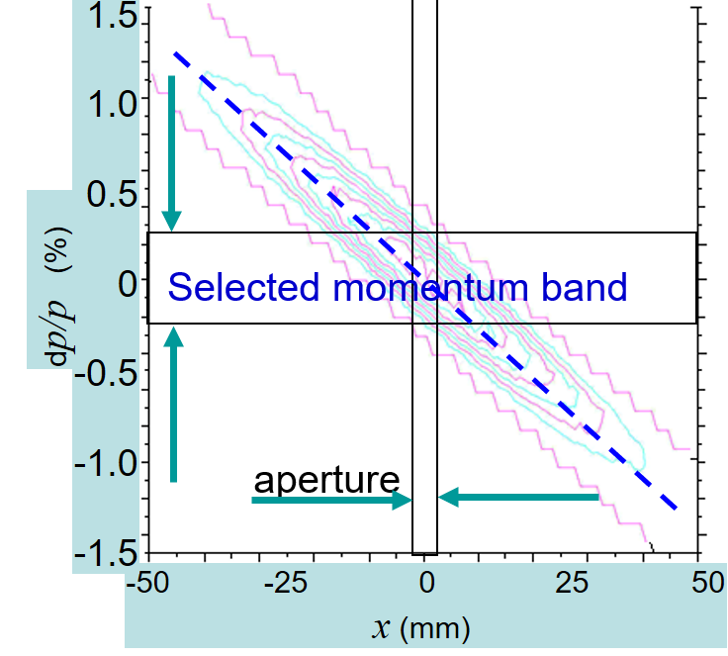
NA secondary beamline - layout
Basic beam design
momentum selection in the vertical plane
two sets of bending magnets
  Upstream BENDs
    Between the primary target and
    the momentum slit
    Vertical focus of monochromatic beam
    at the momentum slit
  Downstream BENDs
    the main spectrometer for the beam momentum definition

Slide 21
Secondary beamline - collimators
  TAX (Target attenuator)
    Define initial acceptance of the beam line
  Acceptance collimators
  Cleaning collimators
    Absorb secondary particles produced on the jaws of acceptance collimators
Acceptance predefined by TAX
Cleaning
collimator
Acceptance collimator

Slide 22
Secondary beamline - intensities
Basic beam design
Selection of particle types
Intensities
Primary
Target (Be)
Secondary
Target
Absorber
(few mm Pb)
Primary beam
400 GeV/c p
Few 10¹² ppp
Secondary beam
Mixed (e+h+μ)
Typically ~100 GeV/c
Flux ~ 10⁷ ppp
Tertiary beam
Typically 10-80 GeV/c
Flux up to 10⁴ ppp, e.g.
Tertiary beam
Pure hadrons
~4 mm Pb: 1X_{o}, <<1 λ_{I}: ‘pure’ electrons
~40 cm Cu: 3 λ_{I}, ~30 X_{o}: hadrons
x . 10¹² ppp
< 10⁸ ppp
< 10⁴ ppp

Slide 23
Selection of particle type - Converter
Collimator
Hadrons, muons, electrons
Electrons from γ conversion
or hadrons from K⁰ or Λ-decay
- polarity
Converter
Primary Target
Protons
Collimator
Primary
protons
+ polarity
Neutral beam
Electrons
or hadrons
Experiment
Where to find at CERN:
North Area: H2, H4
East Area: T9 (starting 2021)

Slide 24
Selection of particle type - Absorber
Primary Target
Absorber
(e.g. 6 mm Pb)
Primary
protons
Large energy loss for electrons, very little for hadrons and muons
Hadrons, muons, electrons
e+
Both bends set to the same beam momentum
Collimator
e-
Hadrons, muons
Where to find at CERN:
North Area: H2, H4, H6, H8
East Area: T9, T10 (starting 2021)
Experiment

Slide 25
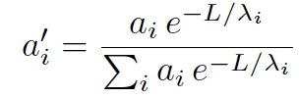
Selection of particle type - Filter
Differential absorption:
Beam through filter
Enrichment = single particle attenuation a_{i} over total beam attenuation
Example: +300 GeV/c beam filtered with 3m polyethylene
Initial flux 5∙10⁸ particles
Drawbacks:
  Small suppression factor for unwanted particles
  Big losses with low efficiency
Particles | % initial beam | % filtered beam | Flux
Protons | 92.5 | 73.4 | 7.9 10⁶
Pions | 5.8 | 19.1 | 2.1 10⁶
Kaons | 1.7 | 7.5 | 8 10⁵

Slide 26
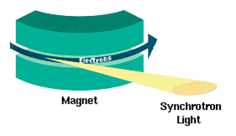
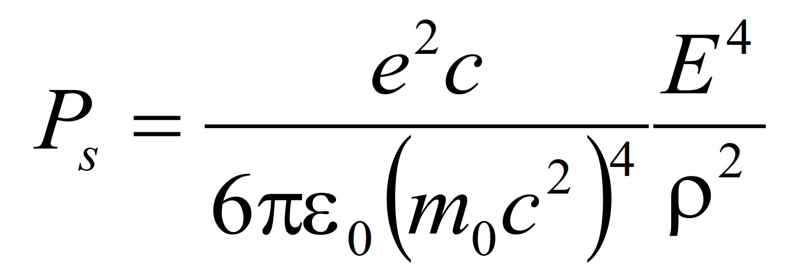
High-energy electron beams
Synchrotron radiation
(for one full revolution)
E.g. e± at 200 GeV lose in 1° bending magnet of 1 T field 590 MeV
  => With beamline momentum acceptance of Δp/p < 0.3 % it is possible to separate them from (heavier) hadrons and muons.
  So set up the following bends either
    at the constant energy to select heavier particles or
    scale it with energy loss of electrons.
    Works only for p_{e} > 120-150 GeV/c

Slide 27
Selection of particle type - Radiator
Radiator
(e.g. 1 mm Pb, Cu, W)
Experiment
Photons
Secondary
electrons (e)
Electrons (e’),
p1
Electrons
p2 < p1
p3 < p2
Photons are created
via Bremsstrahlung
Profile monitor
Time resolution - electron by electron
Transverse position gives information on e- momentum
pγ = pe – pe’
Result : tagged photon beam
Where to find at CERN:
(Ad hoc installation, but usually used at)
North Area: H2, H4
East Area: T9

Slide 28
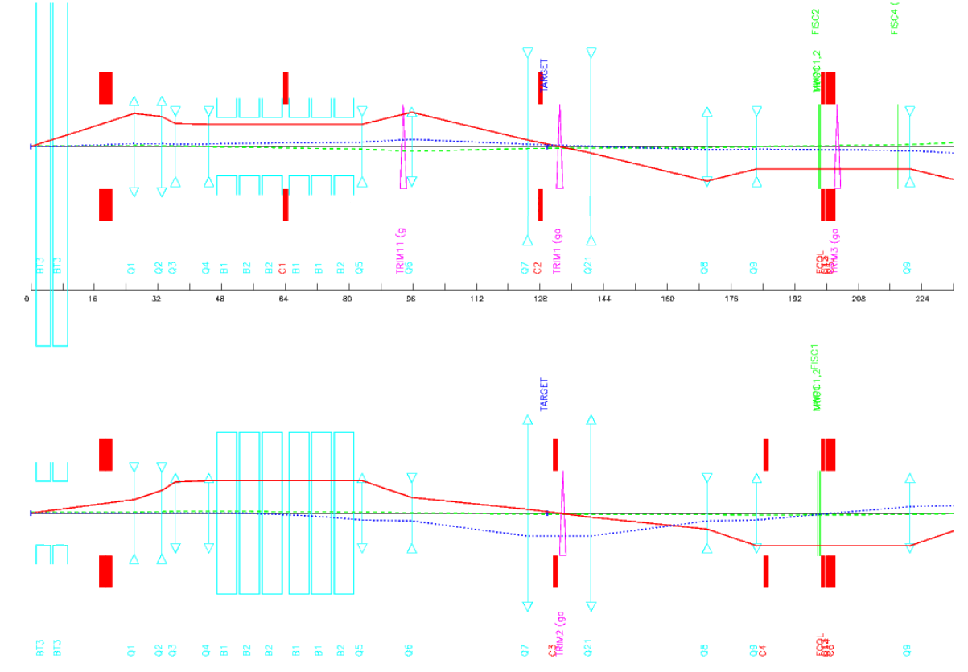
Secondary beamline – beam optics
Optics of a beam line (H8)

Slide 29
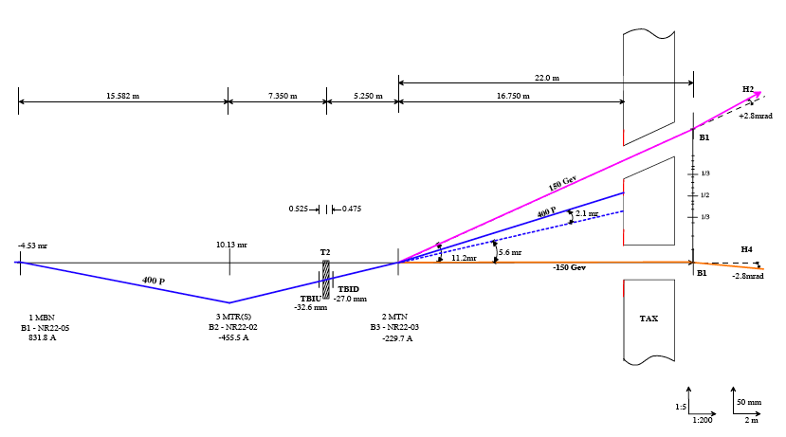
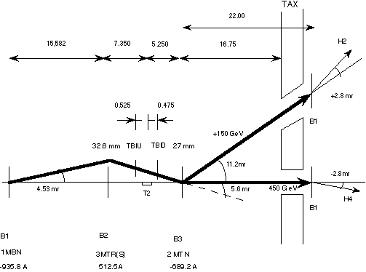
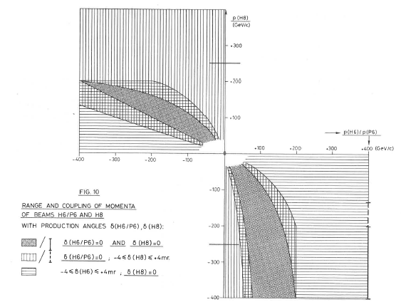
H2-H4 coupling via wobbling in T2 target
P(H2) in GeV
P(H4) in GeV

Slide 30
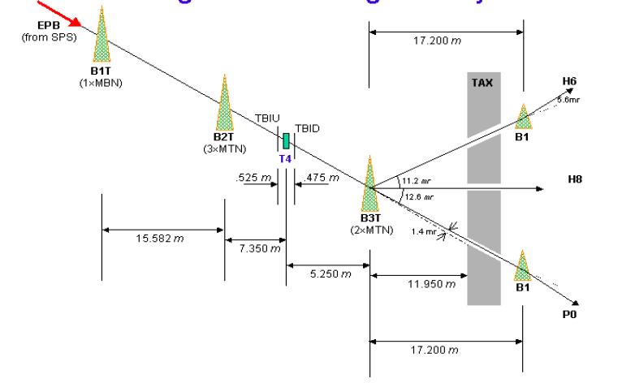
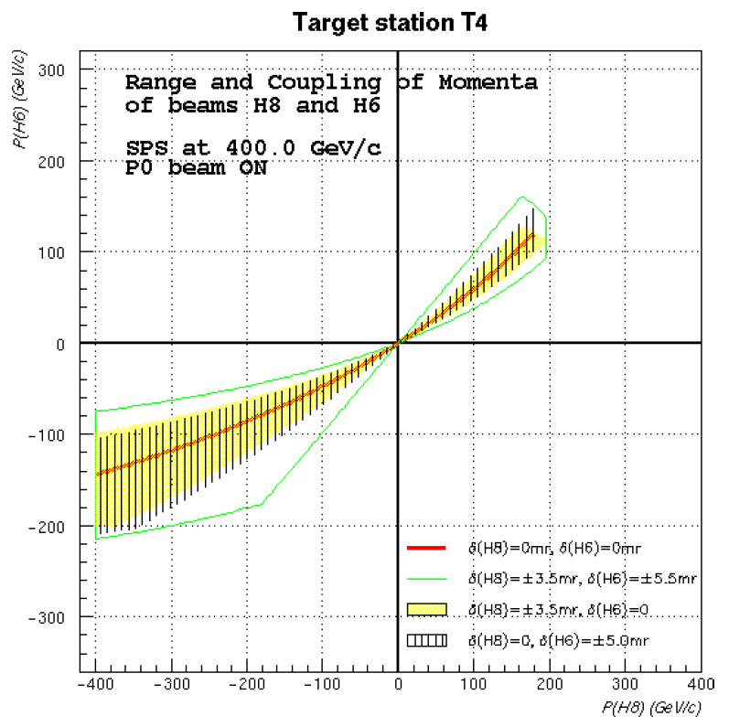
Wobbling in T4 target
Three beams
=> stronger constraints

Slide 31
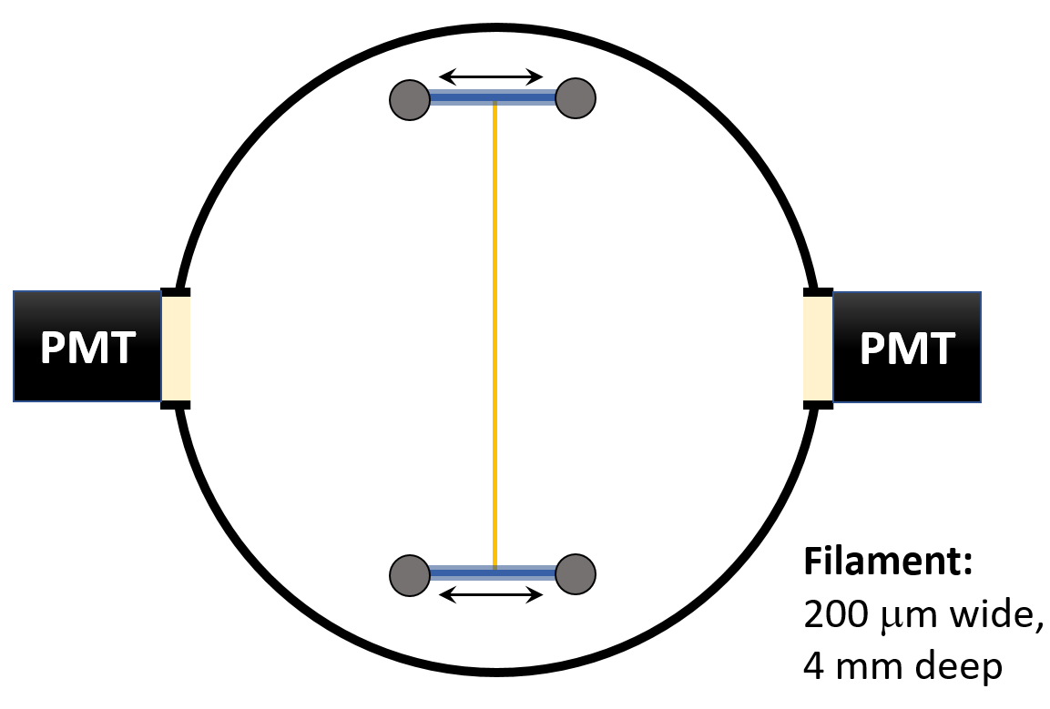
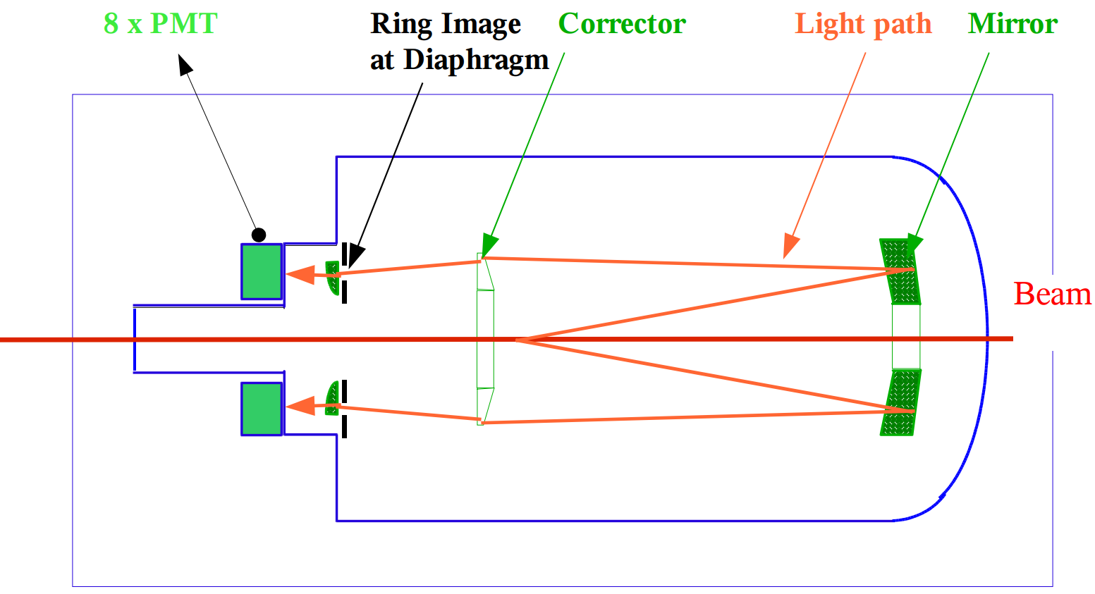
North Area – beam instrumentation
Profile monitors
  XWCA(M) for higher fluxes (> 10⁴ per spill)
  XDWC for lower fluxes (< 10⁴ per spill)
Fiscs
Intensity counters
  Scintillators for lower fluxes (< 10⁷ per spill)
  XION for higher fluxes (> 10⁶ per spill)
Cherenkov detectors
  XCET (Threshold counter)
  CEDAR
SEM counters at the target
  BSI for beam intensity
  BSP split foil for beam symmetry
  BSM and SEM grid for angle set up
  BBS (fisc like)

Slide 32
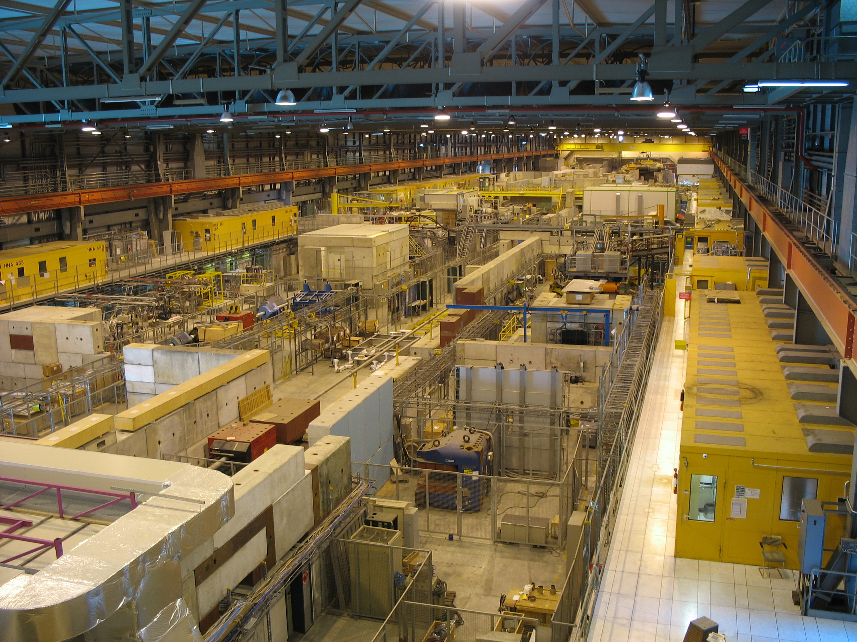
Summary
PARTREC has a high-intensity test beam complex with primary proton and ion beams
CERN has a test beam complex
  East Area
    Momentum : 0.5 GeV/c – 15 GeV/c
  North Area
    Momentum: 10 GeV/c – 400 GeV/c
  Capable to provide
    Protons
    Electrons
    Hadrons
    Pure pions
    Muons
    Tagged photons
  Diverse instrumentation for various purposes

Slide 33
Questions?

