Slide 1
A Trigger/Timing Logic Unit (TLU) for AIDAInnova
David Cussans
BTTB10, June 2022

Slide 2
Outline
What is a TLU and why it is needed.
What exists now
Why it needs to be improved
Possible implementation

Slide 3
Why a TLU?
Often want test a device at a beam-line that has pre-installed equipment
  e.g. beam telescope , beam scintillators, threshold Cherenkov
EUDET, AIDA, AIDA-2020 and AIDAInnova programmes aimed to provide a common interface (hardware, software) to beamlines
→ Trigger(Timing) logic units developed

Slide 4
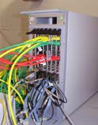
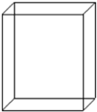
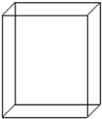

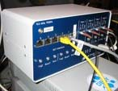

Why?
Beam Telescope with “Detector Under Test”
  Need to correlate data from a single particle in all detectors
  Match tracks in telescope with hits in your DUT
Sensors
AUX
board
DUT
e
-
Readout
From: Infrastructure for Detector Research and Development towards the International Linear Collider. https://arxiv.org/abs/1201.4657
GBit ETH
VME CPU
LVDS
Mechanics to position
the sensors
EUDAQ PC
USB
ETH
Trigger Logic Unit
Secondary PC

Slide 5
How?
Sensors in beam to detect passage of particles.
   Electrical signals  conditioning  binary signal
Combine binary signals from one or more beam sensor to produce a “trigger”
Two choices:
  Distribute a trigger signal to beam telescope and DUT readout systems.
    Correlate data based on trigger number
  Distribute central clock/time-stamp to beam telescope and DUT
    Correlate based on timestamps.
  … can mix time-stamping and triggering: TLU records both trigger-number and time-stamp
Implementation: Box with signal conditioning and an FPGA
Make available to use in home labs – ease integration at beam-line

Slide 6
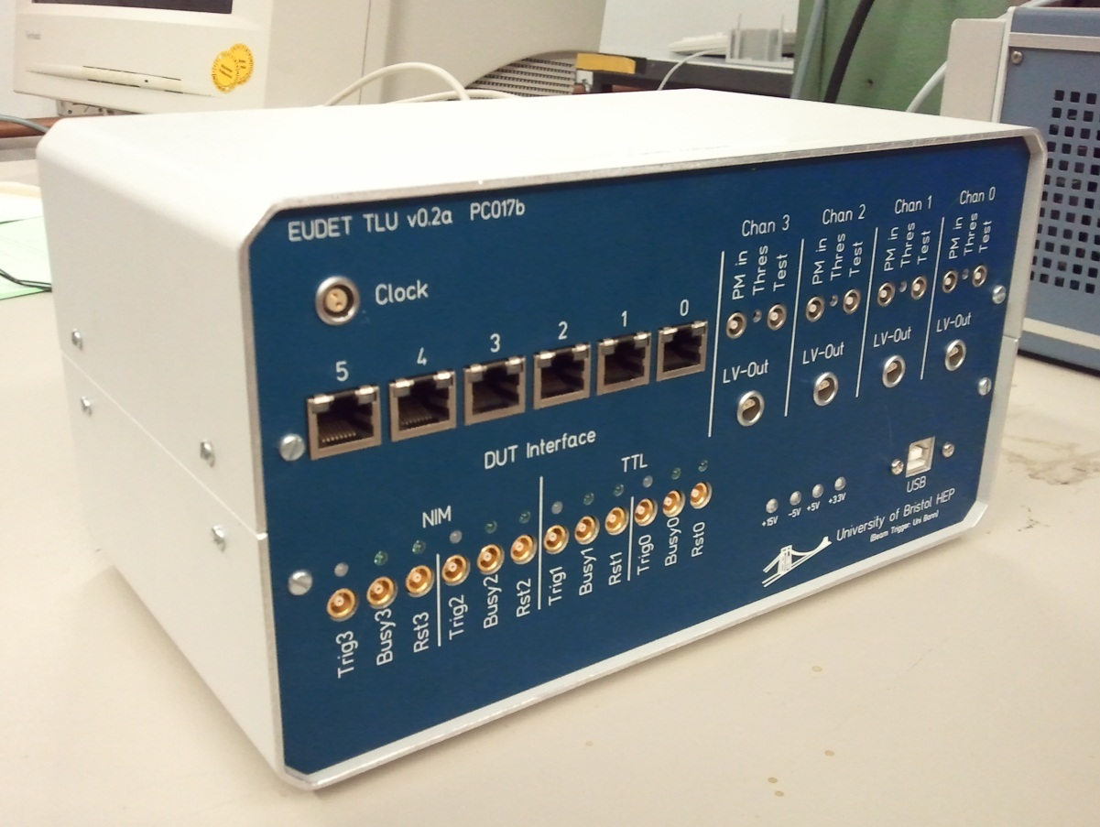
History - EUDET
EUDET TLU
  Supporting beam tests for linear collider detector development at DESY
    Low rate ( < 10kHz )
    Modest time precision
    RJ45 for trigger/busy
      LVDS
  See https://www.eudet.org/e26/e28/e42441/e57298/EUDET-MEMO-2009-04.pdf
  Many still in beam-lines and HEP institutes

Slide 7
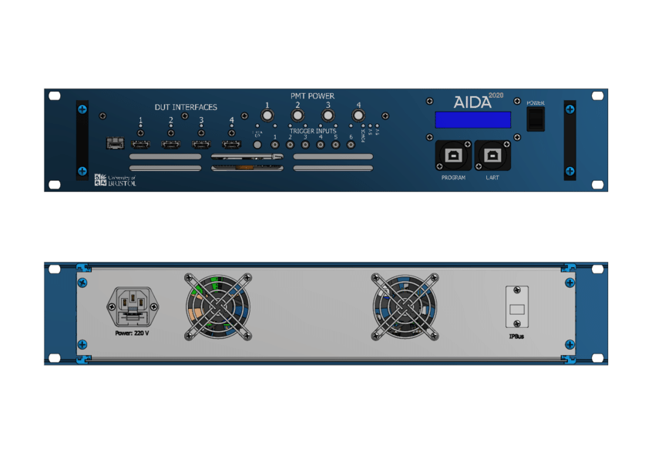
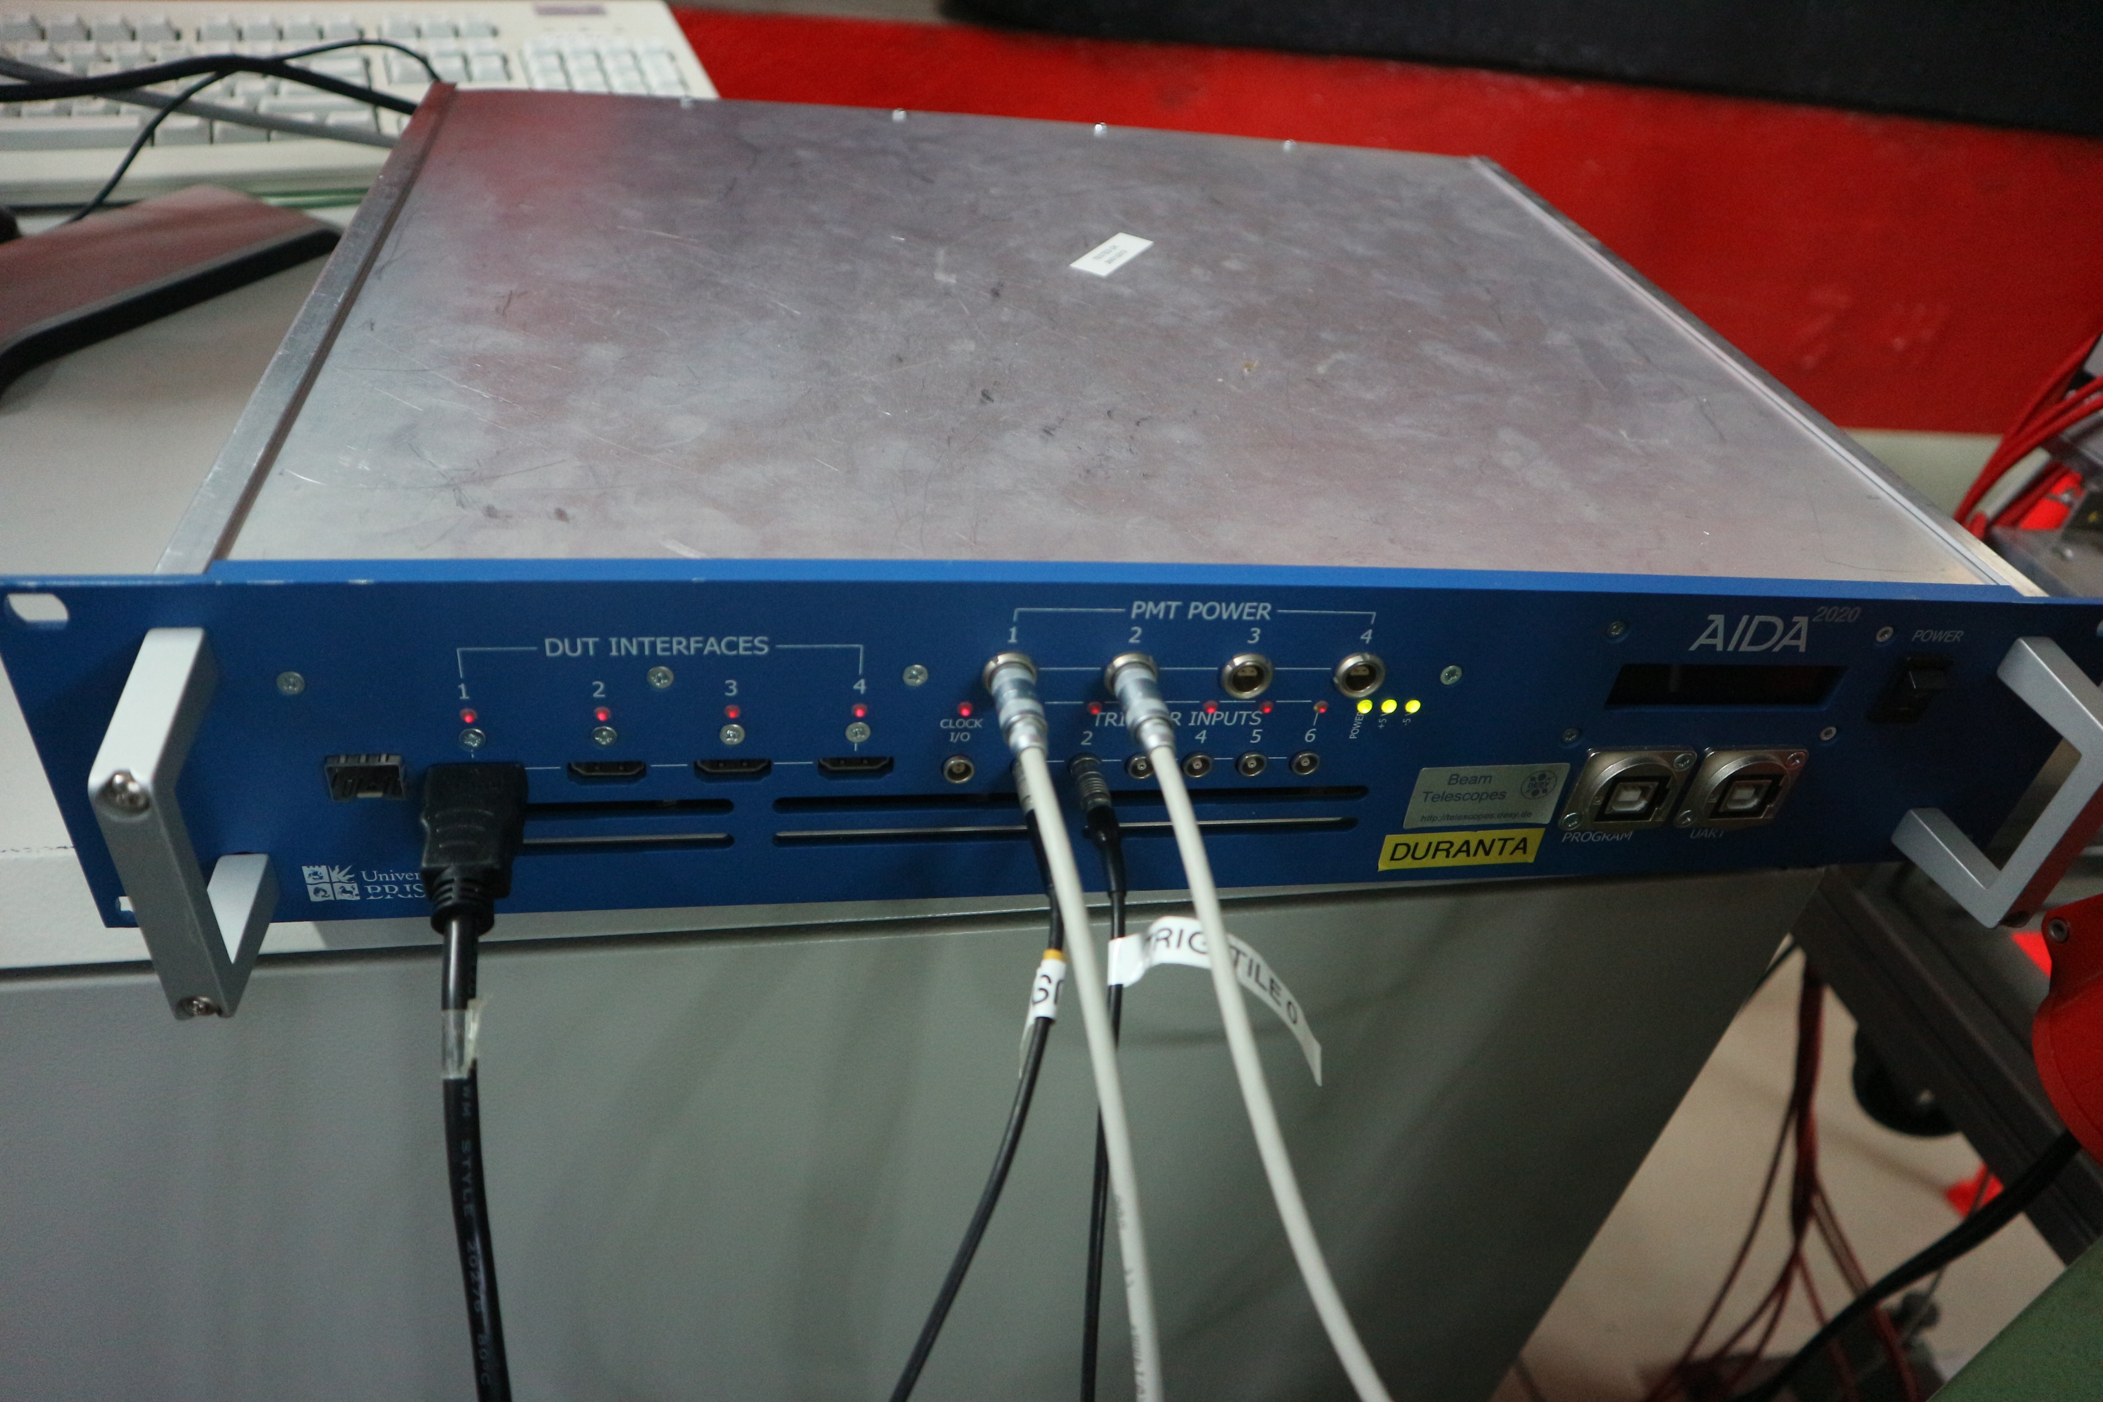
History - AIDA-2020
Current production version
6 trigger inputs
4 DUT connections
  LVDS on HDMI
    But direction of each line can be swapped in hardware to allow different firmware mapping
Low jitter clock
Hardware permits optical distribution of clock/trigger
In small desktop case or rack-mount case

Slide 8
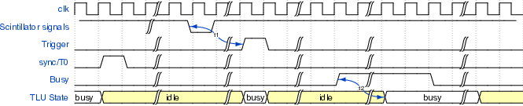
AIDA-2020 TLU – DUT Interfaces
Two interface mode between TLU and DUT:
      “EUDET mode”
          No common clock between TLU and DUT.
          Trigger/Busy handshake
          DUT can read out trigger number from TLU – event-by-event checking
Common clock
  Permits higher trigger rate
    No event-by-event handshake. Cross-check on trigger timestamps.

Slide 9
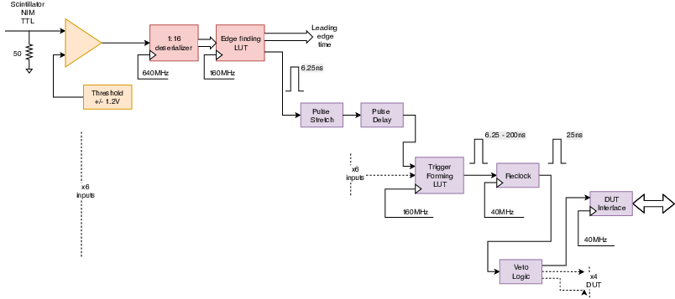
Trigger Logic
Inputs clocked at 160MHz (nominal)
Input signals can be delayed and/or stretched in units of 1/160MHz
Signals from the 6 inputs fed into a look-up table
LUT programmed with which combinations produce a trigger
Trigger output moved to clock fed to DUT (40MHz nominal)
State of all inputs recorded at point that trigger “fires”
  Can be used to tag events – e.g. Cherenkov information.

Slide 10
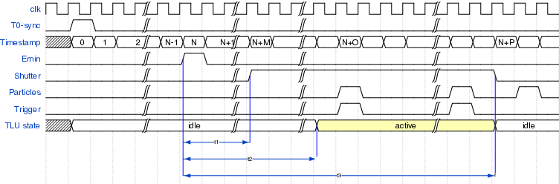
AIDA-2020 TLU
DUT “Shutter”
Some detectors can only capture data with a low duty cycle
In many beam-lines particle are only present a certain times
  DESY – 50Hz cycle
  CERN – SPS cycle
Detectors active period should occur when particles are present
→ Signal from accelerator can be used to generate a “shutter” signal sent to DUT

Slide 11
Documentation
https://doi.org/10.1088/1748-0221/14/09/p09019 “The AIDA-2020 TLU: a flexible trigger logic unit for test beam facilities” , JINST
Open Hardware project “AIDA-2020 TLU”
  https://ohwr.org/project/fmc-mtlu
  Hardware design files https://ohwr.org/project/fmc-mtlu-hw/
  Firmware source code https://ohwr.org/project/fmc-mtlu-fw/
User manual https://ohwr.org/project/fmc-mtlu/blob/master/Documentation/Main_TLU.pdf

Slide 12
Firmware
IPBus for control and readout of time-stamps
  UDP/IP 1 Gbit/s Ethernet
Ipbb build system
  Scriptable build. Working on CI
Open Source
  https://ohwr.org/project/fmc-mtlu-fw/

Slide 13
Software
All versions of TLU integrated with EUDAQ DAQ software.
  Run control
    Configuration
    Monitoring
  Readout of trigger timestamps

Slide 14
Why a New TLU?
Increasing need for more precise timing
      (AIDA-2020 TLU has 1ns time-stamping)
User requests for more trigger inputs
      (Number of DUT interfaces can be increased in common clock mode using external fanout – up to 30 DUTs)
A “PicoSecond TLU” being developed as part of the AIDAInnova programme.

Slide 15







Why a New TLU?
From AIDAinnova grant agreement, part A:
  “To provide a O (100) ps timing for particle hits, a dedicated timing layer as well as a trigger logic unit (TLU) with picosecond-timing support need to be developed, integrated and installed at both CERN and DESY. The precision timing layer will be provided by a TimePix4 plane, which will be fully integrated into the telescope hardware and the EUDAQ2 framework. We foresee having such planes available at all beam lines. To provide an ultimate timing resolution of 30 ps, an LGAD plane based on current developments for the HL-LHC will be included in the EUDET-style pixel telescopes. In order to benefit from this exquisite timing, the TLU needs to provide a stable clock with a 10 ps or better stable edge, which will be part of the AIDA TLU upgrade.”
NWO-I/Nikhef, UNIVBRIS, CSIC-IFCA, DESY,UCL, USC
June 20, 2022
14

Slide 16
Picosecond TLU
Timing specification:
  Clock jitter < 10ps RMS
  Timing-stamping of input signals O(10ps) RMS
Backwards compatible with AIDA-2020 TLU
  Same signals on DUT connections
    trigger/busy/DUT-clk in EUDET-mode
    Global-clk, trigger, busy, shutter, T0 in common-clock mode
AIDA-2020 TLU connected
to beam telescope

Slide 17
Picosecond TLU - I/O
Trigger inputs
  Probably 8
    (c.f. 6 for AIDA-2020 TLU)
  CFD and/or ADC for time-walk correction
    (c.f. threshold discriminator in AIDA-2020 TLU)
  TDC with O(10ps) bins
    Either implemented in FPGA or external PicoTDC (3ps bins)
  Aim to contribute less to timing uncertainly than detector.
Device Under Test (DUT) connectors
  Compatible signal definitions as AIDA-2020 (also LVDS)
  Move to “Display Port” from HDMI
    Mechanically more robust.
    Five good quality differential pairs (c.f. 4 in HDMI)
    Passive adaptor to HDMI if needed
    Opinions?

Slide 18
PicosecondTLU -
Rate Capability
Same goal for rate capability as AIDA-2020 TLU:
      Instantaneous rate ~ 10MHz:
          50ns between hits ( little pile up at 10MHits/s)
Sustained rate ~ 1MHz
  Internal buffer in current AIDA-2020 TLU only 4k events.
    Aiming to expand to O(10M events)

Slide 19
Picosecond TLU -
Optical Interface
Retain optical interface introduced in AIDA-2020 TLU
  Can distribute timing information over fibre
  Used for ProtoDUNE-SP
    https://doi.org/10.1016/j.nima.2019.04.097
  fibre bandwidth much larger than copper cable.
    Possibility of more precise timing over longer distances
      Clock jitter (endpoint w.r.t. master) of 12ps measured

Slide 20
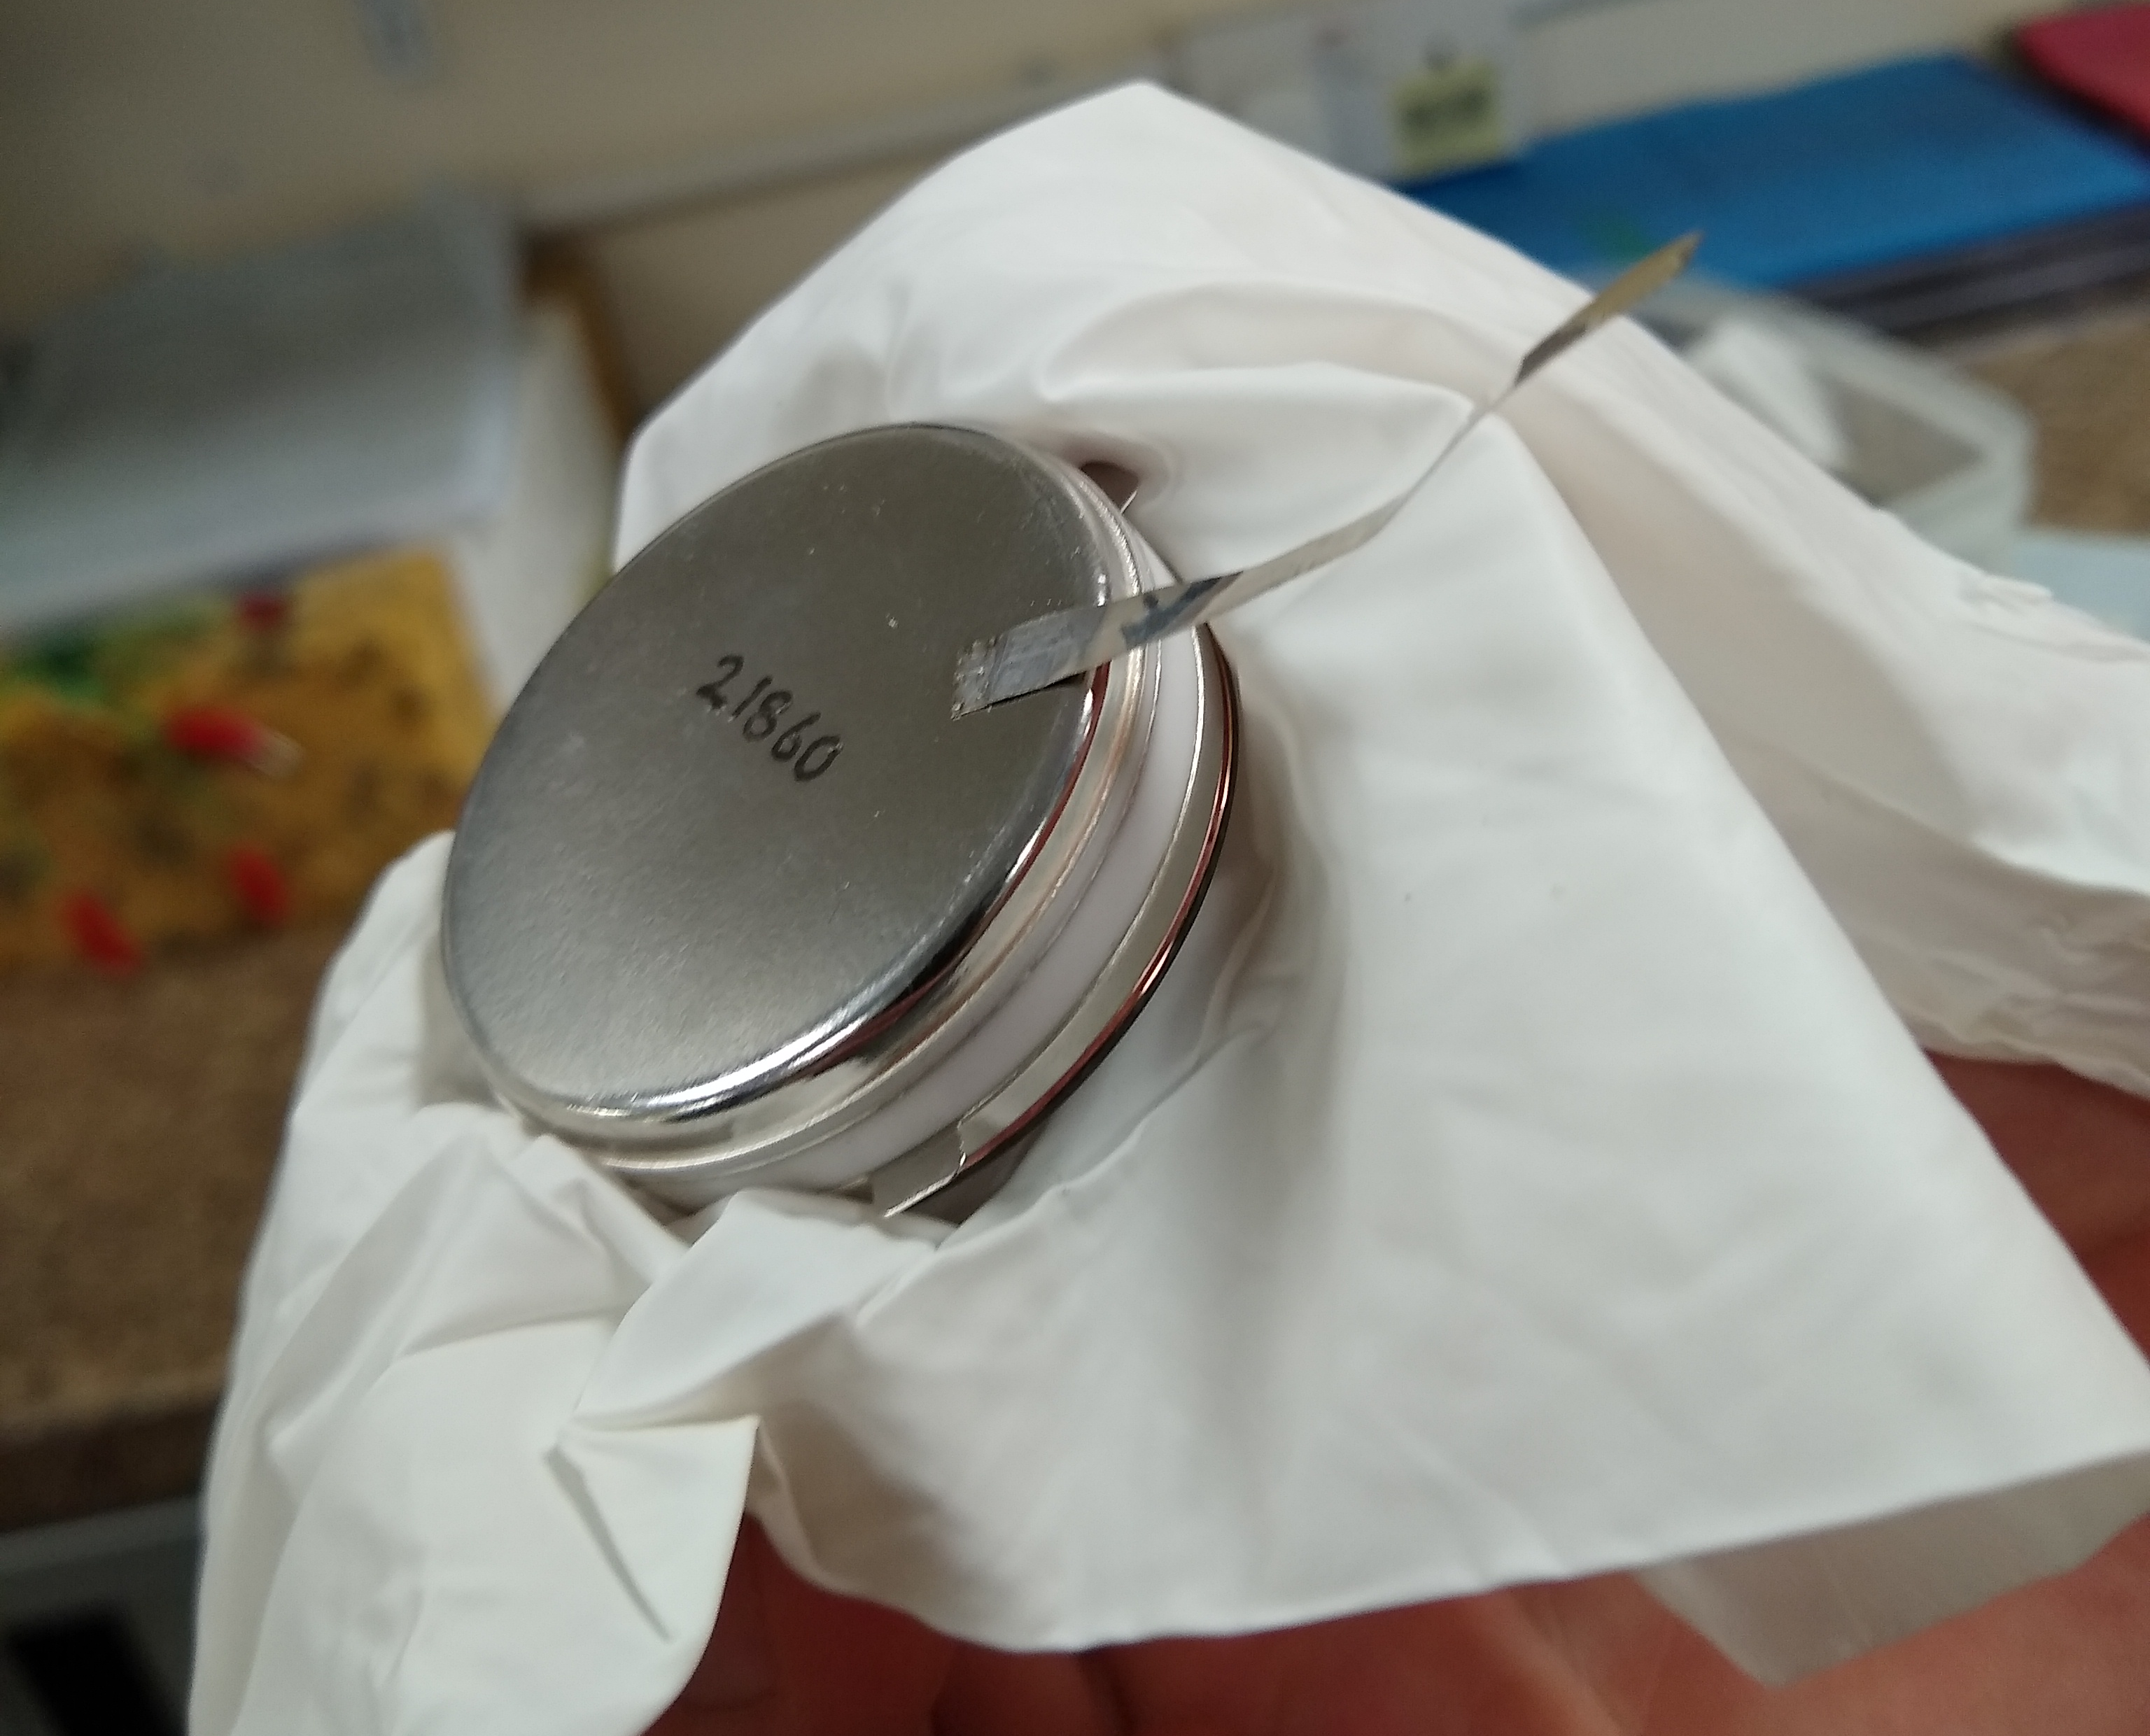
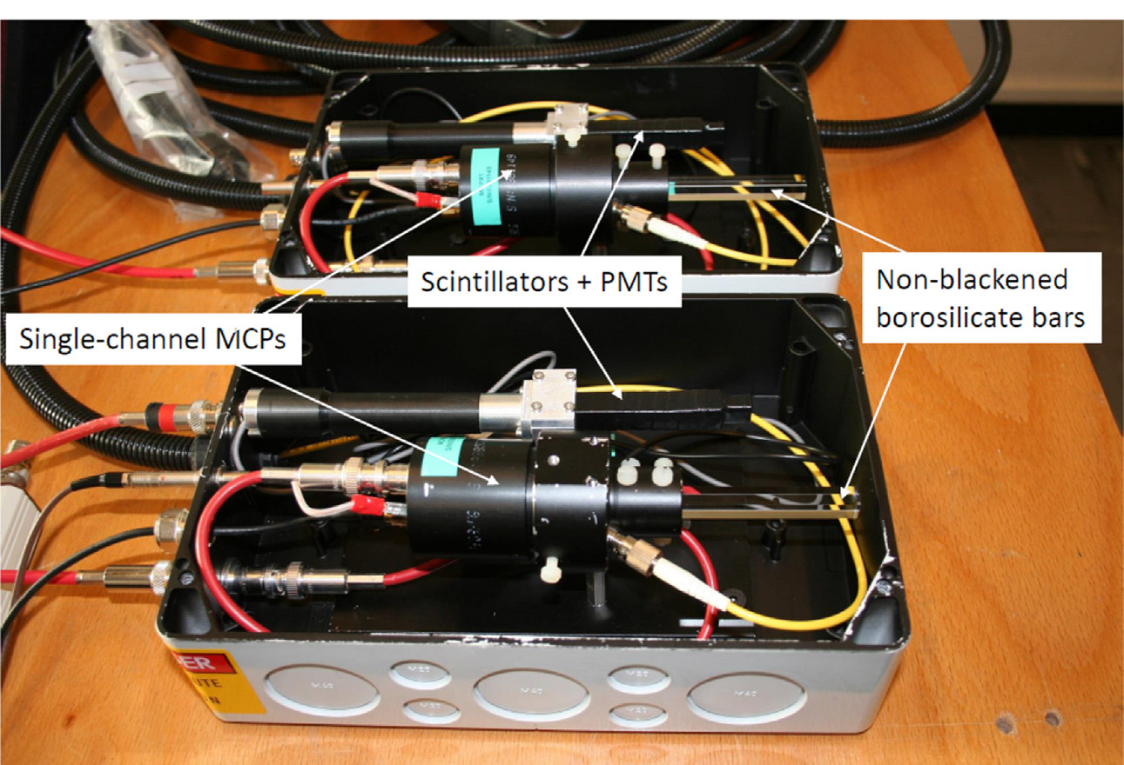
Picosecond TLU - Timing reference
Testing pico-second detectors requires pico-second time reference
  TLU timing only as good as reference
Some beam-line users will bring their own time reference detectors. Some would benefit from precise time reference at beam-line.
  (Providing timing reference not part of WP3.3)
Could use, e.g. Cherenkov light and high speed photo-detector
  Used for “TORCH” LHCb upgrade beam-tests
  MCP-PMT single photon jitter 66ps FWHM http://www.photek.co.uk/pdf/datasheets/detectors/DS006%20Photomultiplier%20Tube%20Datasheet%20issue%202.pdf
  Many photons --> timing precision ~ 10ps
Bare MCP-PMT module
(photo-cathode facing down)
Taken from http://dx.doi.org/10.1016/j.nima.2016.06.087

Slide 21
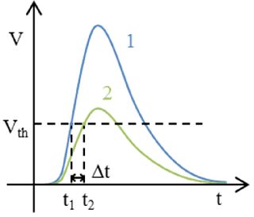
Trigger Inputs
Combine threshold comparator with 160MSample/s ADC for time-walk correction
Prototyping analogue part
CERN PicoTDC ASIC for time-stamping
Optimizing timing resolution for small amplitude fast rise signals.
Use case: single-anode MCP-PMT used as a timing detector

Slide 22
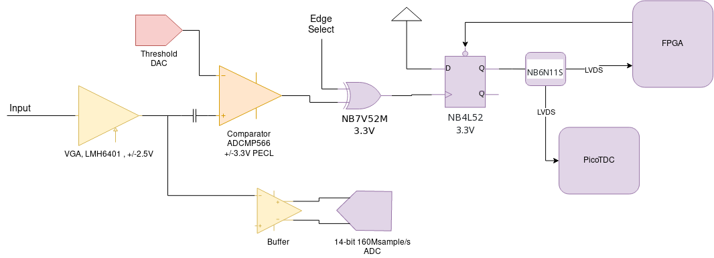
Trigger Inputs

Slide 23
Trigger Inputs
Variable
Gain

Slide 24
Trigger Inputs
ADC for
Time-Walk
Correction

Slide 25
Trigger Inputs
Fast
Comparator

Slide 26
Trigger Inputs
Pulse
Stretching

Slide 27
Trigger Inputs
TDC

Slide 28
Summary
The AIDA(-2020/Innova) TLU provides a common hardware and software interface to beamlines
AIDA-Innova TLU backwards compatible at the hardware signal level with EUDET / AIDA-2020 / AIDA TLU
      Needs passive adaptor for RJ45 , HDMI
      Data format different – will be “hidden” by EUDAQ
Pico-second detectors need pico-second infrastructure
      Aiming for < 100ps timing

