Slide 1



New 4 T Multipurpose superconducting Magnet Facility
BTTB10
Shuvay singh – ep/ado/so
20-24 JUNE 2022

Slide 2
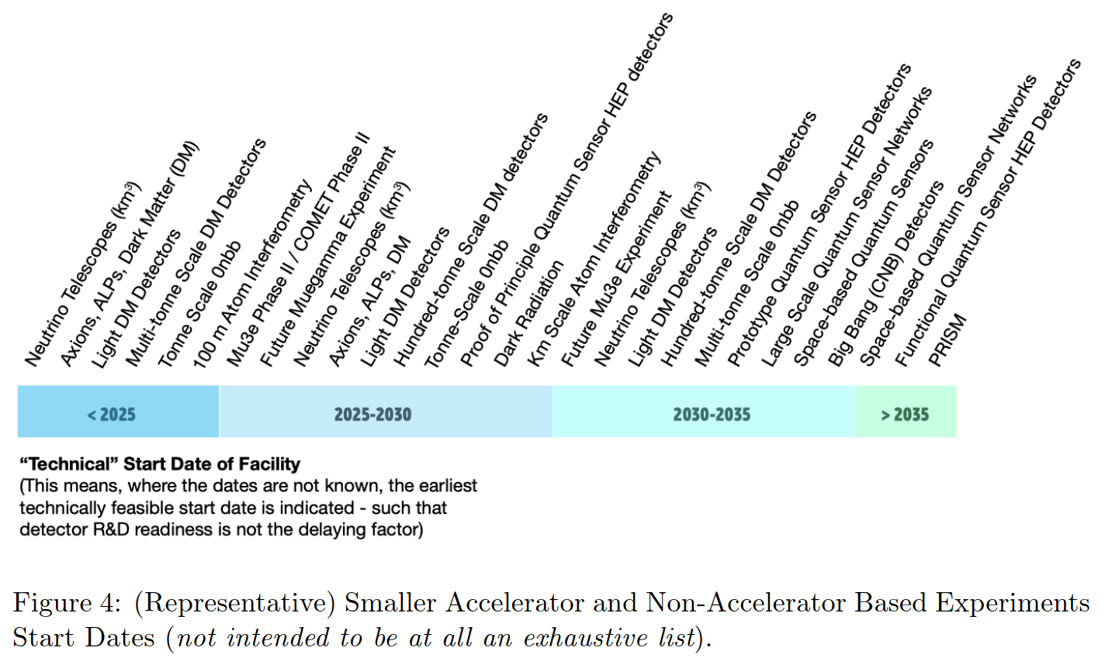
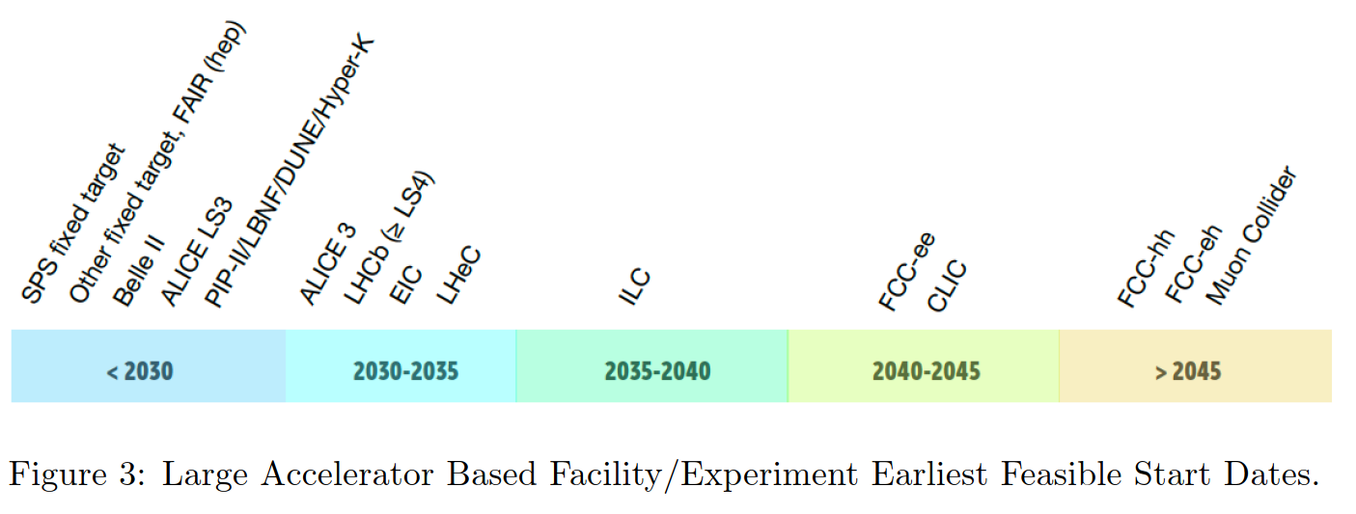
Introduction & Motivations
European Committee for Future Accelerators has developed a global Detector Research & Development Roadmap, published in 2021, following recommendations of the 2020 Update of the European Strategy for Particle Physics.
That roadmap aims to define the backbone of detector R&D required to deploy the community’s vision for both the near- and longer-term. The mandate is to focus on the technical aspects to realise the research facilities in a timely fashion, and to provide strategic guidance for detector development at large, in synergy with neighbouring fields and industrial applications.
A lot of work ahead of us!

Slide 3
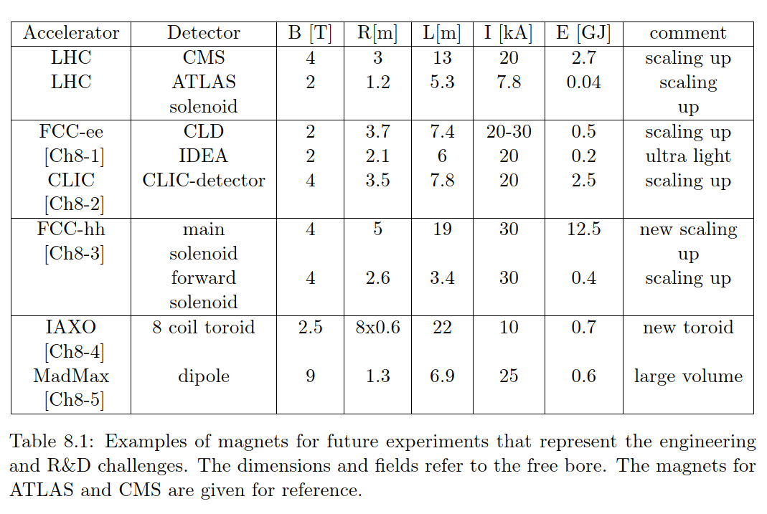
Introduction & Motivations
Some examples of future superconducting magnet systems listed in ECFA roadmap that represent the spectrum of engineering challenges and R&D needs for this topic :
4-T or higher field superconducting solenoids or dipoles,
Placed either in front or behind the electromagnetic or hadronic calorimeters
Large volumes
Specific reinforced aluminium stabilized Nb-Ti superconductors
High Temperature Superconductors (HTS) included as long term development
reference
⇒ need for a high-field large-volume multi-purpose superconducting magnet as a test beam facility for the physics user community.

Slide 4
Motivation for new test beam Magnet
At CERN:
EP department has launched an R&D programme on new Detector Technologies.
This initiative, which spans a 5-years period from 2020 onwards (with a possible extension by another 5 years), covers detector hardware, electronics and software for new experiments and detector upgrades beyond LHC phase II.
WP | Work Packages | WP leaders & deputies
1.1 | Novel hybrid Silicon detectors | Victor Coco, Paula Collins
1.2 | Monolithic depleted Silicon sensors | Walter Snoeys, Michael Campbell
1.3 | Silicon Modules | Petra Riedler, Dominik Dannheim
1.4 | Silicon simulation and characterisation | Michael Moll, Dominik Dannheim
2 | Gas detectors | Eraldo Oliveri, Christoph Rembser
3 | Calorimetry and light based detectors | Martin Aleksa, Carmelo d'Ambrosio
4 | Detector Mechanics | Corrado Gargiulo, Paolo Petagna
5 | IC technologies | Kostas Kloukinas, Davide Ceresa
6 | High Speed Links | Paolo Moreira, Jan Troska
7 | Software | Graeme Stewart, Jakob Blomer
8 | Detector Magnets | Benoit Cure, Matthias Mentink

Slide 5
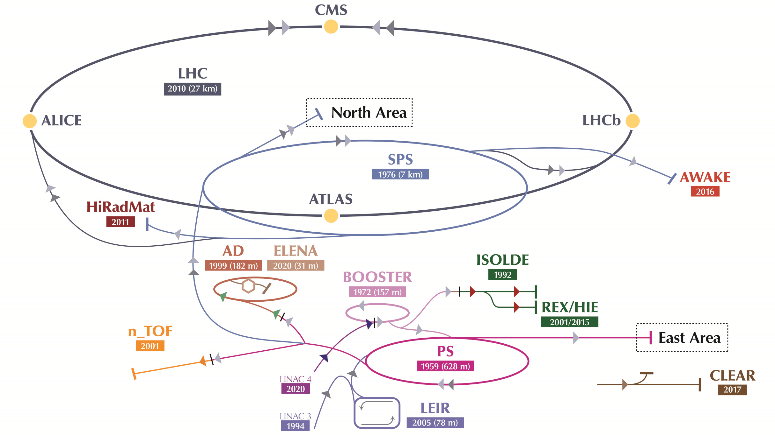
Cern Experimental AREAS WITH TEST BEAM FACILITIES
Beam lines at PS and SPS
Location | Beam line | Experiments & Users
East hall | T8 | IRRAD & CHARM
East hall | T9 | n.a.
East hall | T10 | n.a.
East hall | T11 | CLOUD
EHN1 | H2 | NA61 - SHINE & CERN NP
EHN1 | H4 | GIF++ & CERN NP
EHN1 | H6 | n.a.
EHN1 | H8 | n.a.
EHN2 | M2 | NA58 (COMPASS)
ECN3 | P42/K12 | NA62
TAG41 | TT41 | AWAKE
SPS | TT60 | HiRadMat
The CERN accelerator complex

Slide 6
Motivation for new test beam Magnet
Existing test magnets on beam facilities at CERN (full list at http://ep-dep-dt.web.cern.ch/b-field-mapping/ep-spectrometer-magnets-inventory)
Normal conducting magnets
Superconducting magnets
No 4-T magnet (with useful volume) for detector prototype tests

Slide 7
Motivation for new test beam Magnet
The new cutting-edge high-energy particle detectors of the future accelerators have to work in 4-T magnetic field
For testing detector units and performing calibration with magnetic field, a general purpose 4 T test facility is proposed and will replace or complement the existing CERN general-purpose systems
The magnet shall be installed on a beam line and the facility shared among collaborations to which CERN is contributing
The concept of a new 4-T beam test facility is studied in the context of the EP R&D work package 8
It is noted that the magnet construction itself, commissioning and installation on the beam line is not included in the frame of this EP R&D program
EP and CERN are encouraging institutes with needs in test beam at high field to join and collaborate and in order to find a way to fund such a facility

Slide 8
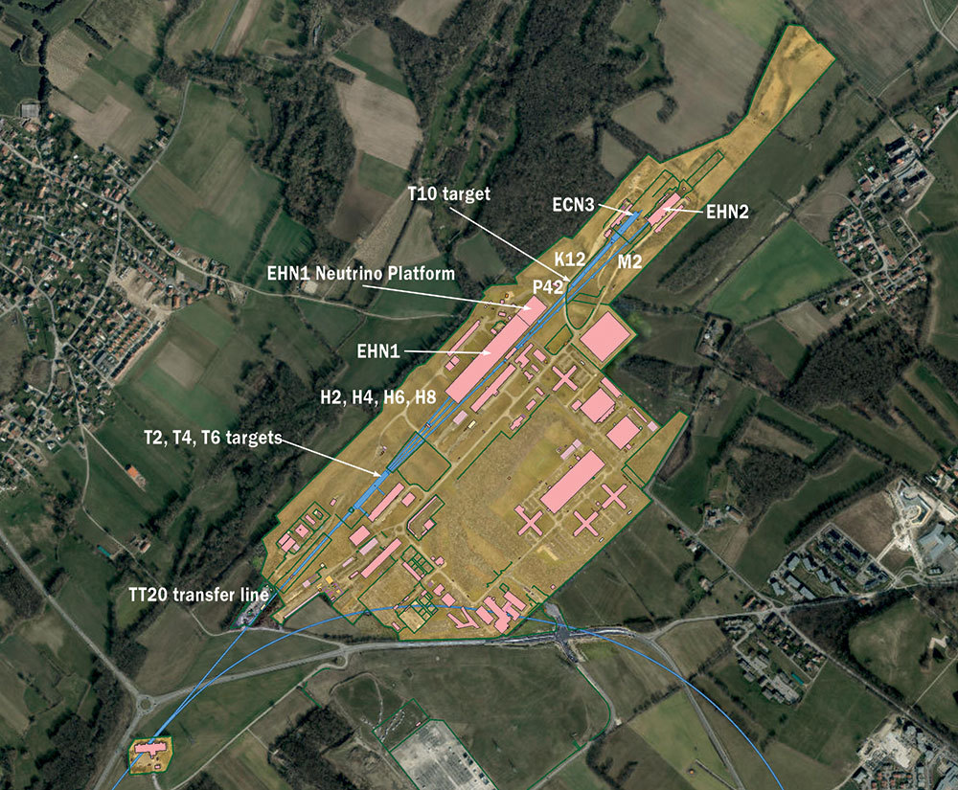
The super proton synchrotron (SPS) and Experimental north area (EhN1)
EHN1:
H2, H4, H6, H8 beam lines
High-energy, high-resolution secondary beam lines. The maximum momentum that can be transported in the experiments is 400 GeV/c protons (primary SPS beam) or secondary mixed hadron beams within the range 10-400 GeV/c

Slide 9
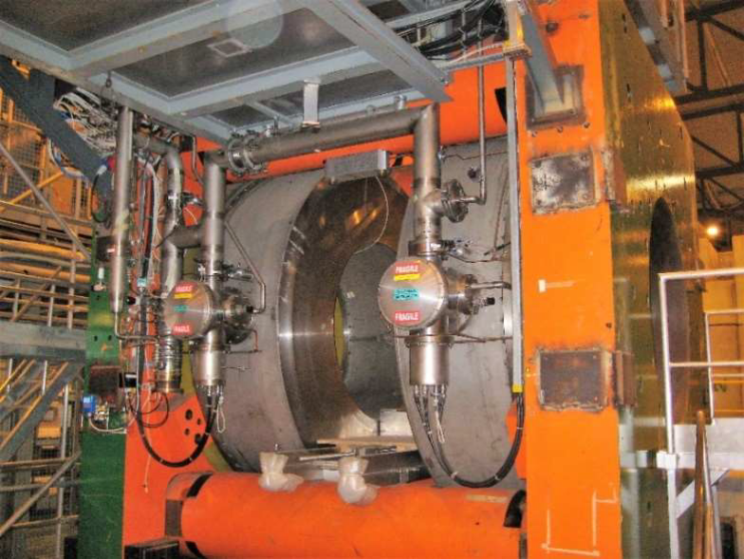
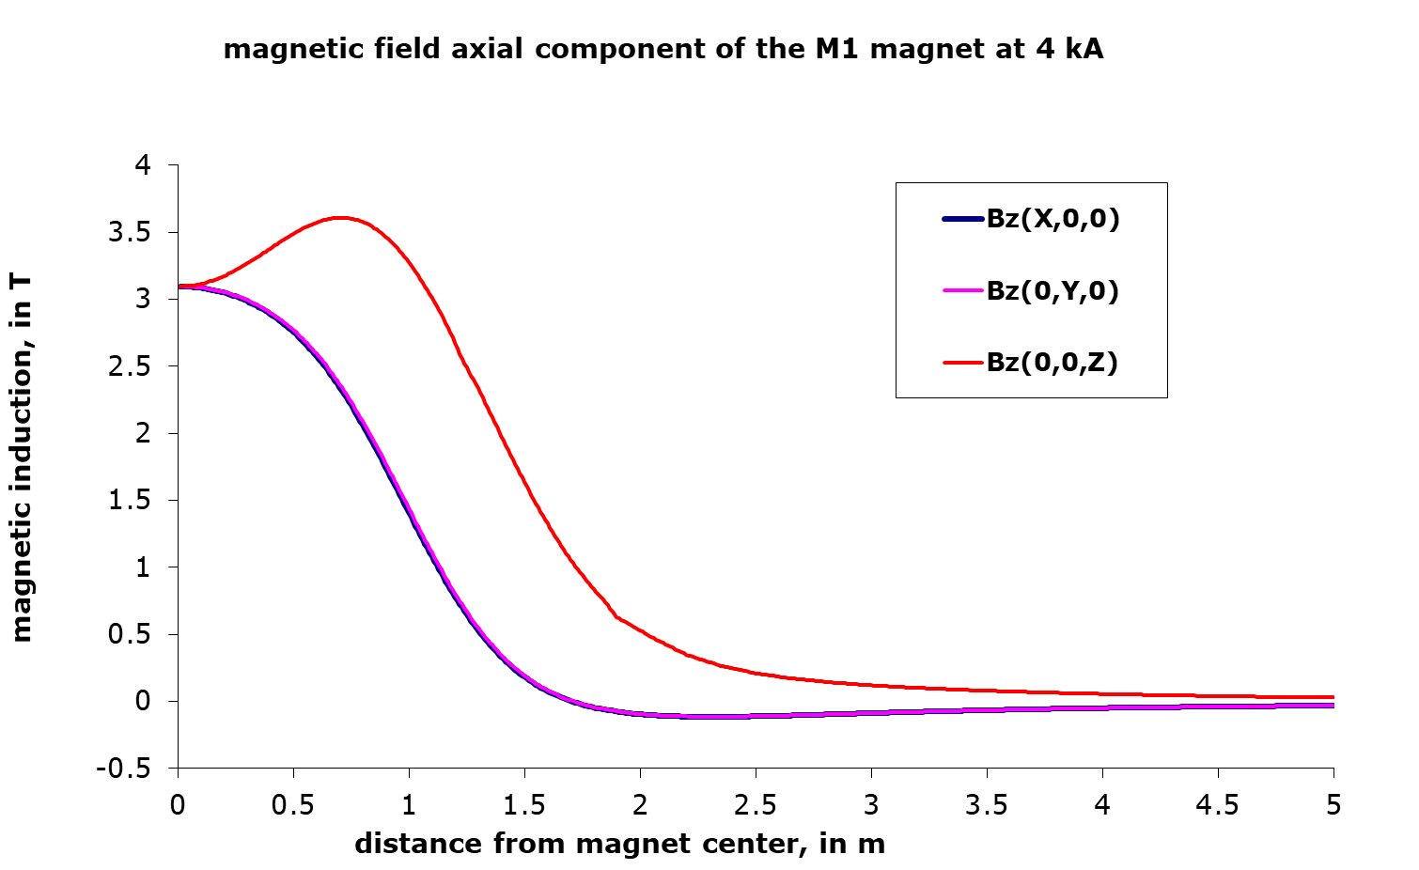
Existing general-purpose magnets in north area
The starting point of the study is the two general purpose facilities available as test beam facilities: Morpurgo and M1 facilities.
These magnets have been in operation since the late 70s, for experiments, then later as test beam facilities.
3-T M1 H2 Superconducting Magnet
Dipole and Solenoidal function (split solenoid)
1.4 m free bore diameter
800 mm free gap

Slide 10
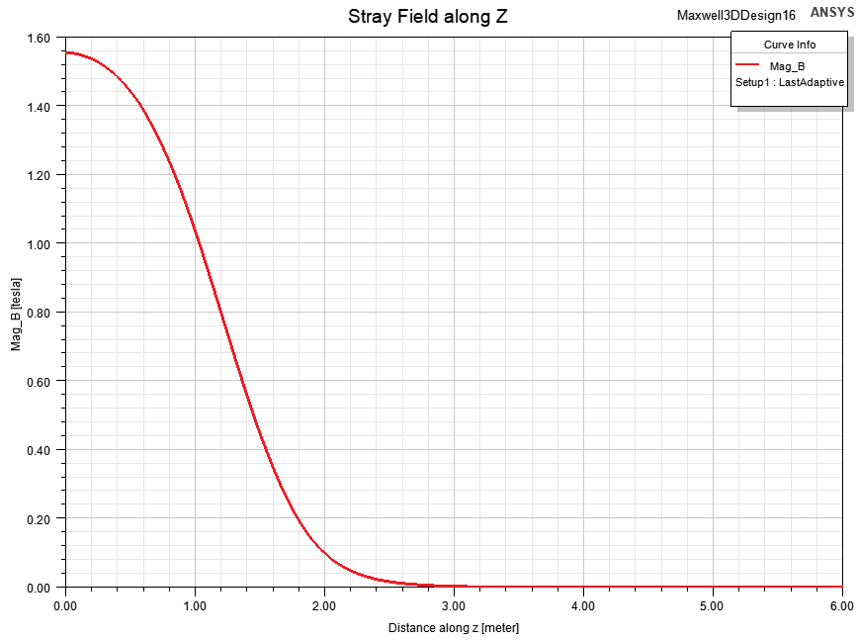
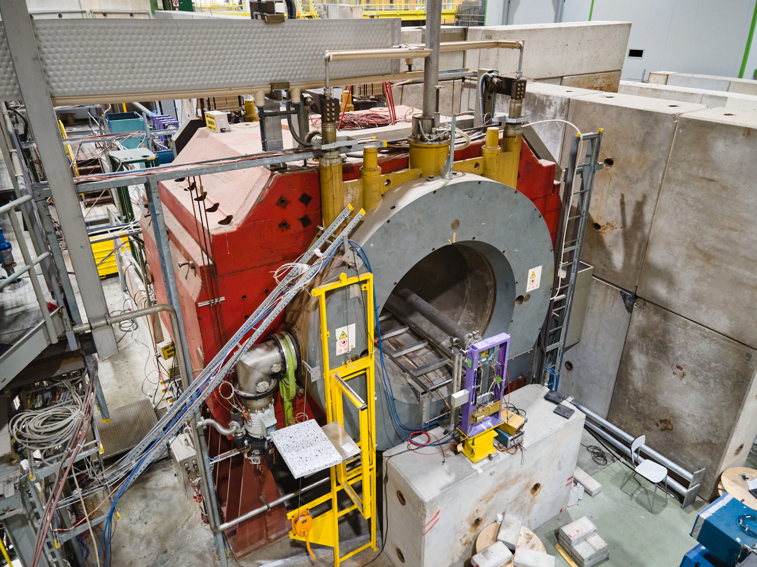
Existing general-purpose magnets in north area
1.6 -T Morpurgo H8 Superconducting Magnet
Dipole function (saddle)
1.6 m free bore diameter

Slide 11

New North Area TEST BEAM Magnet Parameters
4-T central field
1 m³ free volume target
Stray field must be minimised due to proximity of other experiments
This facility will allow to perform tests with the full range of magnetic conditions in a detector:
  constant field value up to 4-T,
  variable field conditions similar to magnet ramps or discharges.
The field homogeneity within the duty volume shall be specified based on the requests of the potential users from the test-beam community.
Please contact us if you are interested in such a facility and let us know your requests
1 m
1 m
1 m

Slide 12
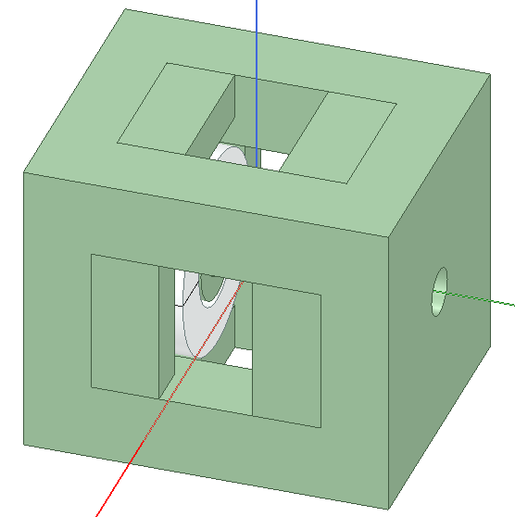
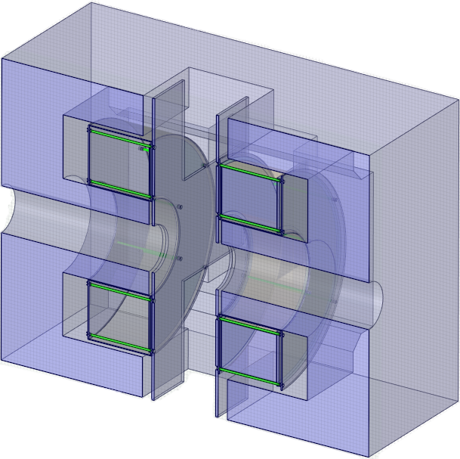
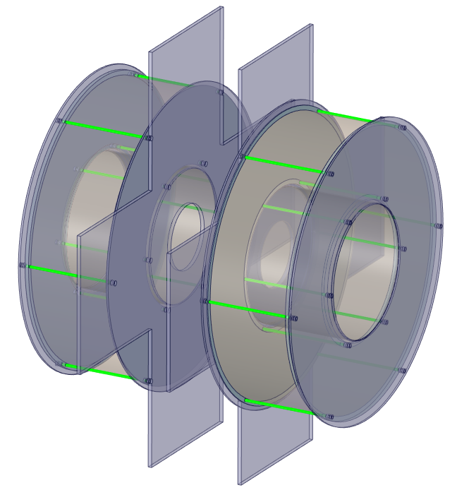
Split Coil Solenoid Magnet
Specifications
Field at Center | 4 T
Free gap | 1000 mm
Free bore diameter | 700 mm
Total Stored Energy | 106 MJ
Axial coil length | 600 mm
Peak field in conductor | 5.7 T
Stray field at 5 m | 15 mT
4500 mm
5380 mm
4500 mm
Split Coil Solenoid (SCS) similar in design and functionality of M1
Iron yoke allows for beam in 2 directions
Coils supported by titanium tie-rods

Slide 13
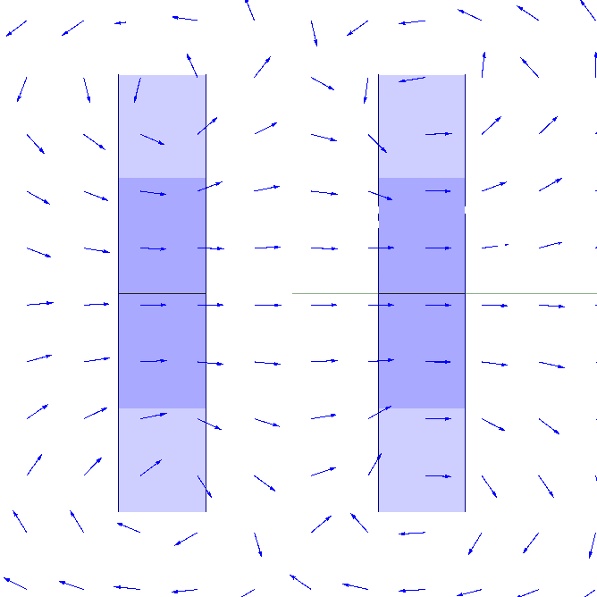
Benefits of a Split Coil Solenoid Magnet
Top view of magnet
Two different testing orientations are possible relative to beam axis
Dual functionality similar to M1
Dipole function
- Beam axis
Solenoidal function

Slide 14
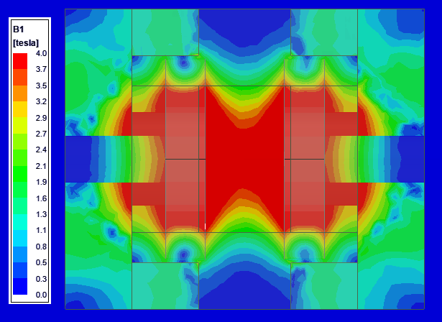
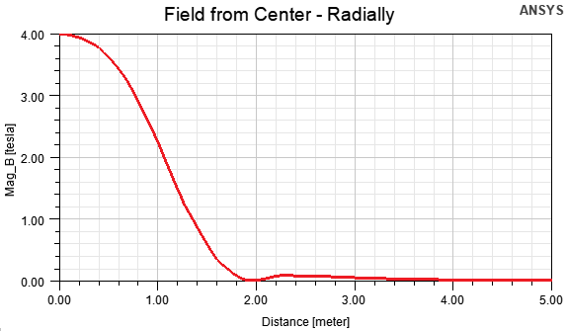
Split Coil Solenoid Magnetic field plots
Sections through central plane

Slide 15
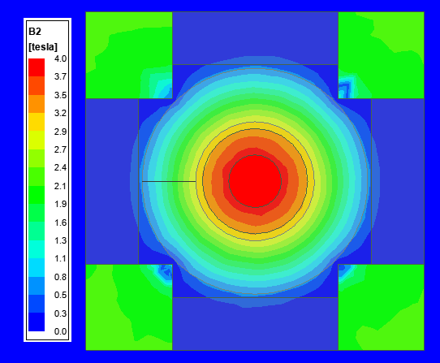
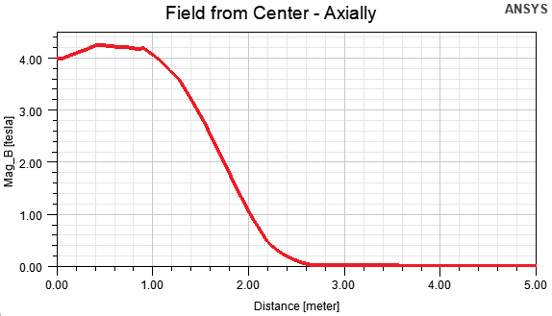
SCS Field Along axial and radial direction

Slide 16
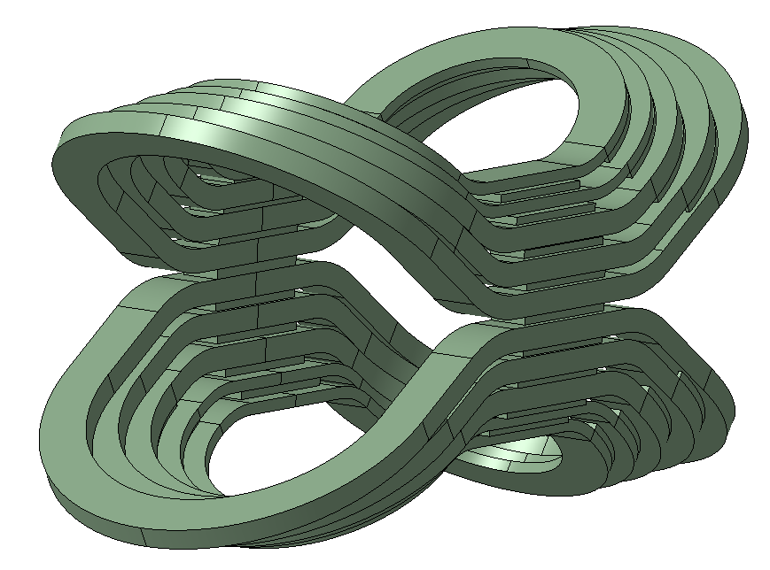
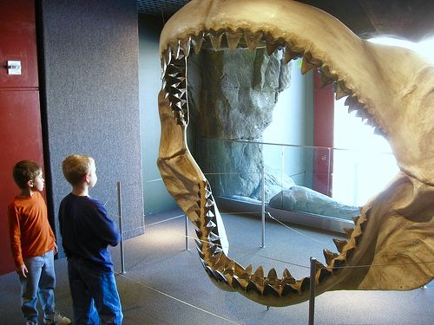
The Magnadon
MAGnet for North Area with a Dipole CONcept
~ 2 m bite radius / outer bore like the extinct Megalodon shark
Like the MADMAX magnet design
Special thanks to CEA - IRFU Saclay for fruitful discussions

Slide 17
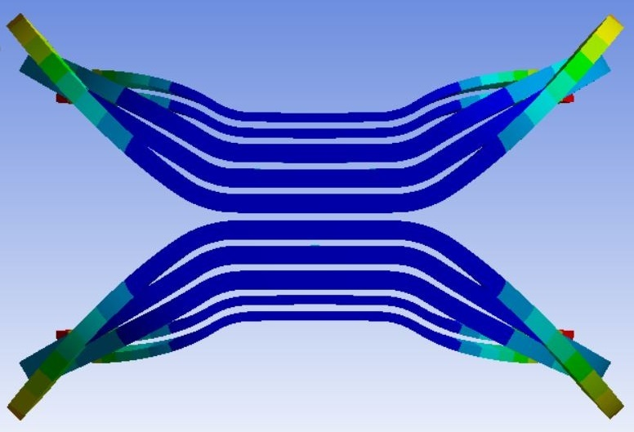
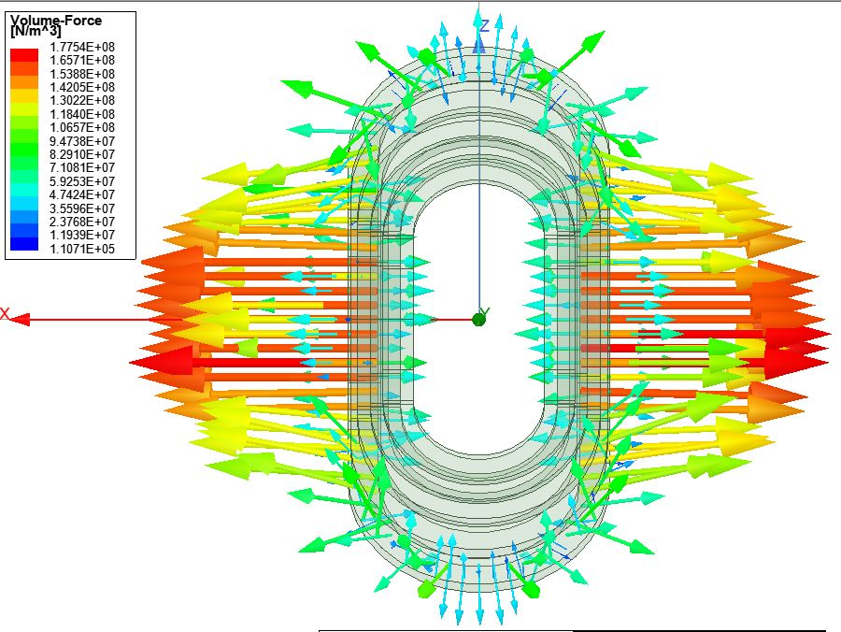
Magnadon Magnet Lorentz forces and Deflection
Coils attempt to “open” and “close” during current ramp up requiring a robust and complex mechanical support structure
Bursting force along X-Axis : 2.5 MN

Slide 18
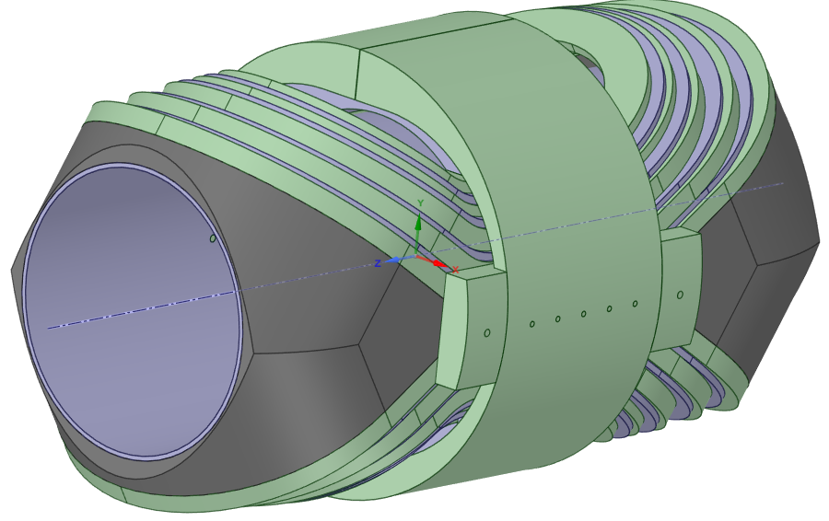
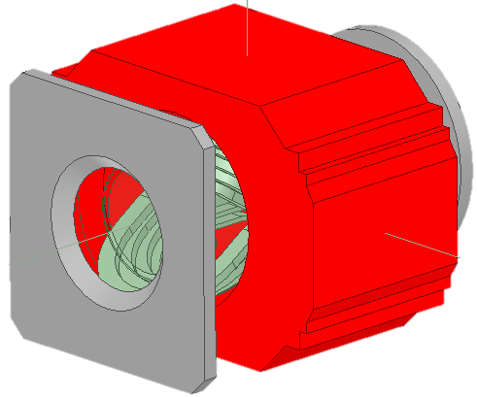
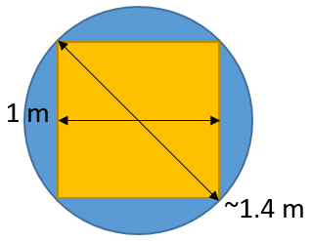
Magnadon Magnet Specifications
Preliminary design of support
Specifications
Field at Center | 4 T
Free warm bore diameter | 1400 mm
Total Stored Energy | 80 MJ
Peak field in conductor | 5.5 T
Stray field at 5 m | 11 mT
New design used a tilted racetrack “skateboard” design
Compatible with Morpurgo iron yoke

Slide 19
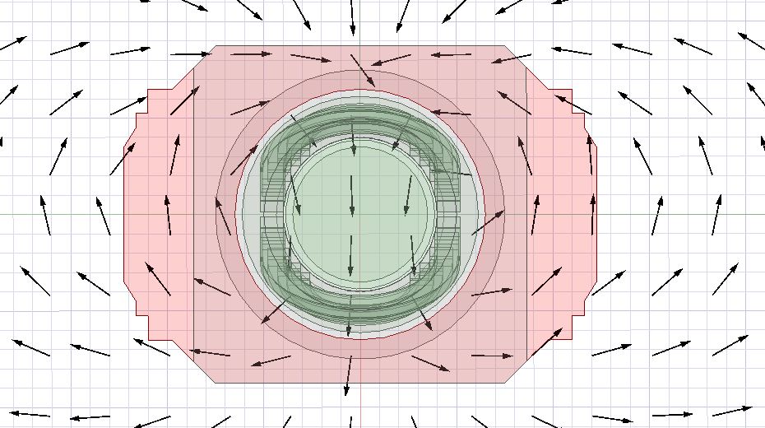
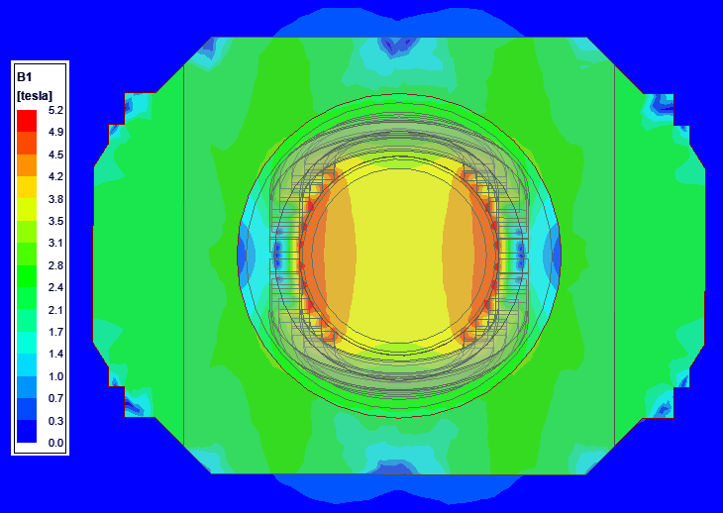
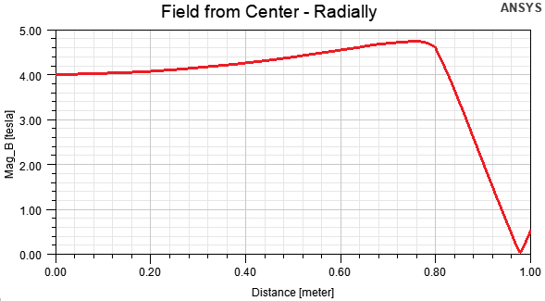
Magnadon Magnetic field plots
The field drops off radially at 1 m due to the iron yoke

Slide 20
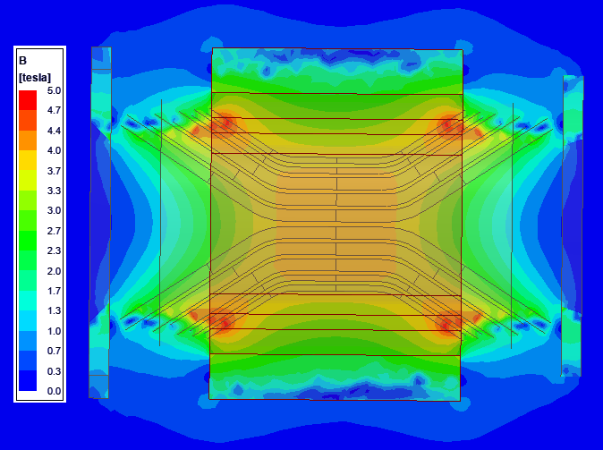
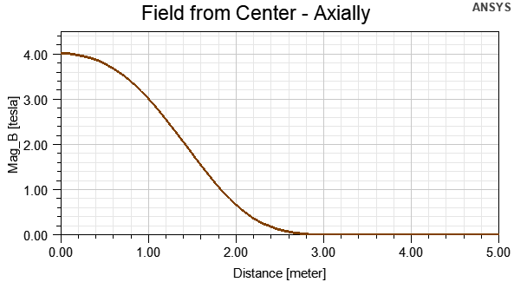
Magnadon Field Along axial and radial direction
Sections through central plane

Slide 21
north area magnets Summary and Benefit comparison
Both magnets have a 4 -T central field
A minimum of 1 m³ free volume
Magnadon has a more complex winding process and mechanical structure to be further developed, so priority has been given the Split Coil Solenoid at this stage
Split Solenoid Coil | The Magnadon
Dual orientation of testing Simpler mechanics and manufacture | Better field homogeneity Larger aperture of 1.4 m

Slide 22
Project Outlook
Split Coil Solenoid 1-T demonstrator to be built
Looking towards future user community for feedback and possible collaborations
Is a 4 -T superconducting magnet facility with 1 m³ free volume appropriate for the user community?

Slide 23

Thank You
Shuvay.singh@cern.ch

Slide 24
Supporting slides

Slide 25
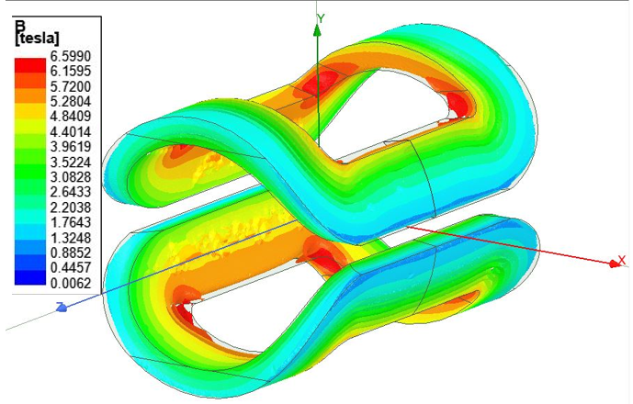
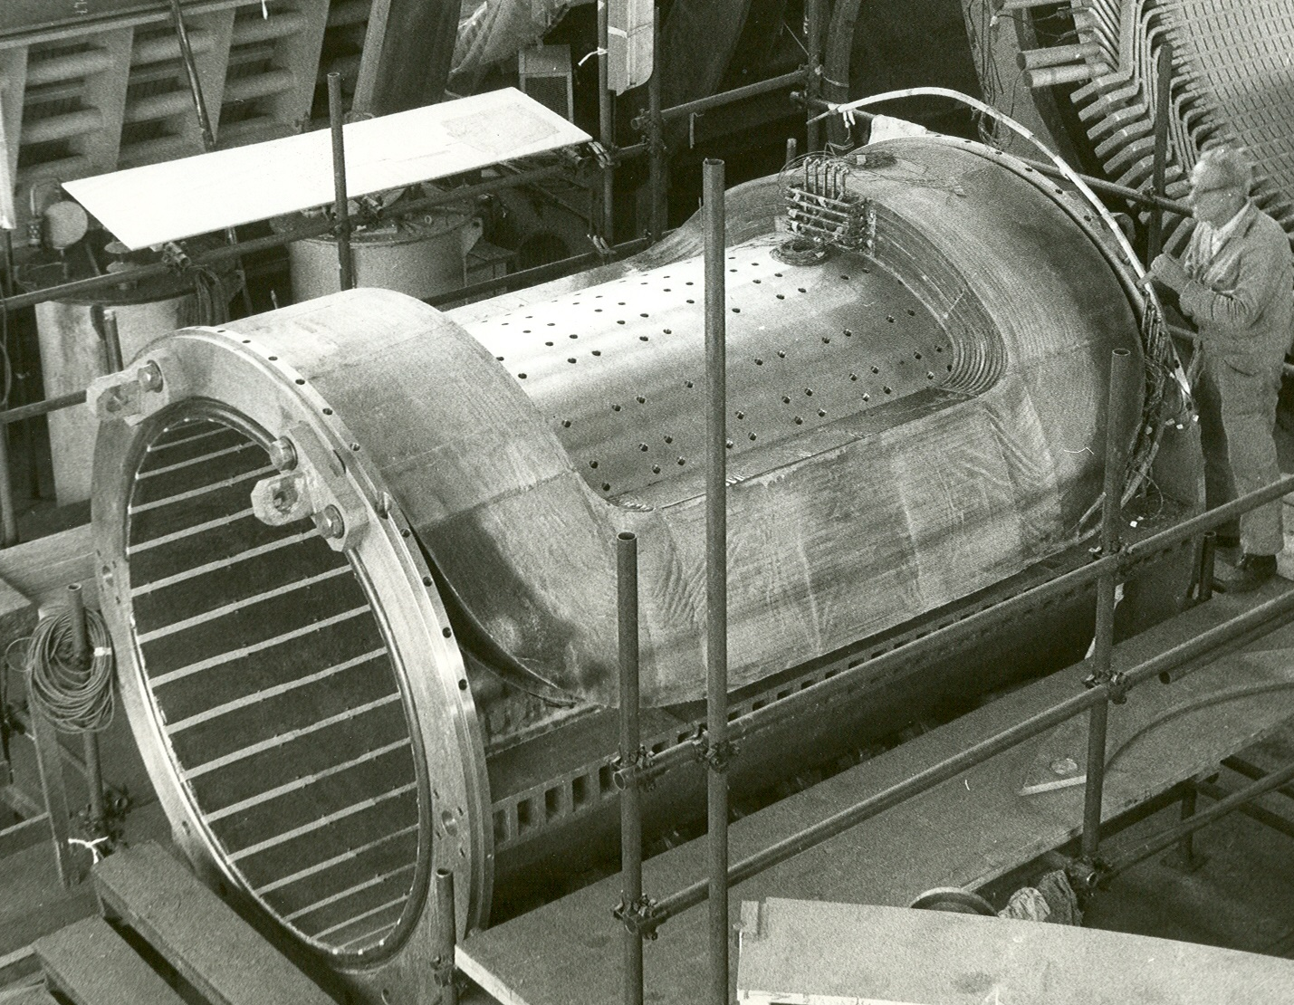
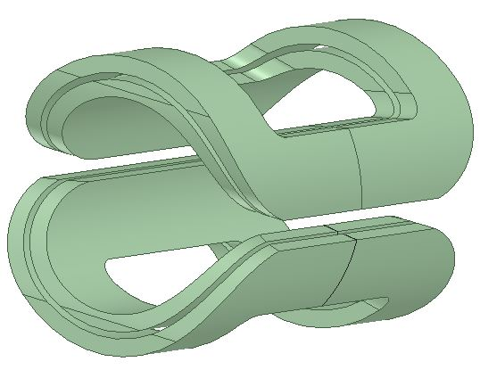
The Magnadon
Alternative saddle shape first considered and studied
Construction of Morpurgo magnet
Like the H8 Morpurgo magnet
Peak field concerns lead focus to Magnadon

Slide 26
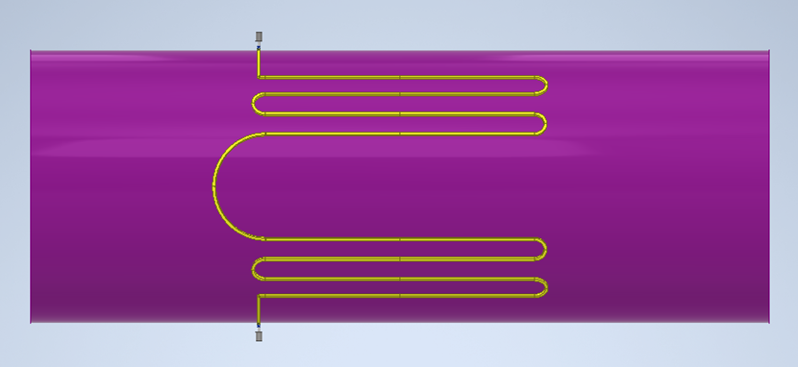
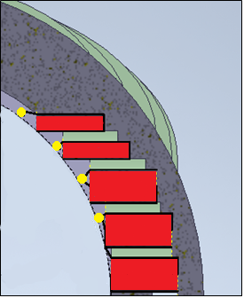
Magnadon Magnet Thermosiphon concept
Cross-section of Magnadon assembly
New code developed (Thermo-ronika) to compute all design parameters and behaviour for thermosiphon of Magnadon and SCS
Fully passive system without the need of pumps

Slide 27
Split Coil Solenoid Magnet Quench Behaviour
Preliminary split coil simulations done with updated “Quench 2.7”
Quench heater concept showed satisfactory results with a good safety margin
With the quench heater variant the coil reaches a temperature of approximately 100 K, but with a relatively small temperature gradient below 25 K
It shows the feasibility with a reduced temperature gradient across the coil, without the need for energy-extraction systems
[2]

Slide 28
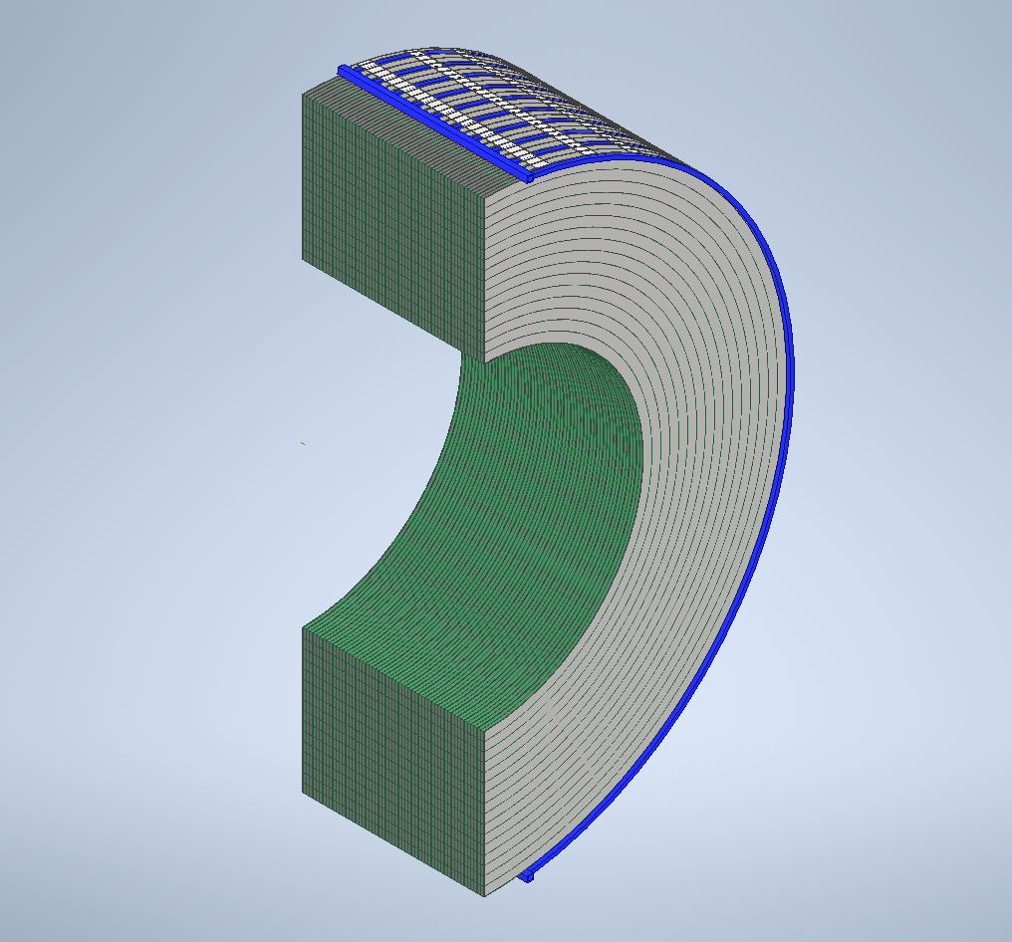
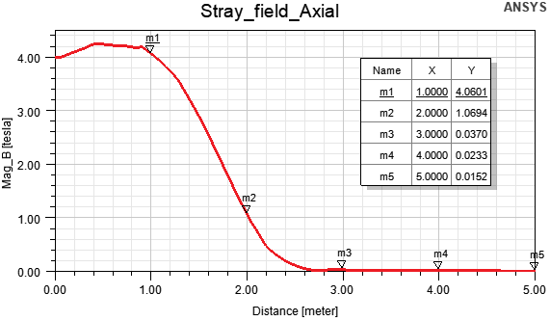
Split Coil Solenoid Stray field and Cryogenics
Current stray at 5 m is 15 mT, lower than M1 magnet
Shaping of iron to reduce stray field
Active shielding has also been investigated however, due to small margin in maximum allowable peak field, reduction in stray field is negligible
Thermo-siphon concept for cooling of stacked double pancakes of each coil

