Slide 1


CERN Secondary Beamlines and Experimental Areas
D. Banerjee, J. Bernhard, N. Charitonidis, A. Gerbershagen, , B. Rae, S. Schuh-Erhard, M. Van Dijk and M. Brugger on behalf of the CERN BE-EA group
20.06.2022

Slide 2
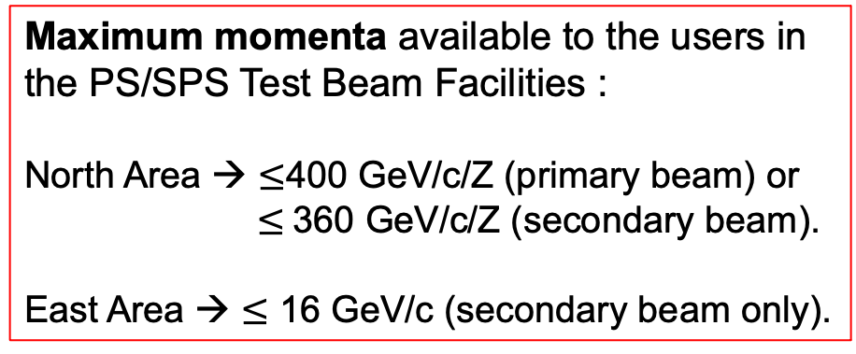
CERN Accelerator Complex
SPS : protons/ions @ 400 GeV/c/Z
PS: protons /ions @ 24 GeV/c/Z
Maximum momenta available to the users in the PS/SPS Test Beam Facilities :
North Area → $≤$400 GeV/c/Z (primary beam) or $≤$360 GeV/c/Z (secondary beam).
East Area → $≤$ 16 GeV/c (secondary beam only).

Slide 3
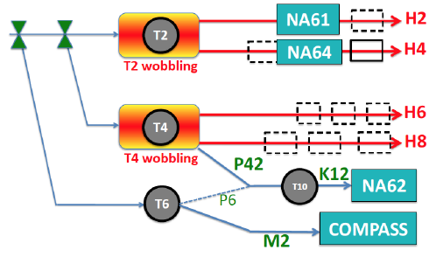
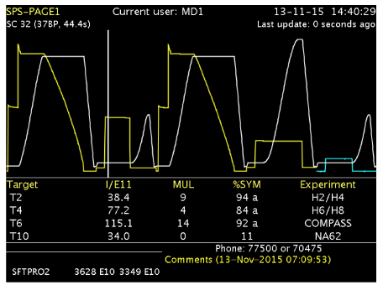
North Area Secondary Beamlines
The 400 GeV/c primary beam is slowly extracted to 3 primary targets → T2, T4 and T6
SPS beam @ 400 GeV/c
E
EHN1
ECN3
EHN2
Spill duration: 4.8 second flat top
Typically : 2 cycles / SPS supercycle for NA and
~ 3000 spills/day
Supercycle structure depends on the physics program of all the facilities served by the SPS including LHC, AWAKE, HiRadMat and the Machine Development program.

Slide 4
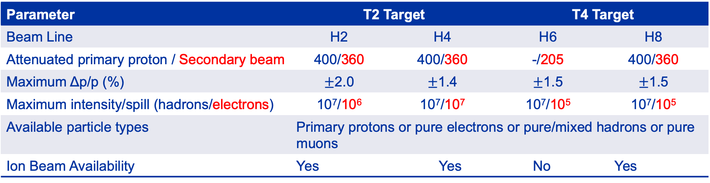
Characteristics of the Beam
Parameter | T2 Target |  |  | T4 Target | T4 Target
Beam Line | H2 | H4 | H4 | H6 | H6 | H8 | H8
Attenuated primary proton / Secondary beam | 400/360 | 400/360 | 400/330 | -/205 | -/205 | 400/360 | 400/360
Maximum Δp/p (%) | $±$2.0 | $±$1.4 | +-1.4 | $±$1.5 | +-1.5 | $±$1.5 | +-1.5
Maximum intensity/spill (hadrons/electrons) | 10⁷/10⁶ | 10⁷/10⁷ | 10⁷/10⁵ | 10⁷/10⁵ | 10⁷/10⁵ | 10⁷/10⁵ | 10⁷/10⁵
Available particle types | Primary protons or pure electrons or pure/mixed hadrons or pure muons
Ion Beam Availability | Yes |  | Yes |  | No |  | Yes
T6 Target → Serves the M2 beam that is currently used for the COMPASS experiment.
  < 10⁸ hadrons/spill < 280 GeV/c.
  < 3 x 10⁸ muons/spill < 250 GeV/c.
  COMPASS will finish their physics program this year and new proponents including NA64µ, MUonE and AMBER aim to run in M2 and had pilot runs in 2021 and 2022.
P42 beam also originates from the T4 target and transports the proton beam that has not interacted, onto the T10 target to produce typically 75 GeV/c kaon beam for NA62.

Slide 5
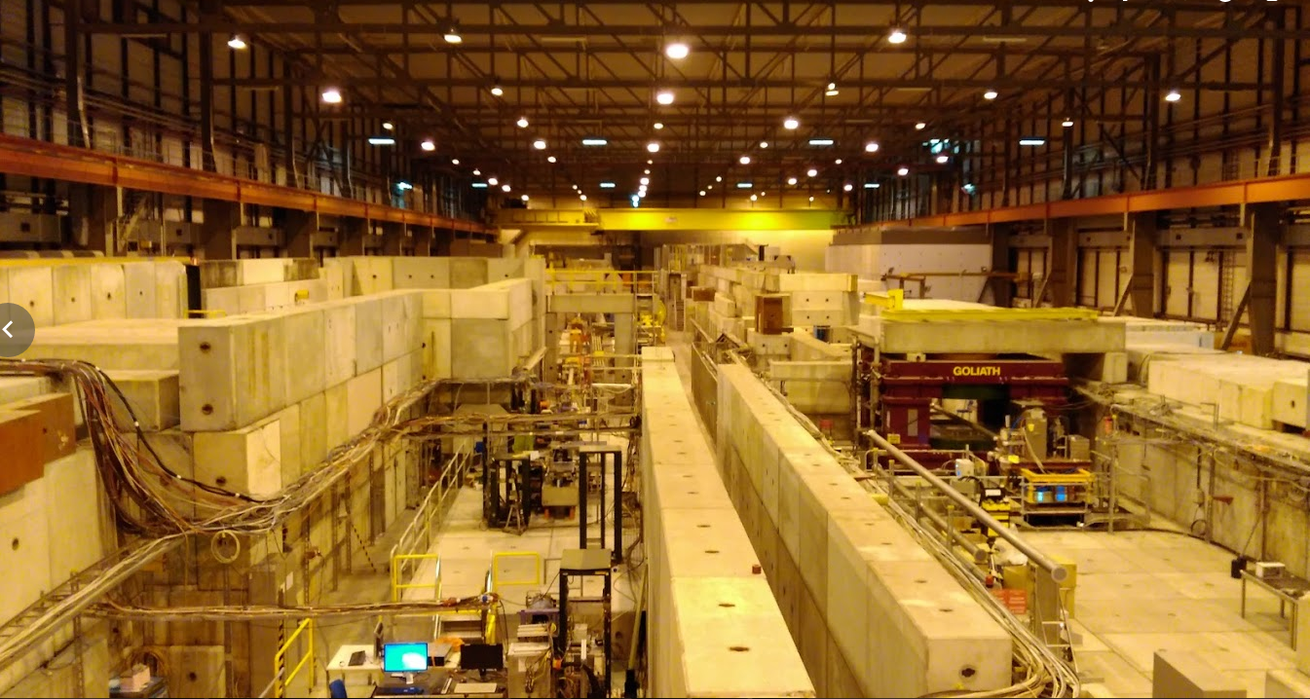
EHN1 (B-887, Prevessin Site)
H6
H8
H4
H2

Slide 6
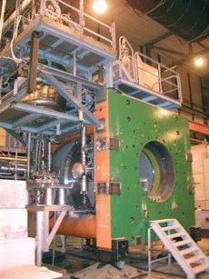
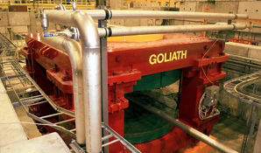
Large aperture magnets available in the North Area for tests with beam
GOLIATH
EHN1, H4 beam line
Large classical dipole
160 x 240 x 360 cm
0.85T field
Morpurgo
EHN1, H8 beam line
Superconducting dipole
1.6 m diameter, 4 m length
1.5 T field
CMS M1 magnet
EHN1, H2 beam line
superconducting dipole
82 cm gap, 1.4m diameter
3.0 T field

Slide 7
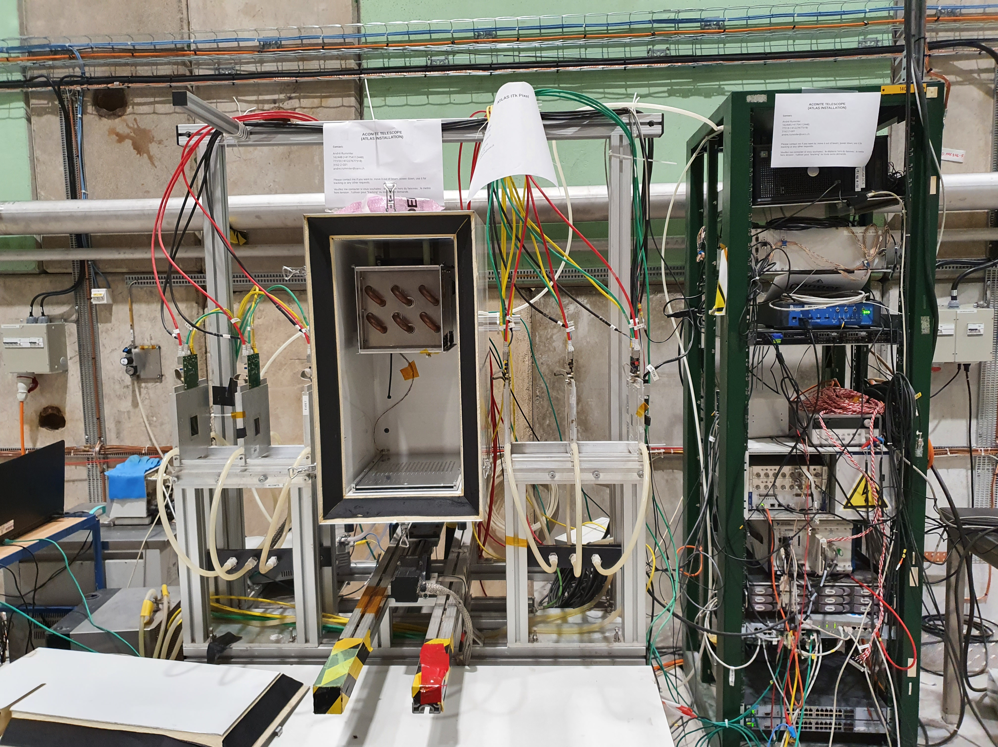
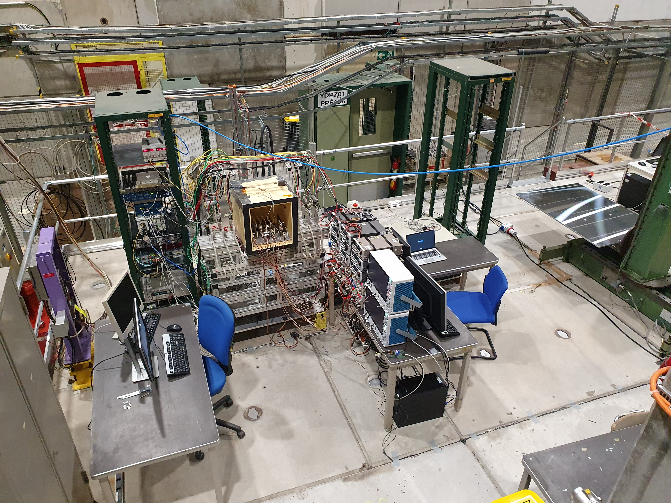
Telescopes in CERN North Area (SPS)
Two telescopes installed permanently in the North Area (not managed by BE-EA):
  ACONITE in H6A
  AIDA telescope in H6B
  A Mobile telescope AZAELA is also available
  Contact: Andre Rummler /PS-SPS Coordinator.
Properties:
  6 Mimosa-26 planes
  TLU/EUDAQ based
  Dedicated remote control PCs in control huts
  High degree of usage and increasingly simultaneously
  Separate x-y table can be booked and installed behind telescopes serving larger DUTs
  Remote controlled high voltage (ISEG modules with 8 channels up to −500V and 8 channels up to −2000V)
H6A
H6B

Slide 8

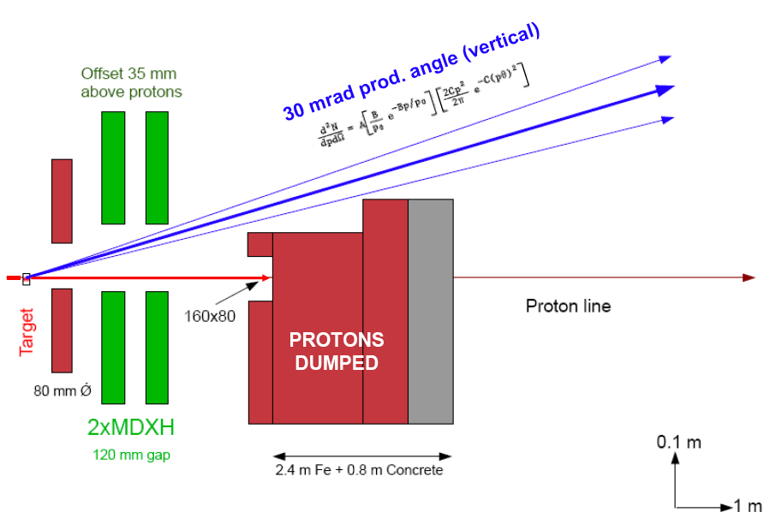
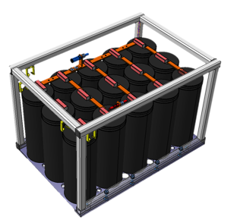
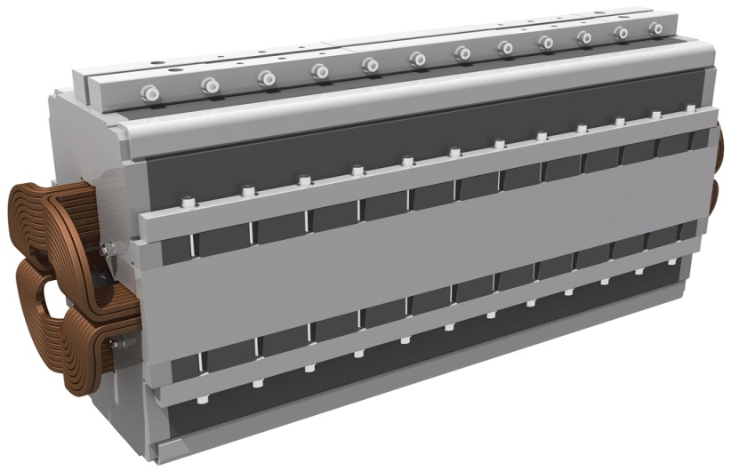
East Area Renovation
The East Area Renovation was completed during the LS2.
The renovation included
  Full refurbishment of the East Hall with its beamlines and infrastructures
    Upgrade of B157, its heating/ventilation, improved thermal insulation, wall and roof cladding (asbestos), separated cooling for primary and secondary beamlines.
  Improved radiation protection.
    Improved equipment accessibility and faster repair times, primary beam dump just downstream of the primary target.
  Change in the beamline layout
    Higher max. p and improved selectivity pf particle types.
  Completely new magnet powering scheme
    Cycled powering leading to reduction of annual power consumption from 11 to 0.6 GWh, less magnet types for better maintenance.
B157
Energy storage unit
New laminated Q74 magnet

Slide 9
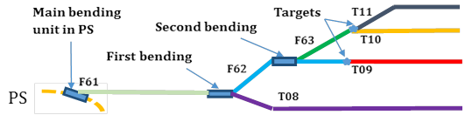
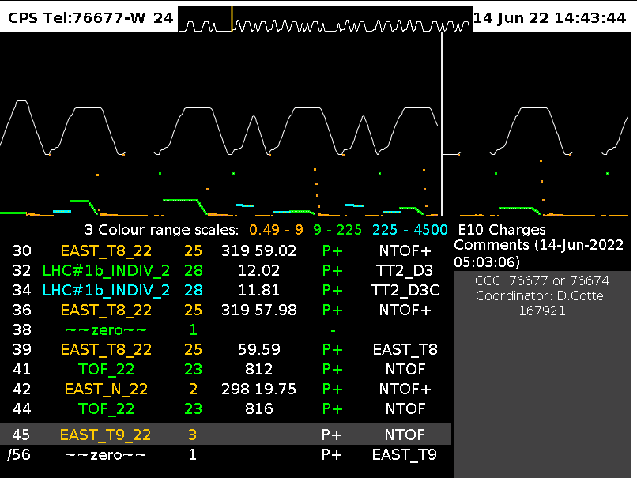
East Area Secondary Beamlines
PS beam @ 24 GeV/c
Spill duration: 0.4 second flat top
Usually : 1-2 cycles per minute per East Destination
Max 6 East cycles / 40 seconds → RP Limit
Super-cycle structure dependent on all users (SPS, nTOF …)

Slide 10
East Area Secondary Beamlines
PS beam @ 24 GeV/c
See B. Gkotse’s talk
Spill duration: 0.4 second flat top
Usually : 1-2 cycles per minute per East Destination
Max 6 East cycles / 40 seconds → RP Limit
Super-cycle structure dependent on all users (SPS, nTOF …)

Slide 11
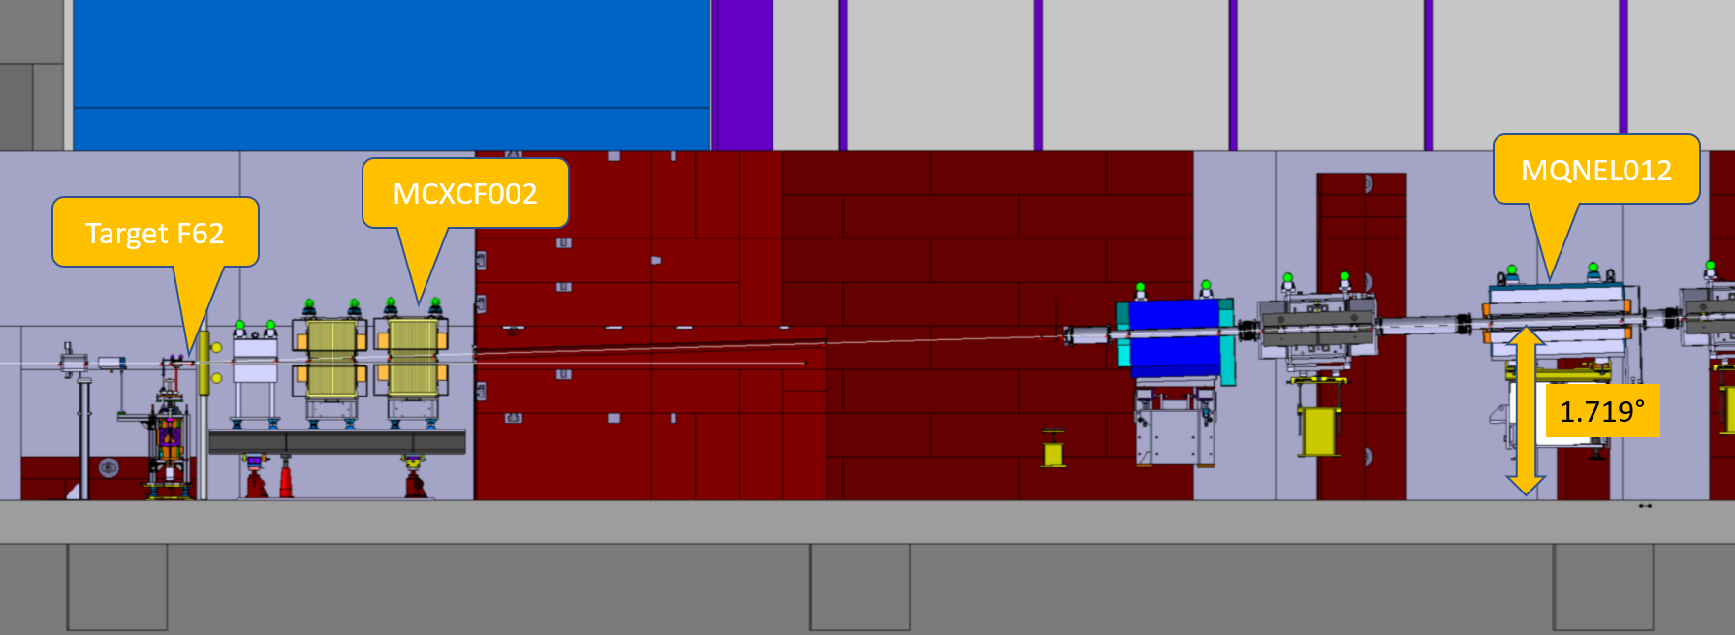
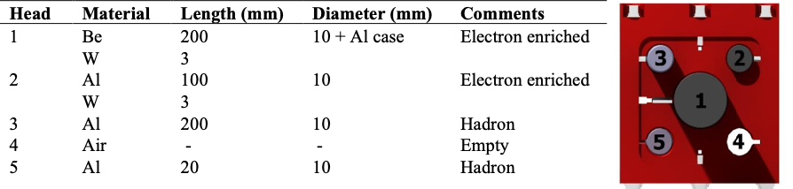
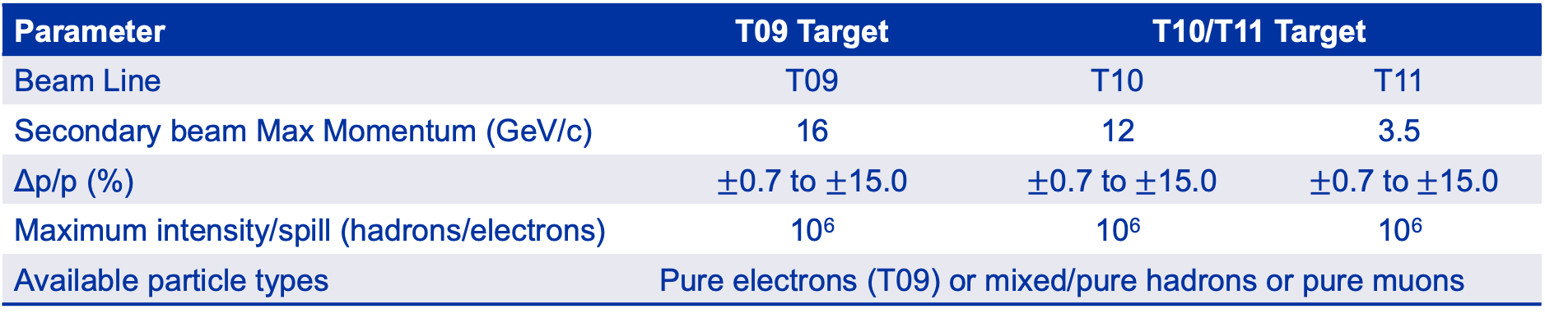
Characteristics of the Secondary Beams
Parameter | T09 Target | T10/T11 Target
Beam Line | T09 | T10 | T11
Secondary beam Max Momentum (GeV/c) | 16 | 12 | 3.5
Δp/p (%) | $±$0.7 to $±$15.0 | $±$0.7 to$±$15.0 | $±$0.7 to$±$15.0
Maximum intensity/spill (hadrons/electrons) | 10⁶ | 10⁶ | 10⁶
Available particle types | Pure electrons (T09) or mixed/pure hadrons or pure muons
T11 serves the CLOUD experiment which is a permanent installation.
The Water Cherenkov Test Experiment aims to use the T09 beamline in 2024 for ~ 13 weeks for testing their 4 m diameter 4 m height 50-ton tank .
30-35 mrad vertical production angle
Multi-target configuration

Slide 12
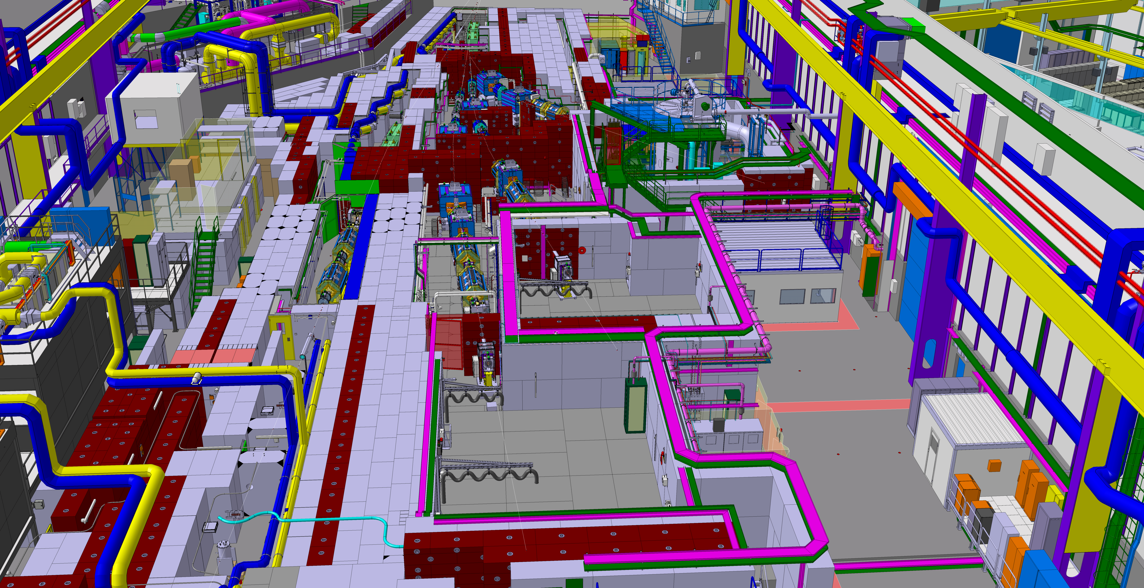
Current Layout
T11
T10
T08
T09
D. Brethoux, M. Lazzaroni

Slide 13
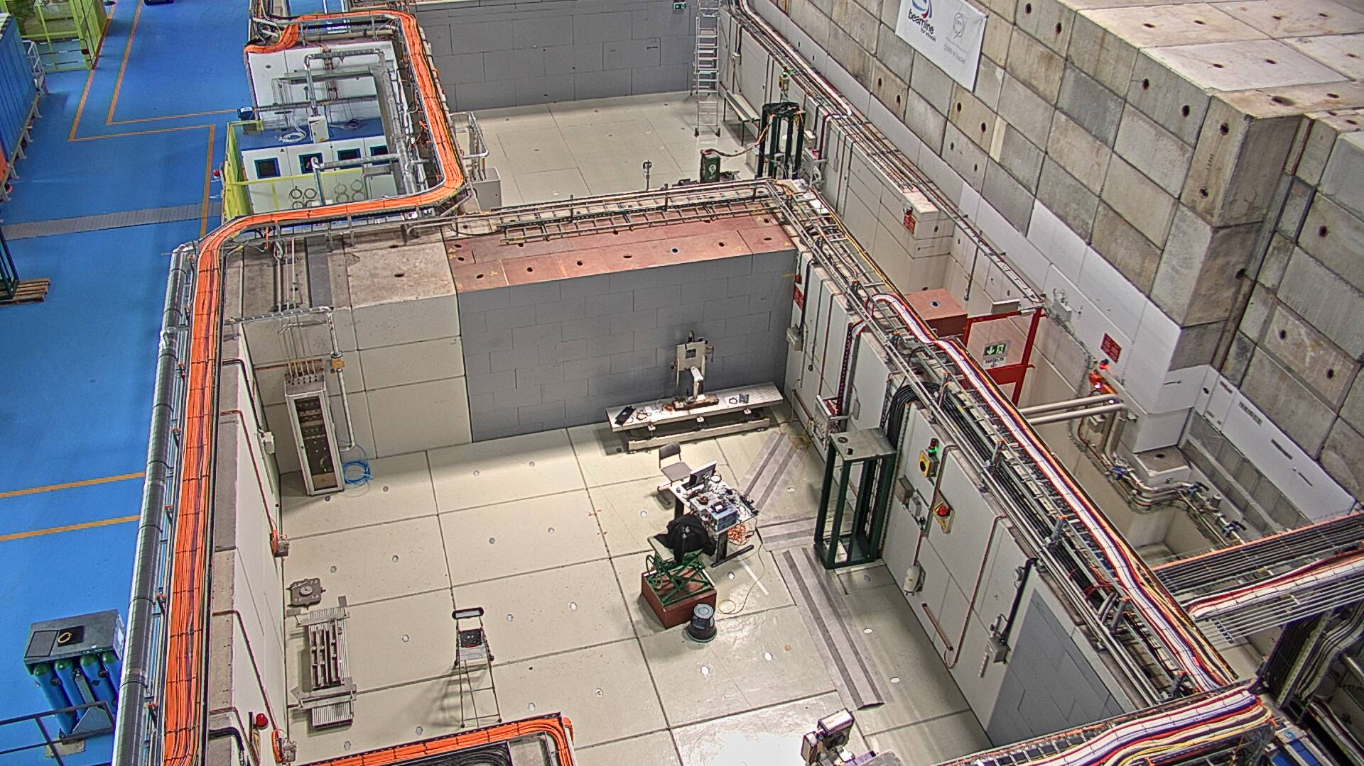
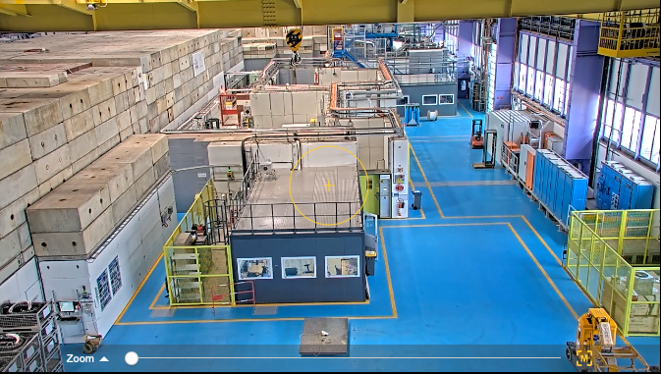
Current Layout
Beam
T09
T11
T10
T09
T10
T08
Beam

Slide 14
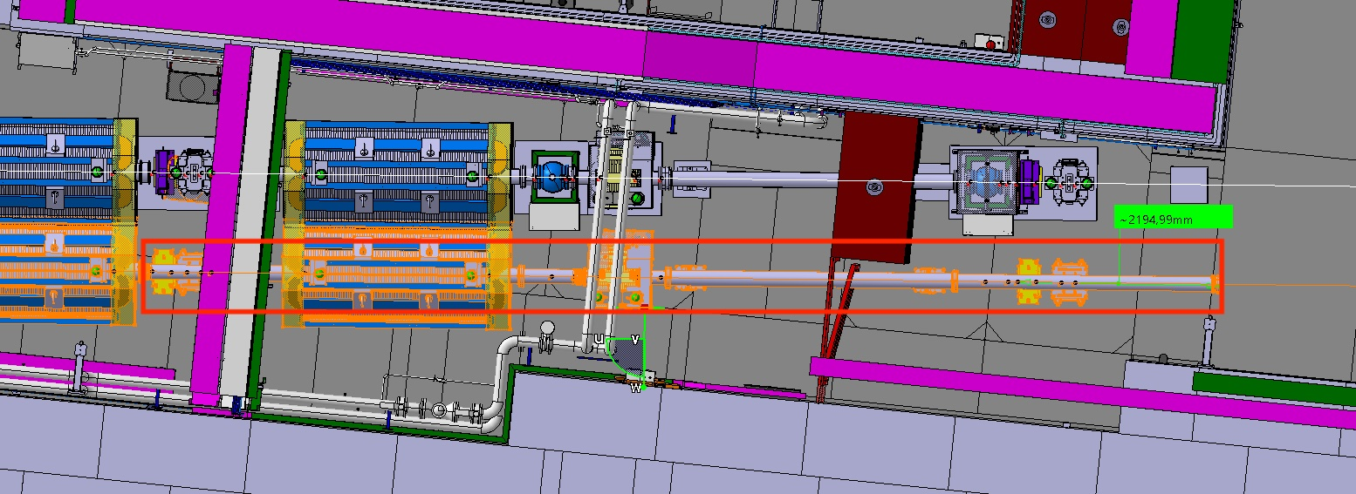
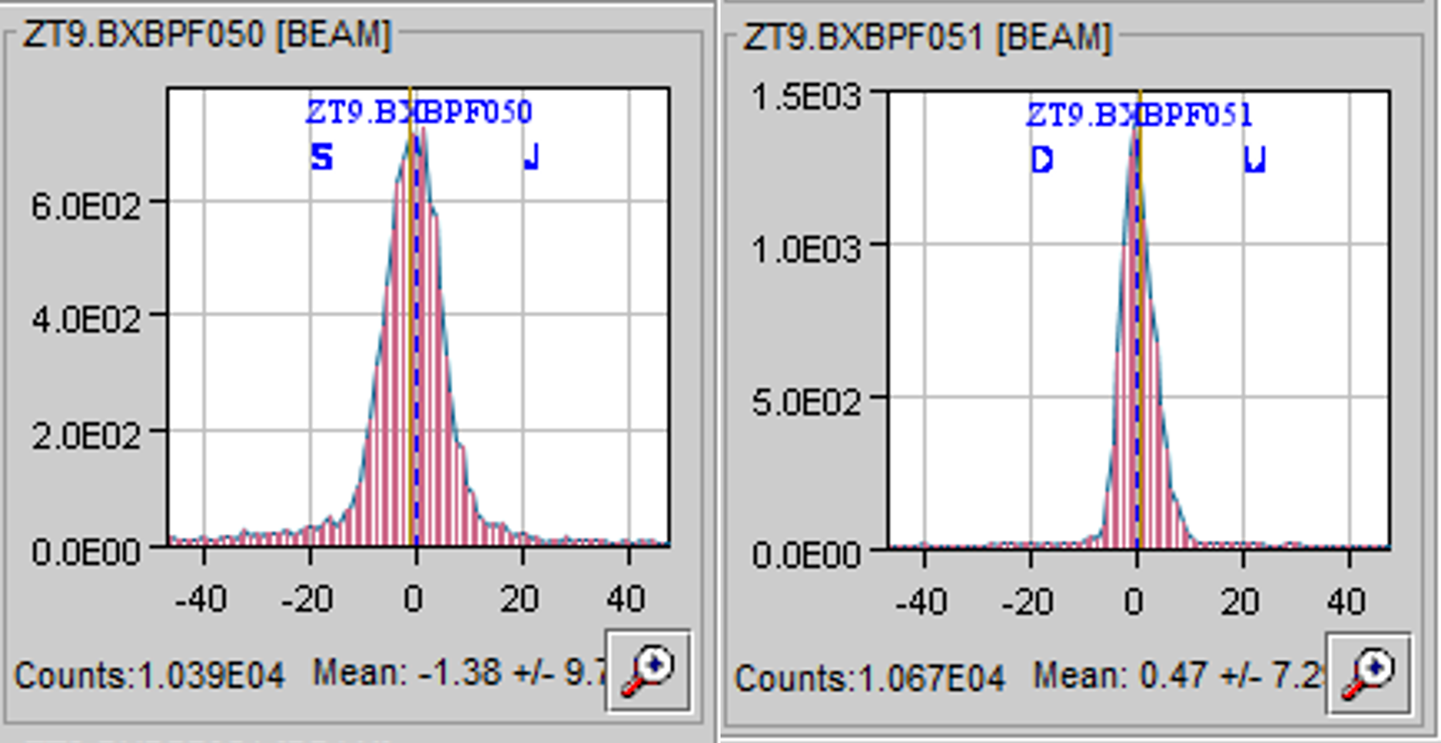
First Beams to the Renovated East Area
The first beams were provided in T9-T11 in 2021 when East Area restarted after the renovation.
The beams were commissioned at the maximum momenta and the transmission was checked. The maximum rate observed was ~ few 10⁶/spill as expected.
Then they were scaled to the lowest momenta of ~ 0.1 GeV/c. A low momentum configuration is also available in T09 from this July when the vacuum can be completed until the user setup.
The users are taking physics data since October 2021 as scheduled without any delays.

Slide 15
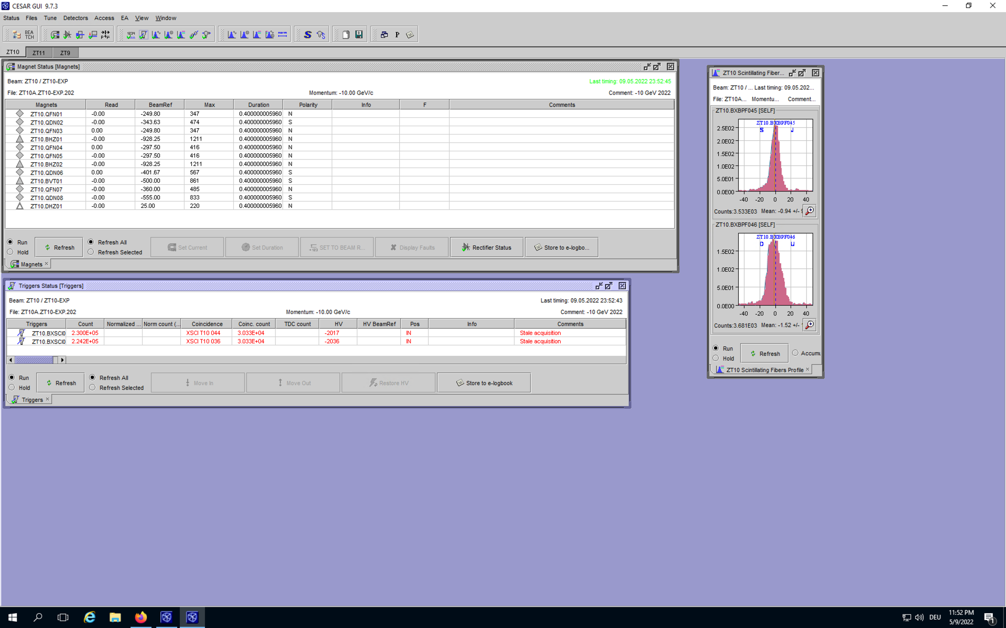
Beam Instrumentation in the North and East Area
Depending on the beam line and the zone :
  Threshold Cherenkov gas counters (XCET) and
  CEDARs → used for particle tagging
    In the east area new high pressure XCETs are available that go up to 15 bars with the option of using refrigerant gases like R218 and R134a for low momenta particle tagging.
  Beam profile & intensity monitors:
    scintillators & analog/delay multi wire chambers are installed in several positions along the beam line.
    In the East Area scintillating fibre hodoscopes (XBPF) are used as
    profile monitors.
    As part of the consolidation efforts under NACONS all
    analog/delay wire chambers will be replaced by XBPFs.
  FISC scanners(only North Area) → precise slower profile
  monitors – can also be used for angular measurements
Beam data available in the control rooms (Online: CESAR, Offline: Timber)

Slide 16
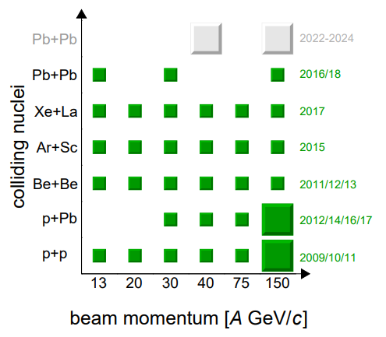
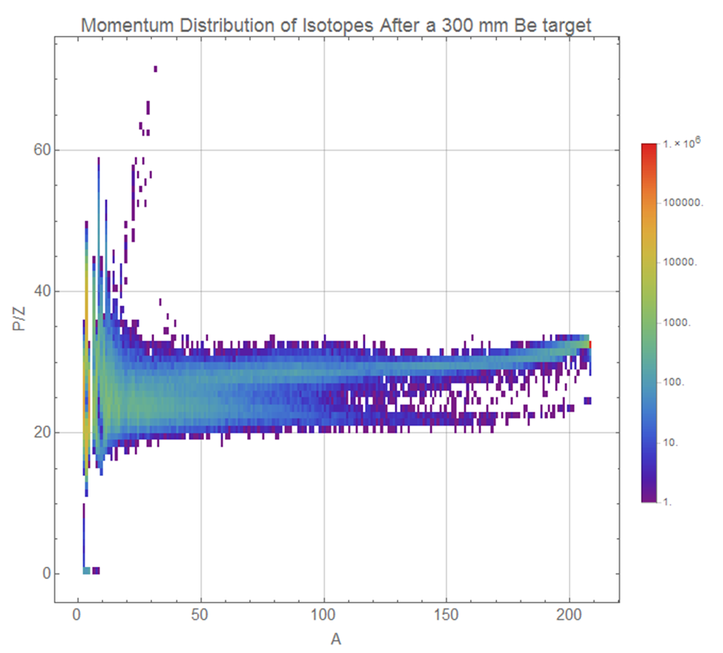
Ion Beams
Ion beams are available in the North and the East Area
  2021: No ions
  2022: Pb
  2023 and later: to be defined
Primary and Fragmented ion beams are available.
Availability for test beam users in H2/H4/H8 and T08.
Experiments like NA61 and NA60+ have ion beam programs in the North Area.
Test-beam users like Medipix, Nucleon (satellite experiments), HERD, PAN also request ion beams.
In 2022 CHIMERA also plans to take low energy ions in T08 (See B. Gkotse’s talk).
Courtesy: NA61
FLUKA simulation

Slide 17
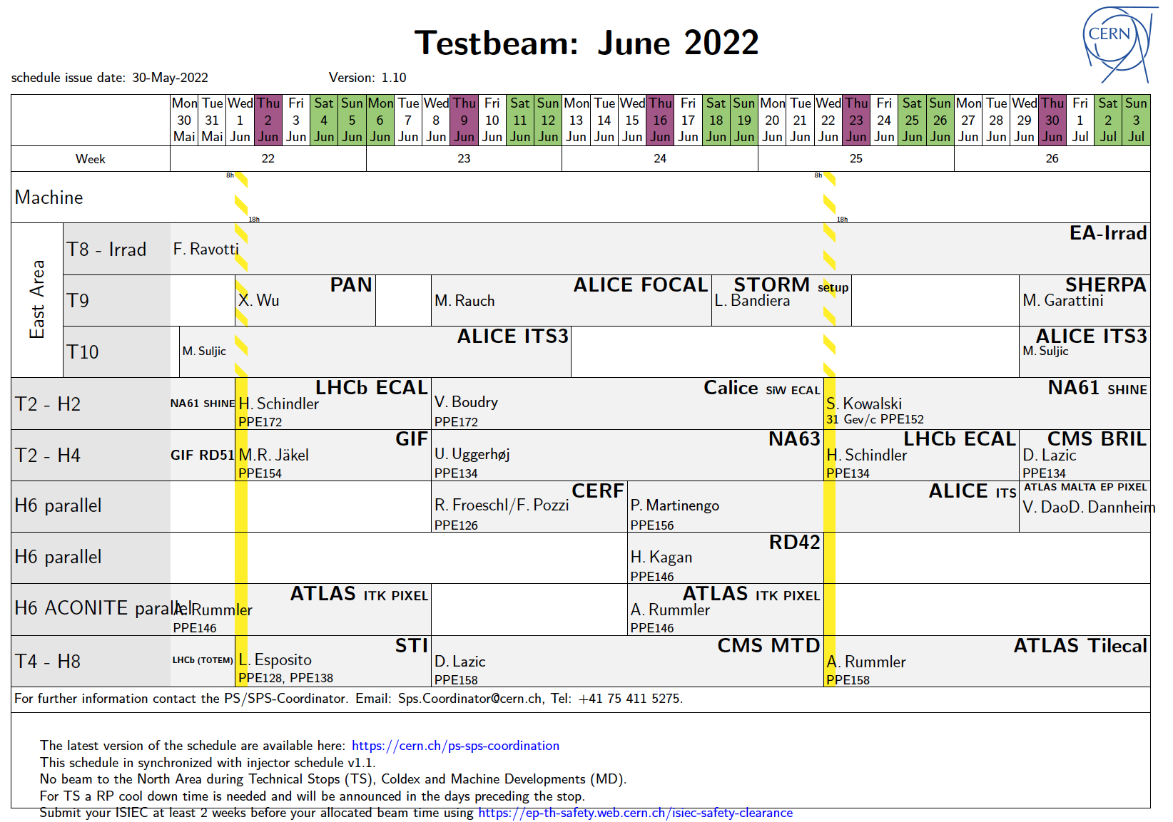
Schedule and planning
The beam time request must be sent to the PS-SPS coordinator ~ November for the following year.
  Short (<1 week @ SPS or < 2 weeks @ PS) requests can be handled by the PS-SPS coordinator only.
  Longer requests require recommendation by CERN physics committees (SPSC, LHCC, REC, RB)
The scheduling is based on priorities of different experiments and is discussed with the scientific committees. The draft schedule is presented at the CERN research board for approval.

Slide 18
Summary
CERN offers a great variety of test-beam options with beams ranging between 0.1 GeV/c – 400 GeV/c.
The experimental areas include:
  EHN1, EHN2 and ECN3 in the North Area.
  T9, T10 and T11 in the East Area.
Please contact in advance Sps.Coordinator@cern.ch and sba-physicists@cern.ch in order to optimally use your beam time and the facilities.
  Visit https://ps-sps-coordination.web.cern.ch/ps-sps-coordination/ for the updated version of the schedule and other useful information.
Looking forward to seeing you at CERN !!

