Slide 1
General Status of Beam Instrumentation
JJ Gras on behalf of BE/BI
  Status of new wire scanners
  TT2 couplers: what is needed to make them operational?
Status of beam current transformers
Status of LHC BLMs: actual and expected performance

Slide 2
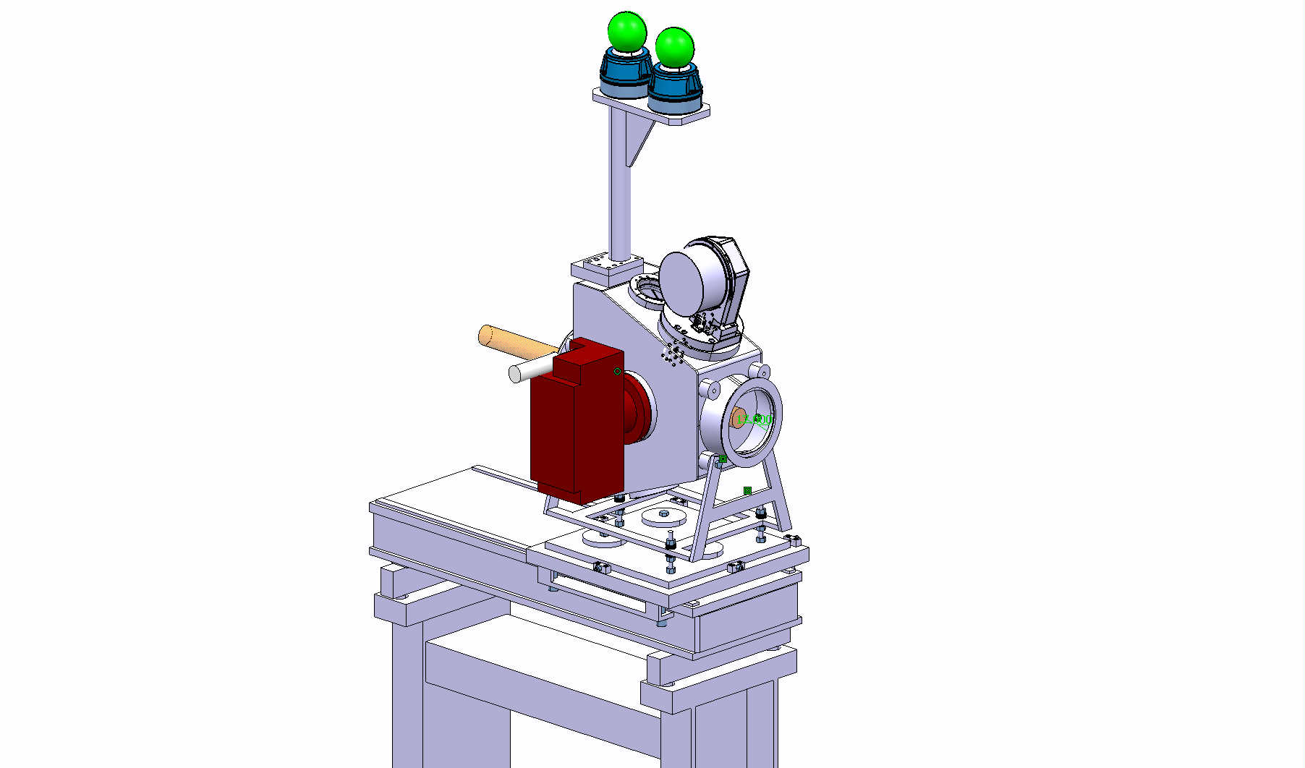
Status of New Wire Scanners
BWS – BPM – BCT – BLM – Conclusions
Goal of the Project:
  Decrease the aperture restrictions due to the horizontal scanner tanks in the PS machine.
  Install an additional horizontal scanner in the SS68.
  Allow calibration on an extended range (+/- 50 mm)

Slide 3
Status of New Wire Scanners
BWS – BPM – BCT – BLM – Conclusions
Design discussed and agreed with OP, ABP and impedance and vacuum experts.
6 new tanks will be made.
  2 are in production now. They’ll be ready for the end of November
  Last 4 will be made in 2011.
The optical bench to calibrate these scanners on an extended range (+/- 50mm) will also be ready by the end of November and installed in 588.
2 additional fast wire scanner mechanisms will also be produced to keep a correct situation for spares.

Slide 4
Status of New Wire Scanners
BWS – BPM – BCT – BLM – Conclusions
In addition, we plan to install one pick up next to each horizontal scanners to allow:
  Quick calibration check
  Monitoring of possible degradation of the calibration
3 pick ups have been ordered by Jeroen to cover this need.

Slide 5
Status of New Wire Scanners
BWS – BPM – BCT – BLM – Conclusions
The plan is to:
  Install a new PS horizontal wire scanner in SS68 during Christmas technical stop, including the extra pick up.
  Replace the 4 current PS tanks by the new ones during 2012 long shutdown. If the experience with the neighboring pick up is positive, we will also equip SS54 and SS64 H wire scanner with one.

Slide 6
Status of New Wire Scanners
BWS – BPM – BCT – BLM – Conclusions
Finally, we agreed with OP to apply more systematic approach to assess the wire scanners performance and behavior over time. This will be based on:
  agreed and stable test conditions and procedures (yet to be published) covering most important use cases (main USERs/Beams)
  Systematic comparison with SEM grids and dp/p measurements.

Slide 7
TT2 couplers: what is needed to make them operational?
BWS – BPM – BCT – BLM – Conclusions
Most BPMs in TT02/TT10 (16 over 20) are on SPS timing and controlled via a dedicated BI FESA class.
The other 4 in TT02 are controlled via samplers on PS timing to
  cover all beam extracted from the PS
  allow position measurement for the 5 PS turns.
The current implementation of these 4 BPMs makes it difficult to have them “operational”, i.e.:
  Calibrated regularly and precisely.
  Integrated into YASP for easy and efficient steering.

Slide 8
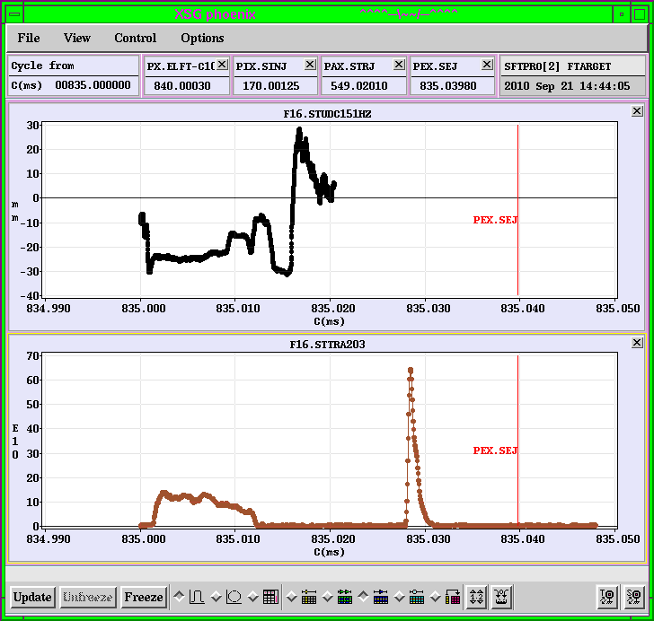
TT2 couplers: what is needed to make them operational?
BWS – BPM – BCT – BLM – Conclusions
The electronics is based on logAmp hiding the signal intensity information
Here are the 5 turns sampled at 200 MS/s.
The rest is logAmps amplifying noise.
The 5 turn positions can nevertheless be derived by averaging around predifined time markers.
Samplers, as generic devices, cannot implement these specific treatments in the front end.

Slide 9
TT2 couplers: what is needed to make them operational?
BWS – BPM – BCT – BLM – Conclusions
A word on calibration for these 4 BPMs separated from their BI acquisition server:
Calibration of these 4 BPMs has to be done manually from surface building in collaboration with OP in CCC. This is working (and Thierry is convinced that the results of the last calibration are correct and still valid) but is very heavy.
We have no precise assessment of the accuracy of our measurements except for cross-checks made by OP (BTV, bumps) on TT10 who declared the results as correct and coherent.

Slide 10
TT2 couplers: what is needed to make them operational?
BWS – BPM – BCT – BLM – Conclusions
A word on the integration in YASP
This is not straightforward for 2 reasons:
  Sampler gives a 200 MS/s position spill based on the BPM logAmp result. This would have to be reduced to 1 position per turn to be swallowed by the steering algorithm.
  YASP is currently limited to one position per extraction
The feasibility of this is currently investigated by Marine and Joerg but BI cannot help much on the current implementation.

Slide 11
TT2 couplers: what is needed to make them operational?
BWS – BPM – BCT – BLM – Conclusions
BI had for some time the plan to renovate this system based on the current CNGS transfer line implementation.
  The proposed solution would have solved the timing domain problem and allow an easy integration in current PS and SPS YASP (1 point per extraction)
  But it would not have provided a position per PS turn.
We are currently designing a new electronics to cover all these needs. We plan to test a prototype next year and have the new system deployed during 2013 start-up.
Any possible adaptation of YASP to 5 turn acquisition and correction done in the meantime will still be valid.

Slide 12
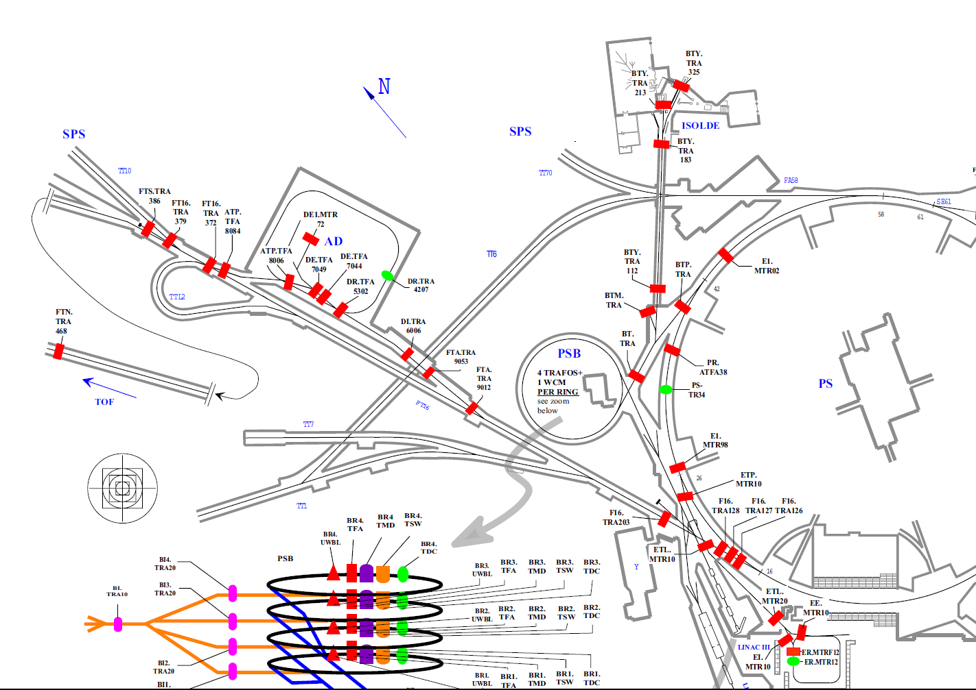
Status of Beam Current Transformers
BWS – BPM – BCT – BLM – Conclusions

Slide 13
Status of Beam Current Transformers
BWS – BPM – BCT – BLM – Conclusions
We clearly understand OP’s interest to get a good absolute accuracy on the different BCTs in the PS complex.
Unfortunately, the current diversity of monitors combined with a serious human resource problem (old PS team is now also responsible for SPS and LHC BCTs) makes it difficult to achieve.
Today, an absolute accuracy to quantify the losses at 1% level looks out of reach but we do think that we should be able to achieve soon a short term relative accuracy from shot to shot within the 1% rms to optimize machine performance

Slide 14
Status of Beam Current Transformers
BWS – BPM – BCT – BLM – Conclusions

Slide 15
Comments on BCTs in TT2
Devices normally used for MTE studies:
  PS ring transformer (reference)
  FBCT in 212 (spill and total intensity)
  BCT372 (total intensity)
Recently additional data should be available:
  126, 203, 372 -> spill data
  All BCTs providing total intensity
In principle everything should be logged.
Cross-calibration still to be improved
Logging to be verified
Massimo’s slide showed a less favorable example this morning on data taken ten days after.
This has to be investigated but what we suspect there is a shift a the analog fast trigger controlling the acquisition window. If this is shifted (and this is not under BI control), then the integration over the acquisition window will be lower.
Has this been checked this day?

Slide 16
Status of Beam Current Transformers
BWS – BPM – BCT – BLM – Conclusions
BCT 212 is our current best candidate (TRIC card, fixed calibration, SPS Monitor)
The remaining jittering (~+/-2% P2P over 3 hours) has 3 potential sources:
Machine Instability
Fast Acquisition Chain Instability
Ring DC BCT Acquisition Chain Instability
This is probably the best relative measurement we can achieve.

Slide 17
Status of Beam Current Transformers
BWS – BPM – BCT – BLM – Conclusions
The short term actions to improve the situation are the following:
  We re-calibrated DC BCT (1,5 year old). This should give us now ~1% rms absolute accuracy on ring DC BCT for high intensity beams
  We will disable the pulse to pulse recalibration of the fast BCTs that introduces an artificial 1% variation. This should eventually allow to get a 1%rms relative accuracy from shot to shot to tune the machine.

Slide 18
Status of Beam Current Transformers
BWS – BPM – BCT – BLM – Conclusions
But 3 main sources of errors still remain:
  the uncertainty on fast BCT absolute calibration inherent to the TRIC card components (calculated around 1.5% rms) and currently varying from TRIC to TRIC.
  The poor quality of the existing amplifiers that can lead to signal distortion of several %.
  The quality of some old monitors
For this, the medium term actions are:
  Build a calibration bench to cross-calibrate all TRIC card during Christmas shutdown (CSD) and:
    Eliminate the 1.5% spread between them.
    Reduce the resulting absolute uncertainty
  Test a new amplifier (to be installed W44 in 203) that should eliminate distortions but also allow low intensity beam observation and deploy it during the CSD.

Slide 19
Status of Beam Current Transformers
BWS – BPM – BCT – BLM – Conclusions
On a longer term, we also plan to standardize our fast BCT monitors to our most performant one, i.e. the SPS type.
This could happen during 2012 long shutdown, depending on budget approval.

Slide 20
Status of LHC BLMs: actual and expected performance
BWS – BPM – BCT – BLM – Conclusions
The BCT situation puts extra pressure on BLM requirements in injection and extraction regions
I’ll not come back to the currently available BLM performance already described but concentrate on the result of our recent discussions.

Slide 21
Status of LHC BLMs: actual and expected performance
BWS – BPM – BCT – BLM – Conclusions
It is clear that the MTE extreme requirements (fast response and high dynamics) can not be covered by a single monitor and that our previous assumptions for the BLM renovation have to be reviewed (including cable policy)
We have already installed different types of monitors with various performance (ACEM, Cerenkov, SEM). They are currently assessed.
We will install our last type (short LHC ionisation chamber) during W44.

Slide 22
Status of LHC BLMs: actual and expected performance
BWS – BPM – BCT – BLM – Conclusions
Our educated guess is that these monitors will be able to cover the different needs. (n.b. we expect ACEM to have a performance close to diamond monitors and they will be less expensive [Bernd D.])
We will then review the functional specifications with OP/ABP to clarify what is need where and derive a technical specifications from there based on these tests.
The goal is to have a first draft of technical specifications ready for Q1 2011 so that we can update the requested budget accordingly.

Slide 23
Ring Trajectories at Extraction
BWS – BPM Extra – BCT – BLM – Conclusions
We recorded your request for PS trajectories just before extraction.
This is currently not possible (system blind at 200 MHz)
We’ll trigger an ad-hoc discussion with OP, ABP and our experts to see what we could do to answer the underlying question:
  Is the extraction energy stable?

Slide 24
Conclusions
BWS – BPM – BCT – BLM – Conclusions
We take this opportunity of demanding MTE operation to improve the functional specifications of instruments under renovation but also understand better the existing ones.
In this context, current support from OP for measurements is extremely valuable. We just would like to optimize this by putting in place test conditions and procedures to be able to benefit from these measurements on the long term.
BI decided to invest one FTE over the 2 coming years (VIA coming 1rst of October) on instrument performance assessment. The guy will be pretty busy on LHC but he will also give a hand on the PS.

Slide 25
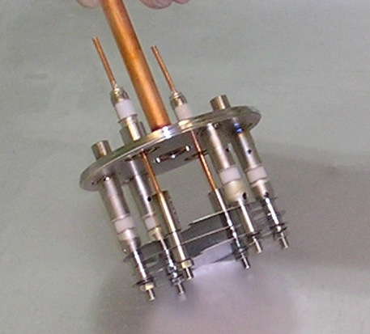
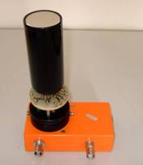
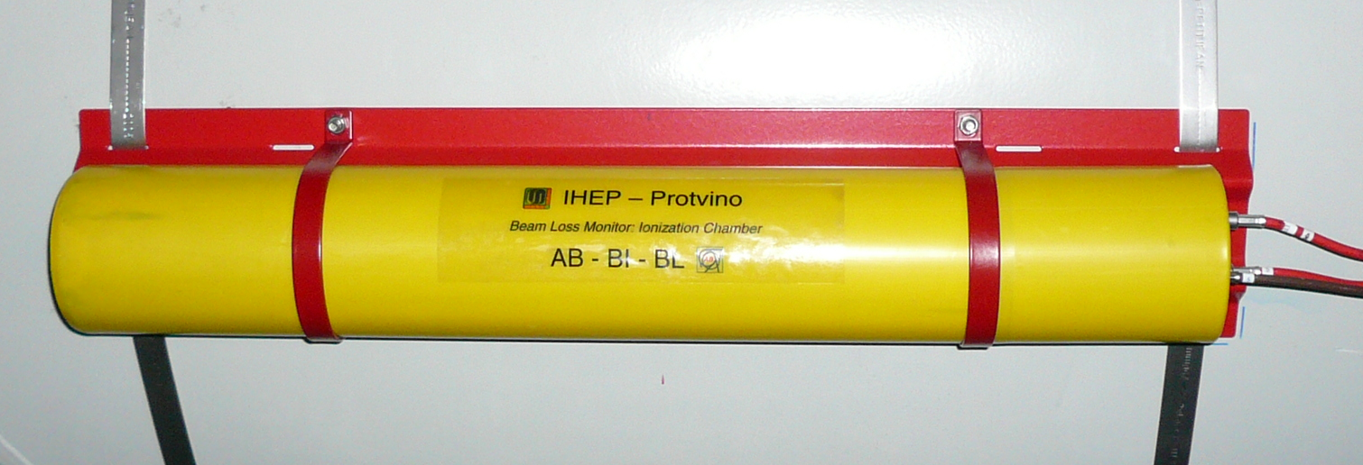
Status of LHC BLMs: actual and expected performance
BWS – BPM – BCT – BLM – Conclusions

