Slide 1



New hybrid organic-inorganic ferrophotovoltaic perovskites nanoparticles for high voltage solar cells and IoT
R. Ndioukane, F. Baldé, N. C. Y. Fall, A. K. Diallo, D. Kobor, M. Touré
Email: r.ndioukane1532@zig.univ.sn

Slide 2
Outlines
Context and problematics
Material and method
Results and discussion
Conclusion and perspectives

Slide 3
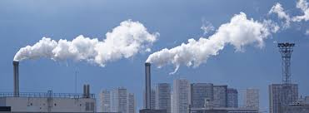
Context and problematics
Energy is considered as one of the primary challenges for the sustainable development of human societies.
Environmentally friendly renewable energy sources, as an alternative to conventional fossil fuels, have witnessed extensive development during past decades because of their potential to provide energy without greenhouse gas emissions and hence mitigate climate change through global warming.
Among a variety of renewable energy sources, PV technologies which enable direct conversion of solar energy to electricity account for a substantial and growing proportion of alternative energy electricity generation capacity globally.
Silicon solar cells are one of the most reliable and efficient technology for renewable energy production.

Slide 4
Context and problematics
However, because of time consuming production processes and high costs production, researchers tried to develop other technologies for solar energy production.
In addition, the prevalent silicon PVs generally have poor performance under ambient light conditions, are also costly when operated at much lower levels of energy conversion than the capability of Si and difficult to integrate into small, lightweight, and portable systems for the IoT.
For indoor applications, the power supply of billions of independent electronic devices and equipment, with the advent of the IoT, is a huge energy requirement that risks compromising reduction decisions of the impact of energy consumption on the climate.
One of the solutions would be the use of photovoltaic cells capable of efficiently converting low intensity light in the indoor environment into megawatt to microwatt class electrical power.
Perovskite solar cells seem to be a good alternative.
Certified record efficiency according to NREL now exceeds 25 %.

Slide 5
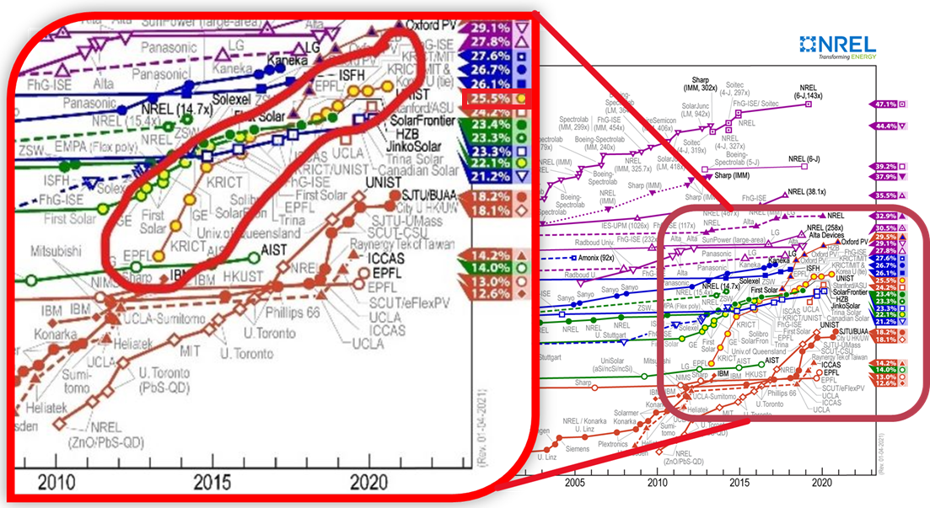
Context and problematics

Slide 6
Context and problematics
Despite this breakthrough, OPV are known to degrade due to moisture and heat, upon prolonged exposure to light and are prone to ion or halide vacancy migration, leading to unstable operation of photovoltaic devices.
To overcome such difficulties, we oriented our research to inorganic PZN-PT oxide perovskite materials with excellent and stable properties compared to the organic ones.
However, despite their excellent properties, one of the greatest difficulties to integrate widely such materials in electronic and photovoltaic devices is to achieve them in thin films form because of their incongruent melting property.
In our previous study, we have successfully fabricate the nanoparticles thin film of such materials, which will facilitate their integration for electronic and photovoltaic devices.
The objective of this work is to initiate an innovative photovoltaic technology based on novel inorganic in biopolymer matrix with suitable bandgap widths, more friendly environment use.

Slide 7
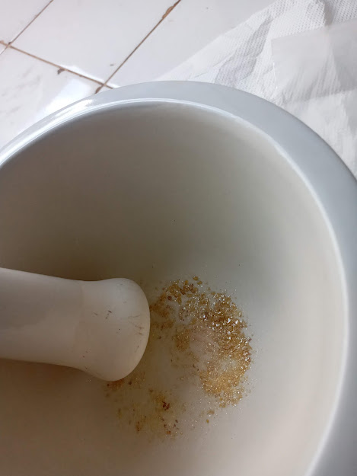
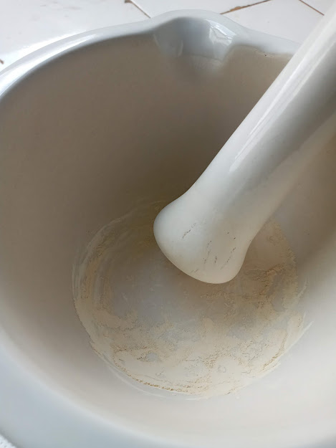
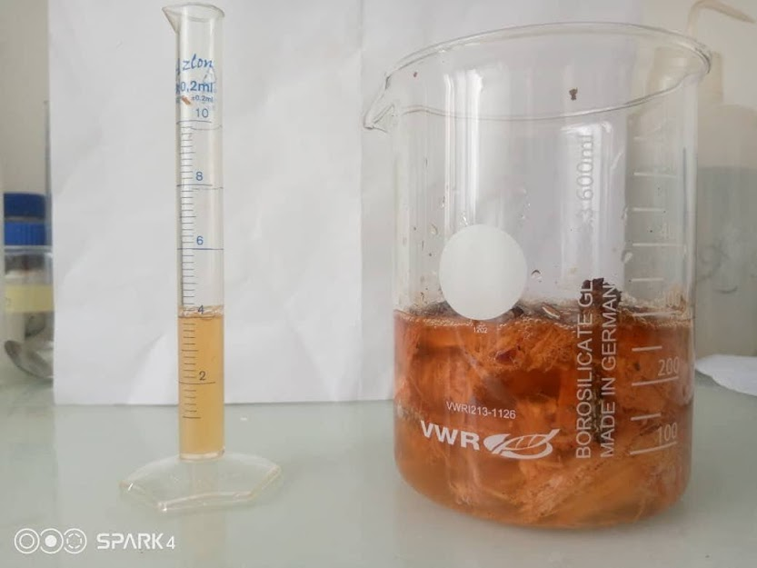
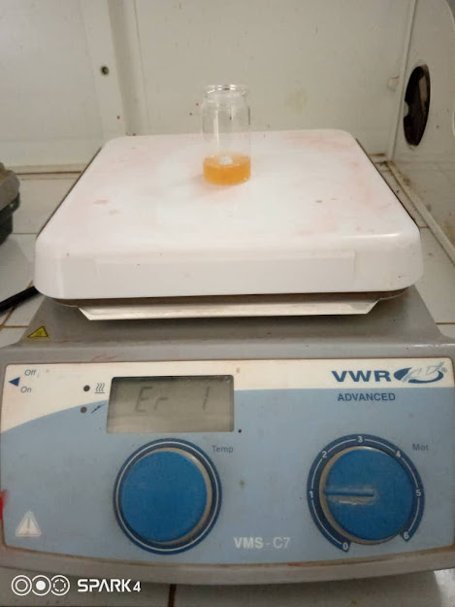
Material and method
Grinding
Biopolymer CC
PZN-4.5PT monocrystal
PZN-4.5PT powder
Pentacene
PZN-4.5PT-np-biopolymer
TiO₂
ITO
Dipersion of the perovskite nanoparticles inside the biopolymer matrix
glass
R. Ndioukane et al. 2020
Stirring for homogenization

Slide 8
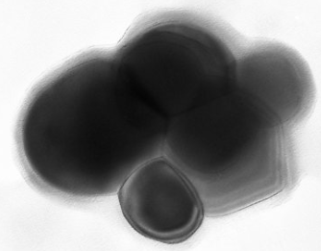

Results and discussion
Nanoparticles characterization
Size distribution
Transmission Electron Microscopy
Dynamic Light Scattering DLS
R. Ndioukane et al. 2018
Spherical shape
It reveals that the average size of ferroelectric nanoparticles is around 78 nm
Diameter : 30 – 100 nm
Conclusion: This proves the nanometric character of the powders produced

Slide 9
Results and discussion
Surface characterization
SEM images
A slightly nonhomogeneous distribution of nanoparticles inside the device, which certainly explain the low current density.
One can see the accumulation of perovskites nanoparticles on the biopolymer surface.
This reduces a better extraction of charges while increasing recombination kinetics at the interface.

Slide 10
Results and discussion
SEM image in transverse mode
Observation in scanning electron microscope in transverse mode, allowed us to see the disposition of the various deposited layers but also to determine their thickness.
Pentacene
Thicknesse (µm) | ITO | TiO₂ | PZN-4.5PT-np-biopolymer | Pentacene
DKFB-PD2 | 1,60 | 1,71 | 1,68 | 1,43
PZN-4.5PT-np-biopolymèr
TiO₂
ITO
R. Ndioukane et al. 2019

Slide 11
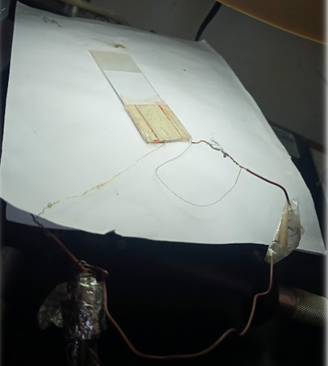

Results and discusion
I-V characteristics
15 min
30 min
I(A)
I(A)
V(V)
V(V)
Time (min) | PCE (%) | V_{CO} (V) | J_{SC} (A/cm²) | FF | P_{max} (mW/cm²)
15 | 21,83 | 5,17 | 3,125x10⁻⁴ | 0,27 | 0,43
30 | 31,62 | 5,86 | 3,125x10⁻⁴ | 0,34 | 0,63
We find that the open circuit voltage increases over time with a max value of 5.86 V.
This is due to the fact that Ferroelectric perovskites have the ability to accumulate electrical charges on the surface of the sample thus can increase the open circuit voltage over time of exposure to light
The P_{max} result shows a promising photovoltaic property for indoor application

Slide 12
Conclusion and perspectives
We successfully fabricated and demonstrated the large improvement of the photovoltaic performance due to the presence of the PZN-PT-np+biopolymer+pentacene layer.
We can note that long exposure to light from a solar cell containing ferroelectric perovskites increase the open circuit voltage but has no effect on the short circuit current of the device.
The yield is proportional to Vco and Isc, will have a direct impact.
P_{max} shows a promising photovoltaic property for indoor application.
Perspective
Investigations are in progress particularly for the stability in time and the temperature effect.

Slide 13
THANK YOU FOR
YOUR ATTENTION

