Slide 1
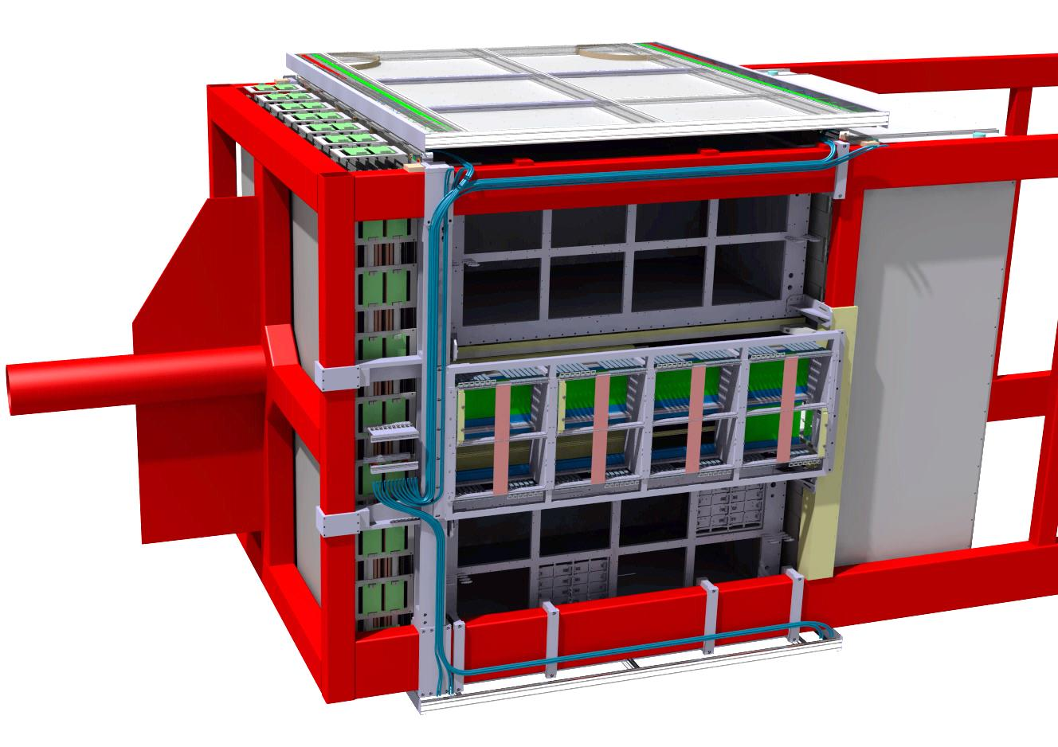
ND280_SFGD Box Envelope
US ECAL
SFGD Envelope definition
Connections to the Basket structure

Slide 2

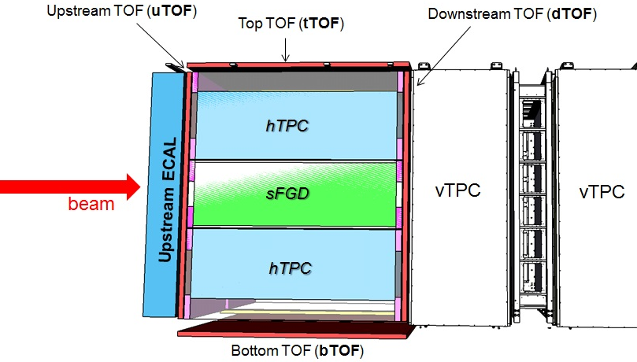
ND280 new configuration @ JParc
SFGD box size depends on:
  some existing detectors (ECAL, vertical TPC..)
  space left by POD removal
  New Upgrade detectors (TOF, HA-TPC)
  Mounting steps (see later)
  Side electronics (readout Crates and Cables)

Slide 3
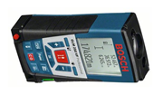
Basket size & measurement @ J-PARC
6930mm
y
x
z
Up ECAL
POD area
TPC
2480mm
?
Basket structure
Laser system
Measurement campaign in October 2018 @ J-PARC (Japan)
Focusing on the “POD area”, for ND280 Upgrade (SFGD, HA-TPC and TOF)
Final precision assumed to be +/-2mm (Laser + access issues)
Good match / CAD model at (2 to 3mm differences).
More checks @ J-PARC to come (as requested by ND280 community)

Slide 4
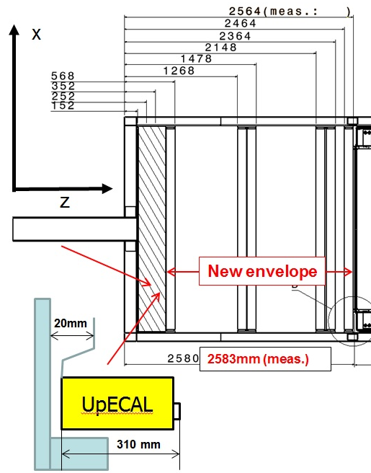
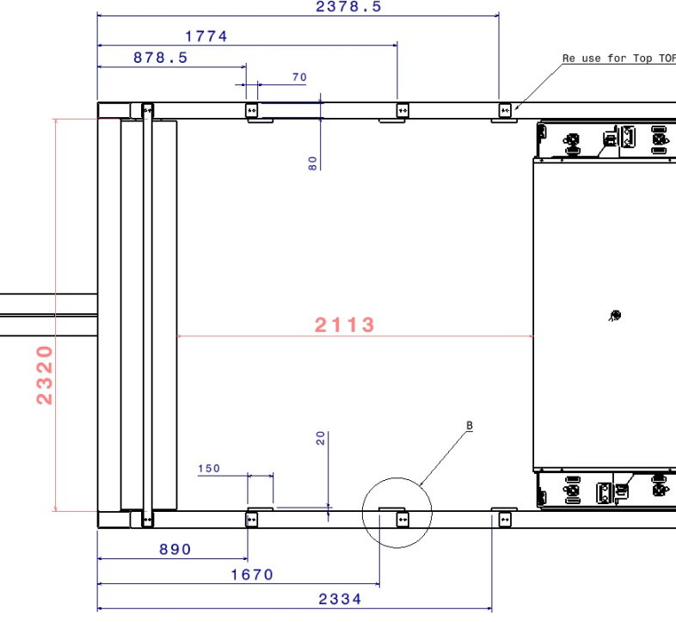
Basket size & measurement @ J-PARC
Top view
Top view
Some tricks used to get access to the ECAL/TOF external parts (extensions)
In red the real measurements (+3mm / CAD along beam axis)
UpECAL includes bolt heads… not easy!

Slide 5
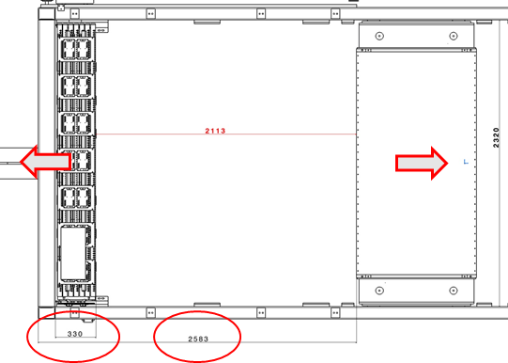
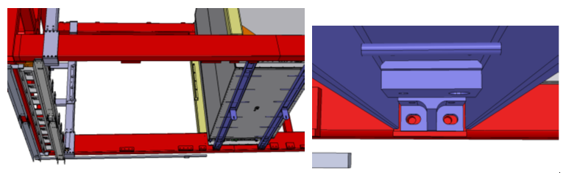
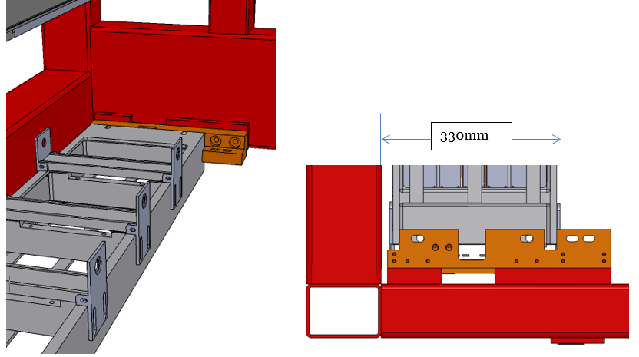
First step: CAD model correction
TPC
UpECAL
x
y
z
UpECAL
Upstream ECAL / TPC moved by a few mm to comply with the measurements
Checked / bracket design (slotted holes) onto the Basket (quite coherent)

Slide 6
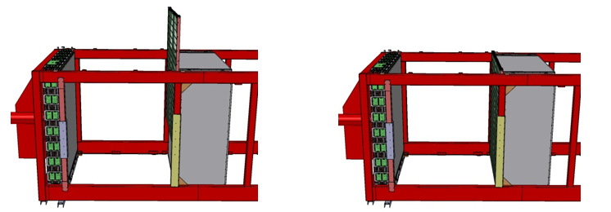
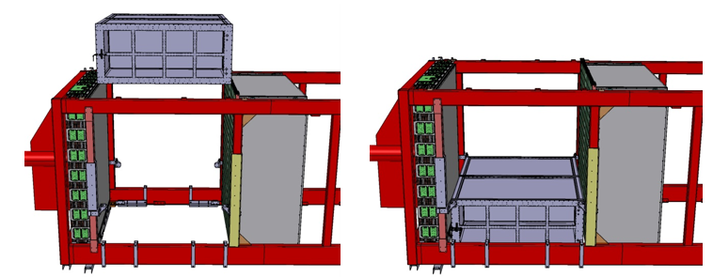
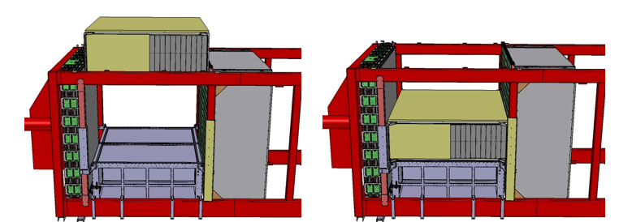
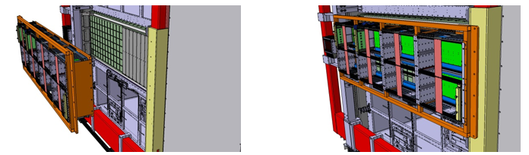
SFGD Box assembly steps
With corrected CAD model
Including final CAD models for HA-TPC and TOF
Here after the main relevant steps regarding SFGD envelope definition
Step1: D_TOF installation
Step2: HA-TPC1 installation
SFGD Box
Step3: SFGD Box insertion
Step4: SFGD electronics assembly

Slide 7
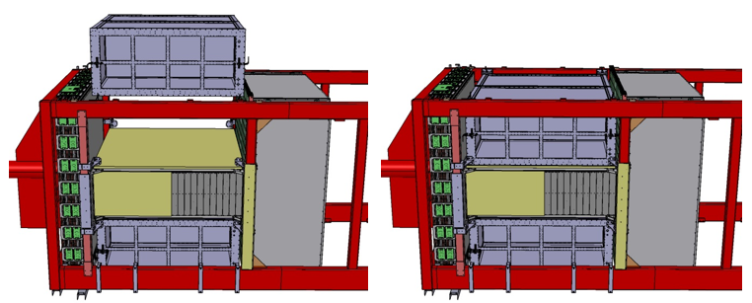
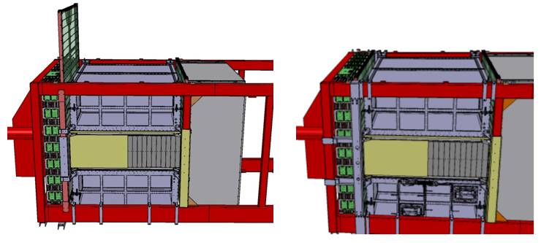
SFGD Box assembly steps
Side Electronics is removed for clarity
Step5: HA-TPC2 installation
x
z
Step6: U_TOF insertion

Slide 8
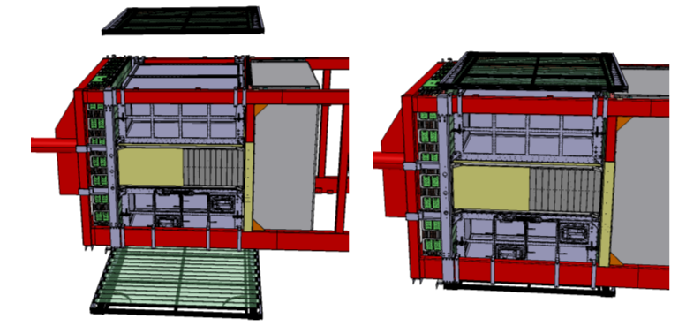
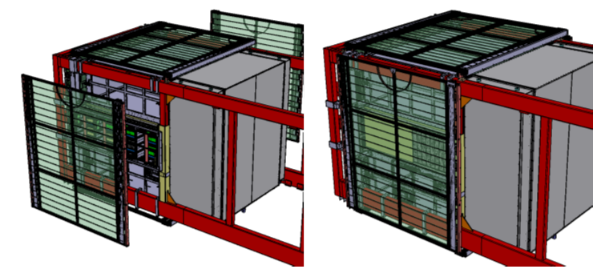
SFGD Box assembly steps
Next steps are for TOF completion
Step7: Top and Bottom TOF fixation
y
x
z
Step8: Side_TOF installation

Slide 9
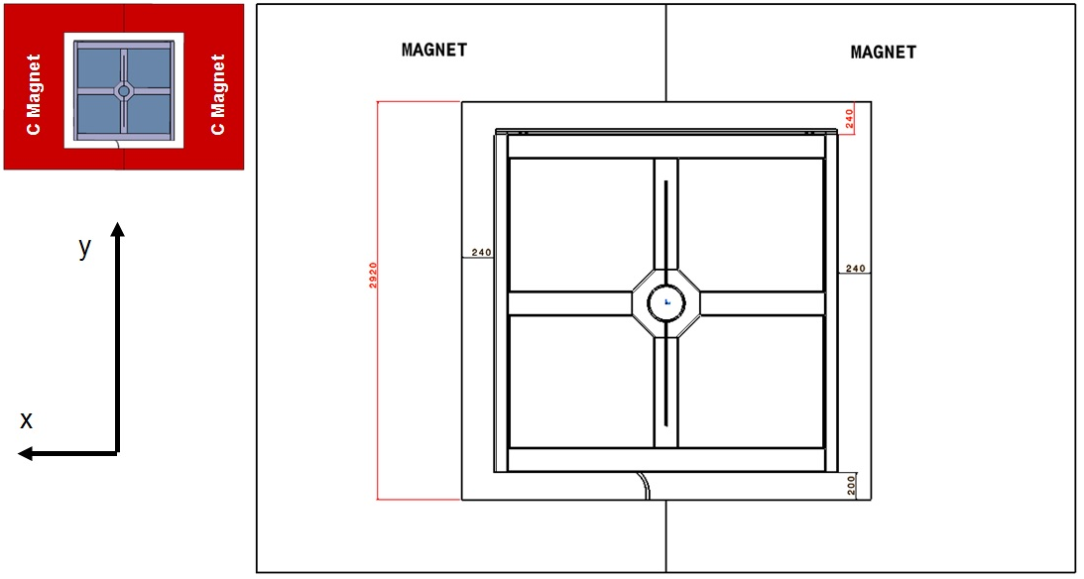
Envelope respect to Magnets
4 TOF modules and SFGD electronics will stick out from Basket
Some clearance / magnets have been defined by measurement
Magnet closed: 200mm at the bottom is left / 240mm on other axes

Slide 10
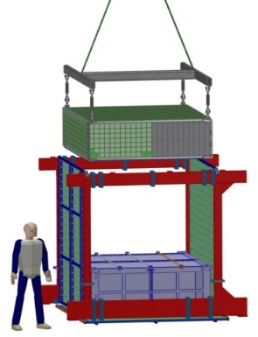
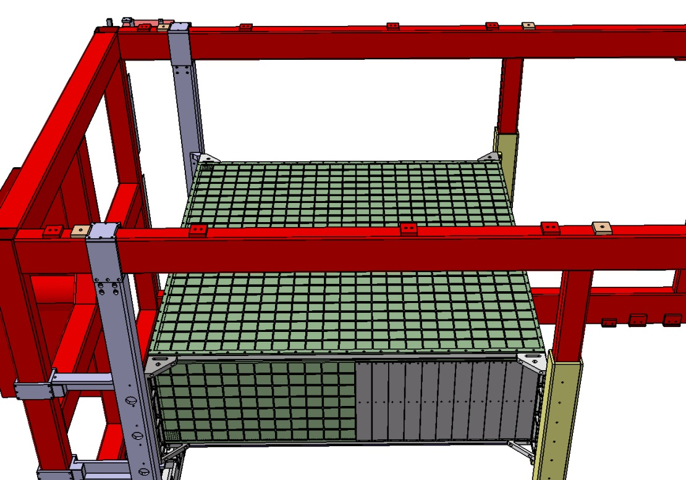
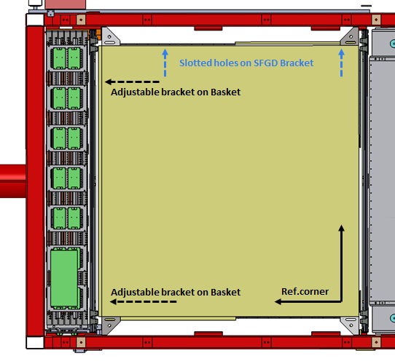
SFGD Box envelope
Back to STEP3 in more details….
Seen from top
Assuming all the MPPC cables are folded back onto the sFGD box, and safely stored
The top side is free for cable storage (plus holder, protections…)

Slide 11
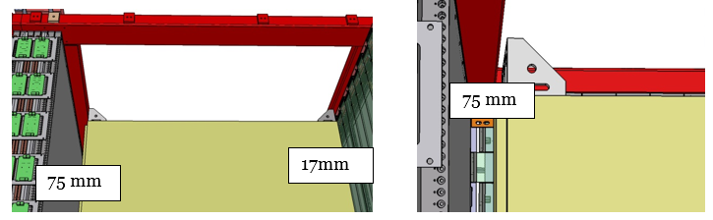
SFGD Box Clearances & Envelope
Back to STEP3 in more details….
2 movements
Installation in 2 steps: first the BOX and then the side electronics
2 movements to get to final location for BOX :
  Down+ Horizontal along Z towards TPC
  > 90mm clearances all in all … quite acceptable for insertion.
  75mm is left for later U-TOF insertion.

Slide 12
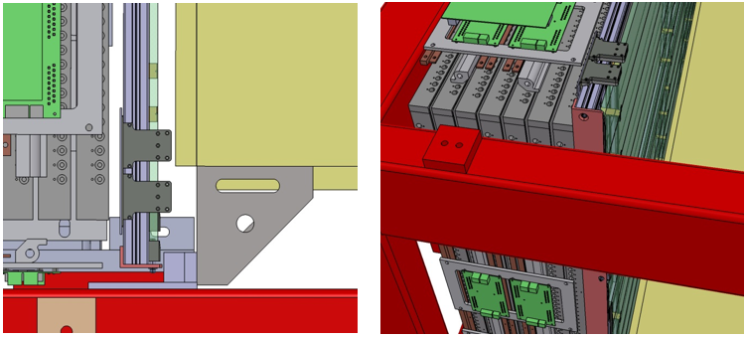
SFGD Box Clearances & Envelope
Clearances respect to U-TOF
SFGD box
SFGD box
Envelope for MPPC cables and others
Above the SFGD box area

Slide 13
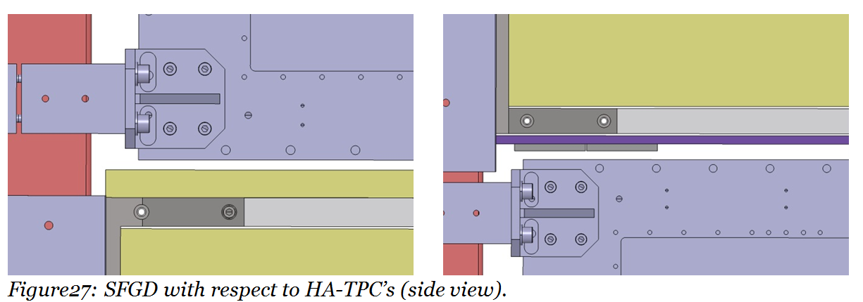
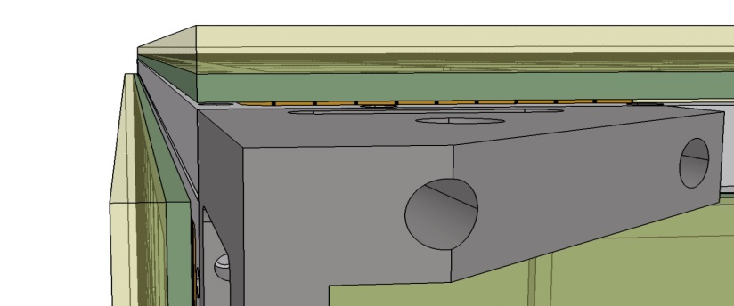
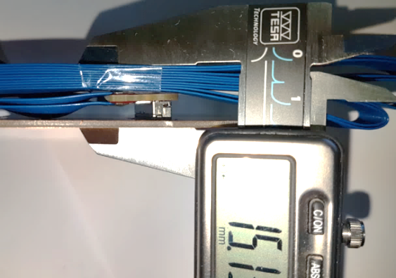
sFGD Clearances
Clearances / Upgrade detectors (TOP and Bottom sides)
SFGD
Top cables envelope
SFGD
10mm minimum with respect to HA-TPC’s
Note that Top HA-TPC can move further up (by +28mm)
In yellow, the MPPC cable envelopes
Calibration system
(partly displayed)

Slide 14
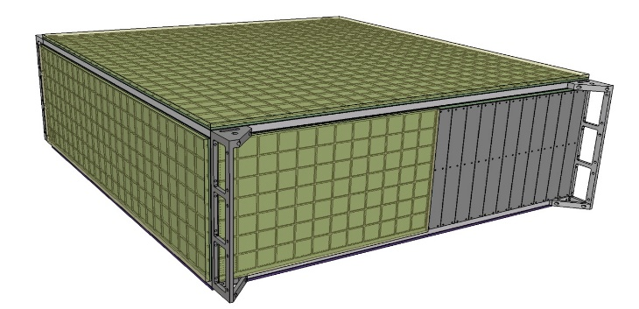
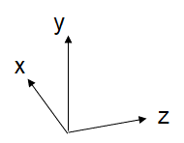
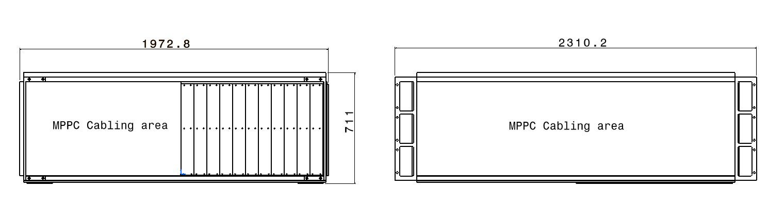
SFGD Box Clearances & Envelope
Summary on the clearances
Item | uTOF | dTOF | HA-TPC (bottom) | HA-TPC (Top) | Basket beam (X axis)
Clearance (mm) / SFGD | 20 | 17 | 10* | 10* | 10
* + 28mm could be shared between 2 HA-TPC
Corresponding to a SFGD box volume of:
  Z axis: 1973mm
  X axis: 2310mm
  Y axis: 711mm

Slide 15

Backup slides

Slide 16
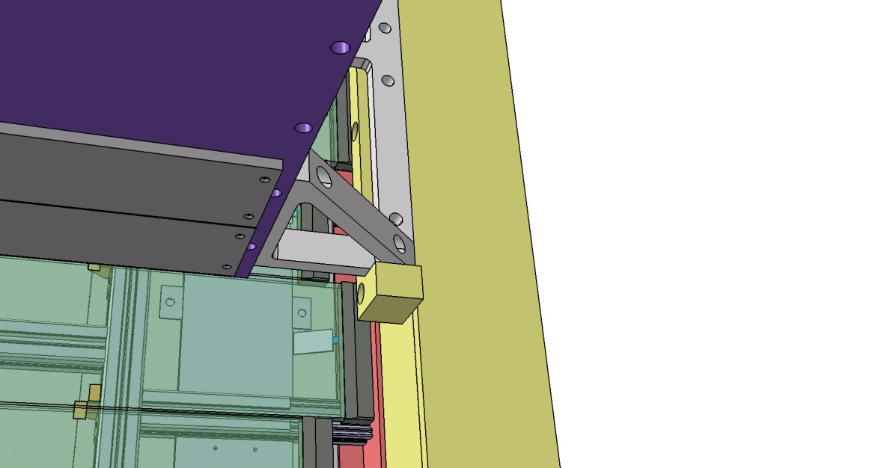
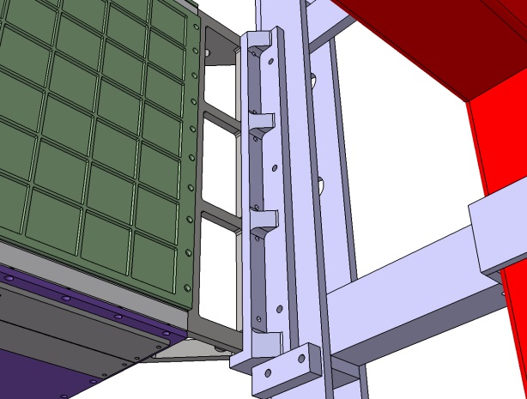
BOX assembly into the Basket
Step 1 is the SFGD BOX fixation (4 corners)
Fixed corner (Ref.)
Adjustable corner (slotted holes / brackets)
Some shimming may be necessary between pieces (SFGD brackets, Basket)

Slide 17
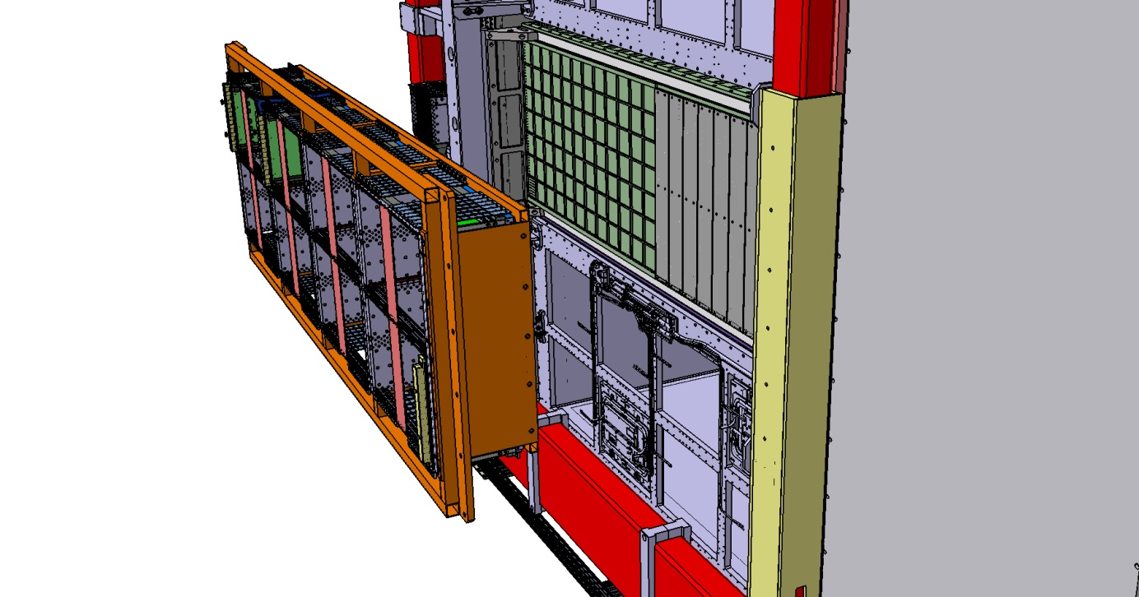
CRATE assembly into the Basket
Step 2 is the CRATE integration into the Basket

Slide 18
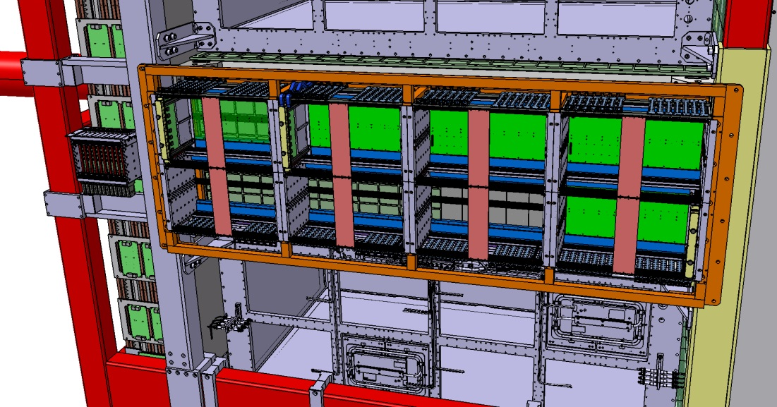
CRATE assembly into the Basket
Step 2 is the CRATE integration into the Basket
Crate fixation
Clearance / Bracket
Crate frame fixation
6mm clearance in total respect to both SFGD corner brackets
Try to squeeze a bit more the CRATE assembly along beam line!

Slide 19
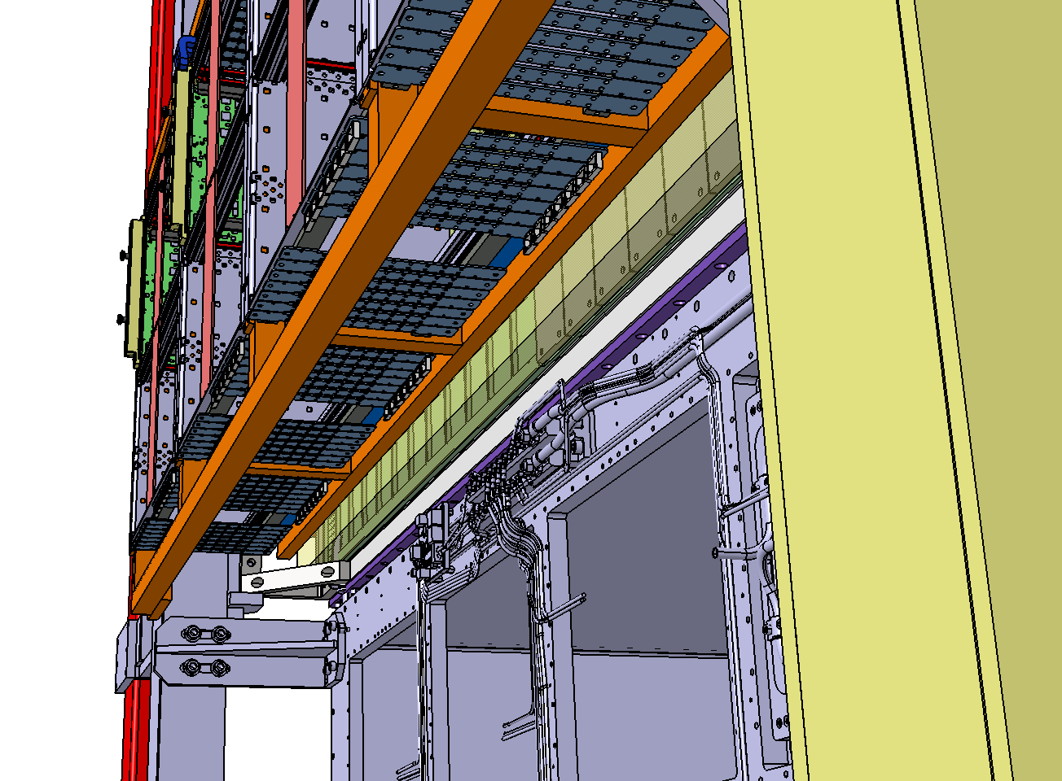
CRATE assembly into the Basket
Step 3 is the CRATE Cabling sequence (seen from the bottom)
No interference with the top / bottom TPC’s

Slide 20
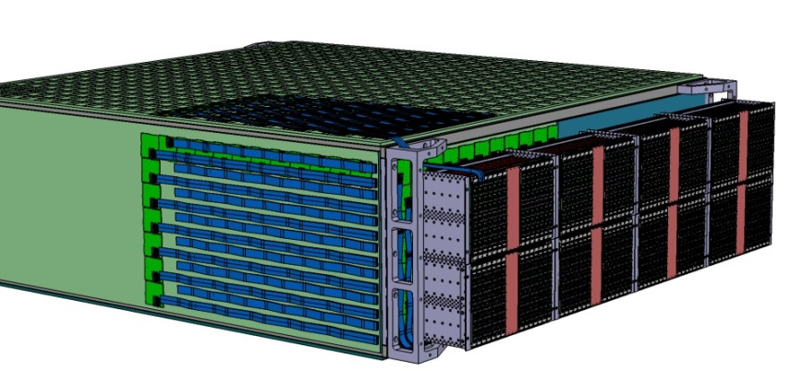
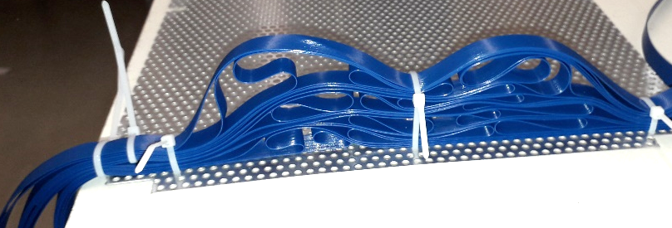
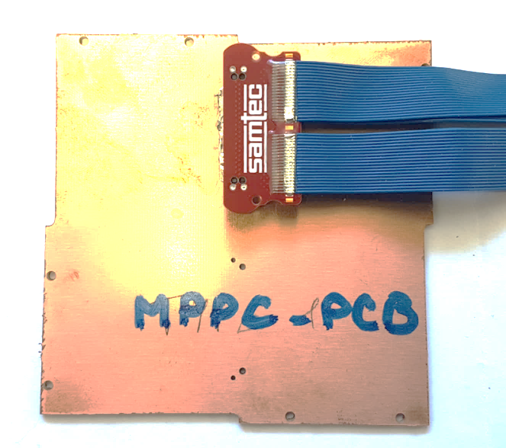
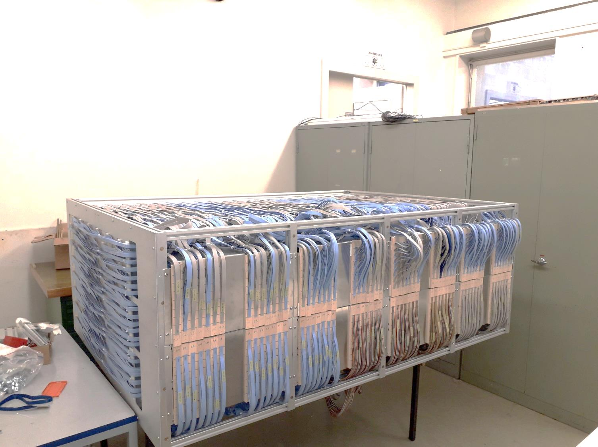
MPPC to CRATE Cabling
CRATE
MPPC
MPPC Harnesses are staggered
Envelope optimization
Extra length storage
MPPC
Half mockup (cables + Crates)

Slide 21
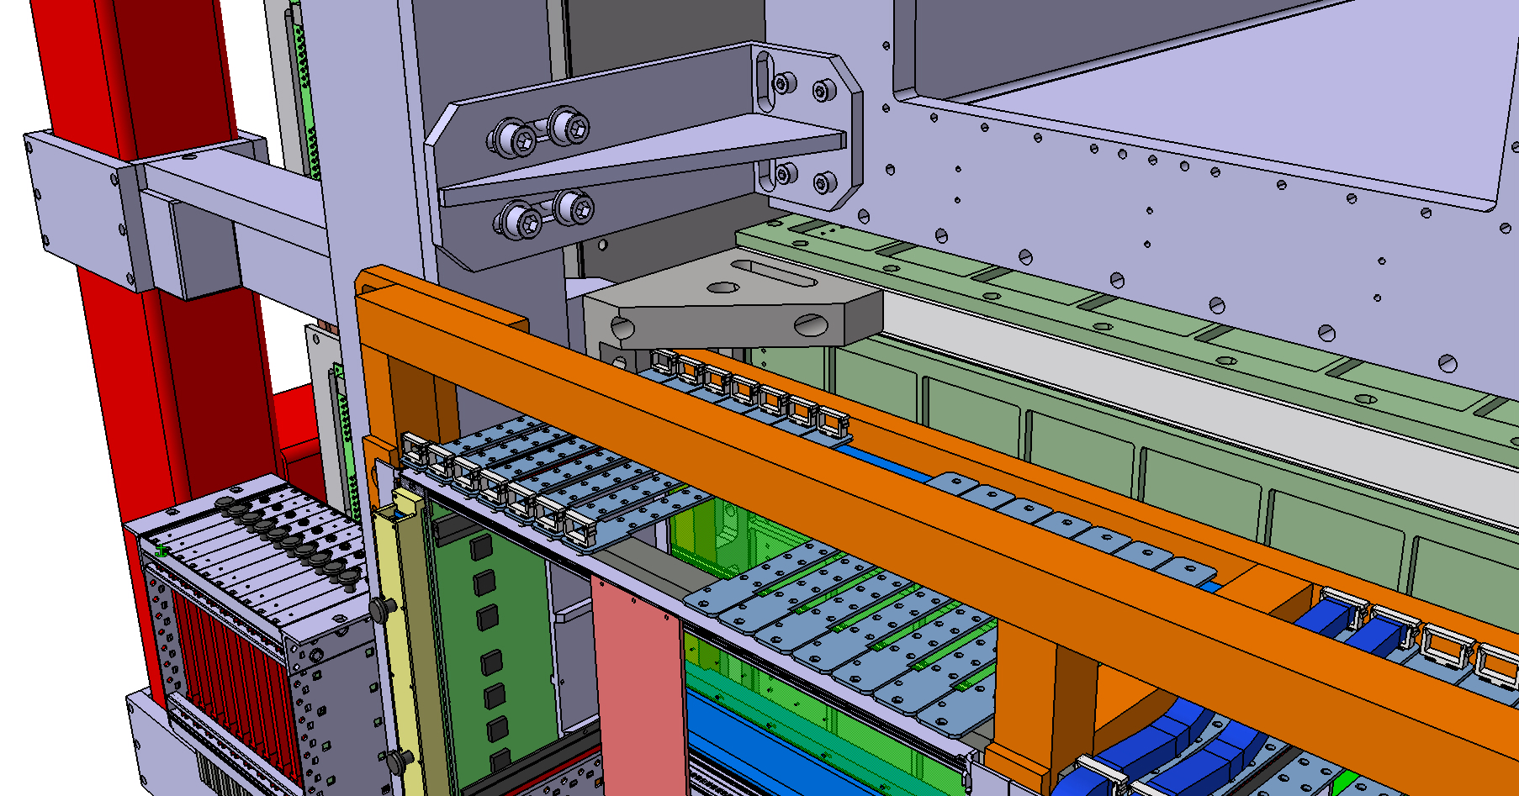
sFGD Clearances
Clearances / Upgrade detectors

Slide 22
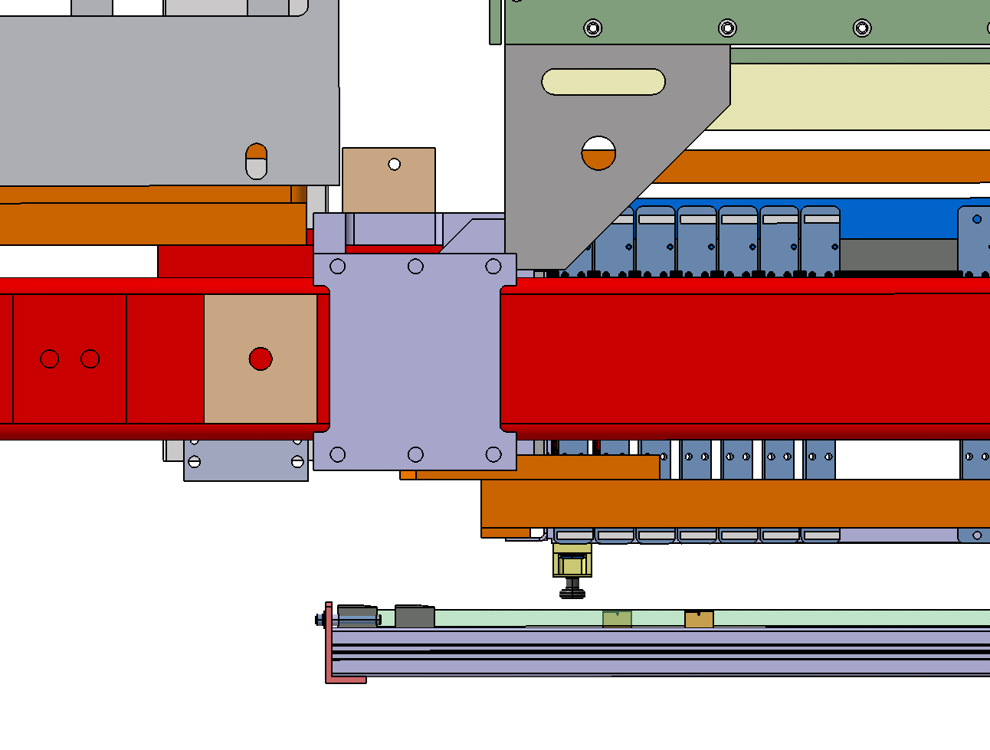
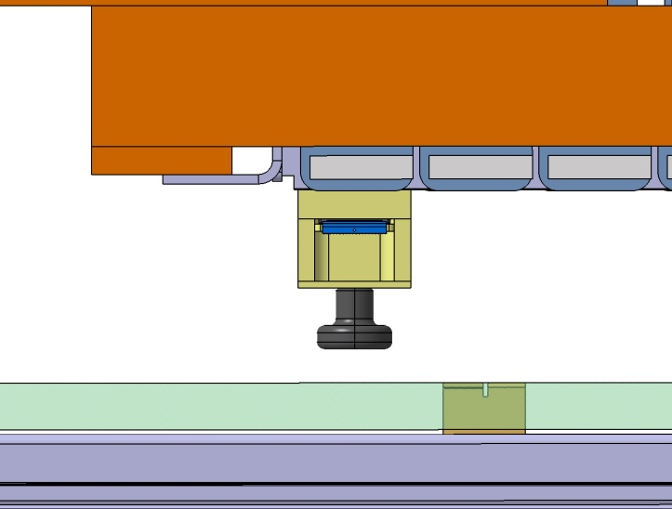
sFGD CRATES / Side TOF
Clearances / Upgrade detectors (sFGD CRATE wrt side TOF)
13mm
TOF
8mm / side TOF (on a particular piece… which can be reduced by 3-5mm)
Or possibility to move a bit the TOF… (150mm / Basket beam…)

Slide 23
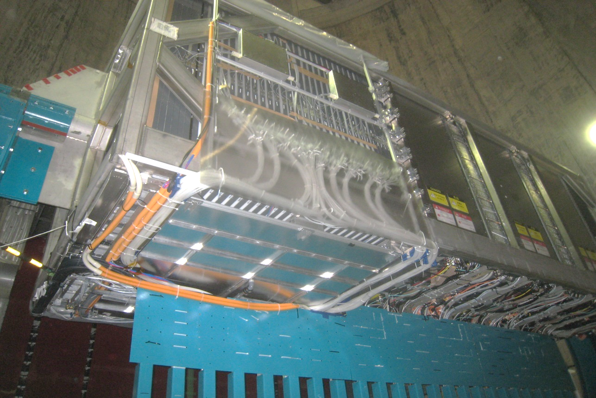
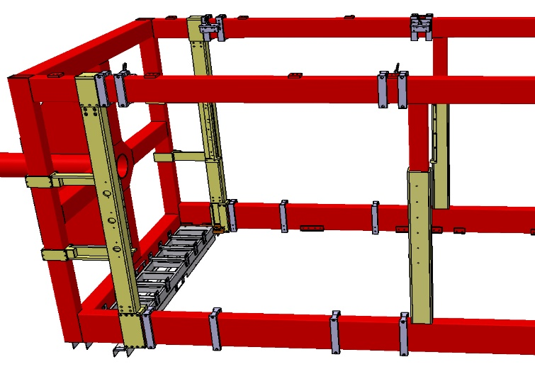
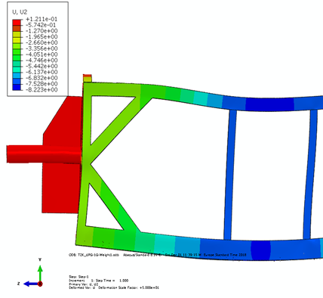
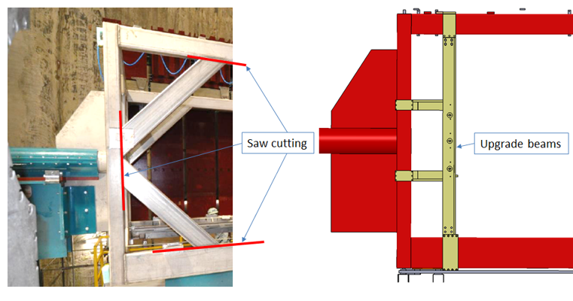
Basket modifications
Next slides for FEA validation

Slide 24
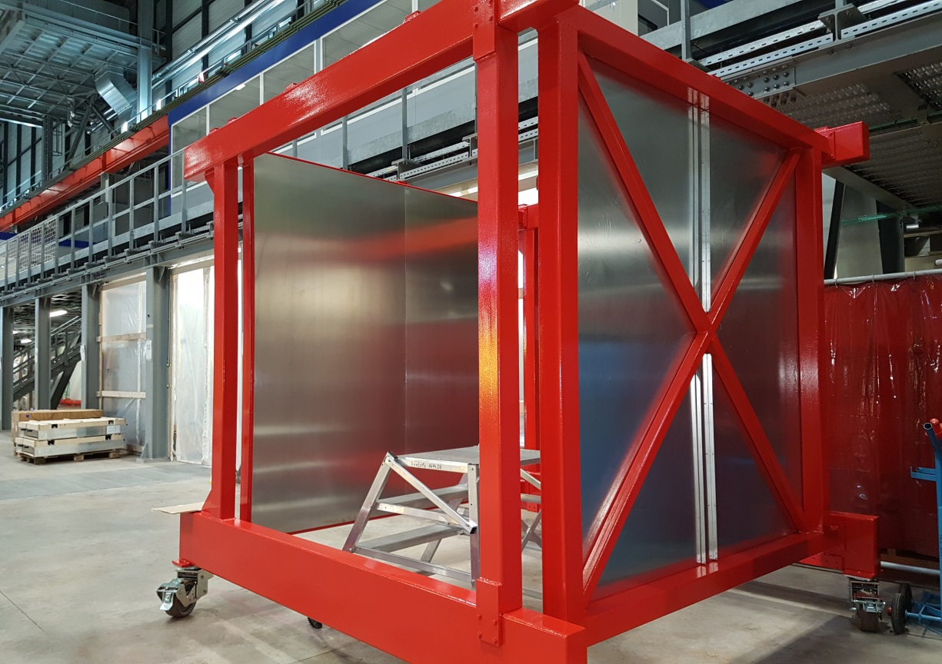
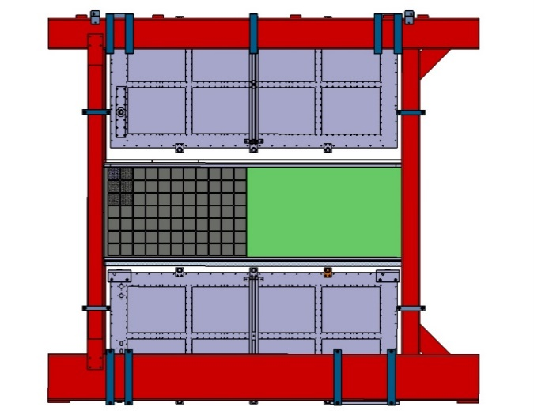
Basket modifications
BabyBASKET to validate the modifications & installation process

Slide 25
Basket modifications_FEA
Preliminary
Modified basket beam
SFGD
2x2 oblique beams removed to clear the access to side electronics
Replaced by 2x1 vertical beams in aluminum (FEA to analyze the impact)

Slide 26
Basket modifications_FEA
Under completion… Results by the review

