Slide 1
Presented at CERN, Geneva, September 6, 2021
State of the art of Positron Emission Tomography:
technology and current challenges
Dr. Maurizio Conti
Director, PET Physics and Reconstruction
Siemens Medical Solution USA, Inc, Knoxville, TN, USA

Slide 2
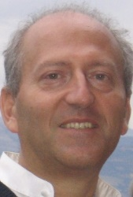
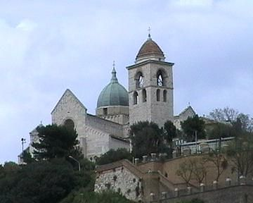
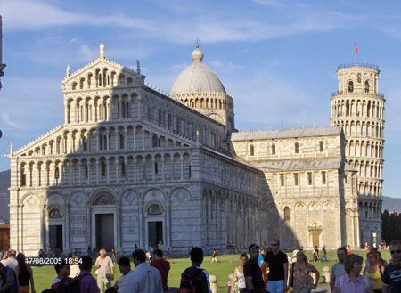
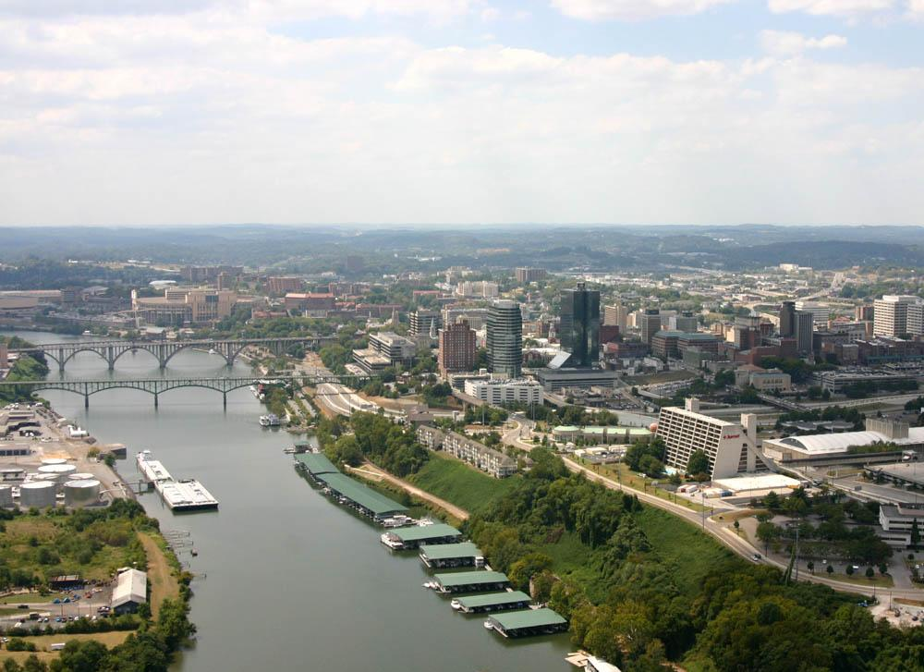
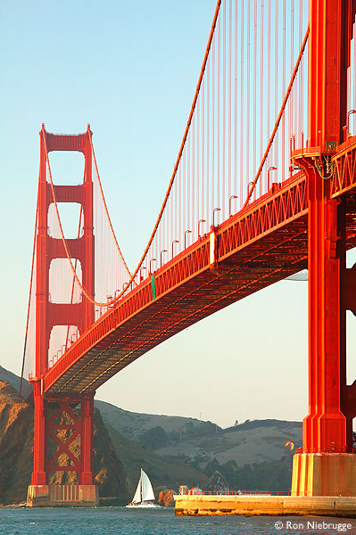
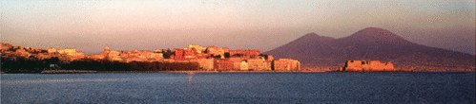
Introduction to myself
Knoxville, TN

Slide 3
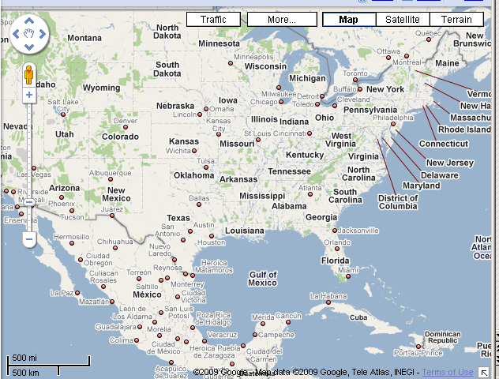
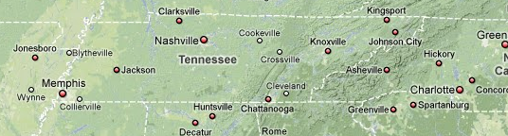
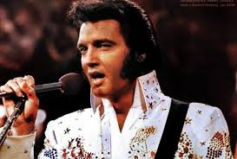

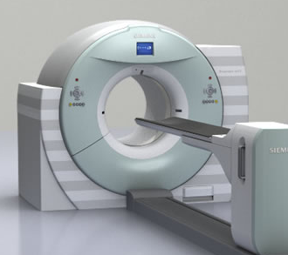
What is Tennessee famous for?

Slide 4
Table of contents
Positron Emission Tomography (PET)
TOF PET methods and applications
Evolution of PET and state of the art of PET scanners today
Long Axial FOV scanner and applications
The role of AI in PET
Future technology development and needs for fundamental research

Slide 5
Table of contents
Positron Emission Tomography (PET)
TOF PET methods and applications
Evolution of PET and state of the art of PET scanners today
Long Axial FOV scanner and applications
The role of AI in PET
Future technology development and needs for fundamental research

Slide 6
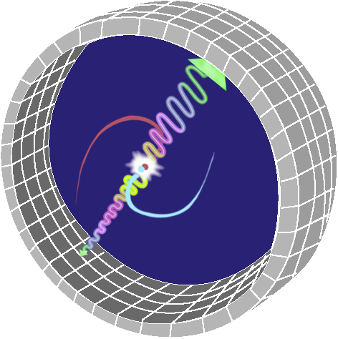
Positron Emission Tomography
A radioisotope β-decays by emitting a positron, a neutrino. Positron energy is typically 0-3 MeV, half-life typically 1-120 minutes.
The positron and an electron annihilate producing two 180º opposed 511 keV gamma rays.
The PET detector system detects the annihilation by detecting the occurrence of two gamma rays within a few nanoseconds.
The positron annihilation occurred somewhere along the line connecting the two detectors.
P N + e⁺ + ν + energy

Slide 7

Tracers used in PET
Use of PET, 2013
Main application: oncology
Measuring Glucose Metabolism
Others: brain studies, cardiac, etc.
Radiopharmaceutical | # of Times Scanned | % of Total
Fluorodeoxyglucose (F-18) | 346442 | 90.68%
Rubidium chloride (Rb-82) | 10211 | 2.67%
Fluorethylcholine (F-18) | 5087 | 1.33%
Germanium (Ge-68) | 1790 | 0.47%
Gallium Solution (Ga-68) | 1468 | 0.38%
Fluoro-L-dopa (F-18) | 1264 | 0.33%
DOTA-TATE (Ga-68) | 1241 | 0.32%
Ammonia (N-13) | 1233 | 0.32%
Sodium Fluoride (F-18) | 1111 | 0.29%
Oxygen (O-15) | 938 | 0.25%
Solution (F-18) | 823 | 0.22%
Acetate (C-11) | 806 | 0.21%
Choline (C-11) | 787 | 0.21%
DOTA-TOC (Ga-68) | 726 | 0.19%
Fluorethyltyrosin (F-18) | 723 | 0.19%
Methionine (C-11) | 606 | 0.16%
Solid Solution (Ge-68) | 598 | 0.16%
Crossed Rods (Ge-68) | 550 | 0.14%
PSMA (Ga-68) | 442 | 0.12%
¹⁸F-FDG
(fluorodeoxyglucose)

Slide 8
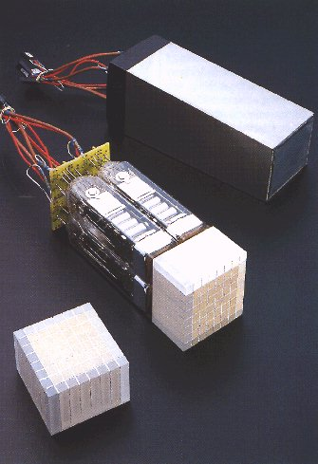

PET detector
γ
PMT
A
B
Detector block
1
0
X1 = 0.95 / (0.95 + 0.05) = 0.95
X2 = 0.55 / (0.55 + 0.45) = 0.55

Slide 9
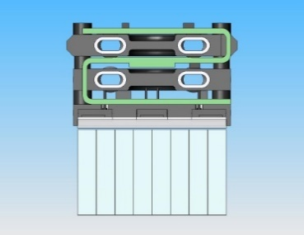

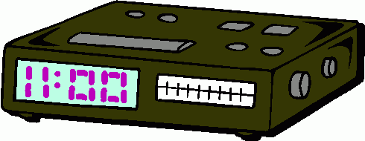
Energy and time qualification of a detected photon
PET events are distributed across a range of energy, not only in the 511 keV range. An energy window is employed to qualify good events and reject scattered events.
Lower Level Discriminator (LLD) 435 keV
ENERGY
WINDOW
511 keV PHOTONS
Positron (e⁺)
Upper Level Discriminator (ULD) 650 keV
SCATTER
511 keV gamma rays
Counts
Is
EventTime A-B less then
4.06 ns
Event Time A
Event Time B
0
100
200
300
400
500
600
700
Yes
Energy (keV)
Coincident Event
(belongs to the same positron annihilation)

Slide 10

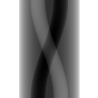
Data organization (sinogram)
angle
Sinogram
Radial offset
Angular Offset
Radial position

Slide 11

How to make an image (the principle)
Algorithms for reconstruction:
analytical (back projection FBP, etc) and iterative reconstruction (MLEM, OSEM, MAP, RAMLA, etc)
But the data need “corrections”…

Slide 12



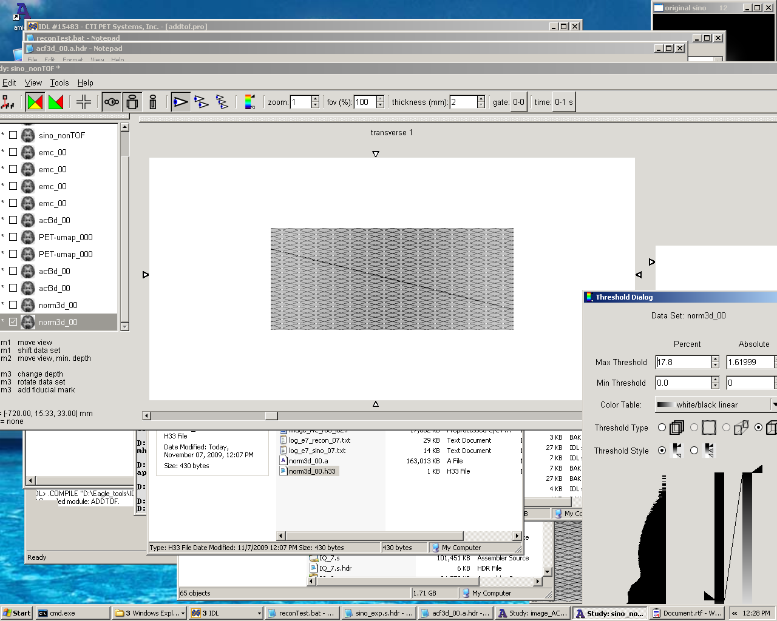
Data correction (1)
Normalization
Attenuation correction
Each detector has a different response: A calibration or normalization is needed
Photons are scattered and absorbed:
A correct quantification of the original source needs attenuation correction
A
C
detector
detector
B
D
Normalization array
A
B
W
–µA
–µB
–µ(A+B)
–µW
(e
)(e
) = e
= e

Slide 13

Data correction (2)
True Coincidence
Scatter Coincidence
Scatter correction
Random Coincidence
Randoms correction

Slide 14
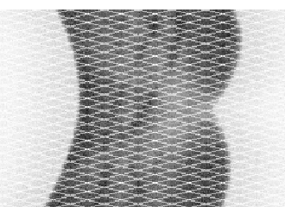
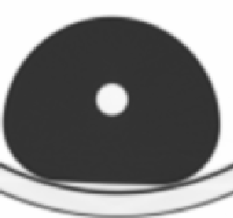
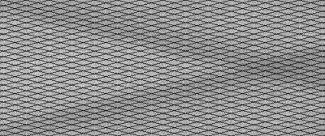
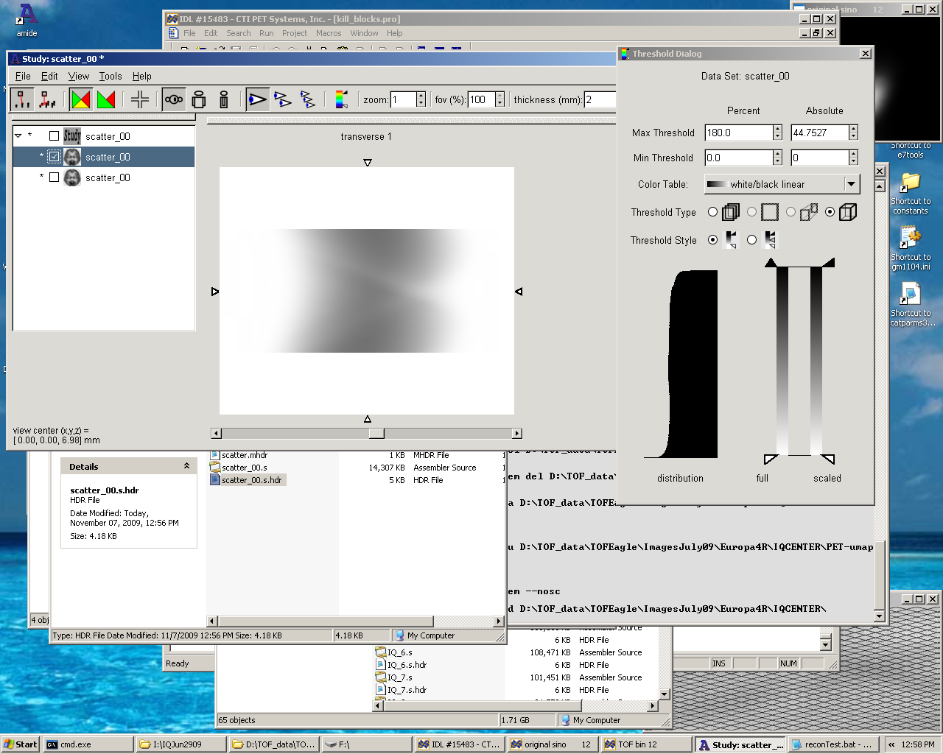
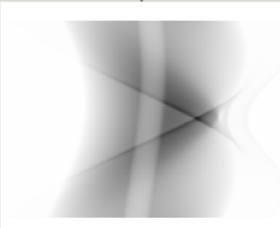
How to implement data corrections (1)
Normalization
Emission Sinogram
μ-map (CT or MR based)
Scatter simulation
Randoms
Scatter correction
Attenuation correction

Slide 15
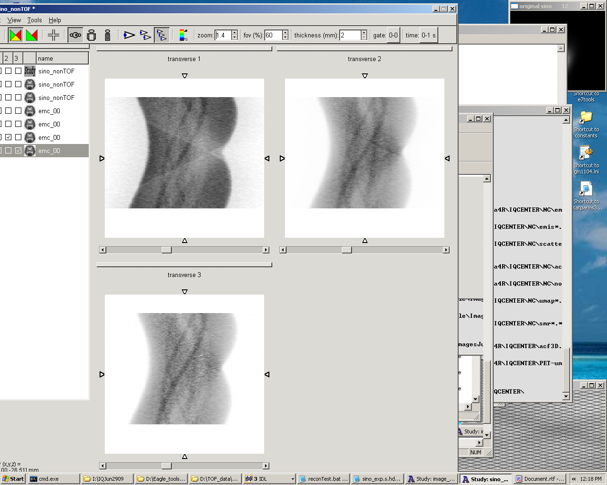
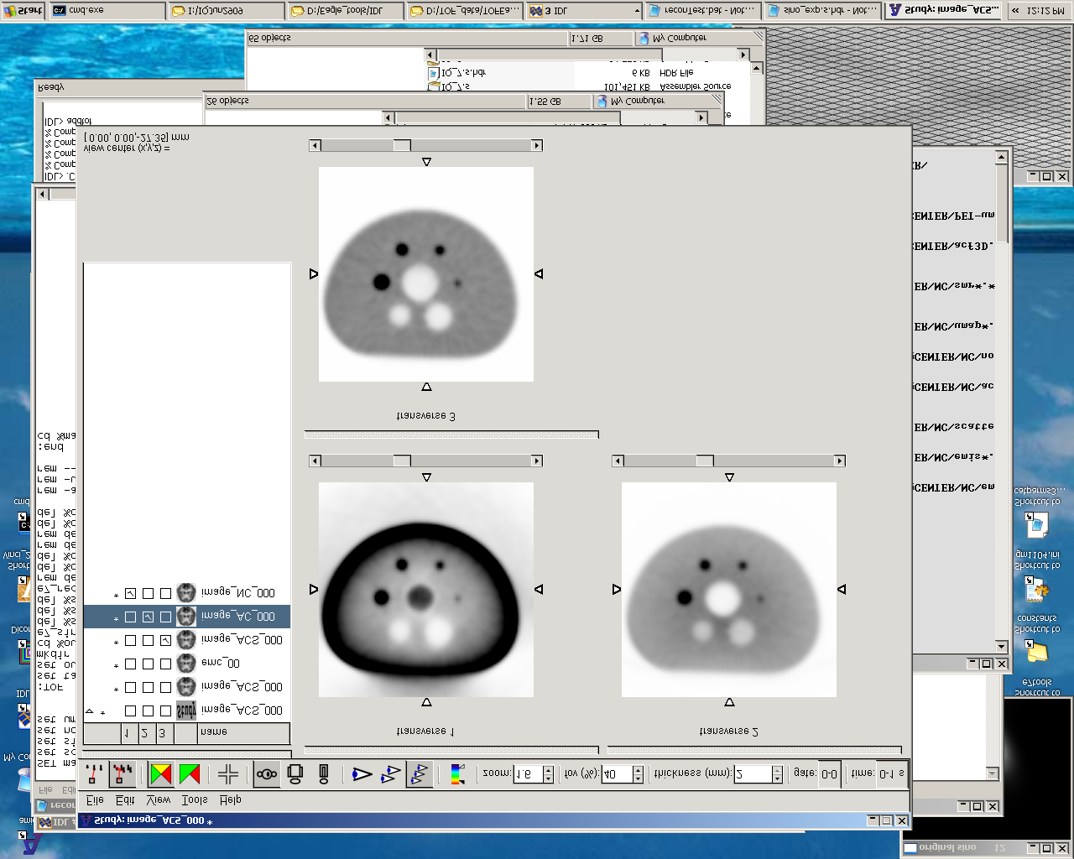
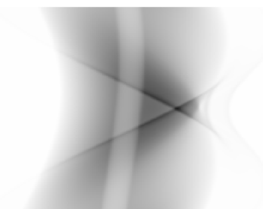
How to implement data corrections (2)
E-R
N
N x (E-R)
recon
Non-attenuation corrected image
X
=
A
A x [N x (E-R)]
recon
Attenuation corrected image
X
=
A x S
A x [Nx(E-R) – S]
recon
Attenuation and scatter corrected image
_
=

Slide 16
Table of contents
Positron Emission Tomography (PET)
TOF PET methods and applications
Evolution of PET and state of the art of PET scanners today
Long Axial FOV scanner and applications
The role of AI in PET
Future technology development and needs for fundamental research

Slide 17
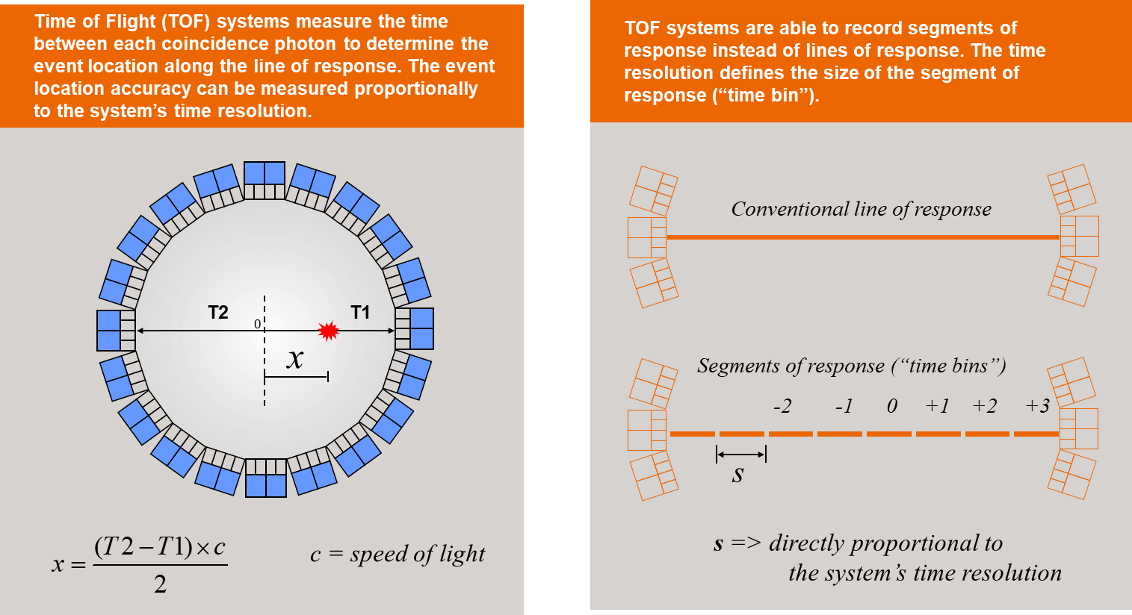
Time-of-Flight PET (TOF) – two photons in coincidence

Slide 18
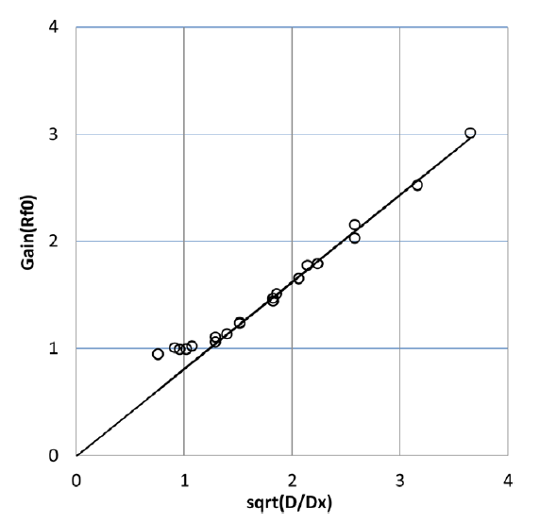
Time-of-Flight PET advantages: noise reduction
TOF reconstruction = sensitivity amplification or noise reduction
D is patient “diameter”, Δt is time resolution of TOF PET scanner
*estimate based on uniform cylindrical object and analytical reconstruction:
T.F. Budinger, “Time-of-flight positron emission tomography: status relative to conventional PET”, J. Nucl. Medicine, vol. 24, pp. 73-78, 1983.
M. Conti, "State of the Art and Challenges of Time-of-Flight PET", Physica Medica, no. 25, pp. 1-11, 2009.
L. Eriksson and M. Conti, “Randoms and TOF Gain revisited”, Phys. Med. Biol. 60 1613-1623 (2015).
Δt (ps) | Δx (cm) | G_{NEC} (D=40cm) | G_{SNR} (D=40cm)
200 | 3 | 13.4 | 5.2
300 | 4.5 | 8.9 | 3.0
400 | 6 | 6.7 | 2.6
500 | 7.5 | 5.3 | 2.3
600 | 9 | 4.4 | 2.1

Slide 19
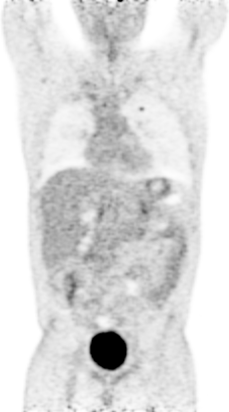

Time-of-Flight PET advantages: noise reduction and improved contrast recovery
same time,
better image
3 minute/bed
550 ps
non-TOF
TOF

Slide 20
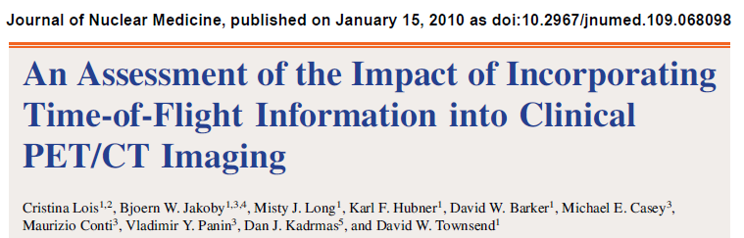
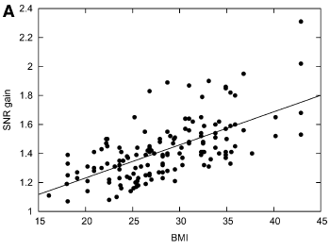
Time-of-Flight PET advantages: noise reduction and patient size
  Multiple lesions (<2cm) analyzed in 30 patients
  Body Mass Index used as a measure of the size

Slide 21
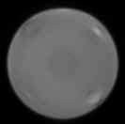
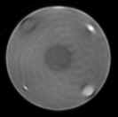
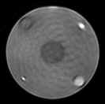
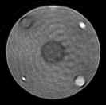
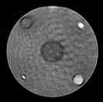
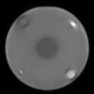
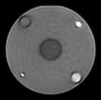
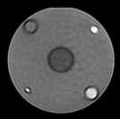

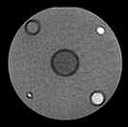
Time-of-Flight PET advantages: more robust with inconsistent data
101 mm
Inaccurate μ-map and normalization
25 mm
51 mm
50 cm diameter water cylinder with cylindrical inserts.
Variable contrast to background.
μ-map was assumed uniform, and normalization
was incorrect.
13 mm
51 mm
non-TOF
Iter 1
Iter 2
Iter 3
Iter 4
Iter 5
TOF

Slide 22
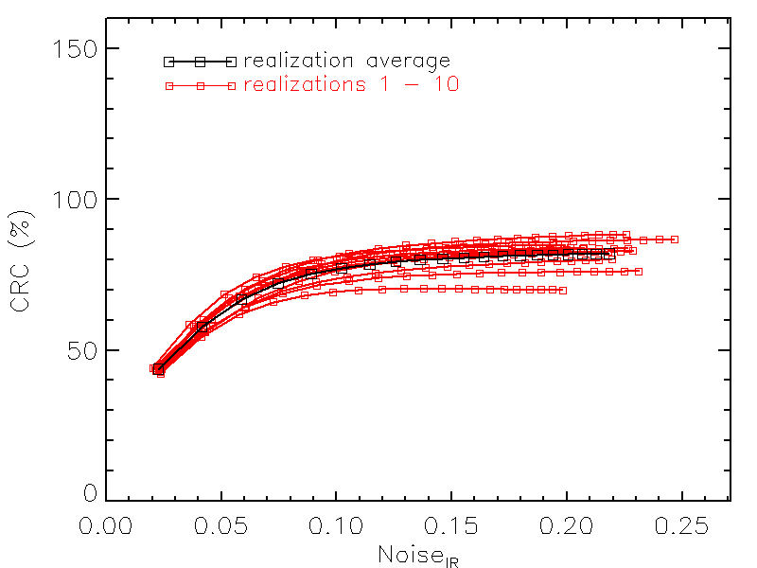
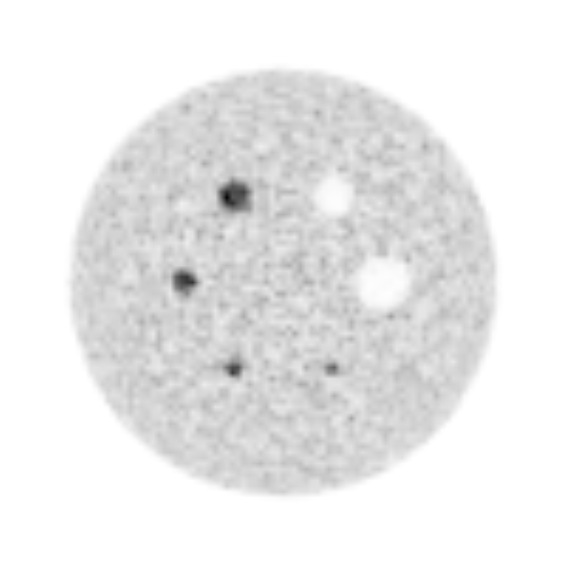
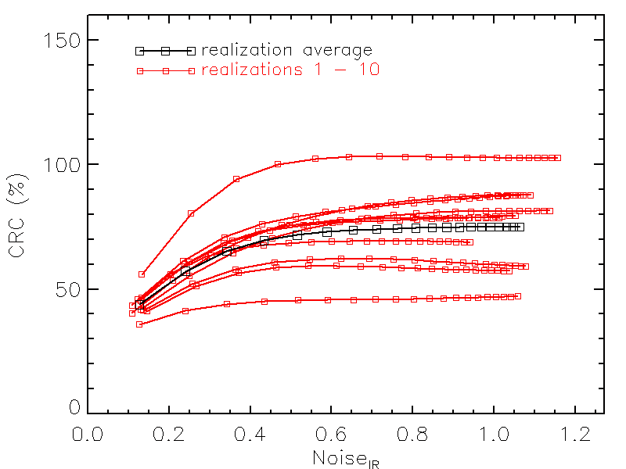
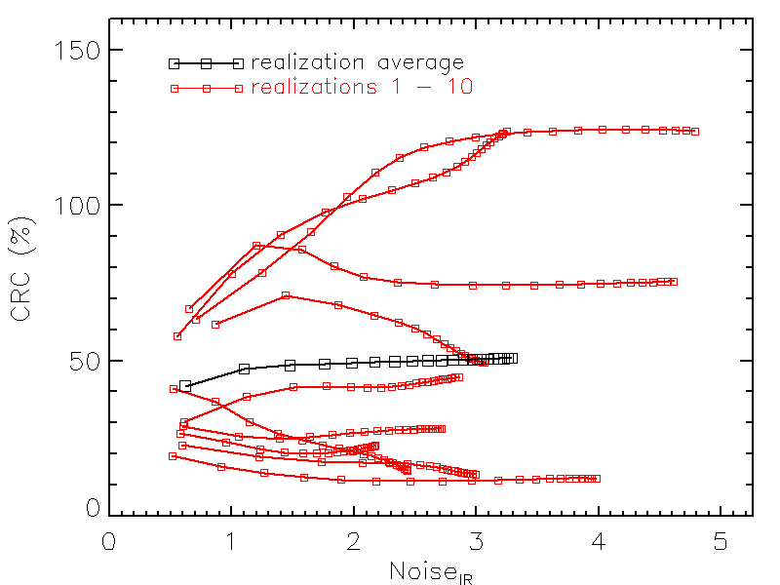
Time-of-Flight PET and the low counts challenge: improved reproducibility
Geant4 simulation
Contrast recovery coefficient (CRC) vs. noise
17 mm sphere and 600 ps time resolution
Plotting 10 realizations and mean value
Signal
Bgrnd
40x10⁶ counts
noise
1x10⁶ counts
Reliability of quantification at low counts:
variation between realizations
0.05x10⁶ counts
V. Westerwoudt, M. Conti and L. Eriksson, “Advantages of improved time resolution for TOF PET at very low statistics”, TNS 61, 126-133(2014)

Slide 23
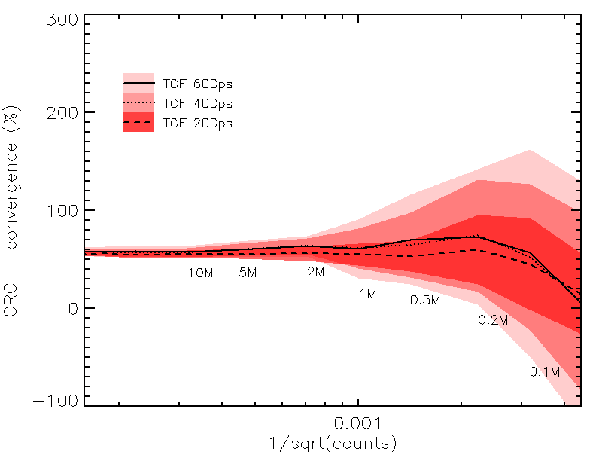
Time-of-Flight PET and the low counts challenge: improved reproducibility
10 mm sphere
Line = mean value over 10 realizations
Contrast recovery
Color band = +/- 1 standard deviation
At very low counts, the uncertainty of the quantification gets considerably smaller with better time resolution
1/sqrt(counts)
Typical FDG patient statistics today (30-40 x 10⁶ counts)
V. Westerwoudt, M. Conti and L. Eriksson, “Advantages of improved time resolution for TOF PET at very low statistics”, TNS 61, 126-133(2014)

Slide 24
New TOF PET technology as enabler for new applications: beyond “diagnostic-only” imaging
Theranostics
a targeting agent which specifically binds to a molecular target on the surface of a cell or tumor
an imaging agent and a therapeutic drug/radioisotope pair
a linker which serves to connect the two entities
    Use imaging to plan therapy, monitor therapy, assess response to therapy.
    Personalize the medical treatment.
Theranostics
Y90
Small compound imaging
mAb imaging
Hadron therapy
More…

Slide 25
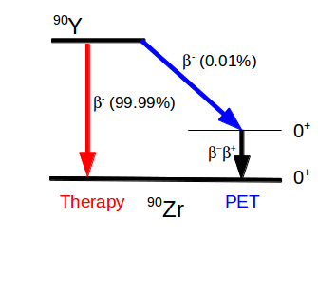
Time-of-Flight PET and the low counts challenge: Y90 imaging
⁹⁰Y is used as a therapeutic radioisotope in microspheres for targeted radiation therapy of the liver. Very weak PET signal from e⁺e⁻ pair creation (BR=30x10⁻⁶)
PET scan characteristics:
long (30 minutes)
low number of counts [10⁵-10⁶]
high random fraction from LSO background (>80%)
high flux of Bremsstrahlung singles in ⁹⁰Y

Slide 26
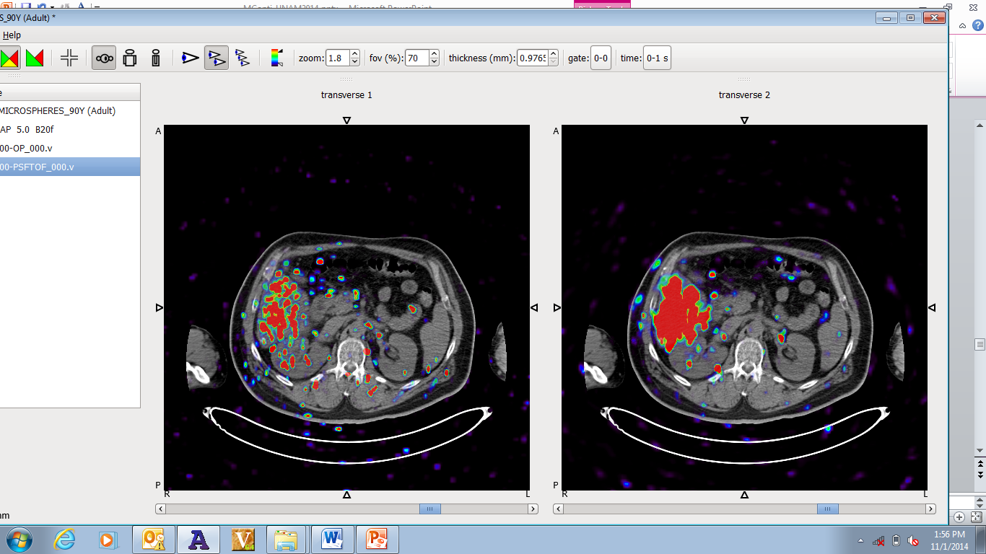
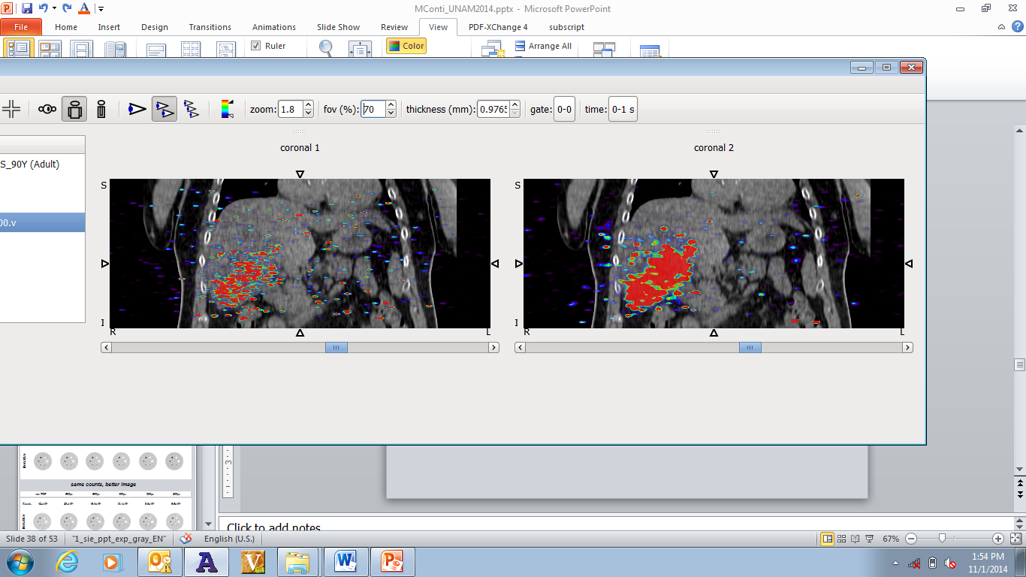
Time-of-Flight PET and the low counts challenge: Y90 imaging
Extremely low counts:
Yttrium-90 imaging
non TOF
TOF
Patient after Y-90 microspheres injection in the liver
(50000 counts, 95% random fraction)
Courtesy of T. Carlier, University Hospital, Nantes, France

Slide 27
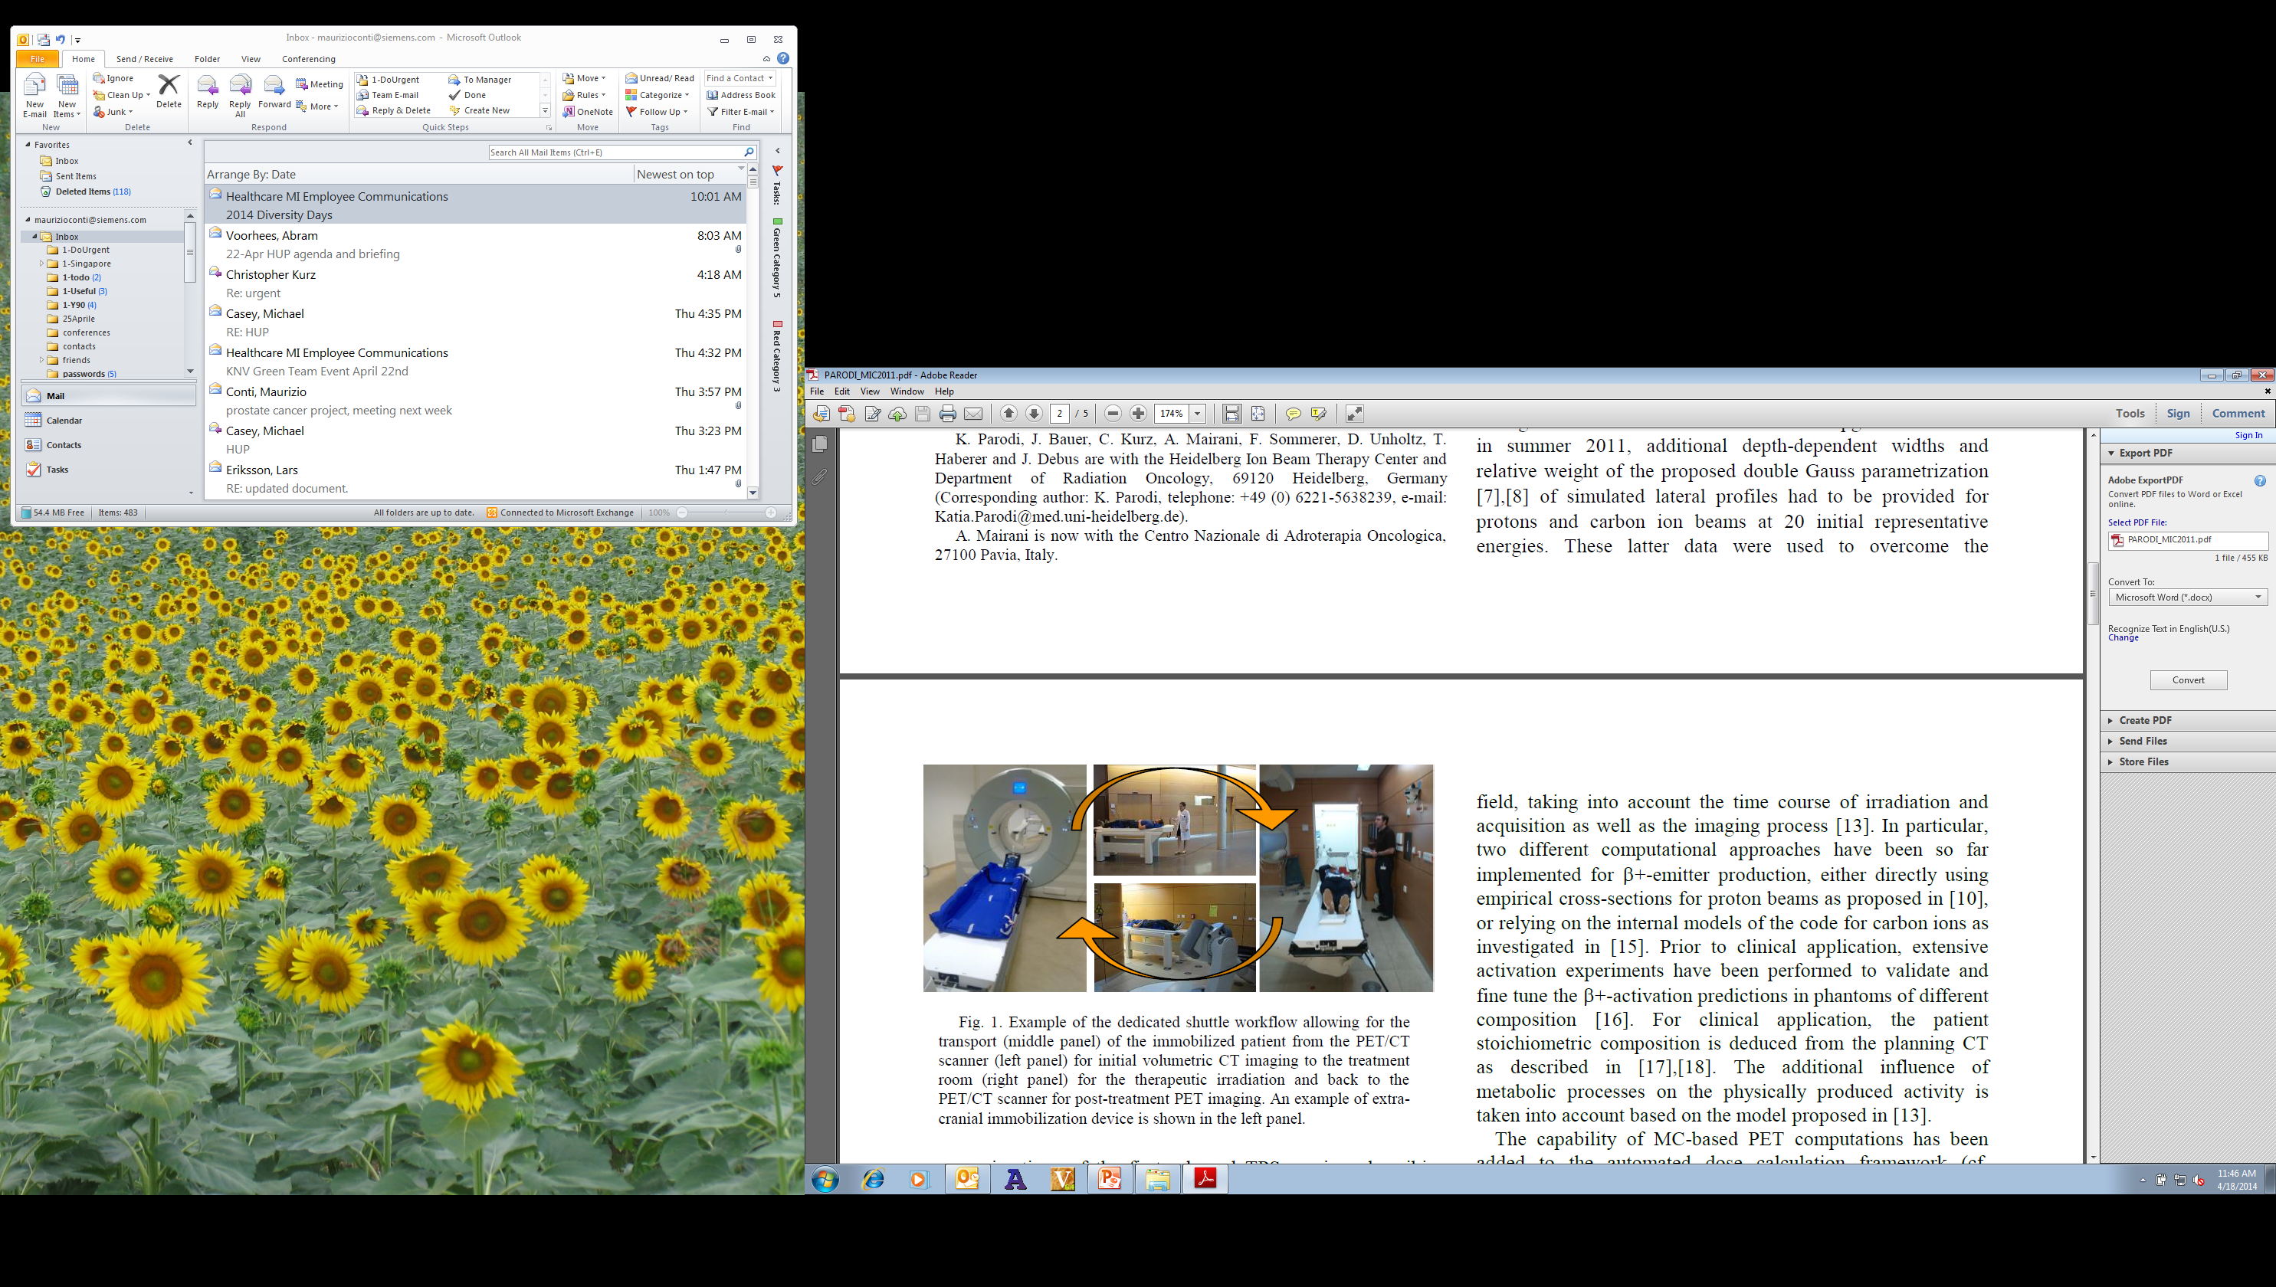
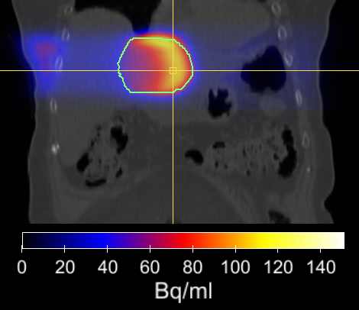
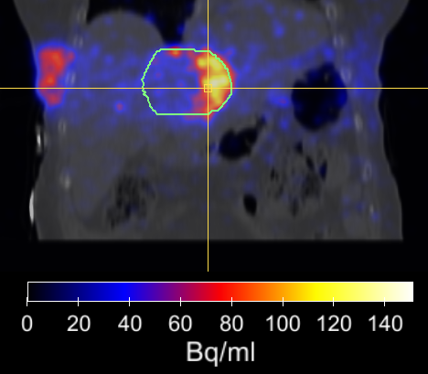
Time-of-Flight PET and the low counts challenge: hadron therapy
    PET imaging of irradiation with proton or ¹²C induces β⁺ emitter (¹⁵O, ¹¹C, etc)
    Hadron and proton therapy are used for local treatment of tumors: liver, brain, eyes, prostate.
    Very weak PET signal from nuclei activation inside the tissue.
PET scan characteristics:
long (30 minutes)
low number of counts [10⁵-10⁶], while typical FDG PET is [10⁷-10⁸]
with high random fraction (>80%)
Prediction
Measurement
    Off-beam PET (about 5-10 minutes post-therapy)
Courtesy of K. Parodi, Heidelberger Ionenstrahl-Therapiezentrum (HIT)

Slide 28
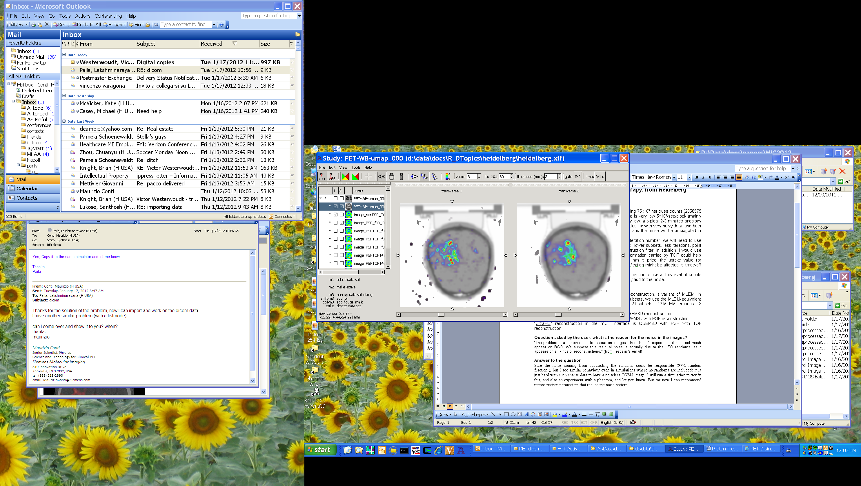

Time-of-Flight PET and the low counts challenge: hadron therapy
OSEM, 21 subsets,
3 iterations
OSEM+PSF+TOF, 14 subsets, 2 iterations
image size 200x200, 5 mm Gaussian filter
Reconstruction methods need to be tailored/optimized for challenging applications
Courtesy of Heidelberger Ionenstrahl-Therapiezentrum (HIT)

Slide 29

Theranostics: small compound imaging
    Matched imaging–therapeutic radioisotopes: ¹²⁴I and ¹³¹I, ⁸⁶Y and ⁹⁰Y
    Matched imaging–therapeutic agents:
    ⁶⁸Ga-DOTA-PSMA ¹⁷⁷Lu-DOTA-PSMA
¹⁷⁷Lu
Imaging
Therapy

Slide 30



Theranostics: mAbs and immunoPET
Monoclonal antibodies (mAb) can target a specific tumor cell surface marker.
They can be used to disease-selective imaging and disease-selective therapy.
Engineering Antibodies
Intact mAbs have a long biological time in humans (days), and they are the format of choice for therapy (pharmaceutical or radiotherapy).
The corresponding imaging radioisotopes must have a long half-life
Intact antibody
150 kDa
Peak 50-100 h
Minibody
80 kDa
Peak 4-6 h
Diabody
55 kDa
Peak 1-2 h

Slide 31


Theranostics: mAbs and immunoPET
Number of therapeutic monoclonal antibodies entering clinical study during 1980 to 2006

Slide 32
Challenges of theranostics for PET physics: radioisotopes
    non-pure beta decay -> accurate prompt gammas corrections
    Long positron range -> range deblurring
    Fewer counts -> reconstruction optimization
Isotope | Half-life | Branching (β⁺) in % | E_{max} (MeV) | E_{mean} (MeV) | R_{max} (mm) | R_{mean} (mm)
¹¹C | 20.4 min | 99.8 | 0.960 | 0.386 | 4.2 | 1.2
¹³N | 10.0 min | 99.8 | 1.199 | 0.492 | 5.5 | 1.8
¹⁵O | 2 min | 99.9 | 1.732 | 0.735 | 8.4 | 3.0
¹⁸F | 110 min | 96.9 | 0.634 | 0.250 | 2.4 | 0.6
⁶⁴Cu | 12.7 hours | 17.5 | 0.653 | 0.278 | 2.5 | 0.7
⁸⁹Zr | 78.4 hours | 22.7 | 0.902 | 0.396 | 3.8 | 1.3
Isotope | Half-life | Branching (β⁺) in % | β⁺ E_{max} (MeV) | Branching (γ) in % | γ E (PG) (MeV)
⁶⁸Ga | 67.8 min | 87.7, 1.2 | 1.899, 0.821 | 3.2 | 1.077
⁷⁶Br | 16.2 hours | 25.8, 6.3 | 3.382, 0.871 | 74.0, 15.9 | 0.559, 0.657
⁸²Rb | 1.3 min | 81.8, 13.1 | 3.378, 2.601 | 15.1 | 0.777
⁸⁶Y | 14.7 hours | 11.9, 5.6 | 1.221, 1.545 | 82.5, 32.6 | 1.077. 0.627
¹²⁴I | 100 hours | 11.7, 10.7 | 1.535, 2.138 | 62.9, 11.2 | 0.602, 1.691
Pure beta emitters
Prompt gamma emitters

Slide 33


Challenges: prompt gamma corrections
F18 decay scheme
“simplified” Y86 decay scheme

Slide 34
Table of contents
Positron Emission Tomography (PET)
TOF PET methods and applications
Evolution of PET and state of the art of PET scanners today
Long Axial FOV scanner and applications
The role of AI in PET
Future technology development and needs for fundamental research

Slide 35


The evolution of Siemens scanners
scintillator(LSO)
TOF (SW/HW)
Photosensor (SiPM)
Volume & data handling
2000
2010
2017
2020

Slide 36

Biograph Vision – system overview
Biograph Vision
SiPM-based LSO detector with 3.2 x 3.2 x 20 mm crystals
82 cm transaxial diameter and 26 cm axial length
19 detector module assemblies with 16 detectors per assembly
60,800 total crystals. 760 per ring and 80 rings
Water-cooled gantry with 3 zones of cooling
Large 78 cm bore
64 or 128-slice CT
FlowMotion continuous bed motion

Slide 37




A new approach to detector design with Biograph Vision™
3.2 mm LSO crystal element
100% coverage¹ of the LSO array
5x5 crystal mini-block
2x4 mini -blocks
Coupled to a 4x4 array of 4.0 x 4.0 mm SiPMs.
2x8 detectors axially =26.3 cm axial FOV

Slide 38


“SiPM TOF-PET Detector”, Sanghee Cho et al. (IEEE MIC 2017)

Slide 39

Biograph Vision performance (IEEE MIC 2018)

Slide 40

Biograph Vision performance

Slide 41




Clear visualization of the 2.4 mm cylinders of the
Mini-Derenzo Phantom with Biograph Vision
Diameter (mm)
Biograph mCT
Biograph Vision
4.0
3.2
2.4
4.8
1.2
1.6

Slide 42
Table of contents
Positron Emission Tomography (PET)
TOF PET methods and applications
Evolution of PET and state of the art of PET scanners today
Long Axial FOV scanner and applications
The role of AI in PET
Future technology development and needs for fundamental research

Slide 43

Biograph Vision Quadra
High time resolution: ̴ 225 ps time resolution
High axial coverage: 106 cm axial length
High detection efficiency: 243200 LSO crystals
Multi-organ coverage
High sensitivity
3.2 x 3.2 x 20 mm crystals
High spatial resolution (it doesn’t hurt ☺)

Slide 44


The evolution of Siemens scanners

Slide 45




TOF sensitivity gain or TOF effective sensitivity
A TOF image is equivalent to a non-TOF image obtained with a larger number of counts: TOF reconstruction acts as a “virtual counts or sensitivity amplifier” for a PET scanner. The sensitivity gain is proportional to the size of the object that is being scanned (D) and the system time resolution $Δt$:
NEMA sensitivity (70cm line)
${TOFGain}_{Sensitivity}=\frac{D}{Δx}$ $=\frac{D}{Δt c/2}$
Two “modes” available:
High Sensitivity and high resolution (HS, 18°)
Ultra High Sensitivity (UHS, 52°) [2nd software release)

Slide 46
Applications of long axial FOV scanners (LAFOV) or Total Body scanners
The Present: today’s clinical applications
Faster scans:
  Faster workflow
  Patient comfort, particularly for sick patients
  Motion artifact reduction
Lower dose:
  Low dose PET
  Repeated scans to monitor therapy
  Pediatric PET
The Future: long axial FOV PET in research and new clinical applications
References:
S.R. Cherry, T. Jones, J.S. Karp, et al., “Total-Body PET: Maximizing Sensitivity to Create New Opportunities for Clinical Research and Patient Care”, J Nucl Med 2018; 59:3–12
S.Surti, A.Pantel, J.Karp, “Total Body PET: Why, How, What for?”, Transactions on Radiation and Plasma Medical Sciences, vol. 4, no. 3, pp. 283-292, 2020.
S. Vandenberghe, P. Moskal and J.S. Karp, “State of the art in total body PET”, EJNMMI Physics (2020) 7:35, pp: 1-33.

Slide 47







The Future: LAFOV as enabler for new applications
High sensitivity
Multi-organ coverage
Fast breath-hold PET/CT
Low dose immunoPET (Zr89 and others)
PET angiography and PET perfusion
Accurate whole-body parametric imaging
SUV
Ki
DV
Pediatric imaging
Interaction inter organs (brain-guts, brain-heart, brain-spine)
Multi organ tracer kinetics and input functions
PET/CT screening

Slide 48
The Future: LAFOV as enabler for new applications (1)
Fast breath-hold PET/CT
Breath-hold scans
The amplification of sensitivity compared to standard scanners like Vision, allows for standard dose but very short scans (how many seconds? TBD as part of the research) – this will provide:
  Patient comfort: sick patients cannot hold breath much!
  Full matching between CT and PET (sometimes because of the longer PET scan there is mismatch, which is problematic)
  Particularly important for lung cancer

Slide 49
The Future: LAFOV as enabler for new applications (2)
Screening of patients at risk
Early detection of disease like lung cancer: this and other deadly diseases in which patients show symptoms when the cancer is in a very advanced state.
Population at risk can be defined for those diseases, and if dose can be reduced to “minimal dose” (TBD within the research) large scale screening of those populations can be done, and lives can be saved with early detection
PET/CT screening

Slide 50
The Future: LAFOV as enabler for new applications (3)
Pediatric applications
For this application probably we will investigate simultaneous reduction of dose and scan time.
A x10 gain in sensitivity allows to reduce both (1/2 of the time and 1/5 of the dose, for example).
Dose reduction is needed for children
Short scans will reduce motion during the scan: children often need to be sedated to keep them still!
Pediatric imaging

Slide 51
The Future: LAFOV as enabler for new applications (4)
ImmunoPET and theranostics
PET imaging (immunoPET) can be associated with therapy (immunotherapy) to predict efficacy of the drug or the radioactive therapy agent, using the same molecule or antibody as a carrier for both (Theranostics).
Low dose immunoPET (Zr89 and others)
Given the long biological half-life of monoclonal antibodies, long life radioisotopes like ⁸⁹Zr are used, and the low positron abundance (23% for ⁸⁹Zr) together with the slow decay, results in very low counts in the scan, and need for high sensitive PET scanners.

Slide 52
The Future: LAFOV as enabler for new applications (5)
Whole-body PET angiography and multiple organs PET perfusion
Fast and full body scans are feasible
Whole-body vascular disease can be imaged dynamically
Imaging of perfusion in multiple organs, simultaneously.
PET angiography and PET perfusion

Slide 53
The Future: LAFOV as enabler for new applications (6)
Interaction between organs
Brain-skeleton, research to develop new opioid drugs that control pain and avoid addition
Brain-guts, research associated with Parkinson’s
Brain-heart, investigation of amyloid deposits associated with Alzheimer’s
Brain-heart, studying cognitive impairment of people with heart attack
Interaction inter organs (brain-guts, brain-heart, brain-spine)

Slide 54
The Future: LAFOV as enabler for new applications (7)
Accurate whole-body parametric imaging
kinetic/parametric parameters imaging tends to be “noisy” because of needing to fit very short frames. High sensitivity allows for more robust parametric images.
Accuracy in quantification of kinetic parameters is greatly improved
Image quality is improved as noise is reduced
Accurate whole-body parametric imaging
SUV
Ki
DV

Slide 55
The Future: LAFOV as enabler for new applications (8)
Multi organ tracer kinetics and input functions
Fast, low dose, multi organ tracer kinetics for drug development
We can study uptake kinetics in all organs in the same time, and also study the uptake in organs that are not target (collateral damage to healthy organs/tissue)
“local” image derived input functions can be computed and compared, input function dispersion can be modeled
Multi organ tracer kinetics and input functions

Slide 56
Table of contents
Positron Emission Tomography (PET)
TOF PET methods and applications
Evolution of PET and state of the art of PET scanners today
Long Axial FOV scanner and applications
The role of AI in PET
Future technology development and needs for fundamental research

Slide 57

Publications on AI in Molecular Imaging
Credit: Vijay Shah

Slide 58
Artificial Intelligence in PET
Detector and system
Improve & speed-up calibrations and normalization
Improve detector performance
Reconstruction
Aid & speed-up reconstruction
Post-reconstruction
Direct reconstruction
Low count reconstruction
Image processing (denoising, registration)
Support to diagnostics and research
Corrections (attenuation, scatter, normalization, motion)
radiomics

Slide 59



Use of Deep Learning: denoising or low counts application
The idea: train the network with some high statistics training set
Applications: mAb, ¹²⁴I, ⁹⁰Y, low dose imaging, low dose PET screening
IEEE 2017 (Stanford)
IEEE 2018 (Singapore)

Slide 60



Use of Deep Learning: alternative or faster reconstruction
The idea: “direct” DL reconstruction from raw data, or mix of trained network and “conventional” methods
Applications: all applications, possibly faster or better reconstruction
TRPMS 2021 (King’s College London)
TRPMS 2021 (Siemens)

Slide 61




Use of Deep Learning: improved data correction
The idea: train networks to computer faster or better attenuation, scatter, motion correction
Applications: all applications, but in particular attenuation
TRPMS 2021 (Seoul)
EJNMMI 2018 (Madison)

Slide 62




Use of Deep Learning: detector performance improvement
The idea: train networks with controlled experiments to be able to extract extra information from signals
Applications: improve corrections for depth of interaction, inter crystal scatter, time of flight
PMB 2020 (Munich, CERN)
PMB 2018 (UC Davis)

Slide 63
Table of contents
Positron Emission Tomography (PET)
TOF PET methods and applications
Evolution of PET and state of the art of PET scanners today
Long Axial FOV scanner and applications
The role of AI in PET
Future technology development and needs for fundamental research

Slide 64



Direct TOF back projection from list mode, or histoimage (simulation)
What happens if we improve TOF resolution?
500 ps
200 ps
10 ps
“cardiac defect“ simulation: 4-cm diameter ring, 1-cm thick , with on 1-cm defect

Slide 65


An example of “no reconstruction”
Direct TOF back projection from list mode (aka histoimage), MIP image
mCT (550 ps resolution)
Vision (215 ps resolution)
No normalization, attenuation, scatter correction
Data Courtesy of University of Tennessee

Slide 66


Do we still need reconstruction physicists?
TOF backprojection or histoimage (200ps)
OSEM TOF reconstruction (200 ps, 4i5s)
Probably yes…
Consistency of space-time information is enforced by iterative reconstruction, together with noise reduction

Slide 67


How to improve time resolution?
new scintillators
new materials with fast emission
new detector geometries (monolithic detectors, side readout, plates, etc)
Cherenkov light
Alternative detector systems (MCP etc)
Deep learning to improve performance
…

Slide 68
My conclusive remarks and questions:
The great technological leap of the past few years provided powerful tools for fundamental research
The future belongs to biological research, medical research, pharmaceutical research
But, is there still space for groundbreaking technological innovation?
Yes! Oui! Si! Ja! Da! Tak ! …
New and improved detectors and architectures
Better time and spatial resolution
Mathematics and reconstruction for challenging new applications (extremely low counts as in cell tracking, motion correction and dynamic studies)
Technology for multidisciplinary teams (physician, biologist, physicist, pharmacologist…

Slide 69
Thanks to:
Siemens Healthineers
Molecular Imaging
Research PET
810 Innovation Drive
Knoxville, TN 37919, USA
  Maurizio Conti
  Director, PET physics and reconstruction
  Phone: +1 865 548-2443
  maurizioconti@siemens-healthineers.com
John Prior (CHUV, Lausanne, Switzerland)
Axel Rominger (Inselspital, Bern University Hospital, Switzerland)
Joel Karp (University of Pennsylvania, USA)
Thomas Carlier (CHU Nantes, France)
Katia Parodi (Ludwig-Maximilians-Universität München, Germany)
Jorge Cabello, Bernard Bendriem, Mike Casey, Lars Eriksson, Curtis Howe, Carl von Gall, Deepak Bharkhada, Paul Schleyer (Siemens, Knoxville, USA)

