Slide 1
CERN’s Year of Environmental Awareness
B. Delille – CERN HSE Head
30/09/2021
EDMS 2637925

Slide 2
Outline
Context of CERN’s Year of Environmental Awareness
      CERN’s commitment to environment
      First public CERN Environment Report
      European Strategy for Particle Physics Update
CERN’s Year of Environmental Awareness
      Launching Townhall event
      Publications in the CERN Bulletin
      Engaging Actions

Slide 3
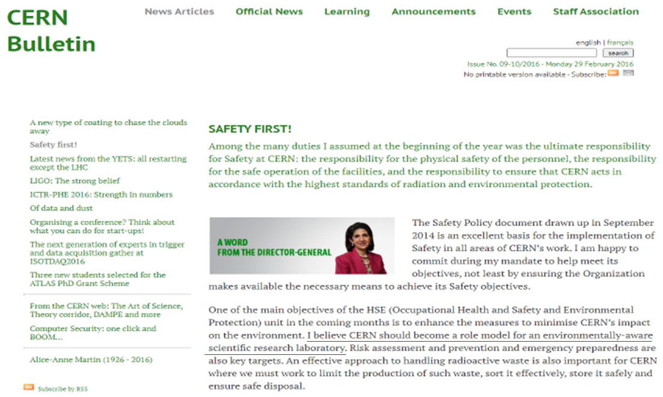
Context of CERN’s Year of Environmental Awareness
CERN’s commitment to environment
The vision of CERN Director- General Fabiola Gianotti

Slide 4
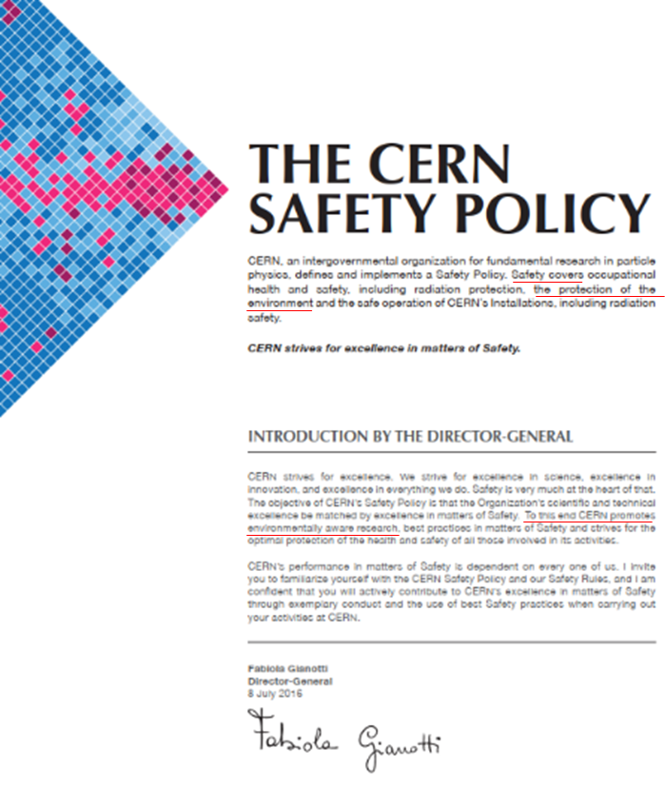
Context of CERN’s Year of Environmental Awareness
CERN’s commitment to environment
Safety at CERN includes the protection of the environment

Slide 5
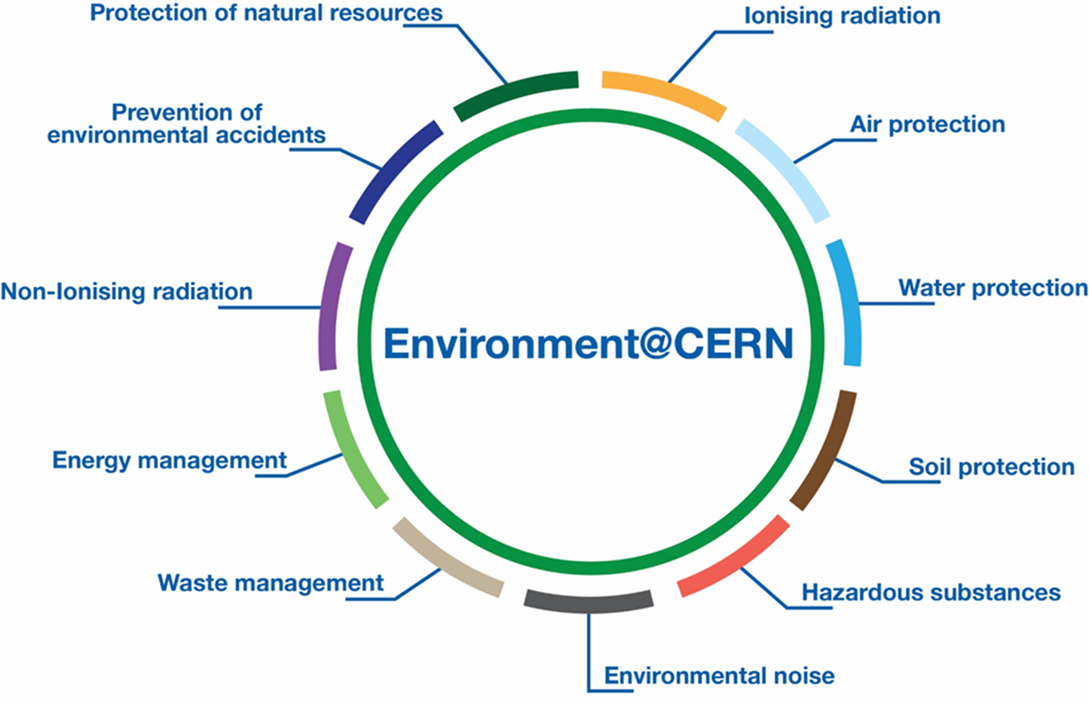
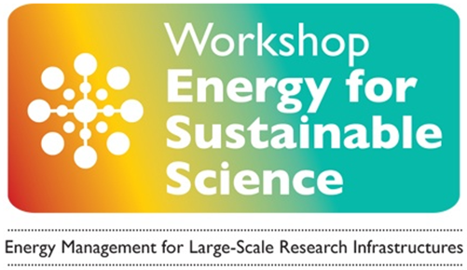
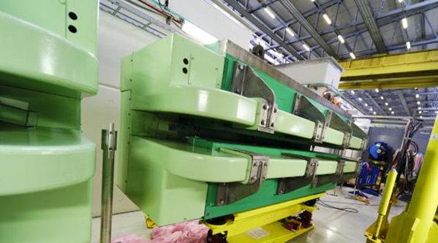
Context of CERN’s Year of Environmental Awareness
CERN’s commitment to environment
CERN Environmental Protection Steering Board established since 2016 – prioritized objectives for 11 Environmental Domains and follow-up of their implementation
Dedicated panel on Energy Management since more than ten years, incl. exchanges with other Large-Scale Research Infrastructures. Increase efficiency – Use less – Recover more

Slide 6
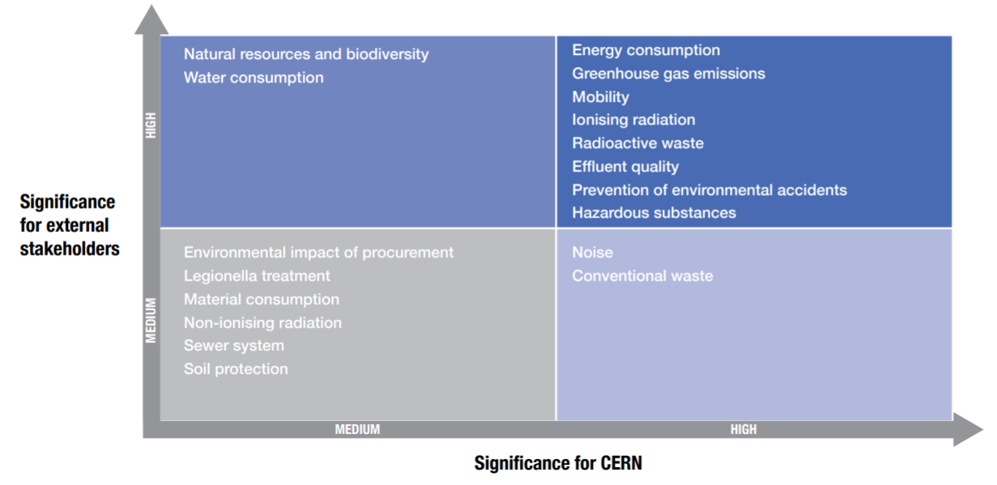
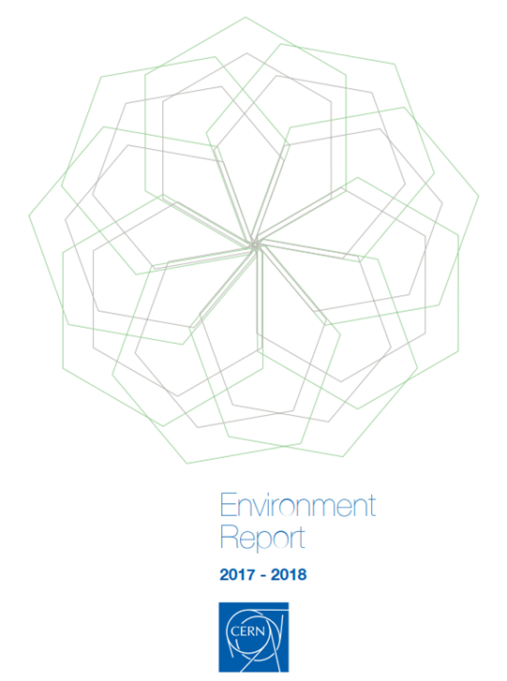
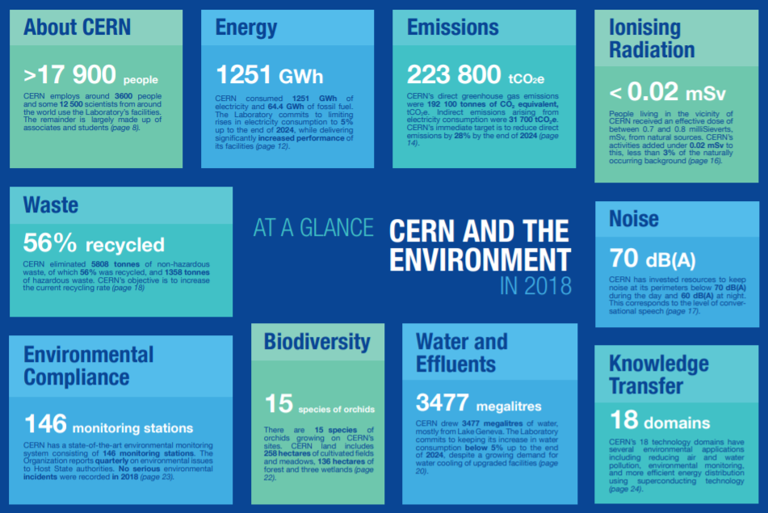
Context of CERN’s Year of Environmental Awareness
First Public CERN Environment Report
Covering the years 2017-2018, published in September 2020
Aligned to the Global Reporting Initiative (GRI). Materiality assessment carried out with internal and external stakeholders
Very positive external feedback, limited feedback from CERN personnel

Slide 7

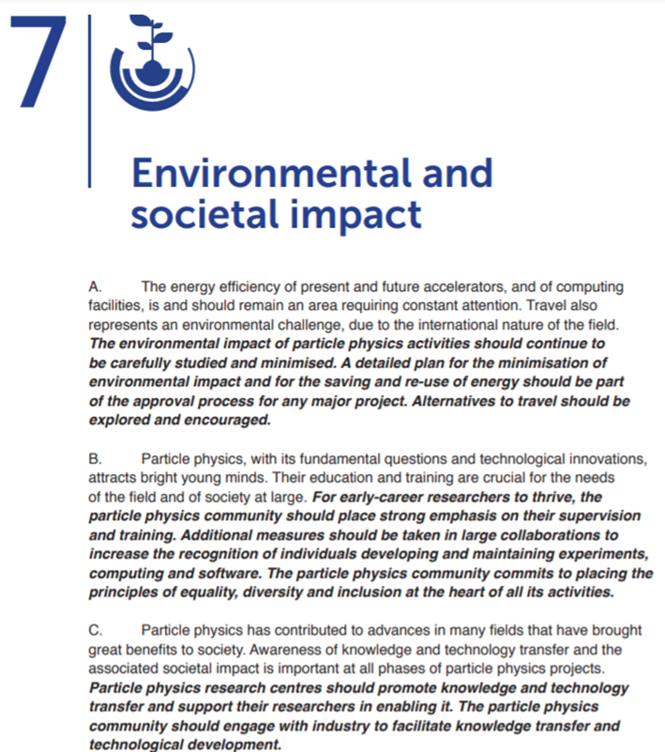
Context of CERN’s Year of Environmental Awareness
European Strategy for Particle Physics Update (ESPPU)
Approved at the June 2020 CERN Council Meeting
Minimising environmental impact of future projects
Engaging with industry to facilitate knowledge transfer and technological development, also in the field of environment
Considering CERN Environment Report and the ESPPU - Decision early 2021 to carry out a CERN internal environmental communication campaign

Slide 8
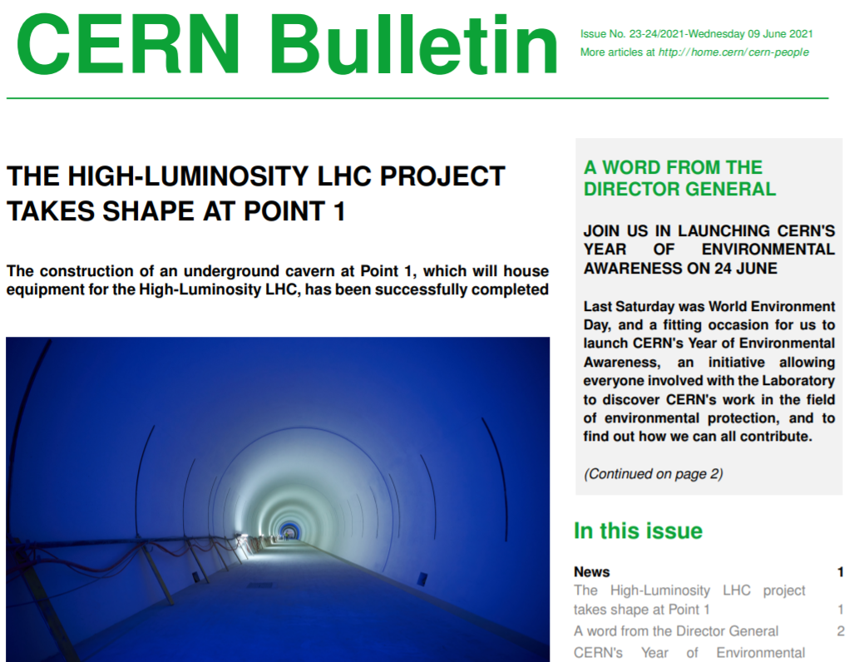
CERN’s Year of Environmental Awareness
Launching Townhall event in June 2021
At the occasion of the World Environment Day (5th of June)
CERN DG, Representatives of the Host States, Member of the ESPPU, CERN talks + online Quiz for participants

Slide 9
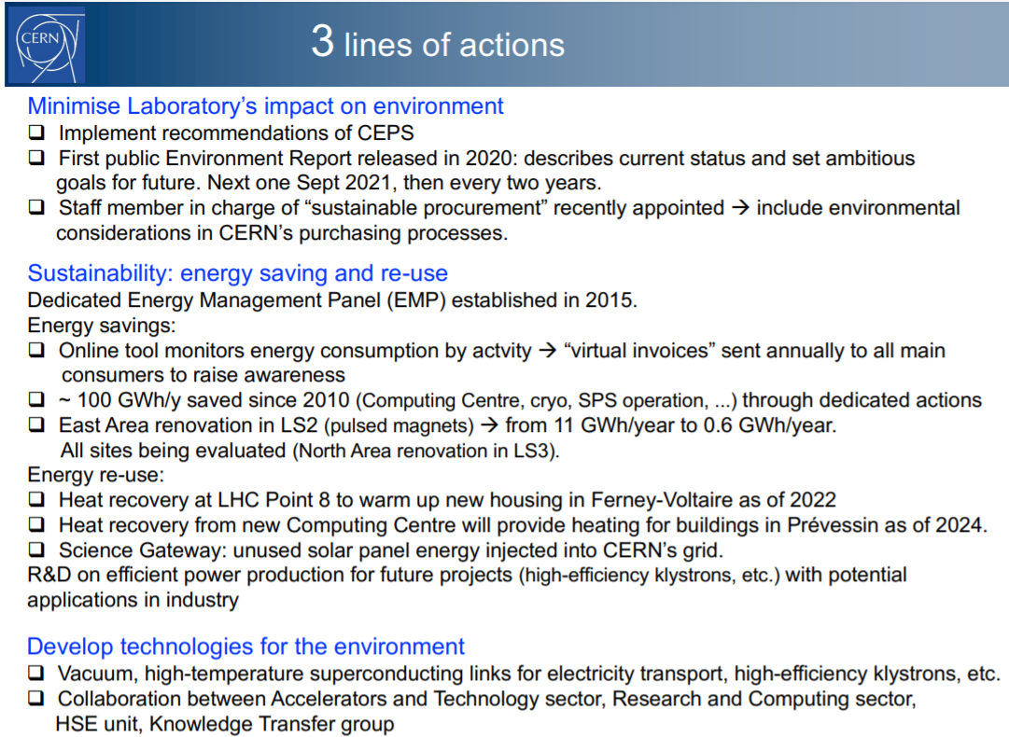
CERN’s Year of Environmental Awareness
Launching Townhall event in June 2021
Objective of the communication campaign: inform CERN community about CERN actions in support of the environment and promoting engagement and active participation of the personnel
Publication of articles, every two weeks in the CERN Bulletin + engaging actions from June 2021 to June 2022
Courtesy of F. Gianotti – 24 June 2021

Slide 10
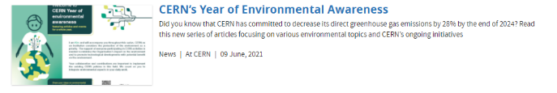
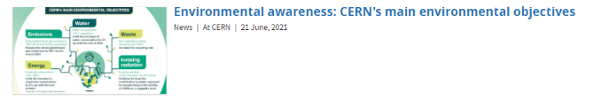


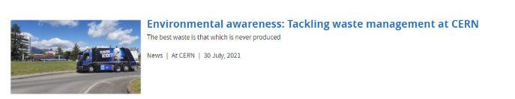
CERN’s Year of Environmental Awareness
Articles/Infographics published so far
Providing data on CERN’s environmental actions, as well as tips and suggestions

Slide 11
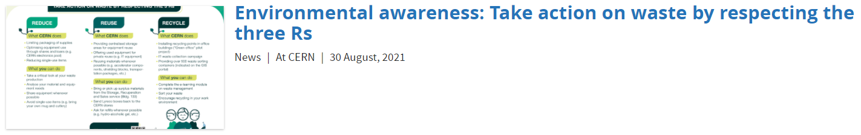
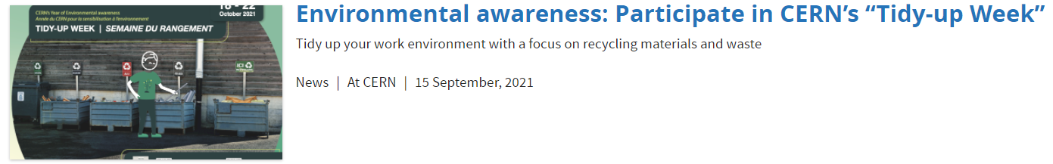
CERN’s Year of Environmental Awareness
Articles/Infographics published so far
+ Article on recycling of non-hazardous waste under publication

Slide 12
CERN’s Year of Environmental Awareness
Publication 2022 | Subject | Layout
January | Technology transfer: technologies linked to Better Planet | Article
 | Technology transfer: Activity announcement | Infographic
February | IT: impact of digital infrastructure | Article
 | IT: impact of digital infrastructure | Infographic
March | Hazardous substances | Article
 | Hazardous substances | Infographic
April | Mobility | Article
 | Mobility: maps of cycling routes | Infographic
May | Energy: CERN strategy | Article
 | Energy: Activity announcement | Infographic
June | Biodiversity | Article
 | Biodiversity: biotopes at CERN | Infographic
Articles/Infographics to come
Publication 2021 | Subject | Layout
12.10.21 | CERN’s noise in the environment | Article
26.10.21 | Noise: annual measuring campaign | Infographic
09.11.21 | CERN Environment Report 2019-2020 | Article
23.11.21 | CERN CO₂ Footprint | Article
07.12.21 | CERN CO₂ Footprint | Infographic

Slide 13
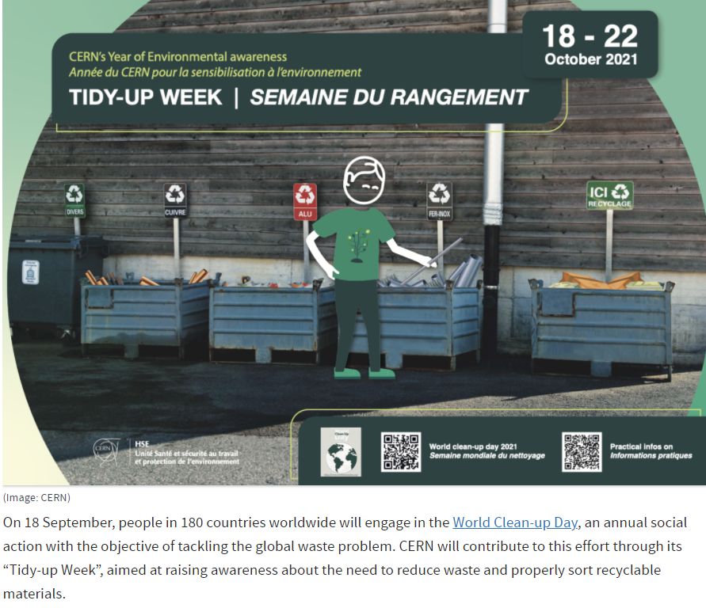
CERN’s Year of Environmental Awareness
Engaging Actions
Tidy-up week organized in collaboration with CERN Safety Representatives and Departments providing operational support (transport services and waste management services)
Other engaging actions under discussion for 2022 (e.g innovation day as follow-up of COP26 - energy saving)

Slide 14
If you want to know more about CERN’s Environmental report https://hse.cern/environment-report-2017-2018

