Slide 1

Enrico Chesta
Aerospace, Energy and Environmental Applications Coordinator

Slide 2



CERN Knowledge Transfer Mission
Maximise the technological and knowledge return to society in particular through Member States industry
Charts
Promote CERN as a centre of excellence for technology and innovation
Demonstrate the importance and impact of fundamental research investments

Slide 3
Areas of expertise
Machine Learning and Deep Learning
Industrial Controls and Automation
Metrology
High and Ultra High Vacuum Systems
Data Analytics
Health, Safety and Environment Management
Cryogenics
Optoelectronics and Microelectronics
High Volume Data Management & Storage
Superconducting Magnets
Particle Acceleration and Control
Radiation Protection and Monitoring
Particle Tracking and Calorimetry
Sensors
Material Science
Cooling and Ventilation
Robotics
Collaboration Tools
Radio Frequency Technology
Manufacturing and Mechanical Processes
Please follow this link to explore CERN KT Detailed Value Proposition

Slide 4
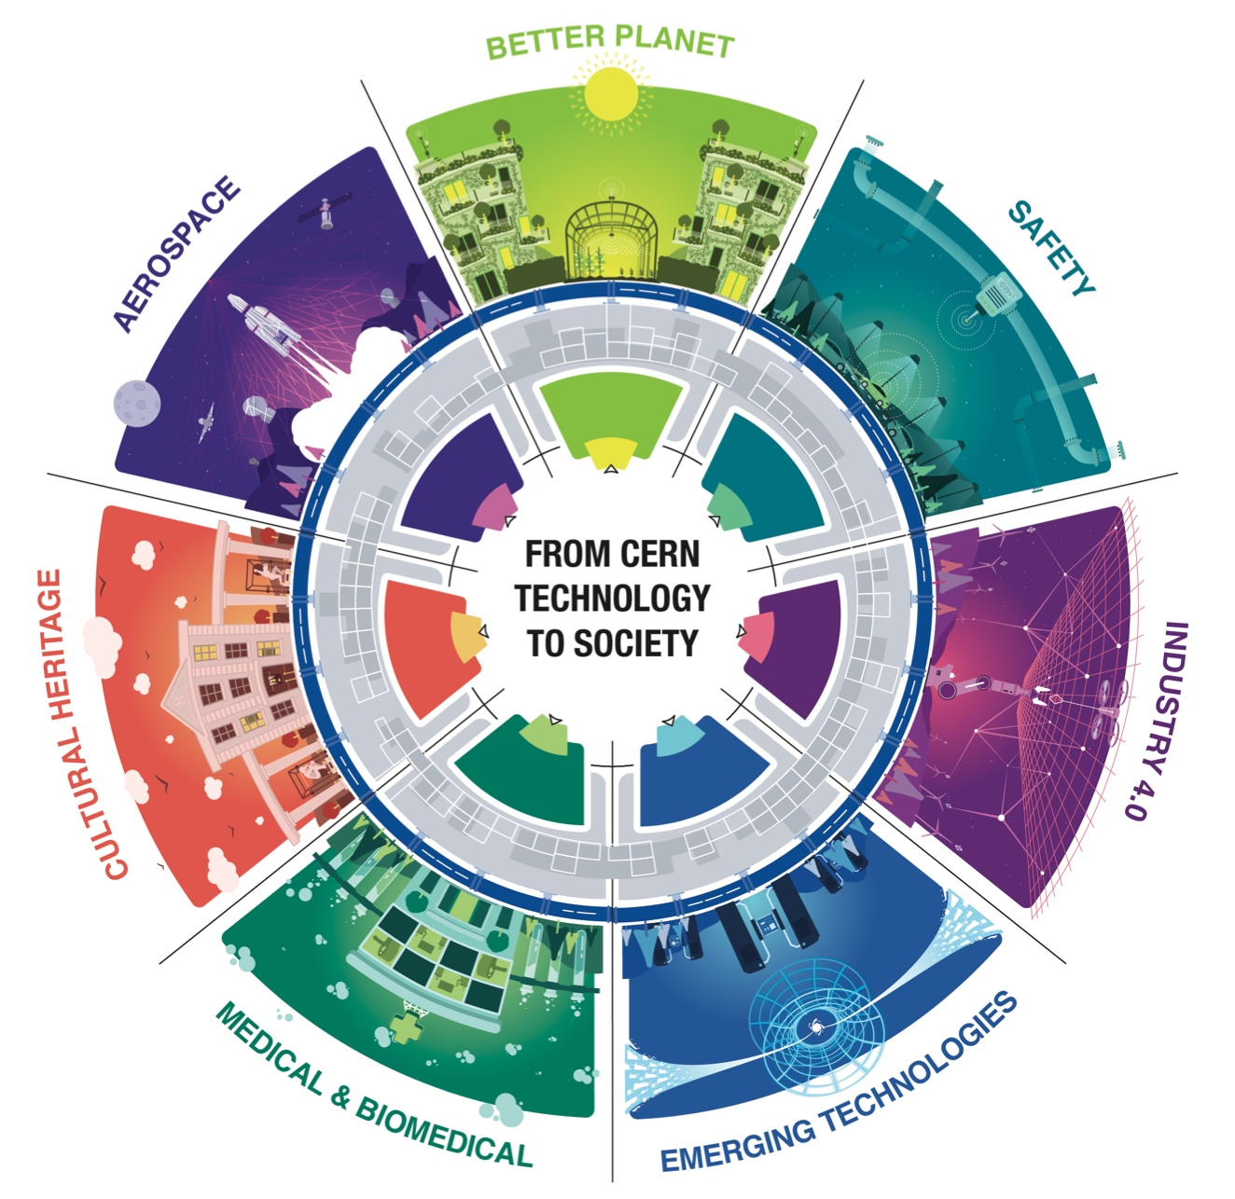
Application Domains
Focus on:
Medical
Aerospace
Energy & Environment
Digital
Quantum
Notes:
The applications of CERN technologies extend beyond high-energy physics to a vast range of areas such as aerospace, medical and biomedical, industry 4.0, cultural heritage and safety. Many technologies are applied in ways that contribute towards a better planet.

Slide 6
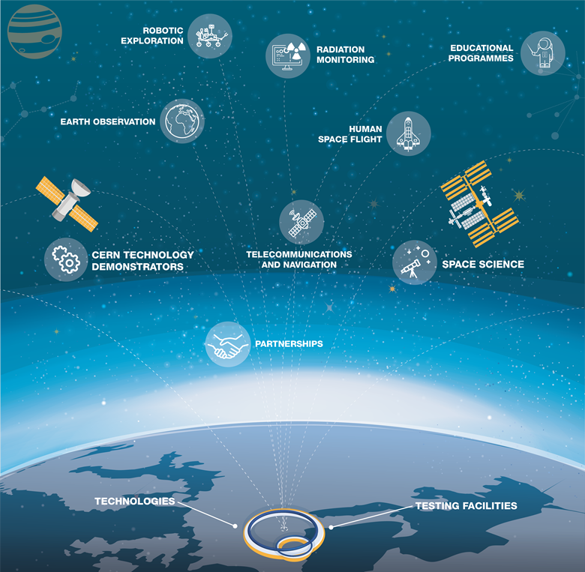

Slide 7
Strategy under definition
Inputs needed!
Some examples

Slide 8
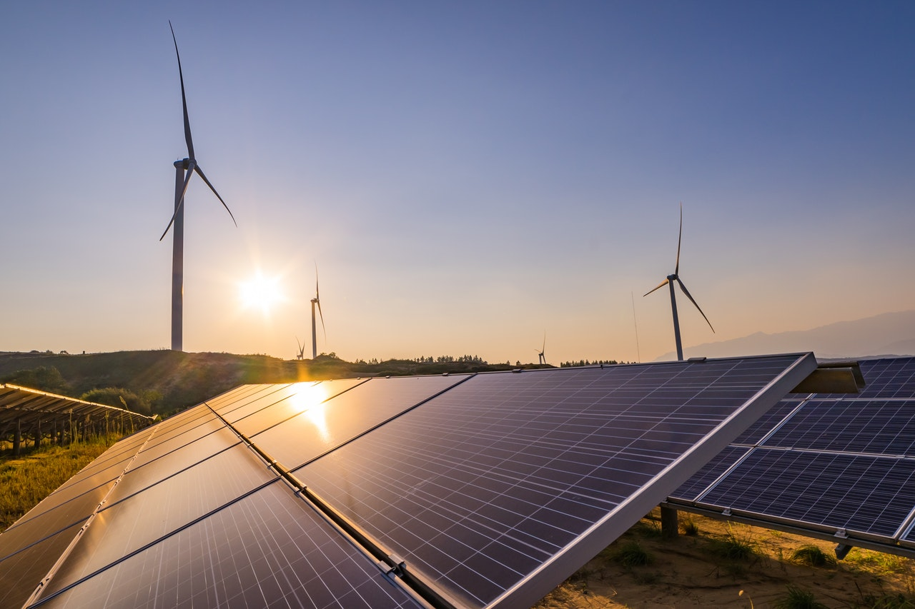

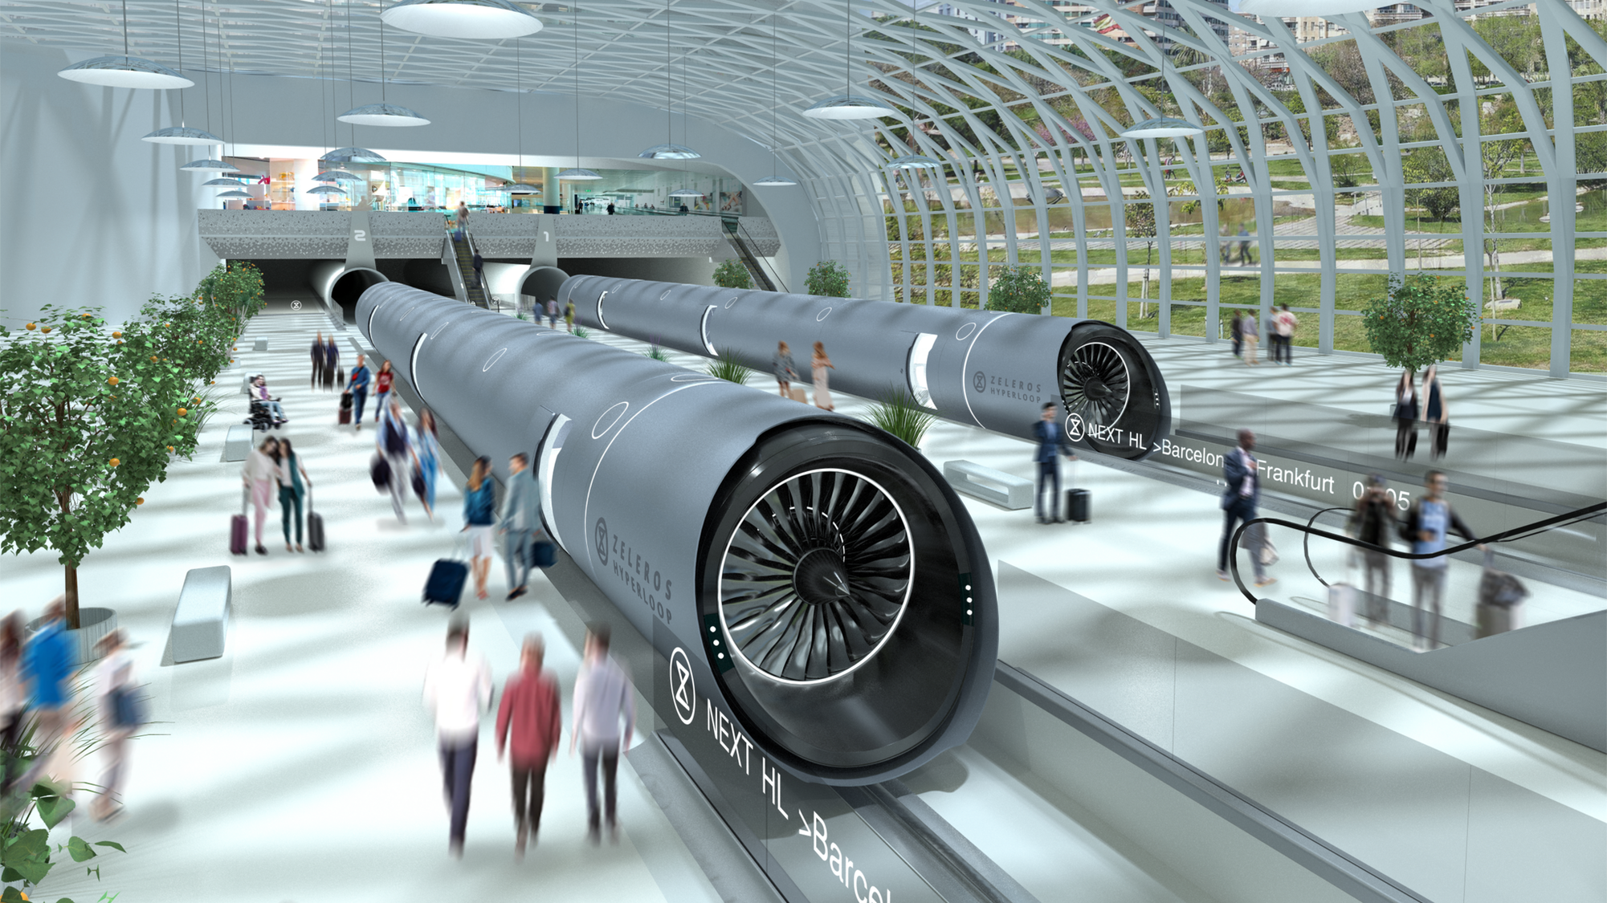

1. Renewable and
Low-Carbon Energy
CERN KNOWHOW
…..
Superconductivity
High Field Magnets
High Vacuum
Cryogenics
Materials
Artificial Intelligence
Advanced Sensors
Rad-tol Systems
Thermal Control
Radioprotection
….

Slide 9
1. Renewable and
Low-Carbon Energy
CERN KNOWHOW
…..
Superconductivity
High Field Magnets
High Vacuum
Cryogenics
Materials
Artificial Intelligence
Advanced Sensors
Rad-tol Systems
Thermal Control
Radioprotection
….
3. Climate Change and Pollutants Control
Production
Distribution
Storage
Monitoring
Modelling
Mitigation
2. Clean Transportation and Future Mobility
4. Sustainability and Green Science
Aviation
Shipping
Rail
Automotive
Power Management
Heat management
Industrial Processes

Slide 10
CERN KNOWHOW
…..
Superconductivity
High Field Magnets
High Vacuum
Cryogenics
Materials
Artificial Intelligence
Advanced Sensors
Rad-tol Systems
Thermal Control
Radioprotection
….
3. Climate Change and Pollutants Control
Solar Thermal Panels
Future Fusion Reactors
Accelerator Driven Systems
Monitoring
Modelling
Mitigation
Compact Wind Turbines
SC
Power
Lines
Liquid
Hydrogen
Tanks
2. Clean Transportation and Future Mobility
4. Sustainability and Green Science
Aviation
Shipping
Rail
Automotive
Power Management
Heat management
Industrial Processes

Slide 11
CERN KNOWHOW
…..
Superconductivity
High Field Magnets
High Vacuum
Cryogenics
Materials
Artificial Intelligence
Advanced Sensors
Rad-tol Systems
Thermal Control
Radioprotection
….
3. Climate Change and Pollutants Control
Solar Thermal Panels
Future Fusion Reactors
Accelerator Driven Systems
Monitoring
Modelling
Mitigation
Compact Wind Turbines
SC
Power
Lines
Liquid
Hydrogen
Tanks
4. Sustainability and Green Science
Long Haul Hydrogen Airplanes
Decarbonized Maritime Vessels
Power Management
Heat management
Industrial Processes
Magnetic Levitation Trains
Autonomous Electric Vehicles

Slide 12
CERN KNOWHOW
…..
Superconductivity
High Field Magnets
High Vacuum
Cryogenics
Materials
Artificial Intelligence
Advanced Sensors
Rad-tol Systems
Thermal Control
Radioprotection
….
Rad-tol Earth Observation Instruments
Distributed Optical
Sensors
Solar Thermal Panels
Future Fusion Reactors
Accelerator Driven Systems
Radioactive Waste Handling
Exhaust Gas Treatments
Compact Wind Turbines
SC
Power
Lines
Liquid
Hydrogen
Tanks
Air Pollutants Propagation Simulation
Earth Digital Twins using AI
4. Sustainability and Green Science
Long Haul Hydrogen Airplanes
Decarbonized Maritime Vessels
Power Management
Heat management
Industrial Processes
Magnetic Levitation Trains
Autonomous Electric Vehicles

Slide 13
CERN KNOWHOW
…..
Superconductivity
High Field Magnets
High Vacuum
Cryogenics
Materials
Artificial Intelligence
Advanced Sensors
Rad-tol Systems
Thermal Control
Radioprotection
….
Rad-tol Earth Observation Instruments
Distributed Optical
Sensors
Solar Thermal Panels
Future Fusion Reactors
Accelerator Driven Systems
Radioactive Waste Handling
Exhaust Gas Treatments
Compact Wind Turbines
SC
Power
Lines
Liquid
Hydrogen
Tanks
Air Pollutants Propagation Simulation
Earth Digital Twins using AI
Computing Power Saving Techniques
Tools for
Operations Monitoring
Long Haul Hydrogen Airplanes
Decarbonized Maritime Vessels
Buildings Insulation
Advanced Cooling Systems
Magnetic Levitation Trains
Autonomous Electric Vehicles
Infrastructure Maintenance &
Safety Tools
3D Printing Technologies

Slide 14
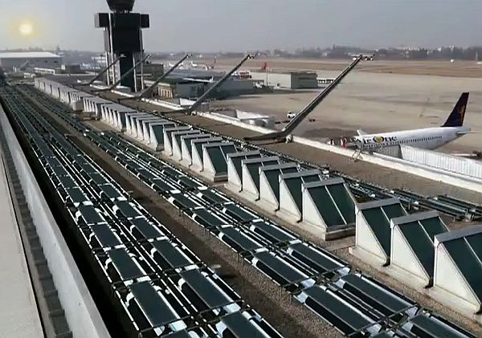
Evacuated solar thermal panels with NEG pumps for Geneva Airport in collaboration with SRB Energy.

Slide 15
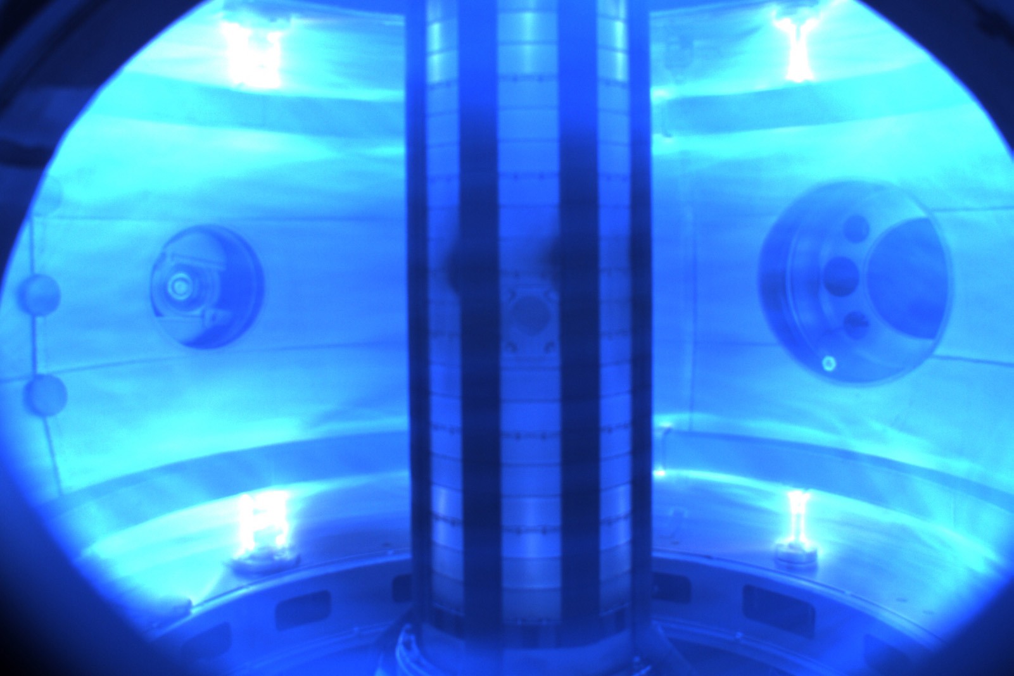
Simulation of currents and magnetic fields for future fusion power generators in collaboration with Tokamak Energy.

Slide 16
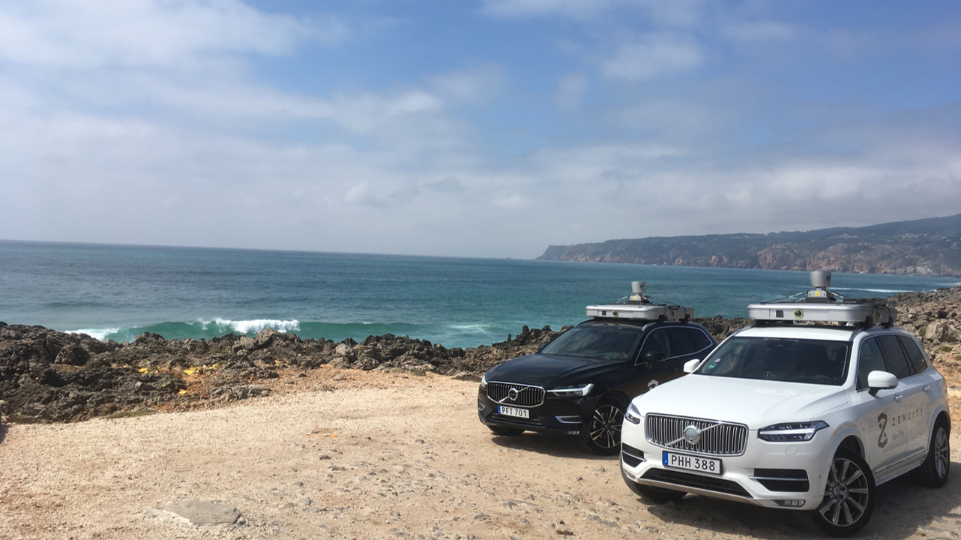
Fast machine learning using FPGAs for autonomous vehicles in collaboration with Volvo.

Slide 17
Global air monitoring network to detect pollution built using CERN data acquisition framework by PlanetWatch.
Notes:
https://kt.cern/article/cern-air-quality-data-analysis-spin-raises-12-million-euros-funding
A global air monitoring network which aims to provide an end to end solution to generate, validate, analyze and record air quality data made possible with the help of a data acquisition framework developed at CERN. The project’s ambition is to provide city and public health administrators, industry as well as citizens with accurate, timely and easy to understand information about air quality:

Slide 18

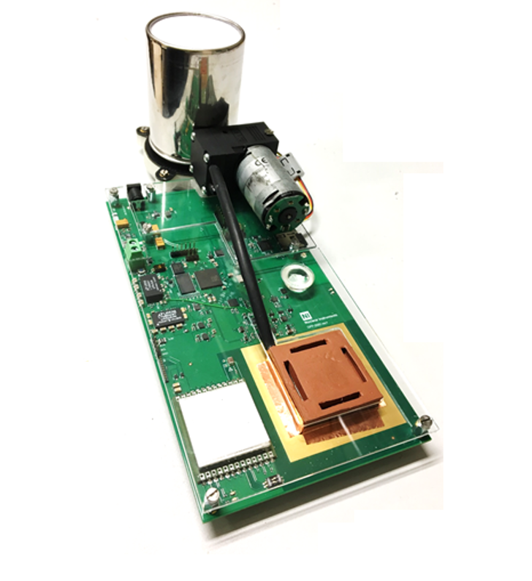
RaDoM (Radon Dose Monitor) technology used by BAQ (Better Air Quality) to tackle Radon gas issues.
Notes:
https://kt.cern/success-stories/baq-start-tackle-radon-gas
Radon is a natural radioactive gas that easily escapes from the soil and accumulates in dwellings and buildings. The progeny from radon decay is radioactive and, over time, can lead to health issues such as lung cancer. RaDoM (Radon Dose Monitor) is an innovative radon-monitoring prototype developed at CERN, and includes a cloud-based service to collect and analyse data, control the measurements, and drive mitigation measures based on real-time data. In 2019, the project gave way to the spin-off BAQ, with CERN and BAQ signing a licence agreement on the RaDoM technology in December.

Slide 19
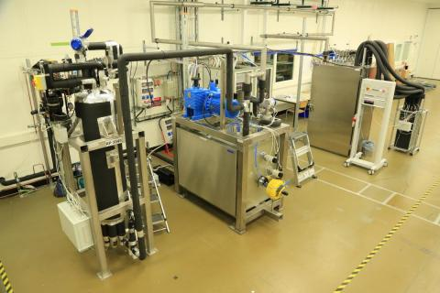
Developing and deploying integrated dual phase CO2 cooling systems as a green alternative to F-gases

Slide 20




How to collaborate with CERN
R&D Collaborations
Service & Consultancy
Licensing
Start a company based on CERN technology or know-how
Find out more at kt.cern/collaborate
Notes:
Whether you work in a large company, an SME or a start-up, we can help you tap into CERN technology or know-how or help you identify solutions based on CERN's area of expertise. Each case is unique and there are many potential ways to collaborate. If you are unsure how to benefit from CERN, we are here to help you discover if there is a fit between your needs and our expertise and services.
Start a company based on CERN technology or know-how
CERN encourages the creation of spin-off companies, and gives support to CERN personnel and external entrepreneurs wanting to establish a company in one of CERN’s Member States.
Service & Consultancy
CERN’s expertise and cutting-edge infrastructures represent a unique opportunity for industry and academia in need of a specific high-tech service. CERN experts are available to provide professional advice or specific studies to your business.
Licensing
CERN grants licenses to commercial and academic partners for the exploitation of its technologies. All CERN technologies available for licensing can be found at kt.cern/technologies
R&D Collaborations
CERN has a well-established tradition of collaboration with research institutes. R&D projects can be developed in CERN’s many areas of expertise. You are invited to contact CERN’s Knowledge Transfer group to discuss how to establish an R&D collaboration.
Additional resources:
https://kt.cern/industry

Slide 21
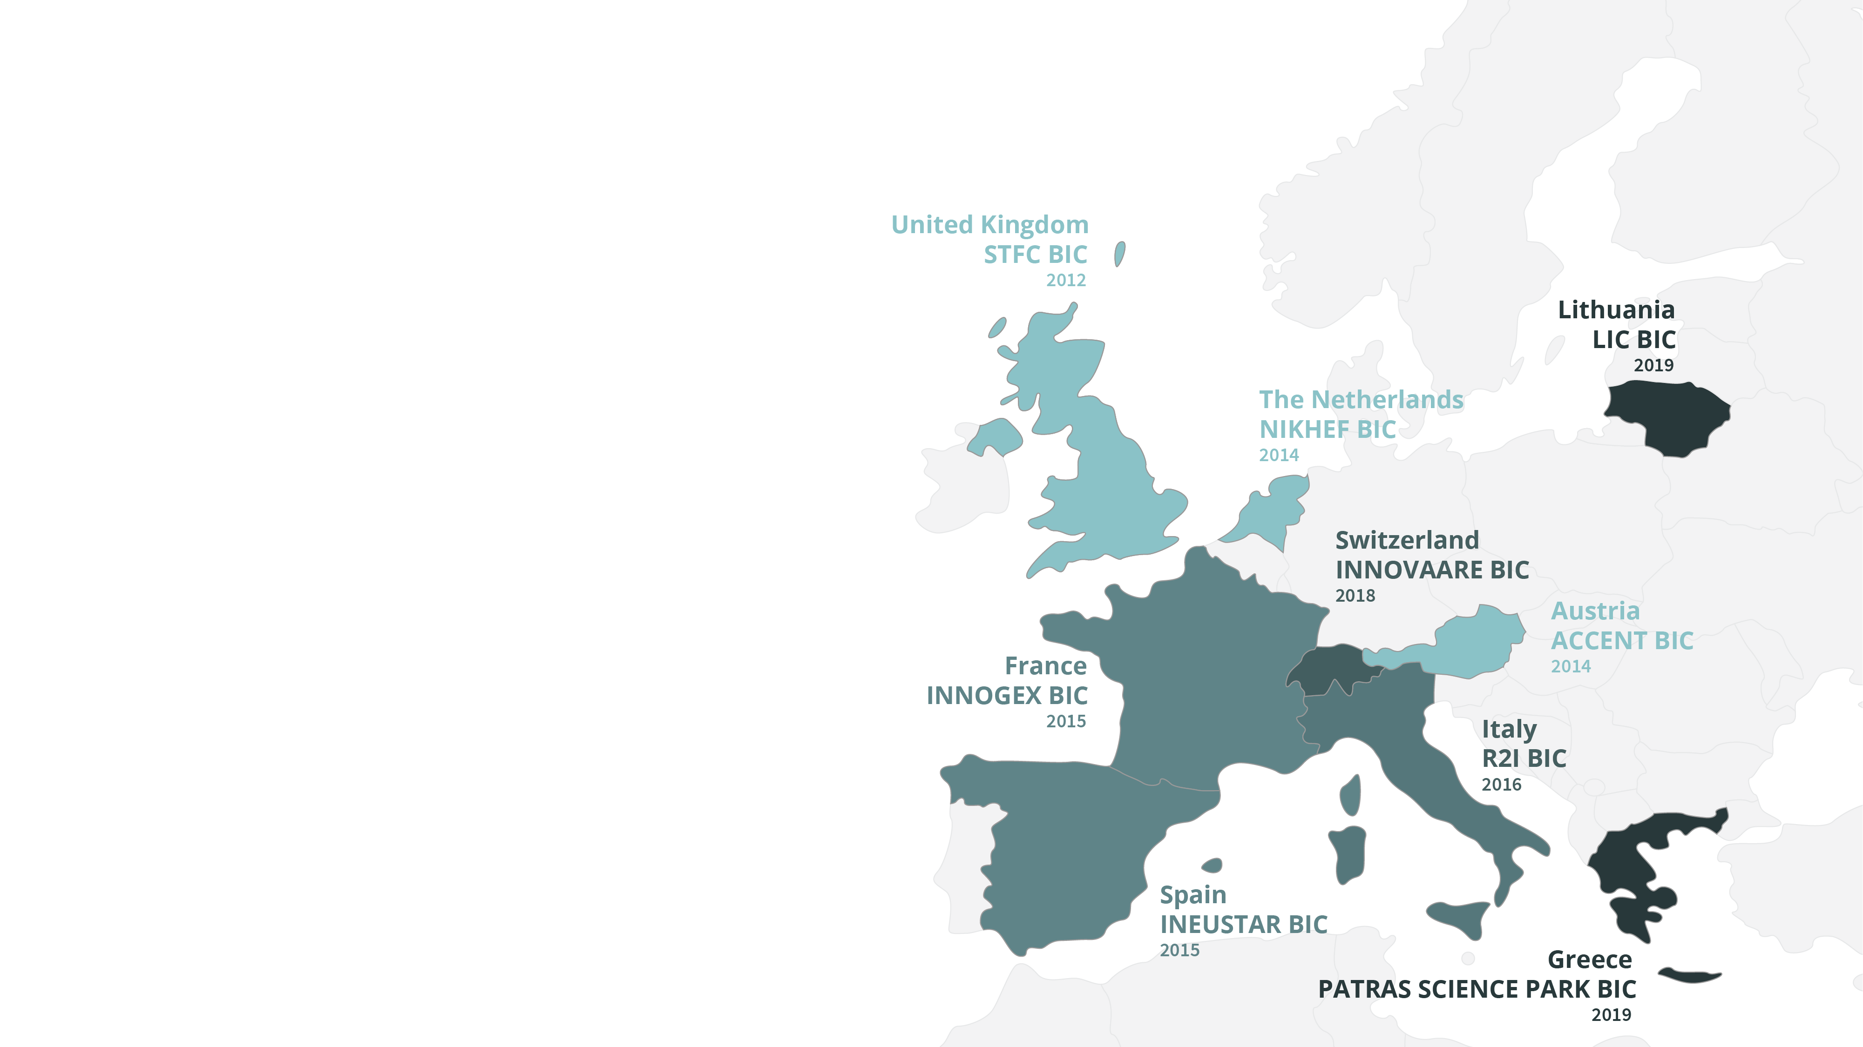
Business Incubation Centre (BIC) Network
1st: STFC-CERN BIC
in Daresbury
Total number of startups incubated till date: 11
Innocryst Quantum Detectors
A20 Innovation Camstech
Croft Additive Manufacturing Artemis Analytical
D-Beam Oxford Nanosystems
2D Heat Ross Robotics
MAAS Spectrometry
Current year: 5 projects under review

Slide 22
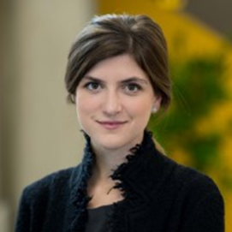
CERN
Knowledge Transfer
in Break-Out Rooms
1
2
3
Margherita Marini

