Slide 1

Particles identification in the CMS experiment
HSSIP
Anita Tarantino, Tommaso Formigli
supervisor Francesca Cavallari

Slide 2
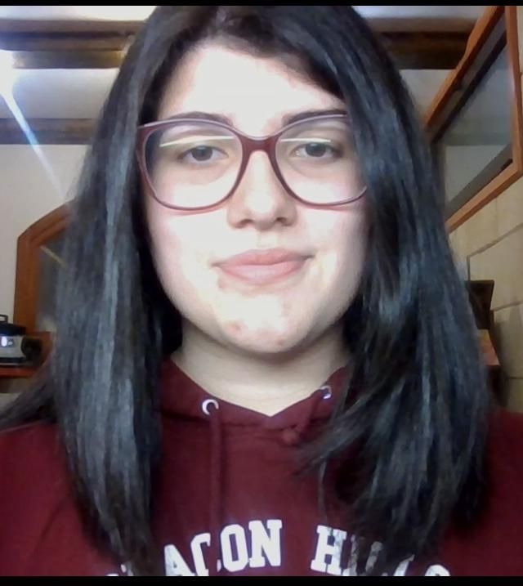
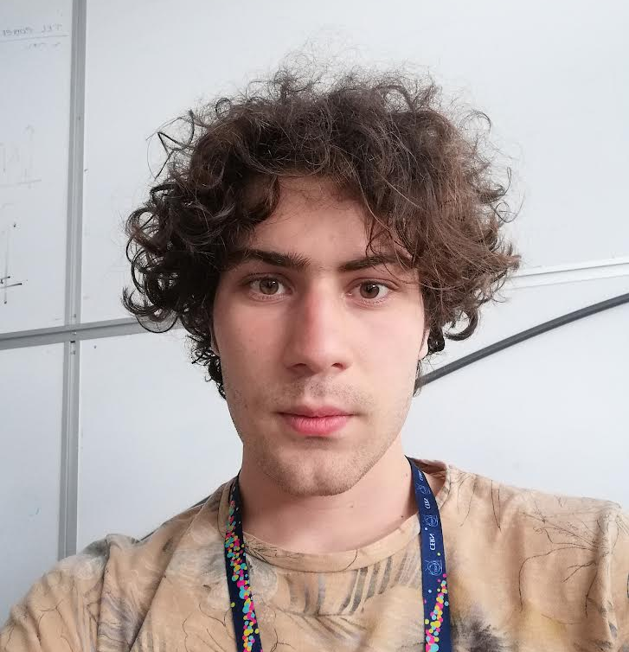

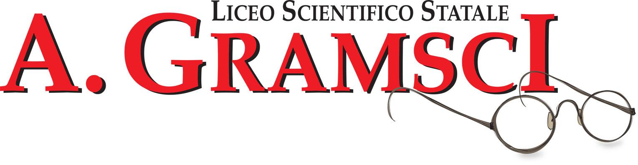
Anita Tarantino
Lecce
Liceo Scientifico Cosimo De Giorgi
Tommaso Formigli
Firenze
Liceo Scientifico Antonio Gramsci

Slide 3
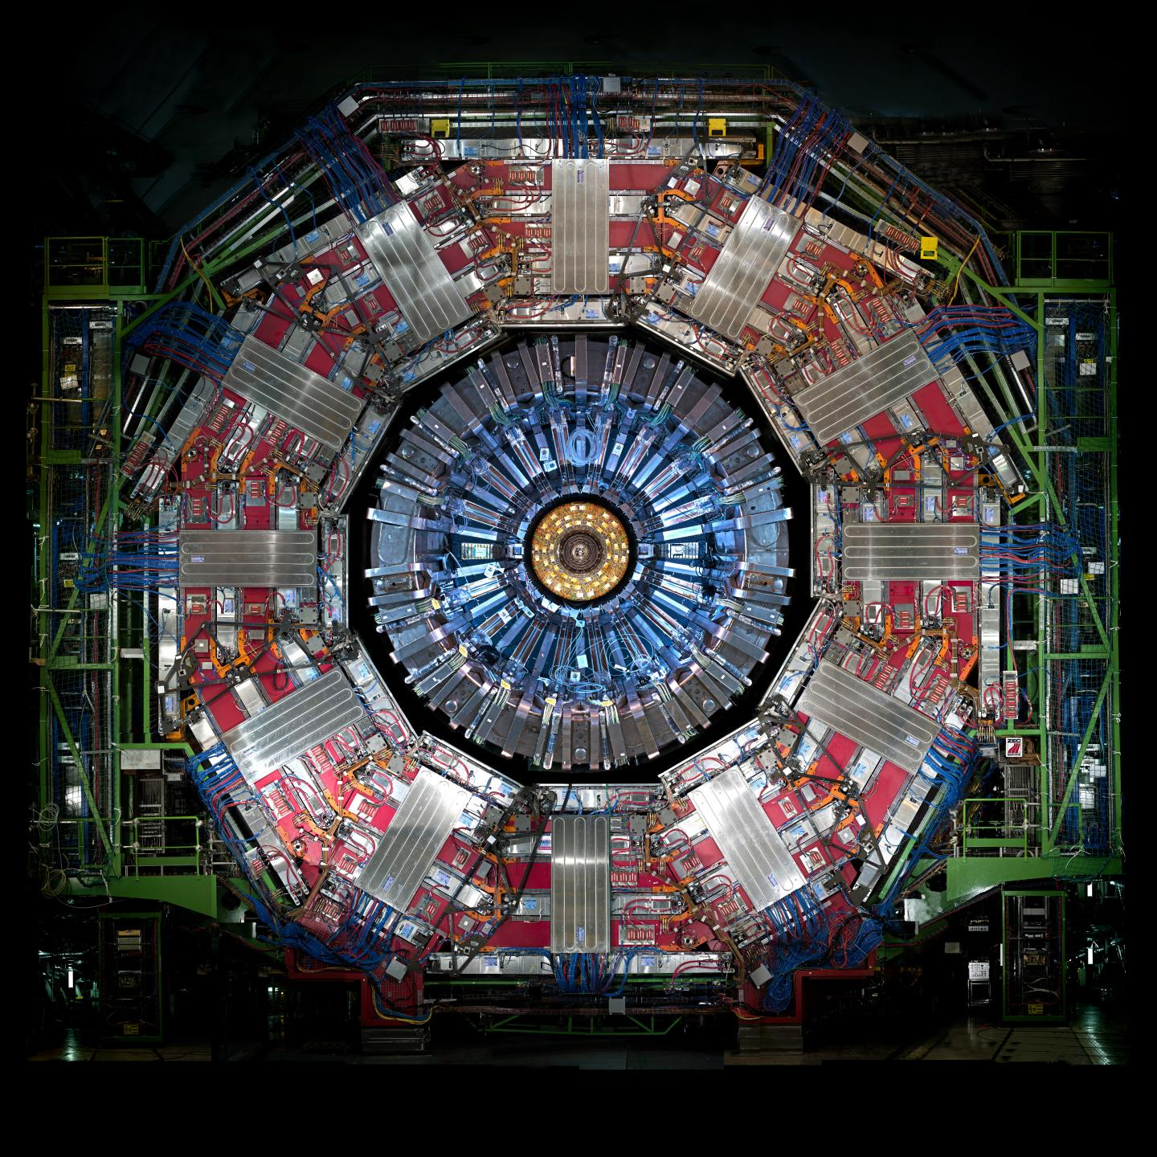
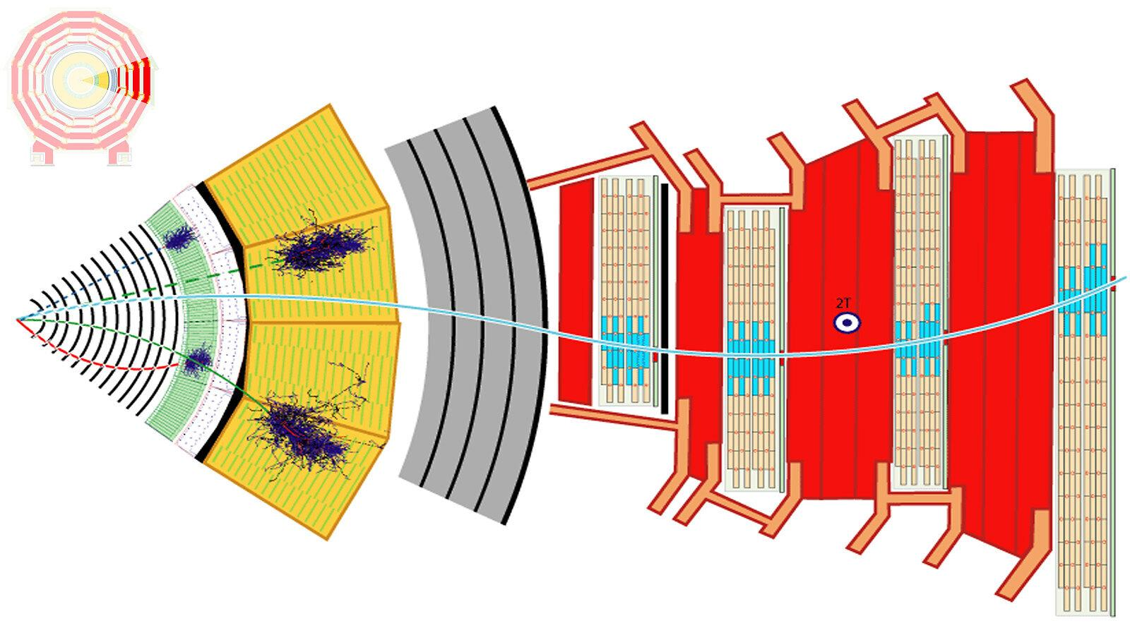
Our Project
CMS (Compact Muon Solenoid)

Slide 4
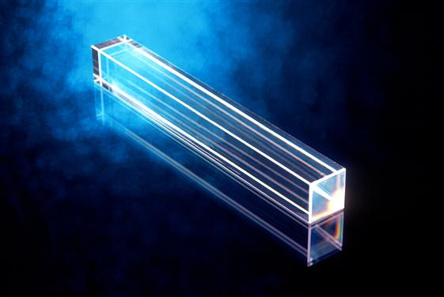
Electromagnetic Calorimeter in CMS
A photons and electrons tracker
Scintillating crystals
was crucial in finding the Higgs boson

Slide 5
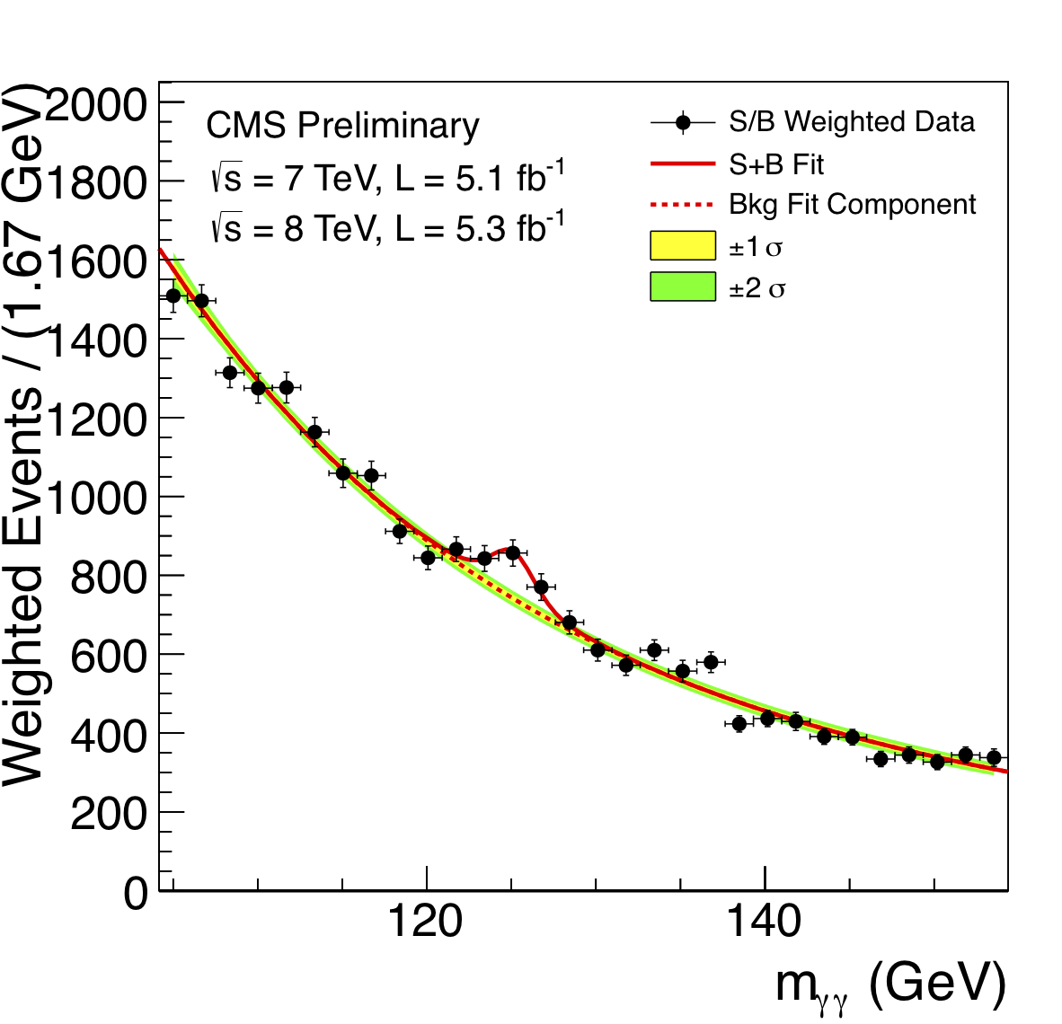
The rush to the Higgs
How was it identified?
Why a peak?
its decay modes
e+e-
Z
μ+μ−
H
e+e-
Z
or
μ+μ−
γ
H
γ

Slide 6
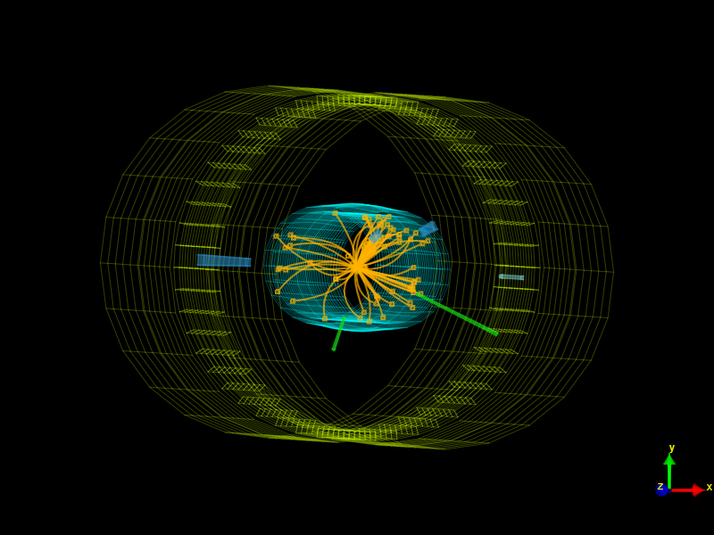
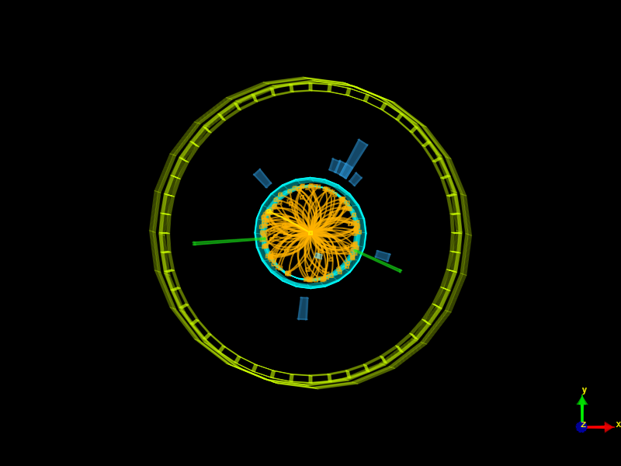

Slide 7
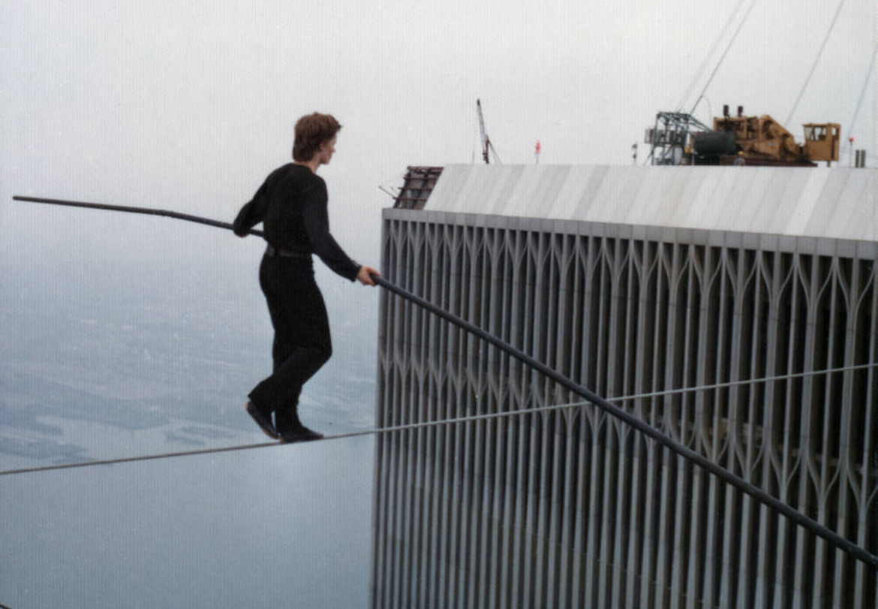
Why so difficult??
The necessity of stability

Slide 8
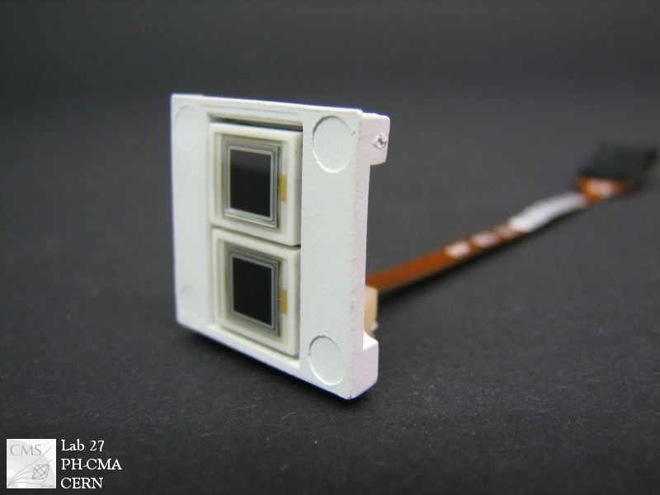
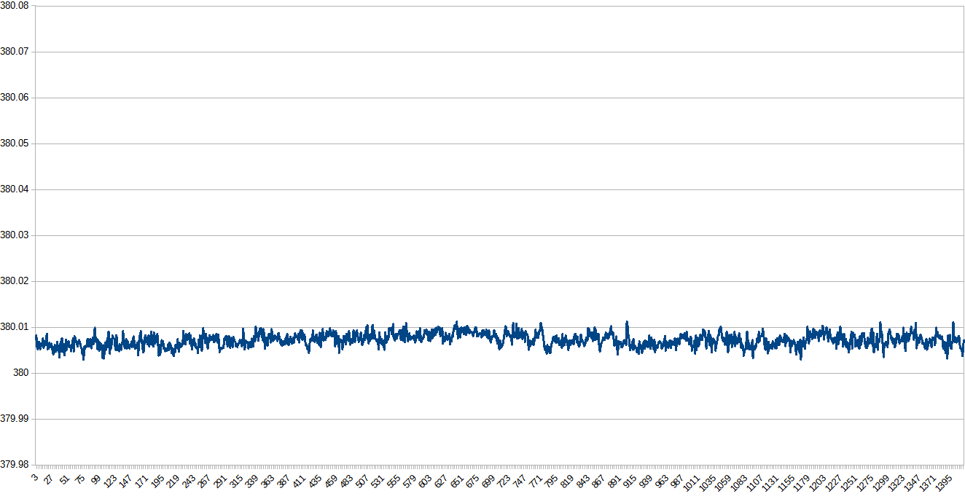
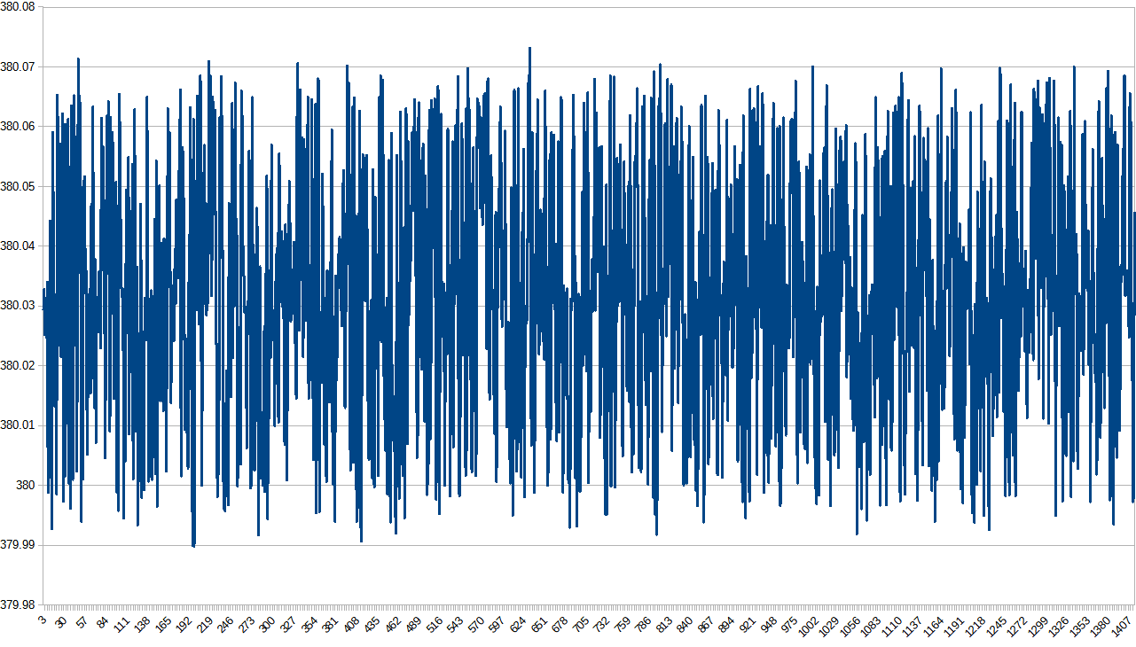
Problem of the high voltage
ΔV<60 mV for every channel in a board
the signal changes of 3% per Volt
we need to check if they work
voltage (V)
voltage (V)
time (10 min)
time (10 min)

Slide 9
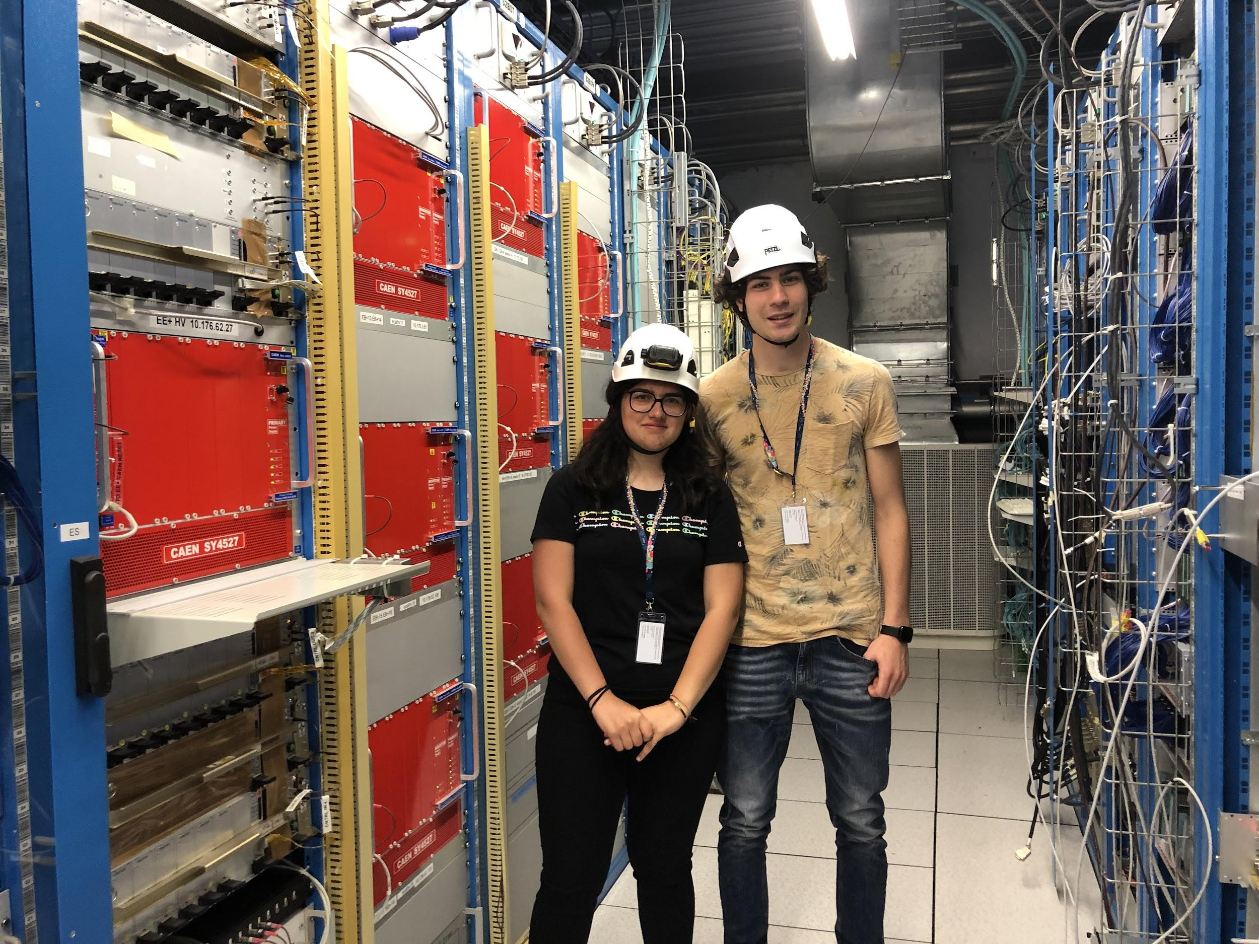
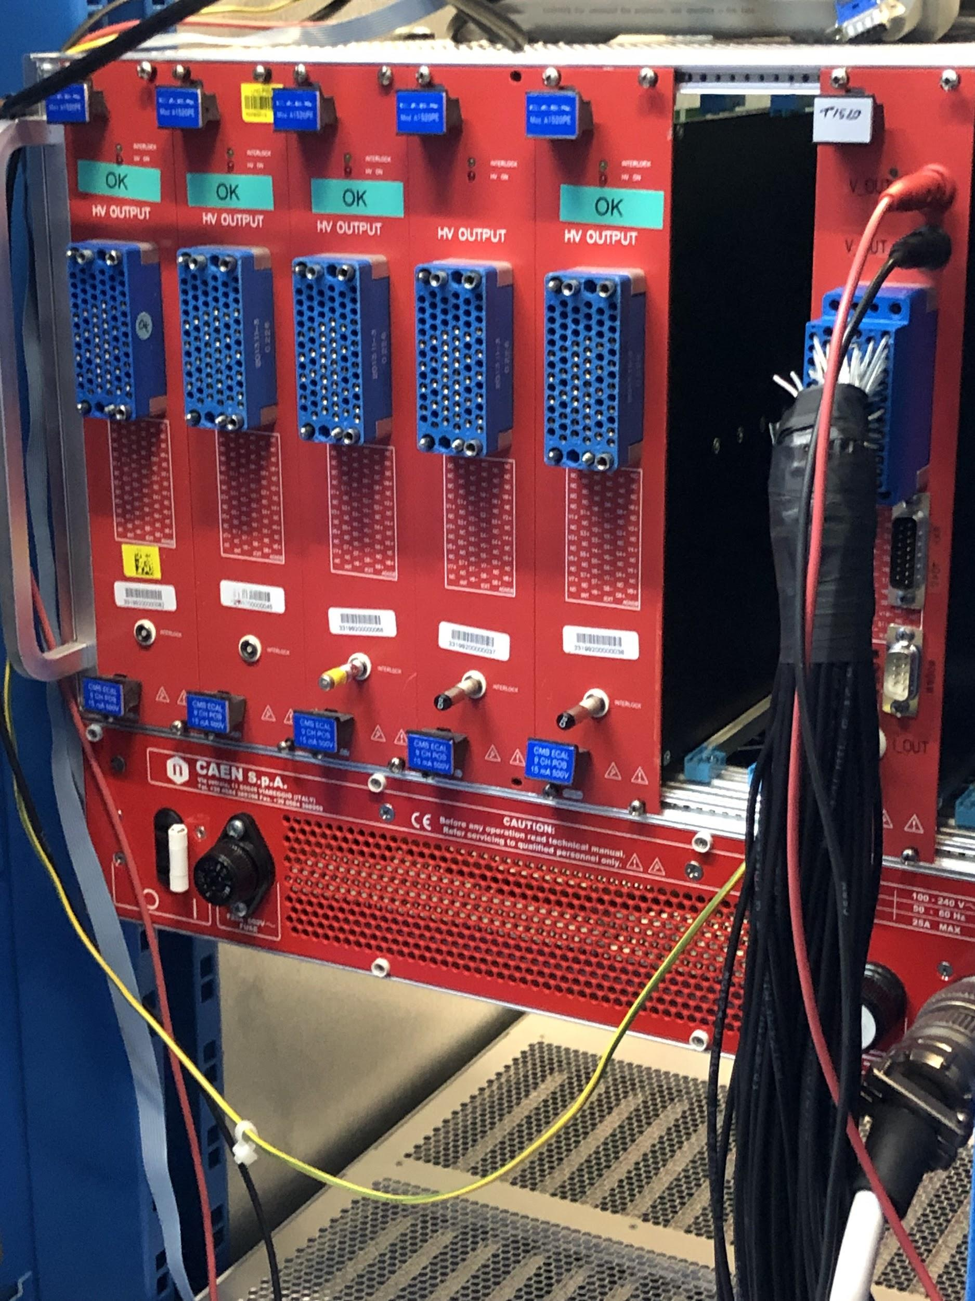

Slide 10
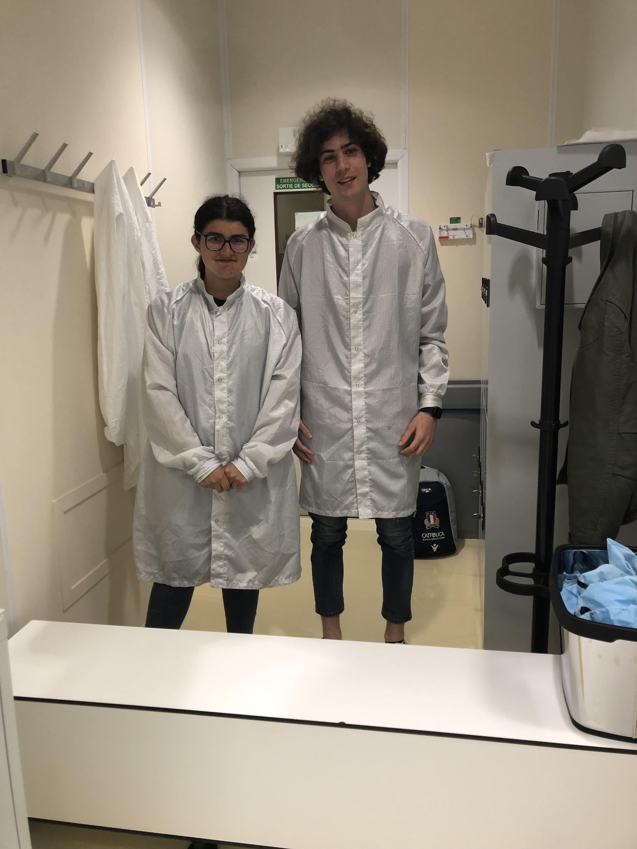
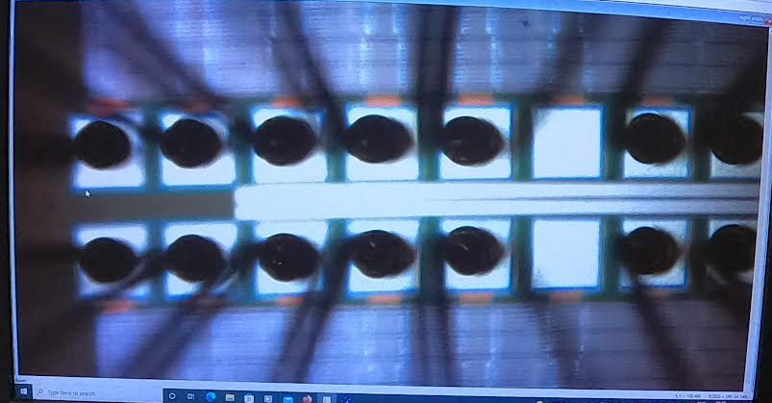
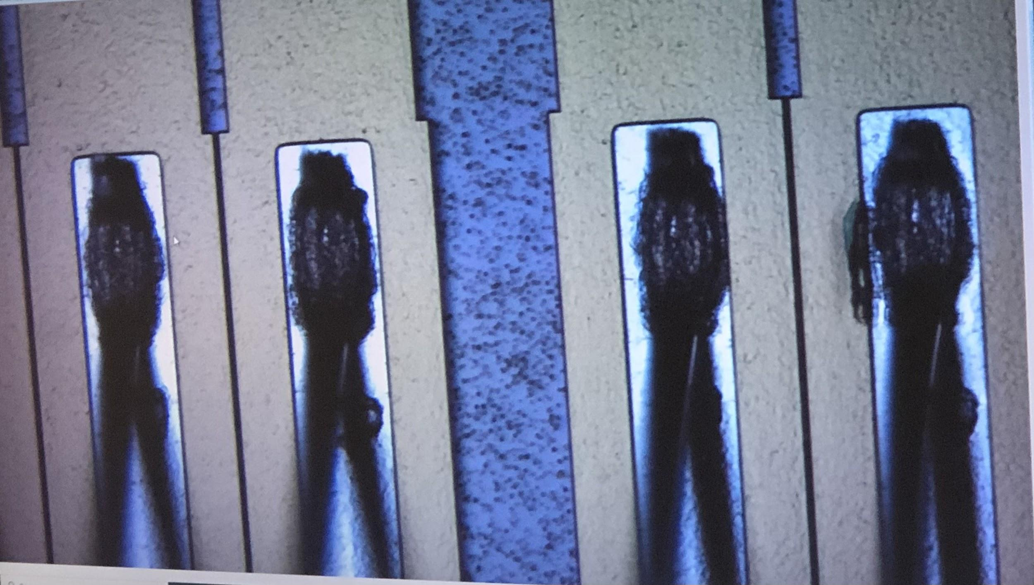
Different types of bonding
for tracker detectors
Gold ball
Gold wire bonding is achieved through thermosonic bonding. This involves melting the end of the wire to form a gold ball, which is known as a free-air ball.
Wedge wire
During wedge bonding, a clamped piece of wire is coupled under a bonding tool and a bond pad. Pressure and ultrasonic energy are applied for a given period of time forming a wedge bond.

Slide 11
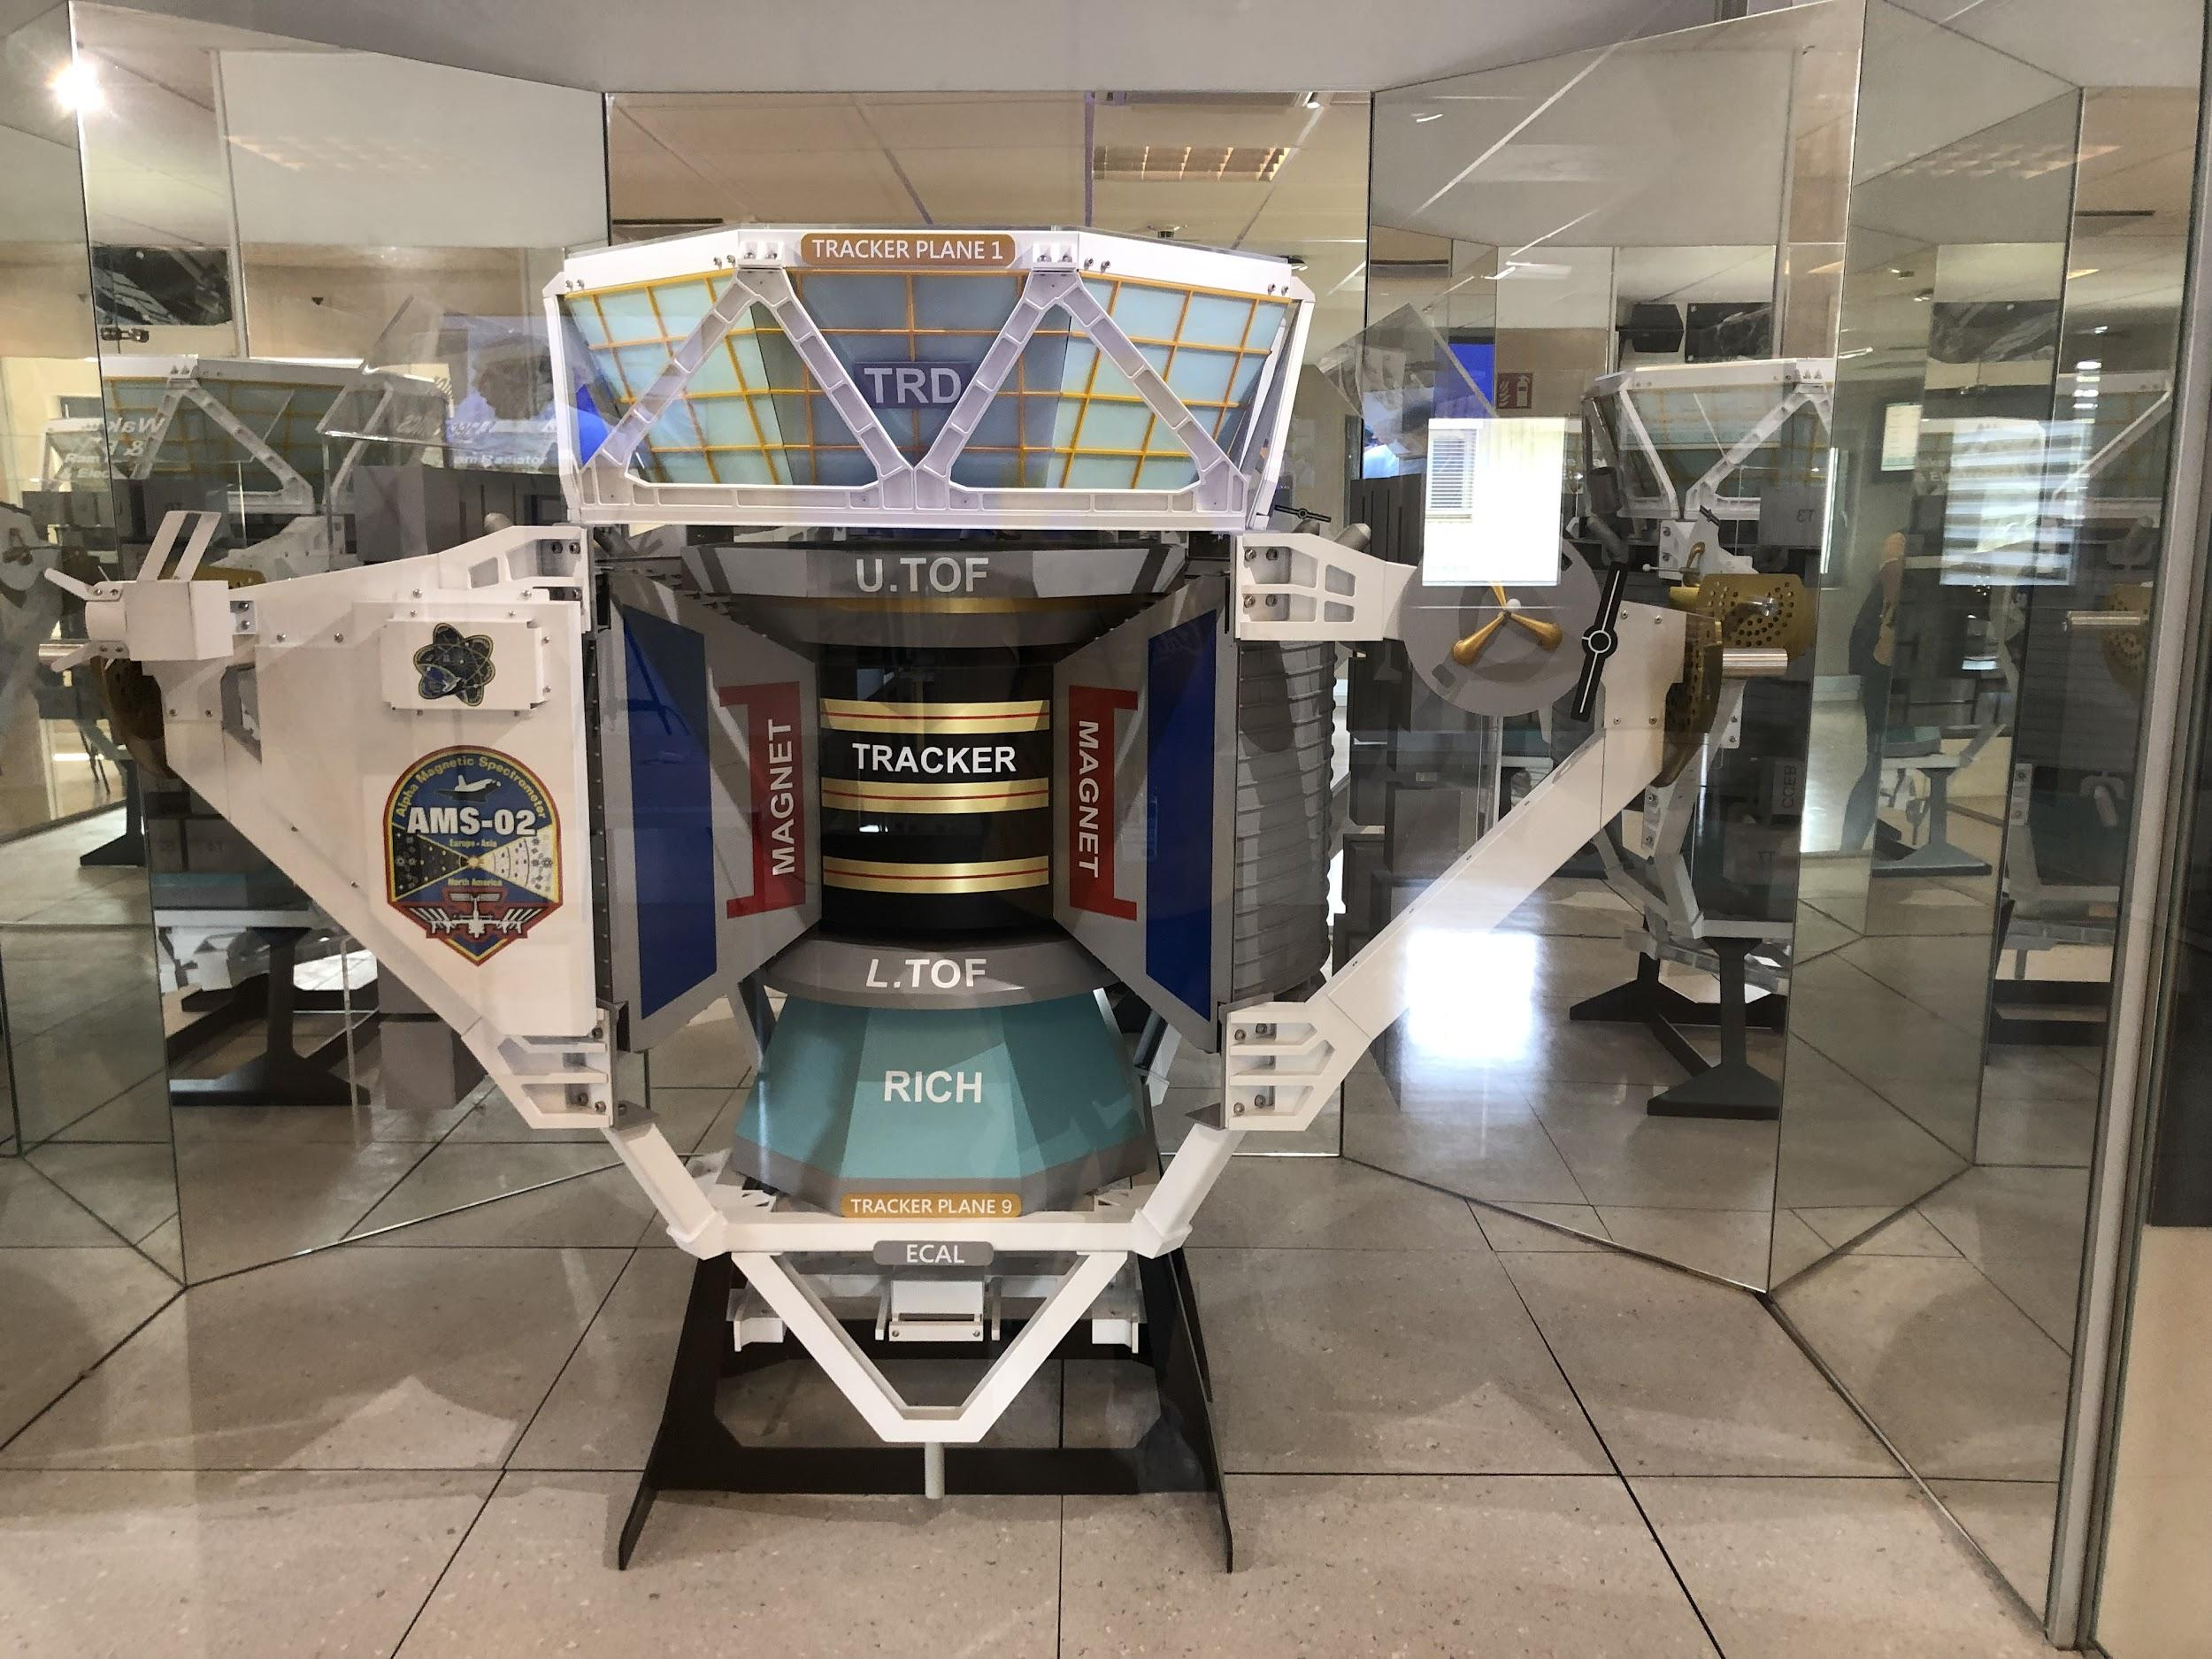
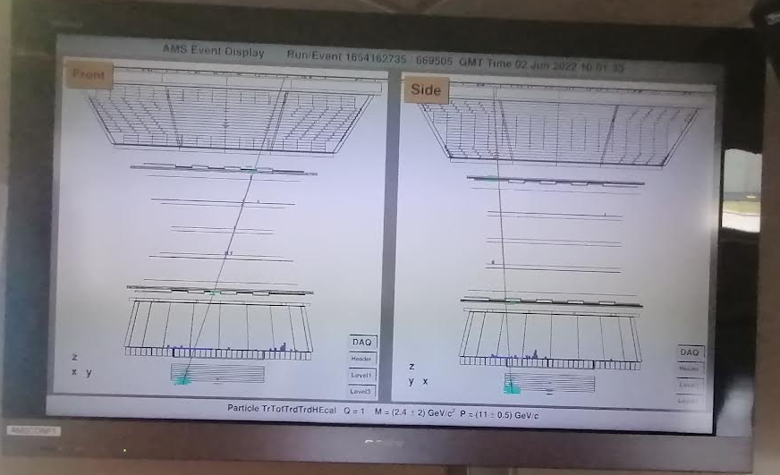
AMS project
The Alpha Magnetic Spectrometer is a particle physic experiment module which is mounted on the ISS (international space station)

Slide 12
Special thanks to
FRANCESCA CAVALLARI our supervisor
FLORENTINA MANOLESCU (clean room)
CORRADO GARGIULO (AMS engineer)
And to all of you

