Slide 1
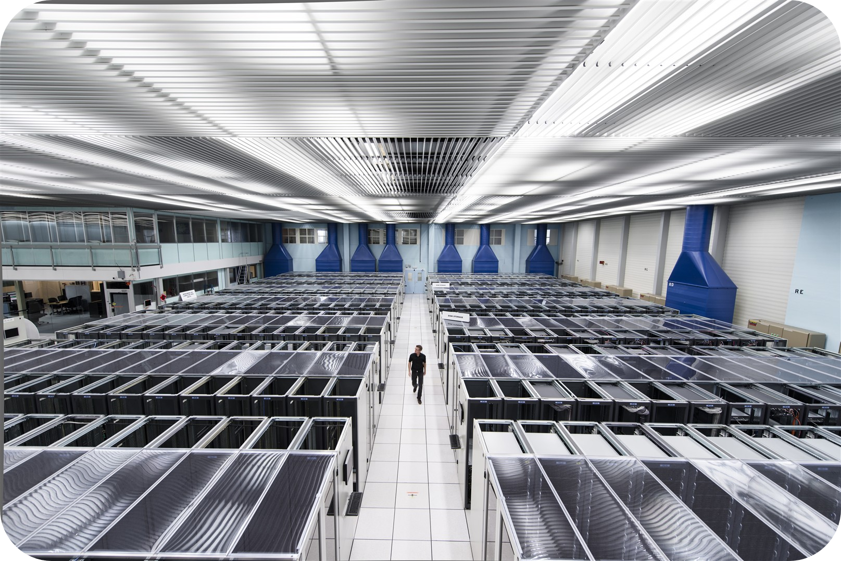
CERN’s DATA CENTER
MONTE
A. Buonocore, E. De Piccoli
Supervisor: Giuseppe Lo Presti
CARLO
Storage, CERNBox and web services

Slide 2
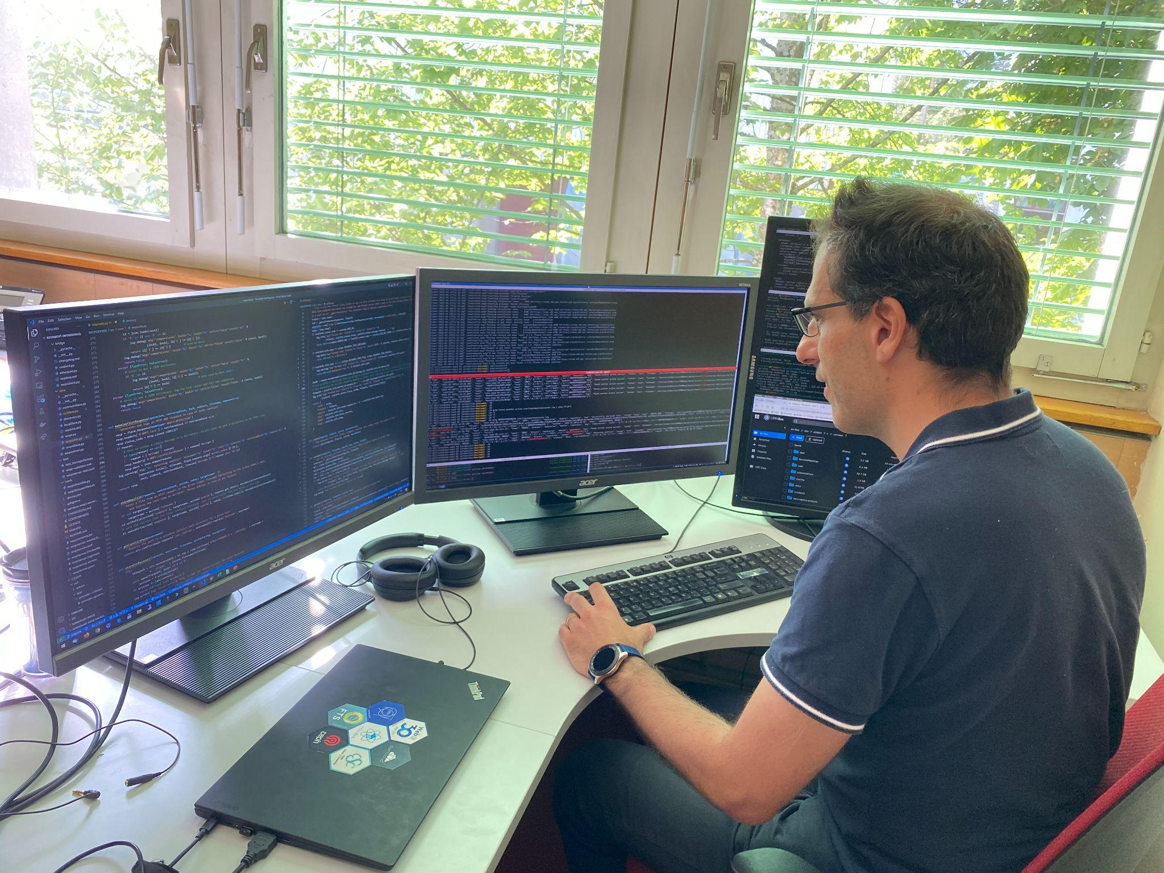
OVERVIEW
UTILITY
SERVERS
All services, such as scientific data management, email, videoconferencing, web services or databases, use equipment based there.
It’s possible to count up to 470 000 processors and 100 000 hard disks, all running 24/7
2

Slide 3
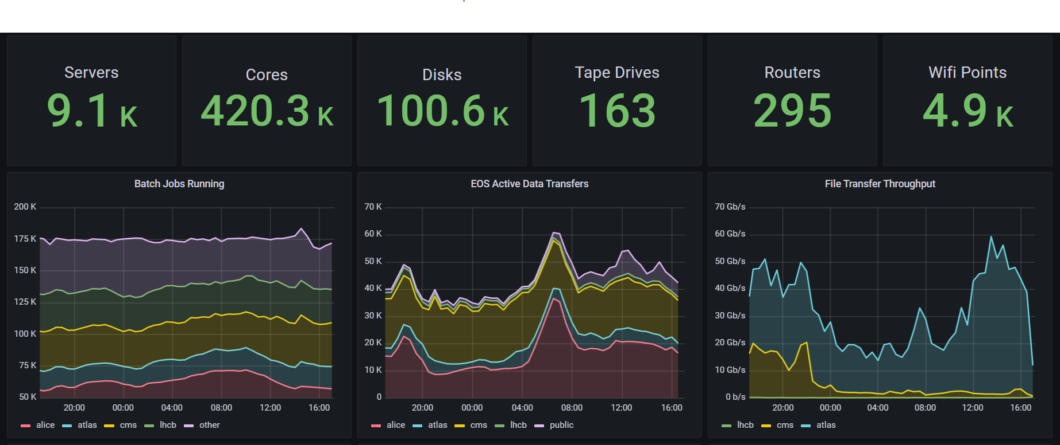
SERVERS’ statistics
http://cern.ch/go/datacentrebynumbers
3

Slide 4
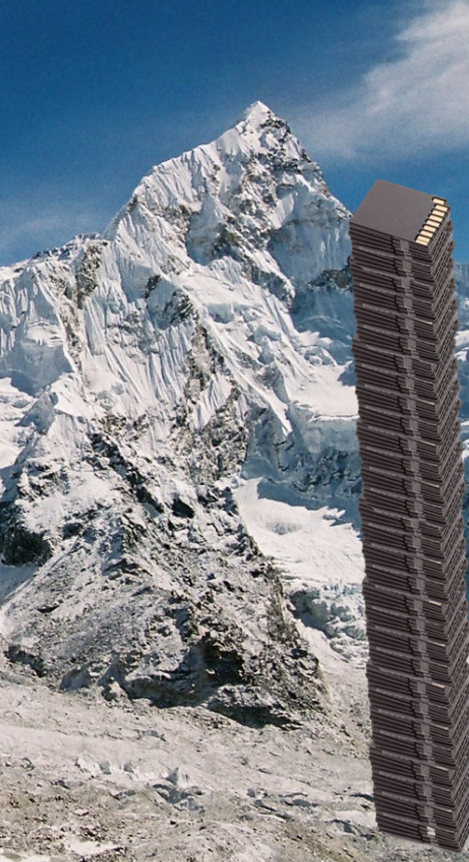
OVERVIEW
DATA
These are 115PB worth of 32GB SD cards stacked on top of each other beside mount Everest!
Experiments send over 10PB of data per month. In 2018, the data center received 115PB of data (record year so far)
4

Slide 5
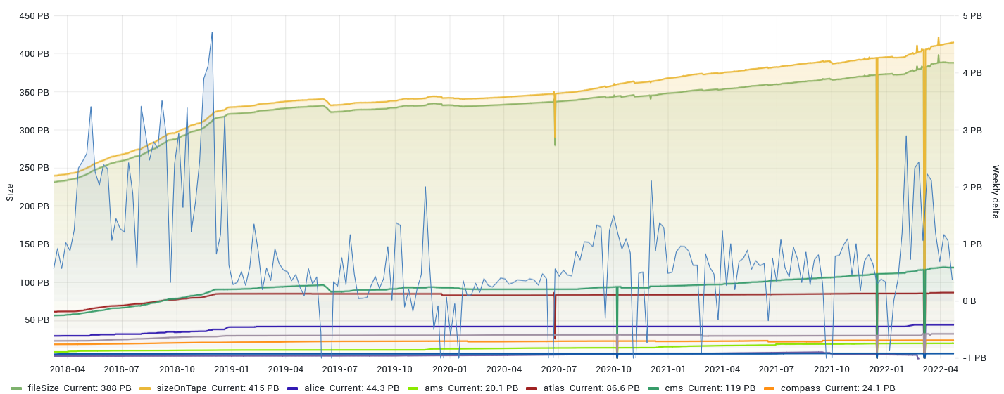
AMOUNT OF DATA PRODUCED SINCE 2018
5

Slide 6

WHAT IS CERNBOX?
CERNBox is CERN’s web storage hub.
It allows synchronizing and sharing files on all major desktop and mobile platforms aiming to provide universal access and offline availability to any data stored in the CERN infrastructure.
6

Slide 7
WHAT DOES CERNBOX OFFER?
SECURITY
ACCESSIBILITY
COLLABORATION
CERNBox has a dedicated security team working on it so you can trust the service without any doubt
You can access CERNBox wherever you want and from whatever device you prefer
Projects and folders in CERNBox can be shared and worked on with your colleagues
7

Slide 8
COOL FACTS ABOUT CERNBox
IT OFFERS 1TB OF SPACE TO EVERYONE AT CERN
CERNBox SERVERS ARE ALL AT CERN’S DATA CENTER
CERNBox IS OPERATED BY A TEAM OF 4 STAFF AND 8 COLLABORATORS
IT HAS 6000 MONTHLY USERS
8

Slide 9
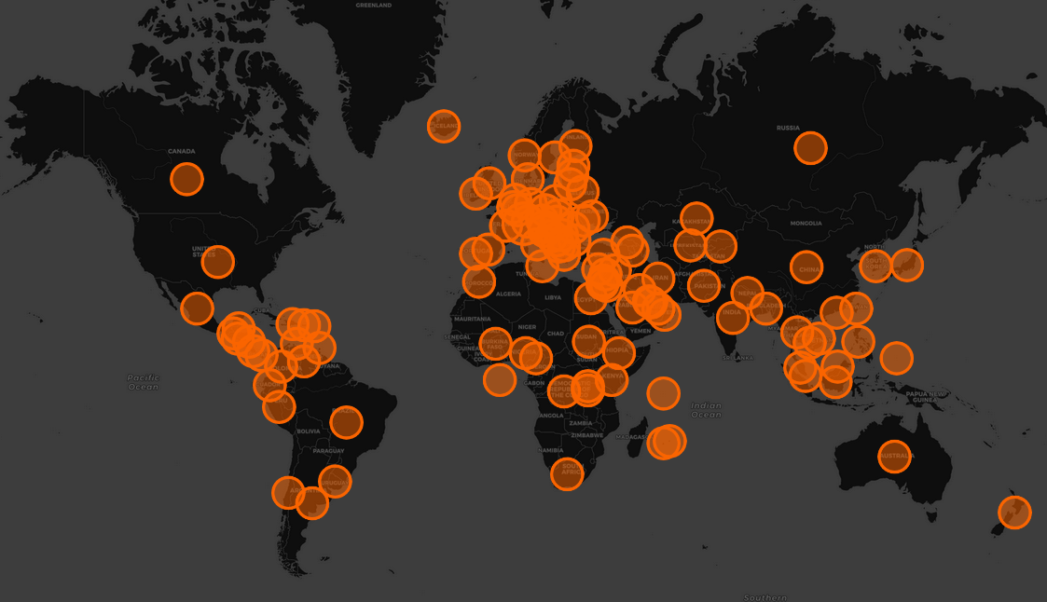
CERNBox WORLDWIDE USAGE
9

Slide 10

THE MONTE CARLO METHOD
In the majority of the lectures we attended during these two weeks, we talked about the “Monte Carlo” method, used to foresee possible results of experiments without actually doing them.
As we’ll clarify in the next minutes, it isn’t that precise, but it helps a lot in terms of understanding the range of logical possibilities.
10

Slide 11
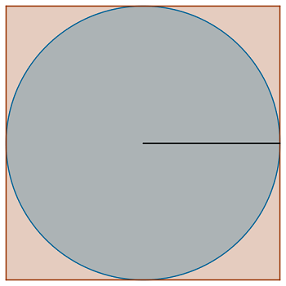
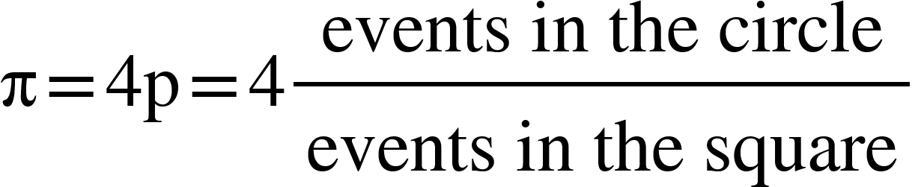
HOW DOES IT WORK?
Let’s apply it to estimate π!
l=2r=2
The probability of hitting the circle with a small point, called “event”, is simply a consequence of the direct application of the definition of “probability” itself: the number of favorable cases divided for the number of possible cases.
The denominator is the whole square, while the numerator is the circle. From here we can solve the equation and find pi.
r=1
11

Slide 12
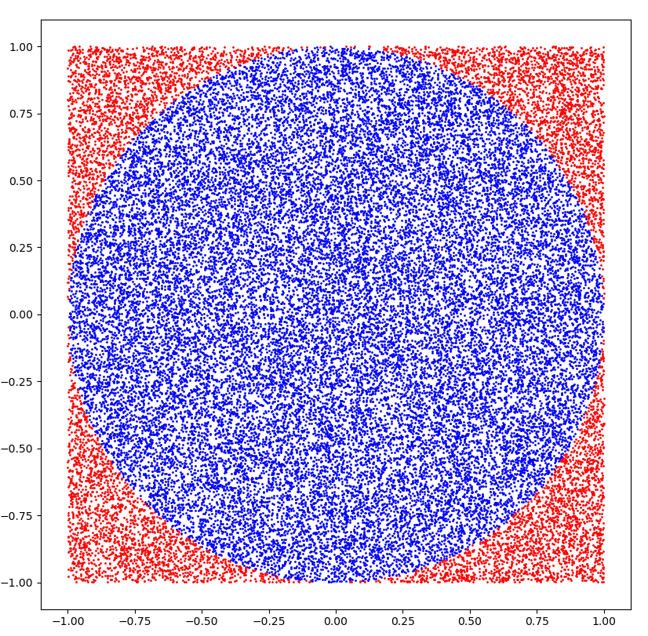
Monte Carlo visualized (with 10 000 points)
12

Slide 13
THANK YOU!
CREDITS:
CERNBox
Supervisor: Giuseppe Lo Presti
Data storage: CERNBox
Software platform: Service for Web based ANalysis (SWAN)
Math editor: MathType
Programming language: Python
13

