Slide 1


Gas detector in ATLAS experiment
Francesco Soddu, Maria Matilde Stellini
ITALIAN HSSIP 2022

Slide 2
Overview
LHC and the ATLAS experiment
Detector used: Micromegas
Measurement of the Gain
Collection of the Data
Data Analysis
Conclusions

Slide 3
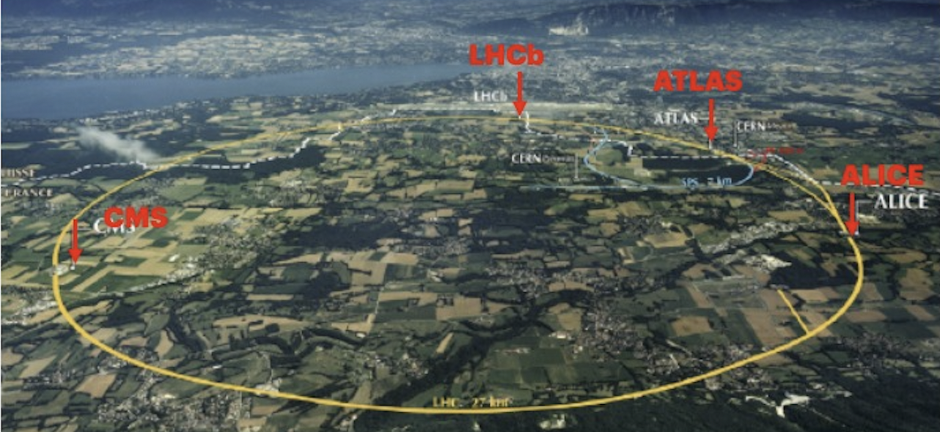
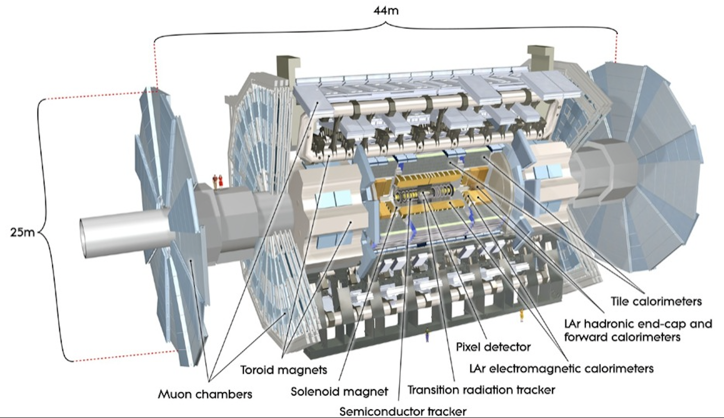
LHC AND ATLAS EXPERIMENT
LHC is the Large Hadron Collider, with a diameter of 27 km.
One of its collision point is where the ATLAS experiment lies
ATLAS (A Toroidal LHC ApparatuS) is a general purpose experiment.
It consists in several different detectors, including trackers, calorimeters and the muon spectrometer system.

Slide 4
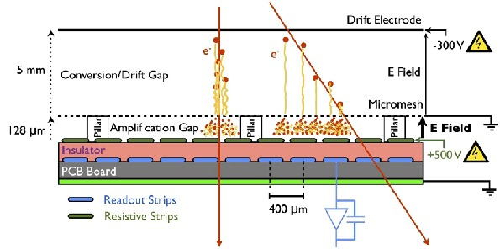
Micromegas
‘Micro Mesh Gaseouse Structure’
Micro pattern gas detector with 1024 read-out strips
It contains Argon (Ag) and Carbonic Dioxide (CO2) that come in different proportions
It is made of 3 planes: the drift electrode, the mesh and the read-out strips
It detects particles with a high spatial precision

Slide 5
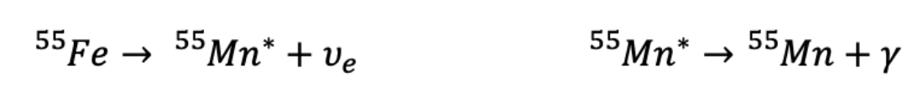
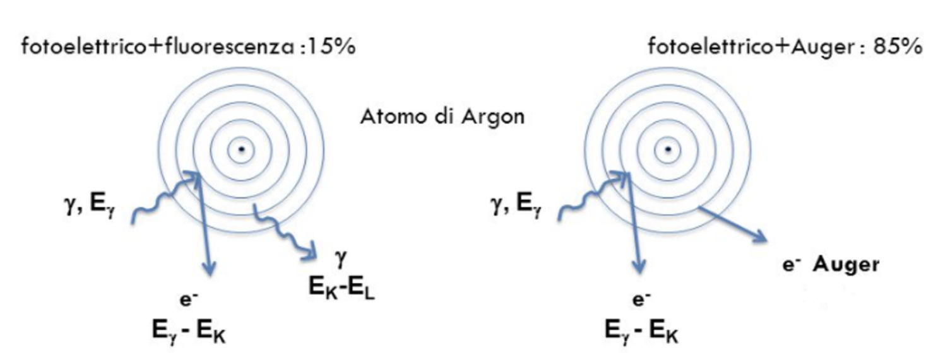
THE RADIOACTIVE SOURCE
The ⁵⁵Fe is the radioactive source used.
Since it is instable, it decades in ⁵⁵Mn
The physics process that happens inside the chamber is the following: when the photon enters the drift region it ionizes the gas and forms an electron-ion couple

Slide 6
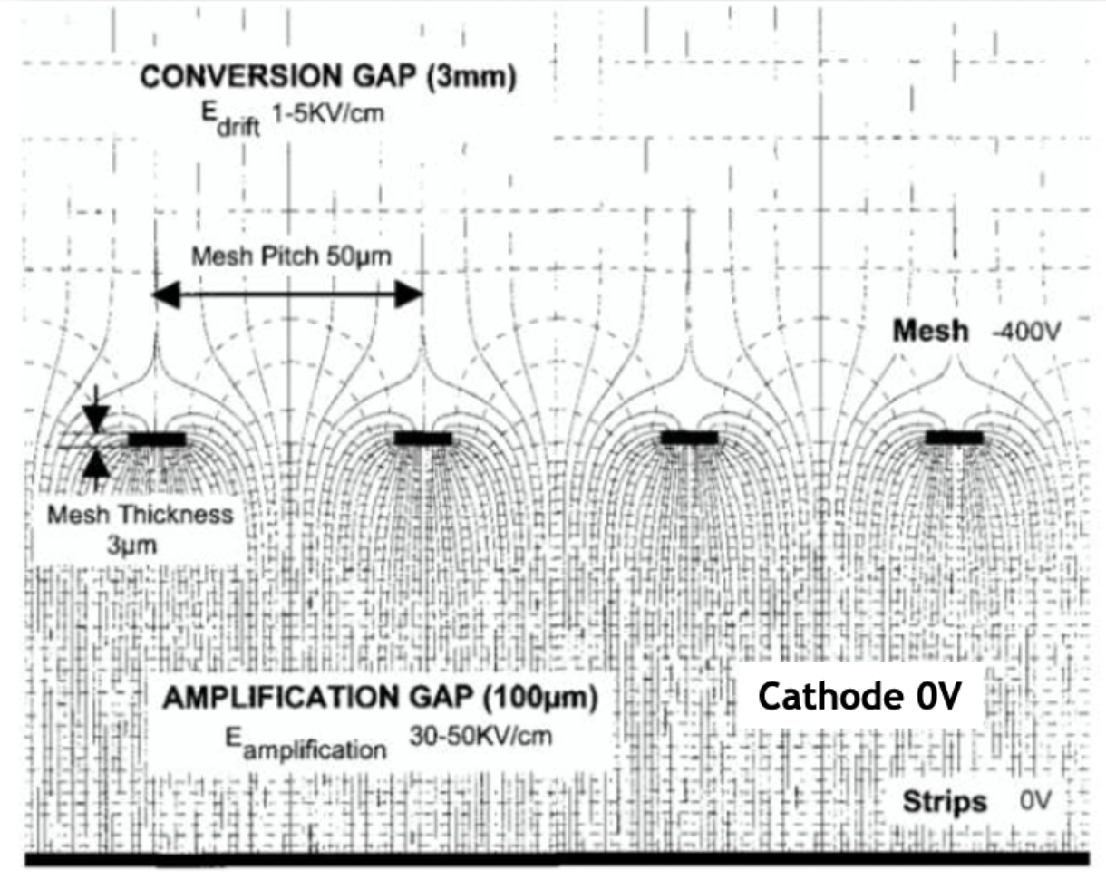
The electric field
Once the electrons are in the amplification region additional electron-ion couples are formed so an electron avalanche is created because of the strong acceleration of the particles due to the electronic field.

Slide 7
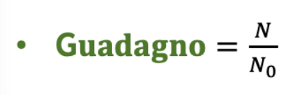
The gain measurement
The gain is the moltiplicative factor of the primary ionization charge
The gain depends on electrical fields ratio between the two regions, therefore it can be measured as the ratio of the voltage provided to the drift and read-out plans
Gain
N₀ stands for the number of the primary electron-ion couples in the drift region
N stands for the number of electrons that are formed in the amplification region

Slide 8
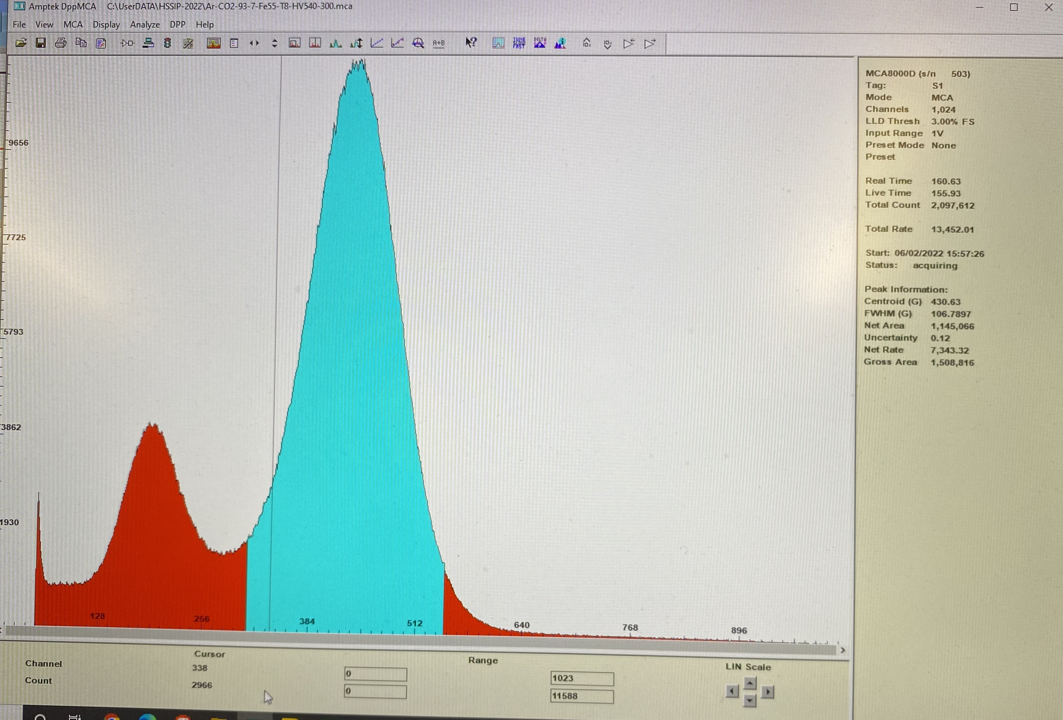
Collecting data
By fixing the drift voltage to -300 V the read-out voltage has been changed with steps of 10 V
Four different proportion of gas were used: Ag 93%- CO2 7%, Ag 90%-CO2 10%, Ag 85%-CO2 15%, Ag 80%- CO2 20%
For every proportion it has been measured the signal corresponding to the Auger effect
Then the gain trend as a function of the read-out voltage has been calculated

Slide 9
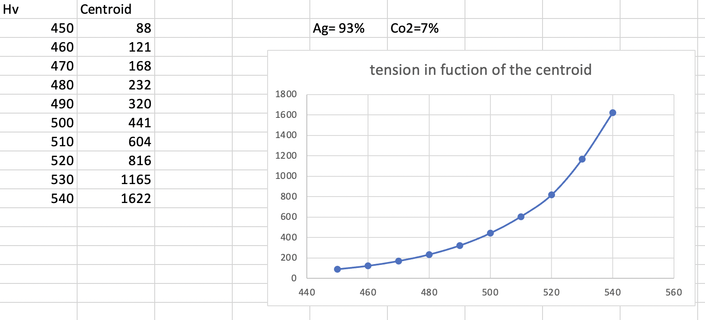
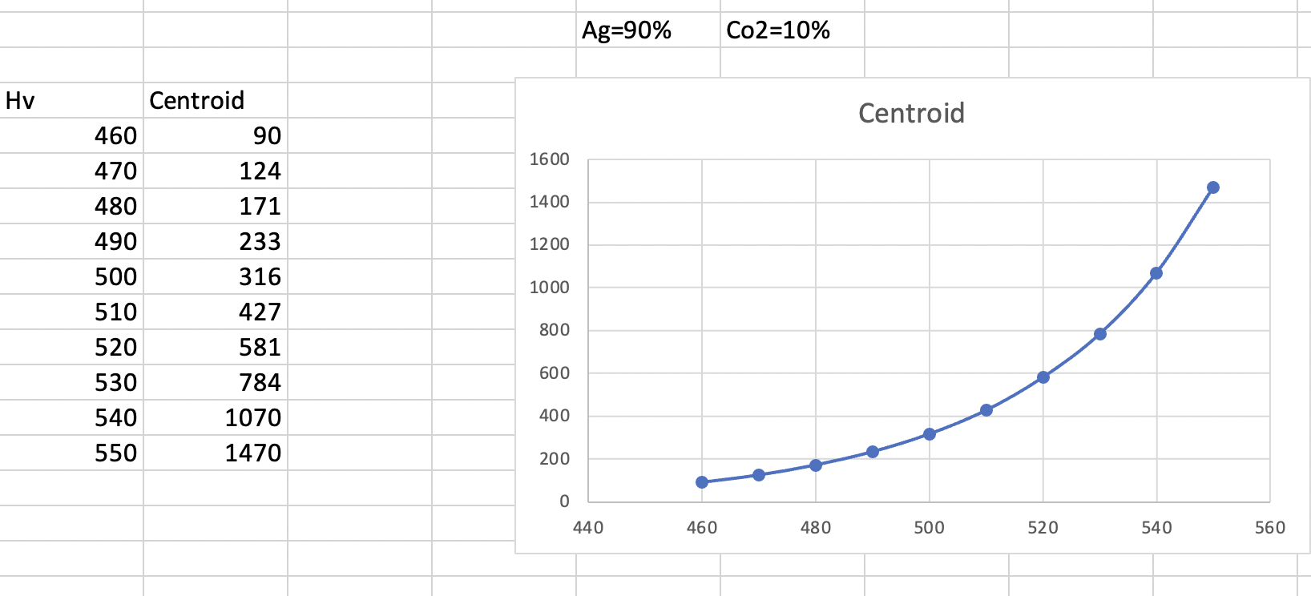
Data analysis
The data have been collected with a software used in the laboratory and analysed with Excel.
The analysis has been done in two different ways:
Manually, measuring the average value of the read signal
V_{monitored} [V]
V_{monitored} [V]
V_{read-out}[V]
V_{read-out}[V]

Slide 10
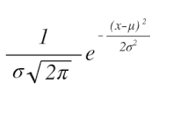
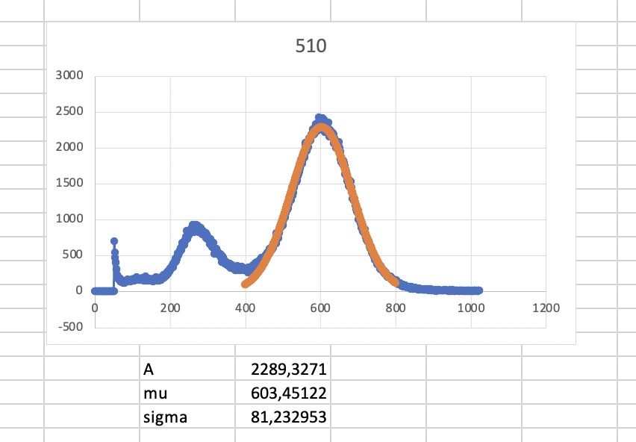
Data analysis
A
2. In a mathematical way, by fitting the signal with a gaussian function
V_{monitored} [V]
Then the best fit of every gaussian function has been calculated and the mean parameter has been used for the gain calculation
V_{read-out}[V]

Slide 11
Gain measurement
In conclusion the graphics of the two different analysis have been compared
The mathematical way
The approximated manual way

Slide 12
conclusions
What we have calculated it is not precisely the gain but it is a measurement that is proportional to it
The data have an esponential trend
It should be added a sperimental error to the data which is related to both the inaccurate manual measurement and the fit’s parameter (𝛍)→but for practical impossibilities we didn’t have the chance to get them

Slide 13
THANKS FOR THE ATTENTION!
Francesco Soddu, Maria Matilde Stellini
ITALIAN HSSIP 2022

