Slide 1

TOTEM
Francesco Pomilio & Matteo Olivieri
Supervisor: Marco Bozzo

Slide 2
What is TOTEM?

Slide 3

Not this…

Slide 4

So, what is TOTEM?
TOTal cross-section, Elastic scattering, diffractive dissociation Measurement
Proposed 1997 (LoI)
About 500 m long
About 100 scientists

Slide 5


The total cross-section
Practically the same thing…
1 mbarn = 10E-24 cm^2

Slide 6
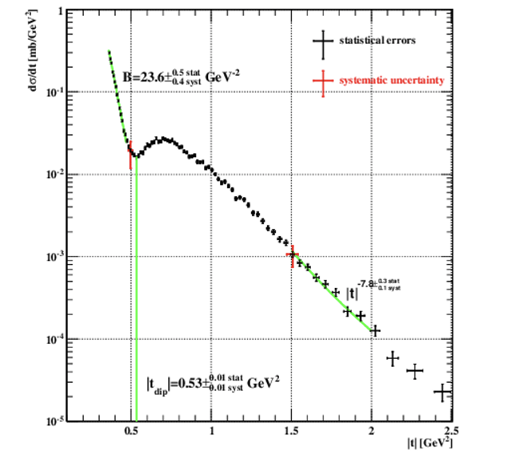
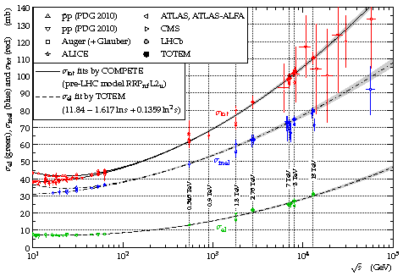
The total cross-section

Slide 7
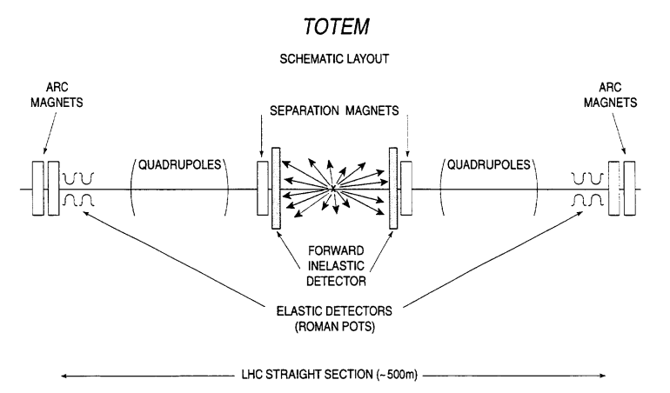
TOTEM: approximate structure

Slide 8
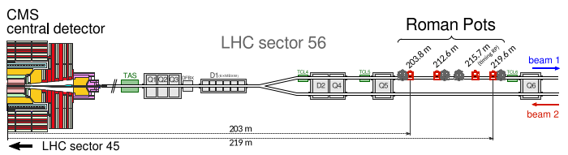
TOTEM: where are we?

Slide 9
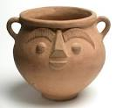
The Roman Pot: not this…

Slide 10
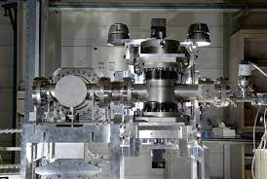
The (real) Roman Pots
Aim: take the detectors the nearest possible to the beam → when the beam is stable!
First used for ISR
Vacuum chamber to avoid beam colliding with residual gas
Cooling system for the electronics

Slide 11
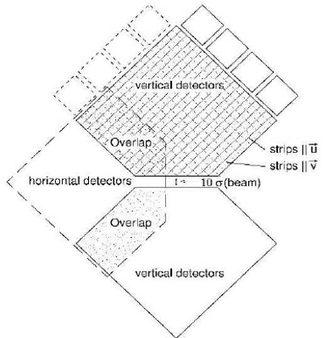
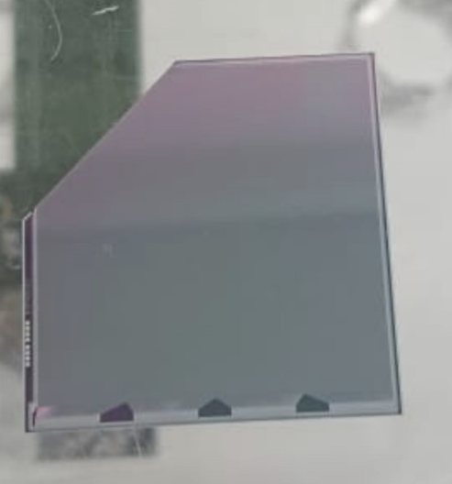
Silicon detectors
Elastic events
Kind of naval battle
Evolution: pixel detectors
Diode strips pitch: 55 micron

Slide 12
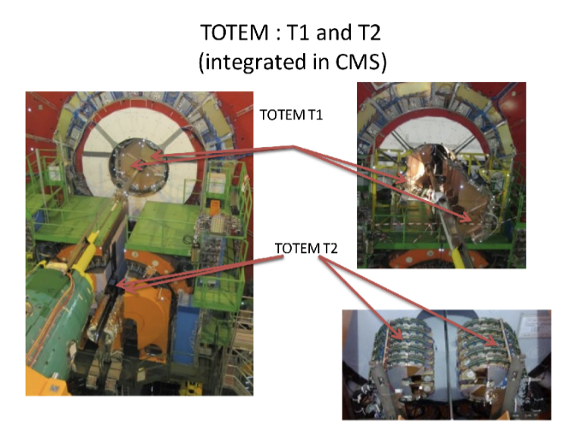
T1 & T2

Slide 13
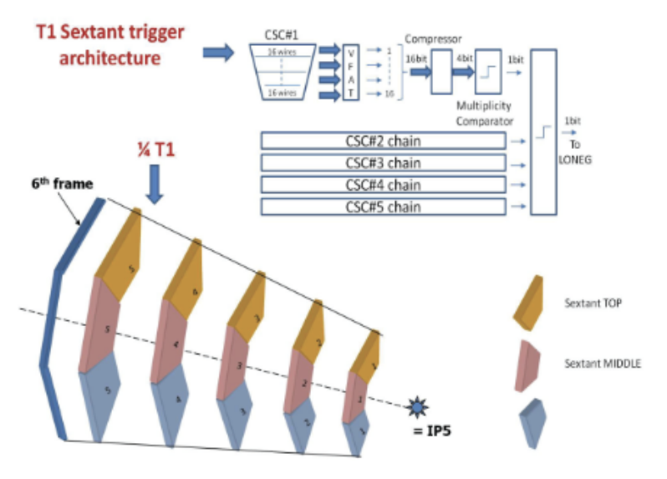
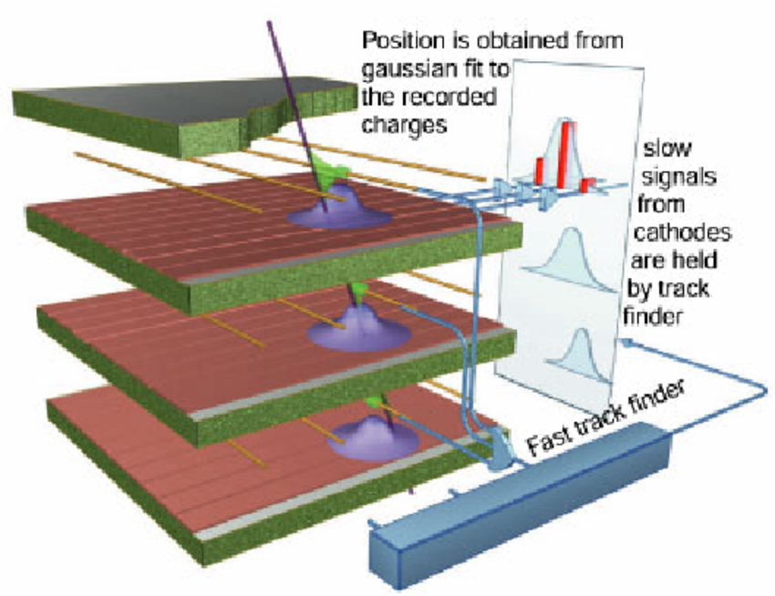
T1
Particle tracker
Identifies products of inelastic events
Counts charged particle
5 planes of Cathode Strip Chambers (multiwire proportional chamber)
TPC (Time Projection Chamber)

Slide 14
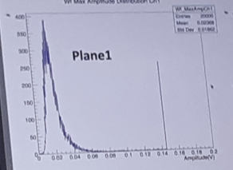
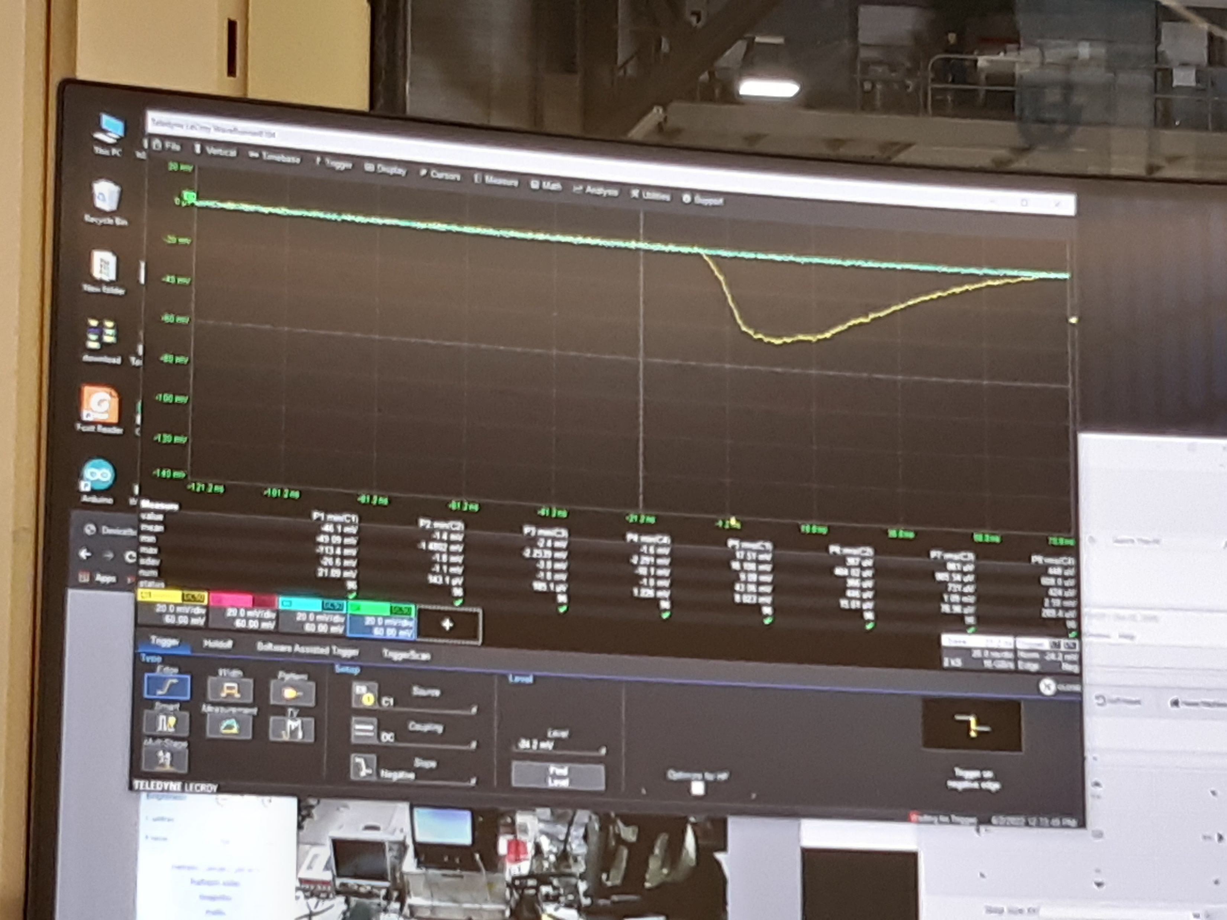
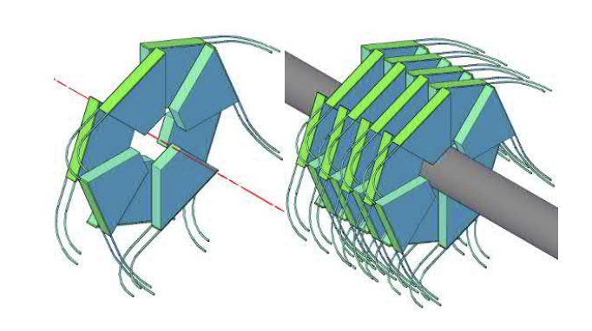
T2
Observed events as a function of the amplitude
The sign of a particle passed through the telescope
Particle tracker made of scintillators

Slide 15
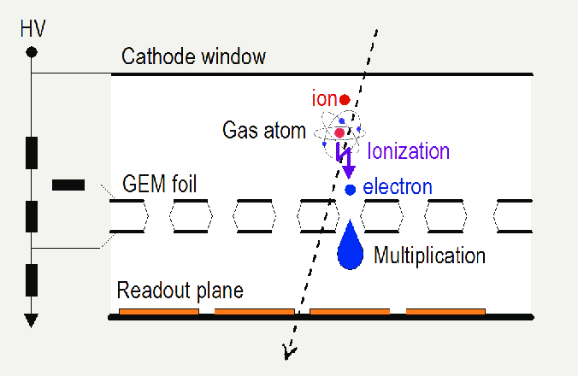
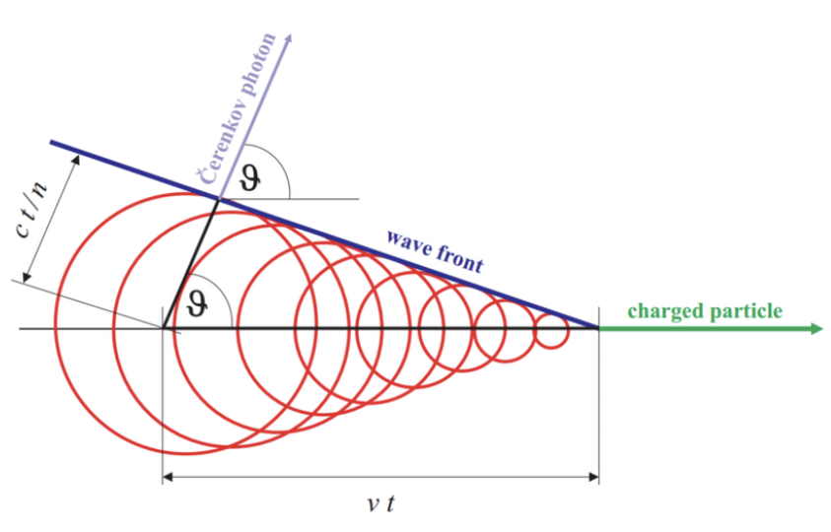
Other detectors
GEM
Crystals (using Cherenkov effect)

Slide 16
Bibliography & Sitography
Letter of Intent, 1997
TOTEM, 2004
The new T2, 2019
https://totem.web.cern.ch/Totem/

Slide 17
THE END
Special thanks to:
Berkan Kaynak
Diego Figueiredo
Eraldo Oliveri
Fabrizio Murtas

