Slide 1
Superconductors and Superconducting Magnets
Luca.Bottura@cern.ch
2 June 2022

Slide 2
Overview
Why superconductors ? A motivation
A superconductor physics primer
Superconducting materials and cables
The making of a superconducting magnet
Examples of superconducting magnet systems

Slide 3
Overview
Why superconductors ? A motivation
A superconductor physics primer
Superconducting materials and cables
The making of a superconducting magnet
Examples of superconducting magnet systems

Slide 4
Why superconductivity anyhow ?
Graphics by courtesy of M.N. Wilson
Abolish Ohm’s law !
  no power consumption (although need refrigeration power)
  high current density
  ampere turns are cheap, so don’t need iron (although often use it for shielding)
Consequences
  lower running cost ⇒ new commercial possibilities
  energy savings
  high current density ⇒ smaller, lighter, cheaper magnets ⇒ reduced capital cost
  higher magnetic fields economically feasible ⇒ new research possibilities
Nb-Ti
Conventional iron electromagnets

Slide 5
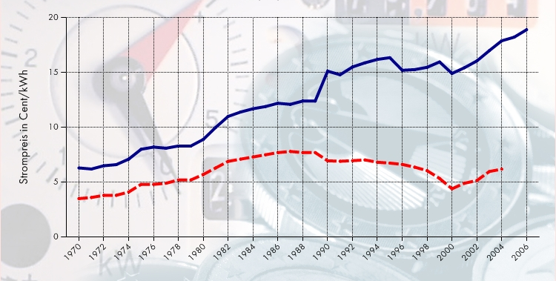
Cost of energy (electricity)
Evolution of energy prices in Germany
Source: Bundesministerium fuer Wirtschaft und Technologie
Private customers
Corporate customers
Energy efficiency is an inevitable design constraint !

Slide 6
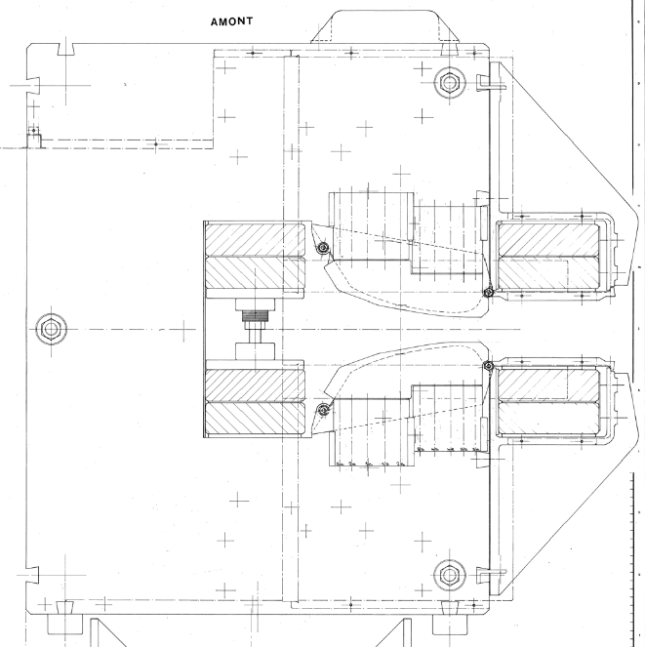
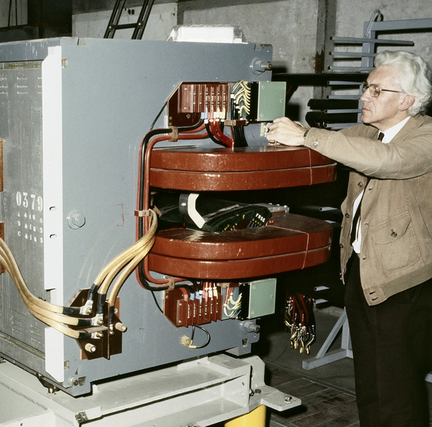
NC vs. SC Magnets - 1/2
Normal conducting accelerator magnets
  Magnetization ampere-turns are cheap
  Field is generated by the iron yoke (but limited by saturation, e.g. ≈ 2 T for iron)
  Low current density in the coils to limit electric power and cooling needs
  Bulky and heavy, large mass of iron (cost driver)
One of the dipole magnets of the PS, in operation at CERN since 1959

Slide 7
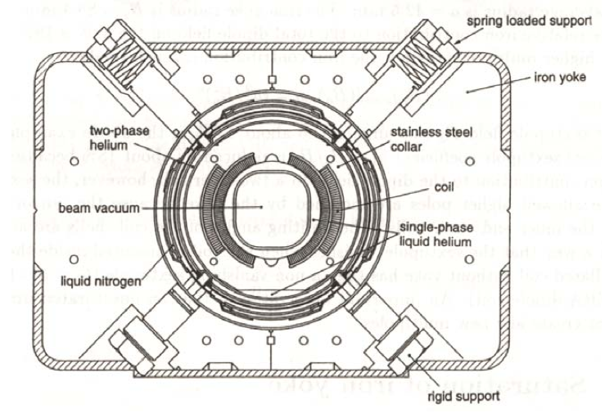
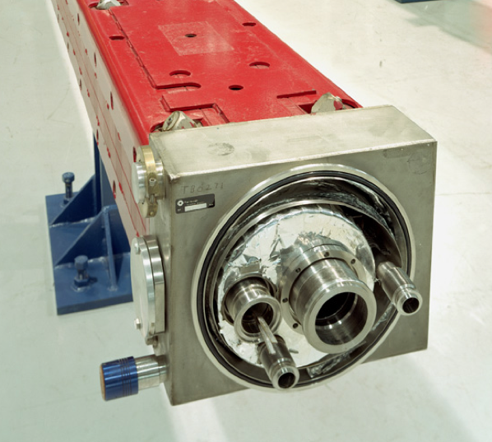
NC vs. SC Magnets - 2/2
Superconducting accelerator magnets
  Superconducting ampere-turns are cheap
  Field generated by the coil current (but limited by critical current, e.g. ≈ 10 T for NbTi)
  High current density, compact, low mass of high-tech SC material (cost driver)
  Requires efficient and reliable cryogenics cooling for operation (availability driver)
A superconducting dipole magnet of the Tevatron at FNAL, the first superconducting synchrotron, 1983

Slide 8
High current density: solenoids
The field produced by an infinitely long solenoid is:
a
t
B
In solenoids of finite length the central field is:
where f < 1, typically ~ 0.8
The thickness (volume and cost) for a given field is inversely proportional to the engineering current density J_{e}
J_{e}
all-SC solenoid record field: 24 T (NIMS, 2011)

Slide 9
High current density - dipoles
Graphics by courtesy of M.N. Wilson
J_{E} = 37.5 Amm⁻²
The field produced by an ideal dipole (see later) is:
J_{E} = 375 Amm⁻²
-J_{E}
J_{E}
LHC dipole
120mm
≈ 1x10⁶ MA-turn
660mm
≈ 5x10⁶ MA-turn
≈ 6 MW/m
all-SC dipole record field:
16 T (LBNL, 2003)

Slide 10

The Hall of Fame of SC colliders
 |  | Tevatron | HERA | RHIC | LHC
Maximum energy | (GeV) | 980 | 920⁽¹⁾ | 250⁽²⁾ 100/n⁽³⁾ | 7000
Injection energy | (GeV) | 151 | 45 | 12 | 450
Ring length | (km) | 6.3 | 6.3 | 3.8 | 26.7
Dipole field | (T) | 4.3 | 5.0 | 3.5 | 8.3
Aperture | (mm) | 76 | 75 | 80 | 56
Configuration |  | Single bore | Single bore | Single bore | Twin bore
Operating temperature | (K) | 4.2 | 4.5 | 4.3-4.6 | 1.9
First beam |  | 7-1983 | 4-1991 | 6-2000 | 9-2008
⁽¹⁾ energy of the proton beam, colliding with the 27.5 GeV electron beam
⁽²⁾ energy for proton beams
⁽³⁾ energy per nucleon, for ion beams (Au)

Slide 11
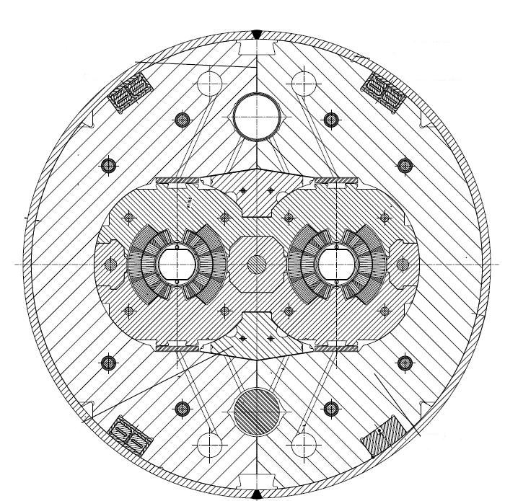
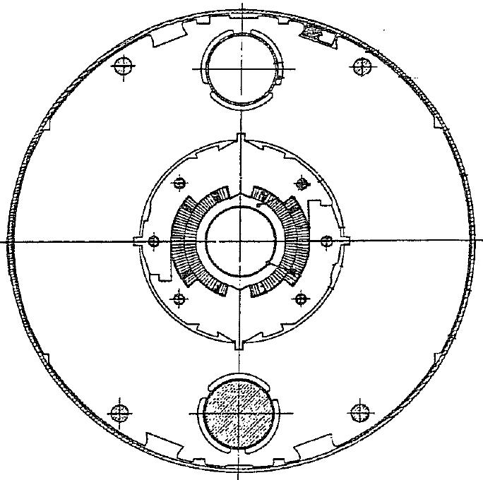
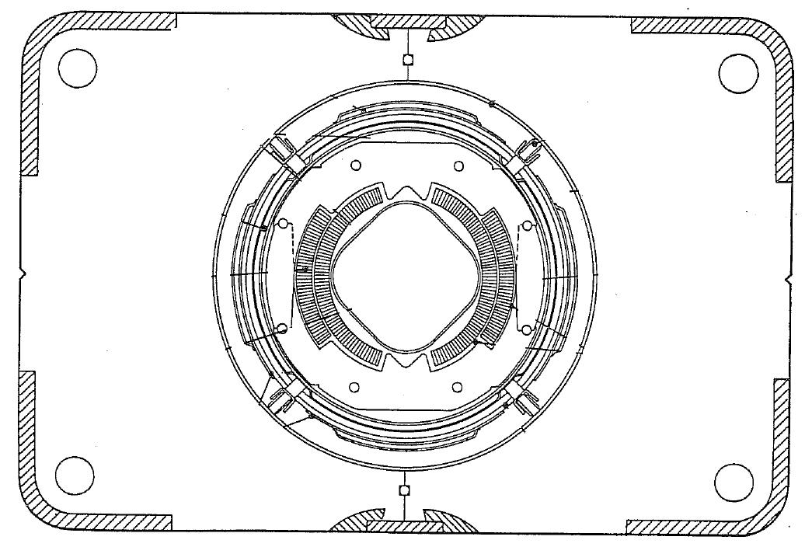
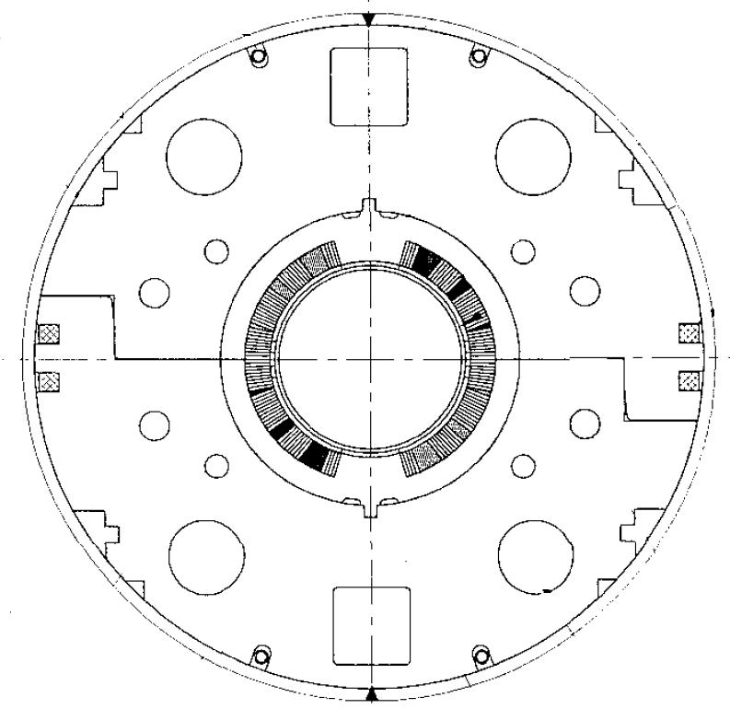
Champion dipoles cross sections
Tevatron
Bore: 76 mm
Field: 4.3 T
HERA
Bore: 75 mm
Field: 5.0 T
RHIC
Bore: 80 mm
Field: 3.5 T
LHC
Bore: 56 mm
Field: 8.3 T

Slide 12
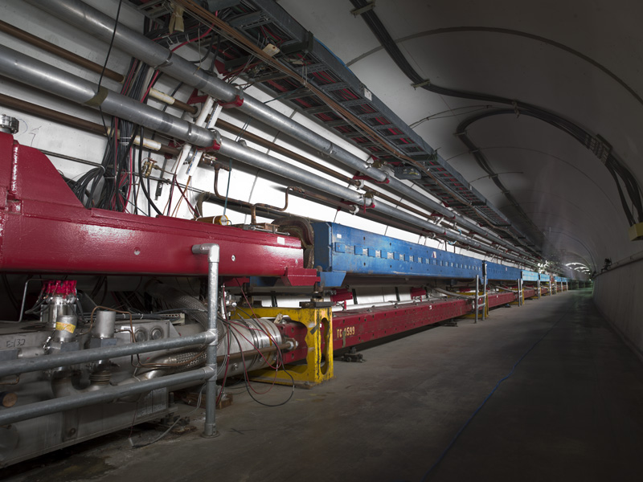
Tevatron at FNAL (Chicago, IL, USA)
Injection | (GeV) | 151
Flat-top | (GeV) | 980
Length | (km) | 6.3
Dipole field | (T) | 4.3
Aperture | (mm) | 76
Temperature | (K) | 4.2
Commisioned |  | 1983
Image by courtesy of Fermi National Accelerator Laboratory

Slide 13
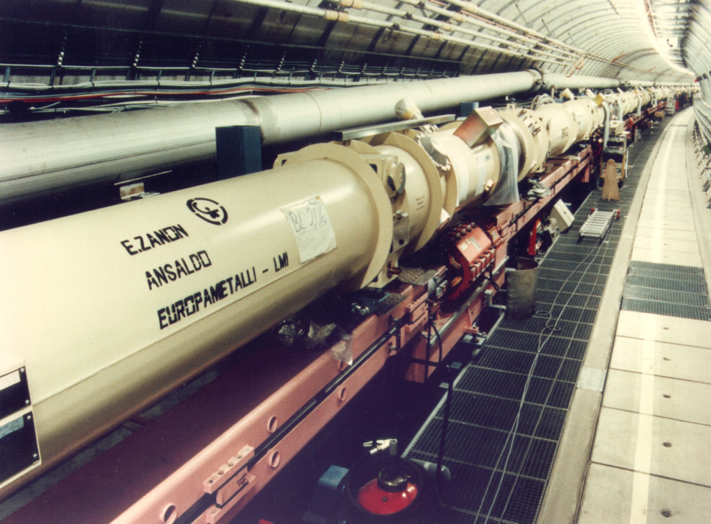
HERA at DESY (Hamburg, D)
Image by courtesy of Deutsches Elektronen Synchrotron
Injection | (GeV) | 45
Flat-top | (GeV) | 920
Length | (km) | 6.3
Dipole field | (T) | 4.7
Aperture | (mm) | 75
Temperature | (K) | 4.5
Commisioned |  | 1991
Closed |  | 2007

Slide 14
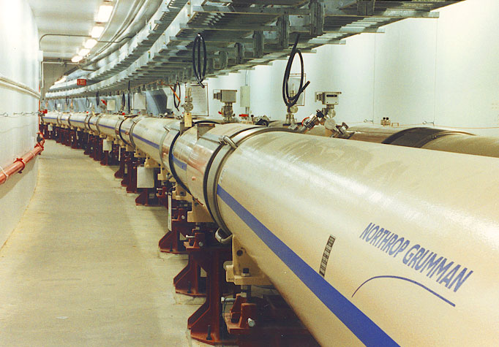
RHIC at BNL (Upton, NY, USA)
Image by courtesy of BrookhavenAccelerator Laboratory
Injection | (GeV) | 12/n
Flat-top | (GeV) | 100/n
Length | (km) | 3.8
Dipole field | (T) | 3.5
Aperture | (mm) | 80
Temperature | (K) | 4.3-4.6
Commisioned |  | 2000

Slide 15
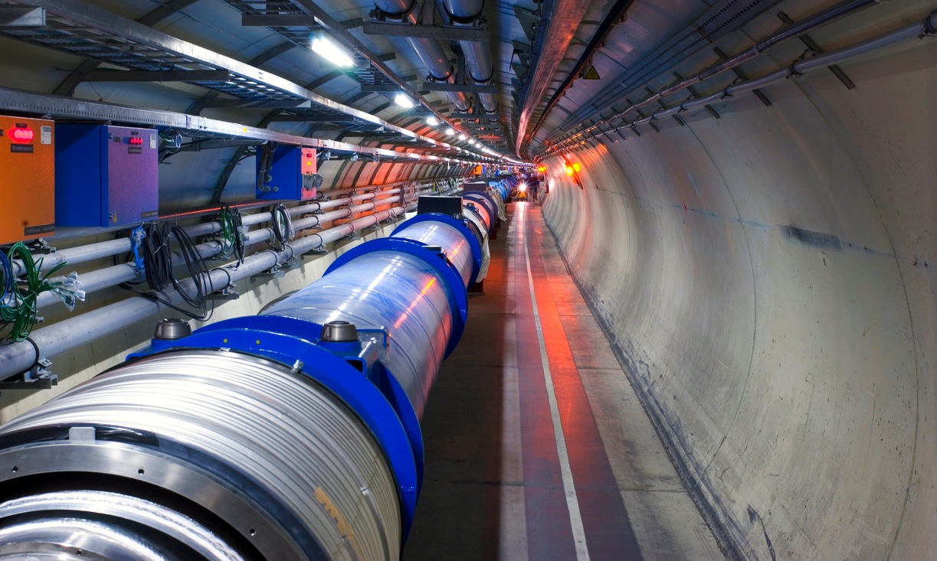
LHC at CERN (Geneva, CH)
Injection | (GeV) | 450
Flat-top | (TeV) | 7
Length | (km) | 26.7
Dipole field | (T) | 8.3
Aperture | (mm) | 56
Temperature | (K) | 1.9
Commisioned |  | 2008

Slide 16
Motivation - Re-cap
Superconductors are used to abolish Ohm’s law, either to:
  Decrease power consumption, and thus improve the performance and operation balance (cost + efficiency) replacing existing technology ⇒ technology displacer
  Allow to reach higher magnetic field, over larger bore and for longer time, allowing new physics or technological opportunities ⇒ technology enabler

Slide 17
Overview
Why superconductors ? A motivation
A superconductor physics primer
Superconducting materials and cables
The making of a superconducting magnet
Examples of superconducting magnet systems

Slide 18
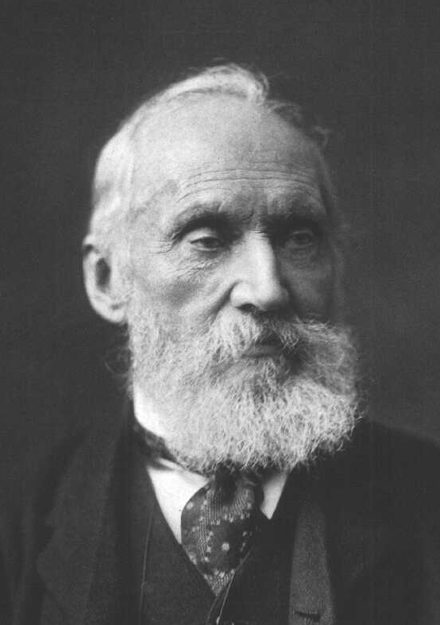
A great physics problem in 1900
ρ
What is the limit of electrical resistivity at the absolute zero ?
… electrons flowing through a conductor would come to a complete halt or, in other words, metal resistivity will become infinity at absolute zero.
“X-rays are an hoax”
“I have not the smallest molecule of faith in aerial navigation other than ballooning or of expectation of good results from any of the trials we hear of”
"There is nothing new to be discovered in physics now. All that remains is more and more precise measurement”
W. Thomson (Lord Kelvin)
T

Slide 19
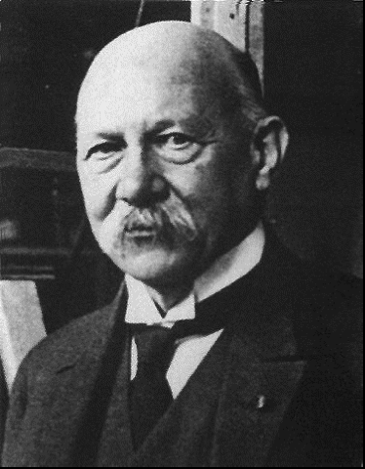
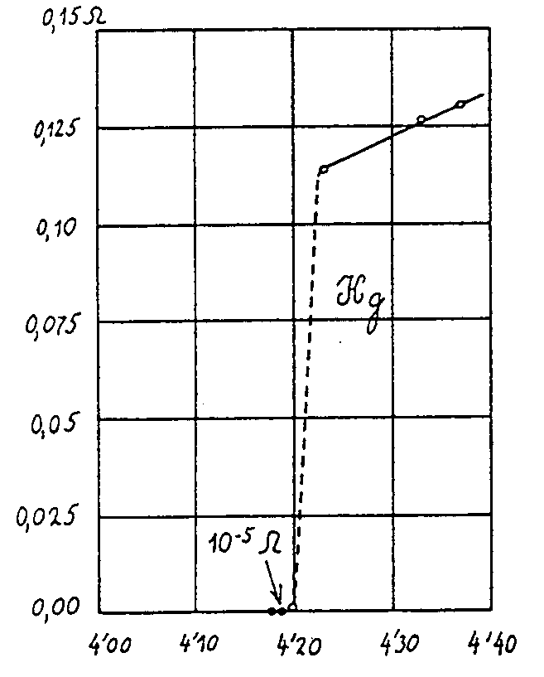
Superconductors Pre-history
… thus the mercury at 4.2 K has entered a new state, which, owing to its particular electrical properties, can be called the state of superconductivity…
H. Kamerlingh-Onnes (1911)

Slide 20
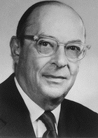
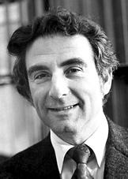
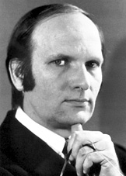
Cooper Pairs
Bardeen, Cooper and Schrieffer
Normal conductor
    scattering of e⁻
    finite resistance due to energy dissipation
Proper physics: a gas of Fermions. The conduction electrons at the Fermi surface have large energy (few eV) and interact with lattice defects, displacements or thermal excitations (hence ρ(T))
Superconductor
    paired electrons forming a quasi particle in condensed state
    zero resistance because the scattering does not excite the quasi-particle
Proper physics: paired electrons in the vicinity of the Fermi surface, with opposite momentum and spin (bosons with zero spin). The binding energy introduces a small energy gap between paired and unpaired state. An external electric field makes the pair drift.

Slide 21
Pairing mechanism
t₁
Lattice displacement
⇓
phonons (sound)
⇓
coupling of charge carriers
Only works at low
temperature
Bardeen, Cooper, Schrieffer (BCS) - 1957
100-1000 nm
t₂
Proper physics: the binding energy is small, of the order of 10⁻³ eV. Pairs can be broken easily by thermal energy. The interaction is long range, and Cooper pairs overlap and can exchange electrons

Slide 22
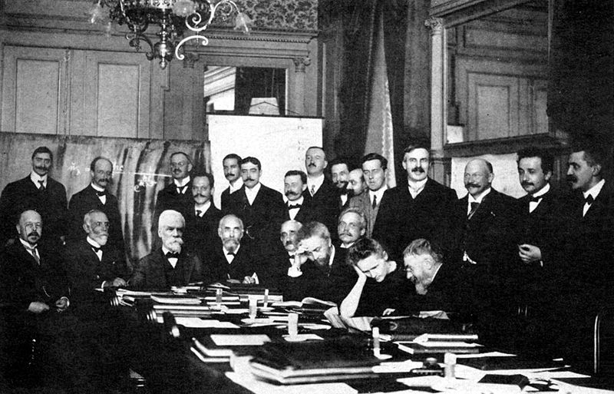
First (not last) superconducting magnet project cancelled
A 100 kGauss magnet ! (H. K. Onnes)
Third International Congress of Refrigeration, Chicago (1913)
The 10 T magnet project was stopped when it was observed that superconductivity in Hg and Pb was destroyed by the presence of an external magnetic field as small as 500 Gauss (0.05 T)
Solvay conference (1914)
Superconductivity languished for 40 years…

Slide 23
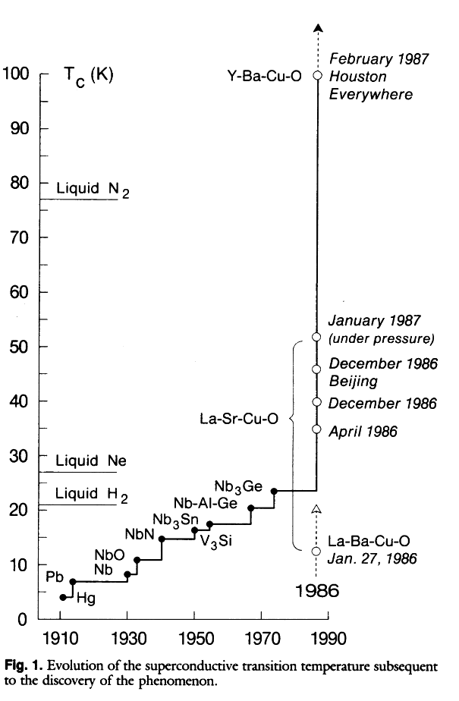
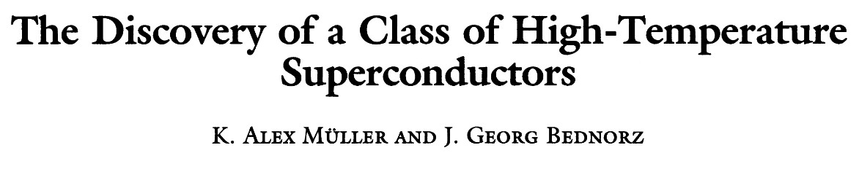
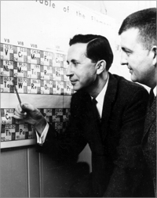
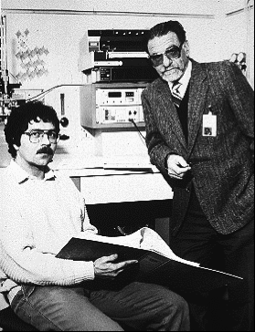
1986 - A Big Surprise
Theoretical limit around 30 K
One Thousand and One Superconductors
B. Matthias (1918-1980)
Bednorz and Mueller
IBM Zuerich, 1986

Slide 24
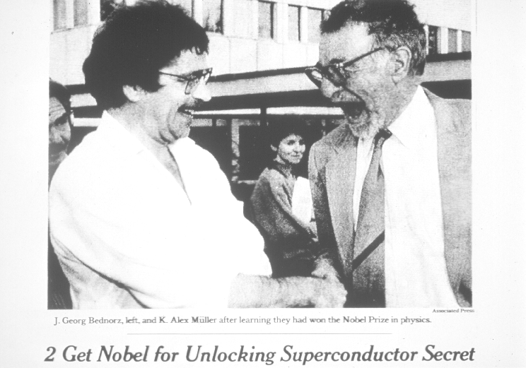
1987 - The prize !

Slide 25
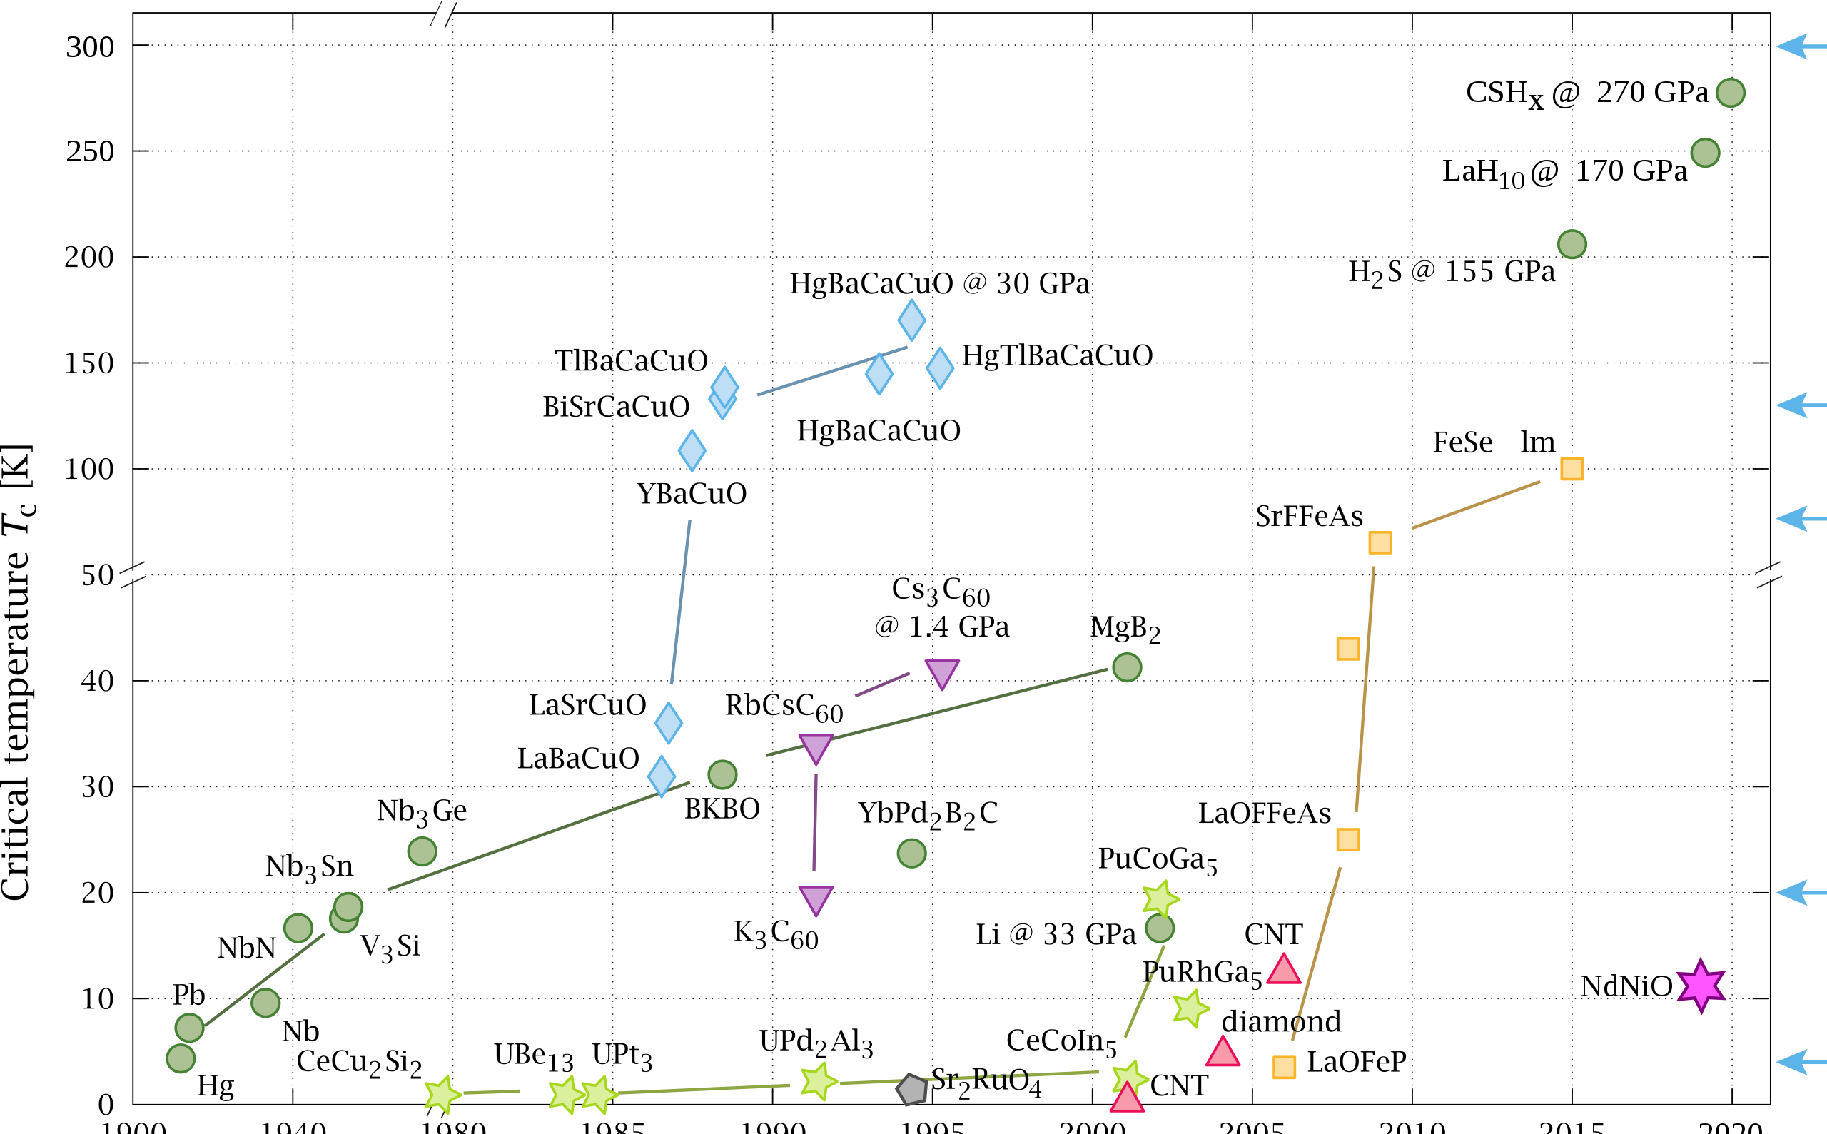


High-Tc timeline
300
Room
Temperature
250
High-p
200
HTS
150
100
Critical Temperature T_{C} (K)
Liquid N₂
50
IBS
40
LTS
30
20
Liquid H₂
10
NbTi
Liquid He
0
1900
1940
1980
1985
1990
1995
2000
2005
2010
2015
2020
Year of Discovery (-)

Slide 26
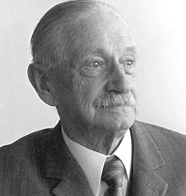


Hey, what about field ?
W. Meissner, R. Ochsenfeld
Type I (κ < 1/√2)
Complete field exclusion
Raise field
superconducting
Pure metals
B_{C} ≈ 10⁻³…10⁻² T
B
Meissner & Ochsenfeld, 1933
Example of magnetic levitation
B
Levitated magnet
normal-conducting
Cool
down
Superconducting disk

Slide 27
Free energy and critical field
Let us define the Gibbs free energy of a material in a magnetic field:
A system in equilibrium will tend to a minimum of G
In zero applied field, the SC phase (being in a condensed state) has lower free energy than the normal phase:
The field expulsion (M=-H) corresponds to a magnetic energy density:
The material prefers to expel the magnetic field (Meissner effect) until the free energy of the SC phase in field equals the free energy of the normal state:
G = U - TS - μ₀ M · H
−μ₀ M · H = μ₀/2 H²
Thermal energy
Magnetic energy
μ₀/2 H_{c}²= G_{normal}- G_{sup}(H=0)
G_{sup}(H=0) < G_{normal}(H=0)
Thermodynamic critical field

Slide 28
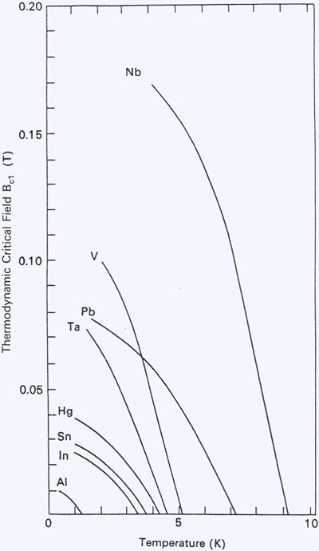
Type I – critical field
The difference in free energy ΔG among the SC and normal state is small
The corresponding values of the thermodynamic critical field are also small, i.e. in the range of few mT to barely above 100 mT
μ₀/2 H_{c}²= ΔG
Not very useful for magnet engineers !

Slide 29
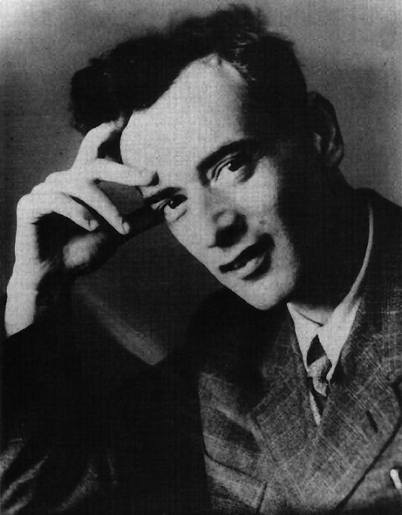

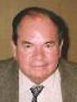
Energy efficient fluxons
Landau, Ginzburg and Abrikosov
Type I (κ < 1/√2)
Complete field exclusion
Pure metals
B_{C} ≈ 10⁻³…10⁻² T
Type II (κ > 1/√2)
Meissner & Ochsenfeld, 1933
Partial field exclusion
Lattice of fluxons
Dirty materials: alloys intermetallic, ceramic
B_{C} ≈ 10…10² T
Ginsburg, Landau, Abrikosov, Gor’kov, 1950…1957

Slide 30
Values of λ_{L} , ξ and κ
Material | λ_{L} (nm) | ξ(B=0) (nm) | κ (-)
Al | 16 | 1600 | 0.01
Pb | 32 | 510 | 0.06
In | 24 | 360 | 0.07
Cd | 110 | 760 | 0.15
Sn | 30 | 170 | 0.18
Nb | 40 | 39 | 1
Nb₃Sn | 200 | 12 | ≈ 20
MgB₂ | 185 | 5 | ≈ 40
YBCO | 200 | 1.5 | ≈ 75
Type I
Type II

Slide 31
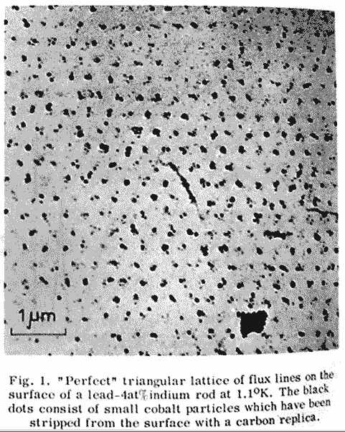
Lattice of quantum flux lines
Graphics by courtesy of Superconductor Lab, Oslo
Supercurrent
Flux quantum
Φ₀ = h/2e = 2.07 x 10⁻¹⁵ Wb
Observation on Pb-4at% In magnetised by a field of 3000 Oe and decorated by Co particles
Essmann & Träuble, 1967

Slide 32
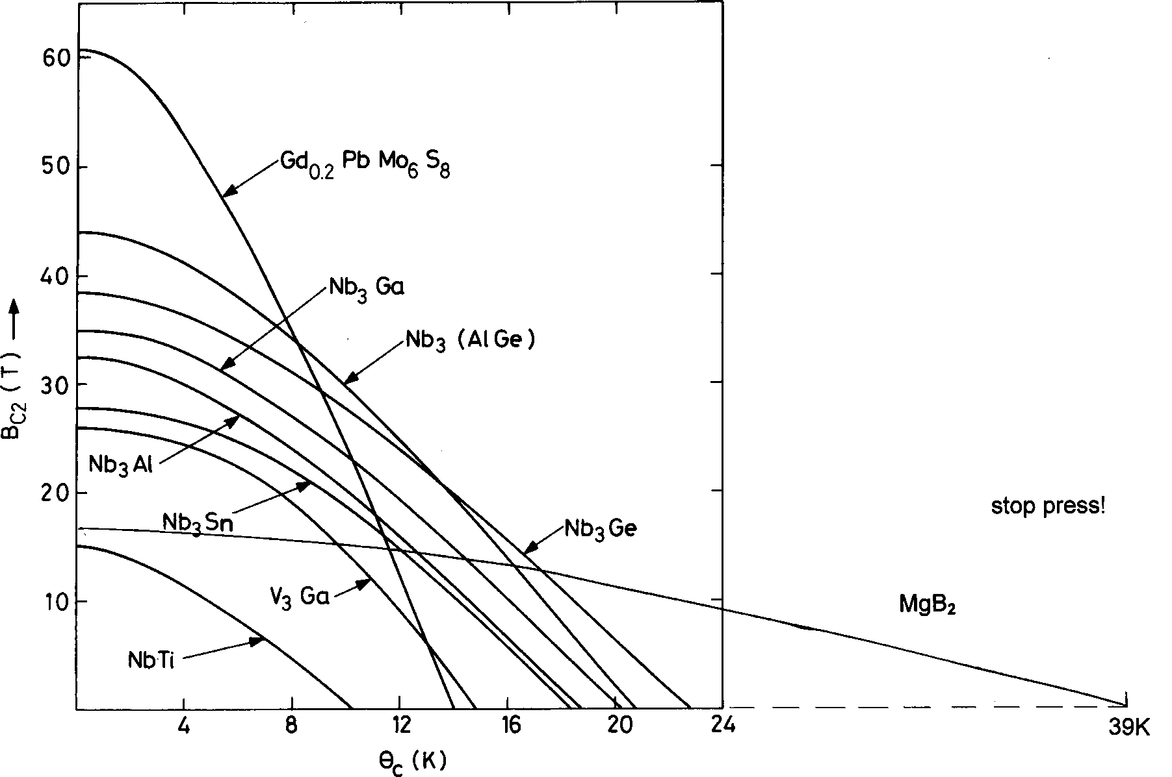
Type II – critical field
Graphics by courtesy of M.N. Wilson
The upper critical field B_{C2} and temperature T_{C} of metallic superconductors are mutually related
Both B_{C2} and T_{C} are determined by the chemistry of the material
HTS
NOTE: of all the metallic superconductors, only NbTi is ductile.
All other are brittle inter-metallic compounds
T_{c}(K)

Slide 33
Hey, what about current ?
A current flowing in a magnetic field is subject to the Lorentz force that deviates the charge carriers:
F = J x B
This translates into a motion of the fluxoids across the superconductor ⇒ energy dissipation ⇒ loss of superconductivity
To carry a significant current we need to lock the fluxoids so to resist the Lorentz force. For this we mess-up the material and create pinning centers that exert a pinning force F_{P}

Slide 34
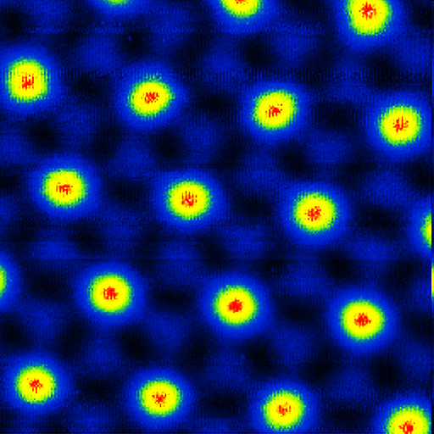

Type II Superconductors (ξ < λ)
Normal state cores
Superconducting region
B

Slide 35
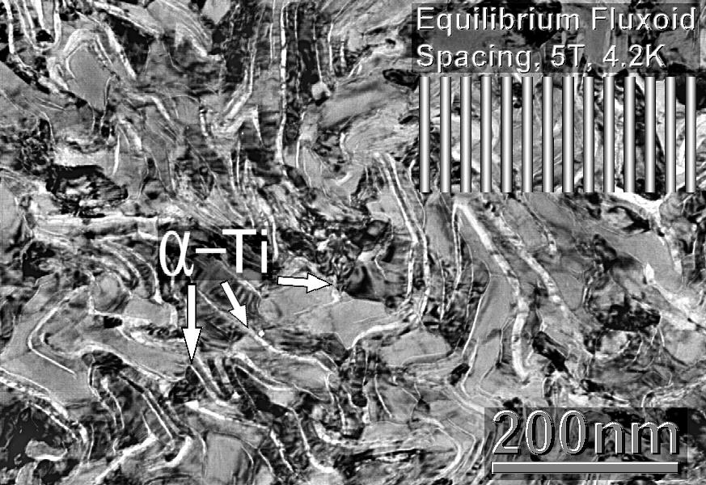
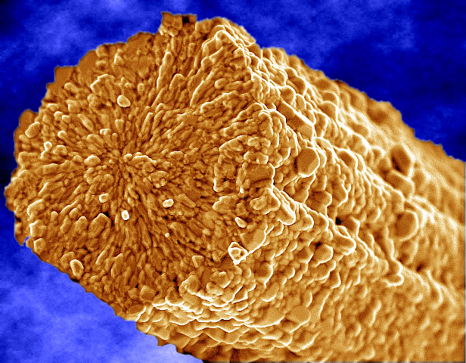
Pinning centers
Graphics by courtesy of Applied Superconductivity Center at NHMFL
Grain boundaries in
inter-metallic compounds
Precipitates in alloys
grain
Microstructure of Nb-Ti
Microstructure of Nb₃Sn

Slide 36
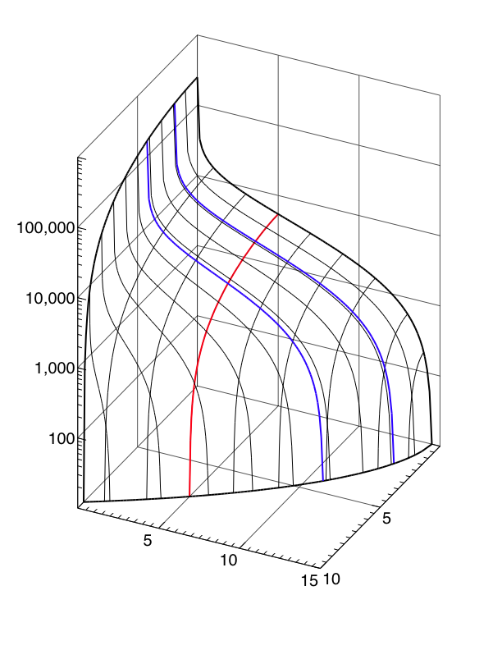
Jc(B,T,…)
Critical surface of a LHC NbTi wire
J_{c} [A/mm²]
T=1.9 K
T=4.2 K
The maximum current that can be carried by the superconductor is the current at which:
|J x B| = F_{P}
The above expression defines a critical surface:
J_{C}(B,T,…) = F_{P} / B
B = 5 [T]
100,000
10,000
1,000
B [T]
100
T [K]
5
5
Jc (5 T, 4.2 K) ≈ 3000 A/mm²
10
10
15

Slide 37
Superconductors physics - Re-cap
Superconducting materials are only useful if they are dirty (type II - high critical field) and messy (strong pinning centers)
A superconductor is such only in conditions of temperature, field and current density within the critical surface, and it is a normal-conductor above these conditions. The transition is defined by a critical current density J_{C}(B,T,…)
The maximum current that can be carried is the I_{C} = A_{SC} x J_{C}

Slide 38
Superconductor types – 1/2
Magnetic field exclusion:
  Type I – full exclusion of field lines from the material bulk up to lower critical field B_{C1}
  Type II – full exclusion of field lines from the material bulk up to B_{C1} followed by partial flux penetration (vortices) up to upper critical field B_{C2}
Underlying theory:
  Conventional – explained by BCS theory (usually applying to LTS)
  Unconventional – needs theory different from BCS (usually applying to HTS)

Slide 39
Superconductor types – 2/2
Critical temperature:
  LTS – low-temperature superconductors, critical temperature T_{C} up to (about) 30 K
  HTS – high-temperature superconductors, critical temperature T_{C} above 30 K, in the range of liquid nitrogen (77K) and higher
  NOTE: MgB₂ is a special case: TC ≈ 40 K but explained by LTS theory
Material class:
  Elements (e.g. Pb, Hg)
  Alloys (e.g. Nb-Ti, Nb-Zr)
  Compounds (e.g. Nb₃Sn)
  Ceramics (e.g. REBCO)
  Pnictides (e.g. IBS)
  Organic, Sulfides, …

Slide 40
Overview
Why superconductors ? A motivation
A superconductor physics primer
Superconducting materials and cables
The making of a superconducting magnet
Examples of superconducting magnet systems

Slide 41
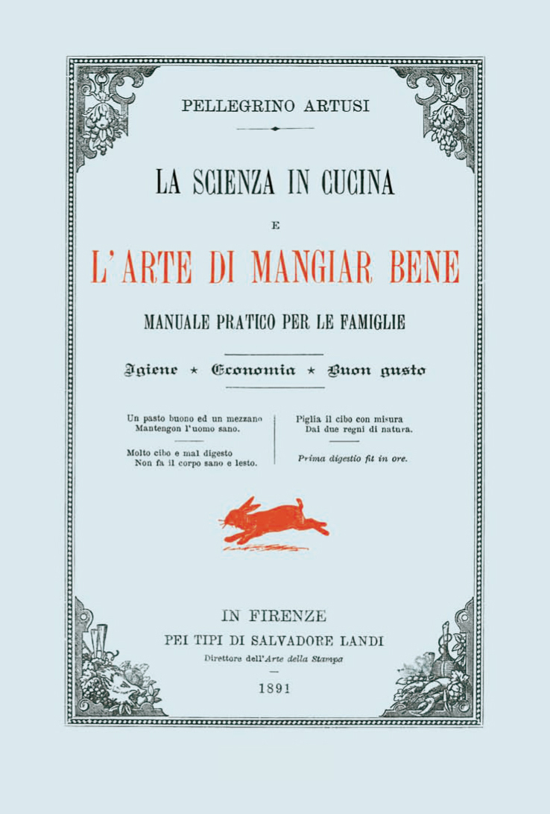

Superconducting magnet cook-book
Devise the desired magnetic configuration for the specified field, bore homogeneity and duty cycle
Analyze mechanically and thermally
Design a cable to fit the winding, by choosing cross sections and cable configuration with:
  Superconductor A_{SC} to carry the current with sufficient margin
  Stabilizer A_{ST} sufficient for stability and protection
  Sufficiently low AC loss
Insulate cable, wind coils, mount in a supporting and magnetic structure, insert in a cryostat
Top-off with current leads and instrumentation as desired
Cool properly to cryogenic temperatures
Power up, shake with quenches
Enjoy the field according to your taste
Science in the Kitchen, P. Artusi, 1891

Slide 42
From materials to magnets
Materials must be made in high-current wires, tapes and cables for use in magnets
The manufacturing route depends, among others on:
  The material (e.g. alloy or chemical compound),
  The material synthesis (e.g. reaction conditions or a crystal growth method)
  The material mechanical properties (e.g. ductile or fragile)
  The compatibility with other materials involved (e.g. precursors or mechanical supports)

Slide 43
A summary of technical materials
 | LTS |  |  |  | HTS
 | Nb-Ti | Nb₃Sn | Nb₃Al | MgB₂ | YBCO | BSCCO | IBS
 | 1961 | 1954 | 1958 | 2001 | 1987 | 1988 | 2006
Tc (K) | 9.2 | 18.2 | 19.1 | 39 | ≈93 | 95⁽⁵⁾ 108⁽⁶⁾ | 16⁽⁷⁾ 38⁽⁸⁾ 55⁽⁹⁾
Bc (T) | 14.5 | ≈30 | 33 | 18⁽¹⁾ 36…74⁽²⁾ | ≈120⁽³⁾ ≈250⁽⁴⁾ | ≈200 | 40⁽⁷⁾ 80⁽⁸⁾ 100⁽⁹⁾
Notes:
⁽¹⁾ wires and tapes
⁽²⁾ thin layers
⁽³⁾ B parallel to c-axis
⁽⁴⁾ B in the ab-plane
⁽⁵⁾ BSCCO-2212
⁽⁶⁾ BSCCO-2223
⁽⁷⁾ IBS-11
⁽⁸⁾ IBS-122
⁽⁹⁾ IBS-1111
HTS are not only superconducting at high temperature, they also have an exceptional critical field ! (important for high magnetic field applications)

Slide 44
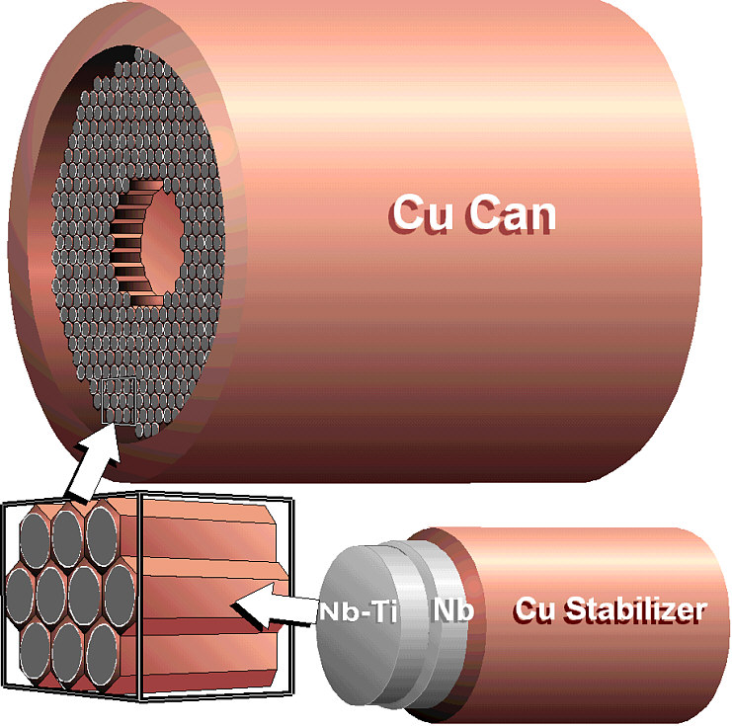
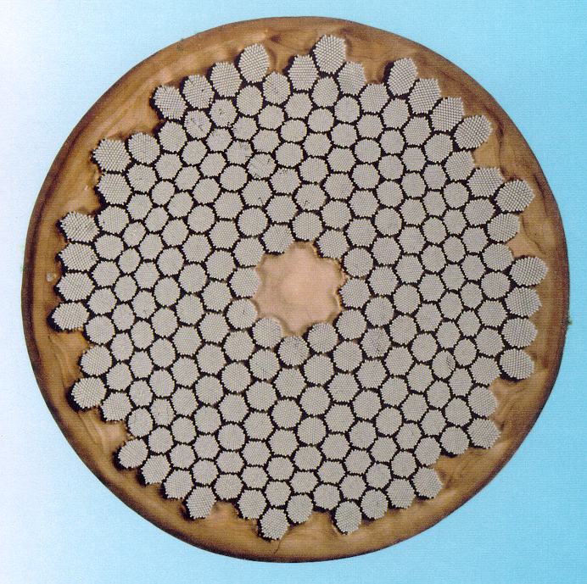
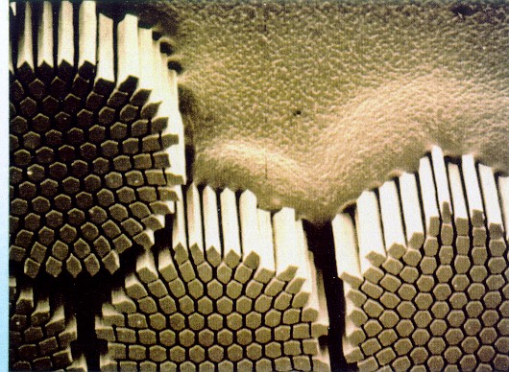
Nb-Ti manufacturing route
Graphics by courtesy of Applied Superconductivity Center at NHMFL
NbTi billet
I_{C}(5 T, 4.2 K) ≈ 1 kA
extrusion
cold drawing
≈1 mm
heat
treatments
NbTi is a ductile alloy that can sustain large deformations
LHC wire

Slide 45
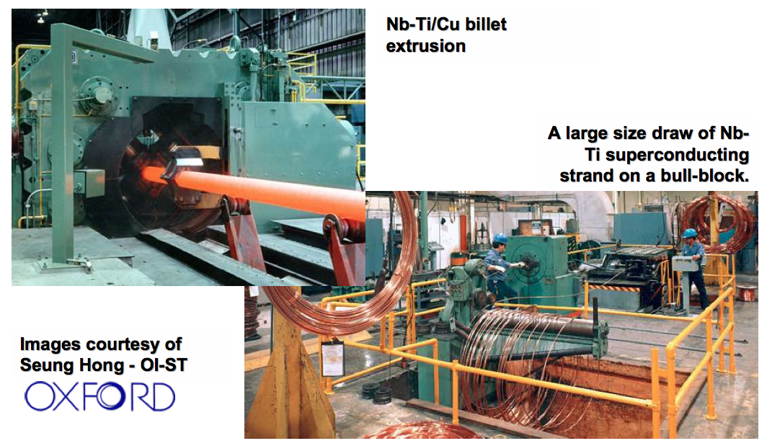
NbTi: an industrial process

Slide 46
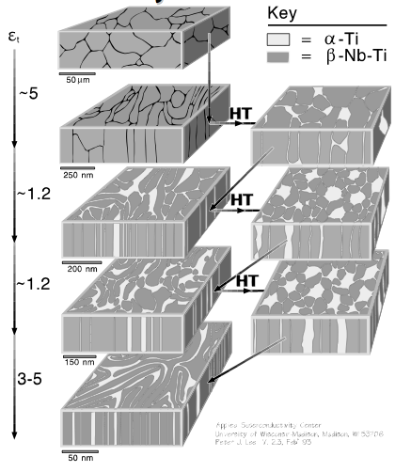
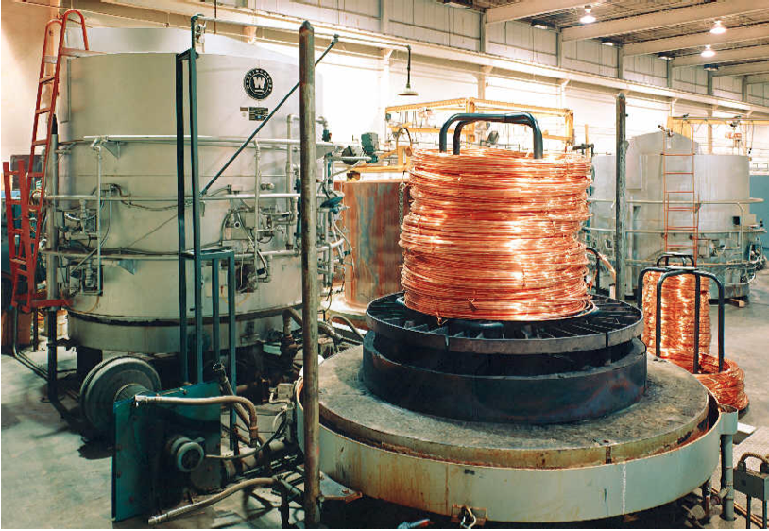
The trick to high Jc in NbTi
Intermediate heat treatment is necessary to form precipitates (pinning centers) and improve draw-ability. Subsequent drawing elongates the precipitates to the desired spacing

Slide 47

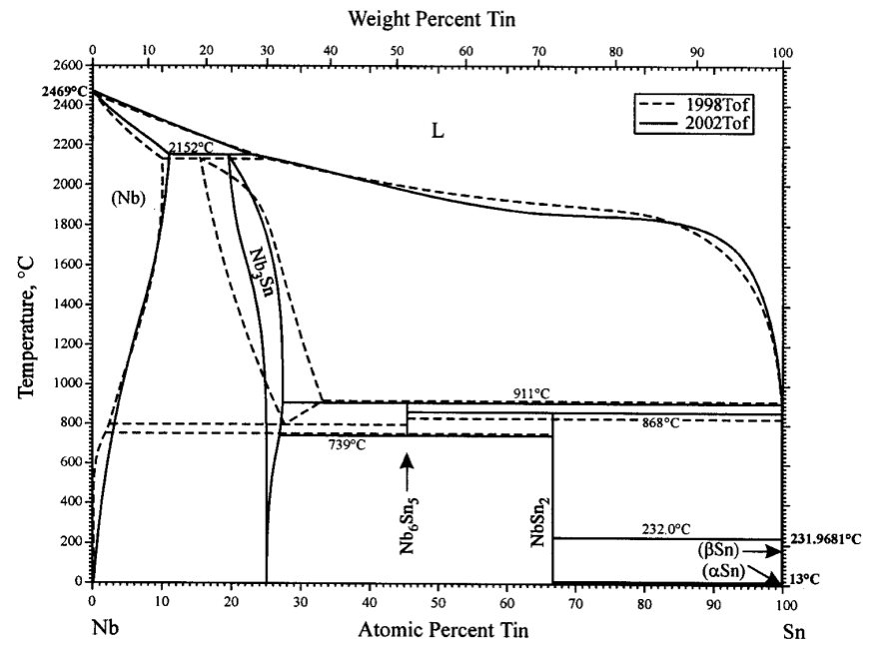
Nb₃Sn synthesis
Breakthrough achieved by three groups in 1969-1970:
  K. Tachikawa at the National Research Institute for Metals in Japan
  A. R. Kaufman at the Whittaker Corporation in the USA
  E . W. Howlett at the Atomic Energy Research Establishment at Harwell in Great Britain.
A15 compound layers (V₃Ga and Nb₃Sn) could be formed by solid diffusion at the interface of Nb/V and Cu-Sn/Ga at modest temperatures, of the order of 700 °C
In addition, Cu de-stabilizes Sn-rich compounds
Initial Nb₃Sn synthesis routes (Kunzler) required high-temperature heat treatment (> 950 °C)

Slide 48
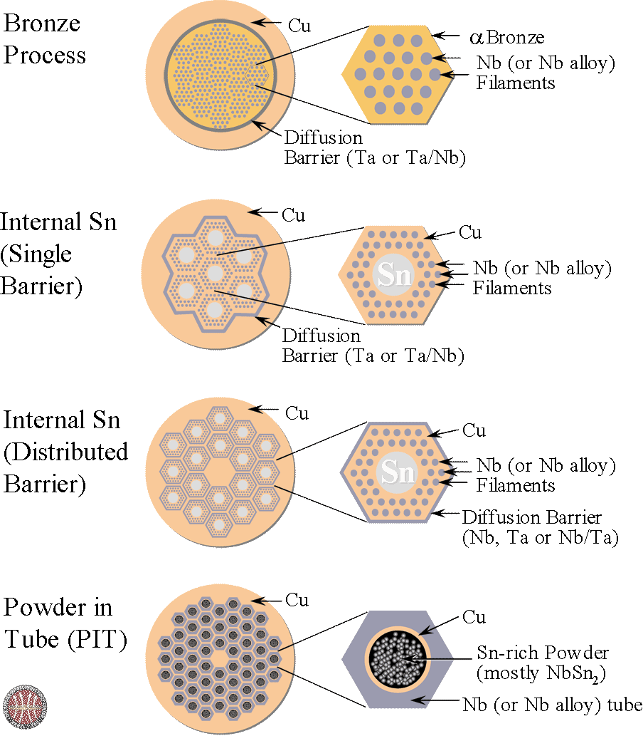
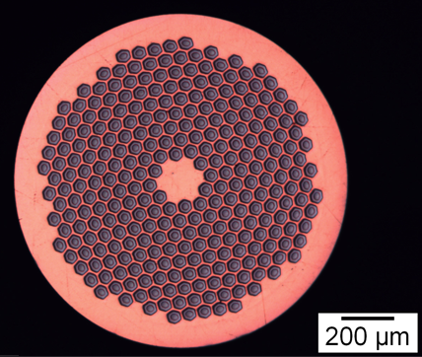
Nb₃Sn manufacturing routes
Graphics by courtesy of Applied Superconductivity Center at NHMFL
Nb₃Sn is brittle and cannot be drawn in final form. The precursors are drawn and only later the wire is heat-treated to ≈650 C for several hrs, to form the Nb₃Sn phase
I_{C}(12 T, 4.2 K) ≈ 1.5 kA

Slide 49
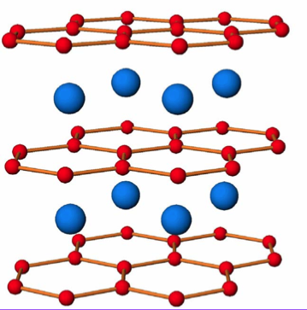
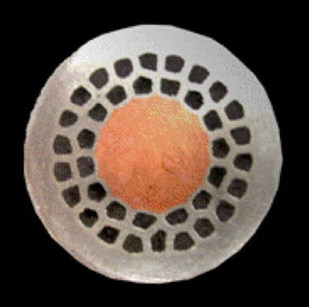
MgB₂ manufacturing routes
Technical MgB₂ is manufactured wires and tapes
  Powder-in-Tube
    In-situ
    Ex-situ
  Mg diffusion
The precursor (Mg/B or MgB₂ powders) requires a high-temperature heat treatment to form the brittle superconducting phase
The MgB₂ must be clad in Fe/Nb/Ni to protect Cu
Critical manufacturing issues:
  Powder quality, granulometry, mixing, final porosity
Doping with impurities the Mg/B powder is beneficial to J_{C}:
  SiC, C, B₄C, C nanotubes, Hydrocarbons
  C substitutes B MgB_{2-x}C_{x}

Slide 50
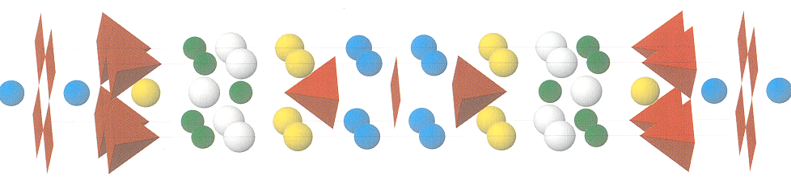
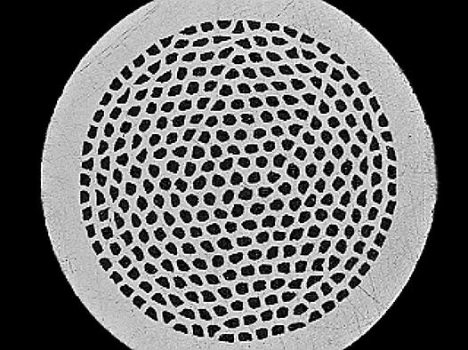

BSCCO manufacturing routes
BSCCO is also brittle: a special sequence of rolling and sintering heat treatments must used. Silver has the important feature that it is transparent to Oxygen at high temperature, but does not react with it
Oxide powder in tube OPIT
1) draw down BSCCO powder in a silver tube
2) stack many drawn wires in another silver tube and draw down again
3) roll the final wire to tape and heat treat at about 900C in oxygen to melt the B2212
BSCCO wire and tape
Graphics by courtesy of M.N. Wilson and
Applied Superconductivity Center at NHMFL

Slide 51

REBCO manufacturing routes
REBCO has better critical properties than BSCCO but, unlike BSCCO, grains do not align during processing. If grains are not aligned the supercurrent cannot jump between the grains. The manufacturing processes are all forcing a certain degree of alignment in the microstructure
1) produce a tape with an aligned texture
2) coat the tape with a buffer layer
3) coat the buffer with a layer RE-Ba₂Cu₃O₇ such that the texture of the RE-BCO follows that of the buffer and substrate
1 μm
≈0.1 mm
I_{C}(20 T, 4.2 K) ≈ 1 kA

Slide 52

YBCO production: high-tech
Work in clean-room conditions, costly processing of long lengths

Slide 53




Practical conductors: high J_{E}
J_{E} ≈ 500 A/mm²
Multifilamentary wires have current carrying capability of 100… 1000 A
Insulated with varnish or glass-braids they can be used to make all kind of small size magnets
Large size magnets (e.g. LHC dipoles) require invariably large operating currents (10 to 100 kA) to:
  Decrease inductance,
  Lower the operating voltage,
  Ease magnet protection (?)
Rutherford cables are ideally suited for this task
LHC cable prototype

Slide 54


Rutherford cable machine @ CERN
Strands fed through a cabling tongue to shaping rollers
Strand spools on rotating tables

Slide 55



Practical conductors: low J_{E}
J_{E} ≈ 50 A/mm²
Super-stabilized conductor, a superconducting cable (e.g. Rutherford) backed by a large amount of good normal conductor (e.g. Al)
Internally-cooled conductor, e.g. Cable-In-Conduit Conductor (CICC), a rope of wires inserted in a robust conduit that provides a channel for cooling

Slide 56








Superconducting wires and tapes for all taste…
YBCO
NbTi
Nb₃Sn, Nb₃Al
BSCCO
MgB₂

Slide 57








… and superconducting cables
Braids for
power transmission
CICC
Rutherford
Super-stabilized
Internally cooled

Slide 58
Overview
Why superconductors ? A motivation
A superconductor physics primer
Superconducting materials and cables
The making of a superconducting magnet
Examples of superconducting magnet systems

Slide 59


LHC dipole
B_{nominal} 8.3 (T)
current 11850 (A)
stored energy ≈ 10 (MJ)
cold mass ≈ 35 (tonnes)

Slide 60

Superconducting dipole magnet coil
−J
+J
−J
+J
Ideal current distribution that generates a perfect dipole
Practical approximation of the ideal distribution using Rutherford cables

Slide 61

Twin coil principle
Combine two magnets in one
Save volume, material, cost

Slide 62

LHC dipole coils
B
B

Slide 63


Fine cables
LHC inner cable
LHC Nb-Ti strand
LHC outer cable cross section
7500 km of superconducting cables with tightly controlled properties (state-of-the-art production)

Slide 64


Coil winding
Cable insulation
10 μm precision !
Stored coils
B
B
Coil winding machine

Slide 65


Ends
Layer jump
Inner layer
Ends, transitions, and any deviation from the regular structure are the most delicate part of the magnet

Slide 66




Collaring and yoking
yoking
collaring

Slide 67



Magnet assembly
Alstom
Noell
Ansaldo

Slide 68

Cold mass

Slide 69





Cryostat
Vacuum enclosure
Low conduction foot
Thermal screens

Slide 70


Cryo-magnets and tests
Magnet reception, cryostating, preparation for cold test and “stripping” for installation
Magnet powering tests and magnetic measurements

Slide 71


Magnet installation
Magnet transport and installation
Descent in the tunnel

Slide 72


Interconnection
65’000 electrical joints
Induction-heated soldering
Ultrasonic welding
Very low resistance
HV electrical insulation
40’000 cryogenic junctions
Orbital TIG welding
Weld quality
Helium leaktightness

Slide 73



Large scale use of HTS
Warm end (300K)
50 K
BSCCO
2223
4.2 K

Slide 74

Finally, in the tunnel !

Slide 75
Overview
Why superconductors ? A motivation
A superconductor physics primer
Superconducting materials and cables
The making of a superconducting magnet
Examples of superconducting magnet systems

Slide 76



Magnetic Resonance Imaging (MRI)
MRI basic components
Superconducting magnet manufacturing at Siemens Magnet Technology

Slide 77




Nuclear Magnetic Resonance (NMR)
sample
SC solenoid
SC solenoid
$$∆ν≈\frac{1}{γB}$$
HTS
28.2 T

Slide 78

Motors and generators
Superconductors offer higher power and torque density

Slide 79





Motors & generators
3.6 MW generator
HTS coils

Slide 80




ASCEND
High power density (motor) and lossless power transmission (cables and leads) to aviation increase efficiency and reduce emissions
Advanced Superconducting and Cryogenic Experimental powertraiN Demonstrator

Slide 81

Energy storage by technology
Days
Discharge Time
Seconds
10 kW
10 MW
10 GW
Power Rating

Slide 82


SC Magnetic Energy Storage
Nb-Ti torus 200 kJ / 160 kW
(B = 4 T, diameter = 1.1 m)
HTS solenoid 814 kJ
(B = 5 T, diameter = 814 mm

Slide 83




Transformers & FCL
HTS Transformer
630 kVA, 18.7kV to 0.42 kV
SC Fault Current Limiter
3.4 kA / 220 kV
SuperOx

Slide 84

Magnetic separation
superconducting solenoid, enclosed within iron shield
stainless steel canister containing ferromagnetic mesh
pipes feeding the kaolin slurry for separation

Slide 85


Thermonuclear fusion
CS
PF1
TF
PF2
PF3
PF4
ITER
International Thermonuclear Experimental Reactor
PF5
PF6

Slide 86


HEP detectors of the past...
Omega
BEBC

Slide 87




… and HEP of the present
(CMS and ATLAS)
CMS
ATLAS

Slide 88




Other uses of superconductivity
The Church of the Latter Day Snakes
founded 1905, revived 1950
…we pull back the curtain in the Snake Chamber and I start to rise up from the ground…
We have a big interest in this machine…
…the Natural Law Party… please do not sell them a machine… they are very bonkers…
Tsonaoumi, 202 Kg
How big is this magnet, and can it be concealed beneath a floor…
Does it make much noise…
Does it hurt… because it will be me doing the levitating.
I put in five pounds for you… This is only the start.
Letter to Prof. Main, University of Nottingham, 14 April 1997

Slide 89
A word of closing
Superconducting magnet design is a lot about superconductors (materials, wires, cables, and their electric and thermal properties)…
… but not only !
  High field & forces bear mechanical problems that are tough to solve (B=10 T ⇒ p_{mag}=400 bar !)
  Materials at low temperature are not what we are used to (mechanical and magnetic properties, thermal expansion, electrical insulation)
  Cooling is an applied science by itself

Slide 90
Where to find out more - 1/3
Superconducting magnets:
  Case Studies in Superconducting Magnets: Y. Iwasa, Plenum Press, New York (1994), ISBN 0-306-44881-5.
  Superconducting Magnets: M.N. Wilson, Oxford University Press (1983) ISBN 0-019-854805-2
  High Field Superconducting Magnets: F.M. Asner, Oxford University Press (1999) ISBN 0 19 851764 5
  Superconducting Accelerator Magnets: K.H. Mess, P. Schmuser, S. Wolf, World Scientific, (1996) ISBN 981-02-2790-6
  Stability of Superconductors: L. Dresner, Plenum Press, New York (1994), ISBN 0-306-45030-5
  Handbook of Applied Superconductivity ed. B. Seeber, UK Institute Physics 1998
  Proc Applied Superconductivity Conference: IEEE Trans Magnetics, 1975 to 1991, and IEEE Trans Applied Superconductivity, 1993 to 2012,
  Proc European Conference on Applied Superconductivity EUCAS, UK Institute Physics
  Proc International Conference on Magnet Technology; MT-1 to MT-20 (2007) mainly as IEEE Trans Applied Superconductivity and IEEE Trans Magnetics

Slide 91
Where to find out more - 2/3
Cryogenics
  Helium Cryogenics S.W. Van Sciver, Plenum Press, 86 ISBN 0-0306-42335-9
  Cryogenic Engineering, B.A. Hands, Academic Press 86 ISBN 0-012-322991-X
  Cryogenics: published monthly by Elsevier
Materials - Superconducting properties
  Superconductor Science and Technology, published monthly by Institute of Physics (UK).
  IEEE Trans Applied Superconductivity, published quarterly
  Superconductivity of metals and Cuprates, J.R. Waldram, Institute of Physics Publishing (1996) ISBN 0 85274 337 8
  High Temperature Superconductors: Processing and Science, A. Bourdillon and N.X. Tan Bourdillon, Academic Press, ISBN 0 12 117680 0

Slide 92
Where to find out more - 3/3
Materials - Mechanical properties
  Materials at Low Temperature, Ed. R.P. Reed and A.F. Clark, Am. Soc. Metals 1983. ISBN 0-87170-146-4
  Handbook on Materials for Superconducting Machinery, Batelle Columbus Laboratories, 1977.
  Nonmetallic materials and composites at low temperatures, Ed. A.F. Clark, R.P. Reed, G. Hartwig, Plenum Press
  Nonmetallic materials and composites at low temperatures 2, Ed. G. Hartwig, D. Evans, Plenum Press, 1982

