Slide 1
2nd IFAST Task 10.5 meeting
Objectives, Milestones and Deliverables
Agreeing in schedules
Oleg B. Malyshev (UKRI)
Task 10.5 leader

Slide 2
Agenda
 | Item | Speaker | Duration
1 | Introduction | Oleg Malyshev | 10 min
2 | DLS: update on status of pumping property testing facility, SR beamline and capabilities in thin film characterisation | Matthew Cox / Cris Burrows | 10 min
3 | Soleil: update on status of pumping property testing facility, SR beamline and capabilities in thin film characterisation | Christian Herbeaux / Nicolas Bechu | 10 min
4 | DESY: update on status of pumping property testing facility, SR beamline and capabilities in thin film characterisation | Lutz Lilje | 10 min
5 | UKRI/SRFC/ASTeC update on status of pumping property testing facility, SR beamline and capabilities in thin film characterisation | Reza Valizadeh | 10 min
6 | Discussion Design of PSD sample First sample exchange for pumping properties (substrate manufacturing, deposition, measurements, schedule, action list Checking scheduling first 12 months activities | Chris Burrows, Nicolas Bechu Nicolas Bechu All | 30 min
7 | Closing

Slide 3
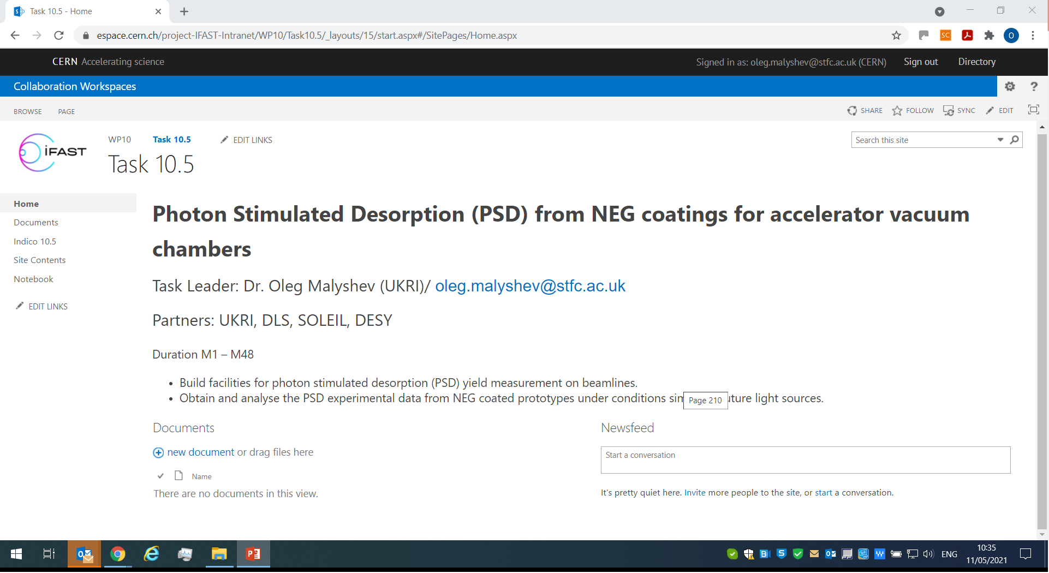
Task 10.5 Collaboration Workspace

Slide 4
Task 10.5 Objectives
Building facilities for photon stimulated desorption (PSD) yield measurement on beamlines at DLS (UK) and Soleil (France) employing an experience from STFC (UK)
Obtaining and analysing the PSD experimental data from NEG coated prototypes under the conditions similar to future light sources such as Diamond-2 and Soleil-2
 | Milestone/Deliverable name | Delivery date (in months) | Content
Milestone | First NEG coated sample are installed on SR beamline at DLS and Soleil | 12 | Report
Deliverable | First PSD data from NEG coating | 36 | Report

Slide 5
Schedule for PSD
Tasks | 1 May21 | 2 Jun 21 | 3 Jul 21 | 4 Aug21 | 5 Sep21 | 6 Oct21 | 7 Nov21 | 8 Dec21 | 9 Jan 22 | 10 Feb22 | 11 Mar22 | 12 Apr22 | 13 May22 | 14 Jun22
DLS
PSD sample S1a and S2a design (d), manufacturing (m) and delivered to UKRI (u) |  | d |  |  | m | u
PSD sample coating with NEG at UKRI |  |  |  |  |  | S0a |  |  |  |  | S1a
SR beamline design (D), installation (I), tested (T) | D | I |  |  | T
Sample installed (SI), SR testing (SR), data analysis (DA) |  |  |  |  |  | SI | SR | SR | SR | DA | SI | SR | SR | DA
Soleil
PSD sample S1b and S2b design (d), manufacturing (m) and delivered to UKRI (u) |  |  | d |  |  | m | u
PSD sample coating with NEG at UKRI |  |  |  |  |  |  | S1b |  |  |  |  | S2b
SR beamline update design (D), installation (I), tested (T) |  | D |  | I |  | T
Sample installed (SI), SR testing (SR), data analysis (DA) |  |  |  |  |  |  |  |  | SI | SR | SR | DA
Milestone report writing |  |  |  |  |  |  |  |  |  |  |  | M

Slide 6
Schedule for pumping properties
Tasks | 1 May21 | 2 Jun 21 | 3 Jul 21 | 4 Aug21 | 5 Sep21 | 6 Oc t21 | 7 Nov21 | 8 Dec21 | 9 Jan 22 | 10 Feb22 | 11 Mar22 | 12 Apr22 | 13 May22 | 14 Jun 22
Samples for pumping properties (Sp1 – Sp12)
DLS: manufacturing (m) and delivered to UKRI (u)
Soleil: manufacturing (m) and delivered to UKRI (u)
DESY: manufacturing (m) and delivered to UKRI (u)
UKRI: sample Sp1 – Sp12 coating with NEG (C), delivering to DLS, Soleil and DESY
DLS: Facility ready (F), sample installation (I), tested (T), data analysis (DA) |  |  |  | F
Soleil: Facility ready (F), sample installation (I), tested (T), data analysis (DA) | F
DESY: Facility ready (F), sample installation (I), tested (T), data analysis (DA) | F

