Slide 1
Selection of environmental topics to focus on, taking into account Horizon Europe priorities
I.FAST Task 12.1 regular meeting
Prof. Toms TORIMS / RTU & CERN
21.07.2021

Slide 2
Environmental topics #HorizonEU «menu»
Society needs / srong visibility and impact
https://ec.europa.eu/info/sites/default/files/research_and_innovation/funding/presentations/ec_rtd_he-investing-to-shape-our-future.pdf

Slide 4
Environmental topics #HorizonEU «menu»

Slide 5
Environmental topics #HorizonEU «menu»

Slide 6
Horizon Europe: cluster 5 “Climate, energy and mobility”
Climate: a core priority for the European Union
The cluster 5 is divided into six ‘destinations’, the first four of which are related to climate and energy (ENVIRONMENT):
  Climate sciences and responses for the transformation towards climate neutrality (Destination 1)
  Cross-sectoral solutions for the climate transition (Destination 2)
  Sustainable, secure and competitive energy supply (Destination 3)
  Efficient, sustainable and inclusive energy use (Destination 4)
+ The European Green Deal

Slide 7
Climate, Energy and Mobility work programme
It is all about GHG emission reduction
climate neutral and clean solutions in the shipping sector,
reduce its environmental impact (on biodiversity, noise, pollution and waste management),
improve its system efficiency,
leverage digital and EU satellite-navigation solutions and
contribute to the competitiveness of the European waterborne sector

Slide 8
Climate, Energy and Mobility work programme
The main impacts to be generated by topics targeting waterborne transport under this Destination are:
[...]
Strong technological and operational momentum towards achieving climate neutrality and the elimination of all harmful pollution to air and water.
[...]
Competitive waterborne industries, including the globally active European maritime technology sector, providing the advanced green and digital technologies which will support jobs and growth in Europe.

Slide 9
Food, Bioeconomy, Natural Resources, Agriculture and Environment work programme
Destination – Clean environment and zero pollution:
[...]
(waste) water treatment
sewage sludge treatmet
[...]
post-harvest treatment

Slide 10
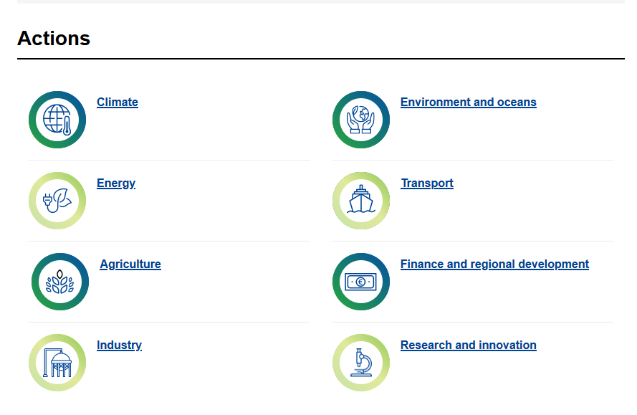
A European Green Deal

Slide 11
Widening participation and strengthening the European Research Area
to building research and innovation capacity for countries lagging behind
Teaming: Support/create centres of excellences as role models to stimulate excellence, new investments and reforms of national research and innovation systems.
[…]
European Cooperation in Science and Technology (COST),cross-border scientific network helping excellent researchers and innovators get access to the European and international networks.

