Slide 1
Analysis of the
Energy Gain Measurements in TBTS
Oleksiy Kononenko
23/Mar/2011

Slide 2
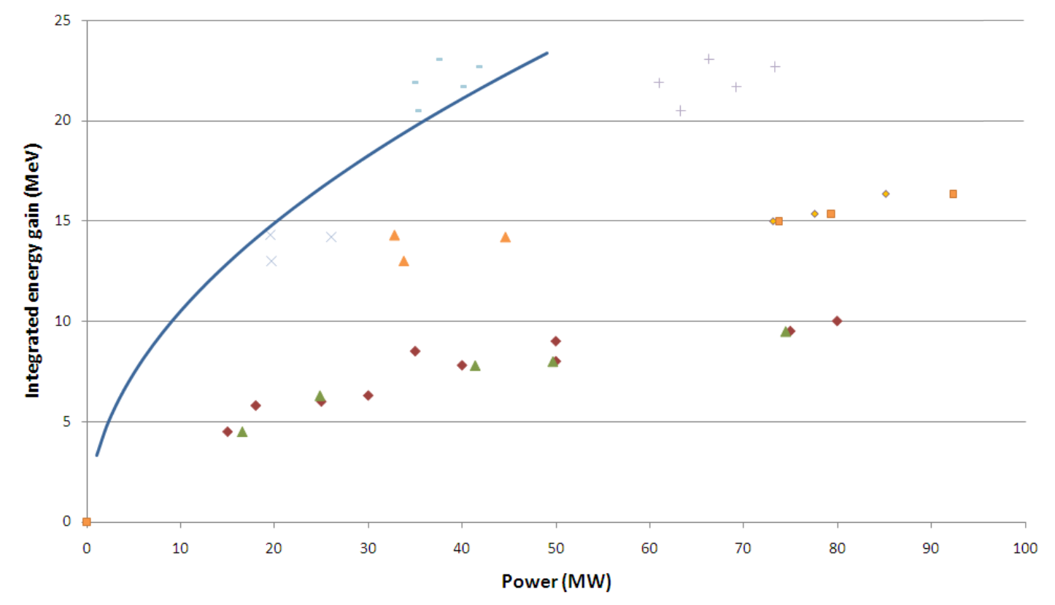
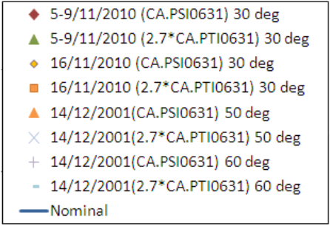
Motivation
PRELIMINARY
New calibration + effective power increase
Javier Barranco

Slide 3
Energy Gain Measurements in TBTS
Analyzed acceleration measurements (events) in TBTS including the
corresponding timestamps are gathered by Javier Barranco Garcia here:
http://elogbook.cern.ch/eLogbook/eLogbook.jsp?shiftId=1032364
http://elogbook.cern.ch/eLogbook/eLogbook.jsp?shiftId=1032385
http://elogbook.cern.ch/eLogbook/eLogbook.jsp?shiftId=1032677
Temperature, C | Total Number of Events
37 | 17
50 | 6
55 | 5
60 | 11

Slide 4
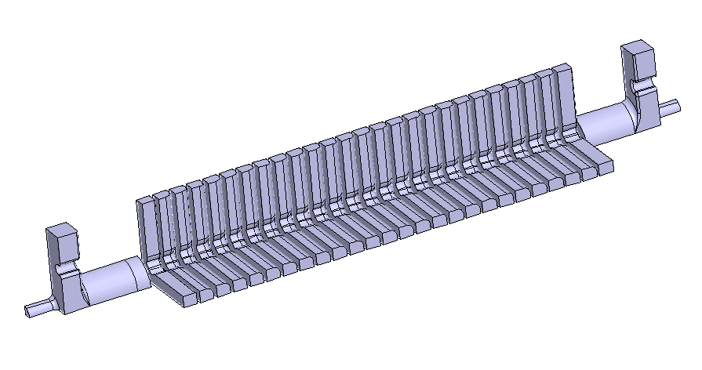
One quarter of the TD24_tank (12WDSDVG1.8T) AS installed in TBTS

Slide 5
Results of the S-parameters
HFSS Simulation

Slide 6
Accelerating Voltage in TD24
(P_{in} = 4W)
11.994 GHz

Slide 7
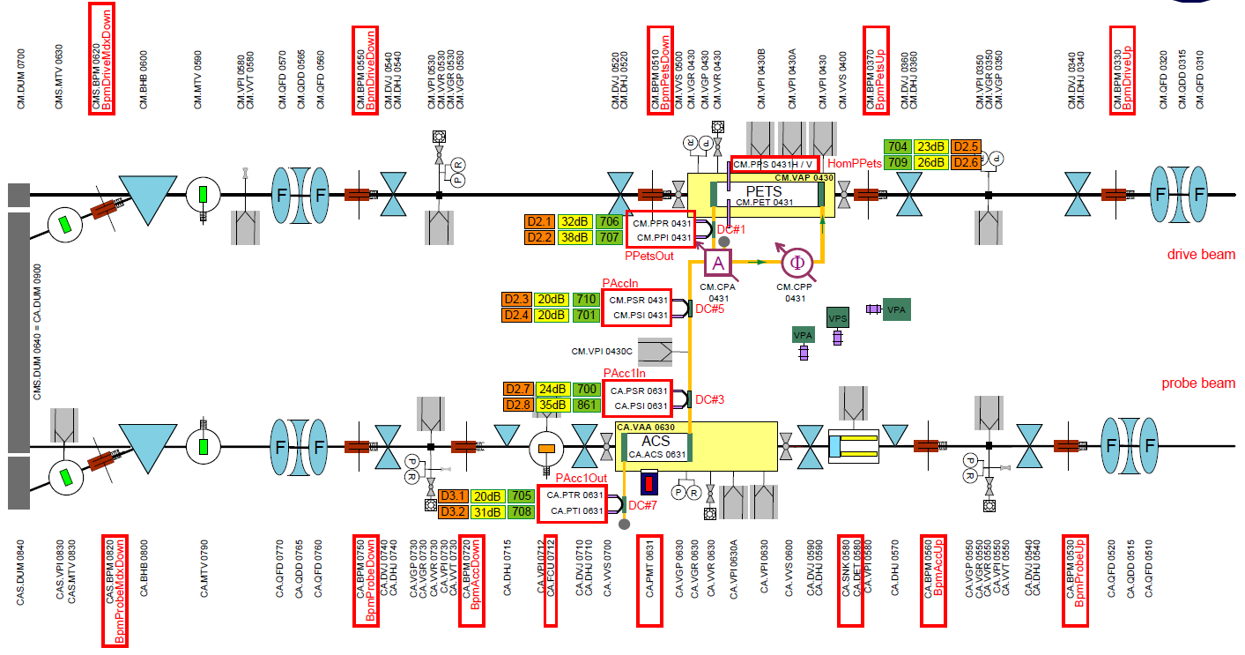
Layout of the Instrumentation for the CTF3 Two-beam Test-stand
Important input from Alexey Dubrovskiy: to use PPI0431 signal instead of the PSI0631 one and then take into account recirculation in PETS and waveguide network between PETS and AS. In this way more reliable input pulse is obtained for AS.

Slide 8
90 MW Pulse in CTF3 vs CLIC nominal (100 MV/m unloaded) pulse

Slide 9
Simulation of the Transmission
P_{trans}(t) = conv (S₁₂(t), sqrt(|P(t)|) * exp (i*(ω₀*t+Δφ)) )

Slide 10
Simulation of the Energy Gain
(no detuning)
V_{acc}(t) = conv (R_{V}(t), sqrt(|P(t)|) * exp (i*(ω₀*t+Δφ(t))) )

Slide 11
Simulation of the Energy
V_{acc detuned} (f) := V_{acc} (f - Δf), assuming that Δf=+10MHz at 30C and Δf = -1MHz/5C

Slide 12
Effect of the detuning in the comparison with the steady-state
Steady-state, df=9MHz
CTF3, df=9MHz

Slide 13
Pulse-Surface Heating for 90MW CTF3 pulse vs CLIC nominal pulse
ΔT(t) = α * conv (1/sqrt(t), |P(t)|), normalization: ΔT (100ns, 100MV/m) = 28K

Slide 14
Conclusions
Introducing detuning we’ve got rather good correlation between the simulations and measurements of the acceleration
Pulse shape effect can also be clearly seen now, even though there is an interesting detuning effect
There are still some calibration errors in the TBTS instrumentation
Pulse-surface heating was comparable with the one for the CLIC nominal pulse

